Slide 1

Replication Project
NGO Aid, Pushing Back or Backing Down?
Original authors: Right, L., Springman, J. and Wibbels, E. (2025)
Nour Kebbi
Trinity College Dublin
Applied Statistical Methods II

Slide 2
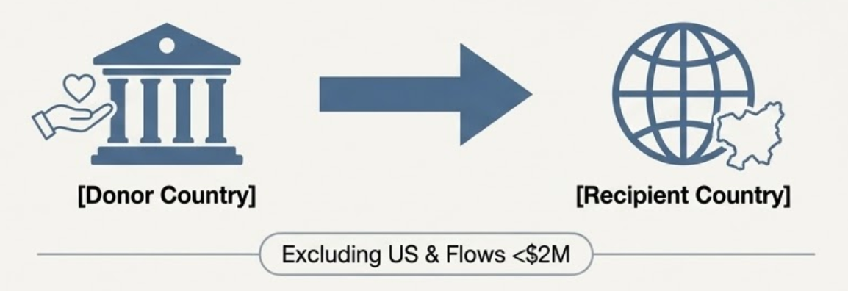
Explaining the Original Study
Original Research Question & Argument
Do international donors "push back" (withdraw aid) or "back down" (maintain aid) when recipient countries pass restrictive NGO laws?
Donor response depends on:
DOR (Relationship Orientation):
Does the donor prioritize democracy aid in that specific country?
DOD (Donor Orientation):
Is the donor globally committed to democracy?
Data: Dyadic dataset (Donor-Recipient pairs) excluding the US and small aid flows (<$2M).

Slide 3
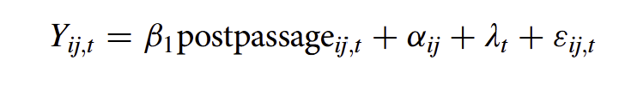
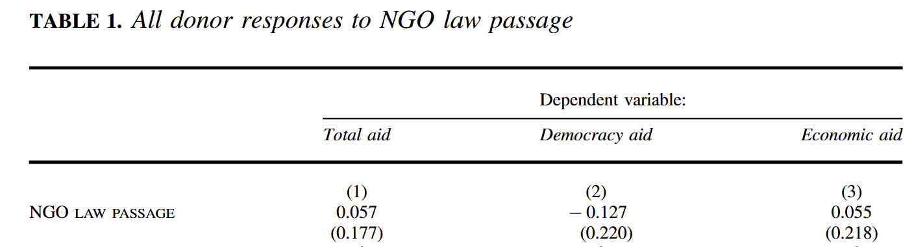
Original Study: Model 1
Model: Linear model
Reason: estimate the effect of NGO laws on aid flows
*Dependent variables are logged using a log y 1 transformation to handle 0$ aid
*postpassage is a dummy variable of whether the law was passed
*alpha: controls for donor recipient specific factors
*year fixed effects
Results:
The coefficients are statistically insignificant.
Hence, this means that on average,
the effect of NGO law has no impact on
the volume of aid a country receives.
Next step:
=> the author implemented an Interaction model

Slide 4
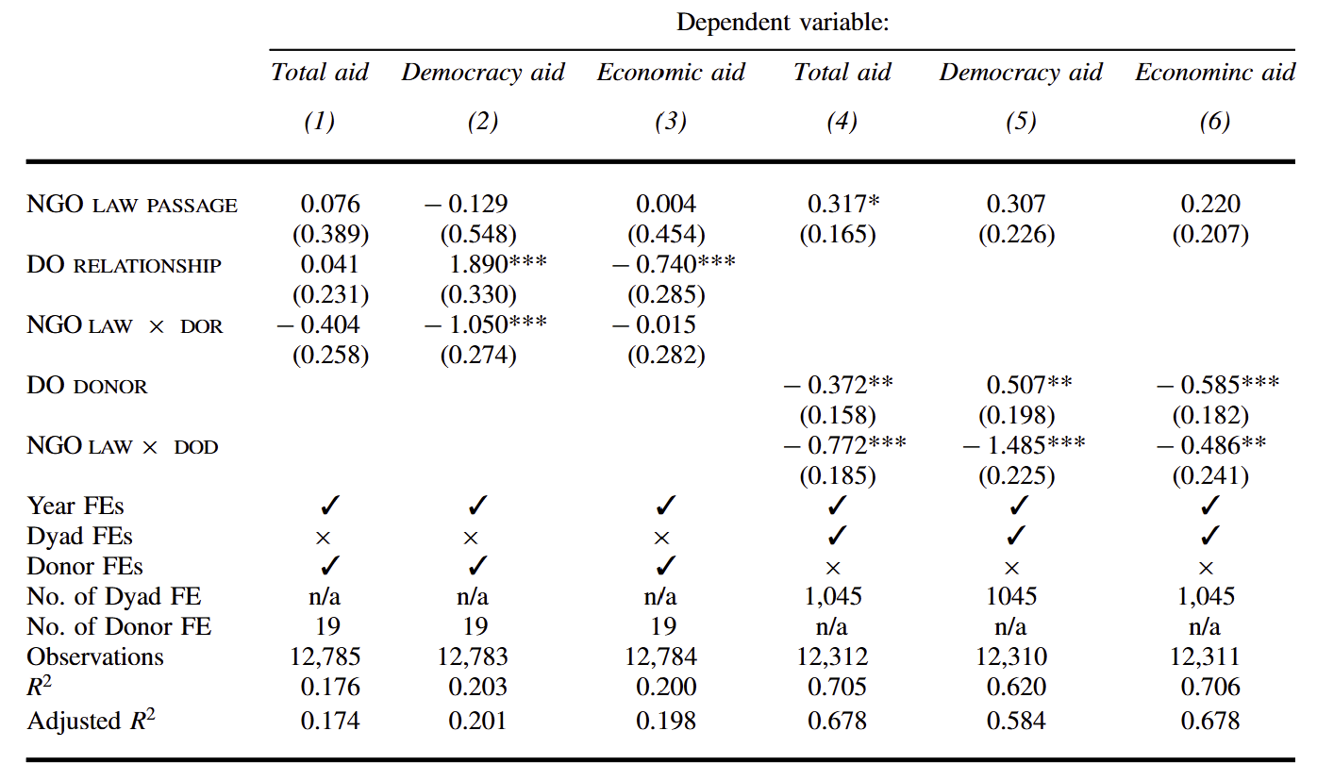
Original Study: Model 2
Donor relationship DOR
Donor orientation DOD
Model: Interactive model
Reason: test whether donors’ past
commitment to democracy promotion
conditions the effect of NGO law passage
on aid flow
Results:
> When NGO laws are passed, reductions in
Aid for specific donor types (DOD) happen,
Specifically in democracy aid
> Democracy-focused donors pull-back

Slide 5
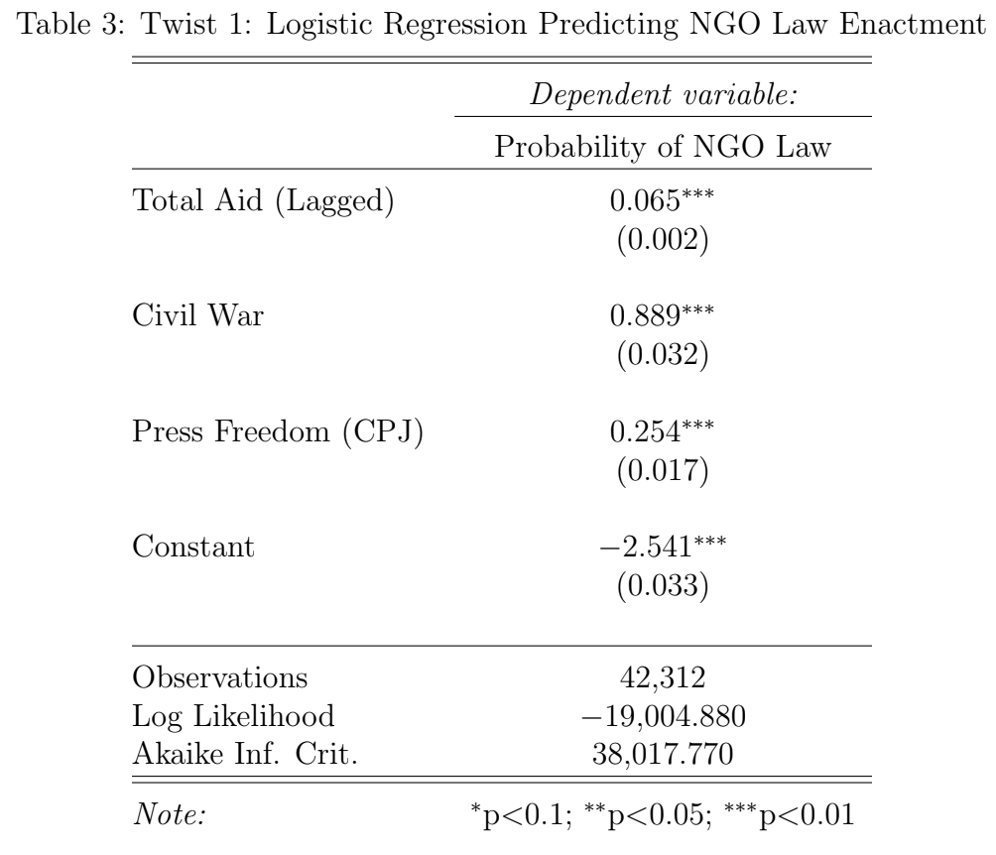
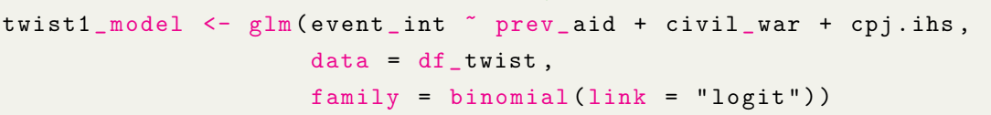
My contribution: Twist 1
NGO Law
Aid Volume
Original study:
Twist: Predicting NGO Restrictions - Reverse Causality
Shifting the focus from donor behavior to recipient behavior
Do governments pass laws because aid is already declining?
Method: GLM to calculate probabilities with a binary outcome (NGO law -> 0/1) &
removed first year of data for every country. I used a logit model to predict
the probability of an event occurring.
Result:
Civil war is the strongest predictor in the model, nearly doubling the log-odds of passing this law.
Aid Volume
NGO Law
Statistically significant

Slide 6
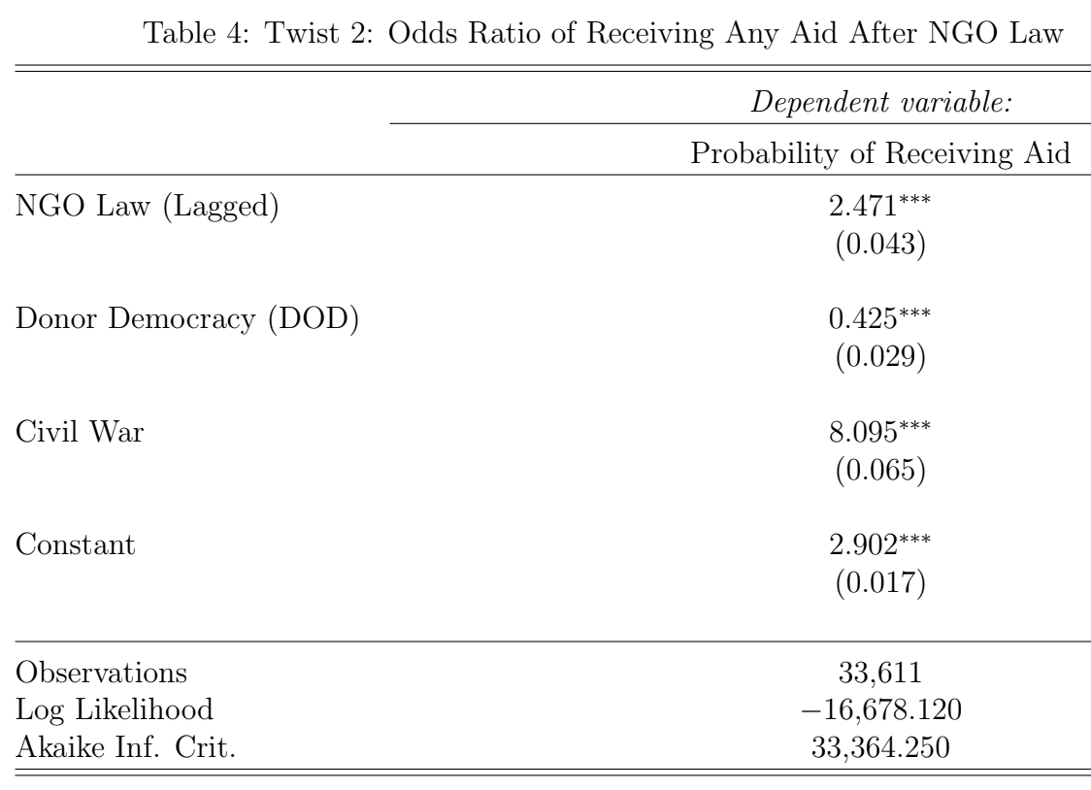
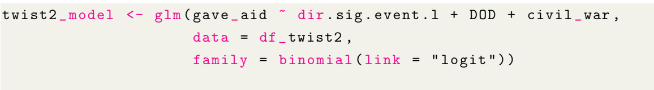
My contribution: Twist 2
Original Study: studies the fluctuation in amount in USD
Twist: analyzing binary choice of whether a donor
gives anything at all instead of reductions
Method: GLM to calculate the Odds Ratio to see how much exactly
less likely a country is to receive any any aid after passing a restrictive law.
This will provide clear punishment metric that a linear regression
Result: The results show that for countries passing
a restrictive NGO law, the odds of receiving aid are
2.47 times higher compared to those
that do not.
Contradicting results

Slide 7
Key takeaways
Twist 1: NGO laws are primarily triggered by factors like Civil War rather than international aid signals.
Twist 2: While donors might reduce the volume of their aid as the original study suggests post law
enforcement, they rarely choose to exit the relationship entirely especially in conflict
zones.
Conclusion: Donors trim budgets to signal disapproval but stay present to address crises or maintain influence.

Slide 8
Bibliography
Right, L., Springman, J. and Wibbels, E. (2025) ‘Pushing Back or Backing Down? Evidence on Donor Responses to Restrictive NGO Legislation’, International Organization, 79(4), pp. 759–786. doi:10.1017/S0020818325100957.
Link for replication files: https://dataverse.harvard.edu/dataset.xhtml?persistentId=doi:10.7910/DVN/FIINC8
Link for the study: https://www.cambridge.org/core/services/aop-cambridge-core/content/view/9365B7A1D39A5548351ADEC6E4F09181/S0020818325100957a.pdf/pushing-back-or-backing-down-evidence-on-donor-responses-to-restrictive-ngo-legislation.pdf#page=13.18

