Slide 1
Blueprint
Step:
Content Drawer -> right click -> Materials & Textures -> Cube Render Target
Window -> Place Actors -> Search “Scene Capture Cube” -> Put into Scene that you want to render
click the SceneCaptureCube in World Outliner -> replace Texture Target in Details to Cube Render Target
double click to open the Cube Render Target which just created in the Content Drawer -> Save
right click the Cube Render Target -> Create Static Texture
put the Texture Cube which created from Step 5 into ParamCube -> Details -> Param
https://www.youtube.com/watch?v=UxZ9lEOSiFw

Slide 2
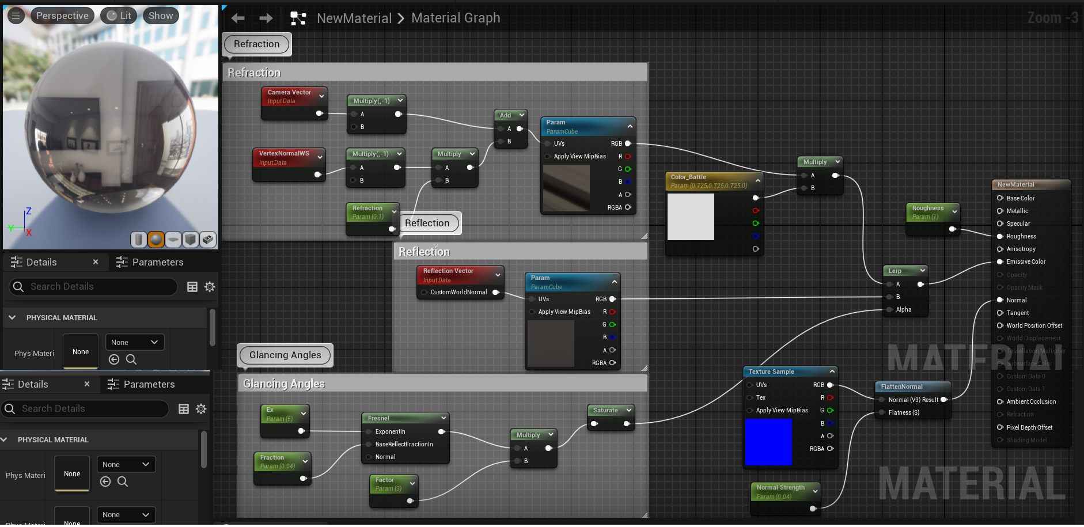
Blueprint

Slide 3
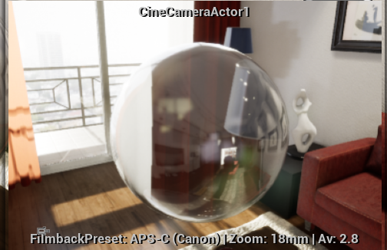
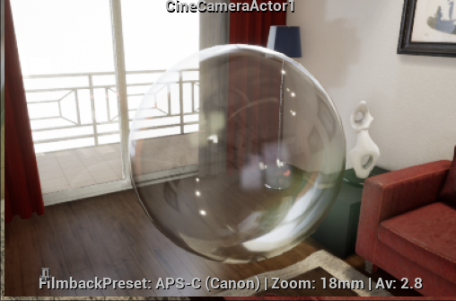
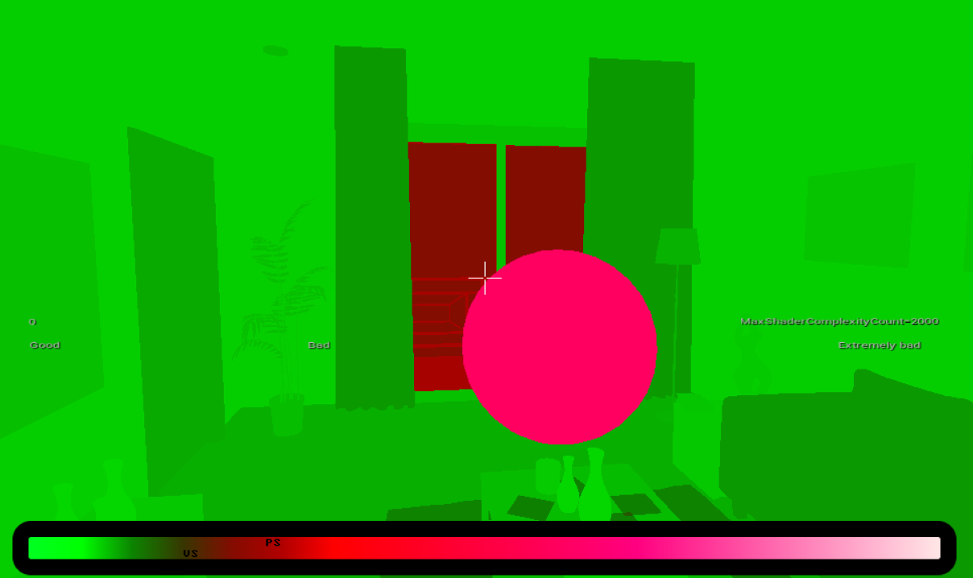
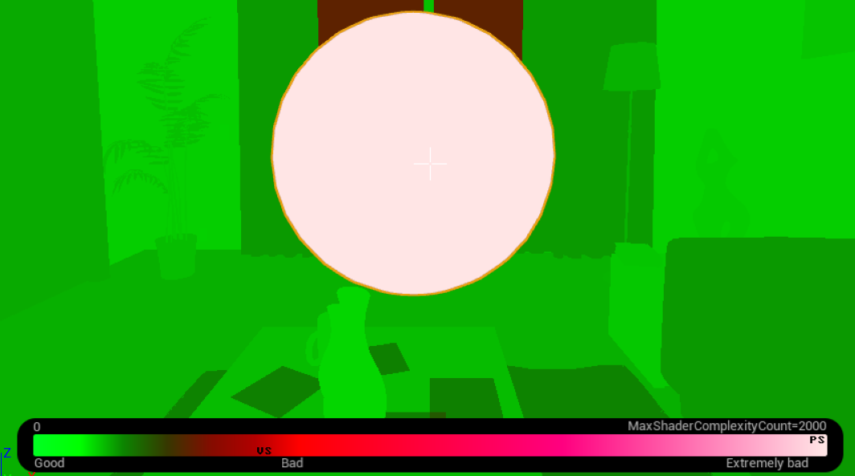
Fake Translucency by Blueprint
Thin Translucency
image
Shader
Complexity

Slide 4
待處理問題
加強折射 & 減少反射
倒立實像

