Slide 1

PROGRAMMING PARADIGMS
Jason Atkin and Graham Hutton
University of Nottingham

Slide 2
Exercise
Write down all the languages you have written a program in.
1

Slide 3
Background
In programming and algorithms, you learned the basics of imperative programming in C:
Variables and assignments;
Basic control structures;
Basic data structures;
Functions and parameters;
Pointers and memory management.
2

Slide 4


Background
In this module, you’ll learn the basics of:
Object-oriented programming in Java
Functional programming in Haskell
and
3

Slide 5
Lectures
Four one-hour lectures per week; further details are available on the module web page.
Labs
One two-hour lab per week, where you can get help with exercises and coursework.
4

Slide 6
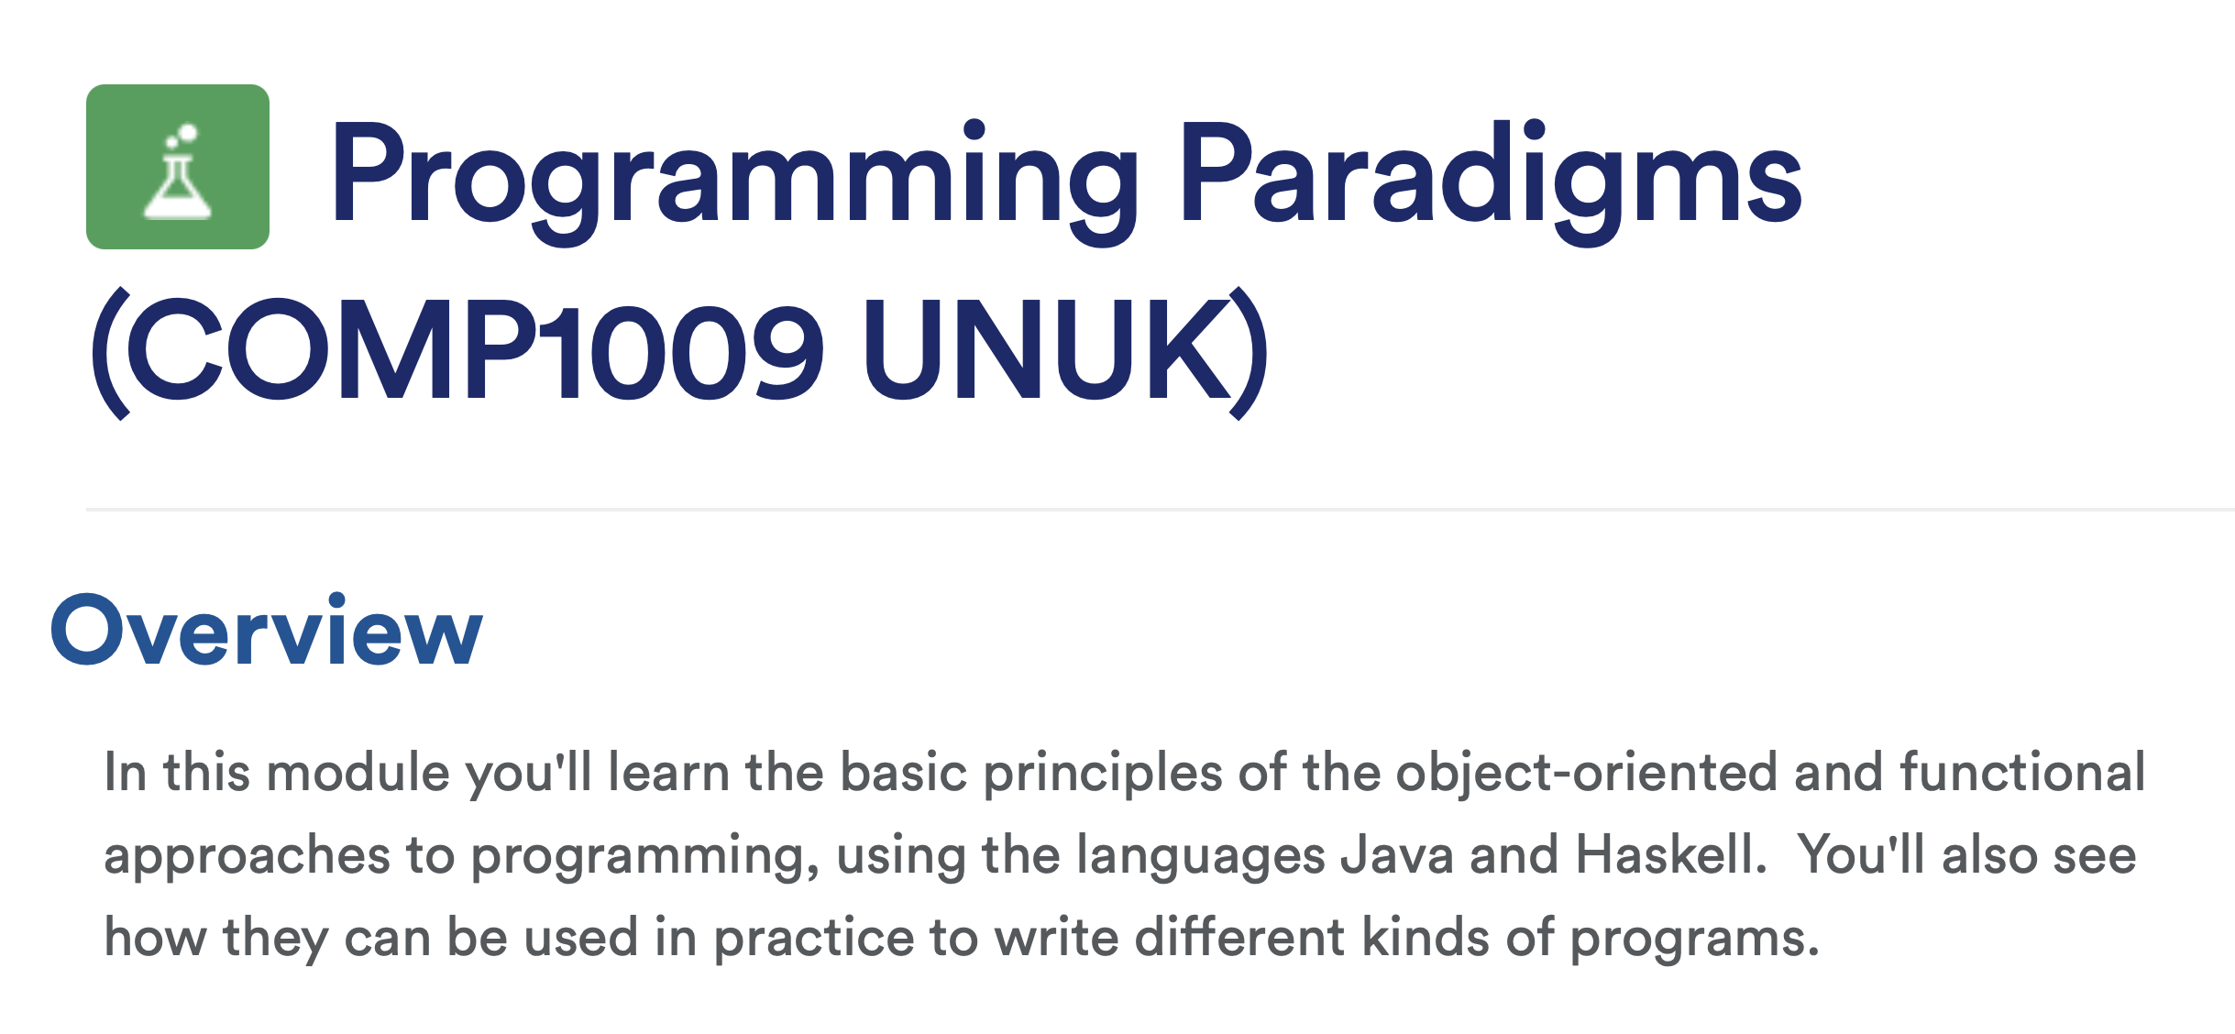
Course Materials
Everything you need is available on moodle:
5

Slide 7
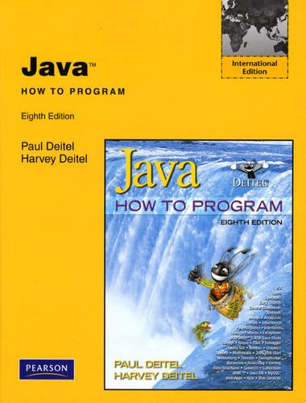
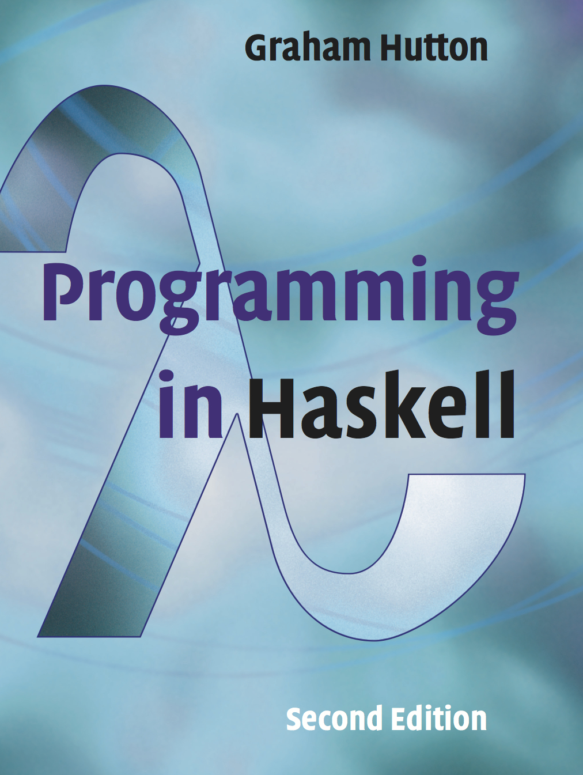
Textbook
In addition to our course materials, there is also a recommended textbook for each paradigm:
6

Slide 8
Assessment
Java coursework (15%);
Haskell coursework (15%);
Written examination (70%).
You can get help with the coursework and exercises in the weekly labs.

