Slide 1
Codeon Lecture
Ted Tseng
08/12/19

Slide 2
Let's Review

Slide 3
Command (Ctrl) + Shift + M

Slide 4
%>% (pipe)

Slide 5
library(dplyr) gapminder %>% filter(Year == 2007)

Slide 6
How to import the csv file "movies.csv" and assign it to object "movie"?

Slide 7
movie = read.csv("movies.csv")

Slide 8
With more details
Make sure your working directory has "movies.csv"
list.files()
Set to the correct working directory
setwd()
Execute the command
Check the imported file
View(movie)

Slide 9
movie = read_excel("movies.xlsx", sheet = 2)
What will happen?

Slide 10
Error in read_excel("movie.xlsx", sheet = 2) : could not find function "read_excel"
read_excel isn't an inbuilt function for R
Install the package if you haven't installed it
install.packages("readxl")
Library the package to make the function executable
library(readxl)

Slide 11
install.packages("readxl") library(readxl) movie = read_excel("movies.xlsx", sheet = 2)

Slide 12
iris[c(1, 2, 3), c(2, 3, 4)] iris[3:1, 2:4] iris[, 2] iris[, c(F, F, F, T, T)]

Slide 13
iris$Sepal.Length iris$Sepal.Length[c(2, 5, 6)] iris$Sepal.Length[iris$Species == "setosa"]

Slide 14
Data Visualization

Slide 15

Why Data Visualization?
Comprehend information quickly
Identify relationships and patterns
Pinpoint emerging trends
Communicate the story to others

Slide 16
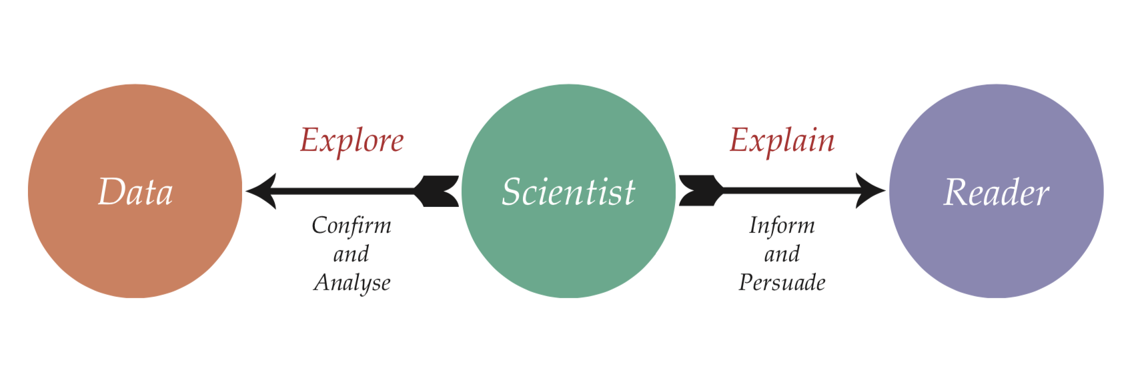

Why Data Visualization?

Slide 17
Choosing a Graph
Line graph: track changes over periods of time
Bar graph: compare things between different groups
Histogram: show distributions of variables
Box and whisker plot: show the shape of the distribution, central value, and variability
Scatter plot (X-Y plot): determine relationships between dependent and independent variables

Slide 18
How does R Draw Graphs?
"graphics" package
Default and inbuilt
Basic
"ggplot2" package
Most popular
Easier grammar (?)
The Grammar of Graphics
Others (https://mode.com/blog/r-data-visualization-packages)

Slide 19
Which one is better?
No one is superior than another
As long as you get used to it and know the limitations
https://flowingdata.com/2016/03/22/comparing-ggplot2-and-r-base-graphics/

Slide 20
Basic "graphics" Package

Slide 21
How Basic "graphics" Work
Setup a frame
2
1
1
5

Slide 22
is How Basic "graphics" Work
Setup a frame
Project the data
2
1
1
5

Slide 23
How Basic "graphics" Work
Setup a frame
Project the data
Add other elements
2
1
1
5

Slide 24
What Could Go Wrong?
Setup a non ideal frame
1
1

Slide 25
What Could Go Wrong?
Setup a non ideal frame
Project the data
1
1

Slide 26
What Could Go Wrong?
Setup a non ideal frame
Project the data, then something goes wrong Wait… I need a legend
Add other elements

Slide 27
"ggplot2" Package

Slide 28
The Grammar of Graphics
The seven layers of a ggplot2 object
Data
Aesthetics
Geometries
Facets
Statistics
Coordinates
Themes

Slide 29
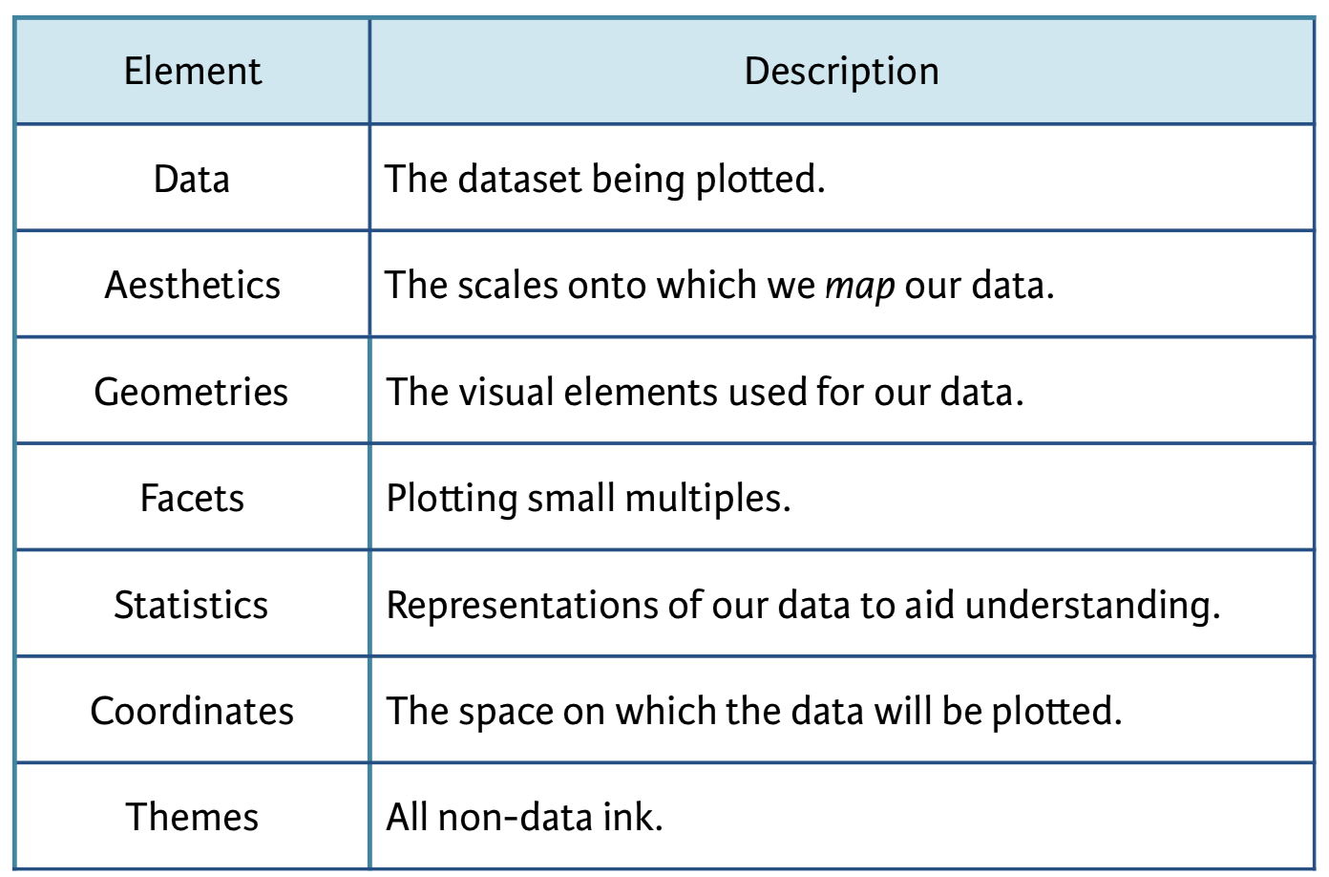

The Grammar of Graphics

Slide 30
How "ggplot2" Work
Decide the data to plot (data layer)
Assign different elements of the graph for a variable (aesthetics layer)
Decide the form of the graph (geometric layer)
Other tweaks (other layers)
Plot the graph (voilà)

Slide 31
The Basic Structure of ggplot2 Command
ggplot(data, aes(x = …, y = …)) + geom()

Slide 32
What Could "ggplot2" Go Wrong
Decide the data to plot (data layer)
Then …?
Decide the data to plot (data layer)
Add the rest layers and think it should work well
Plot the graph (and get a nani?)

