Slide 1
Investigating TCGA Public RNA-Seq Data
CodeOn!
Veronica Ortiz
02/26/2020 Wednesday

Slide 2
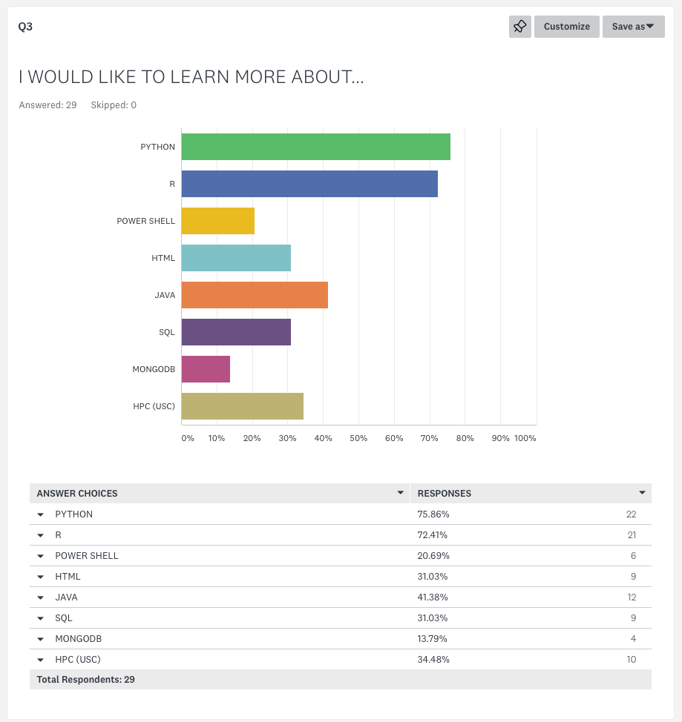

Slide 3
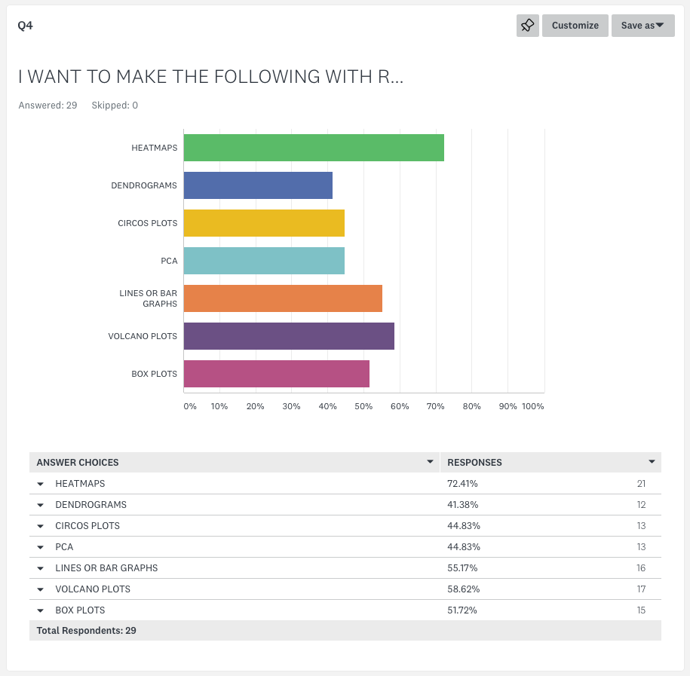

Slide 4
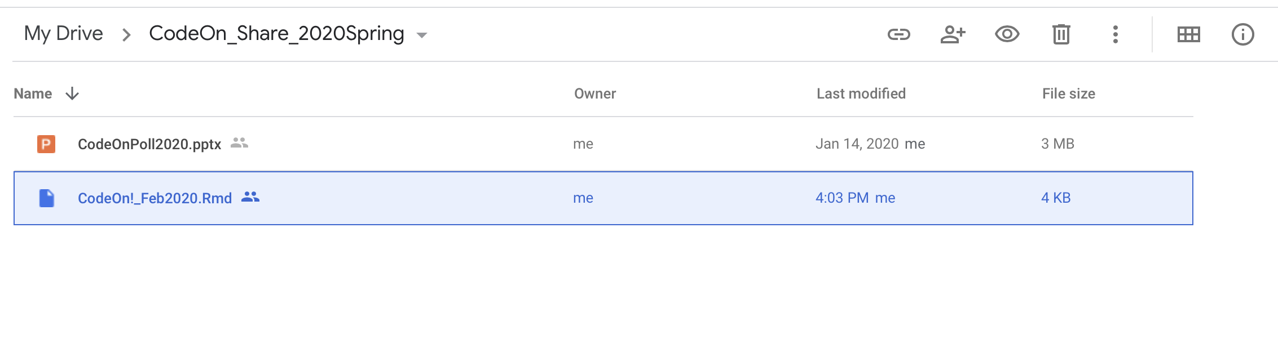
Download R File from Google Drive
shorturl.at/ayEH1

Slide 5
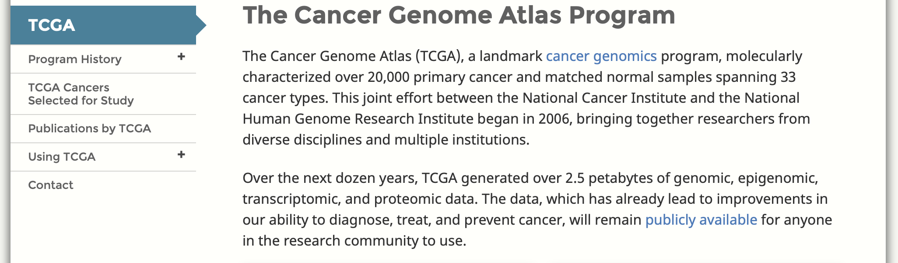
The Cancer Genome Atlas (TCGA)

Slide 6
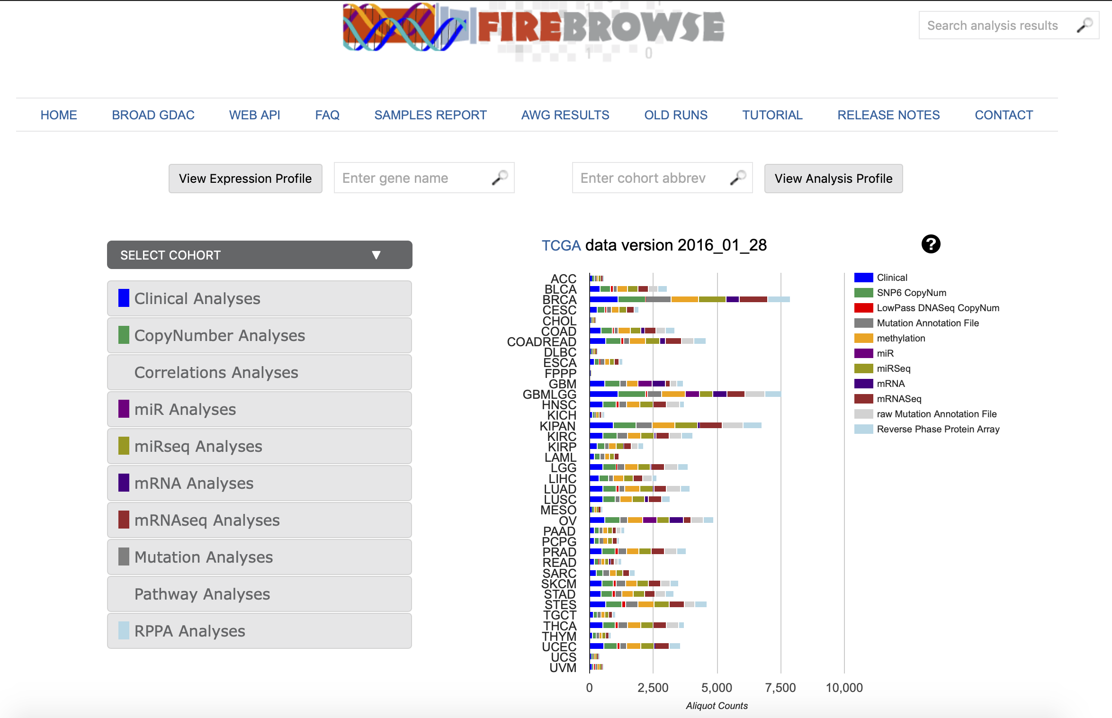
TCGA Data through Fire Browser
http://firebrowse.org

Slide 8
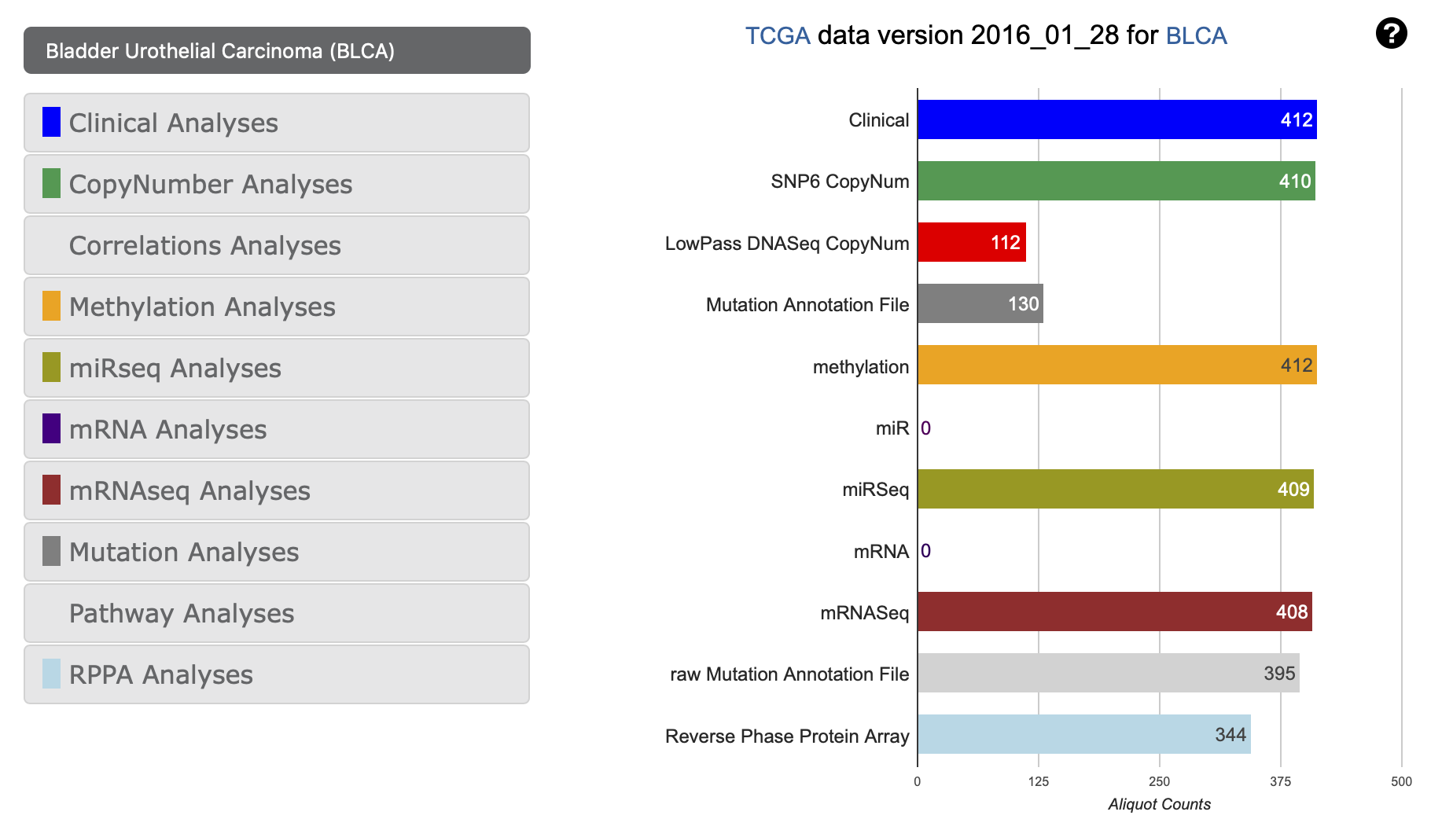

Slide 9
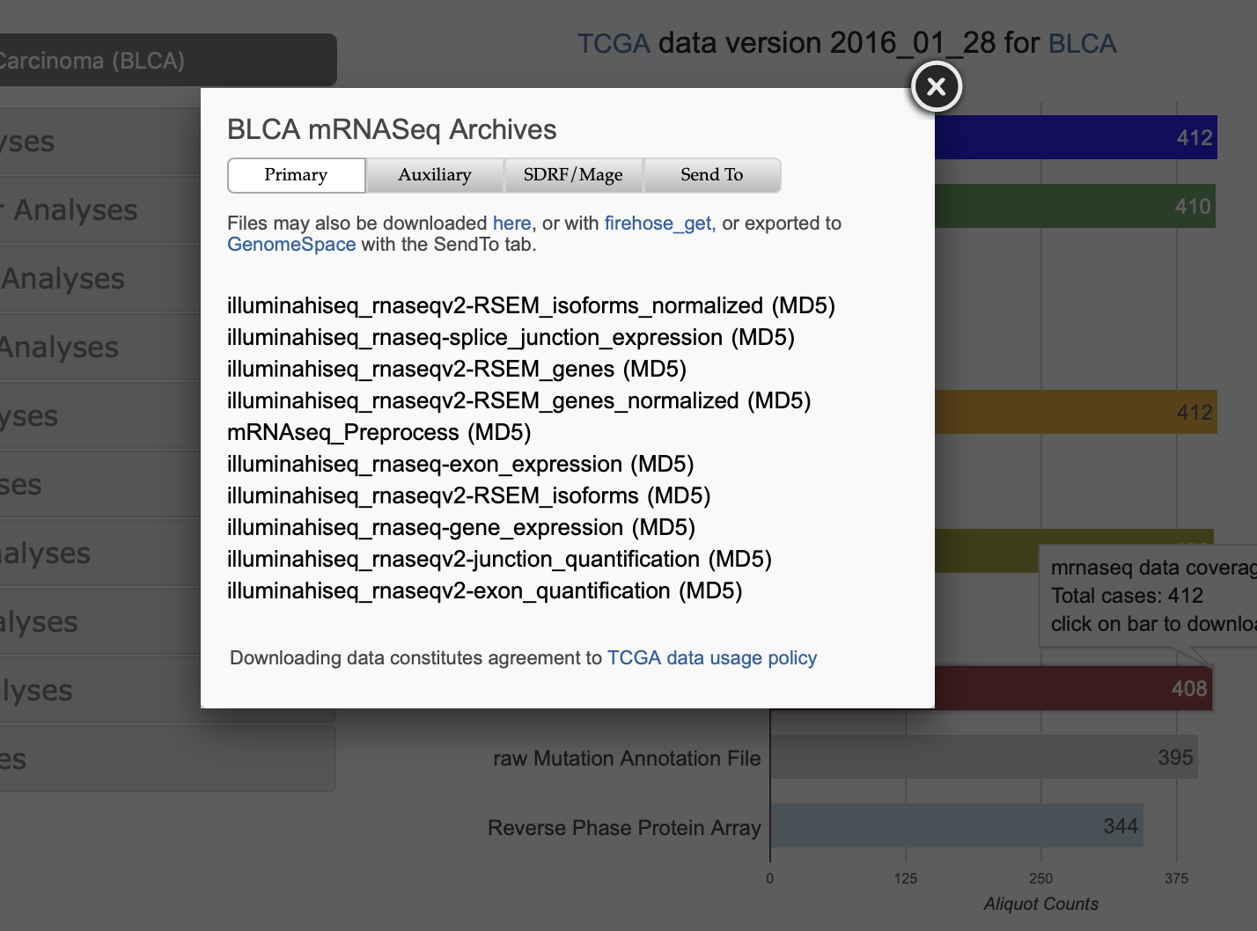

Slide 10
Desktop
Make a folder called “TCGA”
On that folder, make another called “RNA”
Set the file ending in: “.rnaseqv2__illuminahiseq_rnaseqv2__unc_edu__Level_3__RSEM_genes_normalized__data.data.txt” into the RNA folder

