Slide 1
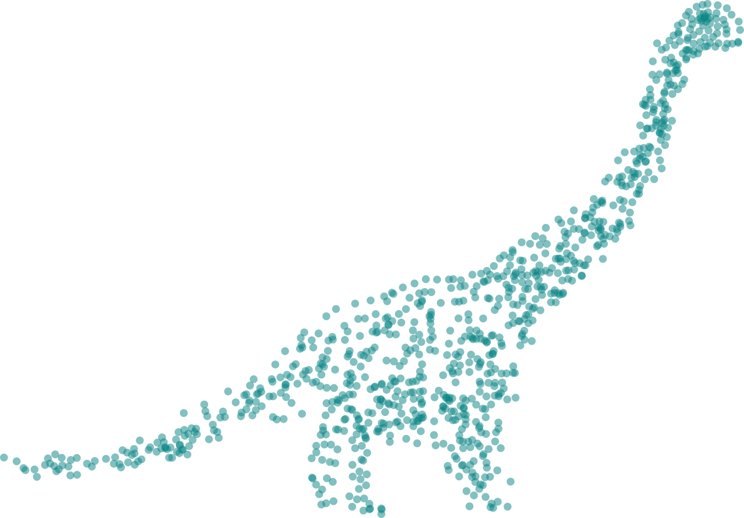




TourDino
A Support View for Confirming
Patterns in Tabular Data
Klaus Eckelt, Patrick Adelberger, Thomas Zichner
Andreas Wernitznig, Marc Streit
tourguide.caleydo.org
klaus.eckelt@jku.at
klaus_lml
Notes:
Paper: https://caleydo.org/publications/2019_eurova_tourdino/
Demo: tourdino.caleydoapp.org/

Slide 2
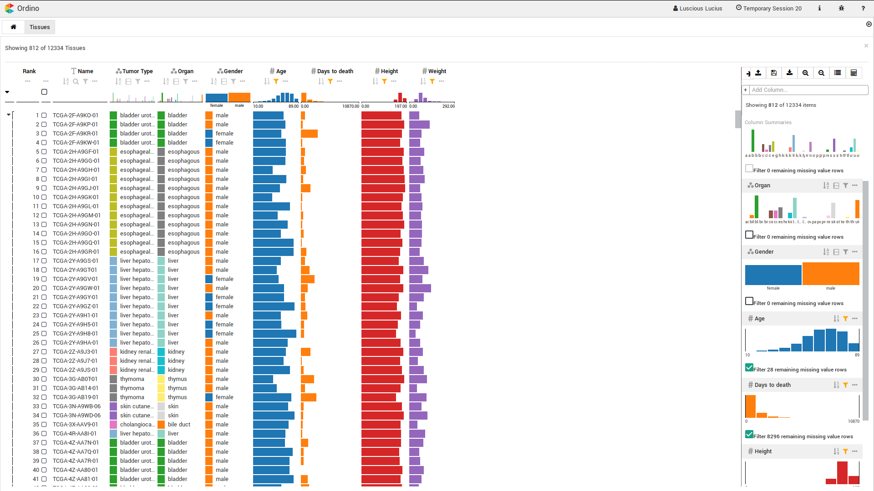
Does the patient's height and weight correlate?
Are some tumors more aggressive than others?
Notes:
Let’s start with an exploratory analysis of tabular cancer data.
Ordino, TCGA Dataset → cancer + patient data
Table lists ~800 patients, attributes
When we explore this data, we want to find some visual patterns like -> 1) very general & 2) more specific

Slide 3

Notes:
Sort by Height
Switch into “table lens”-like overview mode

Slide 4
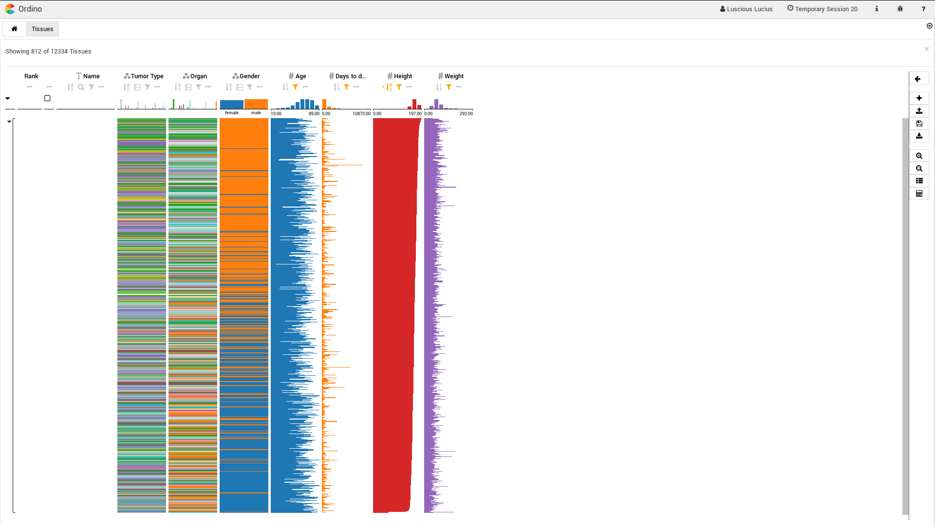
Notes:
Relationship: yes/no/maybe?

Slide 5
Notes:
Sort by “days to death”
Group by tumor type

Slide 6
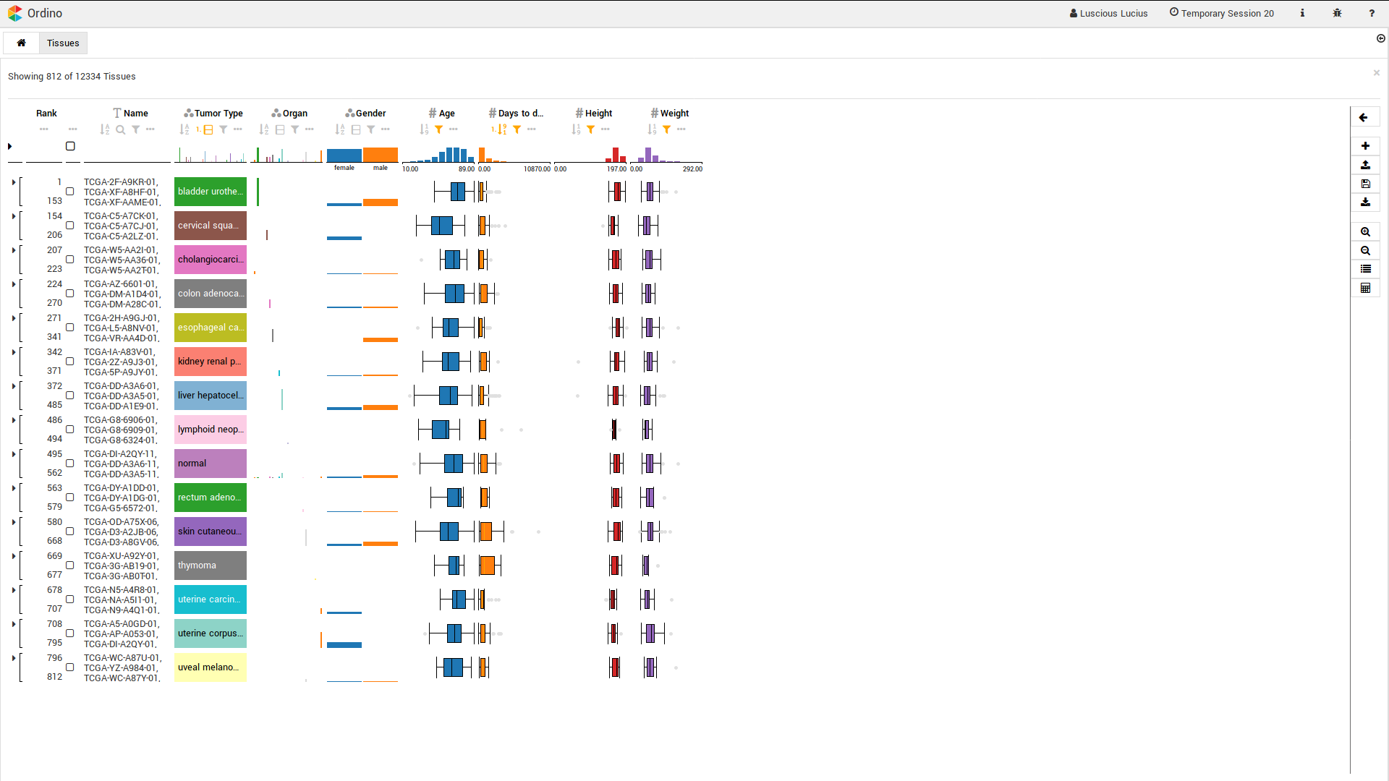
Notes:
Some are less aggressive → good
Some lead to a rapid death → bad

Slide 7

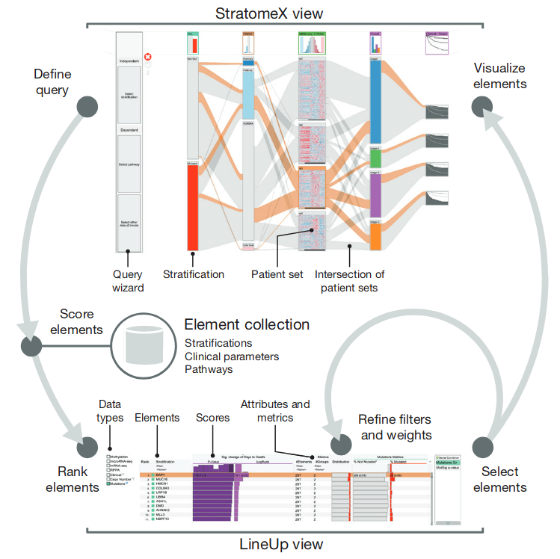
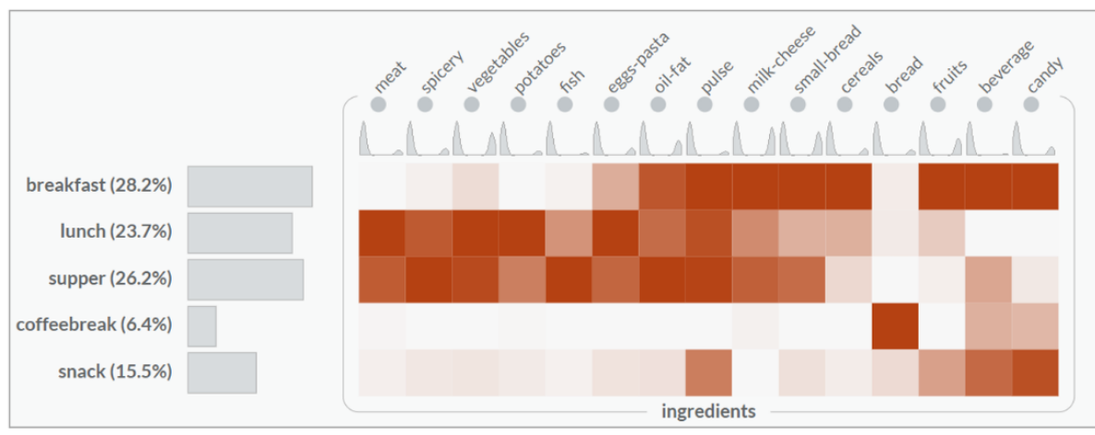
Related Work
https://www.r-project.org/
https://smartexplore.dbvis.de/
https://stratomex.caleydo.org/
Notes:
Confirmatory analysis separately, e.g. in R
Embedded in the visualization, like SmartExplore (differences of groups of meals to dataset as heatmap, chooses test automatically), lacks information on statistical test/explanatory visualization
Support View like the guided exploration stratomex (find similarities with a query wizard) more detailed results, only visible data

Slide 8
Goals
Attribute Types:
Categorical
Numerical
Distribution:
Uniform
Normal
A
B
Verify Visual Findings
Support Users in
Test Selection & Interpretation
Notes:
We want to give users something to test their hypothesis and verify their visual findings.
Correlations between numerical attributes
Similarities between categorical attributes
Impact of categories on numerical values
And make it so that it supports users who are not experts in statistics,
Selecting the test depends on the type and the distribution of the selected data

Slide 9
Hypotheses & Tasks
Similar
Different
Notes:
Sets of patients → similar because same dataset
→ compare patient sets: hypothesis is that they are similar
Attributes → different -> describe distinct characteristics
→ compare attributes: hypothesis is that they are different or independent
With the tests, determine probability, p-value that the hypothesis is true

Slide 10
Tests & Visualizations
Attribute Comparison Item Comparison
Numerical-
Numerical
Categorical-
Numerical
Categorical-
Categorical
Numerical-
Numerical
Categorical-
Categorical
Spearman
Correlation
Kolmogorov-
Smirnov Test
Pearson‘s
Chi-Square Test
Pearson‘s
Chi-Square Test
Wilcoxon
Rank-Sum Test
Notes:
Wie the task & hypothesis at hand, we select the appropriate tests based on the date types
Attribute comparison: compares arbitrary columns → also numerical/categorical
Item comparison: compare values of the same column → only values of the same type
Non parametric tests for the comparison of numerical values
Comparing Numerical attributes: Spearman & Scatter plot
When a categorical attribute is compared with a numerical attribute we use a KS-Test, to test if the values of each category are uniformly distributed.
The line charts shows the deviation of the numerical values from uniform distribution
Chi² Test for independence to compare categorical attributes
How the patients are categorized by the two attributes is shown with parallel sets
Categorical sets are compared with Chi2 Test for homogeneity,
Category distributions in the sets are shown with Rel. freq. Histogram to handle different set sizes
Numerical sets are compared with the wilcoxon rank-sum test / mann-whitney test, and we use box plots to depict the sets and show their differences

Slide 11
Notes:
Let’s get back to our analysis session, we integrated Tourdino by adding a button to the toolbar on the right

Slide 12
Video: TourDino in Action
Notes:
Open TourDino with toolbar
Weight is already compared against all other attributes, add two more for demonstration purposes

Slide 13
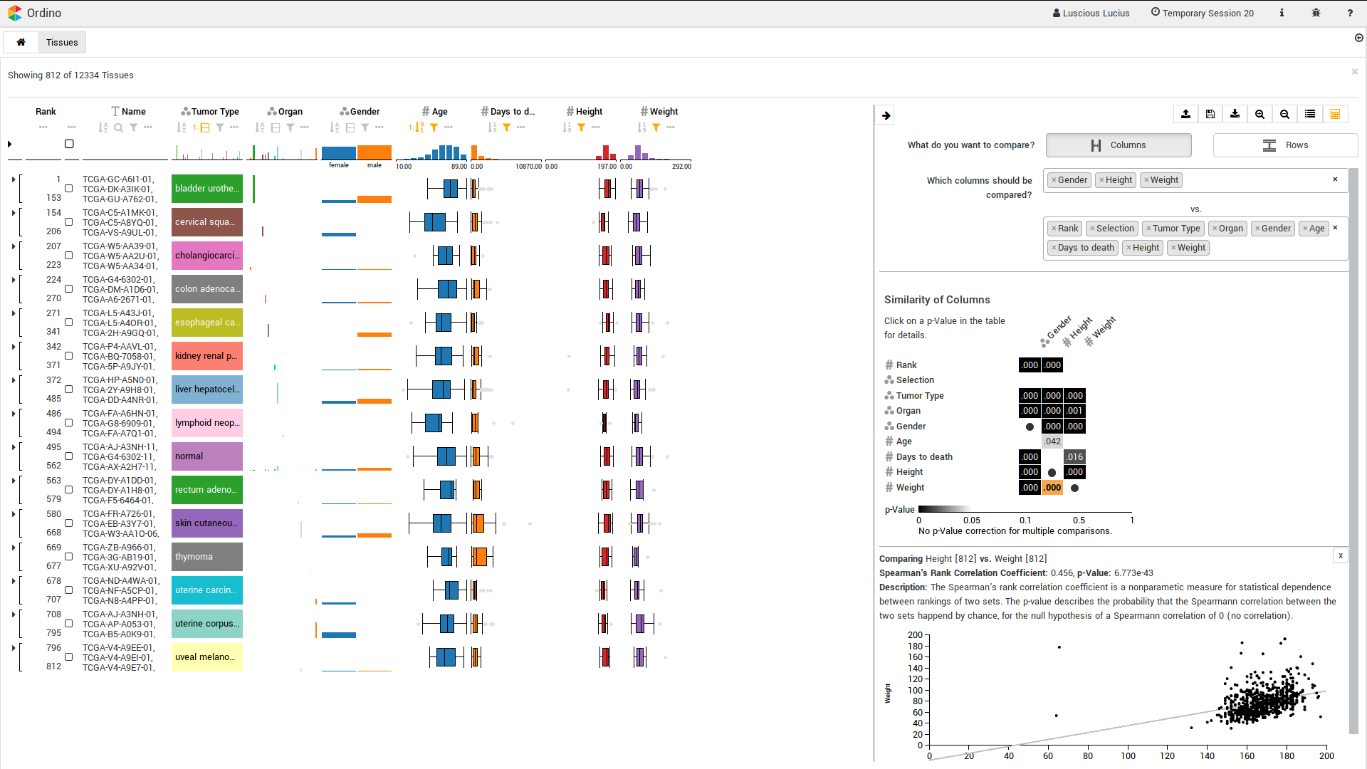
Task & Data
Selection
Significance
Matrix
Detail Visualization
Notes:
3 Sections

Slide 14
Notes:
First we switch to the row comparison task, were the rows are compared by selection

Slide 15
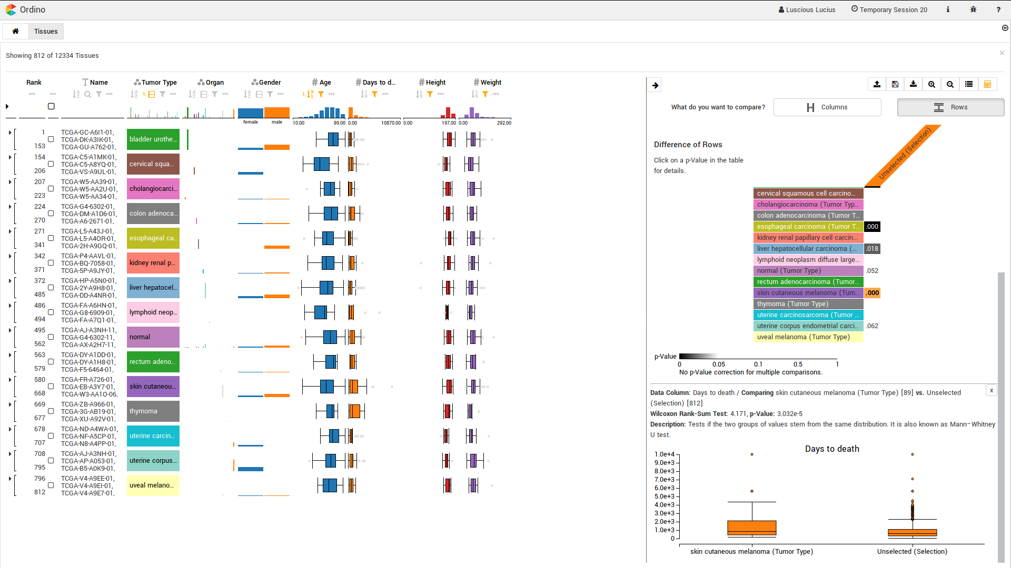
✓
✓
✓
?
Notes:
In the detail visualization we see two box plots, one for the patients with skin tumor and one for all patients.
From the visualization and the significance matrix, we can confirm that three of the 4 tumor types that are highlighted on the left are in fact different from the whole dataset.

Slide 16
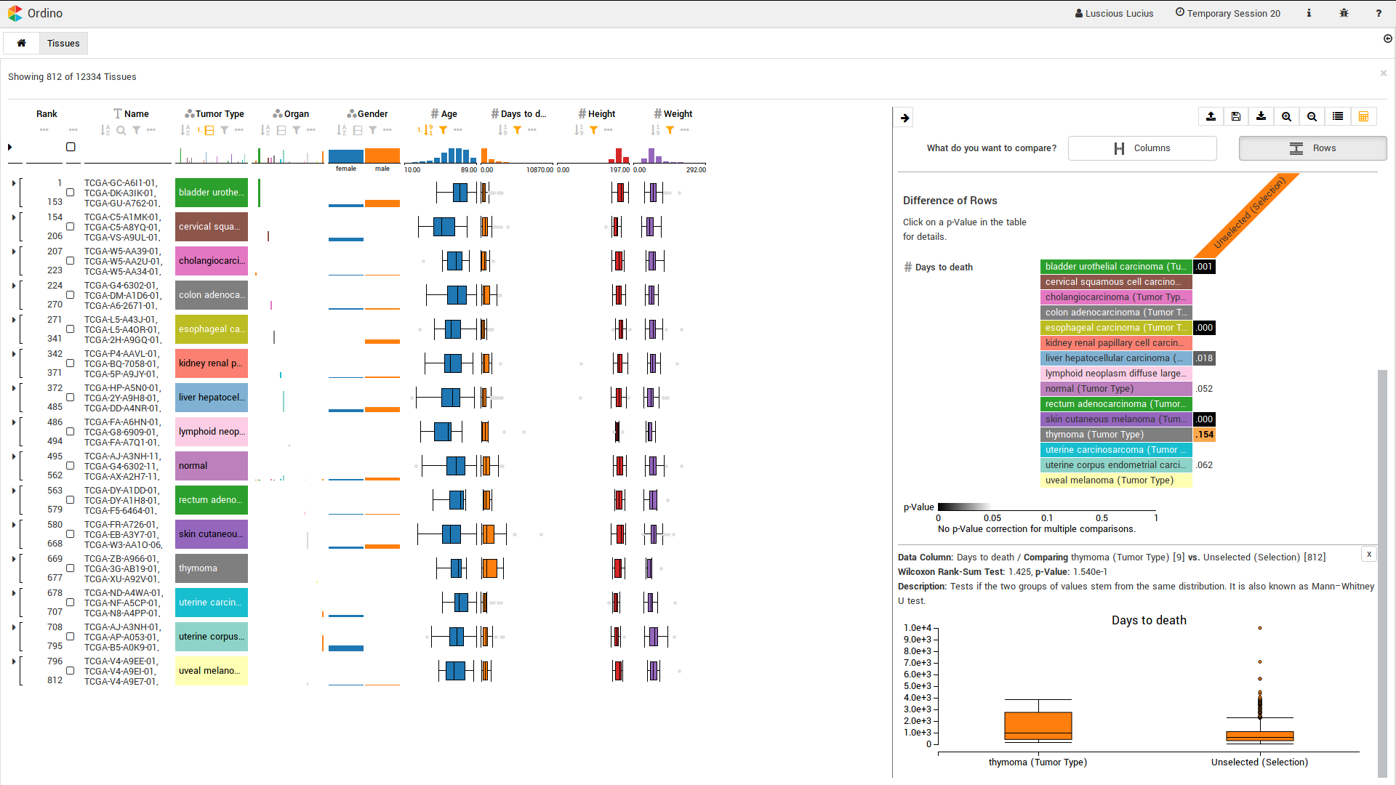
Notes:
Taking a closer look on the thymoma tumor type, we can see that there are only 9 patients, which explains the non-significant result.

Slide 17
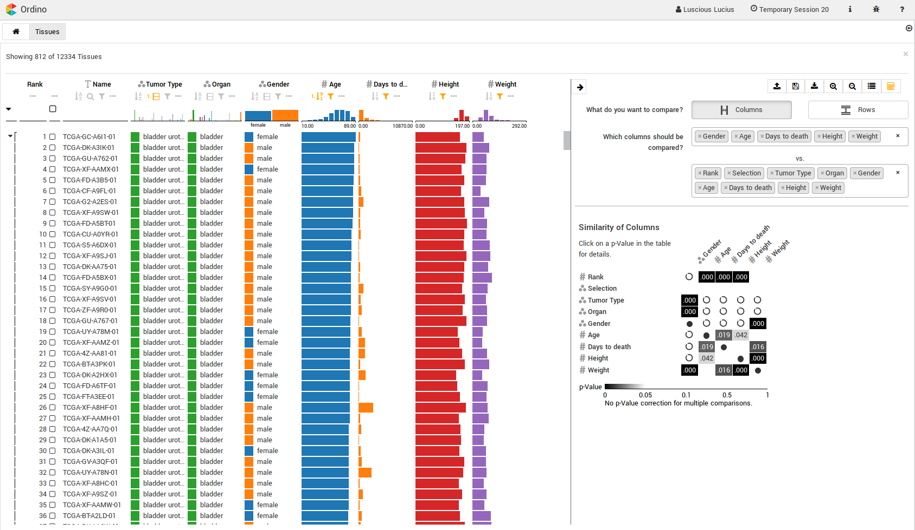



Implementation
Demo at https://tourdino.caleydoapp.org
TypeScript, D3, and web workers
https://github.com/Caleydo/TourDino
https://github.com/datavisyn/tdp_core/
Notes:
You can try this demo at: tourdino.caleydoapp.org/
We implemented tourdino using typescript, the visualizations are created with d3 and the statistics calculated in seperate threads using web workers (keeping the UI respsonsive)
The TourDino library contains all these statistics and visualizations and can return appropriate tests for a given combination of data types.
Our Integration into Ordino contains the input fields, the generation of the matrix and embeds the visualization

Slide 18
TourDino
Support Users in Test Selection and Interpretation to Verify Visual Findings
What are your approaches to measure the relationship between categorical & numerical data?
Combing Significance and Association Strength
to display the results.

Slide 19
TourDino
A Support View for Confirming
Patterns in Tabular Data
Klaus Eckelt, Patrick Adelberger, Thomas Zichner
Andreas Wernitznig, Marc Streit
tourguide.caleydo.org
klaus.eckelt@jku.at
klaus_lml

