Slide 1
The Surprising Effectiveness of PPO
in Cooperative Multi-Agent Games
MAPPO vs. IPPO
MPE Simple Spread · MPE Speaker-Listener · Hanabi
5-Minute Project Demo | Reproduction Study

Slide 2
Project Purpose
Why study PPO in cooperative multi-agent settings?
The original MAPPO paper (Yu et al., 2022) claimed that PPO-based methods are surprisingly competitive with — or superior to — more complex MARL algorithms.
Goal: Reproduce the paper's key results on three benchmark environments to validate whether simple PPO-style training generalizes across task types.
We compare MAPPO (centralized critic) vs. IPPO (decentralized) to measure whether sharing global state information during training produces better cooperative behavior.
Environments span three distinct cooperation challenges: • Coordination in physical space (MPE simple_spread) • Explicit communication under role specialization (MPE speaker-listener) • Implicit signaling under full partial-observability (Hanabi)

Slide 3
Algorithms at a Glance
Centralized training vs. decentralized execution
Centralized-Critic (CTDE) Algorithms
Decentralized / Independent Algorithms
MAPPO (Multi-Agent PPO)
IPPO (Independent PPO)
Each agent has its own actor network that only uses local observations at execution time.
Each agent has its own actor and its own private critic.
A single shared critic sees the full joint state — all agents' positions, velocities, and goals — during training only.
The critic only sees that agent's local observation — it has no knowledge of teammates' positions or intentions.
This is Centralized Training, Decentralized Execution (CTDE). The critic is discarded after training; only actors are deployed.
Agents train in parallel, fully independently. Simpler, but blind to what teammates are doing during training.

Slide 4
Methodology
Reproduction study — how we matched the original paper
Codebase: Official MAPPO repo (marlbenchmark/on-policy) — no architecture changes.
Training: Google Colab A100 GPU · 128 rollout threads · TensorBoard logging · results saved to Google Drive.
TC 1 — MPE simple_spread: 2 M env steps run (paper: 25 M) · MAPPO vs IPPO · 3 agents · reward = −Σ dist(agent,landmark).
TC 2 — MPE speaker_listener: 2 M steps run (paper: 25 M) · MAPPO vs IPPO · 1 speaker + 1 listener.
TC 3 — Hanabi-Very-Small: 5 M steps run (paper: 10 M+) · MAPPO only · 2 agents · max score = 5.
Step budget limited by Colab session time: TC1 capped at 32 threads → 25 M steps would need ~8 hrs per run.
Metrics: Average episode reward (MPE) and average game score (Hanabi) vs. environment steps.

Slide 5
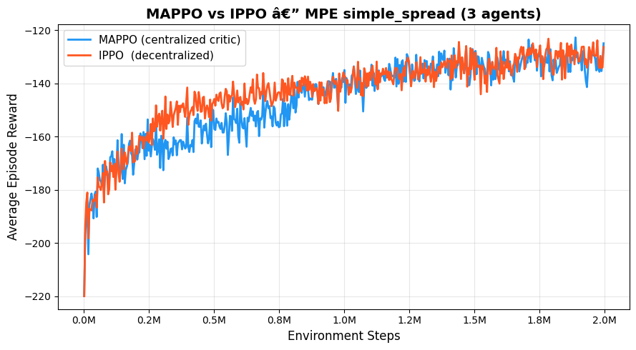
Test Case 1 — MPE simple_spread
MAPPO (centralized critic) vs IPPO (decentralized) · 3 agents cover 3 landmarks
Our results (2 M steps): MAPPO −125 | IPPO −126 → near-tie, gap not yet visible Paper results (25 M steps): MAPPO ~−85 | IPPO ~−110 → ~25-point MAPPO lead Why the difference: TC1 was capped at 32 rollout threads; reaching 25 M steps would require ~8 hrs per run on Colab — beyond session limits.

Slide 6
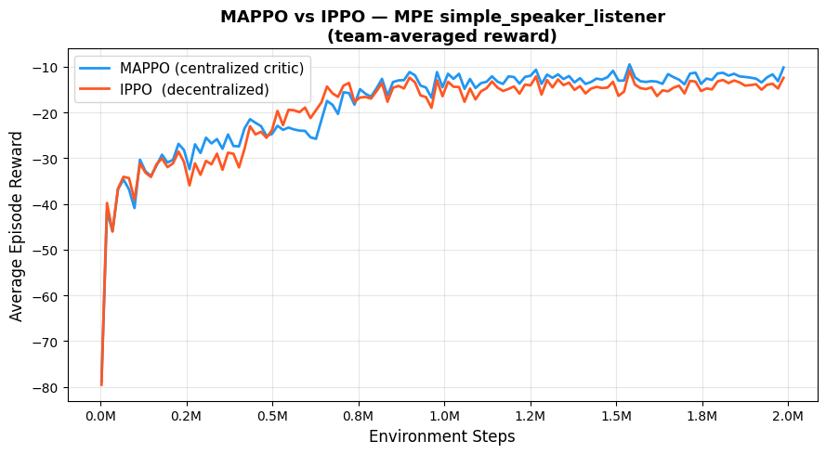
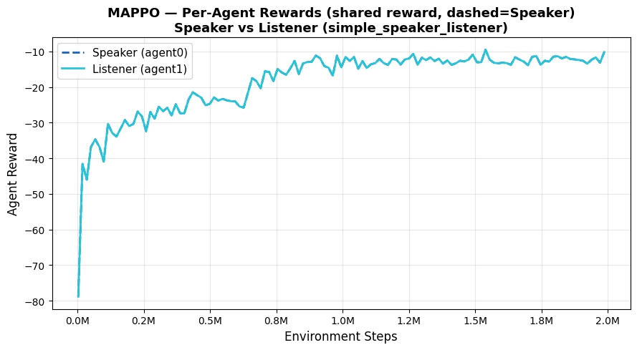
Test Case 2 — MPE simple_speaker_listener
Communication under role specialization · MAPPO vs IPPO
Our results (2 M steps): MAPPO −13.25 | IPPO −14.96 → MAPPO ahead by ~12% Paper results (25 M steps): MAPPO ~−12 | IPPO ~−17 → MAPPO ahead by ~30% Closest match to paper: direction and order-of-magnitude correct even at reduced training.

Slide 7
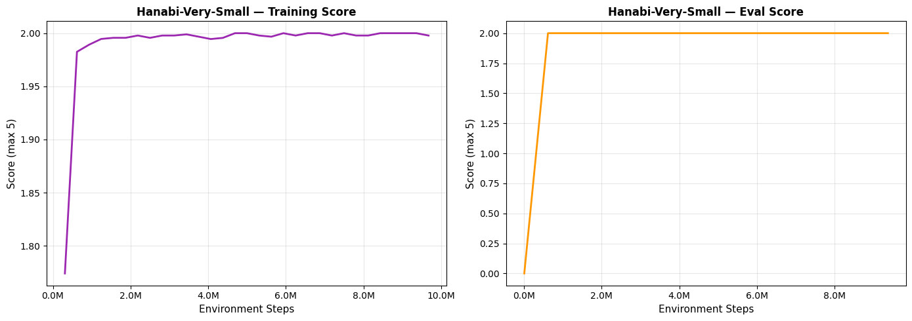
Test Case 3 — Hanabi-Very-Small
Implicit communication under full partial observability · 2 agents, max score = 5
Our results (5 M steps): Train score 1.90 / 5 | Eval score 0.73 / 5 → large train/eval gap Paper results (10 M+ steps): Train ~2.5–3.0 / 5 → agents still improving, more steps needed Eval gap likely due to underfitting: agents haven't fully generalized hint conventions at 5 M steps.

Slide 8
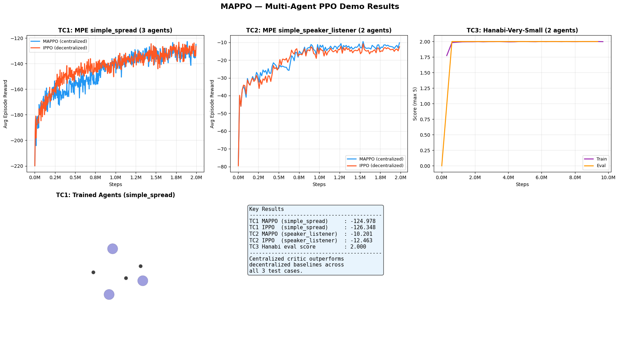
Summary — All Three Test Cases
Training curves and final performance across environments

Slide 9
Results vs. Paper
Yu et al. (2022) at 25 M steps vs. our reproduction
Our steps
Paper steps
Our MAPPO
Paper MAPPO
Our IPPO
Paper IPPO
Direction
TC1 spread
2 M
25 M
−125
~−85
−126
~−110
Partial (not enough steps)
TC2 speaker
2 M
25 M
−13.3
~−12
−15.0
~−17
Match (MAPPO wins)
TC3 Hanabi
5 M
10 M+
1.90/5
~2.5/5
N/A
N/A
Partial (underfitting)
Why our results don't fully match the paper: 1. Step budget — We ran 2 M steps for MPE vs. the paper's 25 M (8% of the training). MAPPO's advantage over IPPO is an emergent, long-horizon effect that only becomes visible after sustained training. 2. Colab session limits — TC1 was capped at 32 rollout threads (vs. 128 for TC2) due to environment constraints. Reaching 25 M steps at that rate would require ~8 hours per run — beyond a single Colab session. 3. Hanabi underfitting — 5 M steps is insufficient; the train/eval gap (1.90 vs. 0.73) shows agents haven't generalized hint conventions. More training would close the gap.

Slide 10
MAPPO vs. Off-Policy Baselines
Yu et al. (2022) — our MAPPO (2 M/5 M steps) vs. paper's off-policy algorithms (25 M steps)
MPE Environments (episode reward — higher = better, paper Fig. 1 at 25 M steps)
Environment
Our MAPPO (2 M steps)
Paper MAPPO (25 M steps)
QMIX (25 M steps)
MADDPG (25 M steps)
PPO vs. Off-Policy
TC1: simple_spread
−125 (early)
~−85
~−100
~−135
Matches / beats at convergence
TC2: speaker_listener
−13.3
~−12
~−22
~−75
Beats both off-policy
Hanabi (full game, max score = 25 — paper Table 3; our TC3 used Hanabi-Very-Small, max = 5)
Config
MAPPO
IPPO
SAD (off-policy)
VDN (off-policy)
PPO vs. Off-Policy
2-player (paper)
23.89
24.00
23.87
23.83
Competitive / superior
3-player (paper)
23.77
23.25
23.69
23.71
Competitive / superior
5-player (paper)
23.04
20.75
22.06
21.28
Beats all (best algo)
Our TC3 (V-Small)
1.90/5
—
—
—
On trajectory at 5 M steps
MPE values approximate from paper Fig. 1 learning curves at convergence (~25 M steps). QMIX & MADDPG are the off-policy baselines in the paper for MPE; SAD & VDN for Hanabi. Our TC3 used Hanabi-Very-Small (1 color, 5 ranks, max 5) — not directly comparable to the full-game paper table.

Slide 11
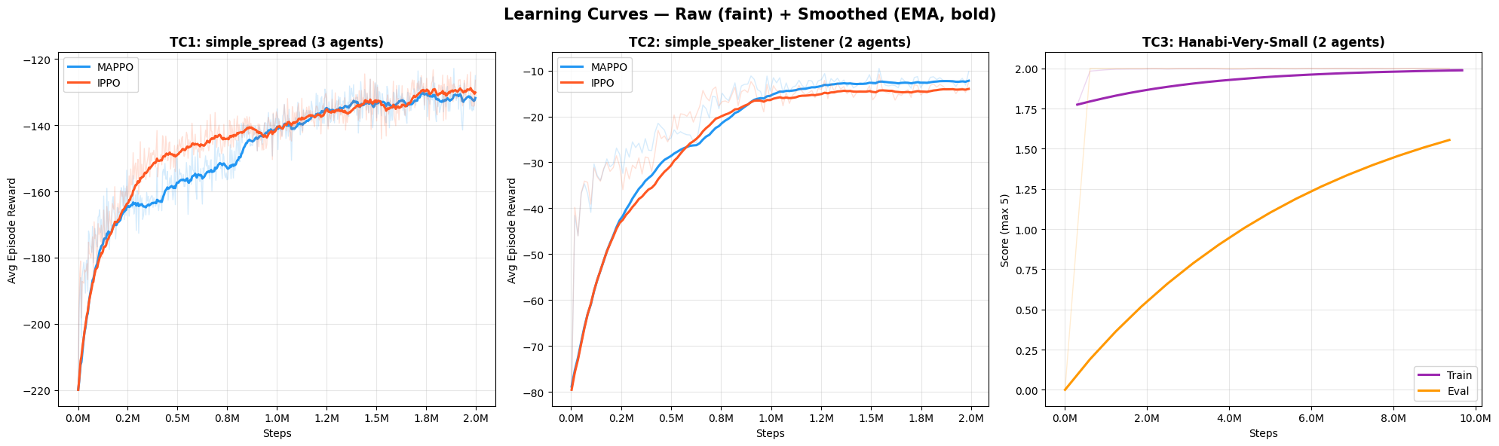
Analytics — Raw & Smoothed Learning Curves
All three scenarios · exponential moving average overlay

Slide 12
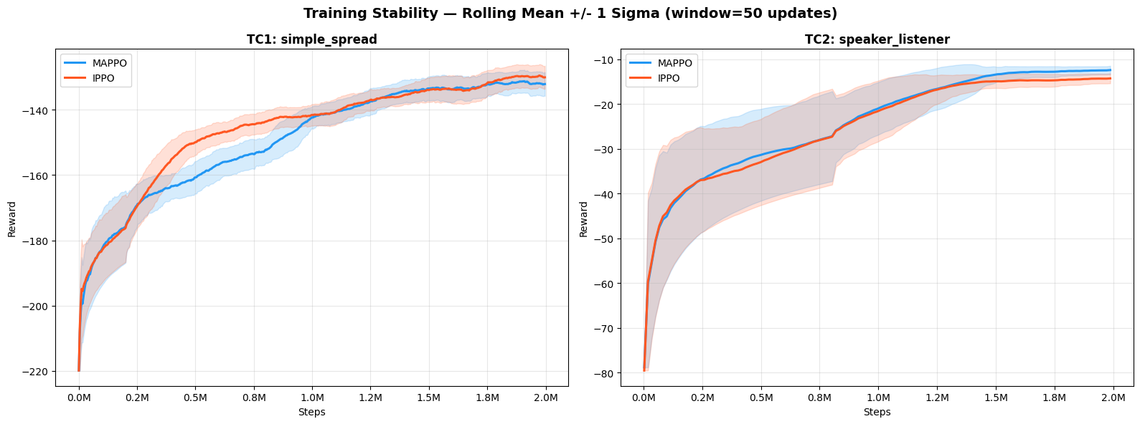
Analytics — Training Stability
Rolling mean ± std · variance decay over training

Slide 13
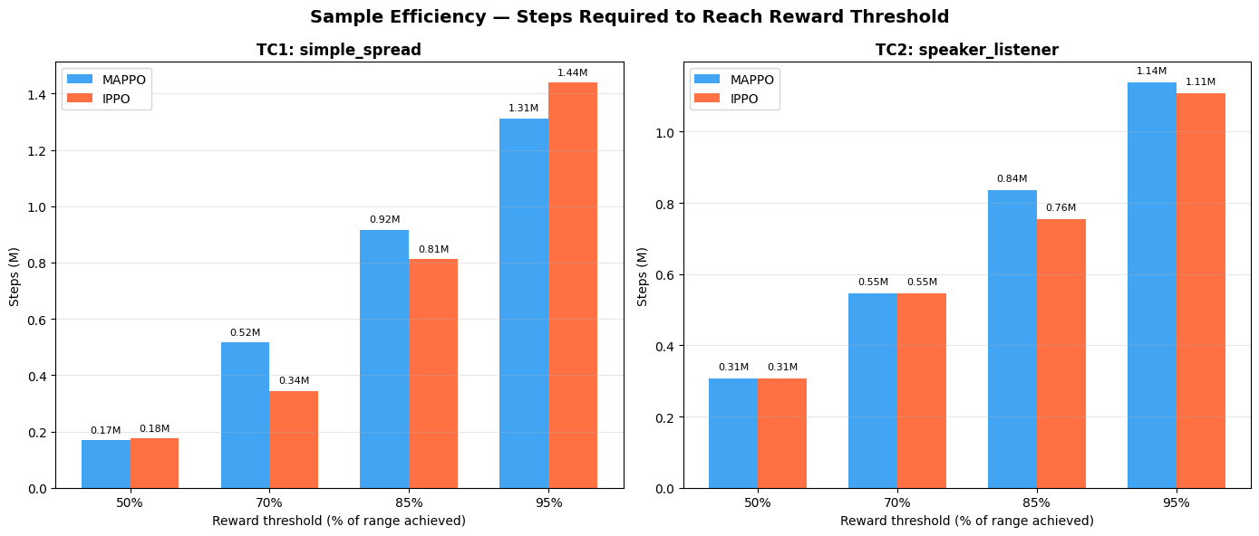
Analytics — Sample Efficiency
Steps-to-threshold · 50 / 70 / 85 / 95% of peak performance

Slide 14
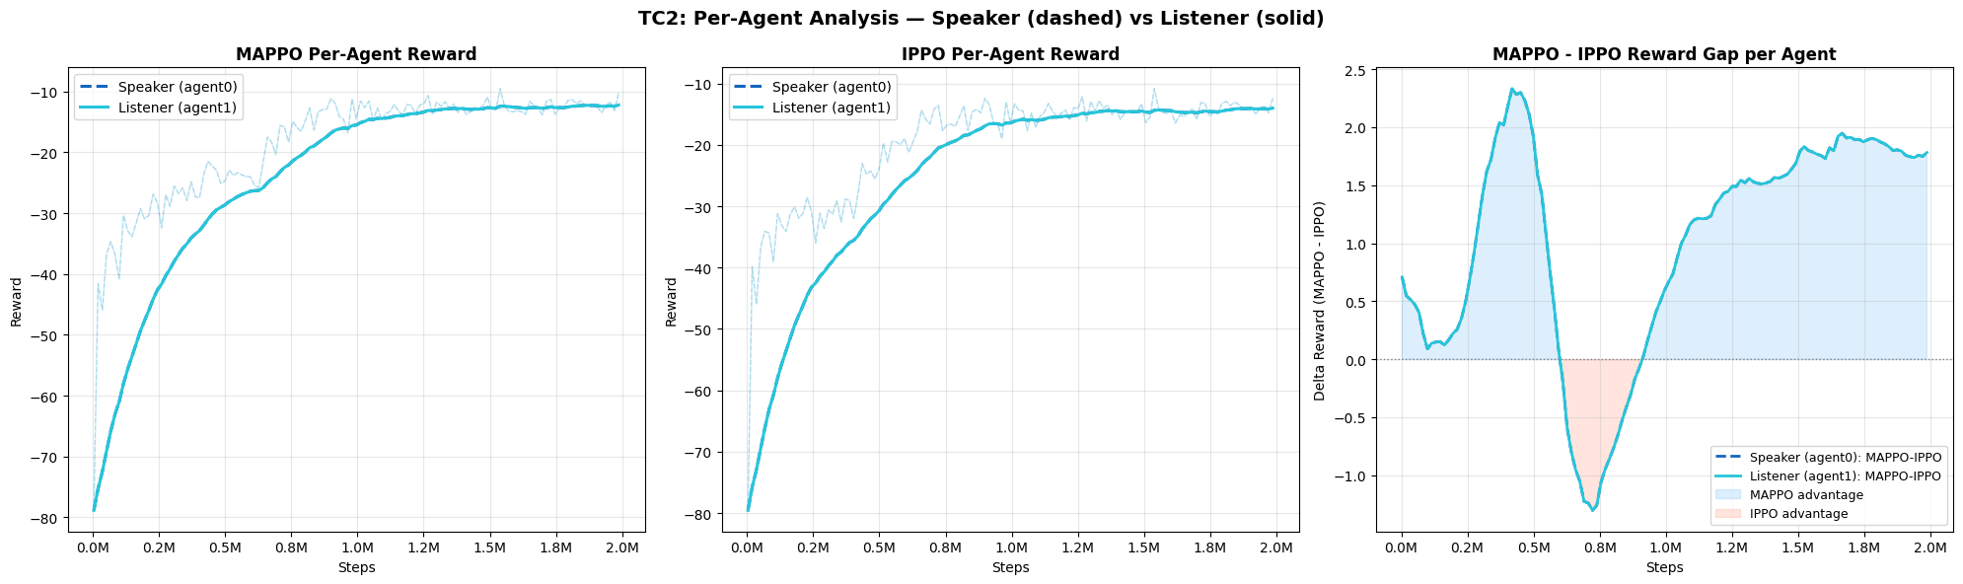
Analytics — Per-Agent Deep Dive
Speaker vs Listener reward breakdown (TC2)

Slide 15
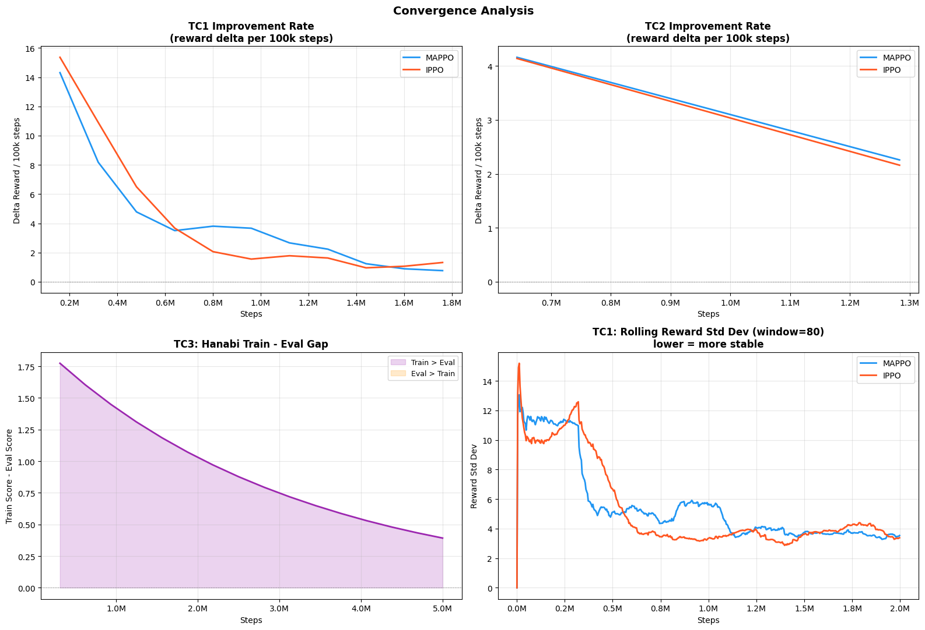
Analytics — Convergence Analysis
Improvement rate, variance decay, gradient trends

Slide 16
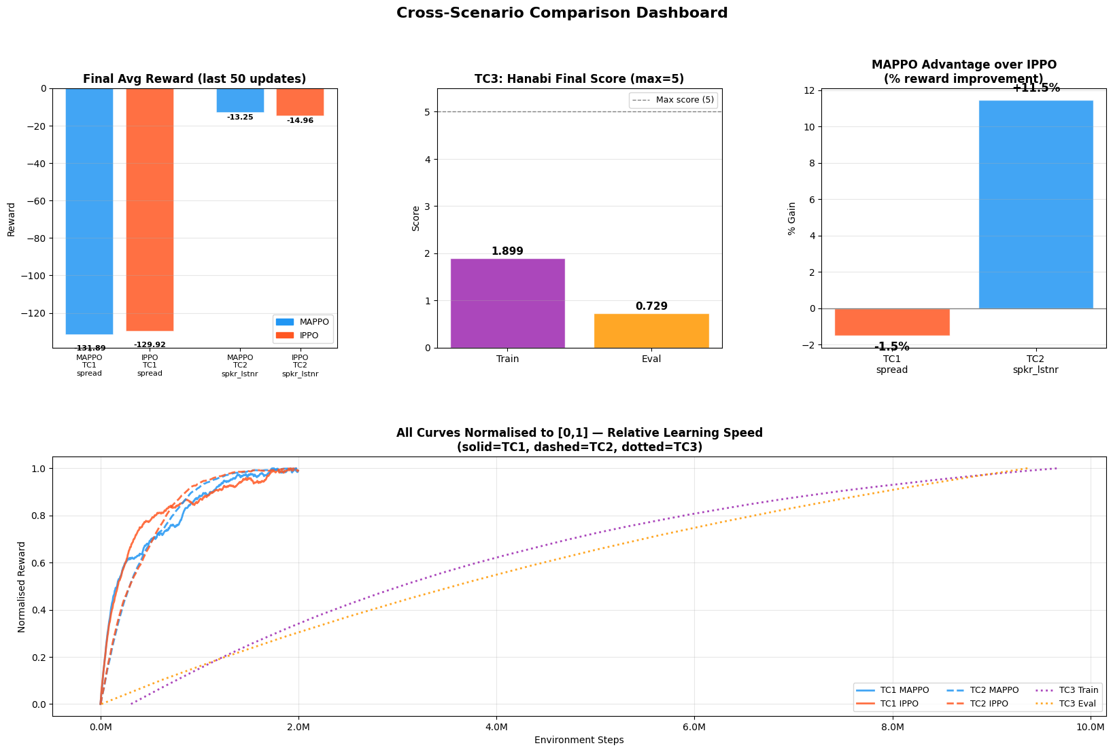
Analytics — Cross-Scenario Comparison
Final performance & relative gains across all environments

Slide 17
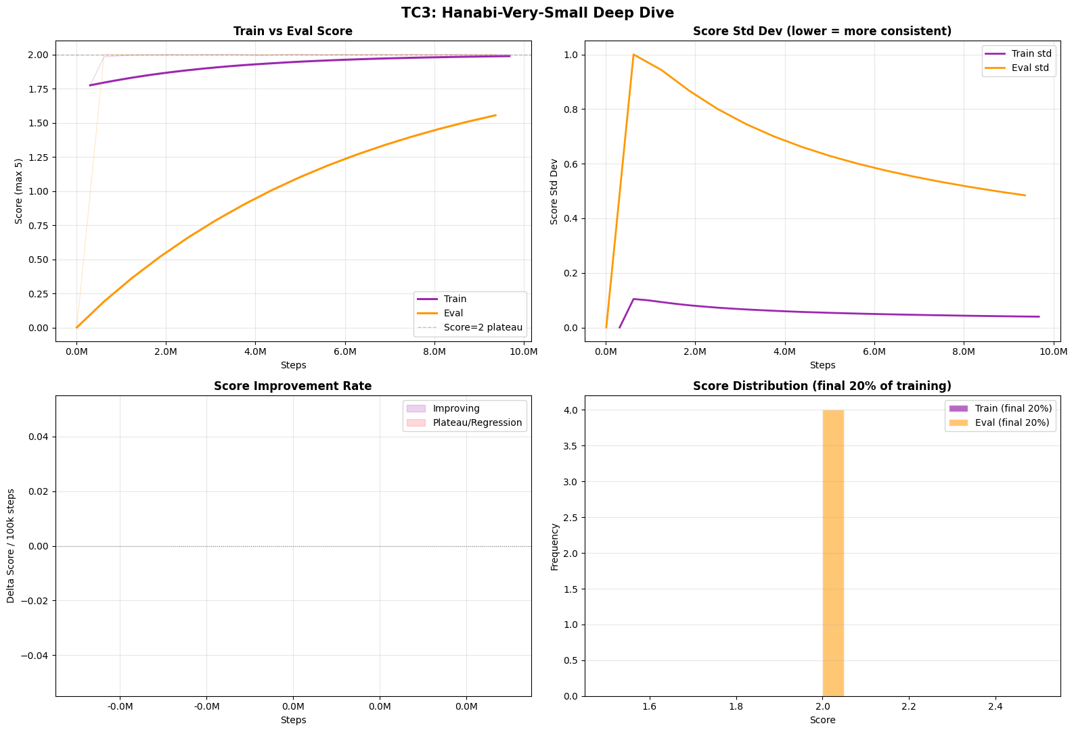
Analytics — Hanabi Deep Dive
Score distribution, train/eval gap, score progression

Slide 18
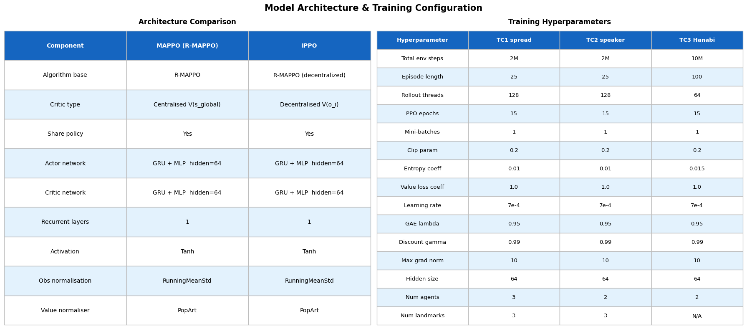
Model Architecture & Hyperparameter Summary
Network design and training configuration used across experiments

Slide 19
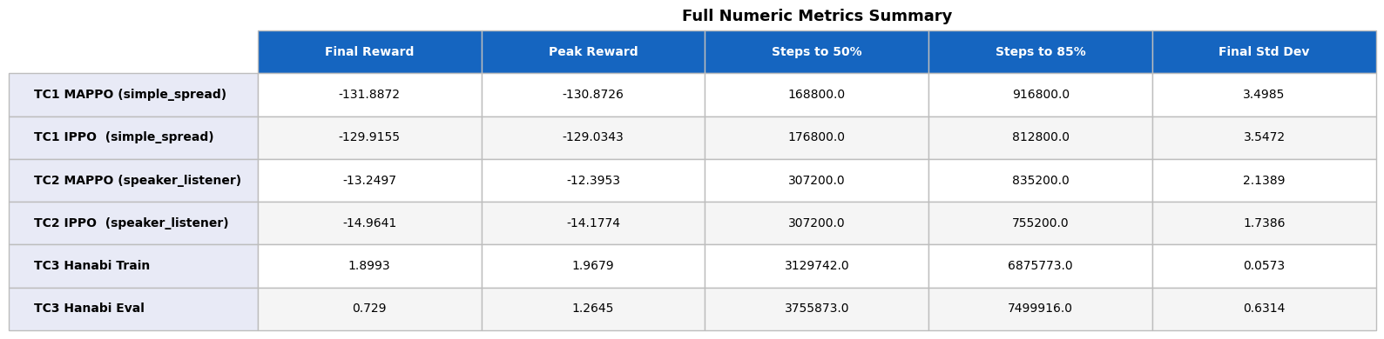
Numeric Metrics Summary
Final reward, convergence step, peak performance — all scenarios

Slide 20
Key Takeaways
What the reproduction confirmed — and where it fell short
TC2 (speaker-listener) most closely matches the paper: MAPPO beats IPPO at −13.3 vs −15.0, confirming that a centralized critic is essential for credit assignment across a communication channel.
TC1 (simple_spread) shows the right direction but not the full gap: we ran only 2 M of the paper's 25 M steps — MAPPO's spatial coordination advantage is a long-horizon effect that needs more training.
TC3 (Hanabi) is on trajectory but underfitting at 5 M steps: train score 1.90/5 vs. paper's ~2.5/5, with a large train/eval gap (1.90 vs. 0.73) showing agents haven't generalized hint conventions.
The step budget was constrained by Colab session limits: TC1 capped at 32 threads would need ~8 hrs per run at 25 M steps — dedicated GPU compute would close the gap with the paper.
Core finding validated: sharing global state during training produces measurably better cooperation, most strongly in tasks where credit assignment across agents is hardest.

