Slide 1
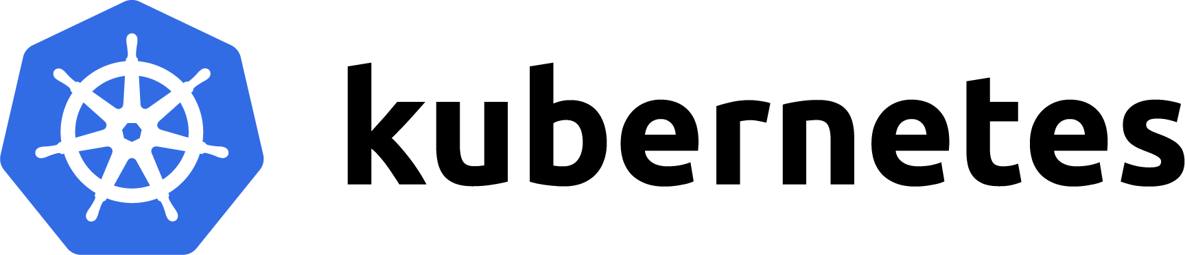

Order Portal container
Order Processor container
ASP.NET Core Website
.NET Core Worker
Get Metrics
Process Messages
Azure Service Bus Namespace
Orders queue
Generate Messages
Order Generator CLI
.NET Core Console

Slide 2




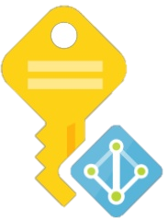

Authentication – Pod Identity
Azure Identity Binding
Deployment
Azure Identity Binding
App
Kubernetes Event-driven Autoscaling provides application autoscaling on a variety of metric sources such as Azure Event Hubs & Azure Service Bus.
Azure Identity
ScaledObject
Azure Identity
Azure AD Pod Identity provides managed identities for applications running on Kubernetes.
It will intercept calls for pods authenticating to Azure AD that want to authenticate with Managed Identity
Autoscaler Azure AD Identity
Orders Queue Azure Service Bus
Order Processor Azure AD Identity

Slide 3

Authentication – Workload Identity
Service Account
Deployment
Service Account
App
Kubernetes Event-driven Autoscaling provides application autoscaling on a variety of metric sources such as Azure Event Hubs & Azure Service Bus.
ScaledObject
Azure AD Workload Identity allows exchanging service account tokens for Azure AD tokens using federated credentials.
Federated Credentials
Federated Credentials
Autoscaler Azure AD Application
Orders Queue Azure Service Bus
Order Processor Azure AD Application

