Slide 1
A Project “Helpers4U” By
Vaibhav Kale -210943120119
Ashwin More -210943120055
Kedar Kumbhar -210943120039
Ketan Deshmukh -210943120041
Guided by : Mrs. Harshita Madam

Slide 2
INTRODUCTION
Helpers4U is the place where customer can find the skilled person or hire the person for various maintenance related work in their home and also they can hire the person for various services which are required in day to day life. The main objective of the project is providing easy way to the customer for hiring the person for different maintenance and services.

Slide 3
Problem Statement:
When someone need aid with small but major household tasks, the trouble arises when service skilled persons are unavailable or the trusted providers are impossible to find, who delivers consistently flawless service on instance.
We aim to help in providing optimal solutions to all your household troubles with more efficiency, ease and majorly, a delicate touch.
Our online system for household services provides the most expedient and annoys free way to get your domestic work done.

Slide 4
Objectives of project:
To reduce time.
Easily available best Vendors on one click.
Easy to use.
Customer will get fulfilled all their requirement in one place.

Slide 5
MODULES AND DESCRIPTION:
Customer Module
Service provider Module.
Customer Module :
Customer can login or register.
Customer can check services.
Add services to cart.
Customer can book services.

Slide 6
Service Provider Module :
Service provider can login or register his own account.
Service provider can add services and sub-services.
Service provider can add charges for services.
Service provider can add description of service.

Slide 7
SOFTWARE:
Eclipse 4.7 Oxygen.
MySQL Workbench 8.0.
Google Chrome version 99.0.
Apache Tomcat Server 8.5.
Maven Dependencies.

Slide 8
Hardware:
Intel i3 processor 6th generation or later / AMD Ryzen 200 2nd generation or later.
8 GB ddr3 ram.
Windows 10 Home edition or later.
1 TB Data HDD Space .
Data Connection 5 mbps.

Slide 9
End to End Flow of Application:
Customer:
User will login to the portal or will have to register if he is not a registered user.
After registration User will login and Dashboard page will be displayed to him which will display the services and its status if any.
From that page can User can click on the ‘buy new service’ button and reach the services details page.
In the services details page the User has to pick a category among the predefined sub-services and select the required sub services they needed.
A ‘confirm service order’ will be displayed on the Website showing all the details of the service the chose.
Then the user will have to make a payment about the service they chose and confirm the order.

Slide 10
Service Provider:
Service Provider will login as Service Provider from the ‘Service Provider login’ page and will be able to see his profile of services and sub-services by the Users of a particular area.
Service Provider can Review the service order and after understanding it Service Provider will ‘Receive’ the service order.
It is the job of Service Provider to assign appropriate service person to resolve the matter at the hand as soon as possible.
After conforming about the completion/resolving of the problem, Service Provider will check the status of the problem as ‘Resolved ’and head over to the next service order if any.

Slide 11
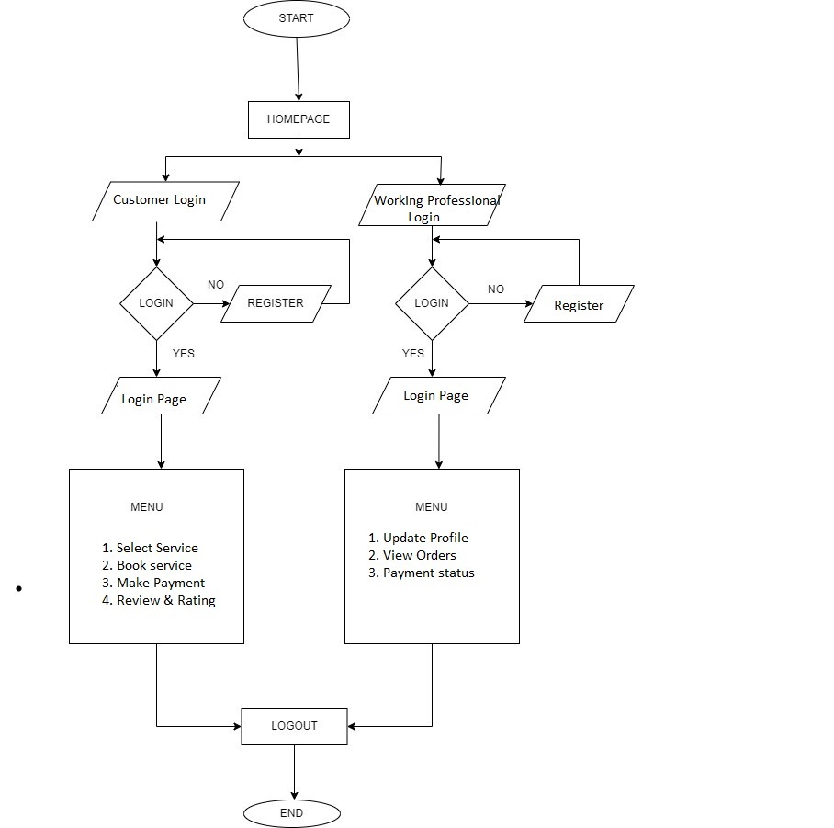
FLOW CHART:

Slide 12
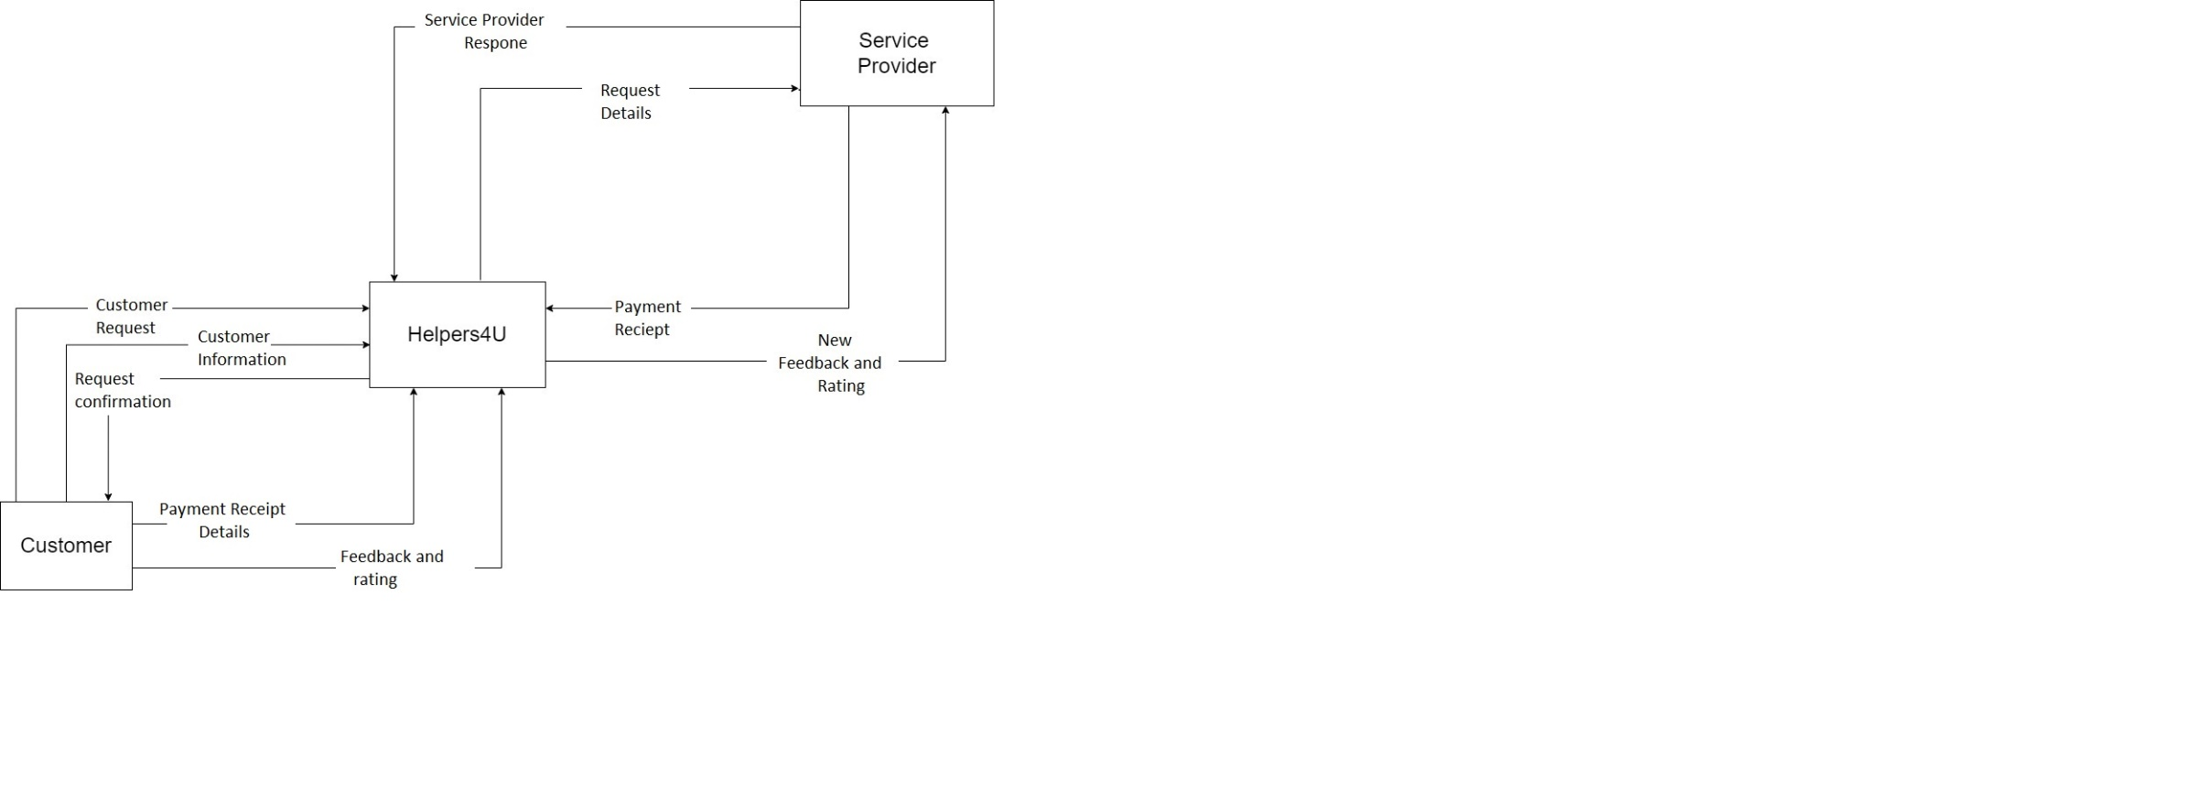
DFD DIAGRAMS :
Fig.1 Level 0 DFD

Slide 13
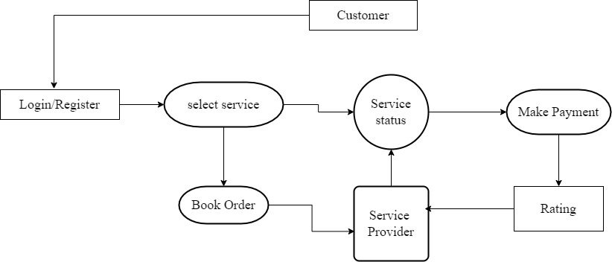
Fig.2 Level 1 DFD

Slide 14
FUTURE SCOPE::
This application can be further enhanced by allowing the users of the application to drag and drop to another location on the maps.
This facility can be used by the user in case if the user wants the service request to be accomplished at another location than his current location.
Since this application is built only for the Android users, this application can also be implemented for other platform like iOS and Windows.
Another useful enhancement can be made by providing more service types to the user.

Slide 15
CONCLUSION
Home services are needed and the demand for services is increasing since the population in Asia is ageing.
Old people are not the only group to benefit from home services, Other consumer groups are also going to benefit from new services also.

Slide 16
THANK YOU!!

