Slide 1
Digital Health Card System

Slide 2
Introduction
Healthcare data is often scattered across hospitals and labs.
Patients face difficulty in carrying and managing medical records.
Paper-based records are prone to loss, damage, and duplication.
A Digital Health Card provides a centralized, secure, and digital solution.
It allows easy access to medical history anytime and anywhere.

Slide 3
Problem Statement
Patients carry multiple paper reports from different hospitals.
Doctors lack access to complete patient medical history.
Lab reports are not centrally stored.
Data duplication and inconsistency occur frequently.
Emergency treatment is delayed due to missing records.
No secure nominee access in critical situations.

Slide 4
Proposed Solution
Develop a Digital Health Card System.
Each patient gets a unique digital health ID.
Centralized storage of medical reports.
Secure access for doctors and lab technicians.
Nominee access during emergencies.
Admin-controlled system management.

Slide 5
Objectives
Digitize patient medical records.
Provide secure and quick access to health data.
Reduce paperwork and redundancy.
Improve emergency medical response.
Enable seamless interaction between patients, doctors, and labs.
Ensure data privacy and security.

Slide 6
System Users
Patient
Doctor
Lab Technician
Nominee
Admin

Slide 7
Patient Module
Register and manage personal details.
View medical reports.
Add nominee details.
Share health card with doctors.
Access health history anytime.

Slide 8
Admin Module
Manage system users.
Verify doctors and lab technicians.
Monitor system activity.
Ensure data integrity and security.

Slide 9
Doctor Module
View patient health records.
Upload diagnosis and medical reports.
Track patient history.
Ensure accurate treatment decisions.

Slide 10
Lab Technician Module
Upload lab test reports.
Associate reports with patients.
Maintain lab information.
Secure report handling.

Slide 11
Nominee Module
Access patient details during emergencies.
View limited medical history.
Use emergency PIN for authentication.
Assist healthcare providers.

Slide 12
PATIENT ────< MEDICAL_REPORT >──── DOCTOR
| |
| |
└─── NOMINEE LAB_TECHNICIAN
ADMIN ─── manages ─── PATIENT / DOCTOR / LAB_TECHNICIAN

Slide 13
ER Diagram Overview
Entities: Patient, Doctor, Lab Technician, Medical Report, Nominee, Admin
Relationships:
Patient → Medical Report (1:M)
Doctor → Medical Report (1:M)
Lab Technician → Medical Report (1:M)
Patient → Nominee (1:1)

Slide 14
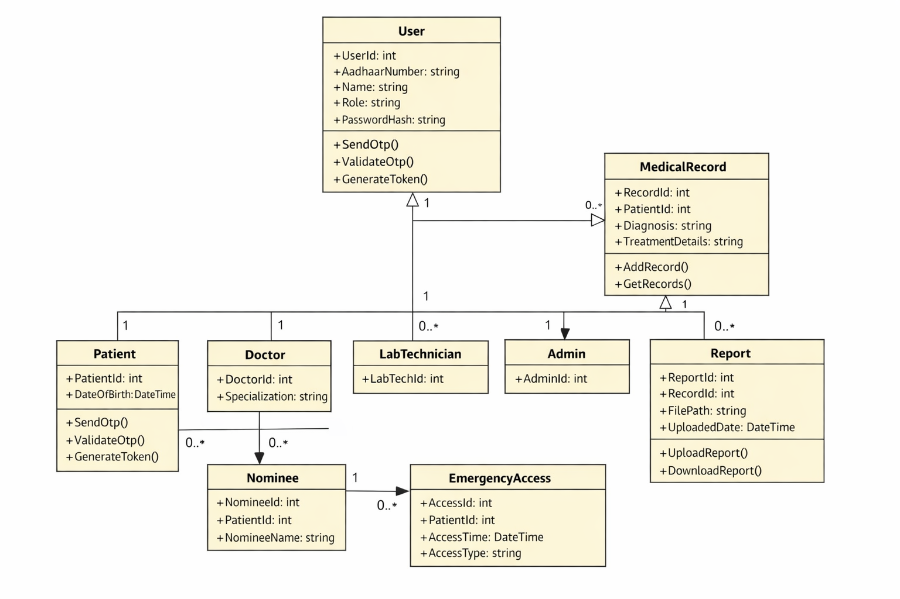
UML Diagram

Slide 15
Advantages
Easy access to medical history.
Reduced paperwork.
Improved emergency care.
Better coordination among healthcare providers.
Secure and reliable data management.

Slide 16
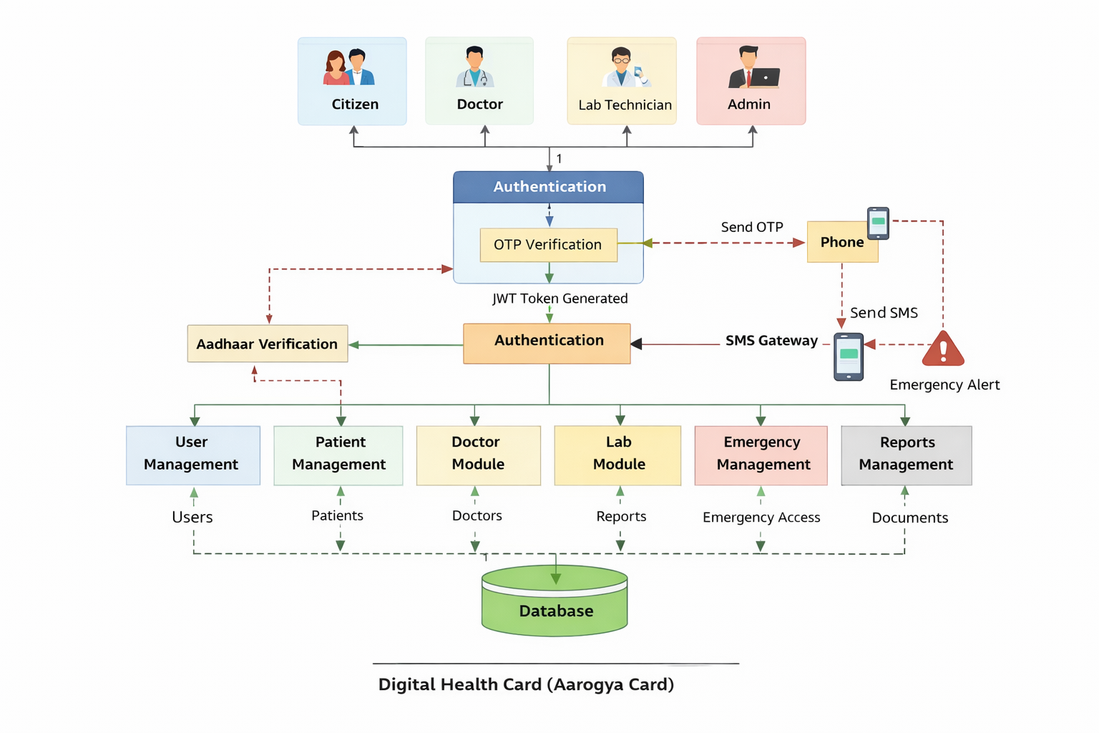

Slide 17
Applications
Hospitals and clinics.
Diagnostic laboratories.
Emergency healthcare services.
Insurance verification.
Government health programs.

Slide 18
Conclusion
Digital Health Card simplifies healthcare management.
Improves efficiency and patient safety.
Ensures secure and centralized medical records.
Supports modern digital healthcare systems.
A step towards smart and connected healthcare.

Slide 19


