Slide 1
SOCIAL FOOTPRINTS Profile information aggregated from multiple OSN accounts
How much aggregated information do we disclose online through multiple Online Social Networking accounts?
How safe is it to disclose that information – can we measure the risk associated with it?
Can we identify a way to reduce disclosed information but keep visibility high?

Slide 2

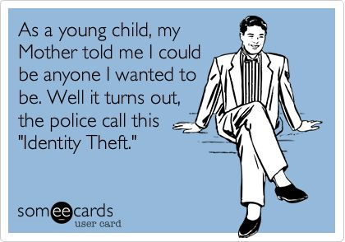
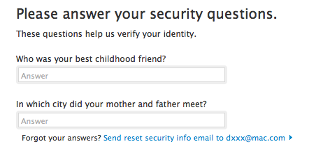
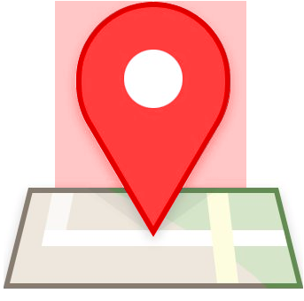

MOTIVATION
More comprehensive profile out there than we expect.
Identity thefts
Dictionary attacks
Stalking / Harassment
General crimes using this information

Slide 3
INTEGRATION
API
ISSUES
With Facebook and LinkedIn using PHP
Filtering only public information to simulate behavior of a malicious user

Slide 4
WEIGHTs for profile attributes
Weights based on risk associated with attributes
The riskier an attribute the more weight it will have
These could be risks of –
Password recovery
Identity theft
Cross Site Linking

Slide 5
PROPOSED SOLUTION
Use OSN APIs for developers to fetch data for a user - In Progress
Aggregate data from all APIs to create the footprint - In Progress
Have weights associated with all attributes - In Progress
Calculate total weight of the footprint and compare with a threshold - Pending
Identify attributes that could be left out to reduce weight with less effect on visibility- Pending

Slide 6
QUESTIONS AND SUGGESTIONS

