Slide 1
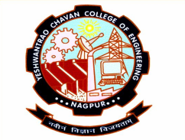
ROBOT CAR AUTOMATION USING HAND GESTURE RECOGNITION WITH PYTHON AND ARDUINO UNO
Mandar Hajare(59)
Vedang Patil(81)
Ayush Kedar(41)
Budharam Kumbhre(43)
Musab Sheikh(60)
Himanshu Samrit(56)
Guided by
Jagdish Yadhav
Department of Information Technology
Yeshwantrao Chavan College of Engineering, Nagpur
Session 2022-23

Slide 2
OUTLINE
Problem statement
Aim & Objective
Technology Used
4. Implementation and Approaches
5.Results
6.Conclusion
7.References

Slide 3
PROBLEM DEFINITION
There are some parts in our society which are not able to access certain priviledges normally through physical touch. Handicapped people are not able to drive a car, or turn on or off lights if they don’t have needed parts or may have been paralysed.
In order to enhance and improve life experience we are attempting to build a bridge between electronic devices and software interfaces to make life easier for these people.
Some situations require hands free interaction with the electronic appliances like quarantine situations , or where we need our parked car come straight to us.

Slide 4
AIM & OBJECTIVE
Aim -
We aim to establish a connection between electronic devices and software to make life easier.
We aim to operate a small motor car using hand gesture recognition algorithm.
Objective -
1. To Build a small motor car and program it using Arduino Uno.
2. Integrate that small motor car with our python hand gesture recognition code.
3. To Drive that motor module using hand gesture only (contactless driving).

Slide 5
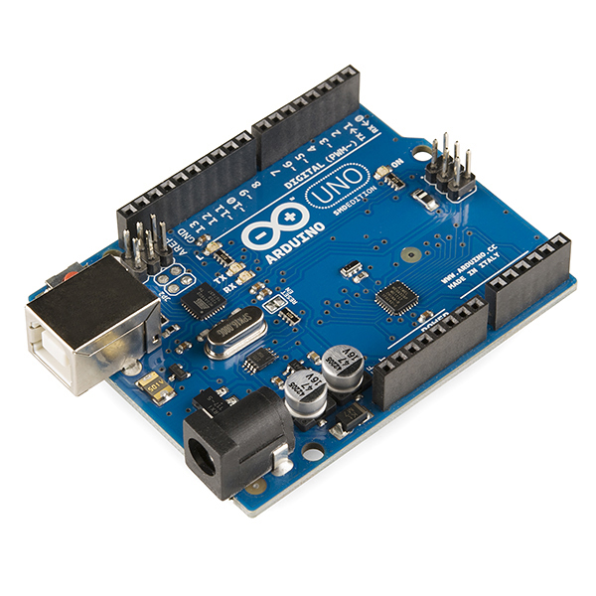
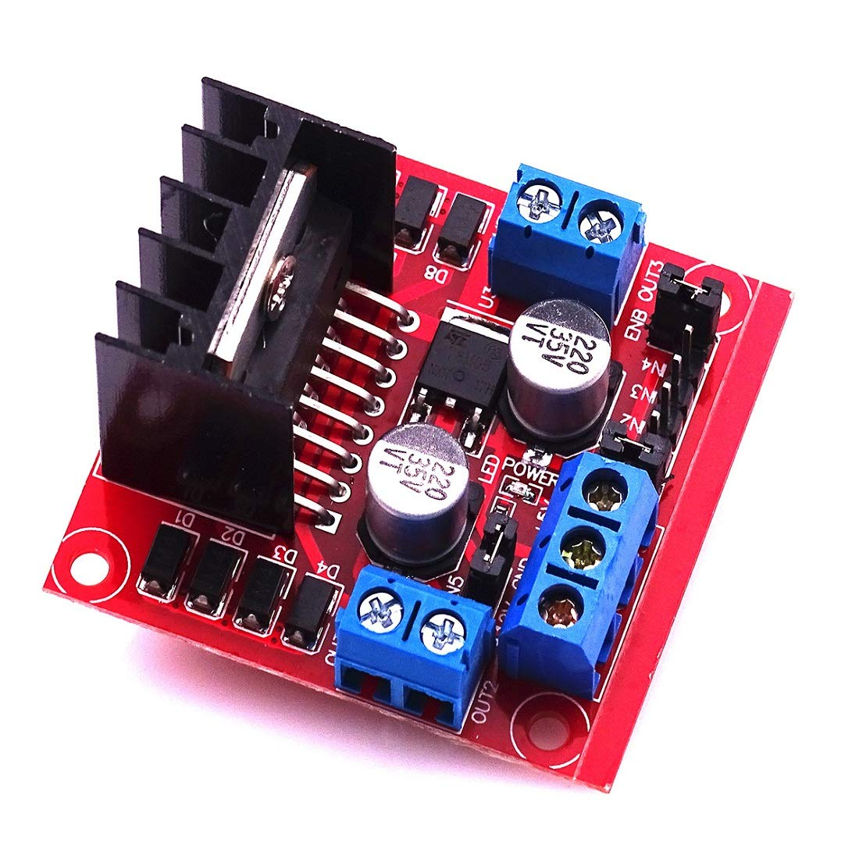
TECHNOLOGY USED
Hardware Components Required [Motor Car] -
1. Arduino Uno :
Arduino Uno was used in this project.
2. L298N Motor Driver Module :

Slide 6
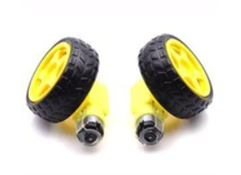
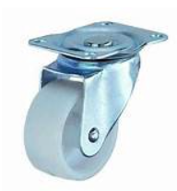
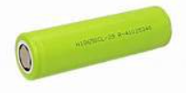
TECHNOLOGY USED
Hardware Components Required [Motor Car] -
3. BO Motors with wheels :
Two motors with wheels.
4. Caster Wheels : 5. Li to provide 12V (3) :

Slide 7
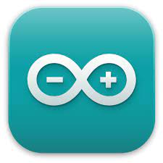



TECHNOLOGY USED
Software Component Used [For both Motor Car and Hand Gesture] -
1. Arduino IDE : 2. Anaconda Distribution :
3. Juptyer Notebook : 4. Python~Pyfirmata :

Slide 8
IMPLEMENTATION AND APPROACHES
We are going to start it off with hardware implementation and construction. All the 5 different approaches will be discussed later on in this presentation. We implemented the Machine Learning Approach particularly in this project as it is most efficient and makes our arduino uno integration easier.
STEPS (MOTOR CAR CONSTRUCTION)-
1. We will use a metal mouting board to make a base chasis for our motor car which will accommodate both Arduino Uno and Motor Driver Module and our both motor wheels.
2. We are going to connect the two motor wheels to the L298N motor driver module which is going to decide the speed and direction of motor rotation.
3. After that we will connect motor driver module needed ports to the arduino uno ports to take commands from arduino.

Slide 9
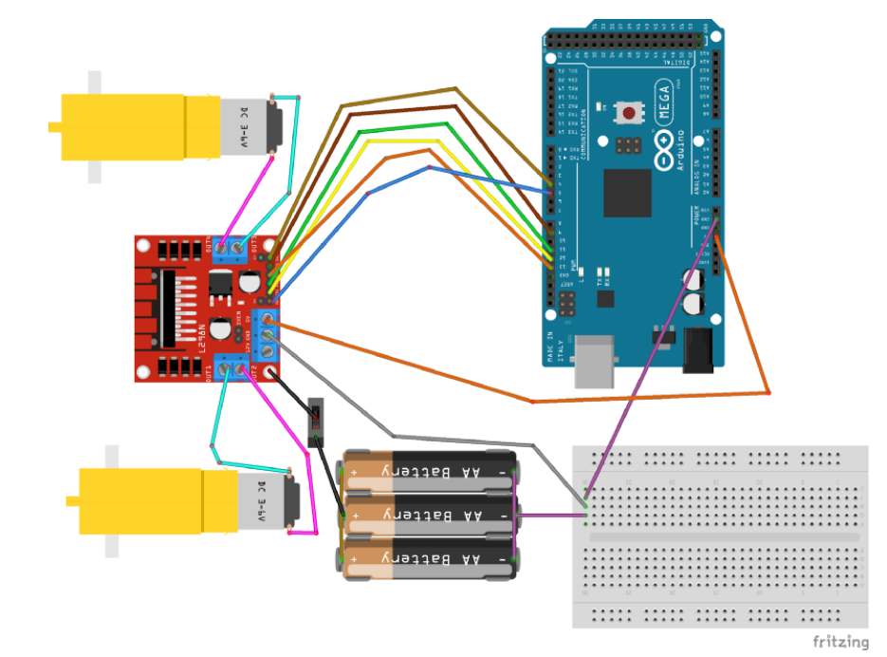
IMPLEMENTATION AND APPROACHES
STEPS (MOTOR CAR CONSTRUCTION)-
4. Connections was made as shown in the following schematic. We pasted the L298N motor driver module at the bottom of the metal plate along with the two motor wheels and we pasted a 12V battery supply at the top in our case we are going to give the power output from outside as an adapter. We pasted Arduino uno at the top of the motor.

Slide 10
IMPLEMENTATION AND APPROACHES
STEPS (Arduino Uno Connection and Code)-
1. Arduino uno is connected with an USB port cable to the laptop where we are going to upload the code through Arduino IDE.
2. We are using firmata sketch in Arduino IDE in order to integrate it with python's pyfirmata interface so that we can run our python code and use arduino with it instead of coding in arduino itself. It makes the job easier.
3. We start Arduino IDE and we go to examples and then we go to firmata from there we go to StandardFirmata Sketch so that we can flash our arduino uno and make our arduino understand pyfirmata program.

Slide 11
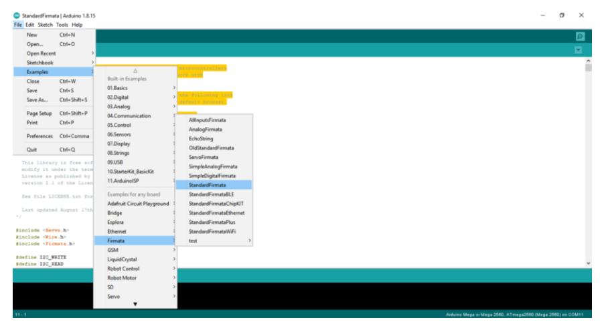
IMPLEMENTATION AND APPROACHES
STEPS (Arduino Uno Connection and Code)-
4. These are the steps mentioned in step 3 :

Slide 12
IMPLEMENTATION AND APPROACHES
STEPS (Arduino Uno Connection and Code)-
5. Select the USB port to which your arduino uno is connected.
6. After that we uploaded that firmata sketch into our arduino uno model. In this way we flashed our arduino uno chipset.
7. Now our arduino uno is set for pyfirmata python interface program. We can run aur python program to manupulate the arduino uno according to our needs.

Slide 13
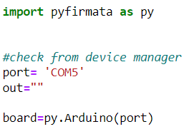
IMPLEMENTATION AND APPROACHES
STEPS (Pyfirmata and Python)-
1. We will need a module which will declare all the pins and its functions to arduino. In order to do that we create a microcontroller module . In python we import the library using "import pyfirmata as py" also we are going to define what port our arduino is connected to, that can be checked in the device managers in arduino IDE. Then we pass that port number to Arduino method which is only for Arduino Uno. For other board it differs.

Slide 14
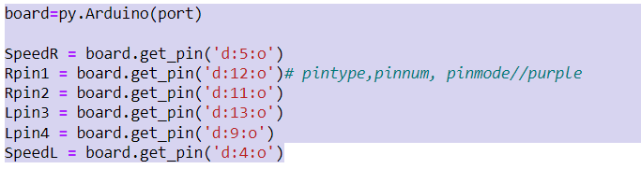
IMPLEMENTATION AND APPROACHES
STEPS (Pyfirmata and Python)-
2. We define the pins on Arduino using .get_pin() commands.
First we define the pin type. ‘a’ for analog and ‘d’ for digital. Then we give the pin number which are the pins we use on Arduino board. Next we define the Pin mode which will be ‘o’ for output and ‘i’ for input.
pin_number = board.get_pin( ‘ pin_type : pin_number : pin_mode ’ )

Slide 15
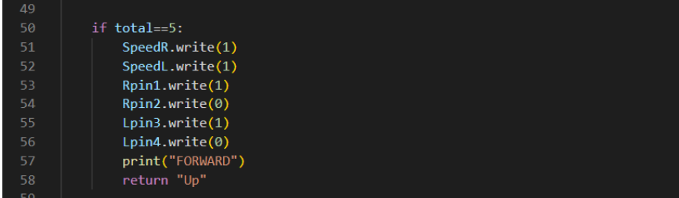
IMPLEMENTATION AND APPROACHES
STEPS (Pyfirmata and Python)-
3. The Ln293 motor module also allows us to control speed via the enable pins. For both tires we introduce speed variables. Speed is an analog value but we have set a certain speed (full in our case) hence we configure those as digital. In this case we first digitally enable the pins for left and right motor and then we digitally write one pin high for right motor and another for left motor.

Slide 16
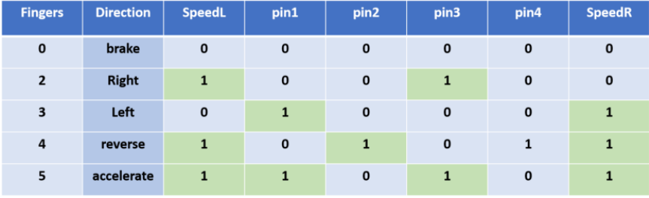
IMPLEMENTATION AND APPROACHES
STEPS (Pyfirmata and Python)-
4. We output HIGH (1) on speed pins for full speed. However speed can be controlled by setting the speed pins as analog.
5. For making our program interactive we developed a small gui window that :
- Allows us to run 2 pre programmed videos .
- Allows to run live webcam and exit the application.

Slide 17
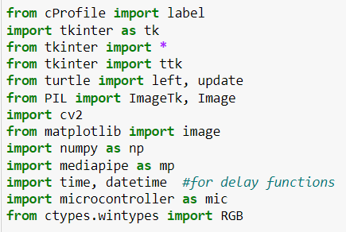
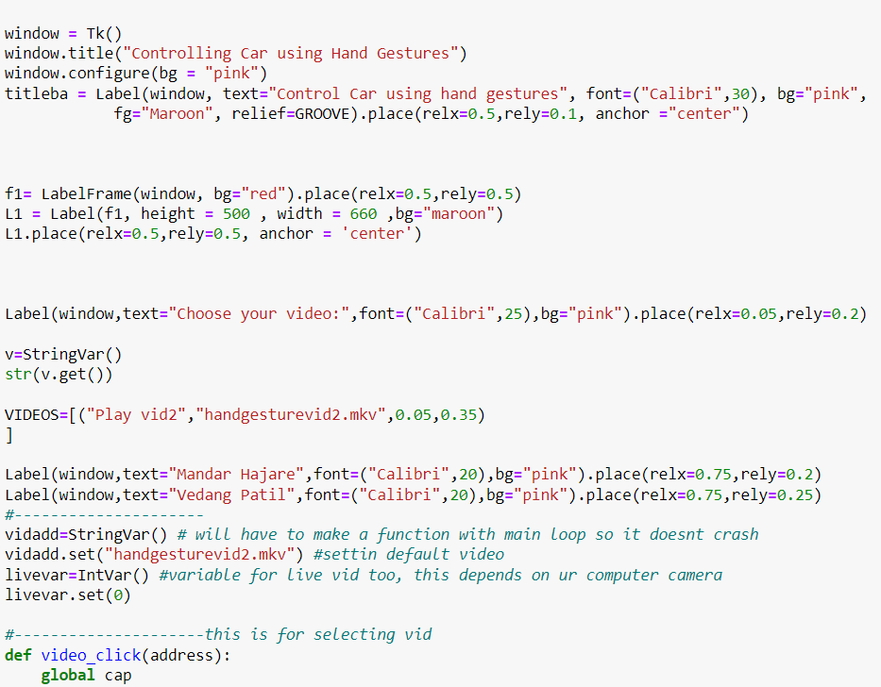
IMPLEMENTATION AND APPROACHES
STEPS (Pyfirmata and Python)-
6. This is our main .py code where we will import the recent microcontroller as a module .

Slide 18
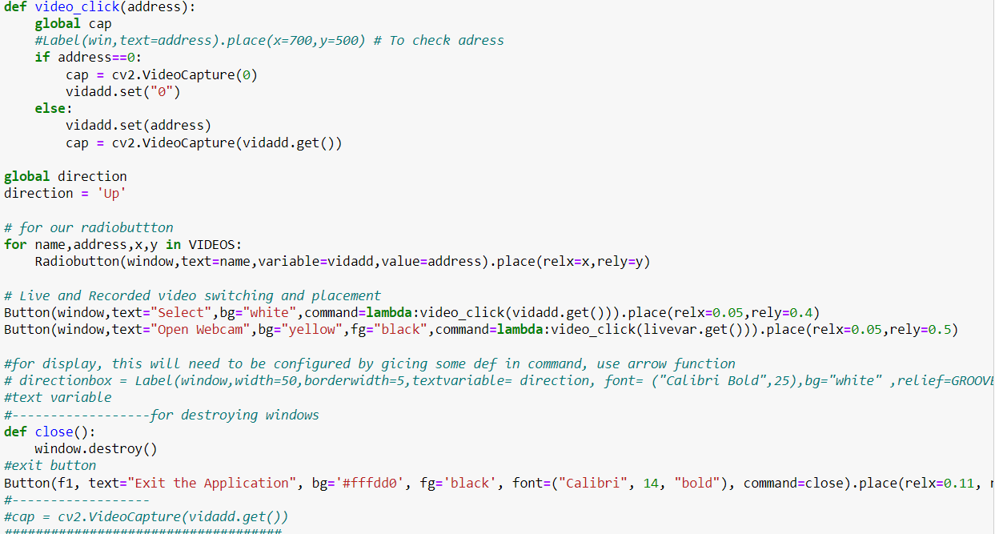
IMPLEMENTATION AND APPROACHES
STEPS (Pyfirmata and Python)-

Slide 19
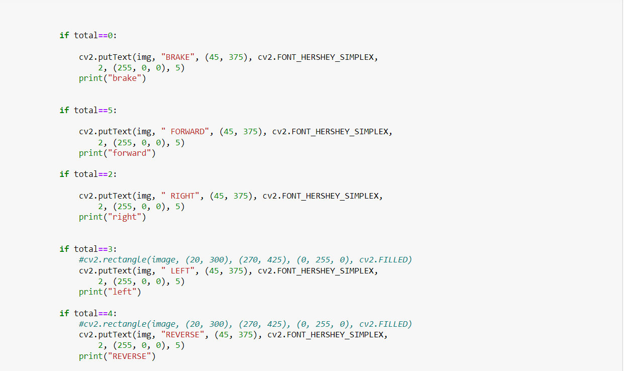
IMPLEMENTATION AND APPROACHES
STEPS (Pyfirmata and Python)-

Slide 20
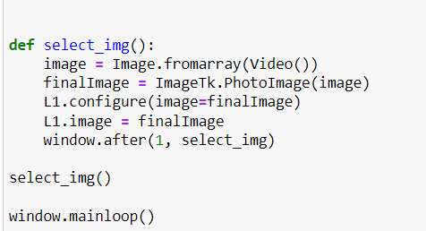
IMPLEMENTATION AND APPROACHES
STEPS (Pyfirmata and Python)-

Slide 21
IMPLEMENTATION AND APPROACHES
STEPS (Pyfirmata and Python)-
In the end of our approach application we run the main code and it opens up a window where we select if we want to run a premade window or open webcam and take commands from there.
In this way we successfully implemented the Hand Gesture Recognition Automation with the help of Arduino Uno and Machine Learning with Python, OpenCV.

Slide 22
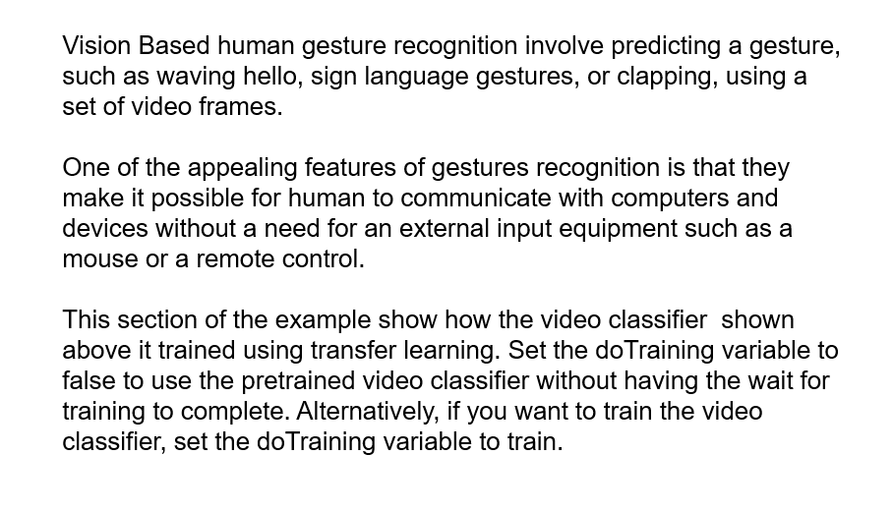
IMPLEMENTATION AND APPROACHES
HUMAN GESTURE RECOGNITION USING DEEP LEARNING MATLAB

Slide 23
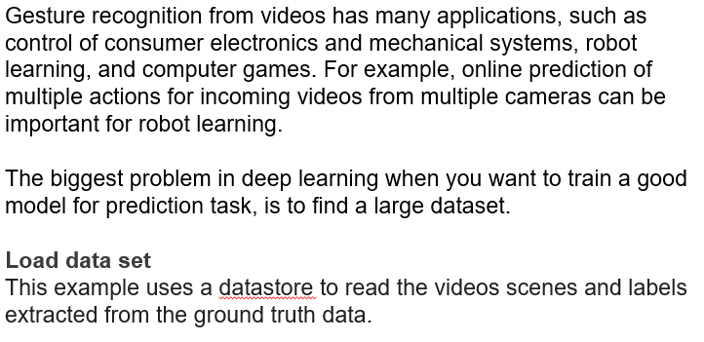
IMPLEMENTATION AND APPROACHES
HUMAN GESTURE RECOGNITION USING DEEP LEARNING MATLAB

Slide 24
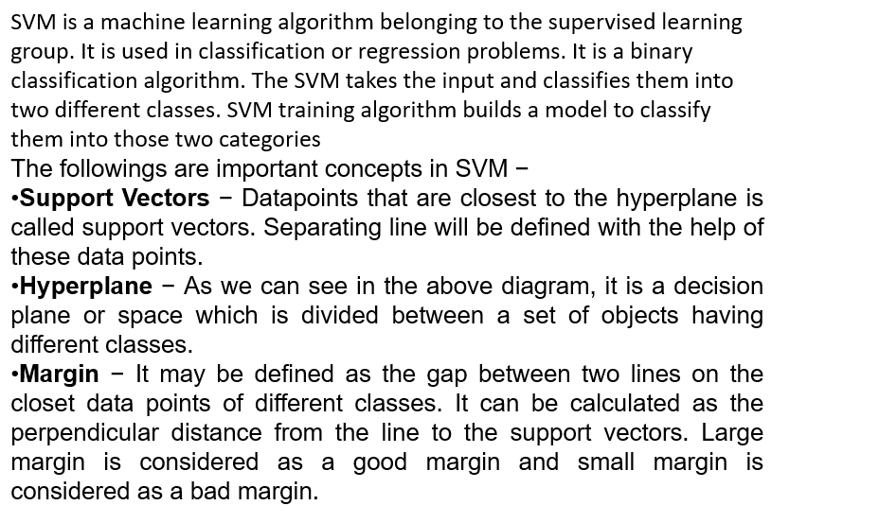
IMPLEMENTATION AND APPROACHES
HUMAN GESTURE RECOGNITION USING SVM MODEL

Slide 25
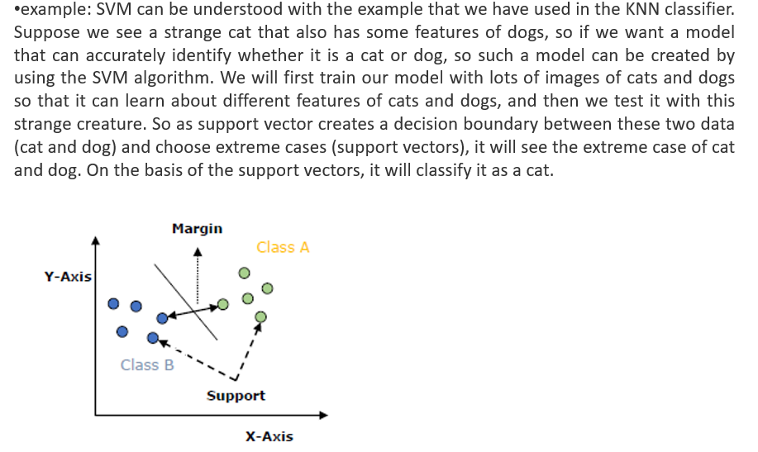
IMPLEMENTATION AND APPROACHES
HUMAN GESTURE RECOGNITION USING SVM MODEL

Slide 26
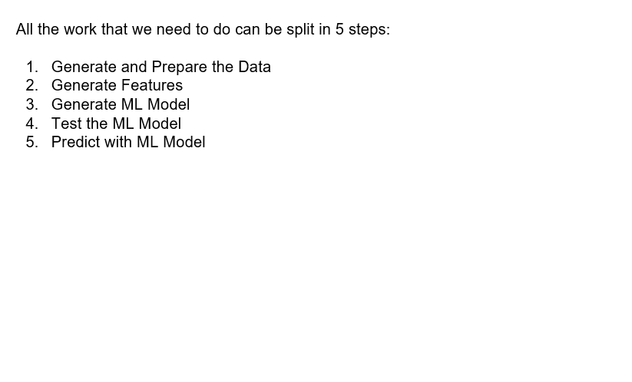
IMPLEMENTATION AND APPROACHES
HUMAN GESTURE RECOGNITION USING NEURAL NETWORKS

Slide 27
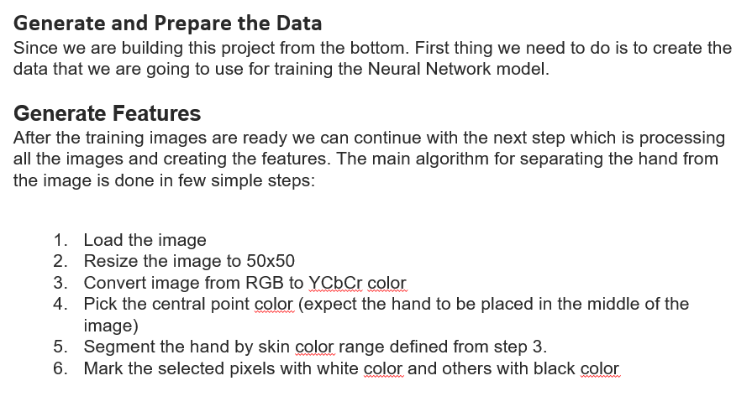
IMPLEMENTATION AND APPROACHES
HUMAN GESTURE RECOGNITION USING NEURAL NETWORKS

Slide 28
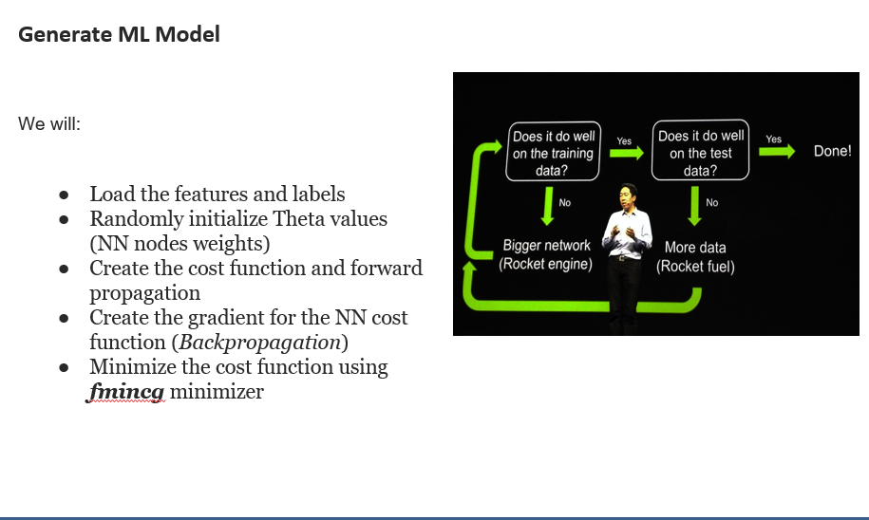
IMPLEMENTATION AND APPROACHES
HUMAN GESTURE RECOGNITION USING NEURAL NETWORKS

Slide 29
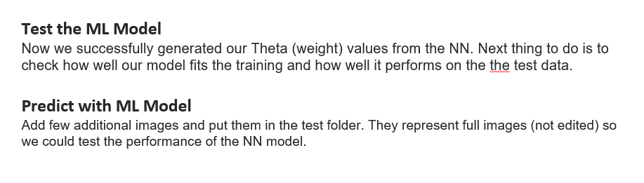
IMPLEMENTATION AND APPROACHES
HUMAN GESTURE RECOGNITION USING NEURAL NETWORKS

Slide 30
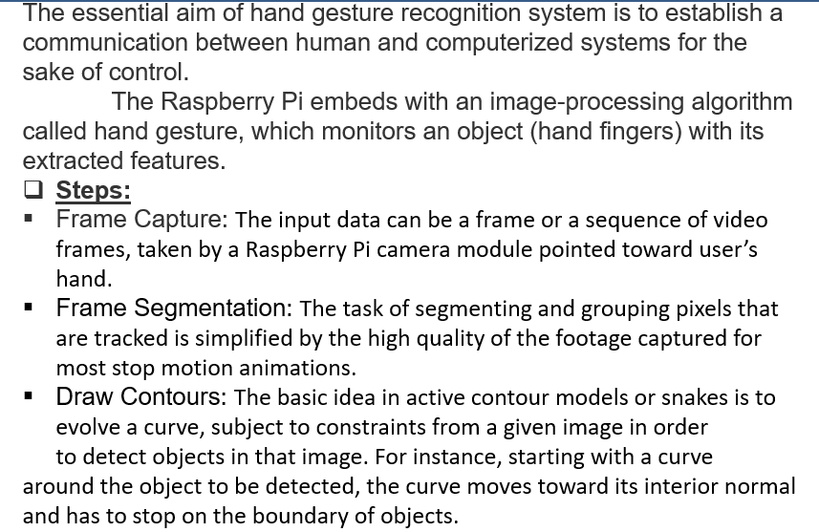
IMPLEMENTATION AND APPROACHES
HUMAN GESTURE RECOGNITION USING PYTHON BASED RASPBERRY PIE

Slide 31
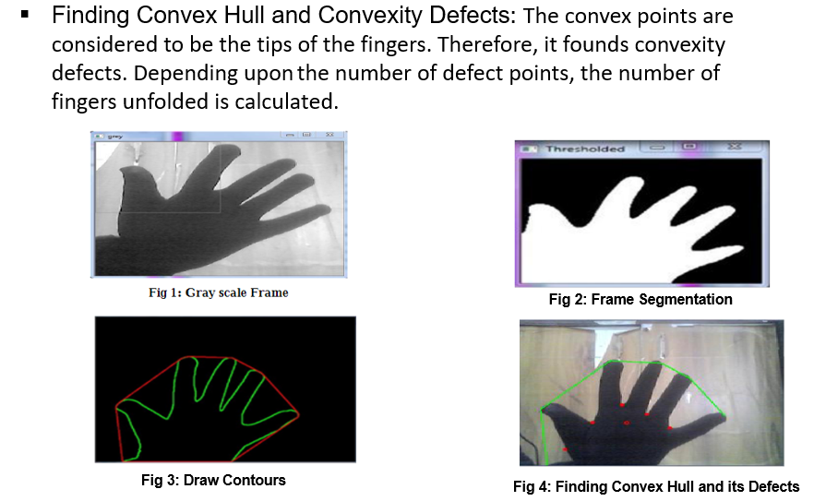
IMPLEMENTATION AND APPROACHES
HUMAN GESTURE RECOGNITION USING PYTHON BASED RASPBERRY PIE

Slide 32
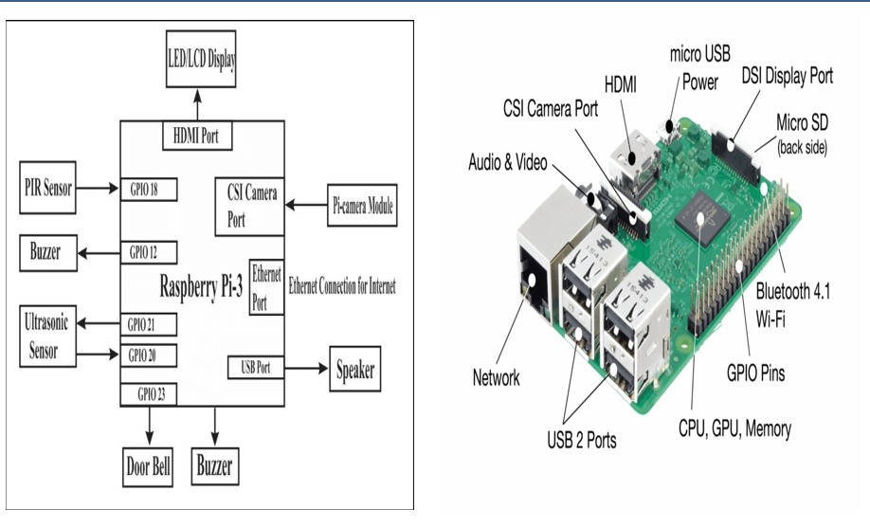
IMPLEMENTATION AND APPROACHES
HUMAN GESTURE RECOGNITION USING PYTHON BASED RASPBERRY PIE

Slide 33
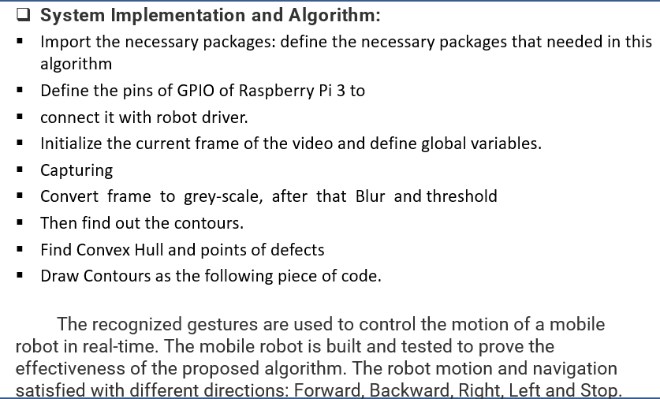
IMPLEMENTATION AND APPROACHES
HUMAN GESTURE RECOGNITION USING PYTHON BASED RASPBERRY PIE

Slide 34
RESULT

Slide 35
CONCLUSION
In the above explained multiple approached we mainly focused on implementing this project using Machine Learning Python approach using Arduino Uno.
All the other approaches explained above can also be implemented to get the same output.
We successfully established bridge network between a device and a software.
In this way we conclude our presentation.

Slide 36
References
Website
[1] M. Bryant, “10 Great Uses of Image and Face Recognition,” Accessed on Novemeber 2011. [Online]. Available: http://thenextweb.com/apps/2011/08/19/10-great-uses-of-image-and-face-recognition
Journal
[2] S. Aggarwal and Y. Gulati, “A Multimodal Biometric System using Fingerprint and Face,” International Journal of Advanced Research in Computer Engineering & Technology, vol. 1, no. 4, pp. 341–356, 2012.
Conference
[3] A. K. Jain, L. Hong, and Y. Kulkarni, “A Multimodal Biometric System using Fingerprint, Face and Speech,” in Proceedings of 2nd International Conference on Audio-and Video-based Biometric Person Authentication, Washington DC, 1999, pp. 182–187.
Tech Report
[4] D. M. Blackburn, M. Bone, and P. J. Phillips, “Face Recognition Vendor Test 2000:
Evaluation Report,” DTIC Document, Tech. Rep., 2001.
Patent
[5] T. Kanade, “Picture Processing System by Computer Complex and Recognition of Human Faces,” Kyoto University, Japan, PhD. Thesis, 1974.
Book
[6] K. I. Diamantaras and S. Y. Kung, Principal Component Neural Networks. Wiley New
York, 2nd edition, 1996.

Slide 37
DEMONSTRATION

Slide 38
THANK YOU!

