Slide 1
DIWALI SALES ANALYSIS
Exploratory Data Analysis of Festive-Season Customer Purchases
Python · Pandas · NumPy · Matplotlib · Seaborn

Slide 2
Project Overview
Objective
Dataset
Analyze festive-season sales data to uncover who buys, what they buy, and where — turning raw transaction records into actionable marketing insight.
11,251 transactions · 13 features
Gender, Age, Marital Status, State, Zone, Occupation, Product Category, Orders, Amount
Data Preparation
1
2
3
4
Dropped
Cleaned
Typed
Explored
Removed empty Status & unnamed columns
Dropped 12 rows with missing Amount
Cast Amount to integer for analysis
describe() on Age, Orders, Amount
Diwali Sales Analysis
2

Slide 3
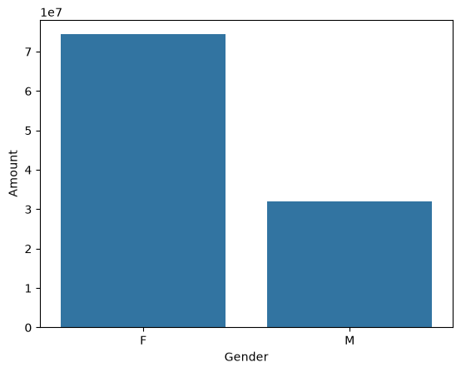
Gender-Wise Sales
Who spends more this Diwali?
KEY INSIGHT
Women drove a noticeably larger share of total sales value than men, making female shoppers the primary revenue segment for festive promotions.
Diwali Sales Analysis
3

Slide 4
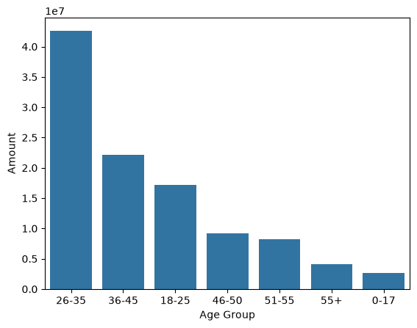
Sales by Age Group
Spending power across generations
KEY INSIGHT
The 26–35 age bracket contributes the highest sales volume — young working professionals are the core festive-shopping audience.
Diwali Sales Analysis
4

Slide 5
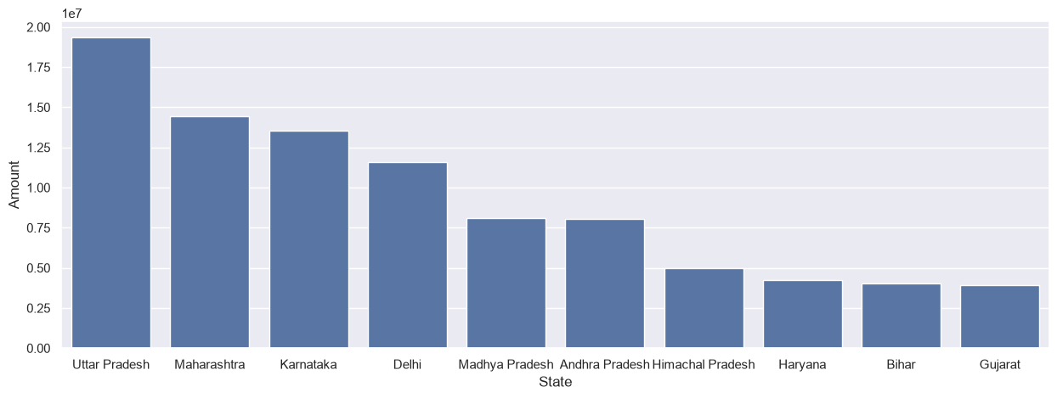
Top 10 States by Sales
Where the revenue is concentrated
KEY INSIGHT
Uttar Pradesh, Maharashtra and Karnataka lead the country in Diwali sales value, marking them as priority regions for inventory and ad spend.
Diwali Sales Analysis
5

Slide 6
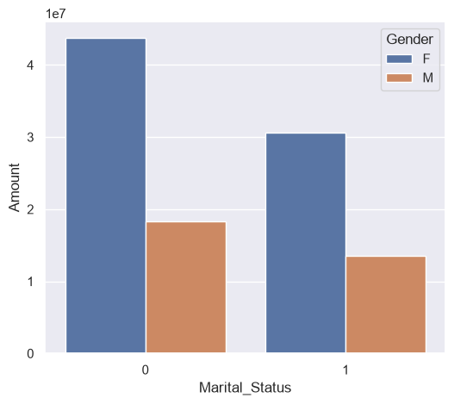
Marital Status & Gender
A closer look at buyer profiles
KEY INSIGHT
Married women form the single highest-spending combination, ahead of married men and unmarried shoppers of either gender.
Diwali Sales Analysis
6

Slide 7
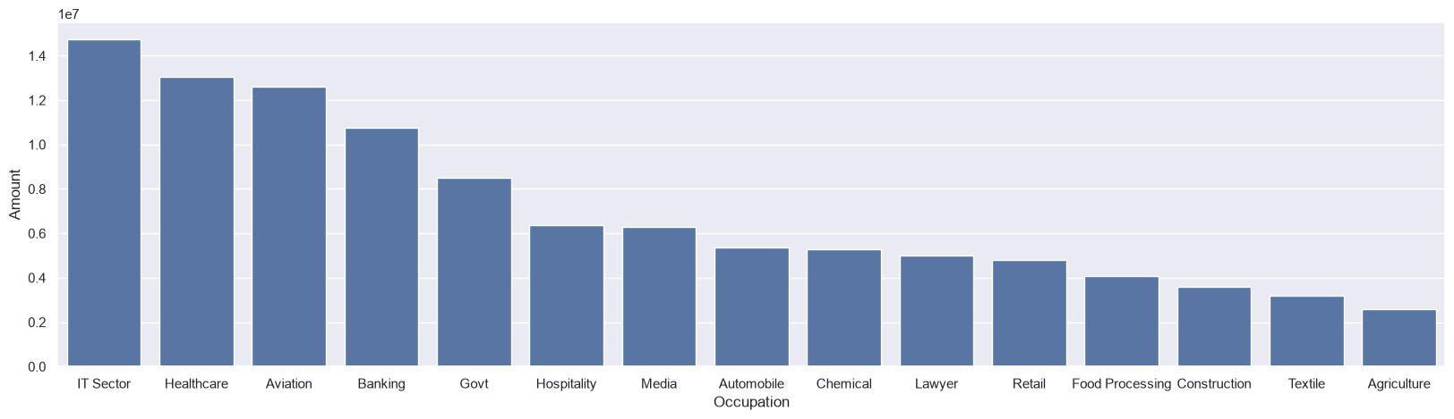
Sales by Occupation
Which professions shop the most
KEY INSIGHT
Buyers working in IT, Healthcare and Aviation post the highest sales totals — professions with steady festive-season disposable income.
Diwali Sales Analysis
7

Slide 8
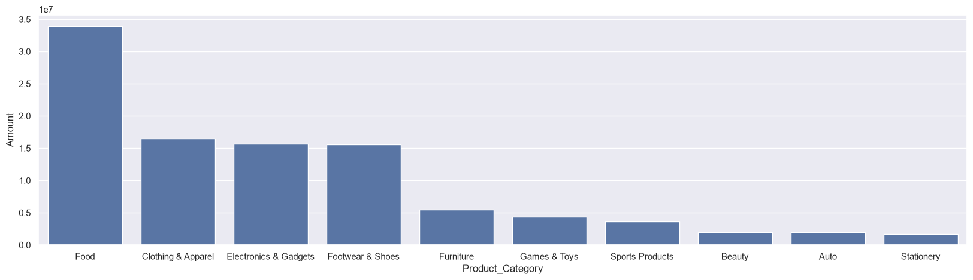
Product Category Performance
What festive shoppers buy
KEY INSIGHT
Food, Clothing & Apparel, and Electronics & Gadgets are the top-selling categories by revenue this festive season.
Diwali Sales Analysis
8

Slide 9
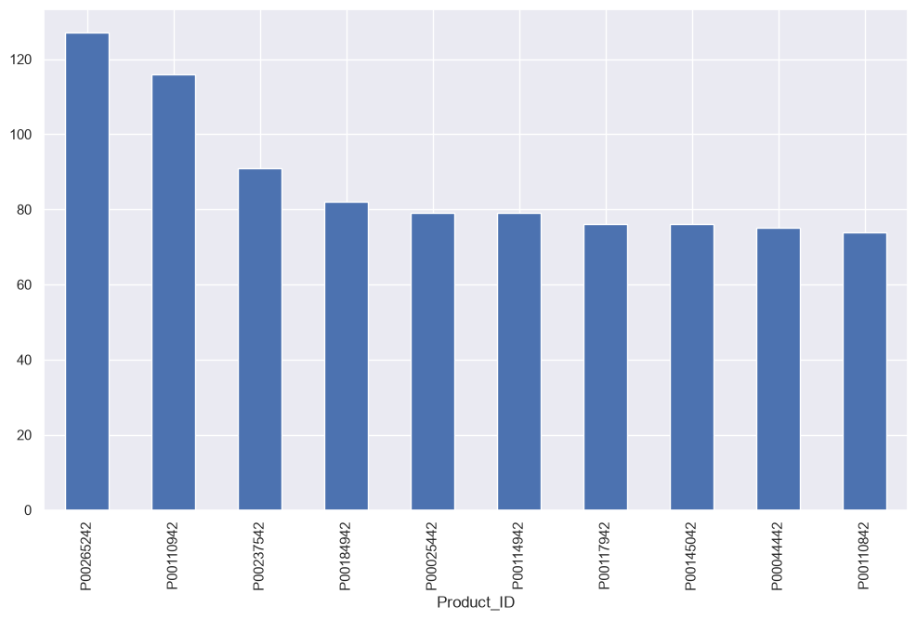
Top 10 Best-Selling Products
Highest order volume by Product ID
KEY INSIGHT
A small set of SKUs accounts for a disproportionate share of orders — strong candidates for stock prioritization next season.
Diwali Sales Analysis
9

Slide 10
Key Takeaways
The Target Customer
Married women, aged 26–35, based in Uttar Pradesh, Maharashtra or Karnataka, working in IT, Healthcare or Aviation — and most likely to buy Food, Clothing or Electronics.
SEGMENT
GEOGRAPHY
OCCUPATION
TOP CATEGORIES
Married women, 26–35 yrs
UP · Maharashtra · Karnataka
IT · Healthcare · Aviation
Food · Clothing · Electronics
Diwali Sales Analysis
10

Slide 11
Thank You
Full notebook, cleaned dataset and charts available on GitHub
Built with Python · Pandas · NumPy · Matplotlib · Seaborn

