Slide 1
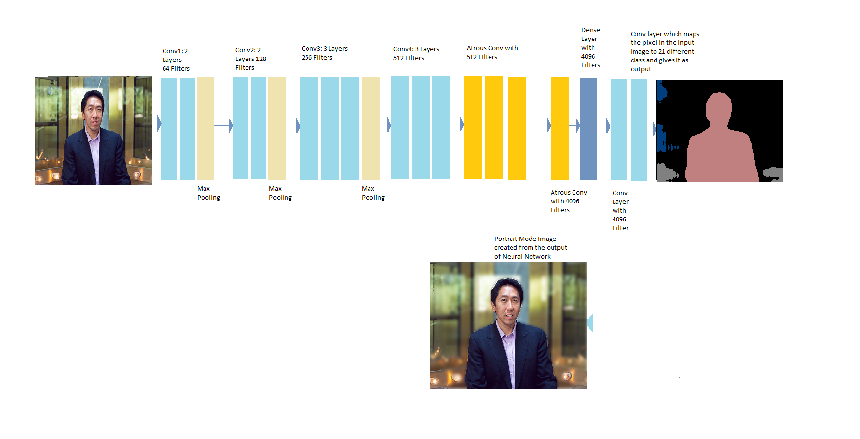

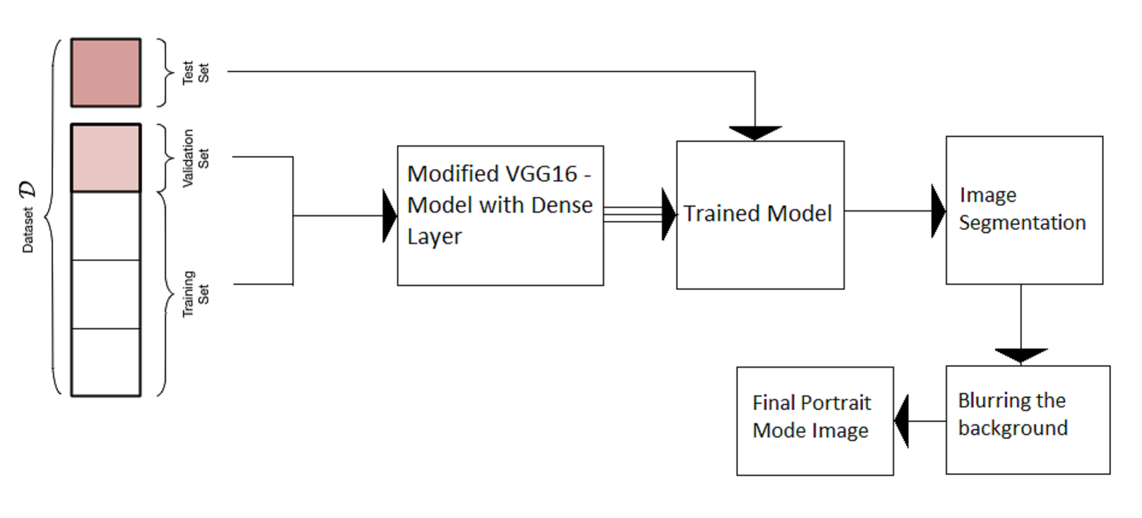
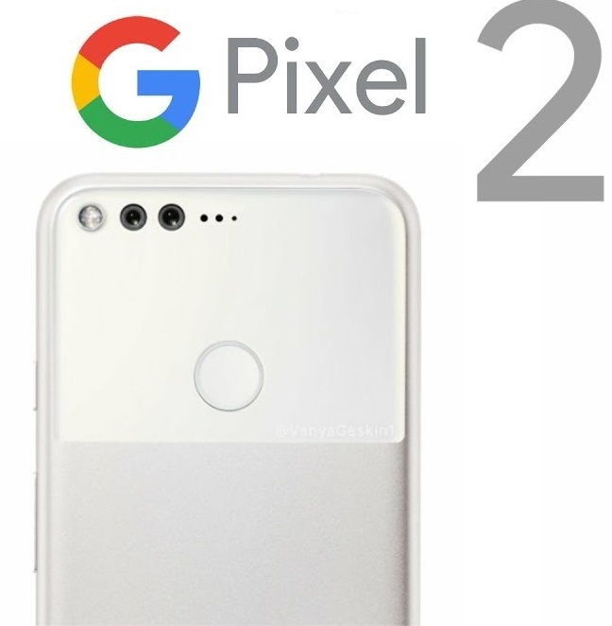
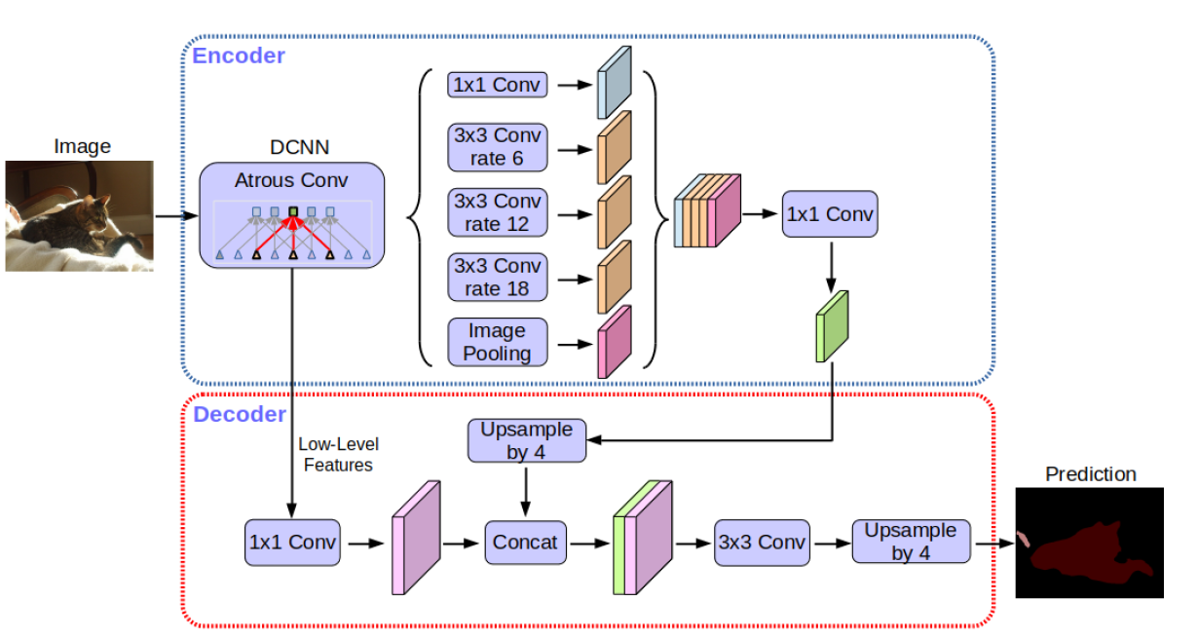

Portrait Mode of an Image using Convolutional Neural Networks
Kedarnath Kurnool Gandla, Sridhar Ramesh Babu, Sri Vishnu Yandrapati
Layer Architecture used in our model
In the basic VGG-16 model, there is a repeated combination of max-pooling and downsampling performed by convolutional layers. This architecture is good for classification but not segmentation. In order to overcome this problem, we have removed the last few downsampling operations with some upsampling using filters. Upsampling of the model using filters is done by atrous convolution.
Find Our Code below
Entire Process of creating a blur effect
Model generated by our architecture is used for foreground detection based on which background is blurred and portrait mode is achieved
Google’s DeepLab-V3+ model for identifying foreground and background in images.
Scan Here for more Information
Acknowledgements:
Dr. Minwoo Jake Lee

