Slide 1




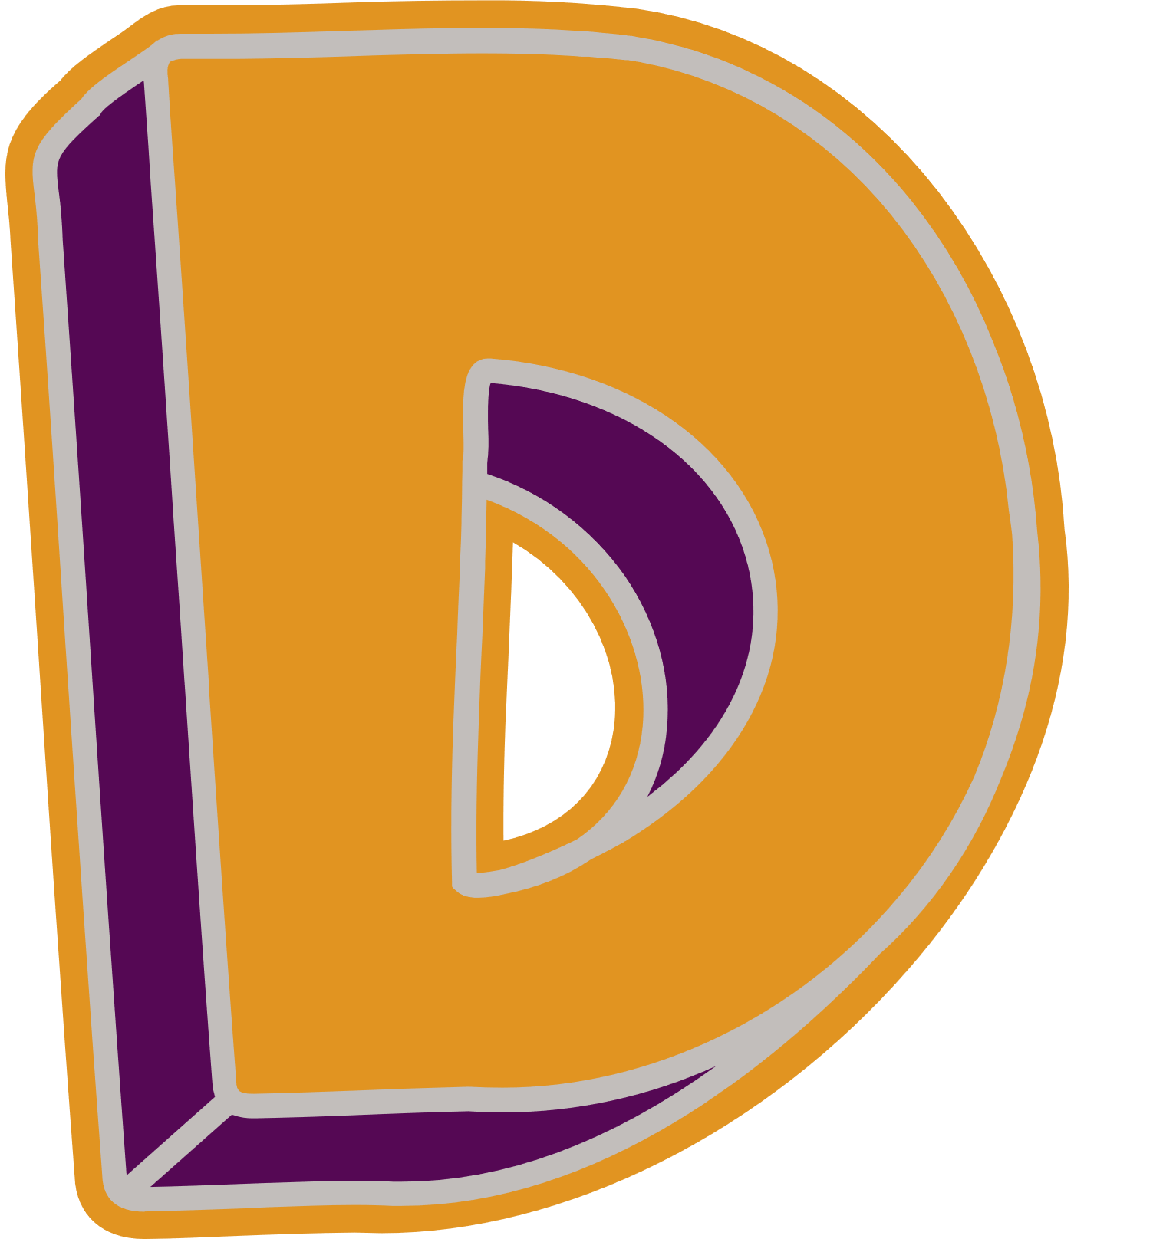

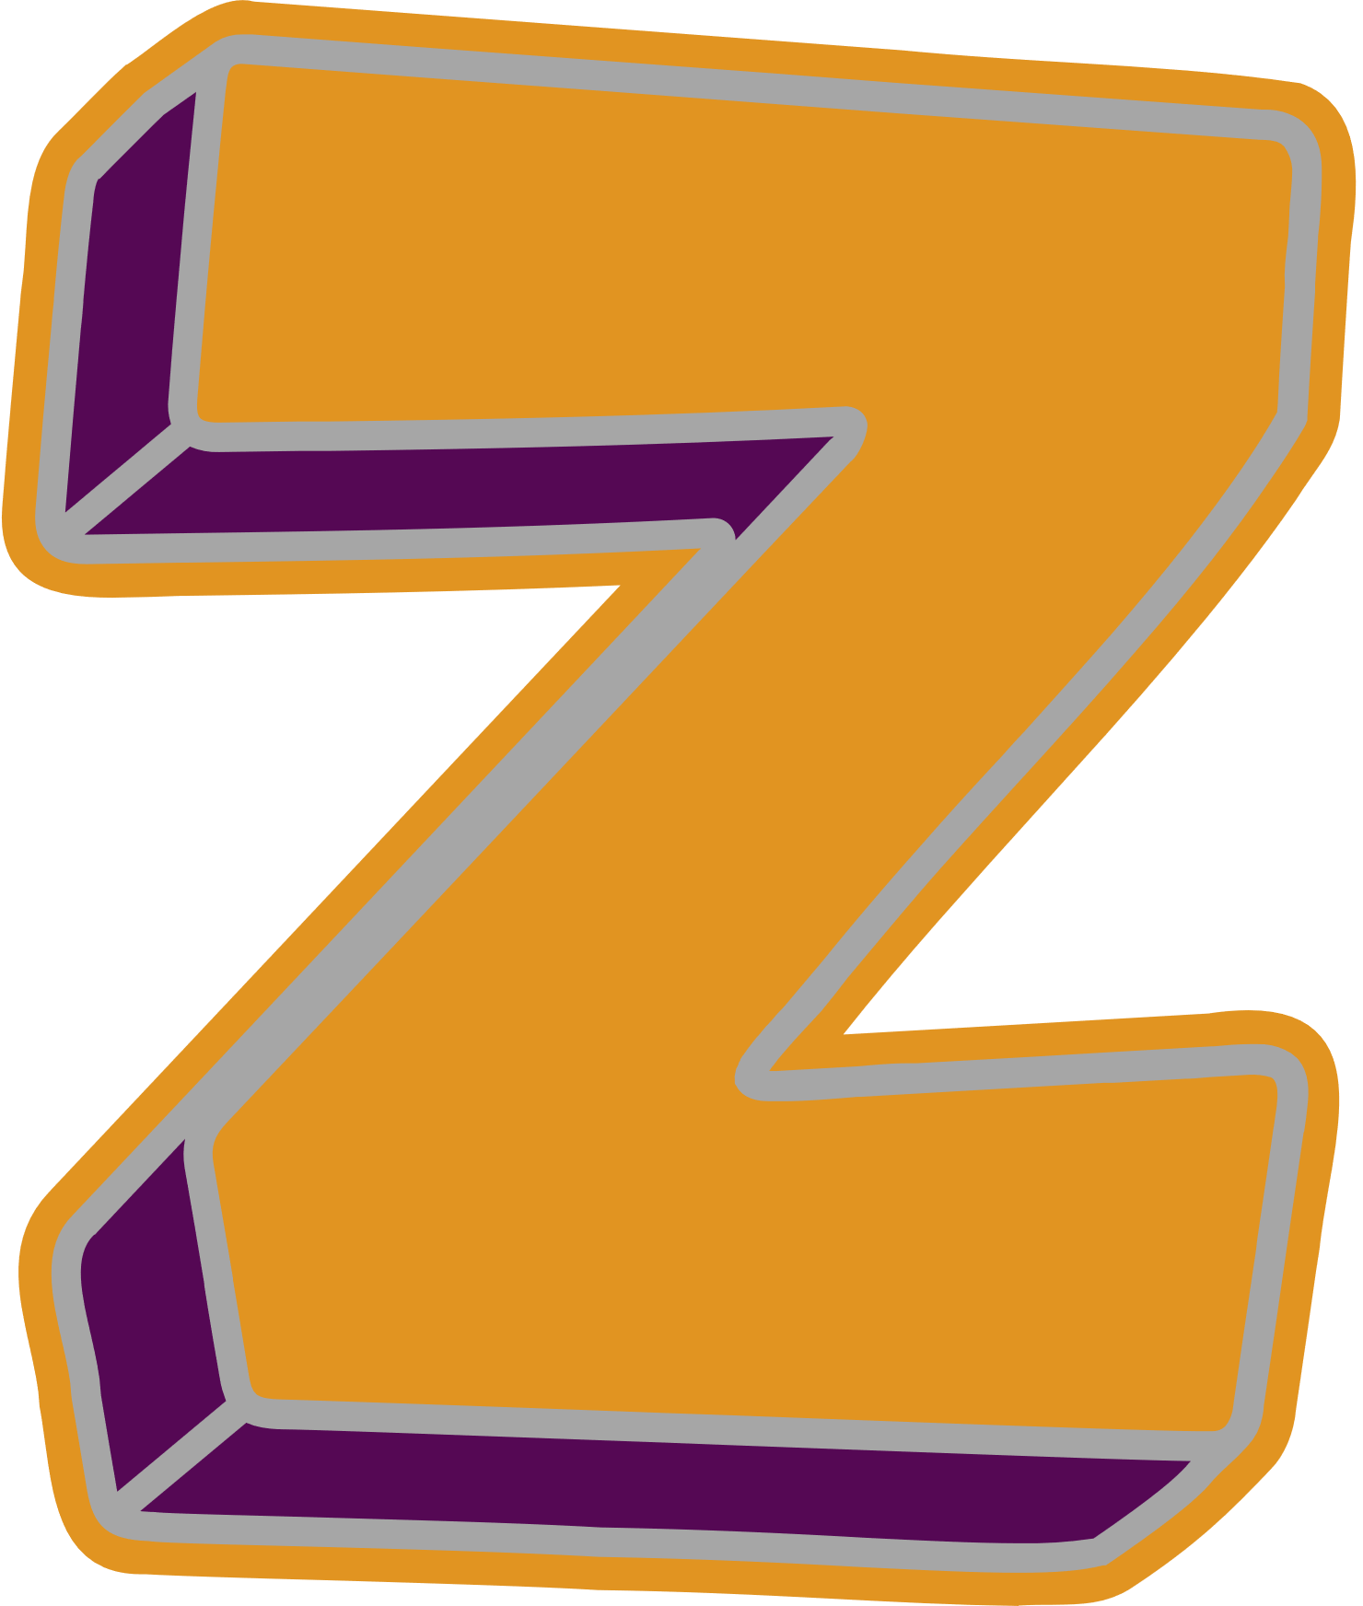


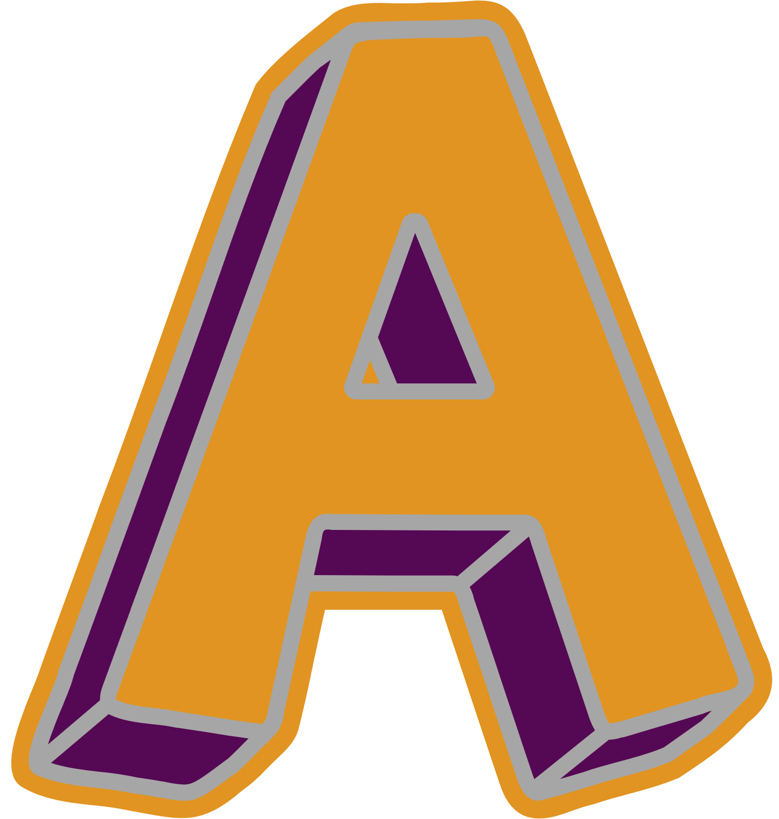
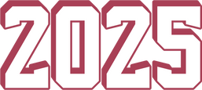

[THE ULTIMATE HACKATHON]
ArtBlock - Decentralized Art Curation & Investment Platform
Sponsor –
Track - Royalty Distribution

Slide 2
TEAM DETAILS
Team Name – Sea King Intern Ships
Team leader – Kedar Vartak
kedar.vartak22@vit.edu | +91 9325487675
Team member – Harsh Badagandi
harshb2204@gmail.com | +91 7559105287

Slide 3
PROBLEM STATEMENT
Develop a blockchain-based platform for fair royalty distribution in media and entertainment. Features include smart contracts for payouts, immutable tracking of content usage, tokenization for fractional ownership, and NFT-based fan engagement.

Slide 4



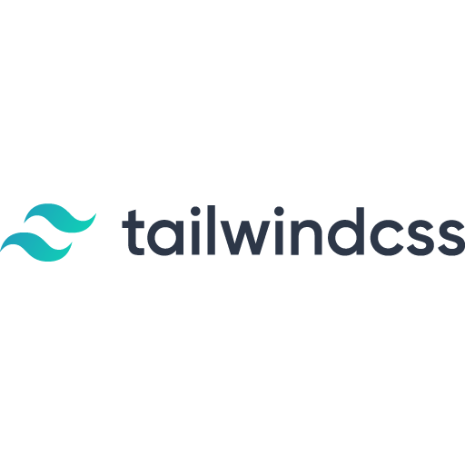

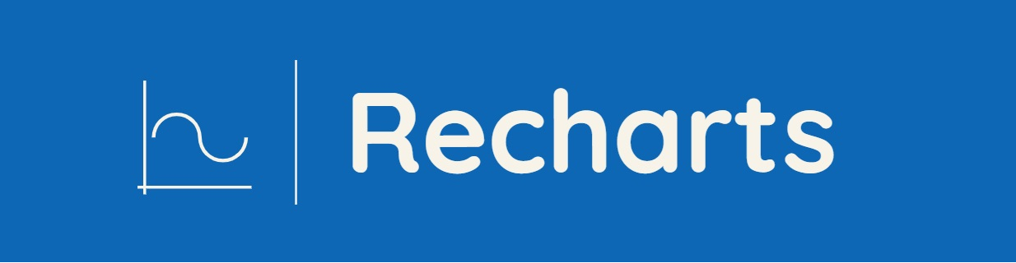
TECH STACK
Frontend Stack
React.js – Frontend library
Ethers.js – Blockchain interaction
TailwindCSS – CSS library
Framer motion – Animations library
ReCharts – Data visualization library
Flutter – App development library
Provider - State management solution
Flutter_secure_storage – secure data storage

Slide 5

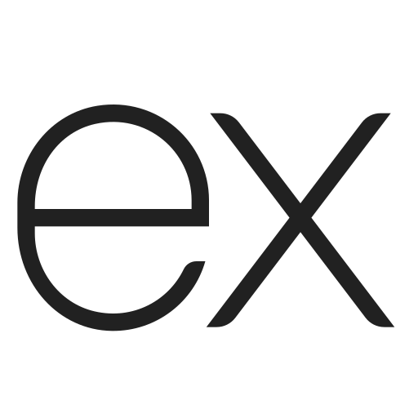
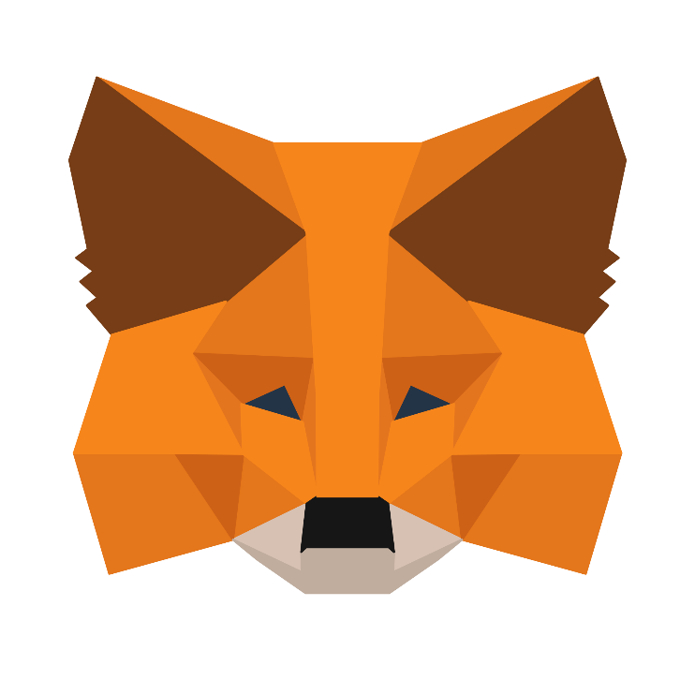
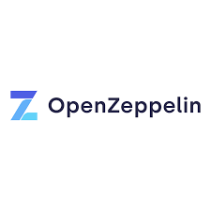
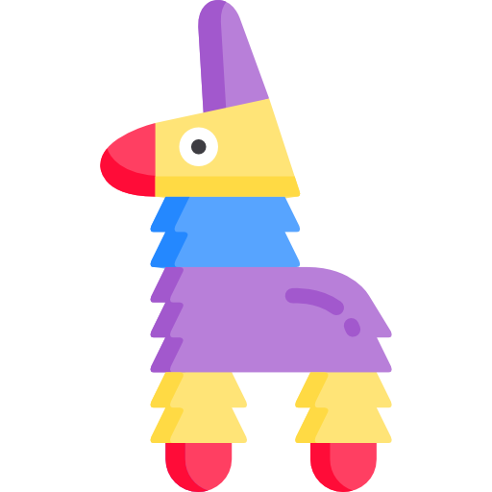
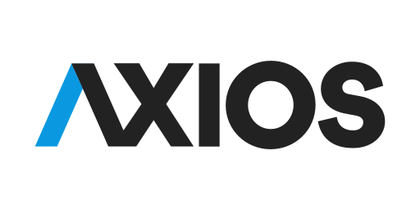
TECH STACK
Backend and Blockchain Stack
MongoDB – User data and metadata
ExpressJs – NodeJs framework
Axios – HTTP Client
IPFS – Decentralised Storage
Pinata – IPFS Pinning Service
MetaMask – Web3 Wallet
OpenZepplin – Smart Contracts library
Verbwire API – To deploy smart contract

Slide 6
API MODEL USED
Verbwire API – for smart contract deployment
when a user registers for our platform our application sends a POST request to https://api.verbwire.com/v1/nft/deploy/deployContract and deploys a smart contract which then provides us with a deployed wallet address which is stored in local storage as well as in MongoDb storage for user
2. Verbwire Magic Pilot AI API – used for overall application development

Slide 7
FEATURES
ArtBlock revolutionizes digital art distribution and investment through blockchain technology and decentralized curation. Our solution addresses key challenges in art monetization, ownership verification, and fair revenue distribution
Core Feaures –
Smart Contract Infrastructure 2. Gallery System
ERC-721 tokens for art ownership Curator-managed spaces
Automated revenue distribution Professional validation
Transparent gallery selection Cross-platform visibility
Real-time payment splitting Community engagement
3. Tokenized Ownership 4. Revenue Distribution Model
Fractional art ownership Artist share (85%)
Transparent revenue sharing Curator share (10%)
Verifiable scarcity Platform fee (5%)
Investment tracking

Slide 8
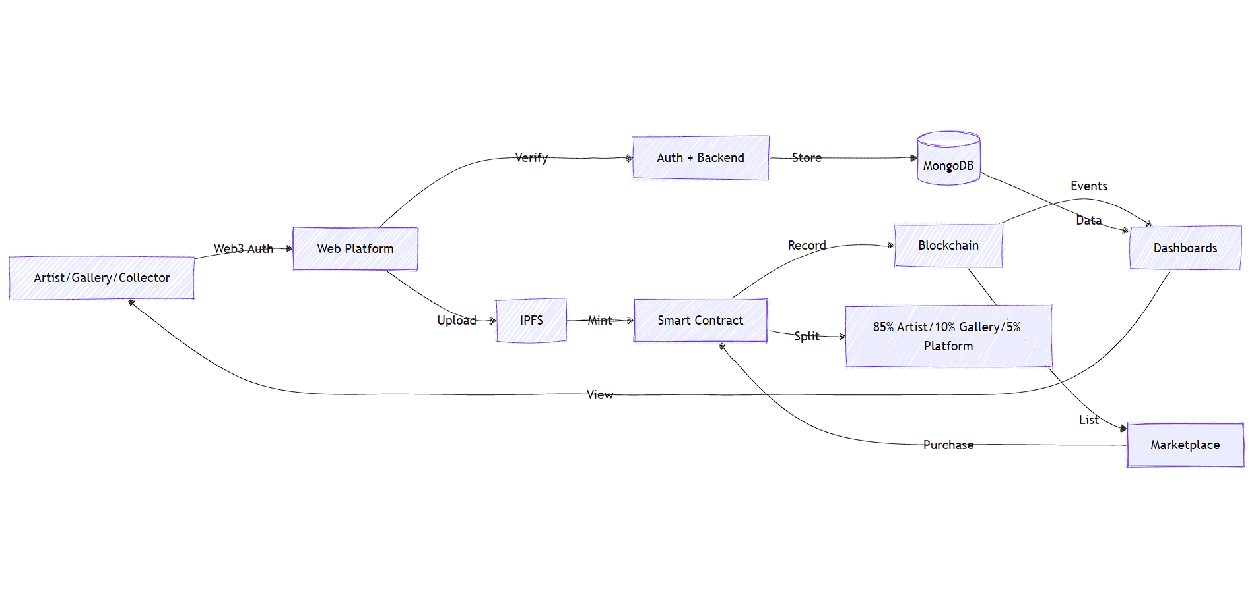
DIAGRAM

Slide 9
IMPLEMENTATION
ArtBlock is divided into a web application and a mobile application. The web application is further divided into 3 parts
Artists
Gallery curators
Investors
where 33.3% or 1/3rd percent of the project has been completed. Frontend in its entirerity has been completed for web application and mobile application both
The implementation can be checked on github –
https://github.com/kedarvartak/ArtBlock-Defi-Protocol

Slide 10
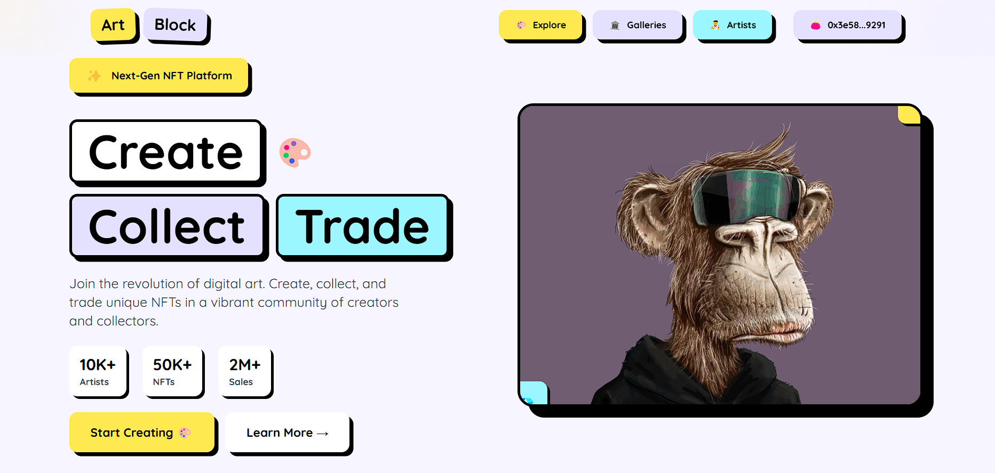
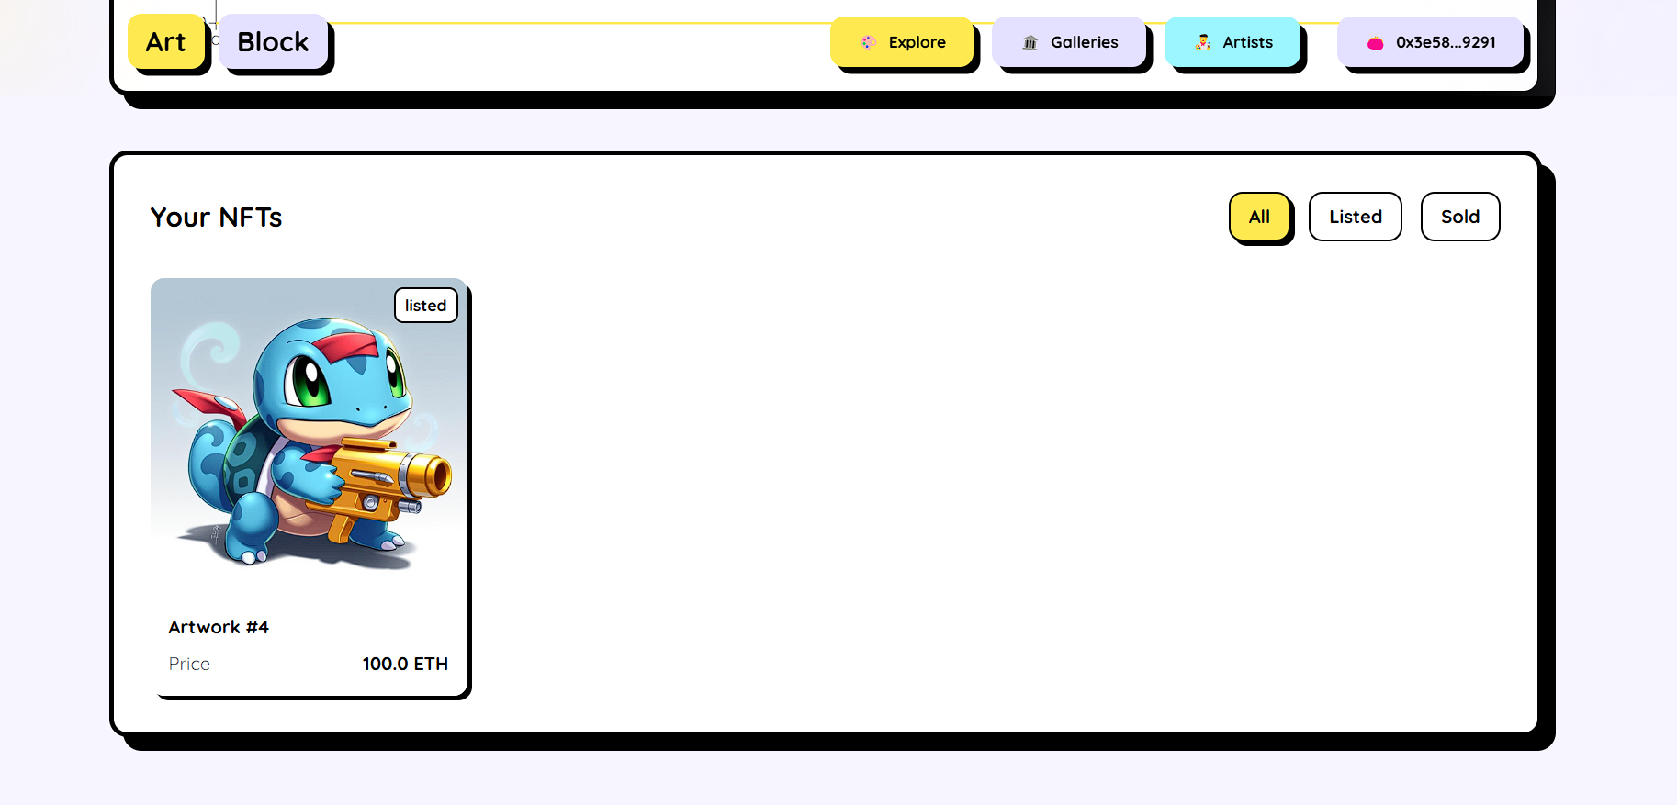
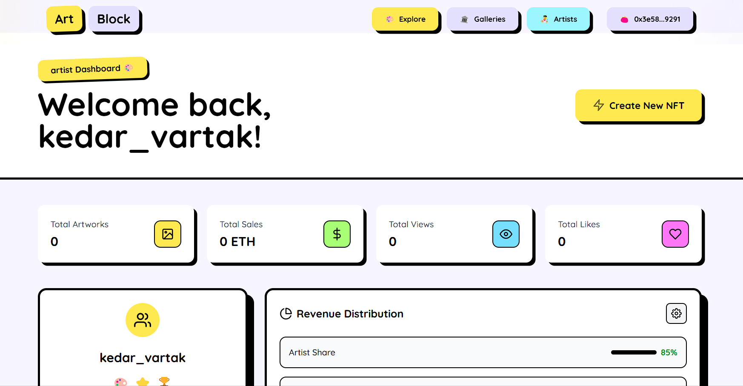
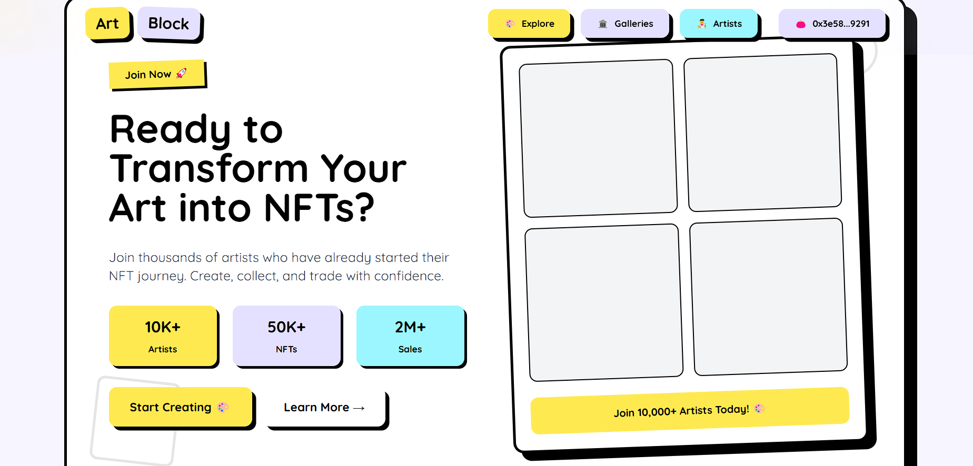
UI OR HOSTED LINK

Slide 11
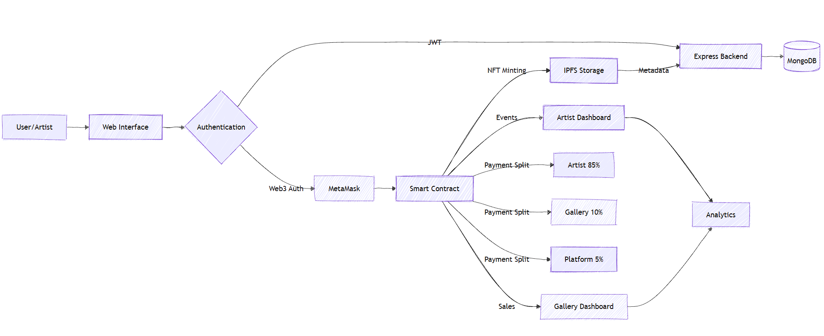
CURRENT STATUS
The project flow below has been thoroughly implemented and tested

Slide 12
THANK YOU!

