Slide 1


Impact Chain : Transparent Donations for Real Impact
SEA KING INTERN SHIPS
VIT PUNE, PUNE, MAHARASHTRA

Slide 2

PROBLEM STATEMENT
In the realm of social welfare, one of the major issues is the lack of transparency in how donations are utilized. Many potential donors are hesitant to contribute due to concerns about misuse or inefficiency.
THEME – WEB 3.0 & BLOCKCHAIN

Slide 3

PROPOSED SOLUTION
ImpactChain transforms traditional donations by leveraging blockchain technology to create a transparent and secure giving ecosystem.
Our platform bridges the trust gap between donors and organizations through automated fund management and real-time tracking, ensuring every contribution creates verifiable impact.
Smart contracts govern the entire donation lifecycle, eliminating intermediaries and reducing administrative overhead while ensuring secure fund distribution.
Each donation generates a unique NFT receipt that serves as both proof of contribution and a dynamic tracker, updating in real-time as funds are utilized.

Slide 4
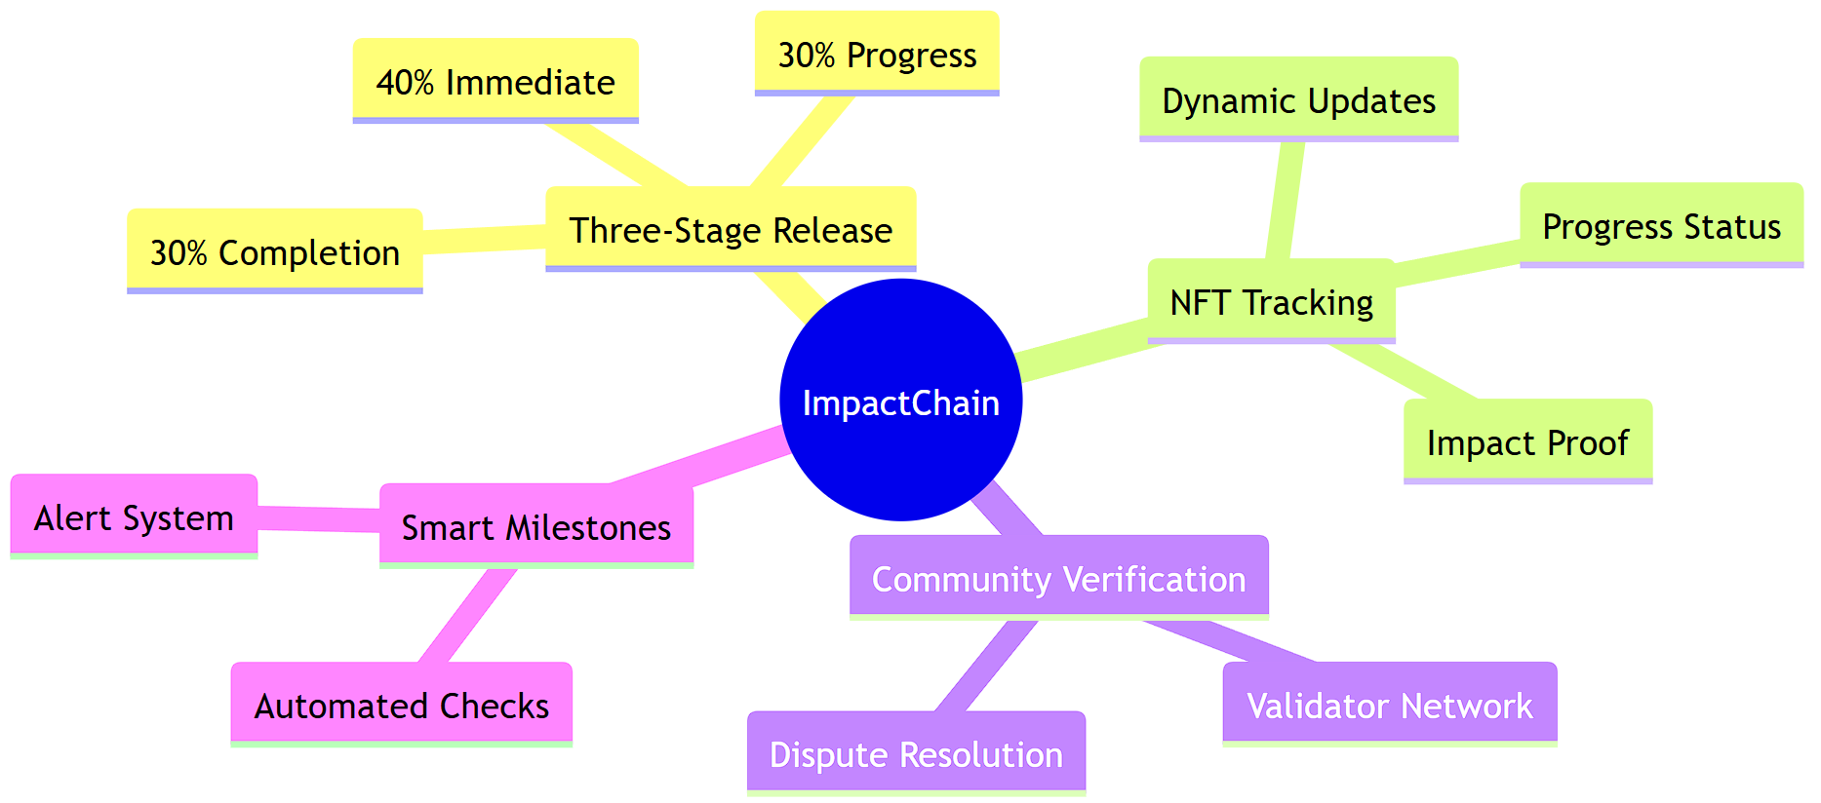
INNOVATION
ImpactChain comprises of several innovations to blockchain and donation industry, some of the major innovations are listed below -

Slide 5
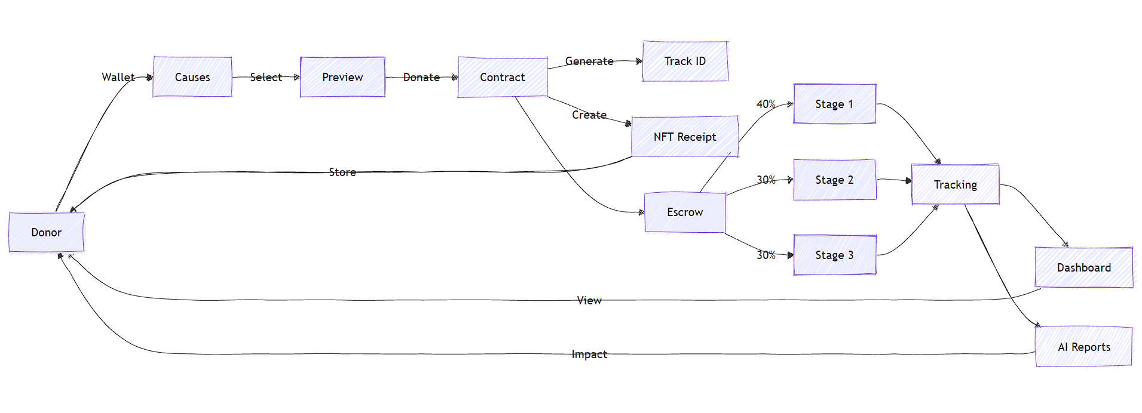
ARCHITECTURE – WORKING
ImpactChain has a complex working but we have narrowed it down to the flowchart below -

Slide 6
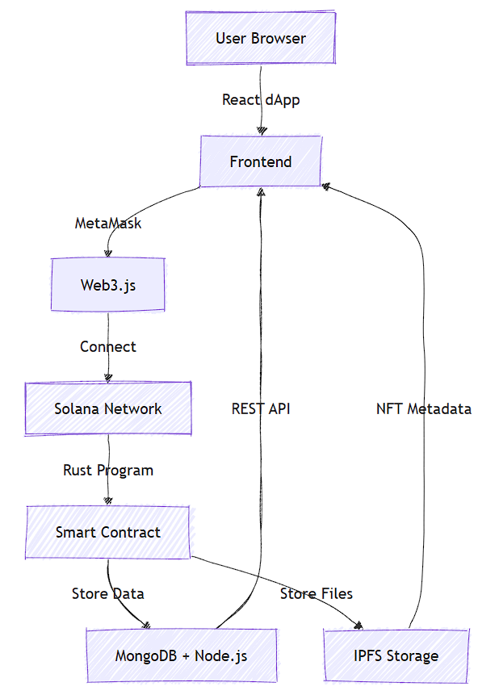






ARCHITECTURE
FLOW
CHART
TECH STACK
The technical
Flowchart is presented below, it comprises of the working amongst tech stack used to develop this project
PROTOTYPE
Github repository - kedarvartak/ImpactChain-Innerve-Hackathon
Frontend deployment link –deployment link

Slide 7
SOCIAL/ MARKET IMPACT
Enhanced Trust & Transparency: Blockchain-verified donation tracking builds donor confidence and reduces fraud in charitable giving.
Global Accessibility: Democratizing philanthropy by enabling anyone with a digital wallet to contribute and track their impact worldwide.
Cost Efficiency: Automated smart contracts eliminate intermediaries and reduce operational costs by 30-40%.
Real-Time Impact: Instant verification and tracking of donation outcomes enables data-driven decision making for charitable organizations.

Slide 8
THANK YOU
ABOUT TEAM
Kedar Vartak
kedar.vartak22@vit.edu
+91 9325487675
TY - Artificial Intelligence and Data Science
Tanishka Pimple
tanishka.pimple22@vit.edu
+91 7249352733
TY - Artificial Intelligence and Data Science
Varun Sahu
manish.varun22@vit.edu
+91 8055553988
TY - Artificial Intelligence and Data Science

