Slide 1

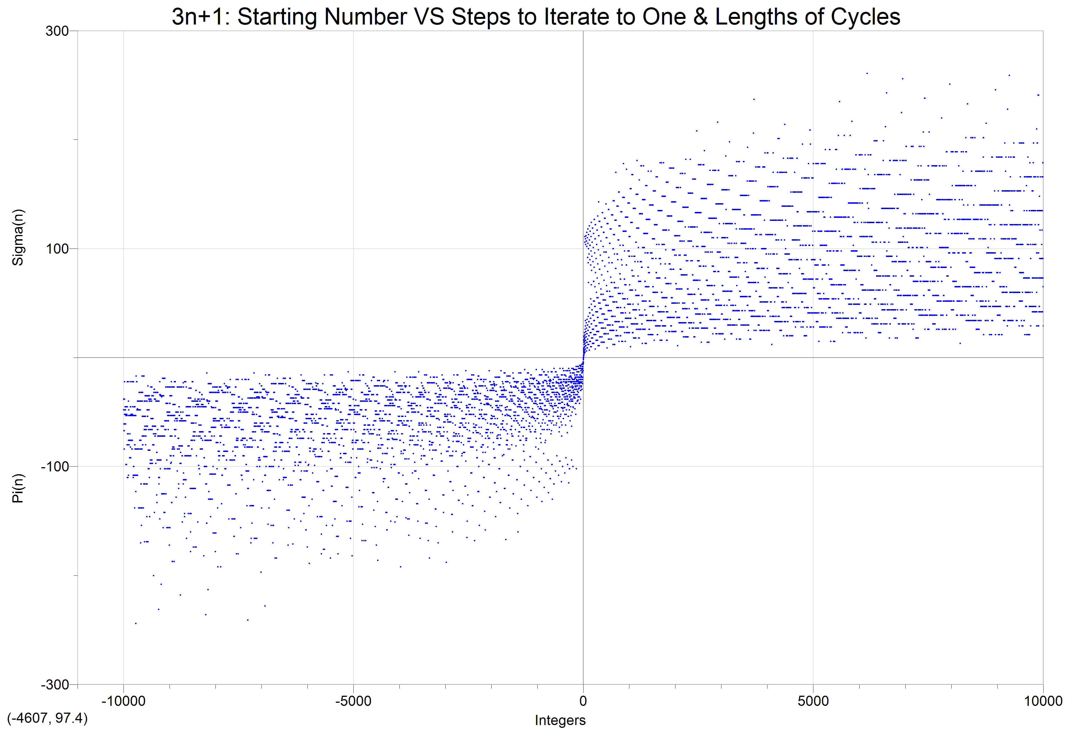
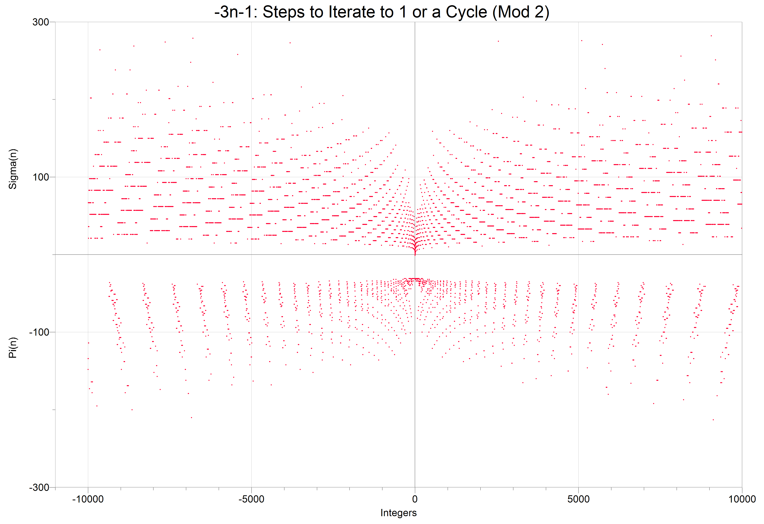
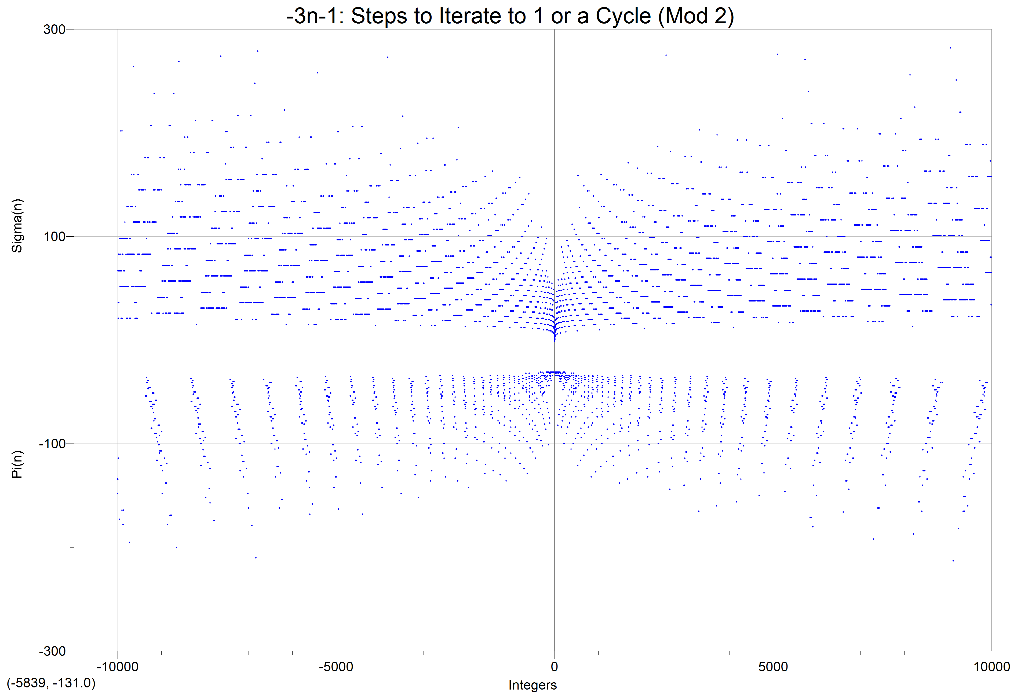
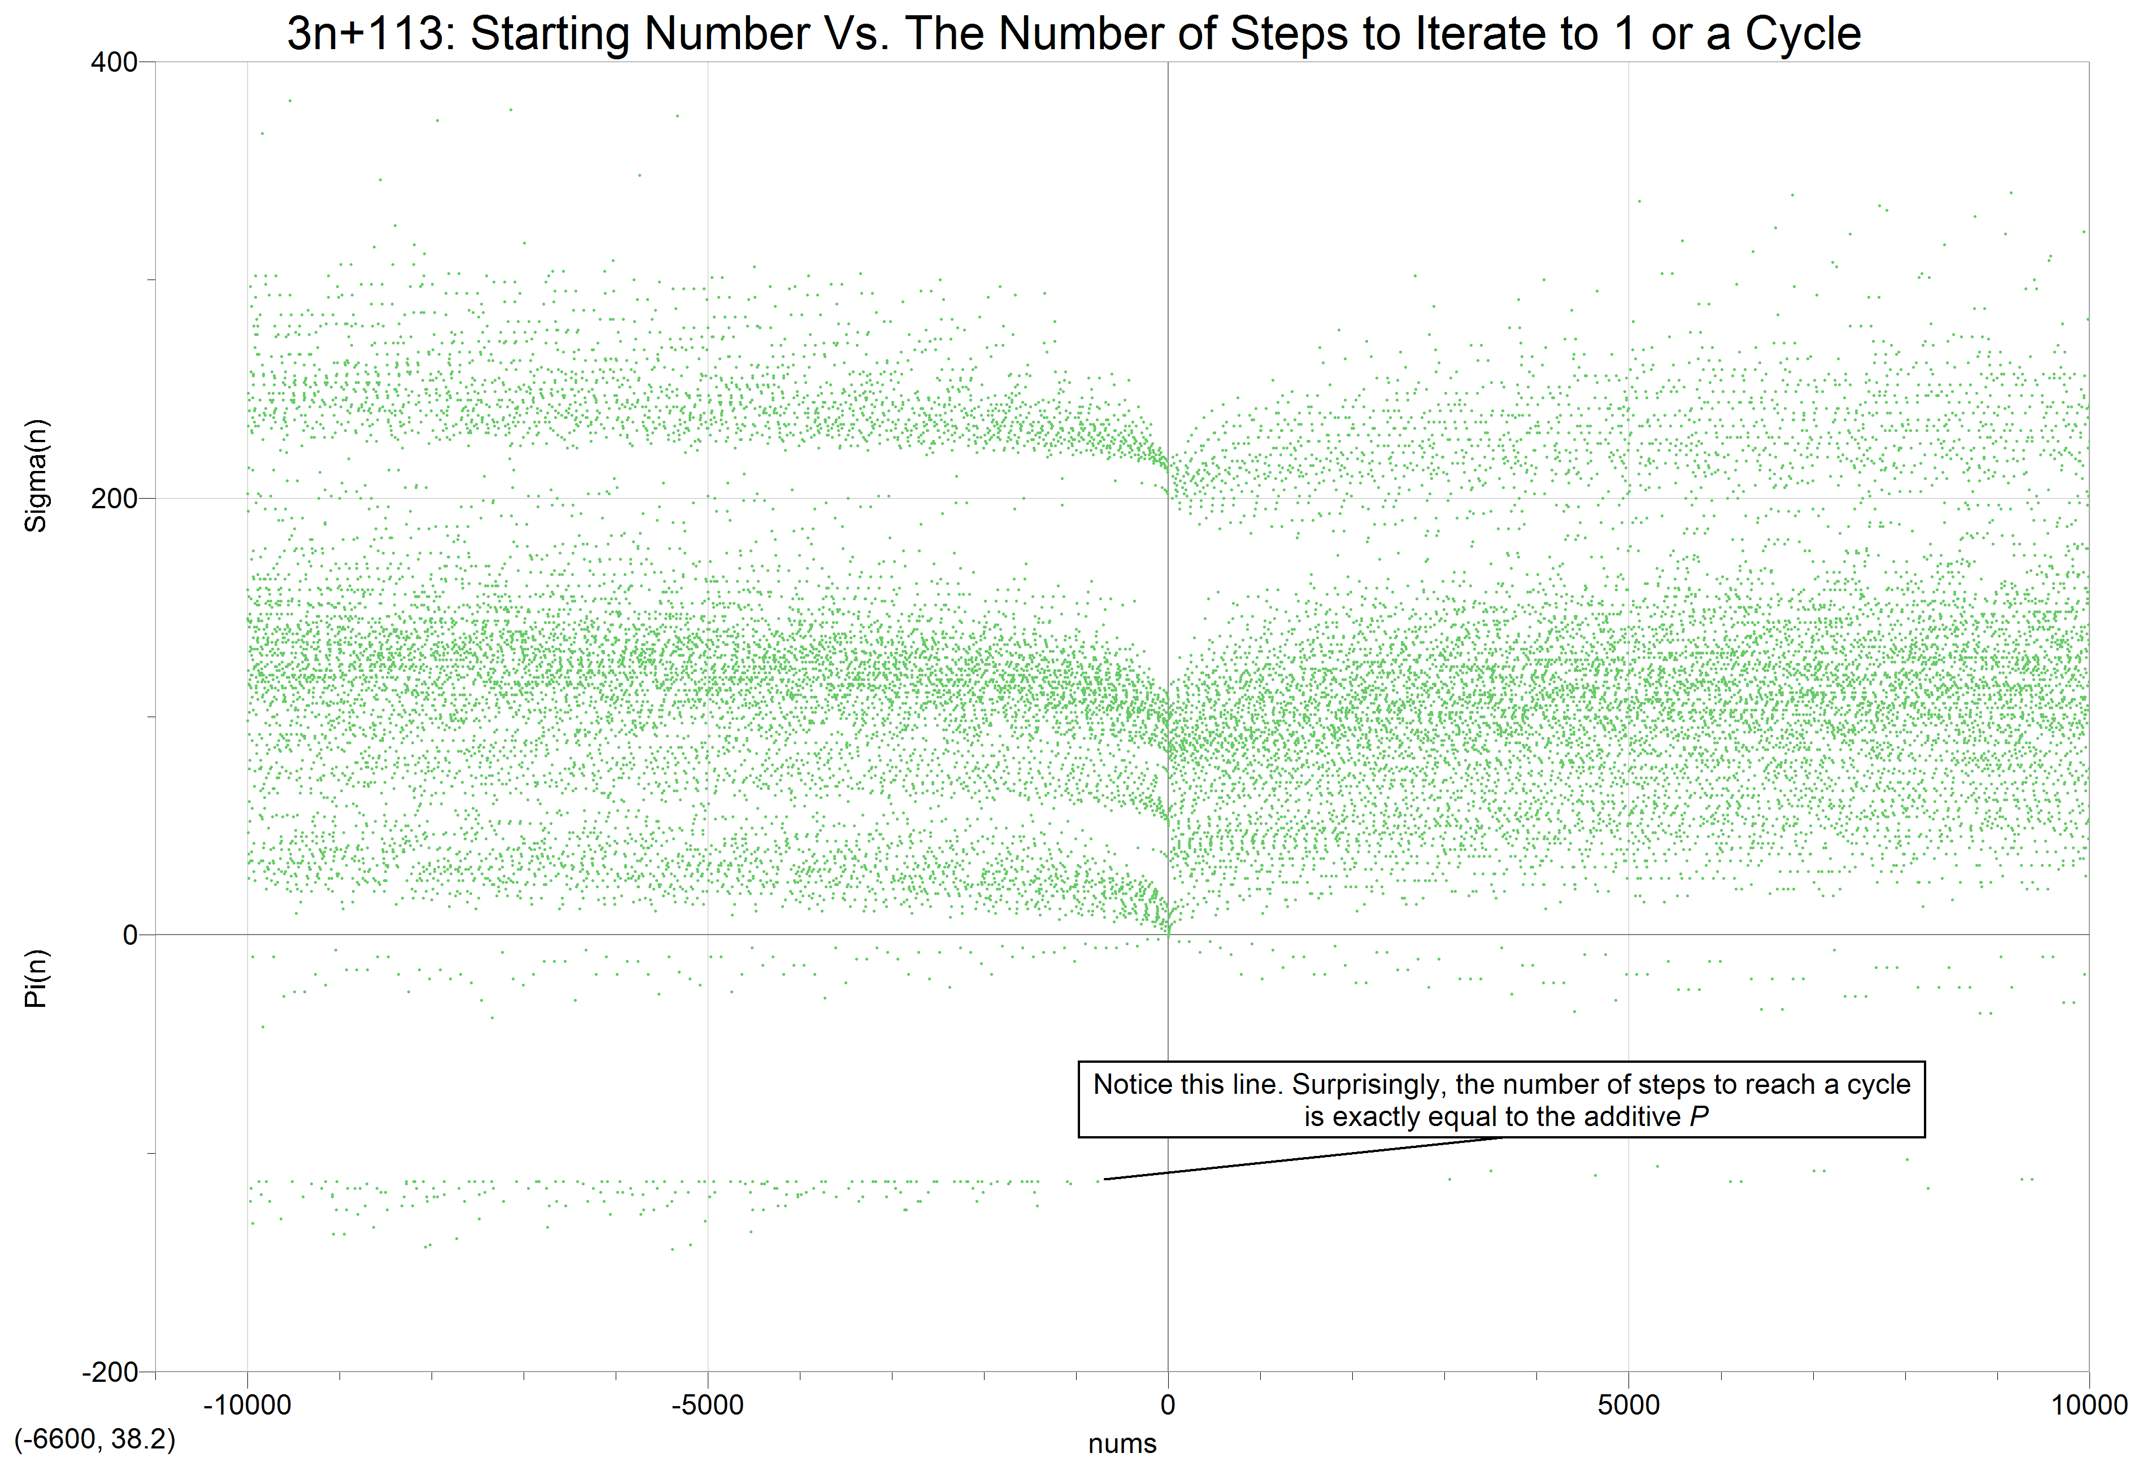

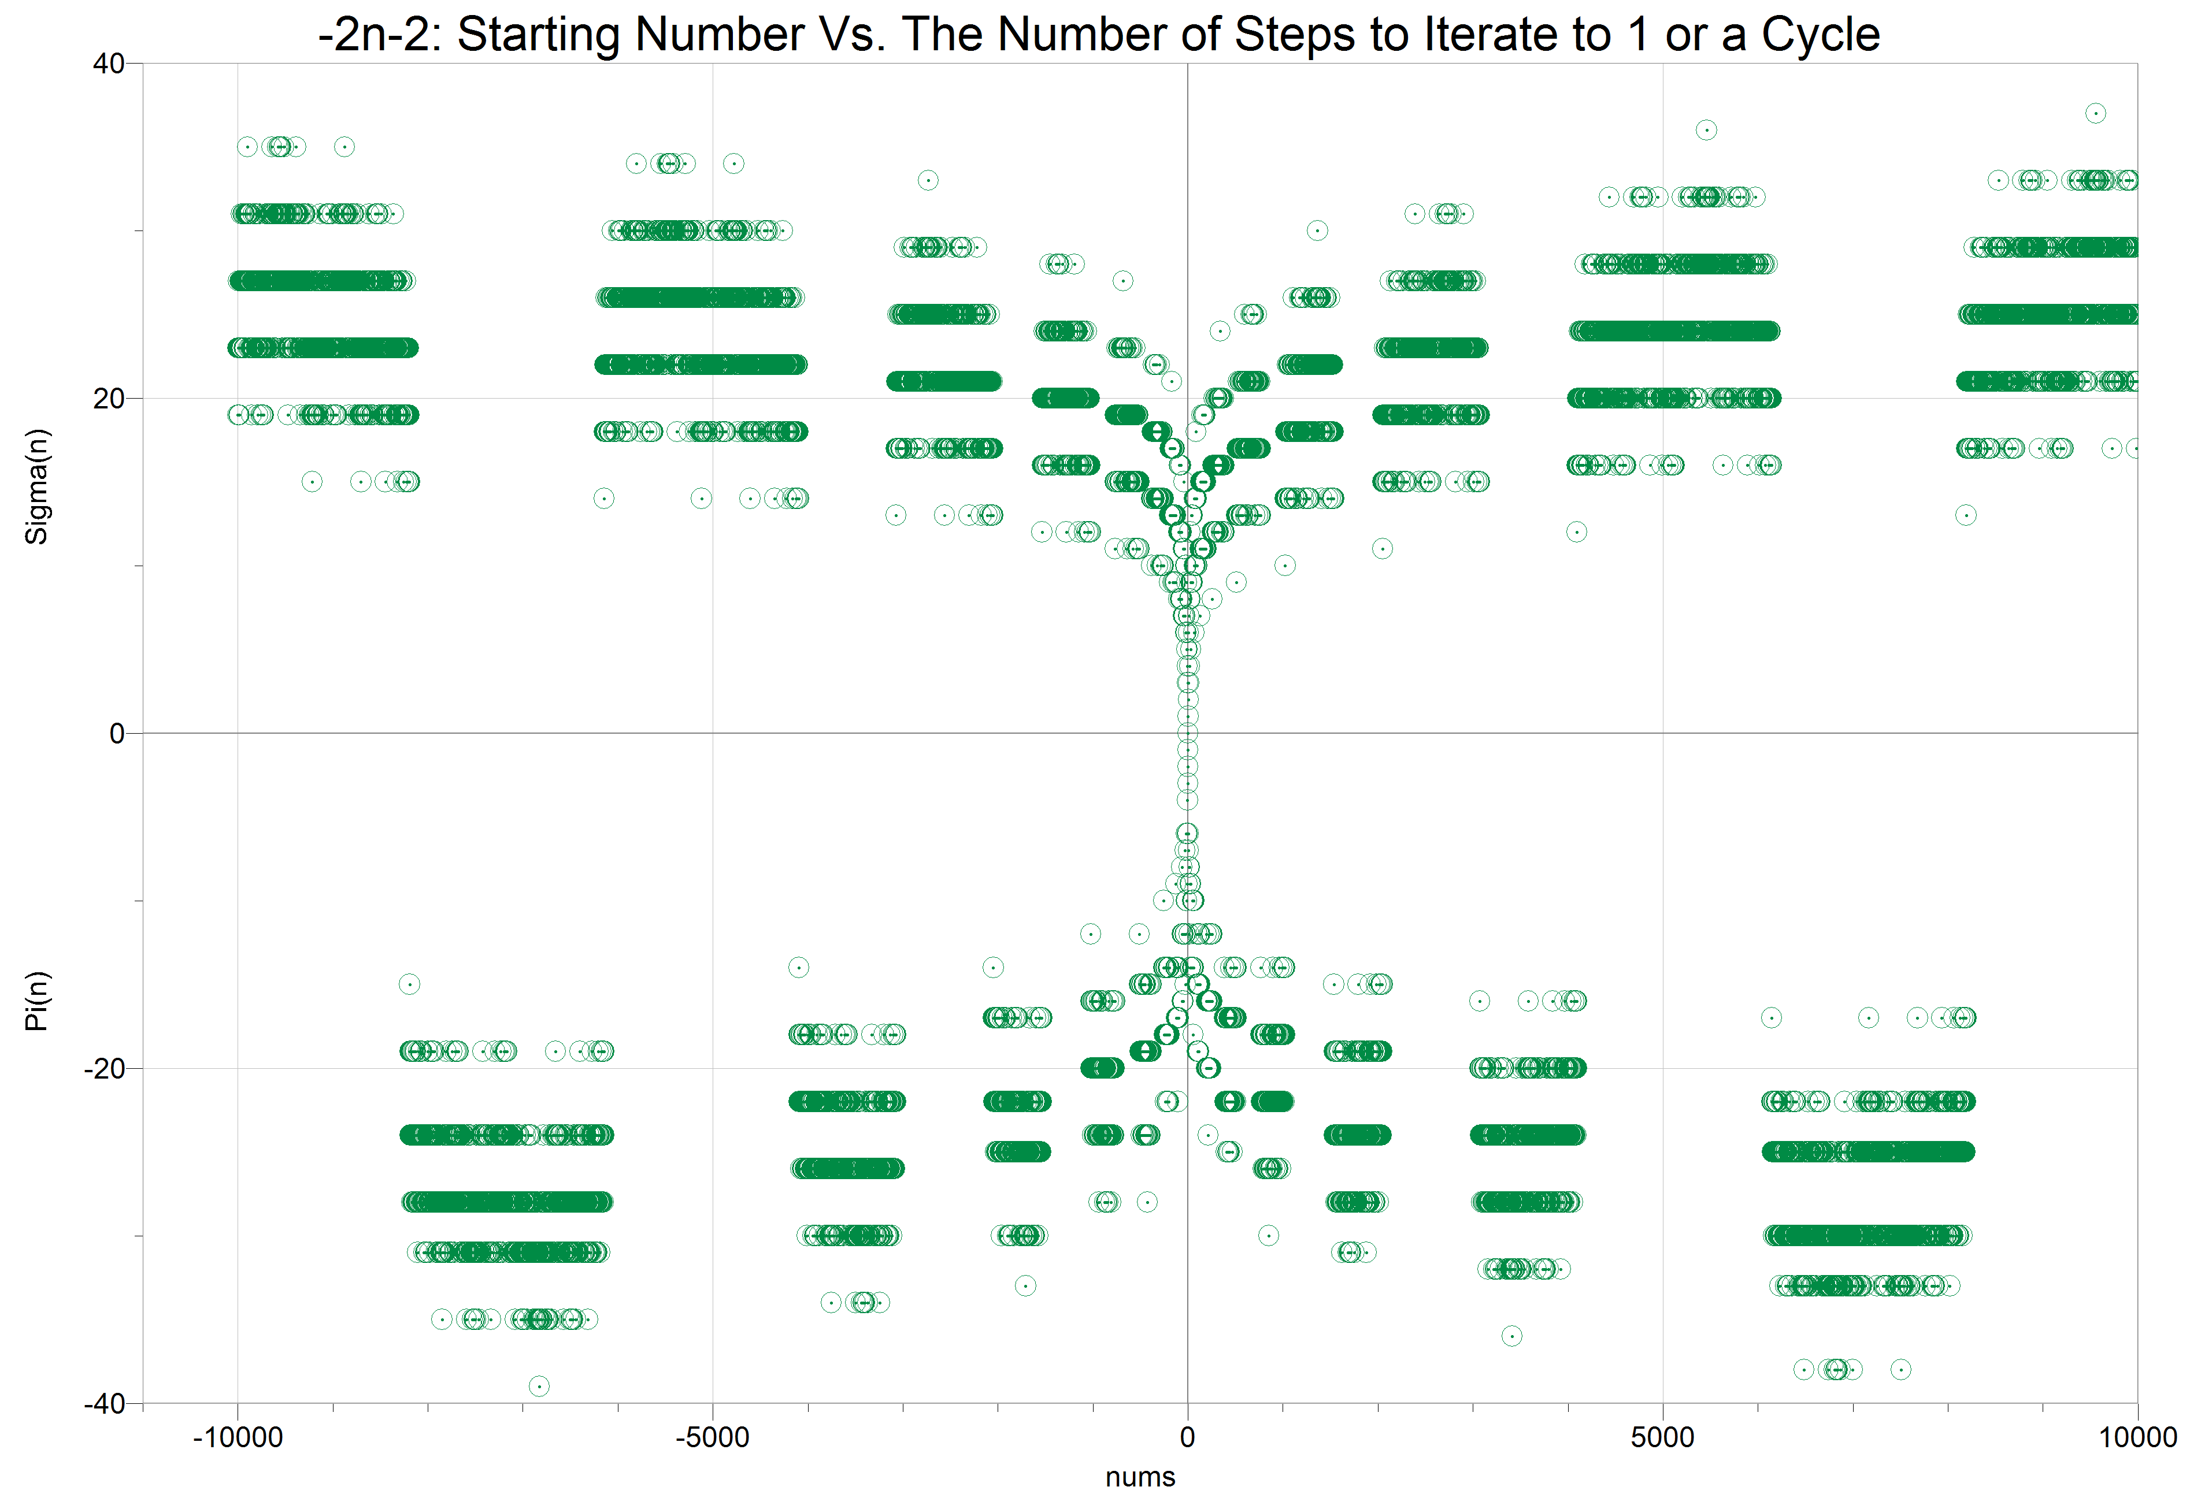
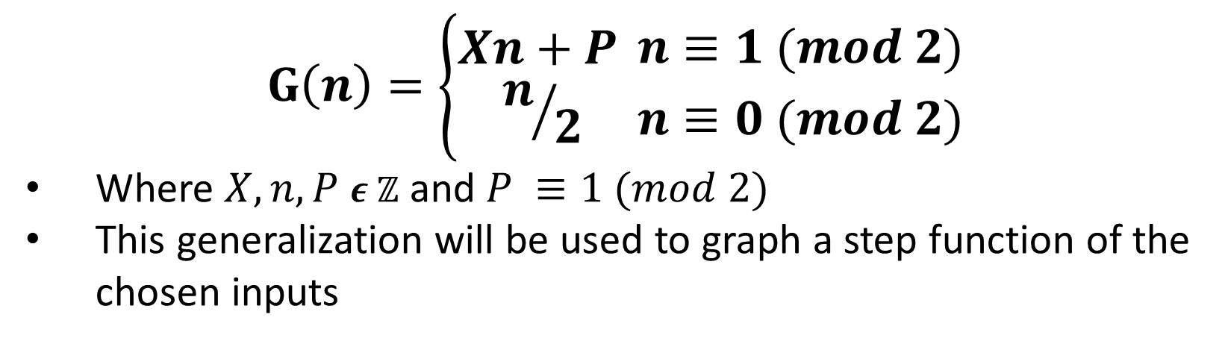


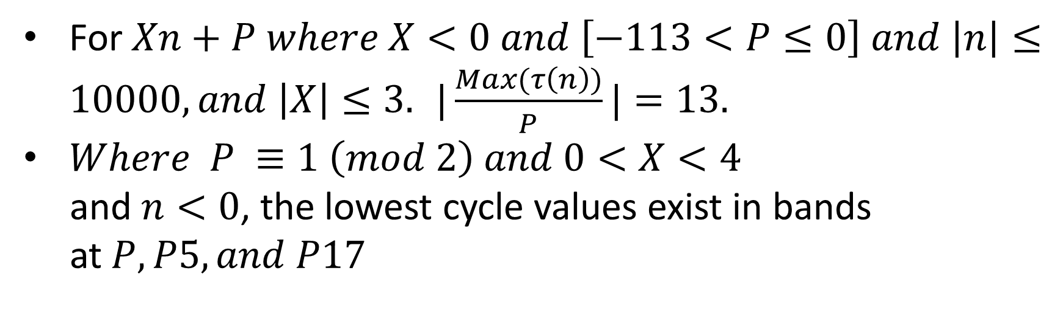

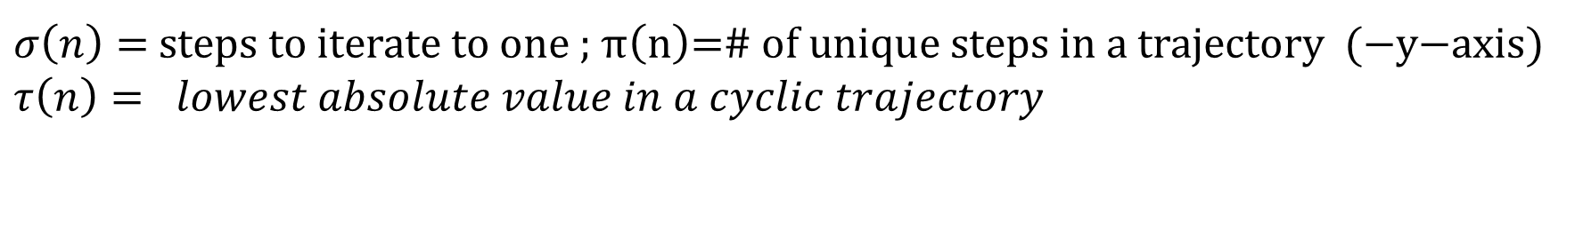
Unraveling The Structure And Aesthetics Of The Most Deceptively Difficult Problem In Number Theory: The Collatz Conjecture K. T. Yadav • University of Washington Bothell Physics Pre-major
Problem Statement
Definition of a Trajectory
$$For each n ε ℤ^{+}there is$$
$$some K ε ℤ^{+}where C^{K}\left(n\right)=1$$
It is conjectured that all trajectories for any positive integer $n$ go to one after $k$ iterations
..Or that there are no divergent or cyclic trajectories aside from the trivial cycle
This has been verified for starting $n$ up to 2^60 or $≈$ 10^18.
Collatz Conjecture
$$C\left(n\right)=\left\{\begin{aligned}3n+1 \\ n/2\end{aligned}{n≡1 (mod 2) \atop n≡0 (mod 2)}\right.$$
$$n ε ℤ^{+}(Lagarias 3)$$
If starting number is even, divide by two
If odd, multiply by three and add one
Iterative/recursive function
$$C^{\left(K\right)}\left(n\right)=C(C^{K−1}(C^{K−2}(⋯C^{1}(n)))$$
$C^{\left(K\right)}\left(n\right)$ is the trajectory of a starting number after K iterates under the Collatz function. Example:
$7→22 →11 →34→17→52→26→13→40→20→10→5→16→8→4→2→1→4→2→1$
Notice the “Trivial Cycle”: 1 $→4→2$ $→1$
Methodology
Generalization
Step Function
“Mathematics is not ready for such problems” – Paul Erdös – One of the most prolific mathematicians of the 20th century.(Lagarias 17)
This project aims to uncover structure within the graphical representation of the generalized Collatz problem through computer algorithmic means
$$G\left(n\right)=\left\{\begin{aligned}Xn+P \\ n/2\end{aligned}{n≡1 (mod 2) \atop n≡0 (mod 2)}\right.$$
Where $X,n,P$ $ε ℤ$ and $P ≡1 (mod 2)$
This generalization will be used to graph a step function of the chosen inputs
$σ\left(n\right)=$steps to iterate to one ;$\text{π}\left(\text{n}\right)\text{=\# }\text{of} \text{unique} \text{steps} \text{in} \text{a} \text{trajectory}\text{ (−}\text{y}\text{−}\text{axis}\text{) }$
$$τ\left(n\right)= lowest absolute value in a cyclic trajectory$$
The Collatz Butterfly
Results
The aesthetic qualities of the starting number vs. the number of iterations to 1 or to cycle can be seen here
There is clearly more underlying properties to these iterative functions than meets the eye.
For $Xn+P where X<0 and \left[−113<P≤0\right] and \left|n\right|≤10000, and \left|X\right|≤3.$ $|\frac{Max(τ\left(n\right))}{P}|=13.$
$Where P ≡1 \left(mod 2\right) and 0<X<4$
and $n<0$, the lowest cycle values exist in bands
at$P,P5, and P17$
Further Reading and GitHub Repository
Lagarias, Jeffrey C. The Ultimate Challenge: the 3x 1 Problem. American Math. Soc., 2012.
Numberphile’s video on the Collatz Conjecture on Youtube
Acknowledgements
Andrew Abian, Lecturer, division of E & M, UW Bothell.
I must thank him for his time and attention. Without him, I would not be able to express my passions for mathematics. Hopefully, I haven’t taken too much of his time hostage

