Slide 1
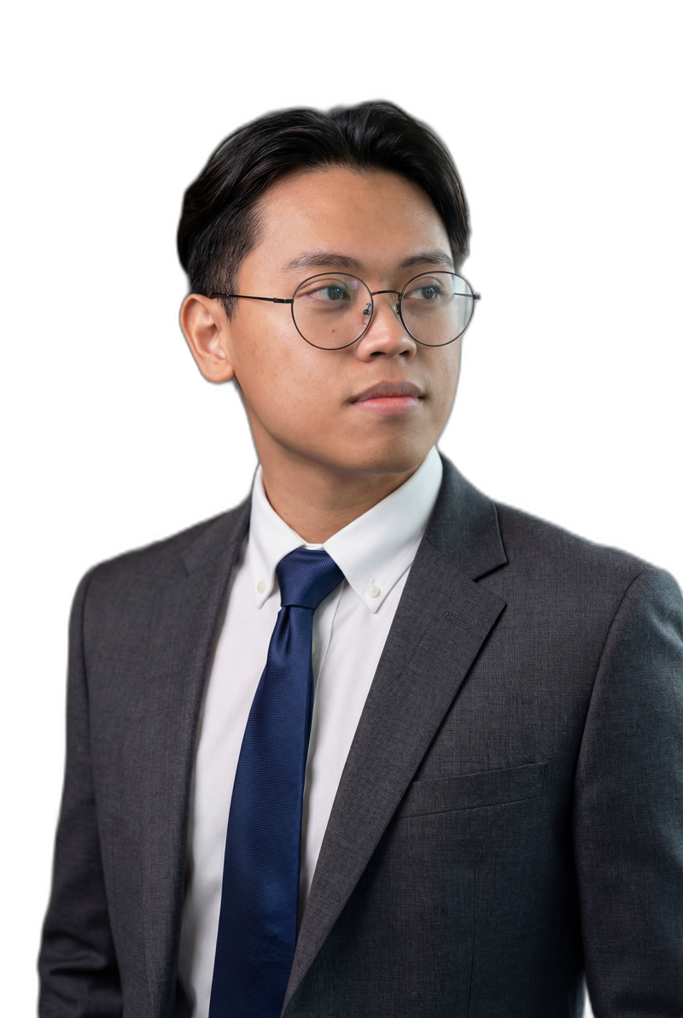
K3
Kim Edrian Binasoy [ relearn.ing ]
hello@binasoy.kim • Toronto, Canada • github.com/kedbin
I build systems
that automate, scale, and learn.
CORE STACK
OPEN TO WORK
Azure
AWS
Python
TypeScript
React
Node.js
Power Automate
Cloud Operations
QA Automation
Runbooks
Incident Triage
GenAI Tooling
Selected experience, certifications, and keywords optimized for human + LLM screening.
SELECTED EXPERIENCE
NOV 2025 — PRESENT
CERTIFICATIONS
Founder Relearn.ing
Google Professional Cloud DevOps Engineer — Feb 2026 — Feb 2028
Google Professional Security Operations Engineer — Jan 2026 — Jan 2028
Google Professional Cloud Architect — Jan 2026 — Jan 2028
Google Generative AI Leader — Dec 2025 — Dec 2028
Azure Developer / AI Fundamentals / Azure Fundamentals / AWS CCP — Additional certifications
• Leading product direction for a digital learning platform centered on AI-era work and continuous improvement.
• Architecting cloud-native workflows for content delivery, automation, and user engagement.
• Designing ethical AI-assisted systems that help users operationalize learning and personal growth.
JUN 2023 — NOV 2025
Quality Automation Engineer Transportation
• Executed 800+ test cases and shipped an automation tool that reduced documentation time by 70%.
• Improved testing efficiency by 40% through cross-functional automation and process improvements.
• Built MS Teams bots and GenAI-powered knowledge transfer tooling for onboarding and operations.
Cloud Engineer
Automation • AI Systems • Developer
2021 — 2023
Program Mgmt & App Dev Banking & IT
• Managed onboarding/offboarding workflows for 200+ resources and improved operational efficiency by 50–75%.
• Built Power Automate, PowerApps, Teams tooling, and automated web workflows across internal operations.
HIGHLIGHTS
Builds cloud-native systems, automation workflows, and AI-assisted tools that reduce friction, improve onboarding, and scale delivery.
• 4+ years across transportation, banking, and IT.
• 800+ executed test cases.
• 70% documentation time reduction via automation.
• 40% testing efficiency improvement.
• 5-Day AI Agents Intensive Course with Google (ULSA).
• Portfolio: binasoy.kim • Publication: relearn.ing

