Slide 1
Coursera Capstone Project — the Battle of Neighborhoods
Indian Techie relocating to America

Slide 2
Introduction/Business Problem
Problem Statement: An Indian Techie has been offered a job in America. He needs to find out an accommodation and explore the neighborhoods for his recreation, food etc. As he’s new to the city, this project is aimed to help him explore the neighborhood and give insights into the same.
Target Audience: This project aims at target audience for those who are new to the city and helping him out with the popular venues, places across the city.

Slide 3
DATA
Wikipedia report for reference - https://en.wikipedia.org/wiki/Indians_in_the_New_York_City_metropolitan_region
New York City data that contains list Boroughs, Neighborhoods along with their latitude and longitude.
Data source: https://geo.nyu.edu/catalog/nyu_2451_34572
Using FourSquare API we will find all venues for each neighborhood
geopy library to get the latitude and longitude values of New York City

Slide 4
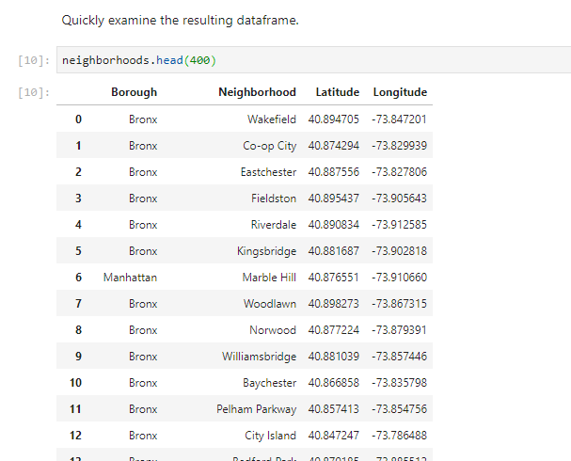
METHODOLOGY
New York DataSet

Slide 5
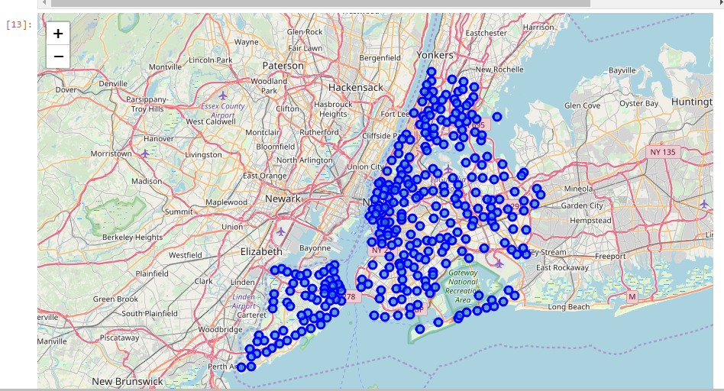
Map of New York with neighbourhoods superimposed on top

Slide 6
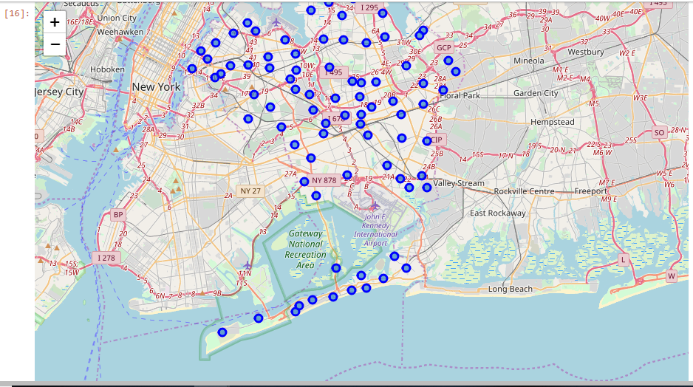
Create map of Queens using latitude and longitude values

Slide 7
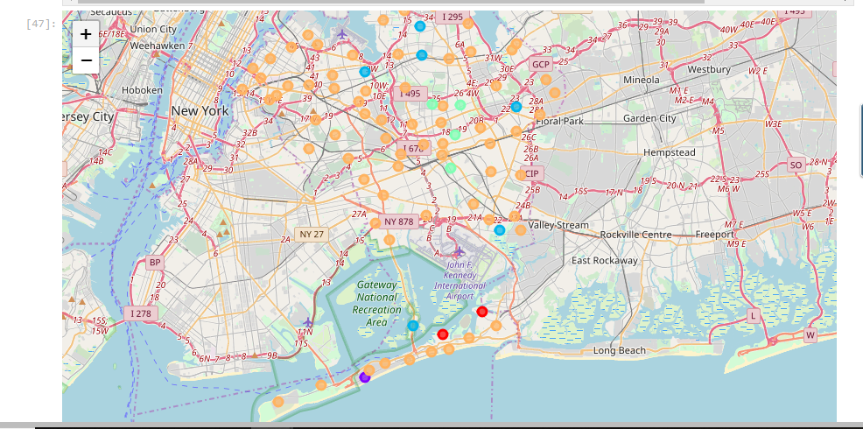
K-means Clustering

Slide 8
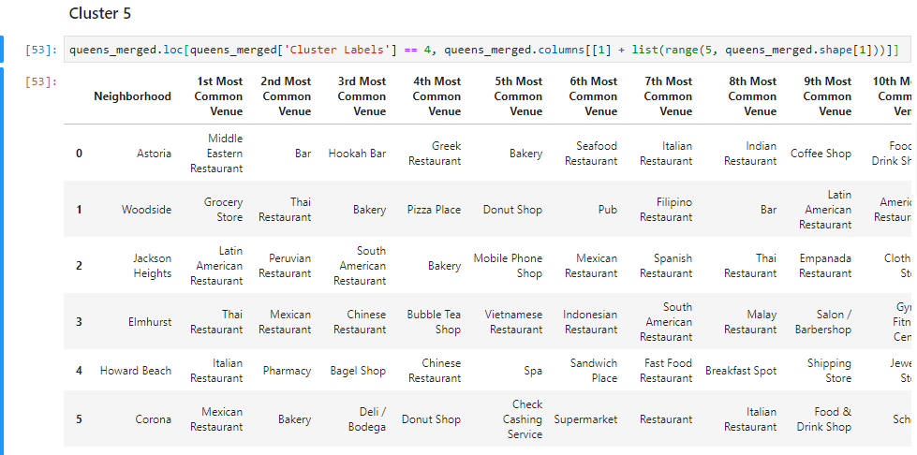
RESULTS & DISCUSSION – BEST CLUSTER

Slide 9
THANK YOU

