Slide 1


23AID434 Robotics Vision
Smart Cardiac Screening System: AI-Driven Heart Sound
Analysis and Automated Report Delivery
Team:- A7
D Dheeraj (CB.AI.U4AID23007)
K Kedhar Nadh (CB.AI.U4AID23015)
M Sai Krishna (CB.AI.U4AID23020)
M Rishitha (CB.AI.U4AID23023)
Date:10-02-2026.
Page no.1

Slide 2
CONTENTS
1. Introduction
2. Problem Statement
3. Objectives
4. Dataset & Preprocessing
5. System Architecture
6. Methodology
7. Results
8. Model Comparison & Ablation Study
9. Summary, Achieved Outcomes & Future Perspectives
Date:10-02-2026.
Page no.2

Slide 3
INTRODUCTION
Background
  Cardiovascular disease is the leading cause of mortality globally; early detection via cardiac imaging is critical.
  Echocardiography and cardiac CT/MRI generate multi-frame image sequences requiring expert analysis of Left Ventricle (LV), Myocardium, and Left Atrium (LA).
  Manual segmentation is time-consuming, subject to inter-observer variability, and unavailable in low-resource settings.
  Our Solution
  An AI-powered cardiac screening system integrating: automatic cardiac structure segmentation (YOLO11n variants), Ejection Fraction (EF) computation from predicted masks, and automated clinical report generation using Gemini 2.5 Flash LLM.
  Deployed as a Streamlit web application — enabling clinicians to upload cardiac scans and receive instant structured reports.
  Key Innovation
  Novel frequency-domain YOLO architecture (YOLO11n-Freq) combining FFT feature extraction, CPCA channel attention, ASPP multi-scale dilation, and deep supervision with two-phase training.
Date:10-02-2026.
Page no.3

Slide 4
PROBLEM STATEMENT
Clinical Challenges
  Manual cardiac image analysis is slow, expensive, and requires specialist availability — inaccessible in resource-limited healthcare settings.
  Existing AI segmentation models lack the sensitivity for fine structures like the myocardial wall and are not validated for EF estimation.
  Standard YOLO architectures are designed for natural images; they underperform on medical images with low contrast and high inter-class similarity.
  No end-to-end system integrates segmentation, quantitative EF computation, and natural-language clinical report generation.
  Research Problem
  Design and evaluate an integrated pipeline that:
  Accurately segments LV, Myocardium, and LA from cardiac scan frames (end-diastole and end-systole)
  Estimates Ejection Fraction using Simpson's method on predicted masks
  Generates structured, clinically meaningful reports via a large language model (Gemini 2.5 Flash)
  Runs in real-time via a web application deployable in clinical or screening contexts
Date:10-02-2026.
Page no.4

Slide 5
OBJECTIVES
  To develop a deep learning–based system for accurate segmentation of cardiac structures including the Left Ventricle (LV), Myocardium, and Left Atrium (LA) from echocardiographic images.
  To design and implement enhanced YOLO11n-based architectures incorporating modules such as CBAM, ASPP, FFT, CPCA, and skip connections to improve feature extraction in low-contrast cardiac ultrasound images.
  To compute Ejection Fraction (EF) from the segmented Left Ventricle masks using Simpson’s Biplane method for quantitative cardiac function assessment.
  To evaluate the clinical reliability of predicted EF values by comparing them with reference measurements using Bland–Altman statistical analysis.
  To develop an automated cardiac analysis report generation system using Gemini 2.5 Flash LLM to produce structured, clinician-readable diagnostic summaries.
  To deploy the entire system as an end-to-end Streamlit web application enabling image upload, segmentation, EF calculation, and automated report generation.
Date:10-02-2026.
Page no.5

Slide 6
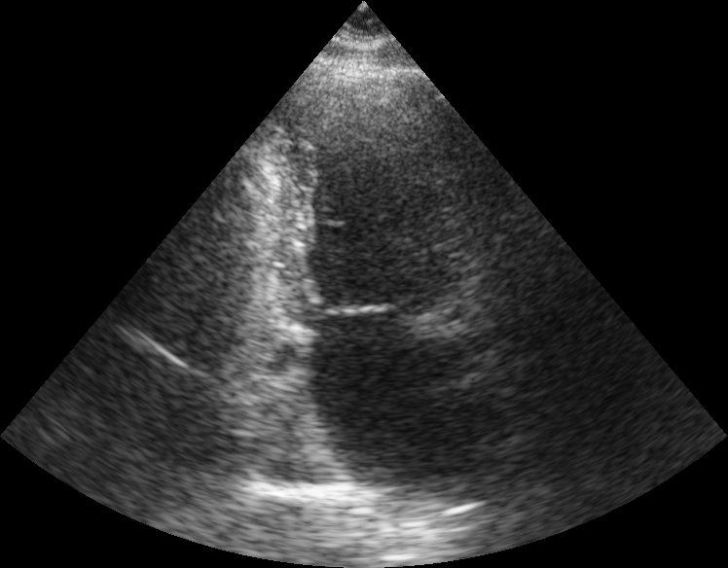
DATASET & PREPROCESSING
Cardiac Segmentation Dataset
  Multi-class echocardiography dataset with frame pairs: End-Diastole (ED) and End-Systole (ES) views.
  Three segmentation classes: Left Ventricle (LV — class 0), Myocardium (class 1), Left Atrium (LA — class 2).
  100-patient subset used for all experiments. Patient views: 2CH (2-chamber) and 4CH (4-chamber).
  Preprocessing Pipeline
  CLAHE (Contrast Limited Adaptive Histogram Equalization) applied for image enhancement.
  Bone window normalization + pixel intensity standardization.
  Train/Val/Test split per patient to prevent data leakage.
Date:10-02-2026.
Page no.6

Slide 7
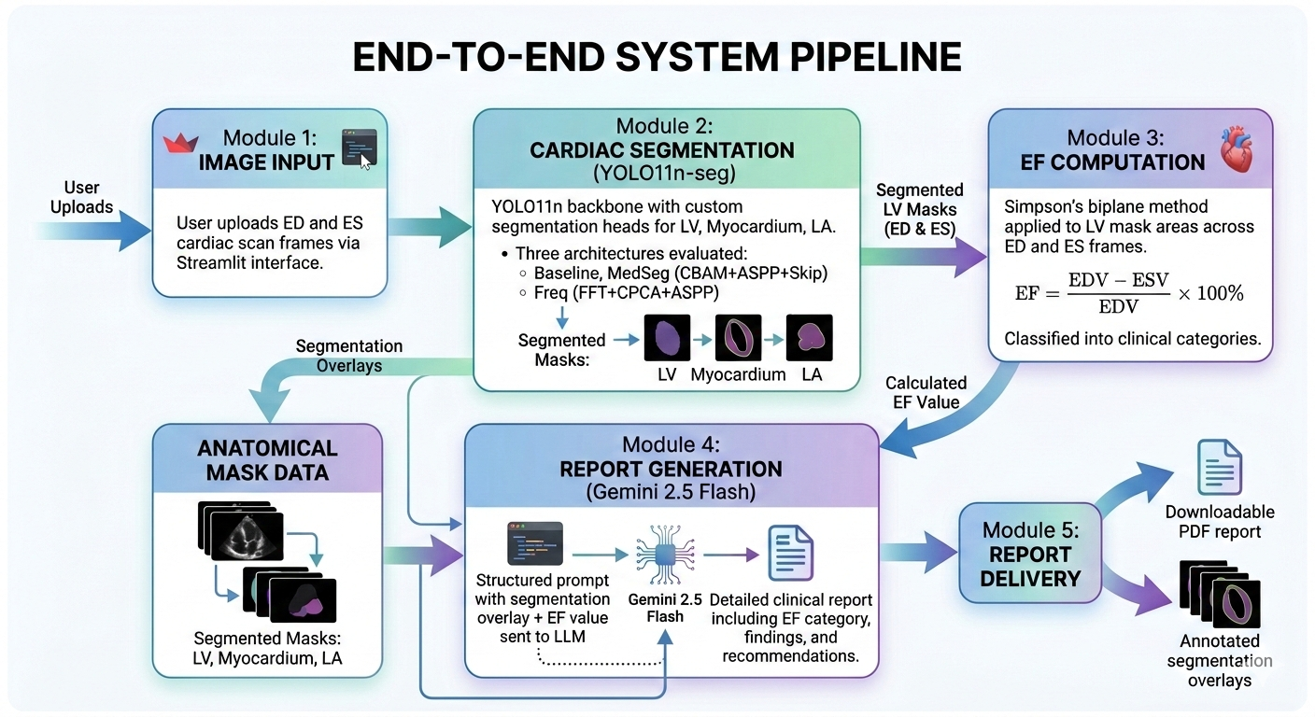
SYSTEM ARCHITECTURE
Date:10-02-2026.
Page no.7

Slide 8
METHODOLOGY
Date:10-02-2026.
Page no.8

Slide 9
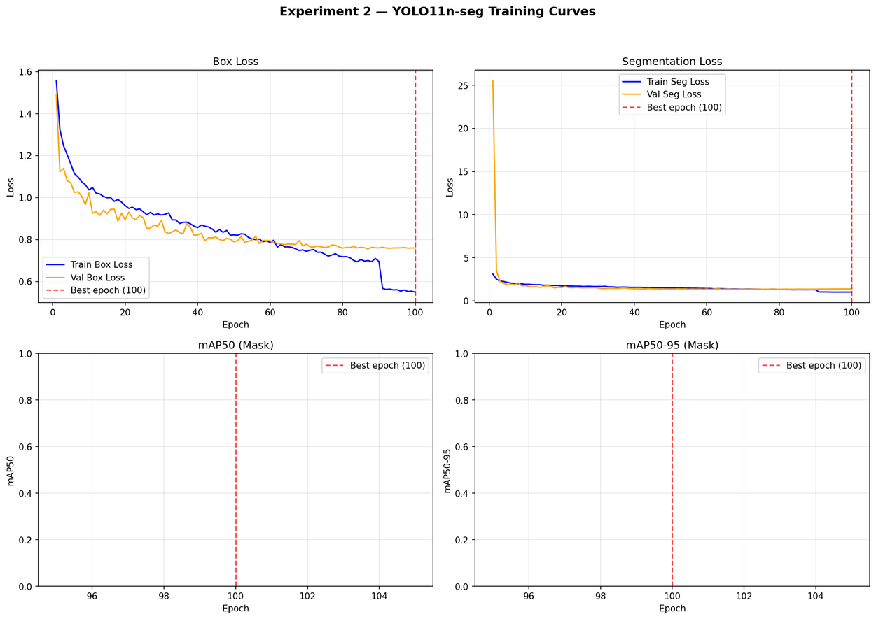
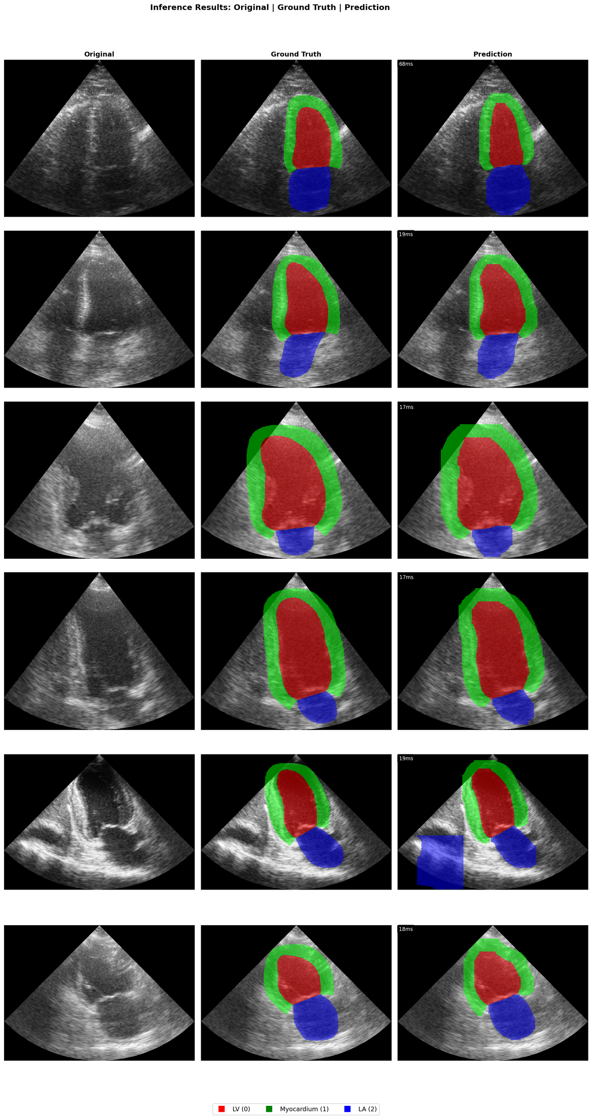
RESULTS: Exp2 — YOLO11n-seg Baseline
Fig 1: Training Curves (Loss & mAP) Fig 2: Segmentation Predictions
Date:10-02-2026.
Page no.9

Slide 10
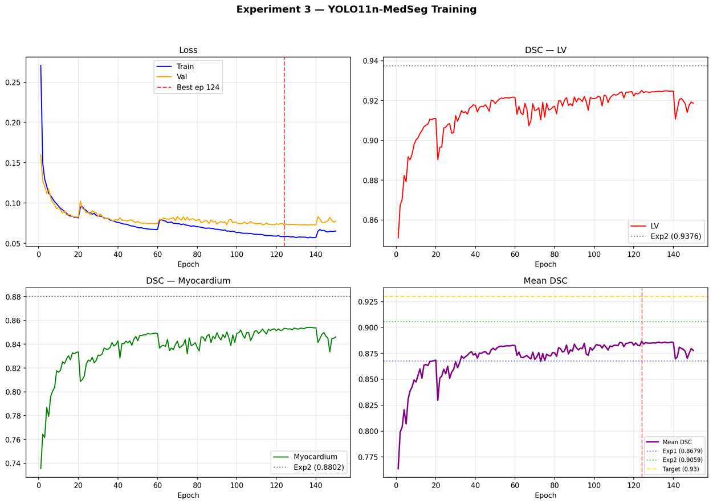
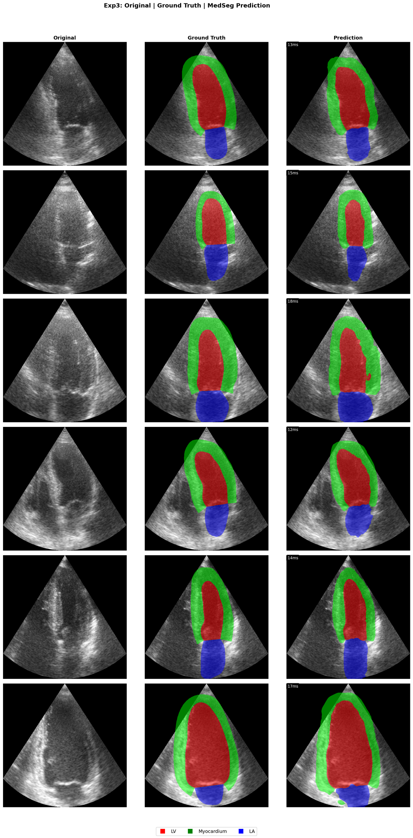
RESULTS: Exp3 — YOLO11n-MedSeg (CBAM+ASPP+Skip)
Fig 1: Training Curves Fig 2: Segmentation Predictions
Date:10-02-2026.
Page no.10

Slide 11
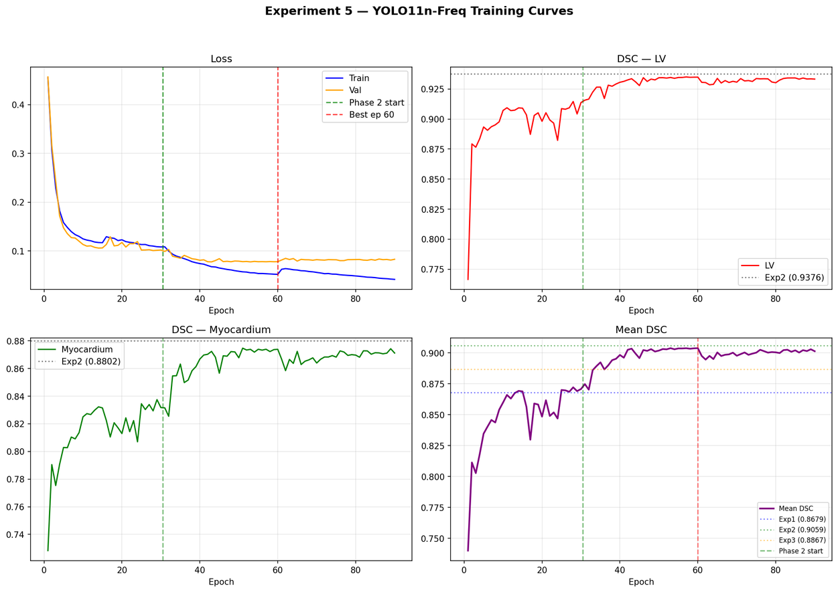
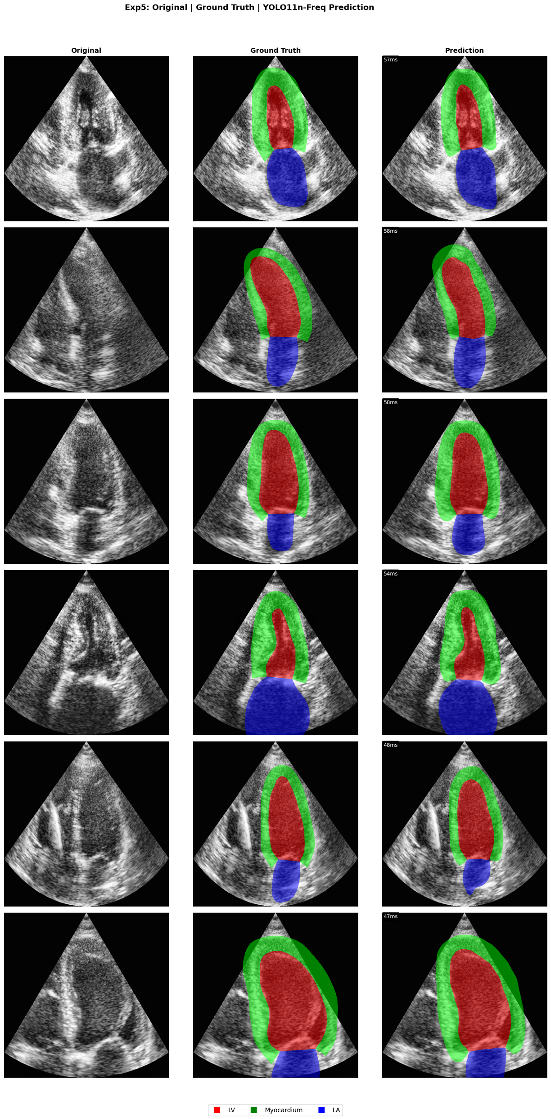
RESULTS: Exp5 — YOLO11n-Freq (FFT+CPCA+ASPP+DeepSup)
Fig 1: Training Curves (2-Phase) Fig 2: Segmentation Predictions (TTA)
Date:10-02-2026.
Page no.11

Slide 12
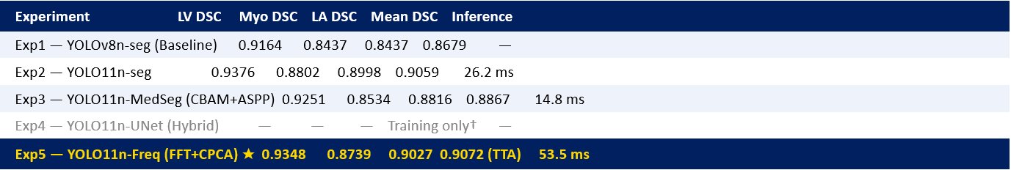

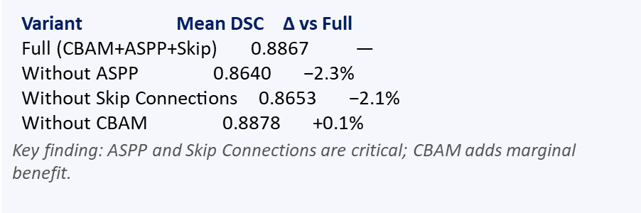
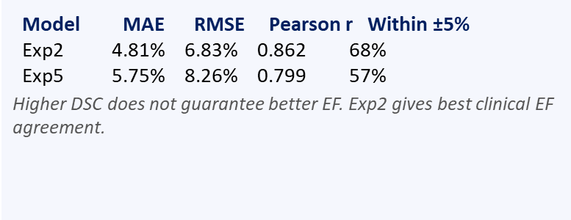
MODEL COMPARISON & ABLATION STUDY
DSC Performance Across All Experiments
Date:10-02-2026.
Page no.12

Slide 13
SUMMARY, ACHIEVED OUTCOMES & FUTURE PERSPECTIVES
Summary
  Developed a complete AI cardiac screening pipeline: YOLO11n segmentation + EF computation + Gemini-powered automated report generation, deployed as a Streamlit web app.
  Five progressive experiments established strong baselines and novel architectures (MedSeg, Freq) for cardiac structure segmentation from echocardiographic frames.
  Future Perspectives
  Extend to 3D volumetric cardiac MRI segmentation using diffusion-based shape priors.
  Incorporate multi-view fusion (2CH + 4CH + PLAX) for improved EF precision.
  Prospective clinical validation across diverse patient cohorts and imaging hardware.
  Integrate real-time stethoscope heart sound analysis for combined audio-visual cardiac screening.
Date:10-02-2026.
Page no.13

Slide 14
Thank you
Date:10-02-2026.
Page no.14

