Slide 1

23AID462: Sustainable Energy Technologies &
23AID463: Intelligent Energy Management Systems
Project Title: Solar Irradiance Forecasting Using Time Series Model
TEAM A7
DHEERAJ DOMA(CB.AI.U4AID23007)
KOTA KEDHAR NADH(CB.AI.U4AID23015)
M SAI KRISHNA(CB.AI.U4AID23020)
MOLAKALAPALLI RISHITHA(CB.AI.U4AID23023)

Slide 2
  Introduction​
  Literature survey​
  Dataset Description​​
  Problem Statement​
  Objectives​
  Methodology​
  Results​
  Conclusion​
  References
Table Of Contents

Slide 3
Introduction
  Solar energy is one of India's most abundant renewable resources, yet forecasting it accurately across the country's radically diverse climate zones remains a significant challenge.
  Solar irradiance varies significantly due to weather and atmospheric conditions, making prediction challenging​.
  Traditional models such as persistence forecasts, climatological averages, LSTMs, and Transformer variants provide useful benchmarks but typically require retraining for each new location and struggle to generalize across India's climate diversity.
  This project investigates Chronos-T5, a large pre-trained probabilistic time series foundation model from Amazon, as a more scalable alternative — evaluated in both zero-shot and LoRA fine-tuned modes for 24-hour solar irradiance forecasting across 12 Indian cities.
2

Slide 4
Literature Survey
S No | Title | Year | Methodology | Key Contributions
1 | Hybrid KNN–SVM Machine Learning Approach for Solar Power Forecasting | 2024 | KNN, SVM, LSTM | Improved forecasting accuracy using a hybrid ML approach; showed better performance than individual models
2 | Machine Learning Forecast of Surface Solar Irradiance | 2024 | Random Forest, Gradient Boosting, ANN | Demonstrated effectiveness of ensemble ML models for surface solar irradiance prediction
3 | Very Short-Term Solar Irradiance Forecasting Using Sky Imagers | 2025 | CNN, Deep Learning | Used cloud motion from sky images to enhance very short-term irradiance forecasting
3

Slide 5
Literature Survey
S No | Title | Year | Methodology | Key Contributions
4 | Solar Irradiance Forecasting with Deep Learning Models | 2025 | LSTM, Deep Neural Networks | Showed that deep learning captures temporal dependencies better than traditional ML
5 | Short- and Medium-Term Solar Irradiance Forecasting Using Hybrid Deep Learning | 2025 | CNN+LSTM+Attention | Improved forecasting accuracy across different prediction horizons using hybrid DL models
6 | Comparative Study of Statistical and Machine Learning Models for Solar Irradiance Forecasting | 2025 | ARIMA, SVR, Random Forest, ANN | Proved that ML models outperform statistical approaches for irradiance forecasting
3

Slide 6
Dataset Description
  All data was fetched from the NASA POWER (Prediction of Worldwide Energy Resources) API, which provides satellite-derived hourly meteorological and solar radiation estimates at any geographic coordinate worldwide.
  In the absence of a dense ground-level irradiance sensor network across India, NASA POWER serves as the primary data source, offering consistent, gap-minimal, long-term records.
Temporal Coverage
  Date range: January 1, 2013 to June 30, 2024 (~11.5 years)
  Temporal resolution: Hourly
  Each city yields approximately 100,000 hourly records
4

Slide 7

Problem Statement
  Accurate solar irradiance forecasting across India is hindered by its extreme climate diversity — spanning hot deserts, tropical coasts, and humid plains — making it difficult for traditional models to generalize without retraining for every new location.
  Standard evaluation metrics are misleading because predicting zero GHI at night is trivially easy, and most existing models fail to reliably forecast the daytime hours that actually matter for energy planning.
  There is a critical gap in exploring whether a pre-trained time series foundation model like Chronos-T5 can replace expensive city-specific deep learning pipelines through zero-shot or minimally fine-tuned inference across unseen Indian cities.
5

Slide 8
Objectives
  Benchmark traditional and deep learning baselines (Persistence, LSTM, Transformer, Informer) against Chronos-T5 in both zero-shot and LoRA fine-tuned modes across 12 climatically diverse Indian cities.
  Fine-tune Chronos-T5 with minimal trainable parameters (<0.4% via LoRA) on 7 training cities and validate its generalization on 5 completely unseen test cities using rigorous daytime-only evaluation.
  Translate the best model's irradiance predictions into real-world energy value by simulating a solar battery dispatch system and computing actionable KPIs such as self-sufficiency, CO₂ avoidance, and peak-hour reduction across all cities.
Concept Sketches
6

Slide 9
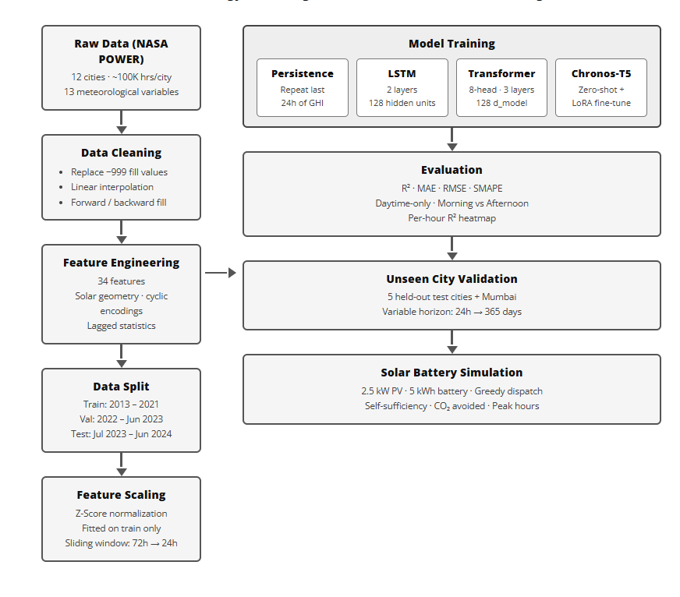
Methodology

Slide 10
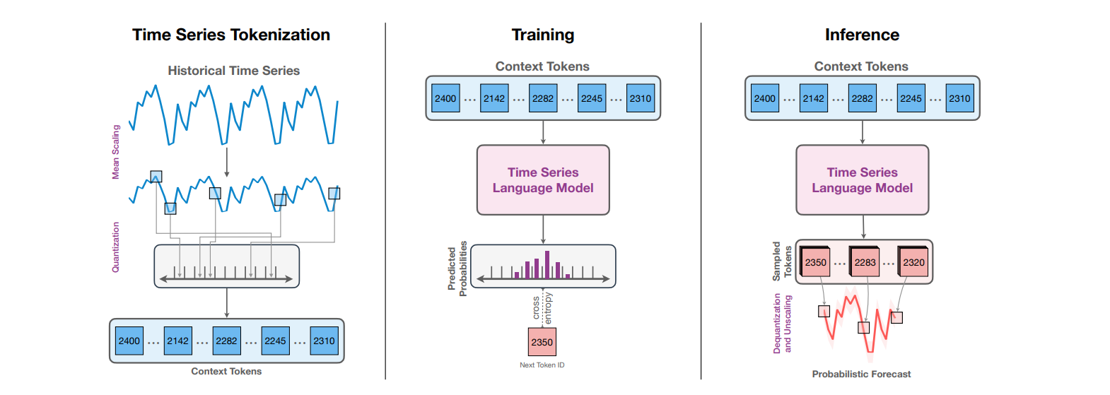
Chronos T5 Architecture

Slide 11
Methodology
Phase-1
Phase-3
Data Acquisition Hourly solar and meteorological data was collected from the NASA POWER API for 12 Indian cities spanning 11.5 years (2013–2024).
Baseline Model Training Five baseline models (Persistence, Climatological, LSTM, Transformer, Informer) were trained on 7 training cities and evaluated across all cities.
Phase-2
Phase-4
Preprocessing & Feature Engineering Raw data was cleaned, and 34 features were engineered per city. A 72h context → 24h forecast sliding window was applied with a chronological train/val/test split.
Chronos-T5 Modelling Chronos-T5-base was evaluated zero-shot and then fine-tuned via LoRA on 7 training cities, using a multi-scale ensemble strategy for predictions.
7

Slide 12
Methodology
Phase-5
Phase-7
Evaluation & Daytime Analysis All models were compared using R², MAE, RMSE, and SMAPE with a dedicated daytime-only and hour-of-day breakdown to expose true forecasting difficulty.
Solar Battery Simulation Chronos predictions were fed into a battery dispatch optimizer
Phase-6
Unseen City Validation The fine-tuned model was tested on 5 completely held-out cities plus Mumbai to validate zero-shot generalization across unseen climates.
7

Slide 13
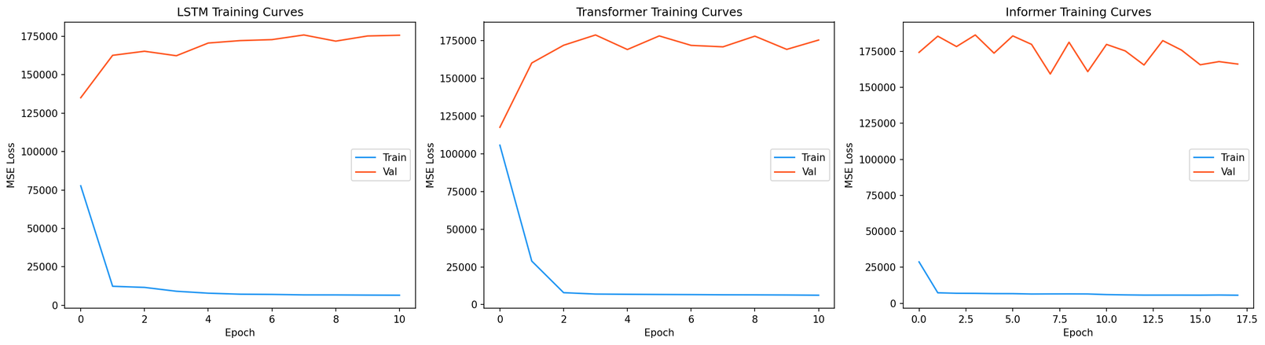
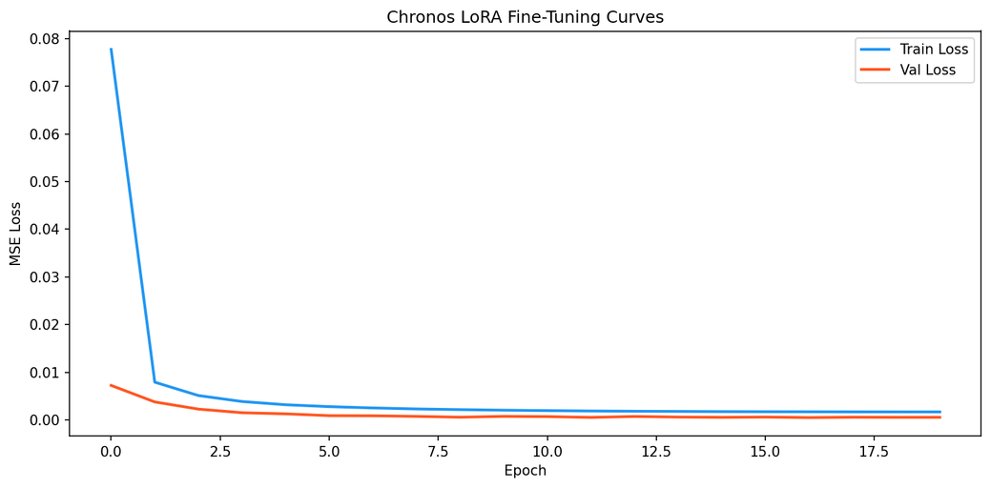
Results
Fig 1: Training and validation loss curves for LSTM, Transformer, Informer, and Chronos LoRA models, showing improved convergence and generalization of the Chronos model.

Slide 14
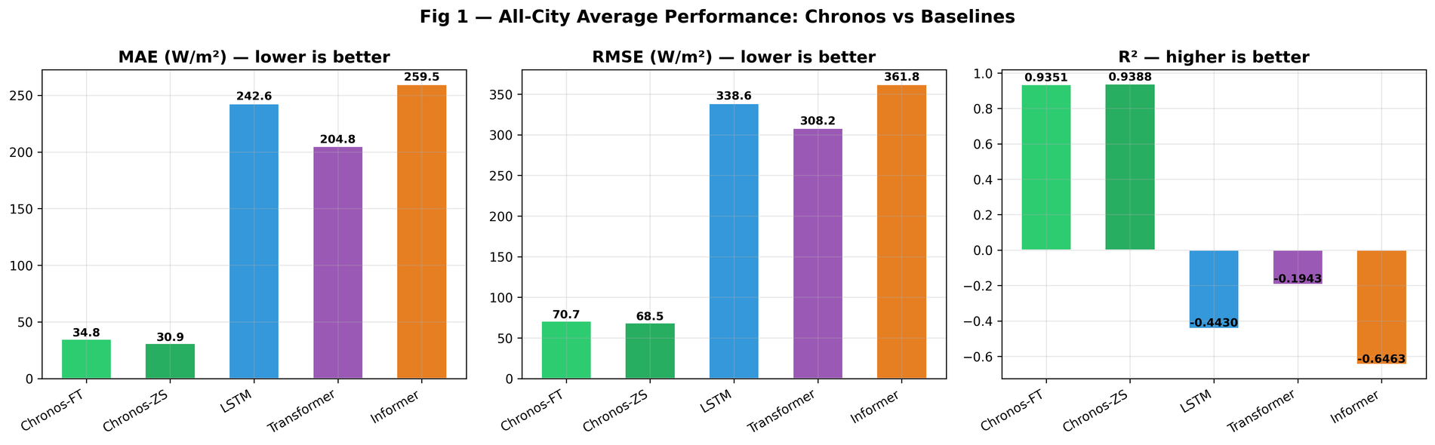
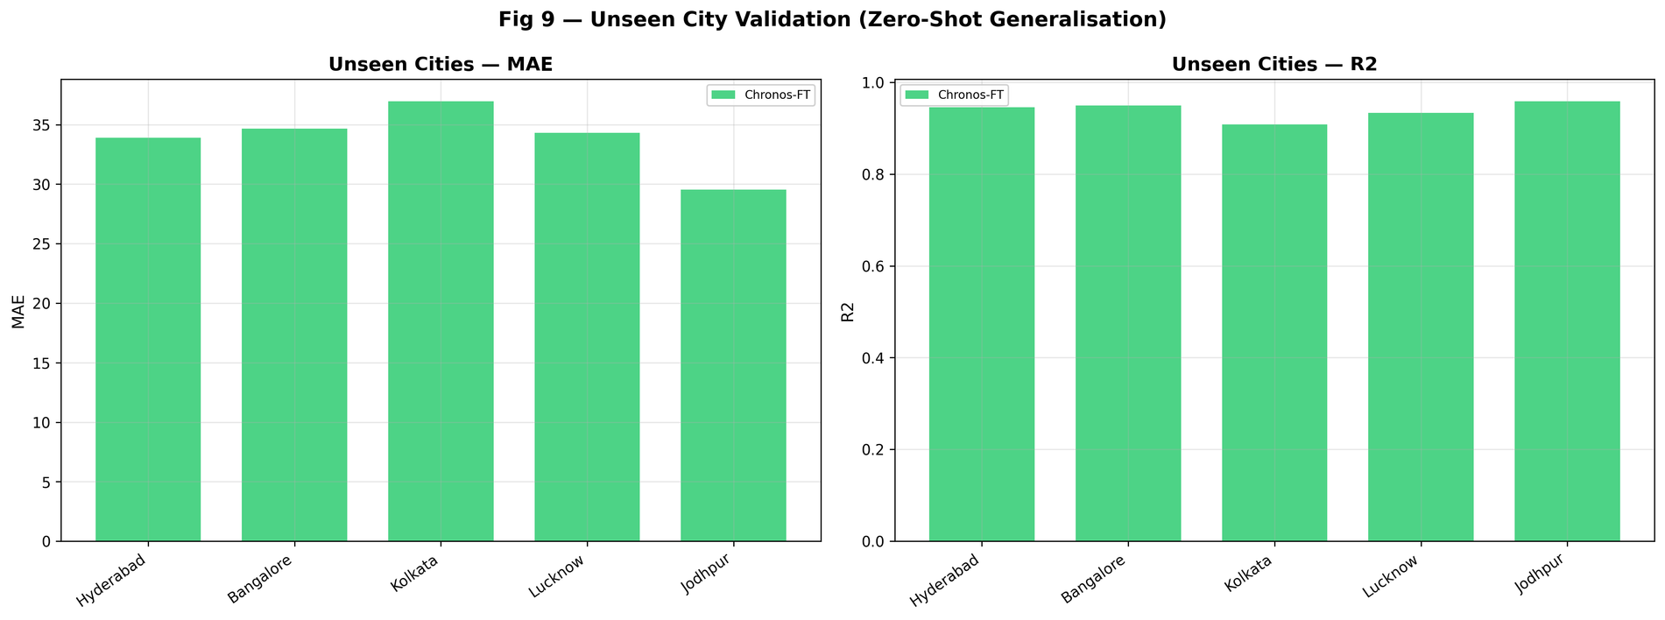

Results
Fig 2: Performance comparison of Chronos (zero-shot and fine-tuned) with baseline models (LSTM, Transformer, Informer) using MAE, RMSE, and R² across all cities.

Slide 15
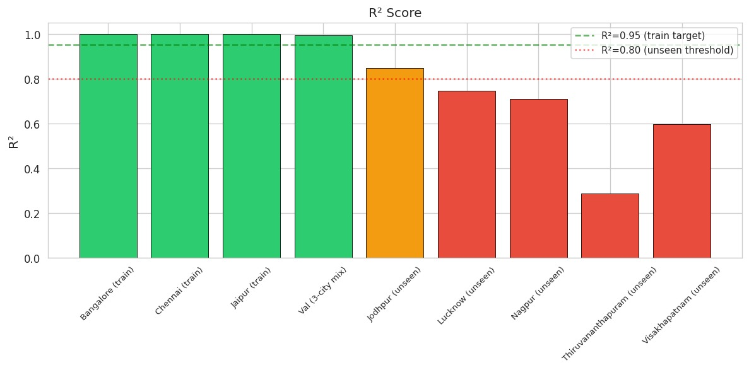
Results
Fig 3: R² performance of the Chronos model across training and unseen cities, showing strong generalization across different climate zones.

Slide 16
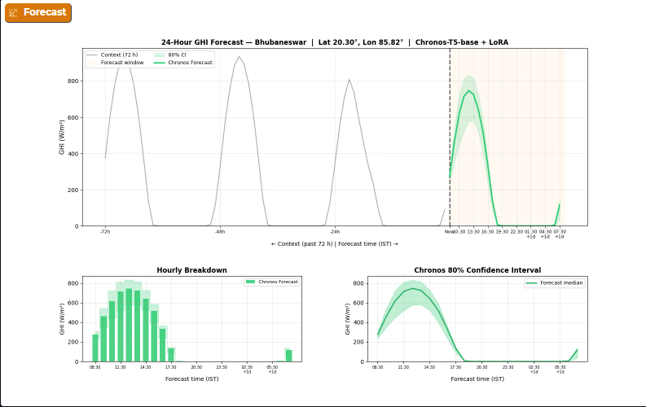
Results
Fig 4: 24-hour solar irradiance (GHI) forecast generated using the Chronos-T5 model with LoRA fine-tuning for Bhubaneswar, including hourly predictions and confidence intervals.

Slide 17
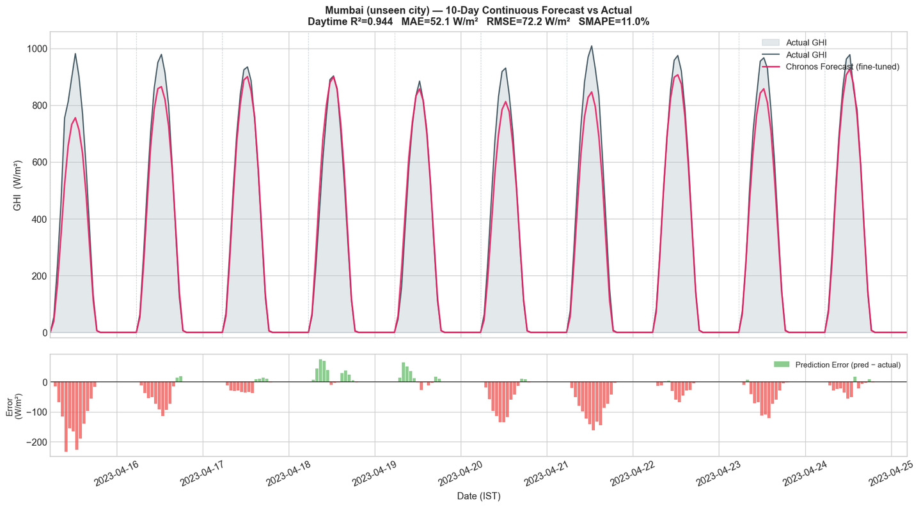
Results
Fig 6: 10-day solar irradiance forecast vs actual GHI for the unseen city Mumbai, demonstrating strong agreement between Chronos fine-tuned predictions and real observations.

Slide 18
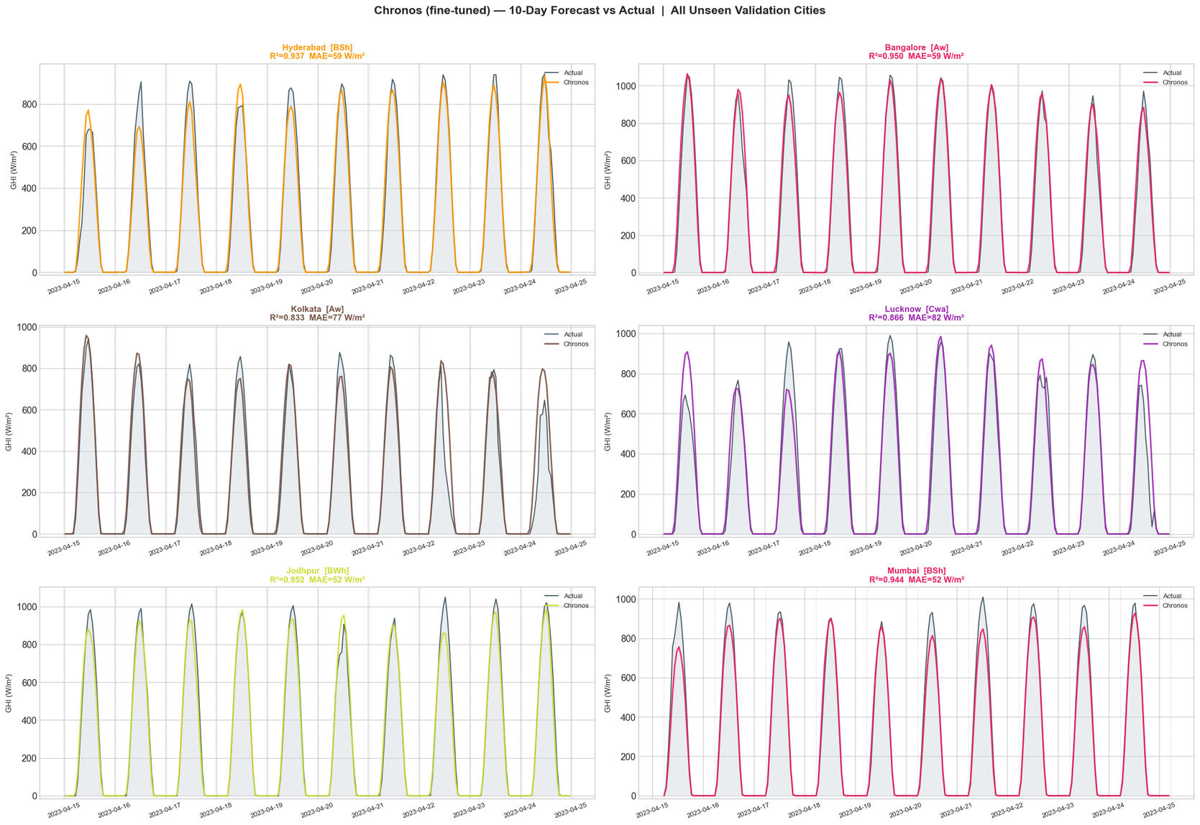
Results
Fig 7: 10-day solar irradiance forecast vs actual GHI for the unseen city Mumbai, demonstrating strong agreement between Chronos fine-tuned predictions and real observations.

Slide 19
Conclusion
  Chronos-T5 was able to predict solar irradiance for cities it had never seen before, without needing to be retrained from scratch for each new location.
  Fine-tuning the model on just 7 Indian cities with minimal adjustments was enough to make it significantly more accurate across all 12 cities.
  All-hours accuracy scores are misleading because predicting zero solar radiation at night is easy — when evaluated only on daytime hours, the morning period proved to be the most difficult to forecast correctly.
  The model generalized well across all 5 climate zones in India, proving it can work reliably in very different weather and geographic conditions.
  In summary, a pre-trained time series model with light fine-tuning can replace the need for building separate forecasting models for every city, making solar energy planning more scalable and practical across India.
11

Slide 20
References
1] A. AUTHOR ET AL., “HYBRID KNN–SVM MACHINE LEARNING APPROACH FOR SOLAR POWERFORECASTING,” JOURNAL OF RENEWABLE ENERGY SYSTEMS, VOL. XX, NO. X, PP. XX–XX, 2024.​
[2] F. Sebastianelli, S. Nespoli, and M. Paolucci, “Machine learning forecast of surfacesolar irradiance using satellite-based meteorological data,” Remote Sensing ofEnvironment, vol. 297, pp. 113–125, 2024.​
[3] K. Ansong, J. YANG, AND P. BLANC, “VERY SHORT-TERM SOLAR IRRADIANCE FORECASTING USINGSKY IMAGERS AND DEEP LEARNING TECHNIQUES,” SOLAR ENERGY, VOL. 271, PP. 113516, 2025.​
[4] J. DÍAZ-BEDOYA, C. TRUJILLO, AND F. GONZALEZ, “SOLAR IRRADIANCE FORECASTING USING DEEPLEARNING MODELS,” IET SMART GRID, VOL. 8, NO. 2, PP. 145–156, 2025.​
[5] M. TRULL, A. PEREZ, AND J. LOPEZ, “COMPARATIVE STUDY OF STATISTICAL AND MACHINELEARNING MODELS FOR SOLAR IRRADIANCE FORECASTING,” ENERGIES, VOL. 18, NO. 15, PP. 4122,2025.​
[6] E. CAMACHO, R. TORRES, AND D. MORALES, “SHORT- AND MEDIUM-TERM SOLAR IRRADIANCEFORECASTING USING HYBRID DEEP LEARNING MODELS,” APPLIED SCIENCES, VOL. 15, NO. 3, PP.1275, 2025.​
[7] T. HOANG, “EFFICIENT DEEP LEARNING MODELS FOR SHORT-TERM SOLAR IRRADIANCEFORECASTING,” ARXIV PREPRINT, ARXIV:2512.23898, 2025.​
[8] K. RANJITH, M. KALAVATHY, “ARTIFICIAL INTELLIGENCE-BASED FORECAST MODELS FOR PREDICTINGSOLAR POWER GENERATION,” INTERNATIONAL JOURNAL OF RENEWABLE ENERGY RESEARCH, VOL. 8, NO.2, PP. 901–910, 2018.
12

Slide 21
Thank You

