Slide 1
Modulatory effects of inhibition on persistent activity in a cortical microcircuit model
Konstantoudaki et al.
Katherine Doxey and Sydney Leaman

Slide 2
Criteria and Motivation
strength of inhibition
complete process of converting a model in NetPyNE
small enough computationally
focus on biologically realistic connectivity and electrophysiology instead of morphology

Slide 3
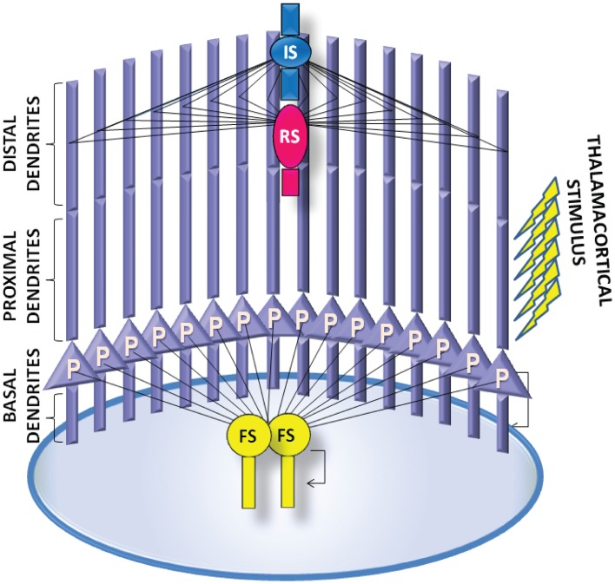
Original Model
“computational approach to study how changes in the excitation/inhibition balance in a prefrontal cortex microcircuit model affect the properties of persistent activity”
firing that persists after the triggering stimulus disappears
16 pyramidal neurons and 2 fast-spiking (FS), 1 regular-spiking (RS), and 1 irregular-spiking (IS) interneurons
in NEURON
Konstantoudaki et al., 2014

Slide 4
Gaps in Models
hoc and mod files from ModelDB did not match model parameters from paper
soma resting potential
no feedback from other cortical areas
only a thalamocortical initial stimulus
NetPyNE model lacks autapses
connection from a pyramidal neuron onto itself
interneurons fired spontaneously without any stimulus

Slide 5
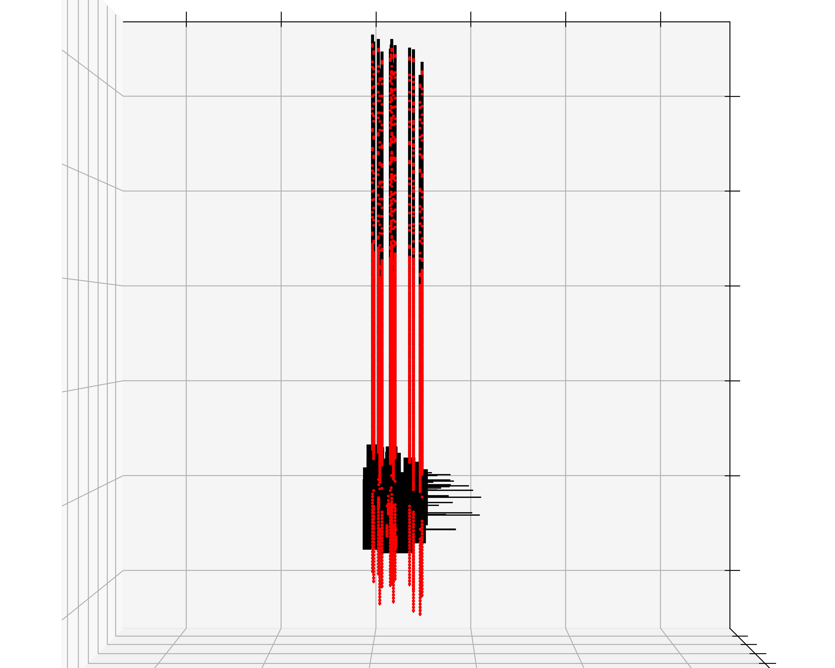
NetPyNE Model Structure

Slide 6
NetPyNE Model Connectivity
Connection | Target Section | Synaptic Mechanism | No. of Synapses
PYR to PYR | Basal dendrite | AMPA, NMDA | 24
PYR to FS | Dendrite | AMPAin, NMDAin | 12
PYR to RS | Dendrite | AMPAin, NMDA | 14
PYR to IS | Basal dendrite | AMPAin, NDMA | 7
FS to FS | Soma | GABAin | 1
FS to PYR | Soma, proximal dendrite | GABAa, GABAb | 15
RS to PYR | Distal dendrite | GABAa | 12
IS to PYR | Distal dendrite | GABAa | 10
IS to RS | Dendrite | GABAa | 2
PYR
FS
RS
IS

Slide 7
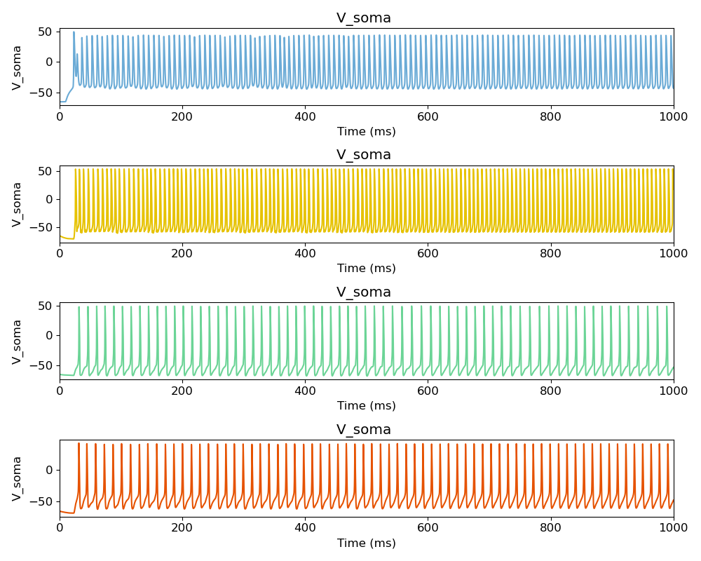
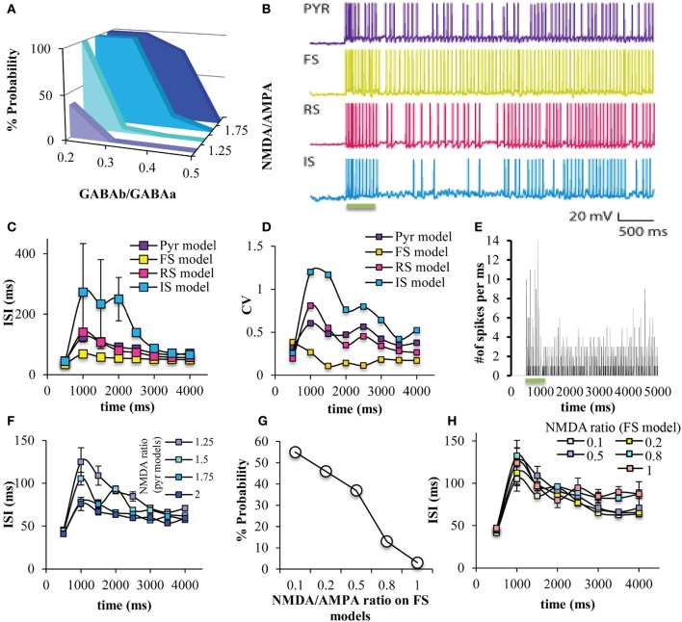
Model Baseline Behavior
continued persistent activity after short stimulus
Konstantoudaki et al., 2014

Slide 8
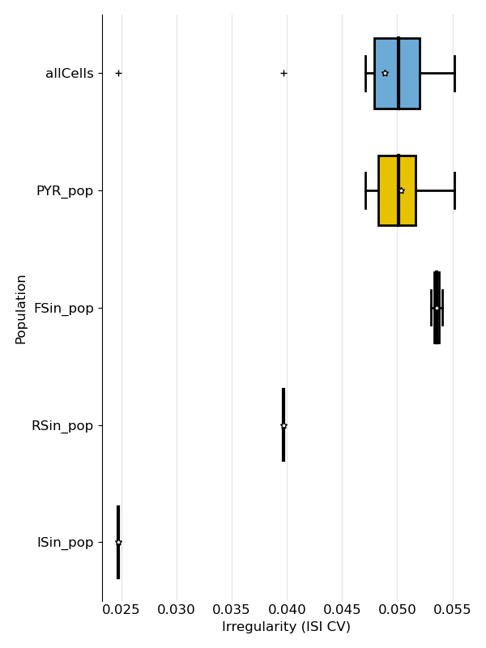
Model Baseline Behavior
irregularity does not match original model
Konstantoudaki et al., 2014

Slide 9
Findings
explored what level of inhibition results in stopping of persistent activity
GABAa and GABAb gain
GABAa and GABAb synapses per connection
number of FS cells
GABAb synapses/connections have biggest influence on network
three activities (??) observed
recurrent firing
fire only with stimulus
inhibition too high for firing beyond initial spike

Slide 10
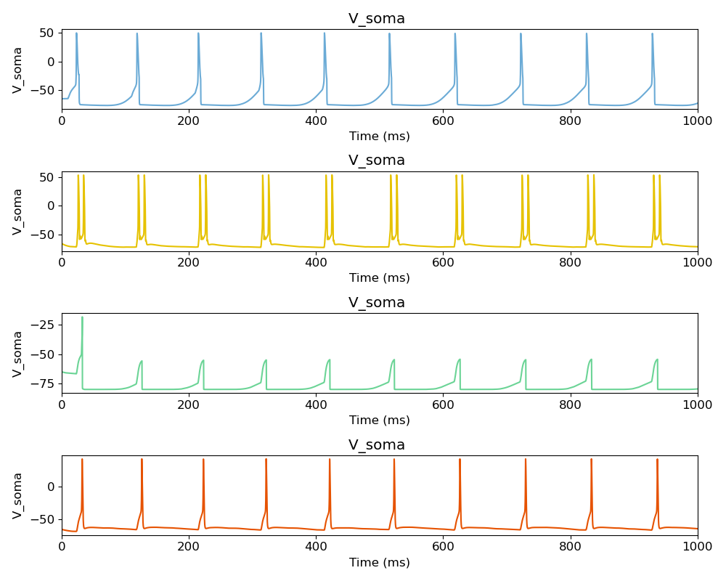
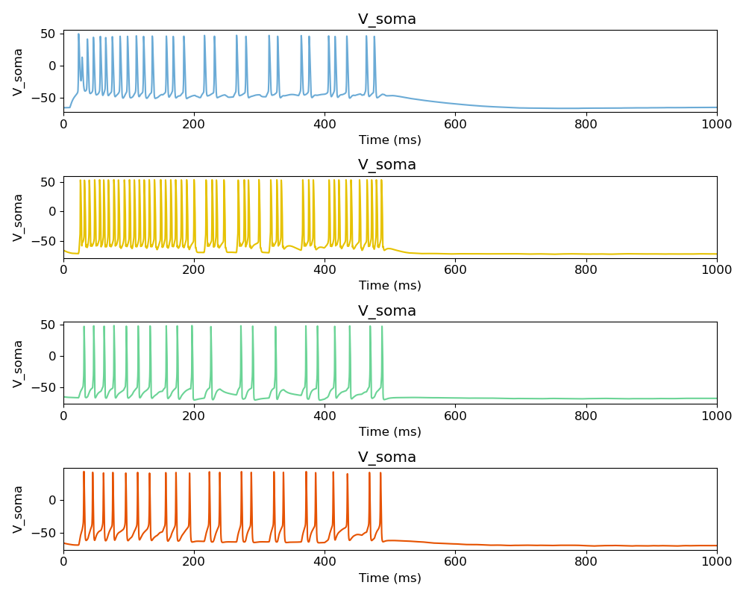
Gain Threshold
RASTER OR VOLTAGE TRACE?
GABAa synaptic weight > 1,000,000x
GABAb synaptic weight = 10-11x

Slide 11
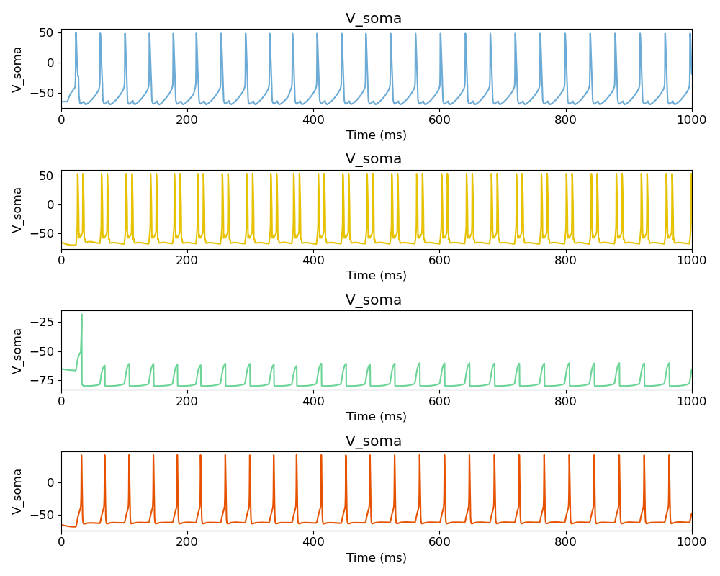
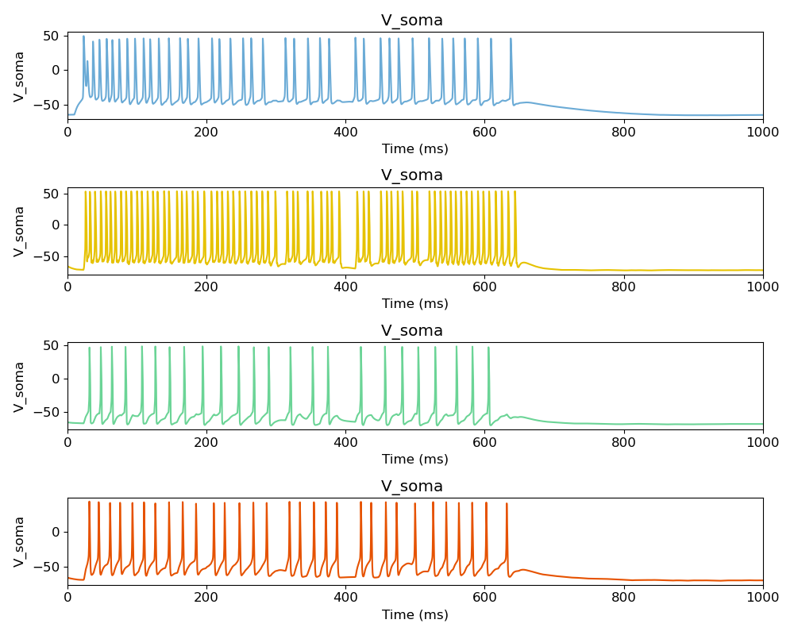
Synapses per Connection
GABAa synsPerConn > +1,000
GABAb synsPerConn = +137-140

Slide 12
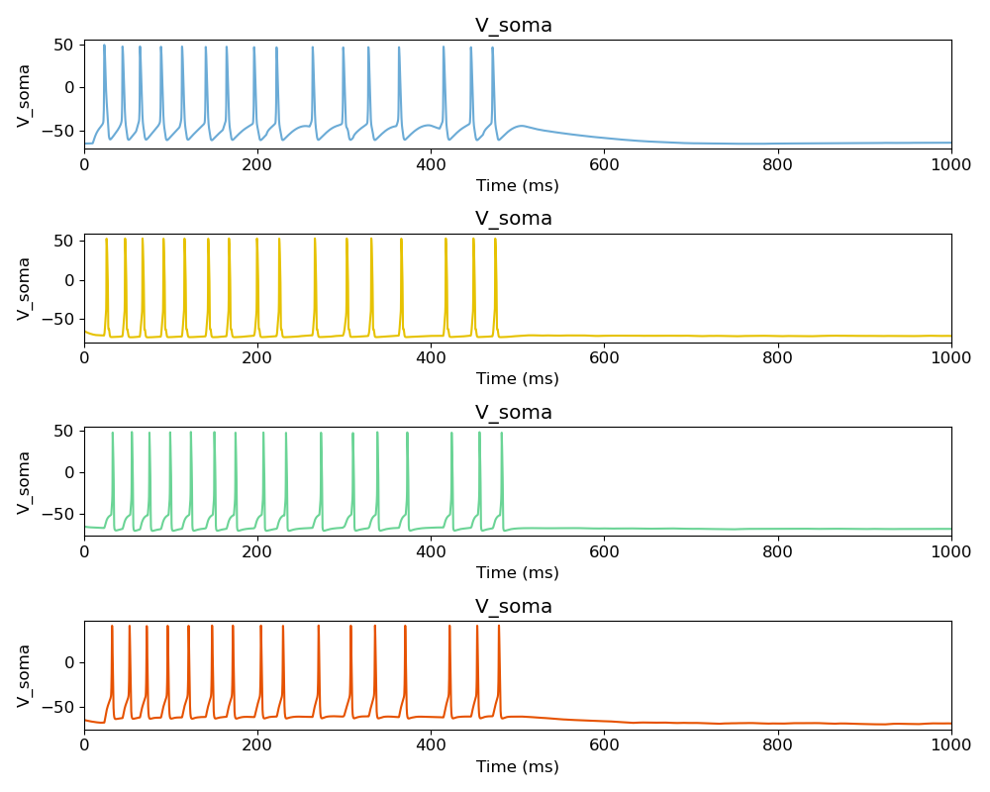
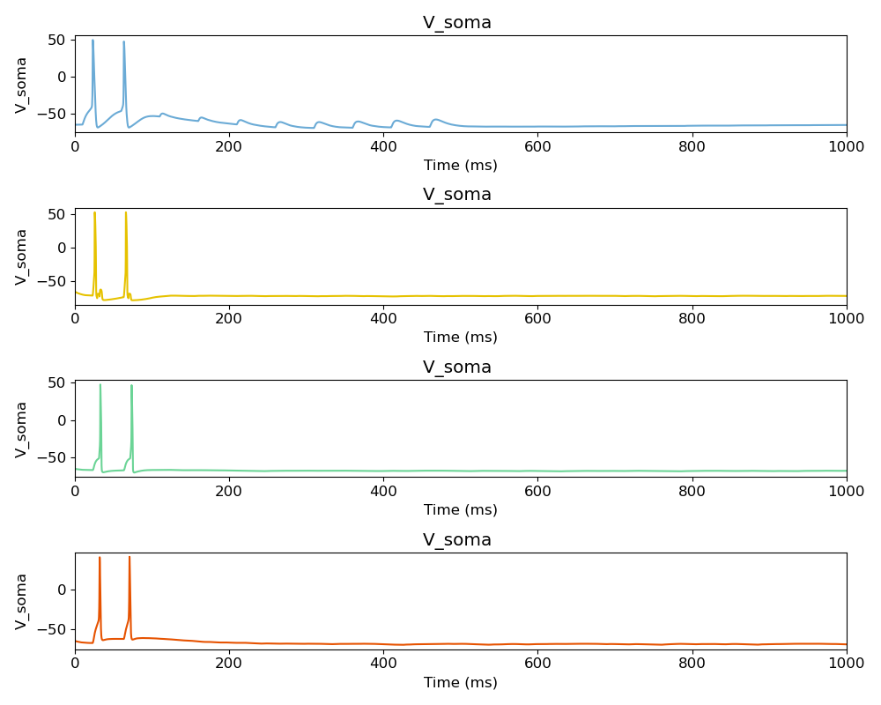
Number of FS Cells
31
124

Slide 13
Unexplored Questions
effects of
adding different types of interneurons
creating different connections
does the spiking return at some point after the persistent activity is stopped

Slide 14
Biggest Lessons
test electrophysiology of cell types outside of network
compare model files and parameters to published paper
models can always be improved or made more realistic
one parameter off can drastically alter dynamics

