Slide 1
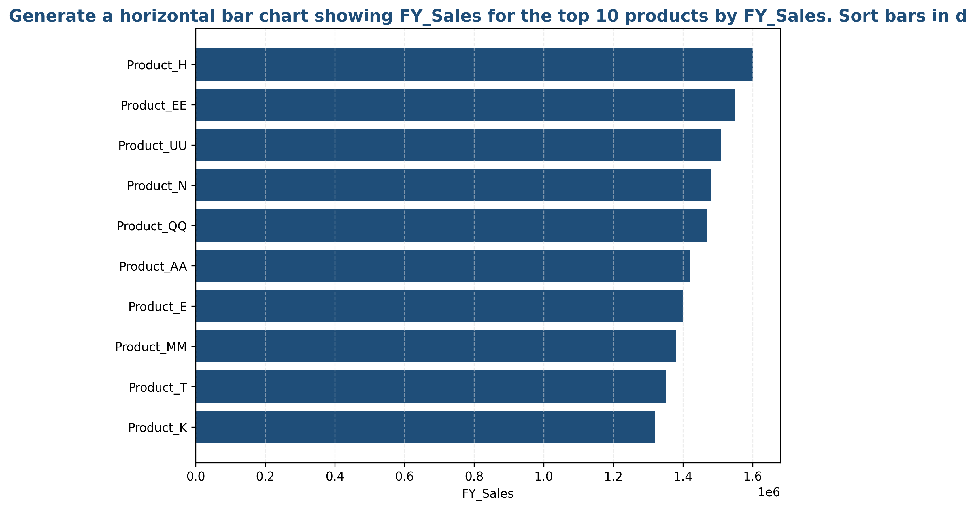
Top 10 Products Performance Analysis
• The top 10 products generated $14,480,000 in total sales, representing 34.0% of overall performance
• Product_H leads with $1,600,000, followed by Product_EE at $1,550,000

Slide 2
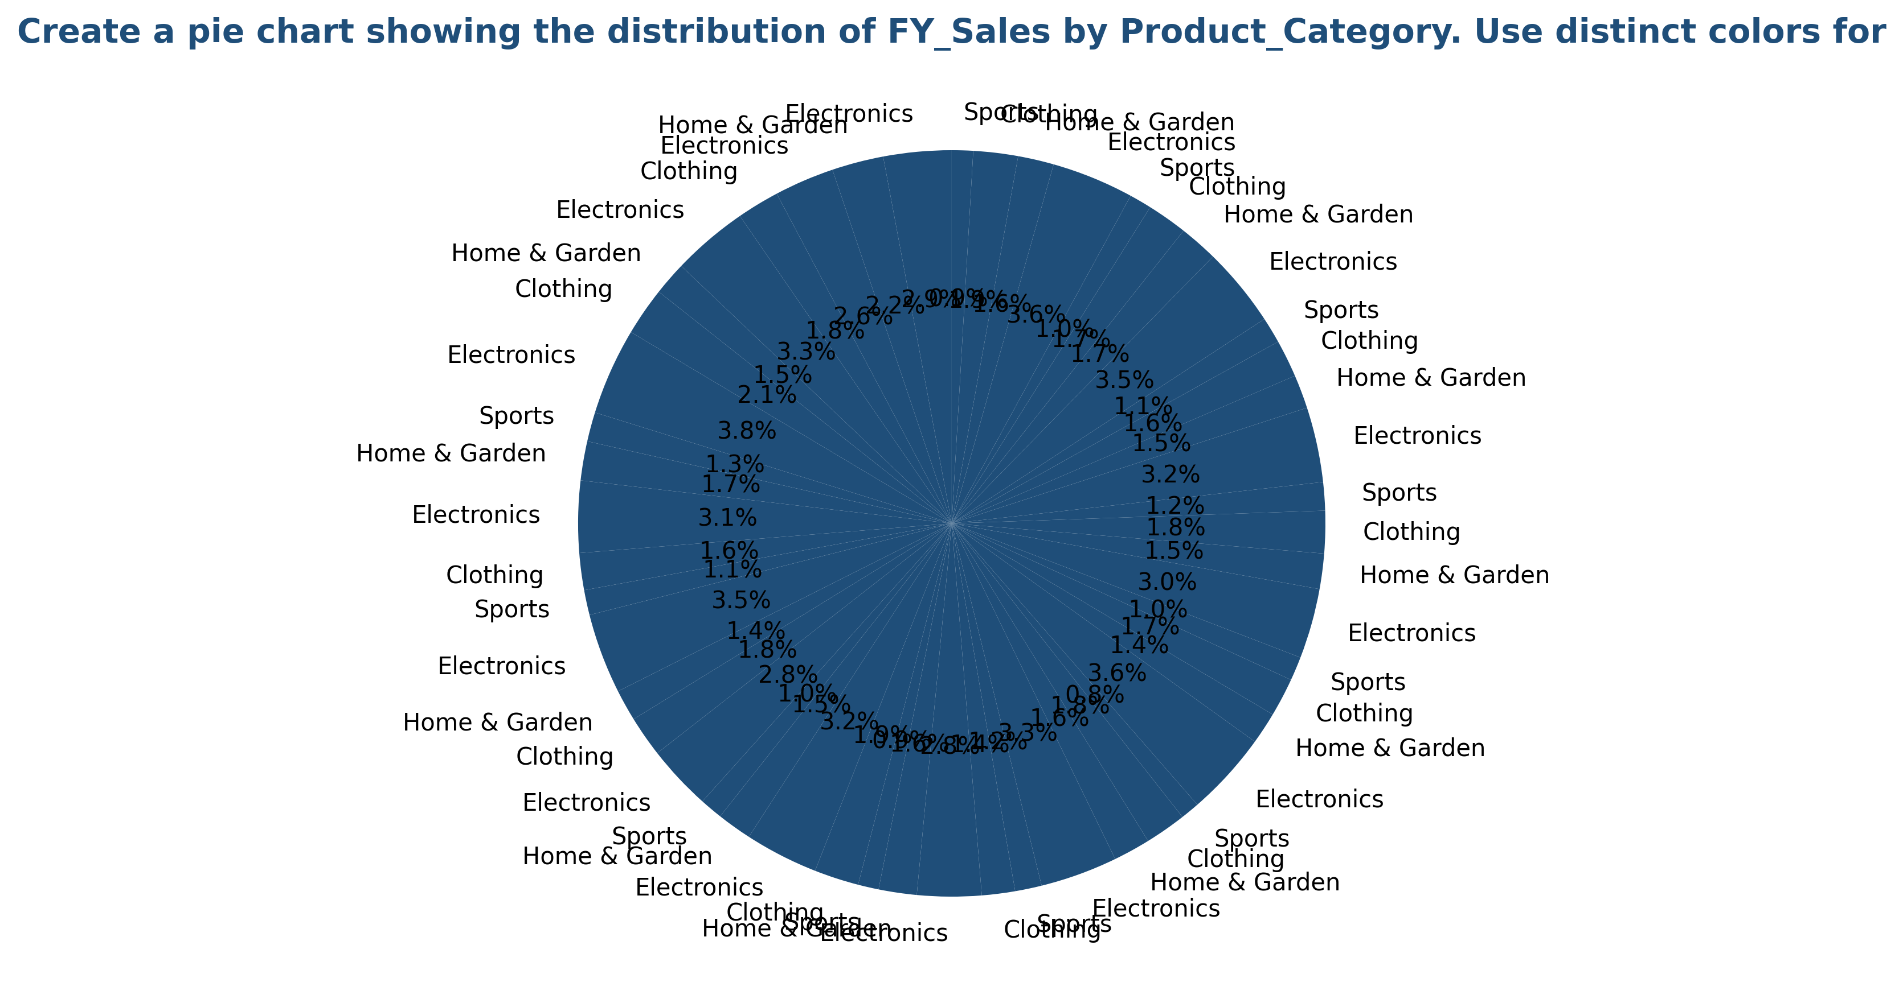
Product Category Distribution
• Electronics dominates with $20,500,000 (48.2% of total sales)

Slide 3
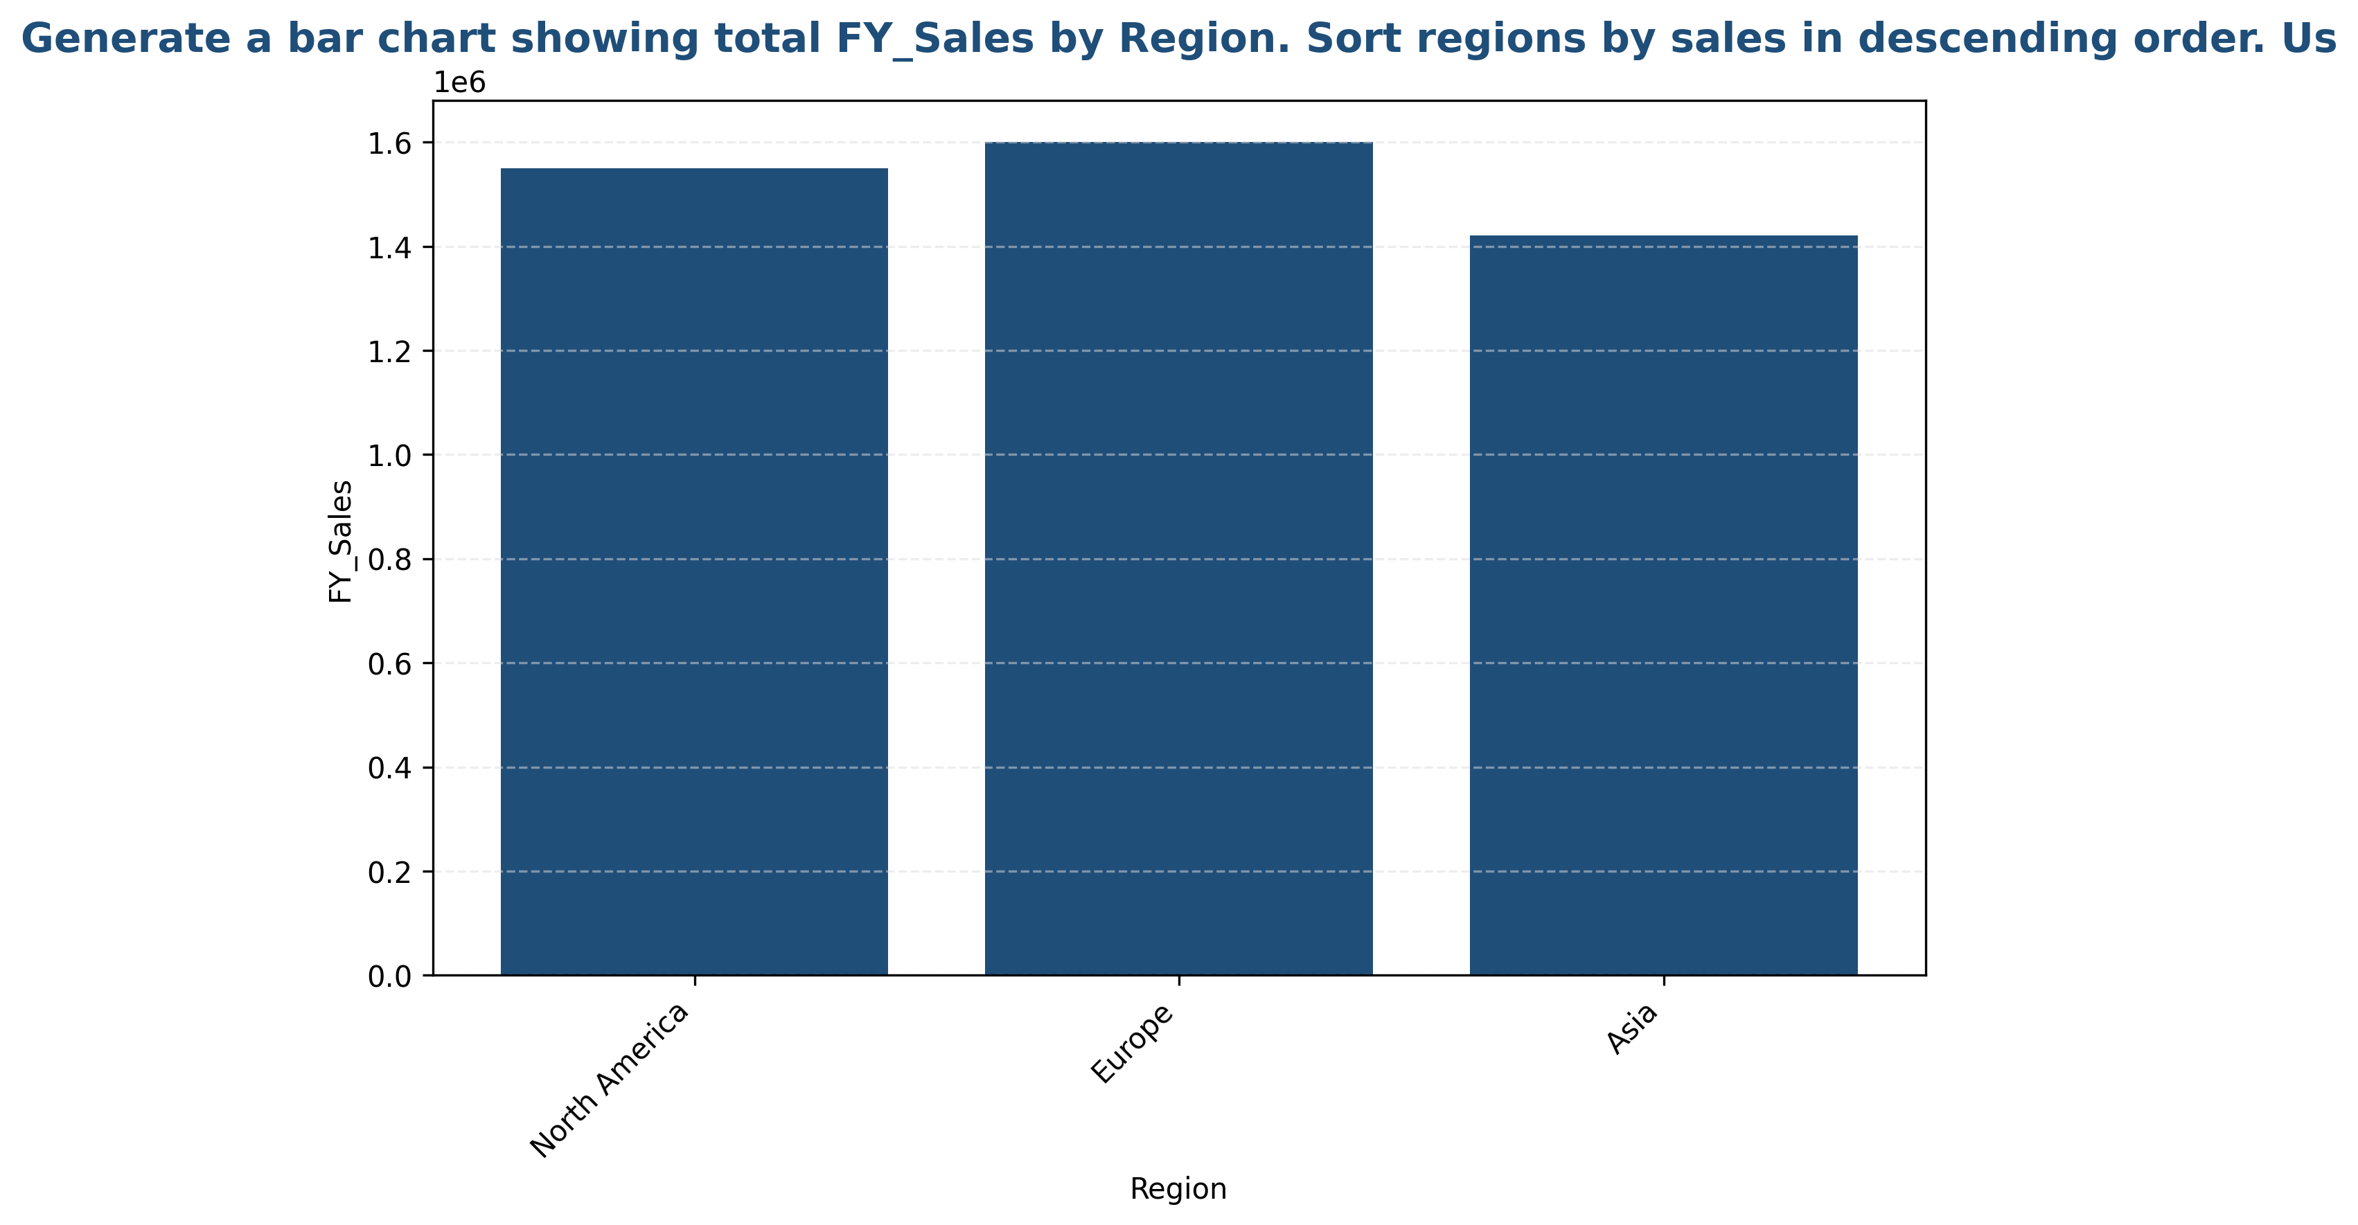
Regional Sales Performance
• Europe leads regional performance with $16,950,000 (39.9% of total)

