Slide 1
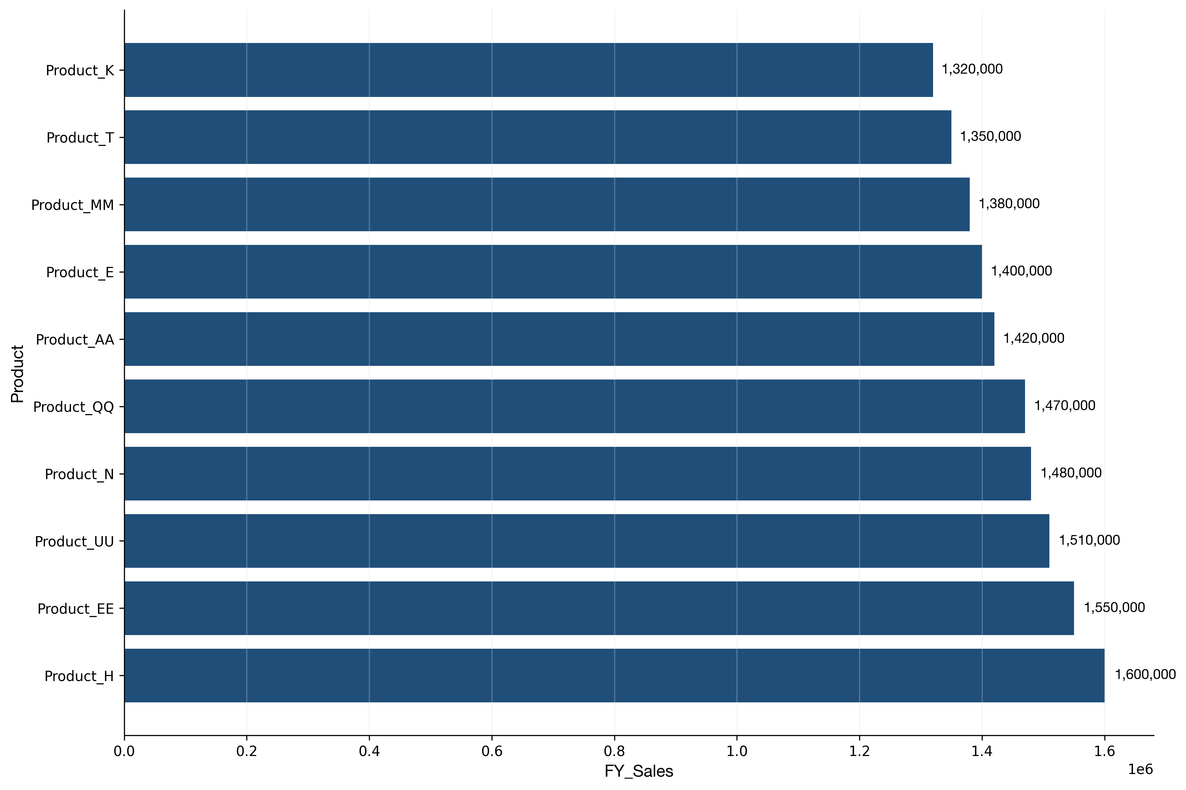
Top 10 Products Performance Analysis
• The top 10 products generated $14,480,000 in total sales, representing 34.0% of overall performance
• ProductH leads with $1,600,000, followed by ProductEE at $1,550,000
• The remaining 40 products contribute $28,050,000, indicating balanced distribution among performers

Slide 2
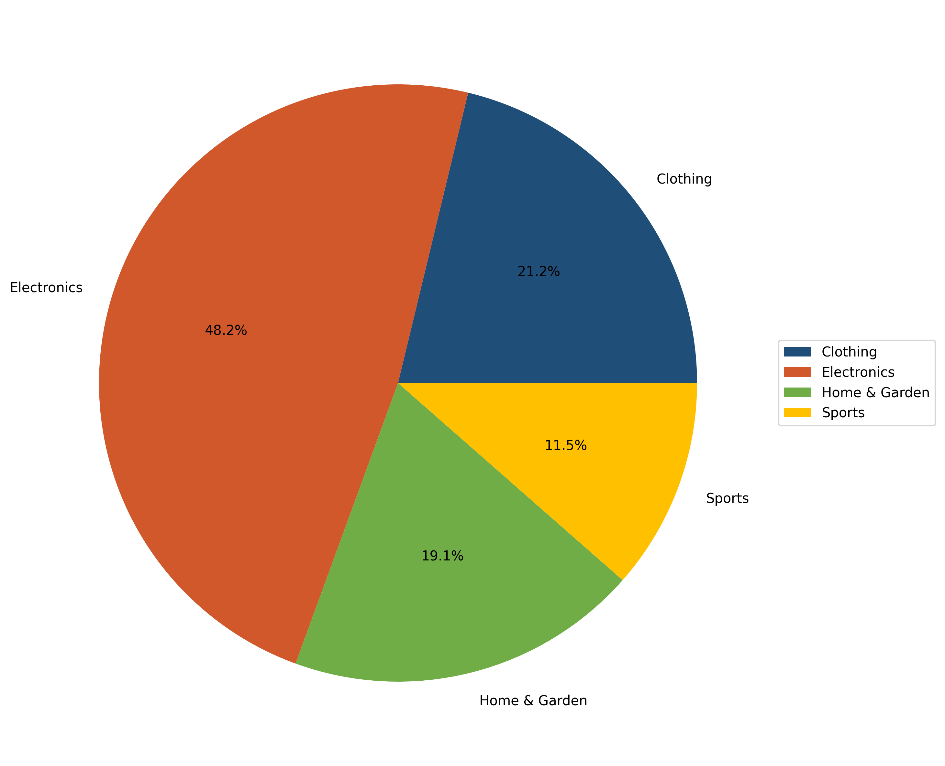
Product Category Distribution
• Electronics dominates with $20,500,000 (48.2% of total sales)
• Clothing follows with $9,030,000 (21.2%)
• Total of 4 categories analyzed with combined sales of $42,530,000

Slide 3
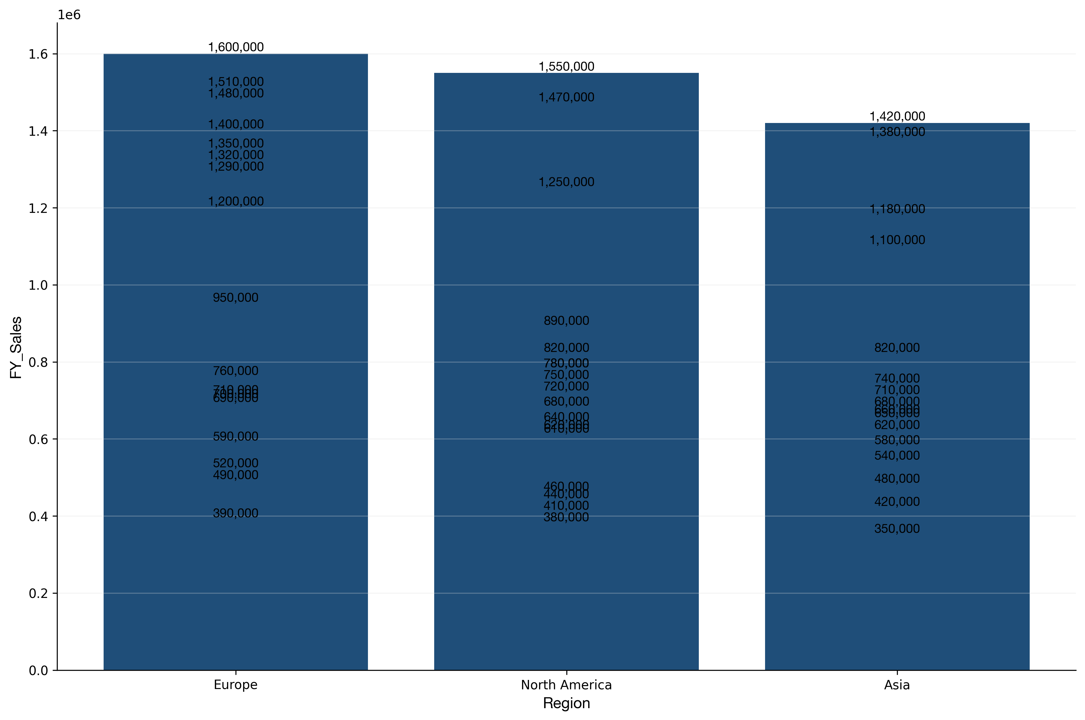
Regional Sales Performance
• The top 10 products generated $14,480,000 in total sales, representing 34.0% of overall performance
• ProductH leads with $1,600,000, followed by ProductEE at $1,550,000
• The remaining 40 products contribute $28,050,000, indicating balanced distribution among performers
• Europe leads regional performance with $16,950,000 (39.9% of total)
• Asia presents growth opportunities at $12,330,000 (29.0%)
• Geographic distribution spans 3 regions with total sales of $42,530,000

