Slide 1
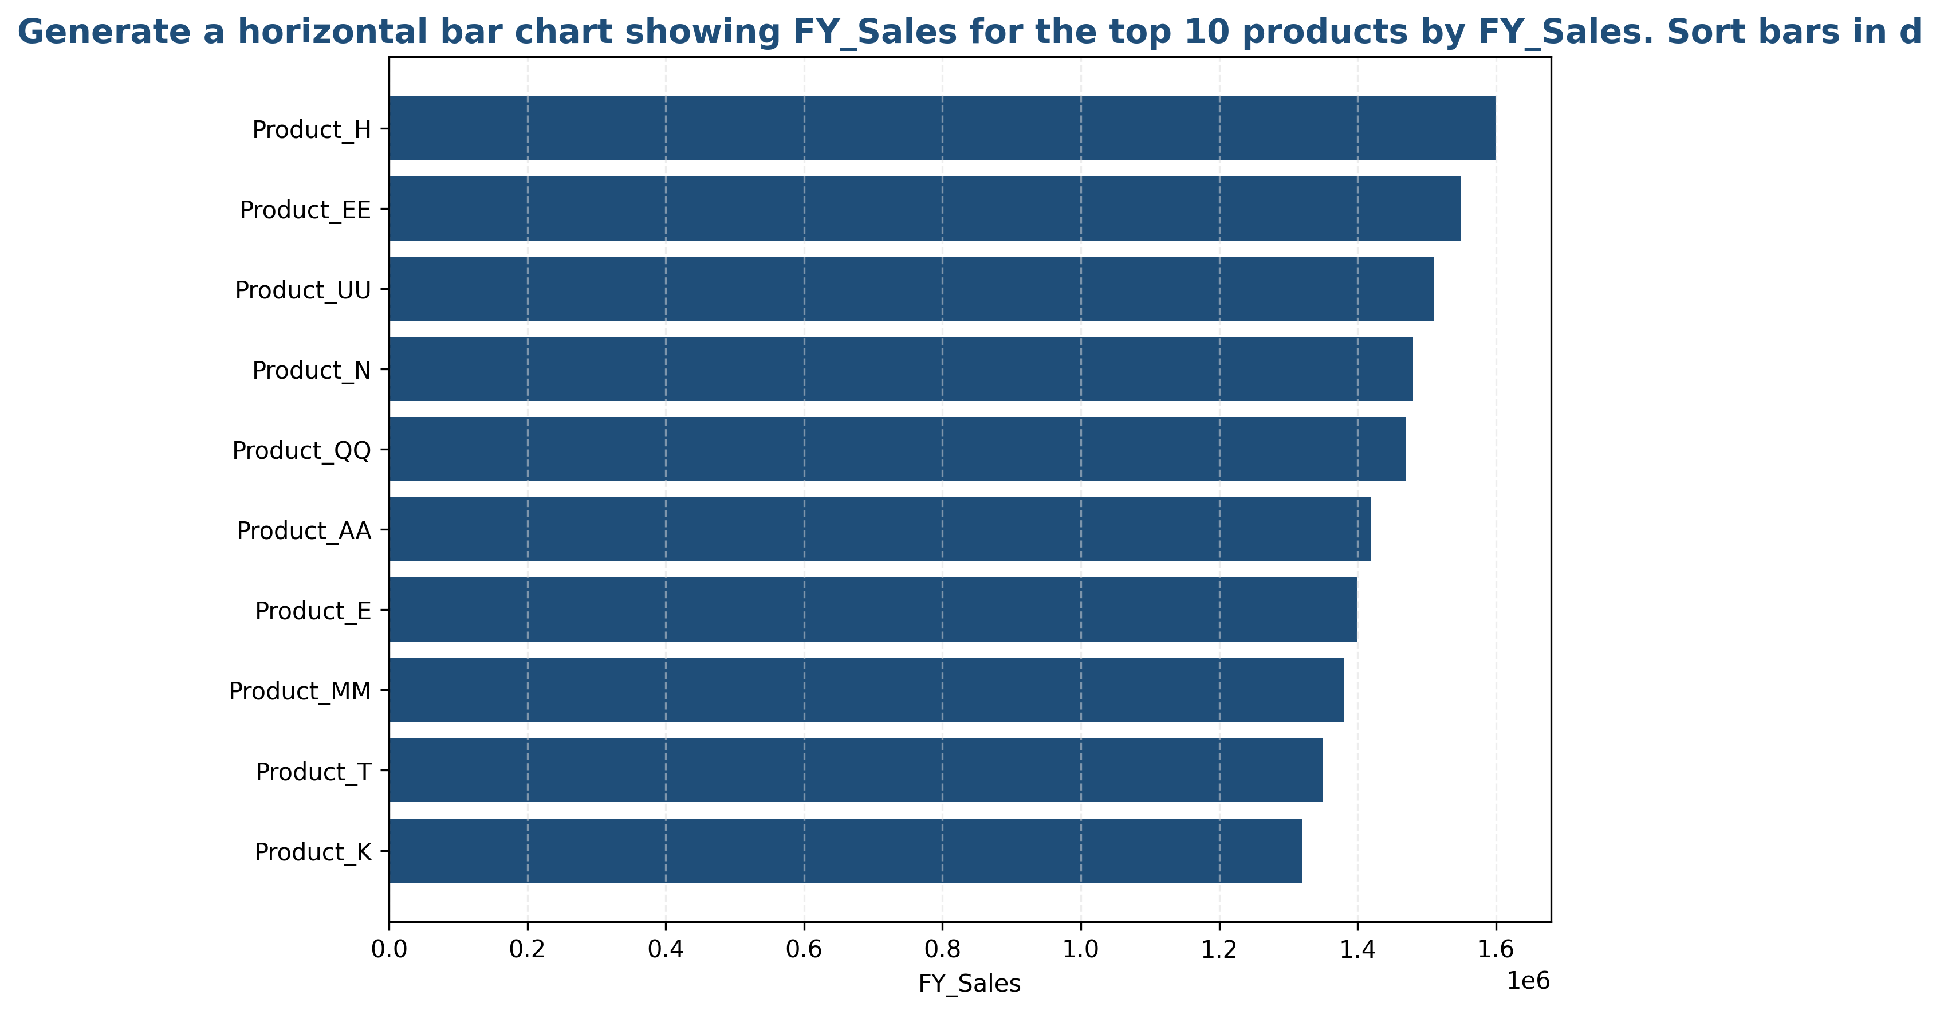
Top 10 Products Performance Analysis

Slide 2
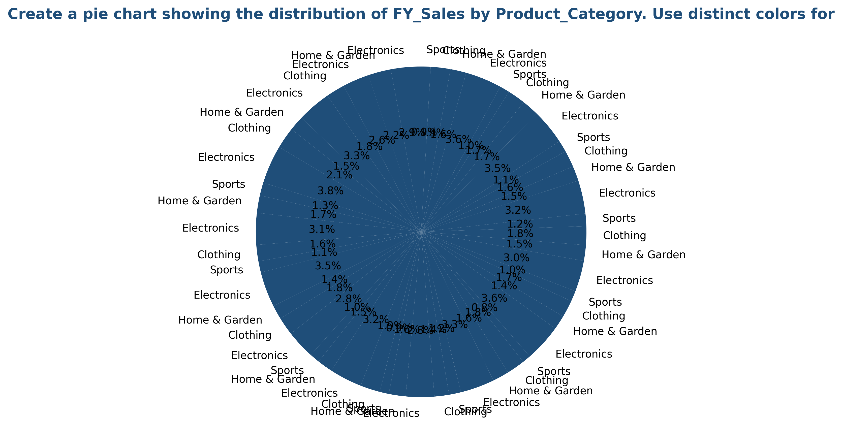
Product Category Distribution

Slide 3
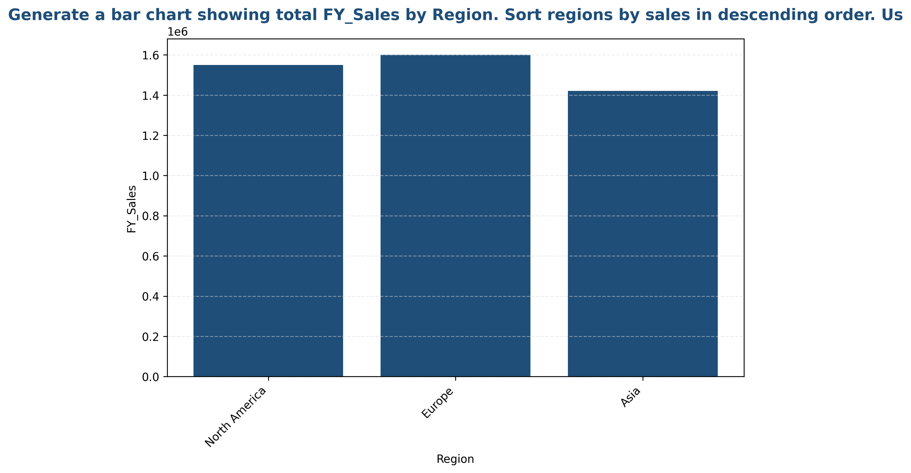
Regional Sales Performance

