Slide 1
No exaggeration is required to pronounce unequivocally that money is available today in quantities, at prices and on terms never before seen in the 100-plus years since U.S. financial markets reached full flower.
Steven Rattner, Quadrangle Group
“The Coming Credit Meltdown” Wall Street Journal, June 18, 2007
Liquidity means you can determine prices at every instant and you can demand cash on a moment’s notice, which means you are more willing to lend money against collateral. Liquidity allows for ready leverage, but it also creates the means for crises.
Rick Bookstaber
A Demon of Our Own Design
Notes:
Steven Rattner quote from http://online.wsj.com/article/SB118212541231038534.html
The Bookstaber quote is from Rick Bookstaber, A Demon of Our Own Design, pg 93.

Slide 2
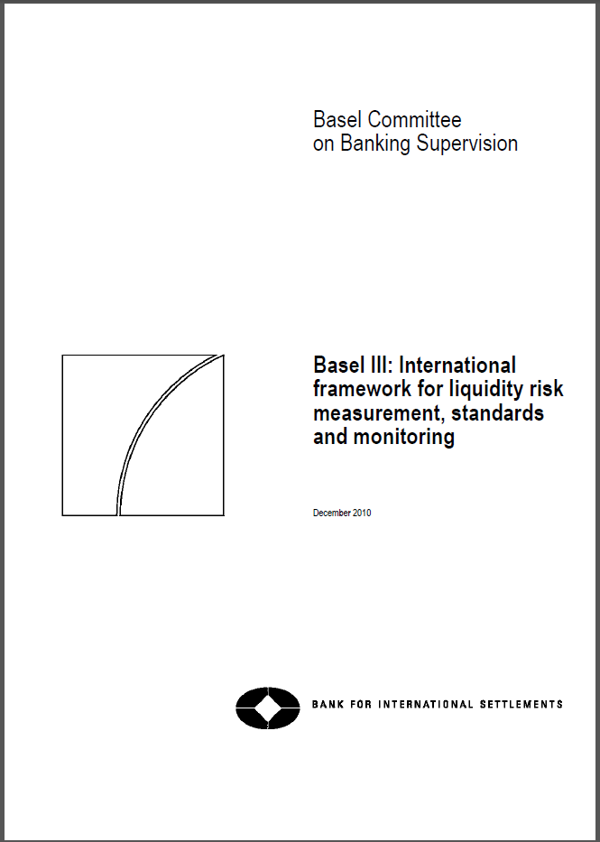

The Basel III Liquidity Framework and Liquidity Modelling

Slide 3
Agenda
Liquidity versus illiquidity risk
The models:
Basel III
Liquidity Coverage Ratio (LCR)
HLA
TNCO
Criticisms
Net Stable Funding Ratio (NSFR)
ASF
RSF
Criticisms
Liquidity Modelling, by Robert Fiedler
Forward Liquidity Exposure (FLE)
Counterbalancing Capacity (CBC)
Comparison and contrast

Slide 4
What is Liquidity?
Variously described as:
Sale-ability of instruments
Bank’s daily cash position
Supply of central bank funds in the market
Ability of a bank to acquire cash
Many other definitions…
From the famous risk manager, Rick Bookstaber:
Not only does the demand for liquidity move prices, but it – and not information – is also the primary driver of prices…[and] the primary driver of crashes and bubbles as well.
From the famous quant Emanuel Derman:
No one quite knows what liquidity really is, and so there’s no good model of it. (Liquidity is a metaphor based on fluids. People define it by its proxies – bid-ask, average daily volume, market impact etc, which are features of but aren’t actually liquidity itself.)
Notes:
Definitions of liquidity from Robert Fiedler Liquidity Modelling, pg. xi
The Bookstaber quote is from Rick Bookstaber, A Demon of Our Own Design, pg 213. Two exceptionally good discourses on liquidity are on pp 93-95 and 212-215

Slide 5
What is Illiquidity Risk?
Both Basel III and Liquidity Modelling have much more narrow goals than their titles suggest
Both try to model and prevent illiquidity risk:
Inability of a bank to stay liquid:
Not capable of executing on contractually agreed-upon payments or delivery of assets
Often viewed as a “consequential risk” by financial professionals:
“First you lose the money, then you go bust”
Not wrong but incomplete
Banks can run into liquidity problems by having an unfavorable relationship between assets and liabilities over time
Notes:
Second bullet point (and its subpoints) from Robert Fiedler, Liquidity Modelling, pg. 1, 19-20

Slide 6
Measuring Illiquidity Risk
Traditional risk management measurements, such as Value at Risk (VAR), don’t work for illiquidity risk:
Unlike market and credit risks, illiquidity cannot be treated with historical distributions
Unlike market and credit risks, illiquidity is not additive:
Being liquid versus illiquid is both binary and existential:
Emanuel Derman again:
“the shattering risks to firms and systems come from illiquidity and contagion”
Example central bank nostro account:
99 simulations: bank has ~ +$100M in account, end of day
1 simulation: bank has -$100M in account, end of day
Average “liquidity” is NOT ~ +$98M
Notes:
Illiquidity not being treated with historical distributions from Robert Fiedler, Liquidity Modelling, pg. 28
Illiquidity being binary from Robert Fiedler, Liquidity Modelling, pg. 5
Example nostro account from Robert Fiedler, Liquidity Modelling, pg. 28

Slide 7
Capital and Illiquidity Risk
Capital does not work as a buffer for illiquidity risk:
Bank capital is not “kept under wraps” at the central bank nostro account:
It is invested in assets for performance reasons
Some banks symbolically attribute a percentage of capital to each asset
Other banks assign capital to physical assets
Bank capital cannot be measured:
Thousands of estimates and arbitrary choices need to be made to compute the capital position of a modern bank
For example:
On 9/10/2008, LEH reported 11% Tier 1 capital and conservative net leverage
On 9/15/2008, LEH declared bankruptcy:
Prior shareholder equity estimated to be $24.8B
Bankruptcy examiner subsequently estimated LEH to be worth -$20B to -$130B, a swing of at least 200%
Notes:
First yellow bullet point and sub point come from Robert Fiedler, Liquidity Modelling, pg. 31
Second yellow bullet point entirely from http://www.interfluidity.com/v2/716.html, but also influenced by discussion from Robert Fiedler, Liquidity Modelling, pg. 16

Slide 8
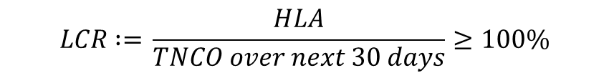
Basel III Liquidity Coverage Ratio (LCR)
Known as “The Bear Stearns Rule”
After an observation period beginning in 2011, will go into effect on January 1st, 2015
Broadly, LCR means that banks are required to have enough cash or cash-like instruments on hand to survive a horrible, financial-crisis-level 30 days, in which funding markets all but shut down.
“The liquidity requirements are a massive deal for banks, although you wouldn’t know that from reading the financial press, which hardly ever mentions them.”
The ratio of “high-quality liquid assets” (HLA) to “total net cash outflows over the next 30 days” (TNCO) must be greater than 100%:
$$LCR ∶= \frac{HLA}{TNCO over next 30 days}≥100\%$$
Notes:
First bullet point from http://economicsofcontempt.blogspot.com/2010/08/basel-iii-liquidity-requirements.html
Second bullet point from http://www.bis.org/publ/bcbs188.pdf, pg. 2 (para 9)
Third bullet point from http://economicsofcontempt.blogspot.com/2011/04/two-major-tests-for-bank-regulators.html
“The liquidity requirements..” from http://economicsofcontempt.blogspot.com/2011/04/basel-iii-liquidity-requirements-not.html
Fourth bullet pint from http://www.bis.org/publ/bcbs188.pdf, pg. 3 (para 16)

Slide 9
High-Quality Liquid Assets
From the specification:
Assets are considered to be high-quality liquid assets if they can be easily and immediately converted into cash at little or no loss of value…even in times of stress.
Very conservatively defined:
Low level of credit and market risk
Ease and certainty of valuation
Low correlation with risky assets – note this excludes bank-issued securities
Listed on recognized market:
Large, stable market with committed market makers, and diverse group of buyers and sellers in low concentrations
Historically purchased during “flights to quality”
Unencumbered:
Cannot be used to secure, collateralize, or enhance any current transaction
Notes:
First bullet point from http://www.bis.org/publ/bcbs188.pdf, pg. 5 (para 22)
Second bullet point from http://www.bis.org/publ/bcbs188.pdf, pg. 5 (para 22)
Red highlight comes from Robert Fiedler, Liquidity Modelling, pg. 251
Unencumbered comes from http://www.bis.org/publ/bcbs188.pdf pg. 6 (para 27)

Slide 10
High-Quality Liquid Assets
Two levels of assets, Level 1 and Level 2:
Level 1 assets have 0% haircut in value and include:
Cash and central bank reserves
Marketable securities issued by sovereigns, central banks, and non-central government public sector entities (IMF, ECB, etc.) with a 0% Basel II Risk Weighting
Level 2 assets have a 15% haircut in value and include:
US Agency MBS (originally excluded – a deliberate negotiating tactic?)
Non-financial corporate bonds from entities rated AA- or higher
Marketable securities issued by sovereigns and public sector entities traditionally assigned a 20% Basel II Risk Weighting
At least 60% of assets in the HLA pool must be Level 1
Notes:
Level 1 assets from http://www.bis.org/publ/bcbs188.pdf pg. 8 (para 40)
Level 2 assets from http://www.bis.org/publ/bcbs188.pdf pp 9-10 (para 42)
Agency MBS and comment from http://economicsofcontempt.blogspot.com/2010/08/basel-iii-liquidity-requirements.html

Slide 11
High-Quality Liquid Assets
Template for calculating them:
Item |  | Factor | Total amount | With factor applied
Level 1 assets:
 | Cash | 100%
 | Qualifying central bank reserves | 100%
 | Qualifying marketable securities from sovereigns, central banks, public sector entities and multilateral development banks | 100%
 | Domestic sovereign or central bank debt in domestic currency | 100%
 | Domestic sovereign debt for non-0% risk weighted sovereigns, issued in foreign currency, to the extent the debt matches the currency needs of the bank in that jurisdiction | 100%
Level 2 assets:
 | Sovereign, central bank, and PSE assets qualifying for 20% risk weighting | 85%
 | Qualifying corporate bonds rated AA- or higher | 85%
 | Qualifying covered bonds rated AA- or higher | 85%
 | Calculation of 40% cap of liquid assets | 2/3 HLA 1
 | Total
Notes:
From http://www.bis.org/publ/bcbs188.pdf, pg. 42

Slide 12
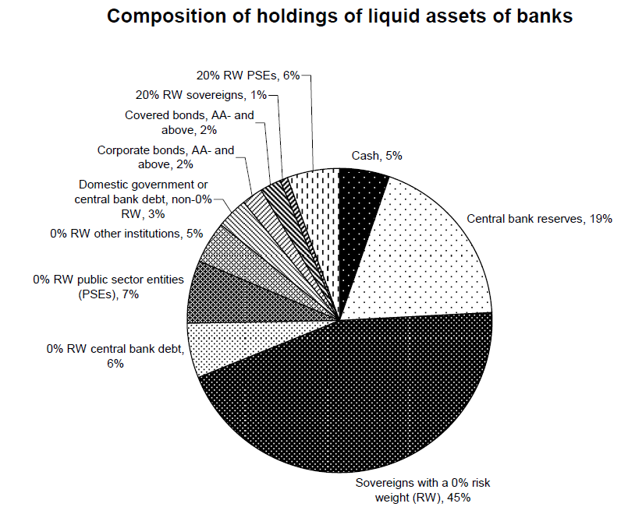
High Quality Liquid Assets
From the Basel III Quantitative Impact Study (2010):
Notes:
From http://www.bis.org/publ/bcbs186.pdf, pg. 20

Slide 13
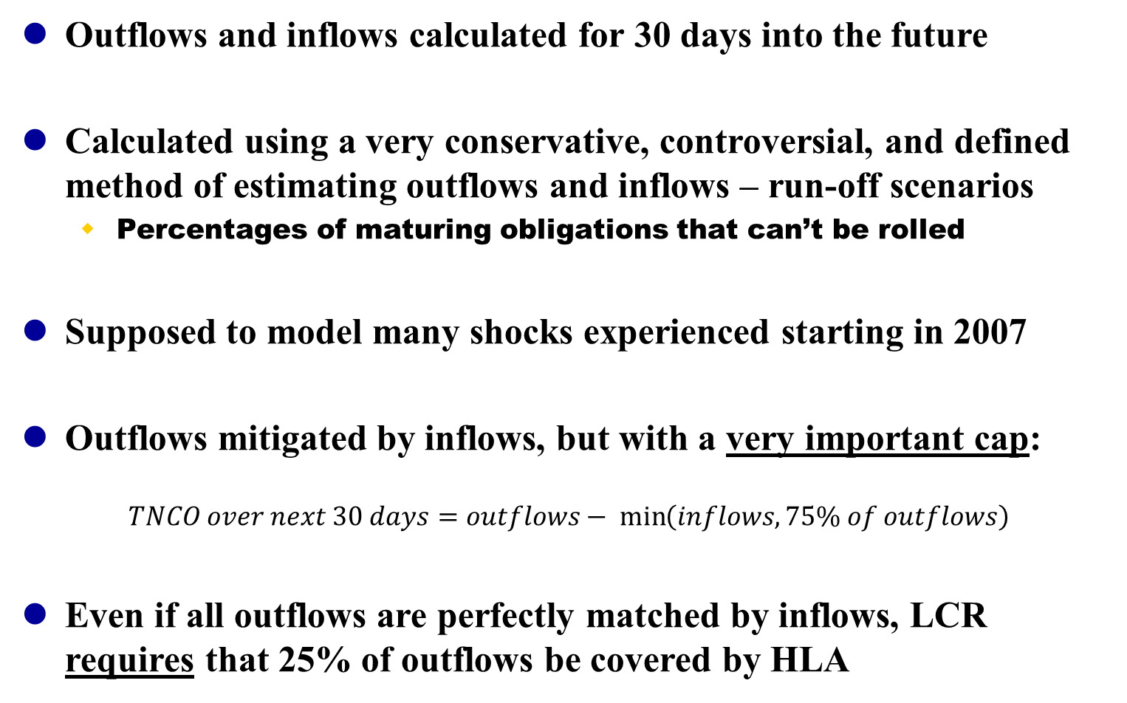
Total Net Cash Outflows
Outflows and inflows calculated for 30 days into the future
Calculated using a very conservative, controversial, and defined method of estimating outflows and inflows – run-off scenarios
Percentages of maturing obligations that can’t be rolled
Supposed to model many shocks experienced starting in 2007
Outflows mitigated by inflows, but with a very important cap:
$$TNCO over next 30 days=outflows− \min_{}\left(inflows, 75\% of outflows\right)$$
Even if all outflows are perfectly matched by inflows, LCR requires that 25% of outflows be covered by HLA
Notes:
First bullet point from www.bis.org/publ/bcbs188.pdf, pg. 12 (para 50)
Second bullet point from http://economicsofcontempt.blogspot.com/2010/08/basel-iii-liquidity-requirements.html
Third bullet point from www.bis.org/publ/bcbs188.pdf, pg. 1 (para 2)
Fourth bullet point from www.bis.org/publ/bcbs188.pdf, pg. 12 (para 50)
Fifth bullet point from Robert Fiedler, Liquidity Modelling, pg. 253

Slide 14
Outflows
Retail deposit run-offs:
5% of stable deposits (insured, with direct deposit transactions)
10% of unstable deposits (high net worth / sophisticated / foreign currency)
Unsecured wholesale funding run-off:
5% / 10% small business customers (same breakdown as retail above)
25% of funding with operational relationships (clearing / custody / cash mgmt)
Does NOT include prime brokerage accounts
If insured, assume 5%
25% of deposits in cooperative banks wrt central institution
75% of funding provided by non-financial corporates / sovereigns / central banks / public sector entities
100% of funding by banks, securities firms, insurance companies, and SPVs
Includes all notes / bonds / debt securities issued by the bank, unless the holders are exclusively retail accounts
Controversial assumption, but mirrored what happened during financial crisis
Notes:
First master bullet point and sub bullet points from www.bis.org/publ/bcbs188.pdf, pg. 12 (para 56 and 57)
Second master bullet point and sub bullet points from www.bis.org/publ/bcbs188.pdf, pg. 14-17 (para 69-83)
“Controversial assumption” bullet point from http://economicsofcontempt.blogspot.com/2010/08/basel-iii-liquidity-requirements.html

Slide 15
Outflows
Secured funding run-offs:
0% of all repos / collateral swaps with HLA Level 1 assets
15% of all maturing transactions backed by HLA Level 2 assets
25% of all transactions with sovereigns and PSEs with a 20% Basel II risk weighting (eg. US Agency MBS)
100% of everything else
100% of all derivative payables
100% loss of funding on ABS, covered bonds, and structured financings issued by the bank itself and maturing in 30 days:
Have to assume that refinancing market does not exist
100% loss of funding on ABCP, conduits, SIVs, and other financing facilities:
Any and all “liquidity puts” are executed
Notes:
First master bullet point and sub bullet points from www.bis.org/publ/bcbs188.pdf, pg. 17-19 (para 84-90)
Second master bullet point from www.bis.org/publ/bcbs188.pdf, pg. 19 (para 91)
Third master bullet from www.bis.org/publ/bcbs188.pdf, pg. 19 (para 92)

Slide 16
Outflows
Committed credit and liquidity facilities:
5% of all facilities to retail and small business customers
10% of all credit facilities, and 100% of all liquidity facilities, to non-financial corporates, sovereigns, and PSEs
100% of all facilities to banks, securities firms, insurance companies, conduits, SPVs, etc.
Other contractual cash outflows, such as dividends:
100%
Notes:
First master bullet point and all sub bullet points from www.bis.org/publ/bcbs188.pdf, pg. 21 (para 97)
Second bullet point from www.bis.org/publ/bcbs188.pdf, pg. 22 (para 104)

Slide 17
Outflows
Template for
calculating them:
Item |  | Factor | Total amount | With factor applied
Retail deposits (maturity or notice period in 30 days):
 | Stable | 5%
 | Less stable | 10%
 | Deposit with maturity greater than 30 days, and either a significant penalty or no legal right to withdraw | 0%
Unsecured wholesale funding:
 | Stable small business | 5%
 | Less stable | 10%
 | Legal entities with operational relationships | 25%
 | Cooperative banks wrt central institution | 25%
 | Non-financial corporates, sovereigns, central banks and PSEs | 75%
 | Other | 100%
Secured funding:
 | Transactions backed by HLA Level 1 assets, any counterparty | 0%
 | Transactions backed by HLA Level 2 assets, any counterparty | 15%
 | Transactions backed by non HLA eligible assets, but are domestic sovereigns, central banks, or PSEs as a counterparty | 25%
 | All other transactions | 100%
Additional:
 | Derivative collateral calls due to downgrade (up to 3 notches) | 100%
 | Market valuation changes on derivatives transactions | Supervisor
 | Valuation changes on posted, non HLA Level 1 assets securing derivatives | 20%
 | Liabilities on maturing ABCP, SIVs, SPVs, etc., as well as returnables | 100%
 | ABS (including covered bonds) | 100%
Credit and liquidity facilities:
 | Retail and small business | 5%
 | Non-financial corporates, sovereigns, central banks and PSEs, credit / liquidity facilities | 10% / 100%
 | Other credit and liquidity facilities | 100%
 | Other contingent funding liabilities | Supervisor
 | Any additional contractual outflows | 100%
 | Net derivative payables | 100%
 | Total
Notes:
From http://www.bis.org/publ/bcbs188.pdf, pp 42-44
Market valuation changes on derivatives transactions comments from http://economicsofcontempt.blogspot.com/2011/04/two-major-tests-for-bank-regulators.html
Other contingent funding liabilities from http://economicsofcontempt.blogspot.com/2011/04/citigroup-rule.html and http://economicsofcontempt.blogspot.com/2011/07/collateral-transformation-services-what.html

Slide 18
Inflows
Only include contractual inflows for exposures that are fully performing, and no reason to expect default in 30 days
Reverse repos (collateral NOT rehypothecated):
0% HLA Level 1 assets
15% HLA Level 2 assets
100% everything else
Reverse repos (collateral rehypothecated):
0%
Bank should always manage collateral such that it can be returned if the counterparty decides not to roll
Notes:
First bullet point from www.bis.org/publ/bcbs188.pdf, pg. 23 (para 105)
Second bullet point from www.bis.org/publ/bcbs188.pdf, pg. 23 (para 108)
Third bullet point from www.bis.org/publ/bcbs188.pdf, pg. 23 (para 109 and 110)

Slide 19
Inflows
Lines of credit and liquidity facilities:
0% (so conservative it’s inconsistent)
Retail / small business inflows:
50% of inflows (due to loans being extended)
Wholesale inflows:
100% inflows from financial institution counterparties
50% from non-financial counterparties (due to loans being extended)
0% deposits from any centralized institution in a cooperative banking network
Derivative receivables (net basis):
100%
Notes:
First bullet point from www.bis.org/publ/bcbs188.pdf, pg. 24 (para 111) / inconsistent commentary from http://economicsofcontempt.blogspot.com/2010/10/latest-basel-iii-controversy.html
Second bullet point from www.bis.org/publ/bcbs188.pdf, pg. 24 (para 113)
Third bullet point and sub bullet points from www.bis.org/publ/bcbs188.pdf, pg. 24 (para 114-116)
Fourth bullet point from www.bis.org/publ/bcbs188.pdf, pg. 24 (para 117)

Slide 20
Inflows
Template for calculating them:
Item |  | Factor | Total amount | With factor applied
Secured funding:
 | Level 1 assets | 0%
 | Level 2 assets | 15%
 | All other assets | 100%
Credit and liquidity facilities:
 | Available lines | 0%
Deposits held at other institutions:
 | Operational deposits | 0%
 | Deposits held at central institution (cooperative banking network) | 0%
Other:
 | Retail and small business receivables | 50%
 | Non-financial wholesale counterparties | 50%
 | Financial wholesale counterparties | 100%
 | Net derivative receivables | 100%
Cap:
 | Inflows cannot exceed 75% of outflows | min(inflows, 75% outflows)
 | Total
Notes:
From http://www.bis.org/publ/bcbs188.pdf, pp 44-45

Slide 21
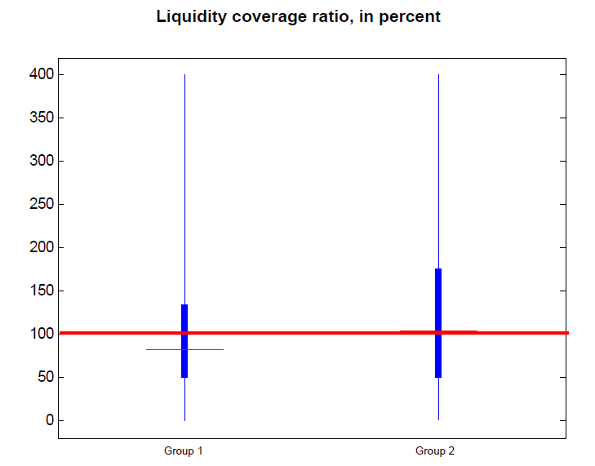
Liquidity Coverage Ratio
From the Basel III Quantitative Impact Study (2010):
Average LCR was 83% for Group 1 and 98% for Group 2. 46% of all banks already met the LCR requirement (2009). Total cumulative shortfall was €1.73 trillion. Basel III capital shortfalls, by contrast, are estimated to be €602 billion.
The study consisted of 94 Group 1 banks and 169 Group 2 banks. Group 1 banks each had in excess of €3B in Tier 1 Capital, were well diversified and internationally active. Group 2 banks were all the others.
Notes:
From http://www.bis.org/publ/bcbs186.pdf, pg. 18

Slide 22
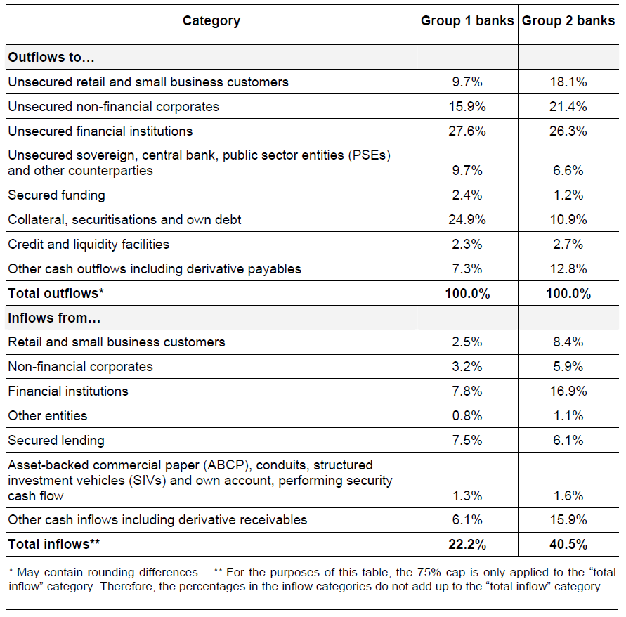
Total Net Cash Outflows
From the Basel III Quantitative Impact Study (2010):
The study consisted of 94 Group 1 banks and 169 Group 2 banks. Group 1 banks each had in excess of €3B in Tier 1 Capital, were well diversified and internationally active. Group 2 banks were all the others.
Notes:
From http://www.bis.org/publ/bcbs186.pdf, pg. 19

Slide 23
LCR Criticisms
Restrictive definition of HLA:
Increased concentration in sources of bank liquidity
Repriced financing for corporate, financial, and PSE commitments, including ABCP backup lines, Conduits, SIVs, interbank lines, etc.
Crowding out of available credit to non-sovereign customers
Narrowed investor base for bank paper
Overly conservative assumptions regarding cash outflows:
No empirical basis for simultaneous worst case scenario across products, markets, and individual banks
Inclusion of off-balance sheet assets and commitments, including cancelable credit lines, with no netting:
Lower bank ROE
According to JPMorgan, global bank ROE would have fallen from 13.3% to 5.4% in 2011, had the proposal been in effect
Harder to attract private capital to fund growth
Notes:
First bullet point from http://www.bis.org/publ/bcbs165/jpmorganchase.pdf, pg. 5
Second bullet point from http://www.bis.org/publ/bcbs165/jpmorganchase.pdf, pg. 6-7
Third bullet point from http://www.bis.org/publ/bcbs165/jpmorganchase.pdf, pg. 1

Slide 24

LCR Criticisms
Increasing LCR requires increasing HLA, or decreasing TNCO. This is not always possible to do in isolation – changing one can affect the other:
$$LCR ∶= \frac{HLA}{TNCO}$$
Purchase additional HLAs
Decrease TNCO (modify outflows or inflows)
Refinancing of purchased HLAs
Asset Exchange
Possible decrease of HLAs
Decrease existing assets
Increase existing liabilities
Non-HLA
Level 2
Sell Repo
Shorten Tenor
Grow Liabilities
Extend Tenor
HLA
Level 1
Notes:
Reproduced from Liquidity Modelling, pg. 260

Slide 25
LCR Criticisms
If the financing of an HLA is required in the next 30 days, then at best the improvement in the LCR nets out to 0. It might even be negative:
Lower rated banks – the ones most likely to game the results – are incentivized to use the lowest quality HLA possible:
Example AA bank with a funding rate of (swaps + 150 bps)
German Bunds might yield (swaps - 25 bps)
HLA with Bunds will yield a loss to the bank of (swaps – 175 bps)
Spanish Debt might yield (swaps + 200 bps)
HLA with Spanish Debt might yield earnings of (swaps + 50 bps)
Temptation will be to use Spanish Debt for HLA assets. But will Spanish Debt really be as liquid as German Bunds in times of stress?
Scenario 1: Purchasing an HLA Level 1 Asset |  |  |  |  |  |  |  | Scenario 2: Purchasing an HLA Level 2 Asset
 | Existing | New | Level | Value | Total | Improvement |  |  | Existing | New | Level | Value | Total | Improvement
LCR | 100.00% |  |  |  | 100.00% | 0.00% |  | LCR | 100.00% |  |  |  | 97.50% | -2.50%
HLA | 25 | 5 | 1 | 5 | 30 |  |  | HLA | 25 | 5 | 2 | 4.25 | 29.25
TNCO | 25 |  |  |  | 30 |  |  | TNCO | 25 |  |  |  | 30
Outflows | 100 | 5 |  |  | 105 |  |  | Outflows | 100 | 5 |  |  | 105
Inflows | 75 |  |  |  | 75 |  |  | Inflows | 75 |  |  |  | 75
Mod in | 75 |  |  |  | 75 |  |  | Mod in | 75 |  |  |  | 75
Notes:
First bullet point reproduced from Robert Fiedler, Liquidity Modelling pg. 266
Second bullet point from Robert Fiedler, Liquidity Modelling pg. 266

Slide 26
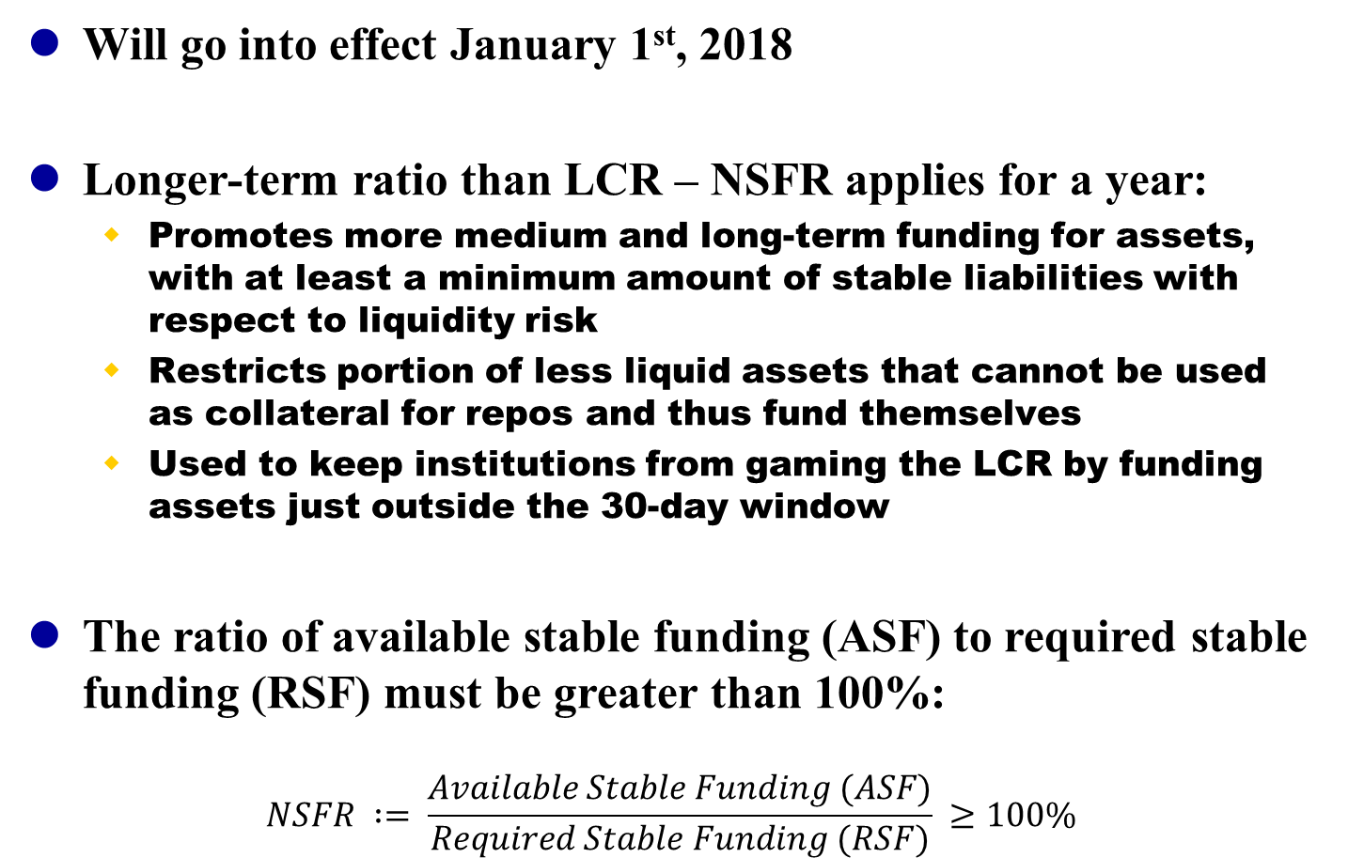
Basel III Net Stable Funding Ratio (NSFR)
Will go into effect January 1st, 2018
Longer-term ratio than LCR – NSFR applies for a year:
Promotes more medium and long-term funding for assets, with at least a minimum amount of stable liabilities with respect to liquidity risk
Restricts portion of less liquid assets that cannot be used as collateral for repos and thus fund themselves
Used to keep institutions from gaming the LCR by funding assets just outside the 30-day window
The ratio of available stable funding (ASF) to required stable funding (RSF) must be greater than 100%:
$$NSFR ∶= \frac{Available Stable Funding (ASF)}{Required Stable Funding (RSF)} ≥100\%$$
Notes:
First bullet point from www.bis.org/publ/bcbs188.pdf, pg. 2 (para 5)
Second bullet point from www.bis.org/publ/bcbs188.pdf, pg. 25 (para 119 and 120)
Third bullet point from www.bis.org/publ/bcbs188.pdf, pg. 25 (para 121)

Slide 27
Available Stable Funding
Reliable sources of funds over a one-year time horizon under conditions of extended stress
Extended borrowing from central banks outside of regular open market operations is not considered
Objective is to ensure stable funding in the face of an extended stress scenario to the bank:
Significant decline in profitability / solvency from credit, market, or operational risk (“first you lose money, then you go bust”)
Downgrade by ratings agency
Other material events that call into question the reputation of the institution
Notes:
First bullet point from www.bis.org/publ/bcbs188.pdf, pg. 25 (para 122)
Second bullet point from www.bis.org/publ/bcbs188.pdf, pg. 26 (para 126)
Third bullet point from www.bis.org/publ/bcbs188.pdf, pg. 26 (para 125)

Slide 28
Available Stable Funding
Template for calculating ASF:
Factor represents the amount of stable funding expected to be available in a year, by source
Category | Factor | Total amount | With factor applied
Tier 1 and Tier 2 Capital | 100%
Preferred Stock, minus any amounts that might mature in less than a year due to explicit or embedded options | 100%
Liabilities that expire in more than a year | 100%
Stable deposits (small business / retail) | 90%
Less stable deposits (small business / retail) | 80%
Unsecured wholesale funding, with a residual maturity of less than a year, provided by non-financial corporates, sovereigns, central banks, and PSEs | 50%
All other liability and equity categories | 0%
Total
Notes:
From http://www.bis.org/publ/bcbs188.pdf, pp 46-47

Slide 29
Required Stable Funding
Stable funding required to support an institution’s assets, off-balance sheet exposures, and other activities
Assets that are liquid, and can provide a source of liquidity in a stressed environment, generally require less stable funding sources
Amount of non-liquid assets that require stable funding is an approximation of the portion that could not be monetized during a liquidity event lasting one year:
For example, if an asset would only capture 35% of its value in a “fire sale,” then 65% of the asset requires stable funding
Notes:
First bullet point from www.bis.org/publ/bcbs188.pdf, pg. 28 (para 129)
Second bullet point from www.bis.org/publ/bcbs188.pdf, pg. 28 (para 129)
Third bullet point from www.bis.org/publ/bcbs188.pdf, pg. 28 (para 130)

Slide 30
Required Stable Funding
Template for calculating RSF. Template only applies for unencumbered assets – any encumbered assets are counted as 100%:
Category | Factor | Total amount | With factor applied
Cash immediately available to meet obligations | 0%
Short-term, unsecured instruments maturing within a year | 0%
Securities maturing in less than a year | 0%
Securities held by reverse repos | 0%
Loans to financial entities maturing within a year | 0%
Marketable securities with residual maturities greater than a year, representing claims on sovereigns, central banks, PSEs, or other entities assigned a 0% risk weight under Basel II, provided active repo and sale markets exist for them | 5%
Corporate bonds / covered bonds rated AA- or higher. Equivalent to HLA Level 2 assets | 20%
Marketable securities with residual maturities greater than a year, representing claims on sovereigns, central banks, PSEs, or other entities assigned a 20% risk weight under Basel II, and meet all guidelines for HLA Level 2 assets | 20%
Gold | 50%
Equity securities listed on recognized exchanges and included in large cap market indexes | 50%
Corporate bonds / covered bonds rated A- or higher, that are NOT issued by the bank itself, and are traded in deep and active markets with low levels of concentration | 50%
Loans to non-financial corporate clients, sovereigns, central banks, or PSEs that mature within a year | 50%
Residential mortgages that qualify for 35% or lower risk weighting under Basel II | 65%
Other loans to non-financial institutions maturing within a year | 65%
Loans to retail and small business customers | 85%
All other | 100%
Total
Notes:
From http://www.bis.org/publ/bcbs188.pdf, pp 46-47

Slide 31
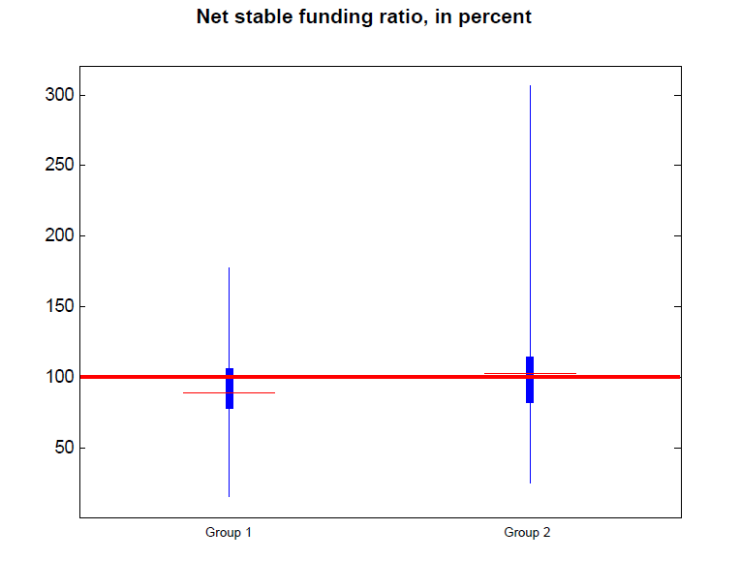
Net Stable Funding Ratio
From the Basel III Quantitative Impact Study (2010):
Average NSFR was 93% for Group 1 and 103% for Group 2. 43% of all banks already met the NSFR requirement (2009). Total cumulative shortfall was €2.89 trillion.
The study consisted of 94 Group 1 banks and 169 Group 2 banks. Group 1 banks each had in excess of €3B in Tier 1 Capital, were well diversified and internationally active. Group 2 banks were all the others.
Notes:
From http://www.bis.org/publ/bcbs186.pdf, pg. 21

Slide 32
NSFR Criticisms
NSFR calculation is done under a single scenario – on the one hand, this is too rigid for going concern scenarios, and on the other hand not rigid enough for real stress scenarios:
10% of stable deposits flowing out is hardly a bank run
35% of mortgages being able to refinance themselves in a crisis doesn’t seem realistic either
It does not appropriately recognize the steps a bank could take to deleverage its balance sheet within a year (JPM, RBS)
The NSFR might limit banks’ effectiveness in performing maturity transformation, i.e. acting as an intermediary between borrowing needs and the availability of credit (WFC, Citi, Barclays):
Amount of total world ASF not enough for total world RSF (UBS, RBS):
Either ASF has to increase, which is not an easy sell to investors, or RSF has to decrease, which could pull liquidity out of financial system
Notes:
First bullet point from Robert Fiedler, Liquidity Modelling, pg. 274-5
Second bullet point from http://www.bis.org/publ/bcbs165/jpmorganchase.pdf, pg. 9 and http://www.bis.org/publ/bcbs165/rbosl.pdf pg. 12
Third bullet point from http://www.bis.org/publ/bcbs165/wellsfargo.pdf pg. 21-2, http://www.bis.org/publ/bcbs165/citigroup.pdf pg.2, and http://www.bis.org/publ/bcbs165/barclaysliquidi.pdf pg. 11
“Amount of total” from http://www.bis.org/publ/bcbs165/rbosl.pdf pg. 12 and http://www.bis.org/publ/bcbs165/ubs.pdf pg. 28

Slide 33
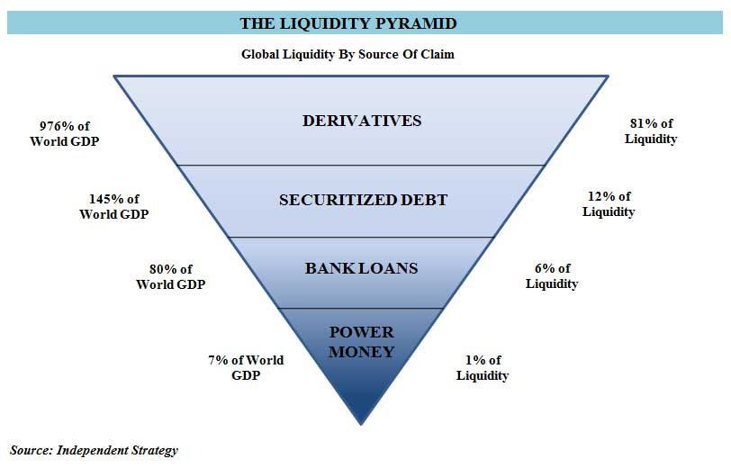
Are There Enough Liquid Assets?
Notes:
From http://zerohedge.blogspot.com/2009/05/exuberance-glut-or-dollar-euro-short.html, based on ideas from here http://www.instrategy.com/docs/products/New_Monetarism260406.pdf

Slide 34
Liquidity Modelling
Model developed by Robert Fiedler for several banks, and covered in depth in Liquidity Modelling:
Scenario-driven, as opposed to distribution-driven
Granular
Ties in with Basel III contractual maturity mismatch tool
Two principal components of the model:
Forward Liquidity Exposure (FLE)
Model of forthcoming payments, based on bank transactions
Represents daily changes to the bank’s nostro account at the central bank
Counterbalancing Capacity (CBC)
Model of bank’s ability to compensate for FLE
Typically stems from contractual options (e.g. credit facilities) and operations with liquid securities (e.g. repos, sells, sell-buy-back, etc.)
Notes:
First bullet point from Robert Fiedler, Liquidity Modelling, pg. 79
“Scenario-driven, as” from Robert Fiedler, Liquidity Modelling, pg. 39, and pg. 28
“Ties in with Basel III” from www.bis.org/publ/bcbs188.pdf, pg. 32 (para 140)
“Model of forthcoming payments” from Robert Fiedler, Liquidity Modelling, pg. 41
“Represents changes to the bank’s nostro account”, from Robert Fiedler, Liquidity Modelling, pg. 6
“Model of bank’s ability” from Robert Fiedler, Liquidity Modelling, pg. 45
“Typically stems…” from Robert Fiedler, Liquidity Modelling, pg. 48

Slide 35
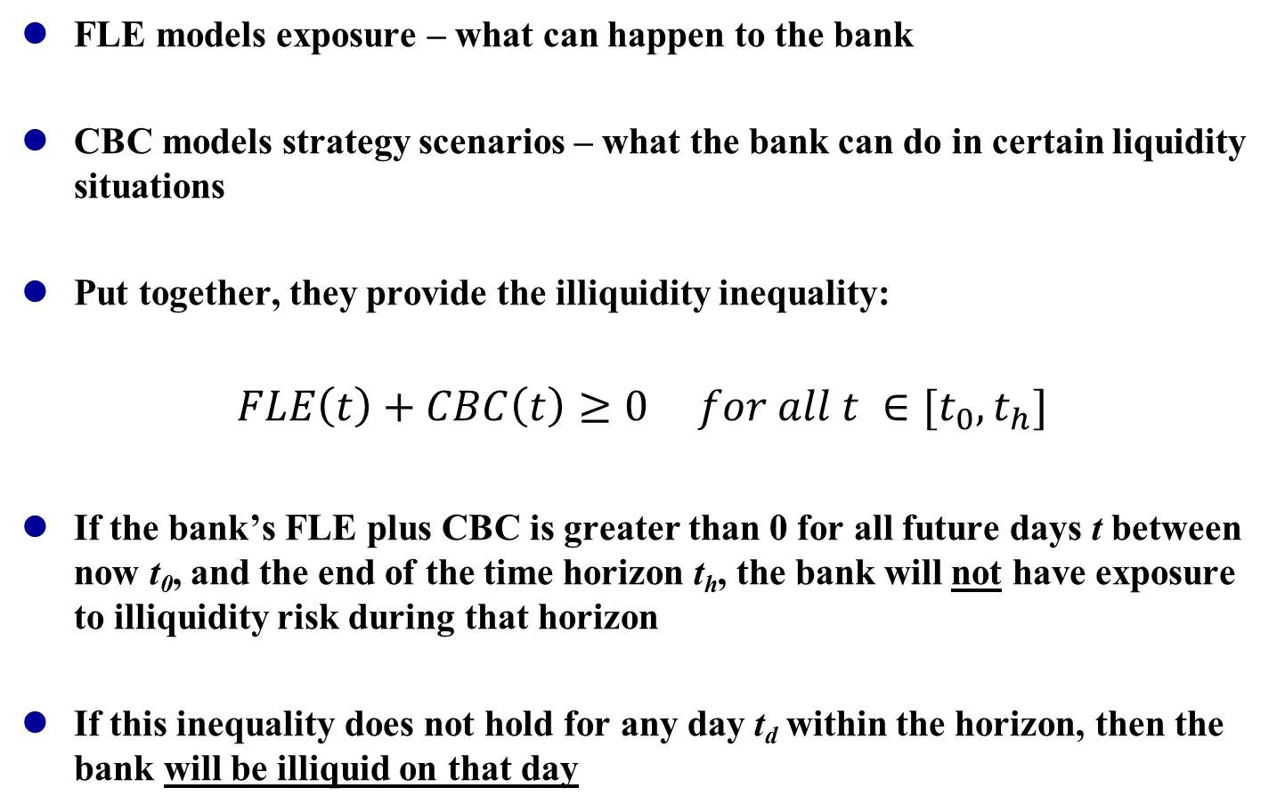
Liquidity Modelling
FLE models exposure – what can happen to the bank
CBC models strategy scenarios – what the bank can do in certain liquidity situations
Put together, they provide the illiquidity inequality:
$$FLE\left(t\right)+CBC\left(t\right)≥0 for all t ∈[t_{0}, t_{h}]$$
If the bank’s FLE plus CBC is greater than 0 for all future days t between now t₀, and the end of the time horizon t_{h}, the bank will not have exposure to illiquidity risk during that horizon
If this inequality does not hold for any day t_{d} within the horizon, then the bank will be illiquid on that day
Notes:
First and second bullet points from Robert Fiedler, Liquidity Modelling, pg. 119
Third through fifth bullet points from Robert Fiedler, Liquidity Modelling, pg. 50

Slide 36
Forward Liquidity Exposure
FLE should model cash flows from:
Contractual transactions:
Fixed
Variable
Conditional transactions:
Options
Draws on existing credit lines
Unenforceable transactions from contract breaches:
Loans that are not repaid
Assets that are not delivered
Intra-day payment limits that are violated
Transactions that the bank fulfills to maintain its reputation:
Loans to fulfill business plan
Requests to pay back deposits early
Notes:
All bullet points from Robert Fiedler, Liquidity Modelling, pg. 89

Slide 37
Forward Liquidity Exposure
FLE should model cash flows according to a variety of scenarios, such as:
Higher inflation
Rising yields
Falling yields
“Lehman revisited”
Scenarios need to affect cash flows consistently:
For example, rising yields might cause loans to fall in value but cause pay-fixed swaps to increase in value
Scenarios should avoid too many variables and over-determination:
The more “determined” the scenario is, the less likely it is to happen
Scenarios don’t necessarily need to be “realistic:”
“Going concern” scenarios are useful for maintenance reasons, but extreme scenarios will likely reveal more serious liquidity issues
Notes:
First bullet point from Robert Fiedler, Liquidity Modelling, pg. 80 and 86
Second and third bullet points from Robert Fiedler, Liquidity Modelling, pg. 81
Fourth bullet point from Robert Fiedler, Liquidity Modelling, pg. 87

Slide 38
Forward Liquidity Exposure
To make the FLE modelling easier, “liquidity units” (LUs) can be created to group similar sources of liquidity, such as deposits, loans, options, etc., and evaluated collectively
Different accounts can be set up for each of the LUs, to keep track of how they change through time. For example, a particular LU might have:
FOI / FOF – Forward Option Inventory / Forward Option Flows. Represents contractually obligated options, such as credit or liquidity lines, and their cash flows
FAI / FAF – Forward Asset Inventory / Forward Asset Flows. Shows asset positions and their cash flows
FUI / FUF – Forward Unused Inventory / Forward Unused Flows. Denotes the unused portion of any options, along with their flows
FCI / FCF – Forward Cash Inventory / Forward Cash Flows. Cash position of the LU, and its flows
If this set of accounts is used, then FCI(t) represents FLE(t) for this LU
Notes:
First bullet point from Robert Fiedler, Liquidity Modelling, pp. 82-85
Second bullet points from Robert Fiedler, Liquidity Modelling, pg. 99-108
Third bullet point from Robert Fiedler, Liquidity Modelling, pg. 93

Slide 39
Forward Liquidity Exposure
Example flows for an LU credit line, with three modeled draws of 40% from available funds. Note that each draw increases the interest rate:
Analysis like this, even without the CBC, is still useful in illustrating maximum amount of expected liquidity needs
Day | Option | Transaction |  | FOF | FOI | FAF | FAI | FUF | FUI | FCF | FCI
 |  |  |  |  | 0 |  | 0 |  | 0 |  | 0.0
0 | Start |  |  | -100 | -100 |  | 0 | -100 | -100 |  | 0.0
 | Premium |  | 2% |  | -100 |  | 0 |  | -100 | 2.0 | 2.0
1 |  | Draw 1 | 40% |  | -100 | 40 | 40 | 40 | -60 | -40.0 | -38.0
2 |  | Interest 1 | 6% |  | -100 |  | 40 |  | -60 | 2.4 | -35.6
 |  | Draw 2 | 40% |  | -100 | 24 | 64 | 24 | -36 | -24.0 | -59.6
3 |  | Interest 1 | 6% |  | -100 |  | 64 |  | -36 | 2.4 | -57.2
 |  | Interest 2 | 7% |  | -100 |  | 64 |  | -36 | 1.7 | -55.5
 |  | Redemption 1 |  |  | -100 | -40 | 24 | -40 | -76 | 40.0 | -15.5
 |  | Draw 3 | 40% |  | -100 | 30.4 | 54.4 | 30.4 | -45.6 | -30.4 | -45.9
4 |  | Interest 2 | 7% |  | -100 |  | 54.4 |  | -45.6 | 1.7 | -44.2
 |  | Interest 3 | 8% |  | -100 |  | 54.4 |  | -45.6 | 2.4 | -41.8
 |  | Redemption 2 |  |  | -100 | -24 | 30.4 | -24 | -69.6 | 24.0 | -17.8
 |  | Redemption 3 |  |  | -100 | -30.4 | 0 | -30.4 | -100 | 30.4 | 12.6
5 | Maturity |  |  | 100 | 0 |  | 0 | 100 | 0 |  | 12.6
FLE_{LU}
Notes:
From Liquidity Modelling, pg. 101

Slide 40
Counterbalancing Capacity
CBC is used to neutralize any illiquidity risk revealed by FLE. CBC reveals “distance to illiquidity” using various strategies
CBC should model non-rejectable and rejectable options, to both reduce assets or increase liabilities:
 | Non-rejectable Options | Rejectable Options
Reducing Assets | ▪ Liquidity puts ▪ Cancellable loans | ▪ Unconditional sales ▪ Sell-and-buy-backs ▪ Shorten maturity of assets
Increasing Liabilities | ▪ Credit facilities ▪ Guaranteed but not paid-in capital ▪ Extendable bonds | ▪ Unsecured funding (new term or deposits) ▪ Secured funding ▪ Extend the tenor of liabilities
Notes:
First bullet point from Robert Fiedler, Liquidity Modelling, pp. 118
Second bullet point from Robert Fiedler, Liquidity Modelling, pp. 121-4

Slide 41
Counterbalancing Capacity
The CBC should model cash flows from strategy scenarios. Example scenarios include:
CBC₀ , aka “null scenario” – all redemption / coupon cash flows run off as scheduled
“Just-enough cash” – the bank generates just enough cash to eliminate any spots where FLE goes negative (“going concern” scenario)
“Maximum cash” – the bank generates as much cash as it can, regardless of whether or not it’s really needed
“Repo-only”– the bank finances its activities via repo only
“Fire-sale” – the bank dumps all securities
The CBC strategies should not contradict the FLE scenarios:
Rising interest rates, for example, should affect FLE and CBC cash flows in a consistent fashion (positively impacting some, negatively impacting others)
Notes:
First bullet point from Robert Fiedler, Liquidity Modelling, pp. 120-121 and 138
Second bullet point from Robert Fiedler, Liquidity Modelling, pp. 120

Slide 42
Counterbalancing Capacity
To make the CBC modelling easier, various securities can be grouped together in “liquidity classes” (LCs), such as UST10, Fixed MBS, ARM MBS, and others, and analyzed collectively:
Add-ons and partial sells of the LC as a whole
Repos and Reverse repos on portions of the LC face
Different accounts – such as Forward Asset Inventories (FAI) and Forward Asset Flows (FAF) – can be used to track securities that are “Out on Repo,” under “Ownership,” in “Possession” (for reverses), or otherwise “Available”
To better simulate cash flows for sells, sell-and-buy-backs, repos and reverse repos, weighted prices for the LC can be estimated forward
To more easily simulate repo rates / coupon payments / dirty prices / etc. for the securities in an LC, an all-in-one “daily spread” can be calculated for the liquidity class, and paid out daily on securities under “Ownership”
The Forward Cash Inventory (FCI) represents the CBC for this LC
Notes:
First bullet point from adapted Robert Fiedler, Liquidity Modelling, pp. 137-142
Second bullet point from adapted Robert Fiedler, Liquidity Modelling, pp. 126-137
Third bullet point adapted from Robert Fiedler, Liquidity Modelling, pp. 126-137
Fourth bullet point adapted from Robert Fiedler, Liquidity Modelling, pp. 144-145
Fifth bullet point adapted from Robert Fiedler, Liquidity Modelling, pp. 145

Slide 43
Counterbalancing Capacity
Example flows from an LC representing similarly repo-able securities:
 |  | Available |  | Ownership |  | Possession |  | Out on Repo |  |  | Daily Price |  |  |  |  |  | Daily Spread | Daily Payment |  | Cash
Day | Transaction | FAF | FAI | FAF | FAI | FAF | FAI | FAF | FAI |  |  | Trade Cash |  | Haircut | Repo Cash |  |  |  |  | FCF | FCI
 |  |  | 70 |  | 155 |  | 15 |  | 100 |  | 102.1 |  |  | 95 |  |  | 0.01%
0 | Sell | -30 | 40 | -30 | 125 |  | 15 |  | 100 |  | 102.2 | 30.66 |  | 95 |  |  | 0.01% | 0.0139 |  | 30.6739 | 30.6739
1 | Repo | -10 | 30 |  | 125 |  | 15 | 10 | 110 |  | 102.3 |  |  | 95 | 9.7 |  | 0.01% | 0.0139 |  | 9.7324 | 40.4063
2 |  |  | 30 |  | 125 |  | 15 |  | 110 |  | 102.4 |  |  | 95 |  |  | 0.01% | 0.0139 |  |  | 40.4063
3 |  |  | 30 |  | 125 |  | 15 |  | 110 |  | 102.5 |  |  | 95 |  |  | 0.01% | 0.0139 |  |  | 40.4063
4 | Reverse Repo | 20 | 50 |  | 125 | 20 | 35 |  | 110 |  | 102.6 |  |  | 95 | -21.6 |  | 0.01% | 0.0139 |  | -21.5861 | 18.8202
5 | Buy | 10 | 60 | 10 | 135 |  | 35 |  | 110 |  | 102.7 | -10.27 |  | 95 |  |  | 0.01% | 0.0150 |  | -10.2550 | 8.5652
6 | Reverse Off | -20 | 40 |  | 135 | -20 | 15 |  | 110 |  | 102.8 |  |  | 95 | 21.6 |  | 0.01% | 0.0150 |  | 21.6571 | 30.2223
7 | Sell-back | -25 | 15 | -25 | 110 |  | 15 |  | 110 |  | 102.9 | 25.725 |  | 95 |  |  | 0.01% | 0.0122 |  | 25.7372 | 55.9595
8 |  |  | 15 |  | 110 |  | 15 |  | 110 |  | 103 |  |  | 95 |  |  | 0.01% | 0.0122 |  |  | 55.9595
9 | Repo Off | 10 | 25 |  | 110 |  | 15 | -10 | 100 |  | 103.1 |  |  | 95 | -9.8 |  | 0.01% | 0.0122 |  | -9.7823 | 46.1772
10 | Buy-back | 25 | 50 | 25 | 135 |  | 15 |  | 100 |  | 103.2 | -25.8 |  | 95 |  |  | 0.01% | 0.0150 |  | -25.7850 | 20.3922
CBC_{LC}
Notes:
Amalgamation of several different tables in Liquidity Modelling, pg. 127, 128, 130, 153

Slide 44
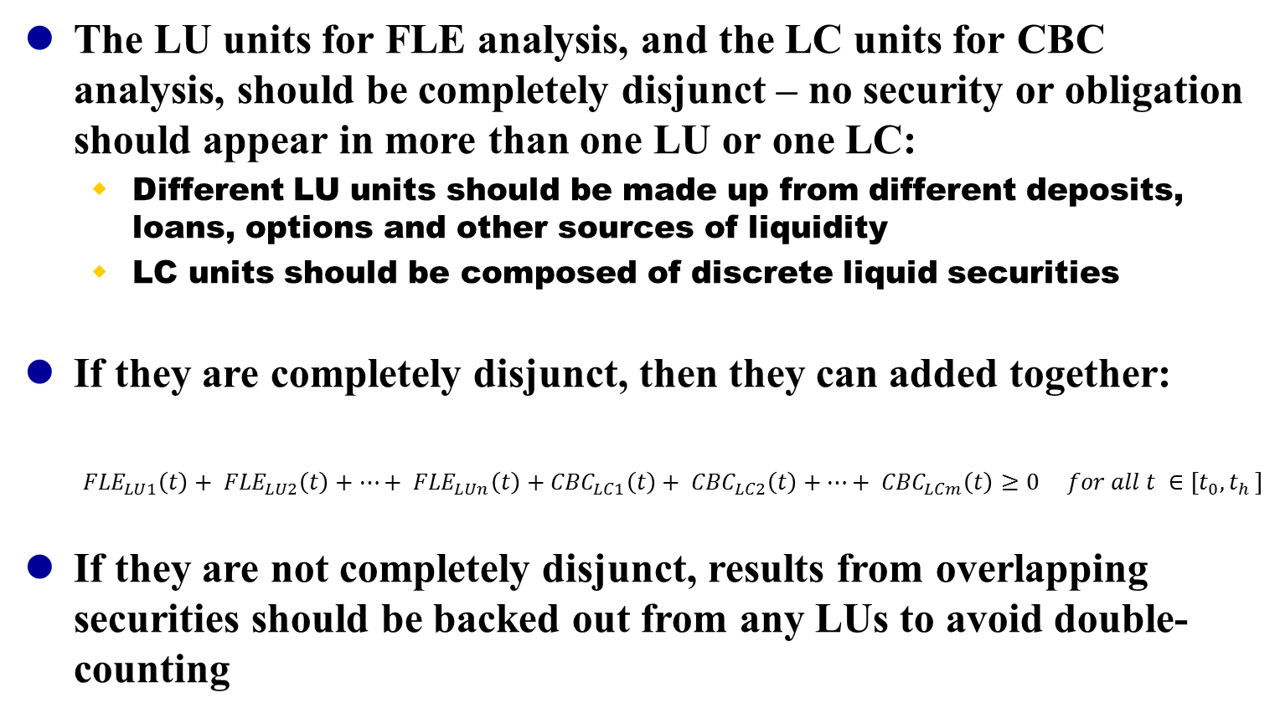
Putting It Together
The LU units for FLE analysis, and the LC units for CBC analysis, should be completely disjunct – no security or obligation should appear in more than one LU or one LC:
Different LU units should be made up from different deposits, loans, options and other sources of liquidity
LC units should be composed of discrete liquid securities
If they are completely disjunct, then they can added together:
$${FLE}_{LU1}\left(t\right)+ {FLE}_{LU2}\left(t\right)+…+ {FLE}_{LUn}\left(t\right)+{CBC}_{LC1}\left(t\right)+ {CBC}_{LC2}\left(t\right)+…+ {CBC}_{LCm}\left(t\right)≥0 for all t ∈[t_{0}, t_{h }]$$
If they are not completely disjunct, results from overlapping securities should be backed out from any LUs to avoid double-counting
FLE(t)
CBC(t)
Notes:
All bullet points adapted from Robert Fiedler, Liquidity Modelling, pp. 84 and 157

Slide 45
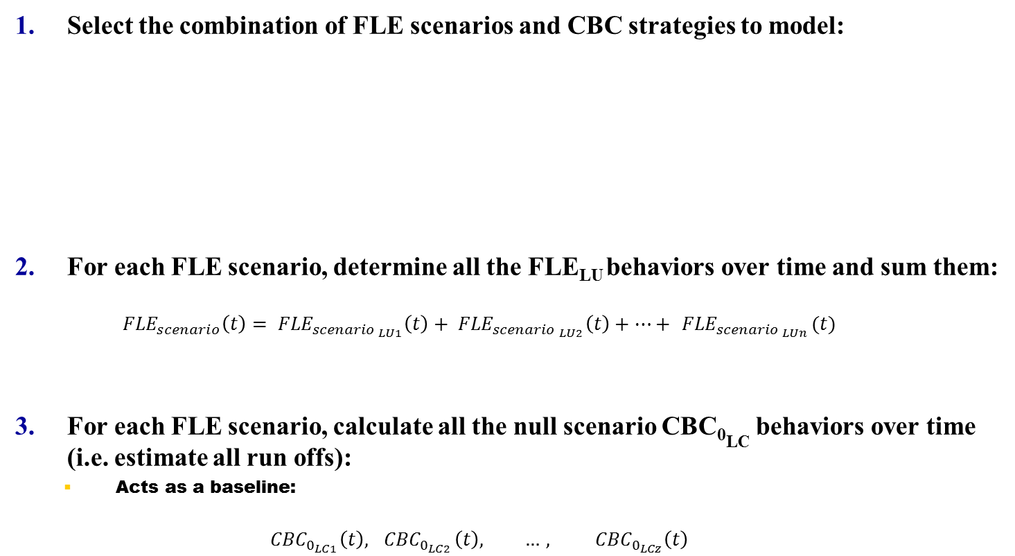
Modelling Approach
Select the combination of FLE scenarios and CBC strategies to model:
For each FLE scenario, determine all the FLE_{LU} behaviors over time and sum them:
$${{FLE}_{scenario}\left(t\right)= FLE}_{{scenario}_{ LU1}}\left(t\right)+ {FLE}_{{scenario }_{LU2}}\left(t\right)+…+ { FLE}_{{scenario}_{ LUn}}(t)$$
For each FLE scenario, calculate all the null scenario CBC_{0LC} behaviors over time (i.e. estimate all run offs):
Acts as a baseline:
$${CBC}_{0_{LC1}}\left(t\right),{ CBC}_{0_{LC2}}\left(t\right), …, {CBC}_{0_{LCz}}\left(t\right)$$
 |  | CBC Strategies
 |  | Null | Just-enough cash | Max cash | Fire-sale | Repo-only
FLE Scenarios | Higher inflation | X | X
 | Rising yields | X | X
 | Falling yields | X
 | "Lehman revisited" | X |  | X | X
Notes:
1st bullet point adapted from Robert Fiedler, Liquidity Modelling, pp 83, 120 and 124
2nd bullet point adapted from Robert Fiedler, Liquidity Modelling, pp. 84 and 91
3rd bullet point from Robert Fiedler, Liquidity Modelling, pg. 138

Slide 46
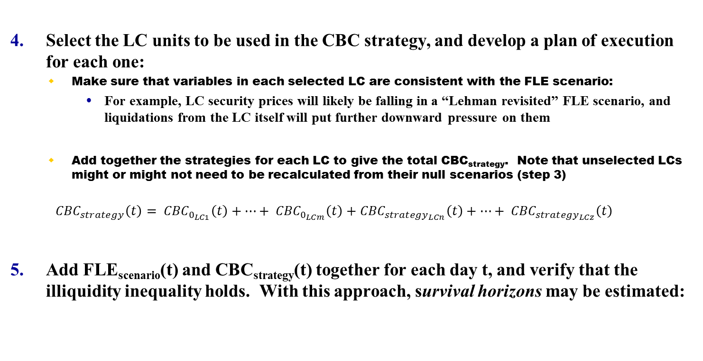
Modelling Approach
Select the LC units to be used in the CBC strategy, and develop a plan of execution for each one:
Make sure that variables in each selected LC are consistent with the FLE scenario:
For example, LC security prices will likely be falling in a “Lehman revisited” FLE scenario, and liquidations from the LC itself will put further downward pressure on them
Add together the strategies for each LC to give the total CBC_{strategy}. Note that unselected LCs might or might not need to be recalculated from their null scenarios (step 3)
$${CBC}_{strategy}\left(t\right)= {CBC}_{0_{LC1}}\left(t\right)+…+ {CBC}_{0_{LCm}}\left(t\right)+{CBC}_{{strategy}_{LCn}}\left(t\right)+…+ {CBC}_{{strategy}_{LCz}}\left(t\right)$$
Add FLE_{scenario}(t) and CBC_{strategy}(t) together for each day t, and verify that the illiquidity inequality holds. With this approach, survival horizons may be estimated:
null strategy LCs
LCs used in the strategy
FLE(t₀) | + | CBC(t₀) |  | ≥ | 0
FLE(t₁) | + | CBC(t₁) |  | ≥ | 0
FLE(t₂) | + | CBC(t₂) |  | ≥ | 0
… |  | … |  |  | …
FLE(t_{h}) | + | CBC(t_{h}) |  | ≥ | 0
Notes:
4th bullet point adapted from Robert Fiedler, Liquidity Modelling, pp. 138 and 139
5th bullet point adapted from Robert Fiedler, Liquidity Modelling, pp. 158

Slide 47
Survival Horizon
A bank’s survival horizon is the number of days, from now, until it faces illiquidity:
Small changes to CBC assumptions might dramatically alter the survival horizon. In the example chart above, the survival horizon is formally 79 days. However, if CBC assumptions are slightly off, then the survival horizon could shrink to 45 days
Notes:
Similar to a chart in Liquidity Modelling, pg. 159

Slide 48
Comparison and Contrast
In LCR approach, all HLAs are transformed into hypothetical inflows, but only by multiplying the HLAs by a market price (and possibly a haircut). Left undecided are:
How fast the assets are liquidated
In what manner they’re used to raise cash (sell / sell-buy-back / repo)
Due to the 75% rule with TNCO, the LCR can show a worse situation than the Fiedler FLE / CBC approach
The Fiedler FLE / CBC approach shows how liquidity exposure and strategies progress through time. The Basel III LCR approach does not:
The LCR approach only works in 30-day aggregates
Balances can fluctuate from day to day and the minimum balance might happen sometime before the end of the 30-day window
Notes:
All bullet points from Robert Fiedler, Liquidity Modelling, pp. 254

Slide 49
Comparison and Contrast
In the example set of cash flows below, the FLE / CBC approach reveals that the amount of liquidity needed (on day 25), $89.9, is 25% greater than what the TNCO would calculate, $71.9:
Time (Days) | CF in | CF out | CF net | FLE + CBC | min(FLE + CBC) | TNCO
0 | 3.2
1 | 5.6 | -9.3 | -3.7 | -0.5 | -89.9 | -71.9
2 | 5.5 | -12.5 | -7 | -7.5 | -89.9 | -71.9
3 | 11.4 | -13.8 | -2.4 | -9.9 | -89.9 | -71.9
4 | 1.4 | -14.5 | -13.1 | -23 | -89.9 | -71.9
5 | 11.2 | -8.2 | 3 | -20 | -89.9 | -71.9
6 | 8.4 | -0.2 | 8.2 | -11.8 | -89.9 | -71.9
7 | 1.8 | -5.3 | -3.5 | -15.3 | -89.9 | -71.9
8 | 9.4 | -12.5 | -3.1 | -18.4 | -89.9 | -71.9
9 | 10.6 | -3 | 7.6 | -10.8 | -89.9 | -71.9
10 | 4.8 | -14.8 | -10 | -20.8 | -89.9 | -71.9
11 | 0.8 | -7.1 | -6.3 | -27.1 | -89.9 | -71.9
12 | 5.5 | -3.9 | 1.6 | -25.5 | -89.9 | -71.9
13 | 1.9 | -7.8 | -5.9 | -31.4 | -89.9 | -71.9
14 | 6.3 | -11.6 | -5.3 | -36.7 | -89.9 | -71.9
15 | 0.5 | -14.6 | -14.1 | -50.8 | -89.9 | -71.9
16 | 4.9 | -9.3 | -4.4 | -55.2 | -89.9 | -71.9
17 | 10 | -13.9 | -3.9 | -59.1 | -89.9 | -71.9
18 | 4.6 | -12.5 | -7.9 | -67 | -89.9 | -71.9
19 | 2 | -6.4 | -4.4 | -71.4 | -89.9 | -71.9
20 | 7.8 | -10.8 | -3 | -74.4 | -89.9 | -71.9
21 | 10.1 | -11.7 | -1.6 | -76 | -89.9 | -71.9
22 | 2.4 | -7.1 | -4.7 | -80.7 | -89.9 | -71.9
23 | 4.1 | -8.5 | -4.4 | -85.1 | -89.9 | -71.9
24 | 4.7 | -7 | -2.3 | -87.4 | -89.9 | -71.9
25 | 5 | -7.5 | -2.5 | -89.9 | -89.9 | -71.9
26 | 7.6 | -3.2 | 4.4 | -85.5 | -89.9 | -71.9
27 | 8.3 | -6 | 2.3 | -83.2 | -89.9 | -71.9
28 | 8.5 | -1.2 | 7.3 | -75.9 | -89.9 | -71.9
29 | 5.3 | -2.8 | 2.5 | -73.4 | -89.9 | -71.9
30 | 7 | -2.3 | 4.7 | -68.7 | -89.9 | -71.9
Total | 177.4 | -249.3 | -71.9
Notes:
From Liquidity Modelling, pg. 255

Slide 50
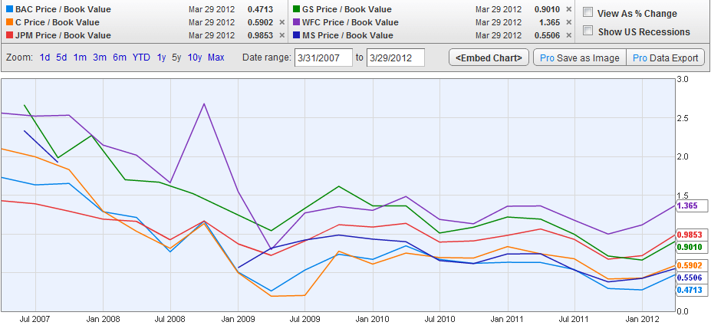
Final Thoughts
Given price-to-book ratios of some of the biggest banks, illiquidity risk should be of major concern:
If shareholders don’t trust bank valuations, how long will creditors?
Notes:
From http://ycharts.com/companies/BAC/price_to_book_value#series=type:company,id:BAC,calc:price_to_book_value,,id:C,type:company,calc:price_to_book_value,,id:JPM,type:company,calc:price_to_book_value,,id:GS,type:company,calc:price_to_book_value,,id:WFC,type:company,calc:price_to_book_value,,id:MS,type:company,calc:price_to_book_value&zoom=5&startDate=&endDate=&format=real&recessions=false

Slide 51
Next Steps?
What are your comments, thoughts, and recommendations?
Where should we take this next?

Slide 52
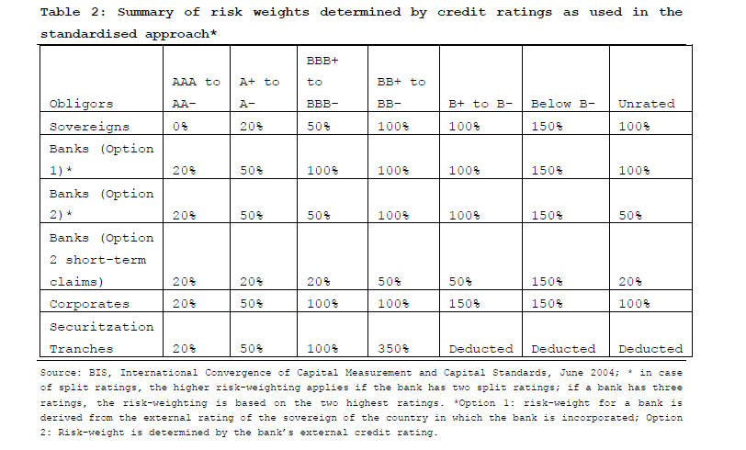
Appendix: Basel II Risk Weights
Notes:
From http://people.stern.nyu.edu/igiddy/ABS/BaselII_Nomura.pdf, pg. 5

Slide 53
References
Basel III Liquidity Framework Main Site:
Proposal
Quantitative Impact Study
Comments
JPMorgan
Citi
Barclays
Wells Fargo
UBS
Robert Fiedler, Liquidity Modelling
Economics of Contempt Main Site:
Basel III Liquidity Requirements
The Latest Basel III Controversy
Basel III Liquidity Requirements: Not Set In Stone
Two Major Tests for Bank Regulators
The Citigroup Rule
Collateral Transformation Services: What Could Possibly Go Wrong?
Others as noted in text

