Slide 1



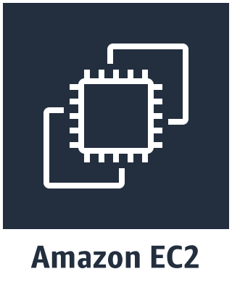


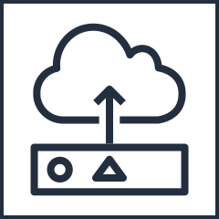


AWS Cloud
VPC
Subnet
On-Premise
Data source
Message producer
Message consumer
Sensor
Apache ActiveMQ Client
Apache ActiveMQ Client
Web App

