Slide 1
Candy Calculator
By: Pranav Dadu, Yojith Mandapati, Thien Nguyen, Kegan Edwards, Ninh Nguyen
Notes:
Pranav

Slide 2
Aim of the project
Is it possible to predict what candy you prefer based on your likes and dislikes?
Notes:
Pranav

Slide 3
Features in our dataset
269 thousand votes were collected from 8,371 different IP addresses
chocolate: Does it contain chocolate?
fruity: Is it fruit flavored?
caramel: Is there caramel in the candy?
peanutalmondy: Does it contain peanuts, peanut butter or almonds?
nougat: Does it contain nougat?
crispedricewafer: Does it contain crisped rice, wafers, or a cookie component?
hard: Is it a hard candy?
bar: Is it a candy bar?
pluribus: Is it one of many candies in a bag or box?
sugarpercent: The percentile of sugar it falls under within the data set.
pricepercent: The unit price percentile compared to the rest of the set.
Notes:
Pranav

Slide 4
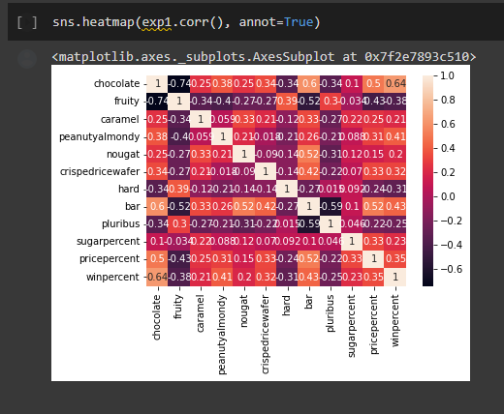
*correlations? What do they mean do they
Matter?
Notes:
Questions are rhetorical

Slide 5
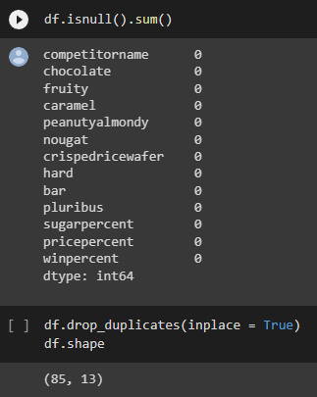
Methods
Preprocessing:
We first started by checking for nulls.
Then we dropped duplicates.
For this project, there are a variety of techniques that will be used to try to find the meaningful associations.
Our primary interest is to build a recommendation systems, namely content-based filtering.
We are also interested in applying clustering to give more complete understanding of our data.

Slide 6
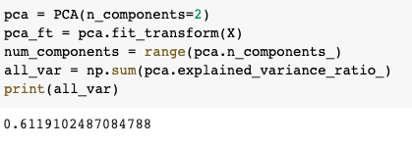
Principal Component Analysis (PCA)
We decided to use PCA to further shorten our list of features.
PCA is the process of computing the principal components and using them to perform a change of basis on the data.
Since our dataset has more than two features, we decided to use PCA to combine these features into just two so that we are able to plot these features in an “x-y” Cartesian plane and are able to cluster them properly.
Notes:
Pranav got this

Slide 7
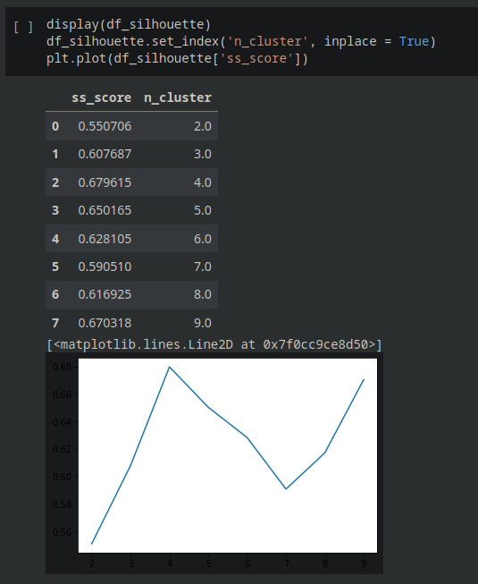
Silhouette Method
We also used the Silhouette Method to find the optimal number of clusters.
The Silhouette Method computes the silhouette coefficients of each point that measure of how much a point is similar to its own cluster compared to other clusters.
The value of the silhouette ranges between [-1,1], where a high value indicates that the object is well matched to its own cluster and poorly matched to neighboring clusters.
Notes:
Thien has mic issues, Pranav got this.

Slide 8
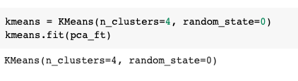
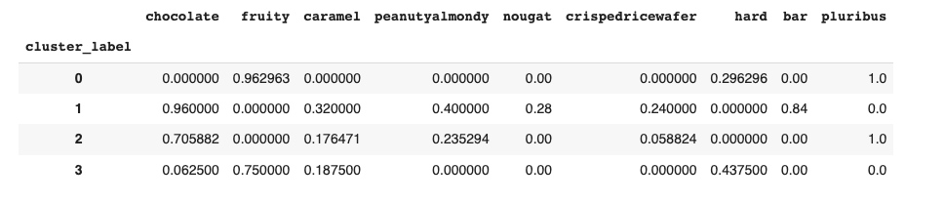
Clustering Model
We will be building a clustering model with the number of cluster of 4.
The result shows what kind of flavours of candies these clusters are composed of by getting the mean of the flavours that belong to each cluster.
For example, we can see that 100% of the candies in the cluster 0 are pluribus and 96% of them are are fruity so we can say if any candy are pluribus and fruity then they belong to this cluster.
Notes:
Thien has mic issues, Pranav got this

Slide 9
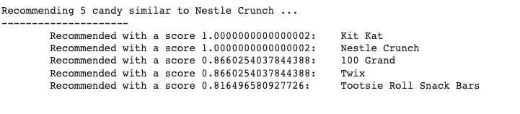
Recommendation Systems
Notes:
Kegan edwards

Slide 10
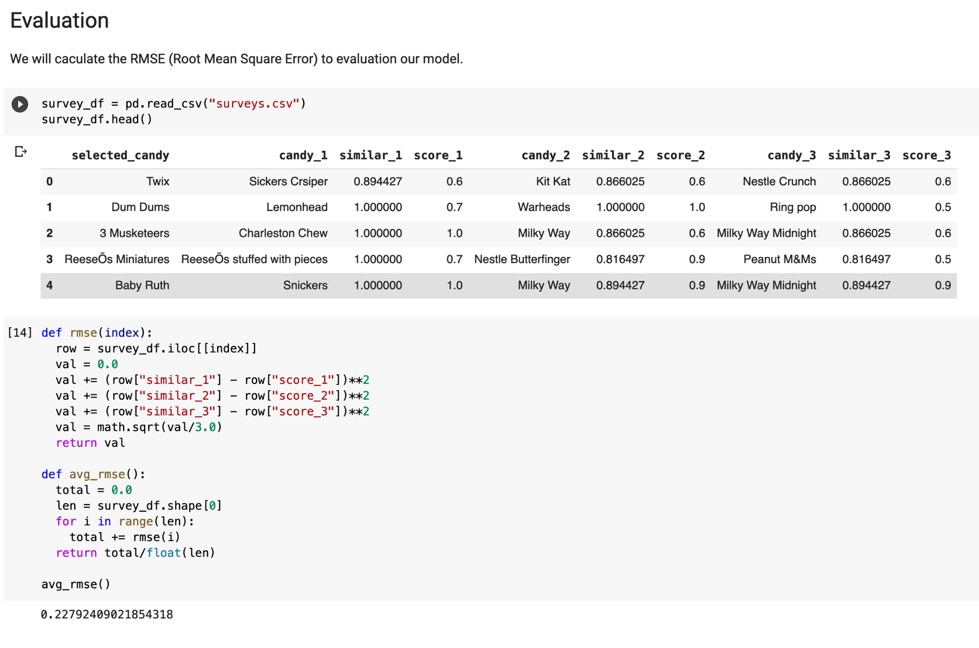
Evaluation and Results
Participants: 6, rated 3 candies each
Method: Subjective rating from 0 to 1 As true rating, compared to CC rating.
Evaluation: Rmse: .228
Notes:
Woah its Kegan’s Slide

Slide 11
Things We Learned and Things to Learn Later
Candies Cluster (pretty) Cleanly
Experiential things are hard to quantify
Branding influences -> blind taste test?
People may just like candy(?)
Notes:
Also kegans slide (wowzers)

Slide 12
Impact on Society
Negative
Sugar rush for Kids
Positive
Recommend similar candy
Tourists and cuisine
Health Awareness
Notes:
Yojith got this

Slide 13
Questions?

