Slide 1
BioAcknowledgements
Passionate researchers of the world.
Scientists who shaped the world as we know by being scientific, rational, honest, and free-thinking.
Tax payers who support researchers.
My former and present colleagues in MRC, Harvard Med., EBI, KAIST, and KOBIC from whom I learned so much.
Korean Perl Conference organizers

Slide 2
BioDisclaimer
The contents of these slides are produced by Jong after shamelessly stealing other people’s copyrighted ideas and knowledge.
Everyone is welcome to take the slides in part or in entirety without any permission whatsoever.
Everything synthesized and presented here is under (♡) BioLicense.
(http://biolicense.org)

Slide 3
BioPerl: philosophy, history, & future
박종화
(Jong Bhak or Jong Park)
KOBIC
(Korean Bioinformation Center)
http://kobic.kr
Korea
jongbhak@yahoo.com, http://jongbhak.com

Slide 4
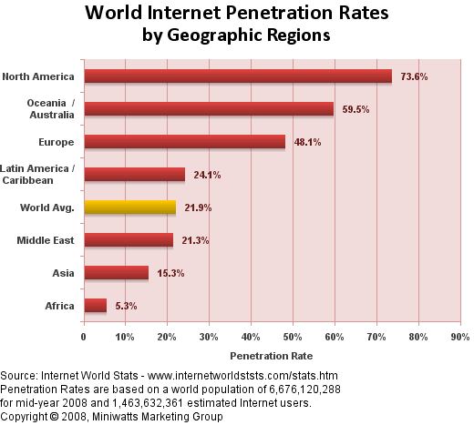
http://www.internetworldstats.com/stats.htm

Slide 5
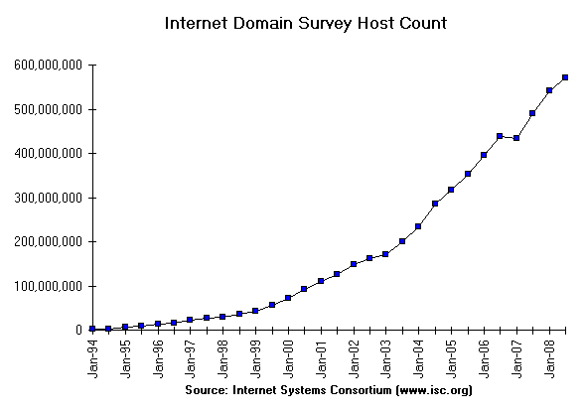
Internet host count

Slide 6
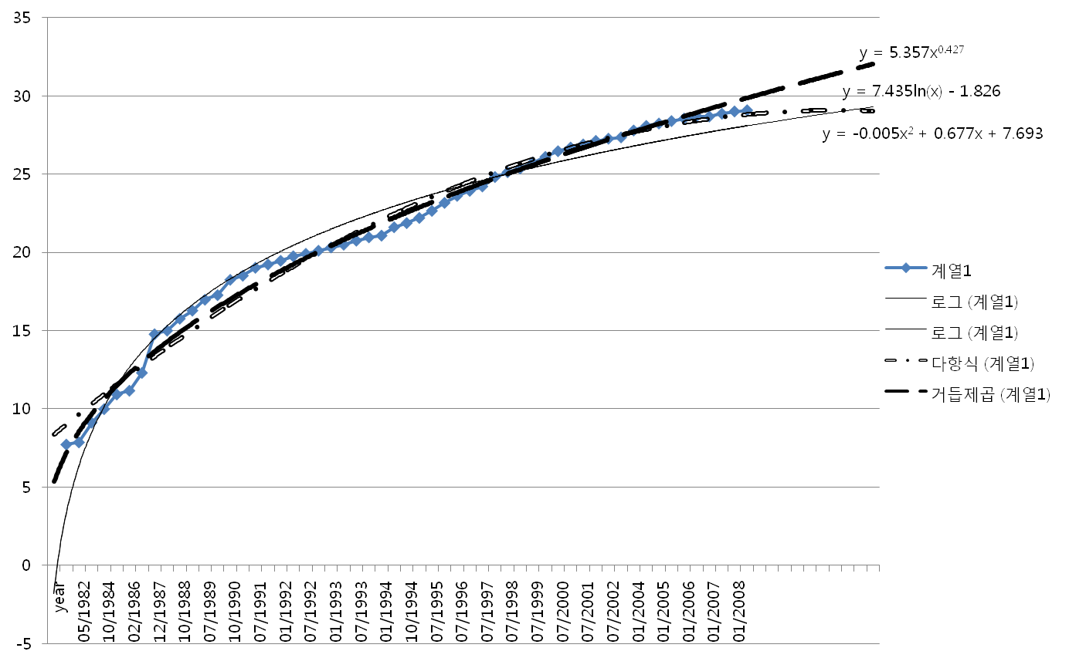
Internet Host Count (1982 ~ )
2013: 16 Billion Hosts
2013

Slide 7
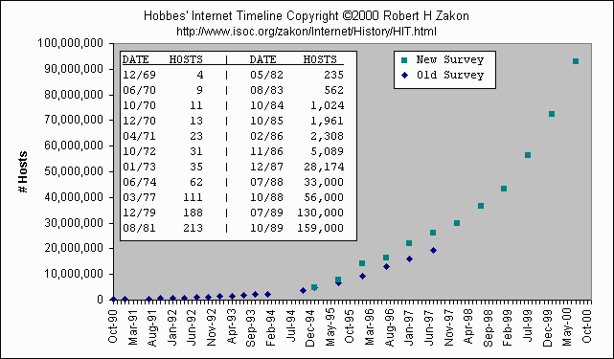
Brief history of the Internet

Slide 8
Brief History of Perl
1987: Larry Wall released version 1.0
  Unhappy by Sed, C, awk, and Bourne Shell
The first edition of “Programming Perl”
1994: Perl version 5.0, complete re-write
1995: First official public release (0.6.2) of the Apache web server. (April)
1995: CPAN officially introduced
2009: Perl 6?

Slide 9

Darwin (evolution)
Mendel (genetic principle)
DNA modelling (Watson & Crick, 1953)
Hemoglobin/Myoglobin structure (Max Perutz, John Kendrew)
Computational
Methodology (Chris
Sander & Arther Lesk )
Structure
Sequence
DNA ➔ codon ➔ anticodon
➔ peptide ➔ Protein
X-174 Genome (F.sanger)
First full genome sequencing
Dynamic programming
Sequence comparison
App module
(Niedleman & Wunsch)
DB (Gen Bank, PIR, ...)
Southern blot
Hybridization methology
DNA chip &
Microarray technology
Bioinformatics Established
Structural genomics
Comparative genomics
Sequencing
Functional genomics (DNA chip)
SNP
Proteomics (Mass spec. protein chip)
DataBases
Computational analysis Methodology
1995
Expression
Omics
World
Computer
INTERNET

Slide 10
Long Definition of Bioinformatics
Bioinformatics is a discipline of science that analyses, seeks understanding and models the whole life as an information processing phoenomenon utilizing energy with methods from philosophy, mathematics and computer science using biological experimental data.
-- Jong Bhak

Slide 11
A short definition of Bioinformatics
Biology is bioinformatics and bioinformatics, biology.
-- Jong Bhak

Slide 12
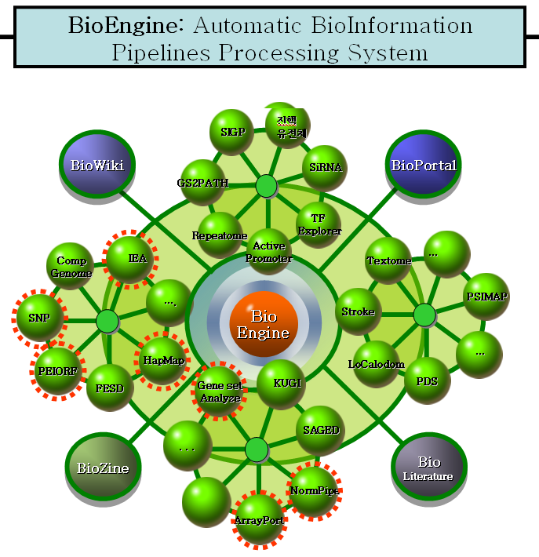

Slide 13
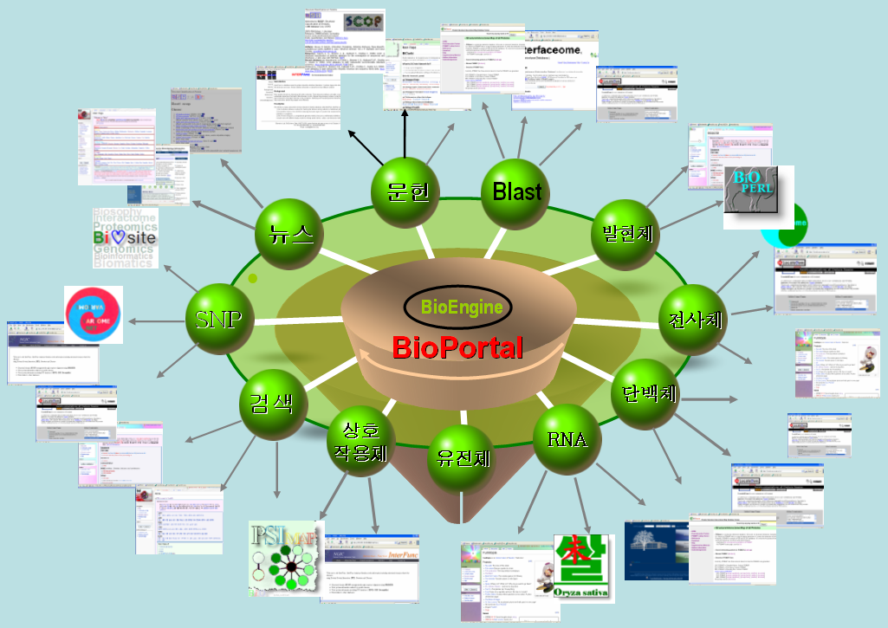

Slide 14
Genome sequence
gagttttatc gcttccatga cgcagaagtt aacactttcg gatatttctg atgagtcgaa
aaattatctt gataaagcag gaattactac tgcttgttta cgaattaaat cgaagtggac
tgctggcgga aaatgagaaa attcgaccta tccttgcgca gctcgagaag ctcttacttt
gcgacctttc gccatcaact aacgattctg tcaaaaactg acgcgttgga tgaggagaag
tggcttaata tgcttggcac gttcgtcaag gactggttta gatatgagtc acattttgtt

Slide 15
Perl Parsers
Converting DNA to Protein sequence

Slide 16
#!/usr/bin/perl
# Made by make_standalone_subroutines.pl at: Sat Sep 27 15:51:22 BST 1997
#________________________________________________________________________
# Title : convert_dna_to_protein
# Usage :
# Function : translate DNA or RNA seq to protein seq.
# Example :
# Warning : Copyright (C) 1993-1994 by James Tisdall
# stolen from Tisdall
# Keywords : dna2protein, dna_2_protein, DNA2protein, translate_dna
# dna2protein, convert_DNA_to_protein, translate_nucleic_acid
# rna2protein, rna_2_protein, RNA2protein, translate_rna
# dna2protein, convert_RNA_to_protein
# Options :
# Returns : a ref. of an array for protein translation
# Argument : a scalar for DNA sequence data
# Version : 1.2
#--------------------------------------------------------------------
sub convert_dna_to_protein{ ##### RnaToProtein
my(%seq) = %{$_[0]};
my($seq, $i,$len, $j, $PY, %out, $codon, @keys);
@keys=keys %seq;
$PY = '\[UT\]';
for($i=0; $i < @keys ; $i++){
my ($output);
$seq=$seq{$keys[$i]};
$len=length($seq);
for($j=0; $j < ($len-2) ; $j+=3){
$codon = substr($seq, $j, 3);
if ($codon =~ /^[UT]C/i) {$output .= 'S'; } # Serine
elsif($codon =~ /^[UT][UT][UTC]/i) {$output .= 'F'; } # Phenylalanine
elsif($codon =~ /^[UT][UT][AG]/i) {$output .= 'L'; } # Leucine
elsif($codon =~ /^[UT]A[UTC]/i) {$output .= 'Y'; } # Tyrosine
elsif($codon =~ /^[UT]A[AG]/i) {$output .= '_'; } # Stop
elsif($codon =~ /^[UT]G[TUC]/i) {$output .= 'C'; } # Cysteine
elsif($codon =~ /^[UT]GA/i) {$output .= '_'; } # Stop
elsif($codon =~ /^[UT]GG/i) {$output .= 'W'; } # Tryptophan
elsif($codon =~ /^C[UT]/i) {$output .= 'L'; } # Leucine
elsif($codon =~ /^CC/i) {$output .= 'P'; } # Proline
elsif($codon =~ /^CA[UTC]/i) {$output .= 'H'; } # Histidine
elsif($codon =~ /^CA[AG]/i) {$output .= 'Q'; } # Glutamine
elsif($codon =~ /^CG/i) {$output .= 'R'; } # Arginine
elsif($codon =~ /^A[UT][UTCA]/i) {$output .= 'I'; } # Isoleucine
elsif($codon =~ /^A[UT]G/i) {$output .= 'M'; } # Methionine
elsif($codon =~ /^AC/i) {$output .= 'T'; } # Threonine
elsif($codon =~ /^AA[TUC]/i) {$output .= 'N'; } # Asparagine
elsif($codon =~ /^AA[AG]/i) {$output .= 'K'; } # Lysine
elsif($codon =~ /^AG[TUC]/i) {$output .= 'S'; } # Serine
elsif($codon =~ /^AG[AG]/i) {$output .= 'R'; } # Arginine
elsif($codon =~ /^G[UT]/i) {$output .= 'V'; } # Valine
elsif($codon =~ /^GC/i) {$output .= 'A'; } # Alanine
elsif($codon =~ /^GA[TUC]/i) {$output .= 'D'; } # Aspartic Acid
elsif($codon =~ /^GA[AG]/i) {$output .= 'E'; } # Glutamic Acid
elsif($codon =~ /^GG/i) {$output .= 'G'; } # Glycine
else {print "\n# convert_dna_to_protein: unrecognized codon $codon \n";}
}
$out{$keys[$i]}=$output;
}
return (\%out);
}

Slide 17
History of Bioperl
1994: Tim Hubbard: th_lib.pl
1994: Jong Bhak: jong_lib.pl, Bio.pl
1995: Jong and Steve Brenner: Bioperl
1995: Bio.pm
1996: Georg Fuellen and bioinformatics course in Bielefeld Germany
1997->: Steve Chervitz, Ewan Birney
2000~ a world wide project

Slide 18
Bioperl: 1995
BioPerl: is to enhance the adoption of an easy and efficient programming
language for Biology community.
Perl is a very easy but powerful programming language which can be used
for Biology. It has built in functions for various types of text handling which can be used for sequence handling. As there is no easy and wide spread common language in Biological computing field, it would be very nice to develop such a language to enhance the exchange of programs between biologists. Perl has been already used for many genome research works and it is extremely easy to learn and fun to use. Rather than wasting time and
resource to develop independent programs which do basically same things, why do we borrow other people's perl codes and give them ours. Perl codes can be easily copied and modified but if we set up a standard way of programming (which is not strict or needed to be followed) with basic guideline it will even enhance the exchange of completely developed codes.
Perl is the largest and very extendable general purpose language comprising of numerous 'modules'. By registering bioperl as a module, we can extend perl language to be used in Biology community with great efficiency.
-Cambridge, 1995.

Slide 19
Philosophy of Bioperl
…Bioperl's authors not only the people who are in the past, present but also the future. There is no one who created 'vision' :-) or anything like
that. Everybody who agrees and like the idea of Perl and more open attitude in exchanging idea
has the real 'vision'. …

Slide 20
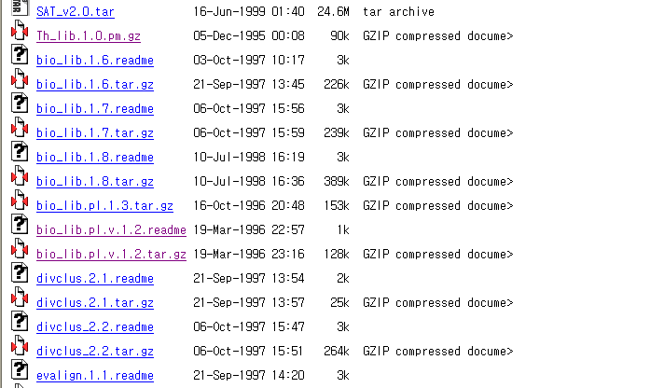
http://backpan.cpan.org/authors/

Slide 21
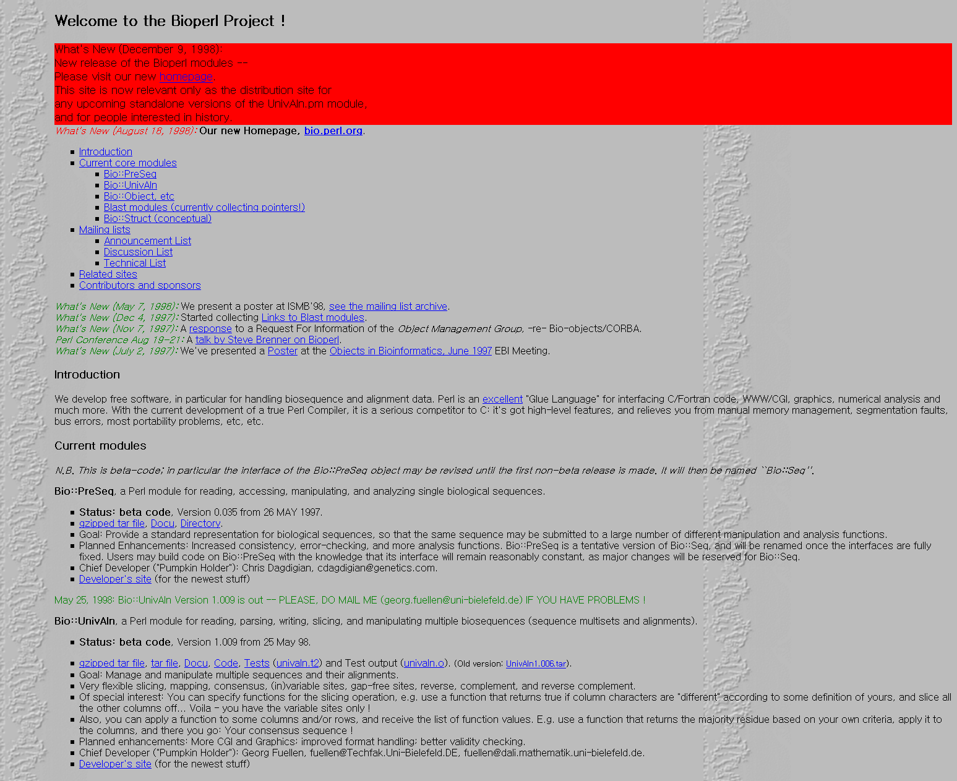
Georg Fuellen’s Bioperl page

Slide 22
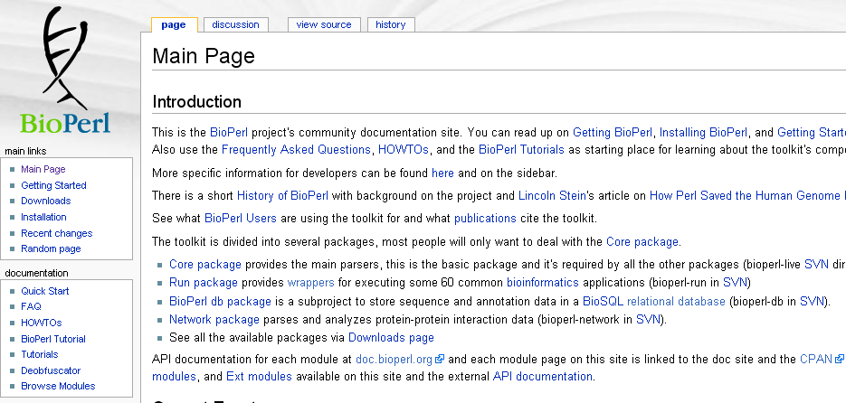
Bioperl.org

Slide 23
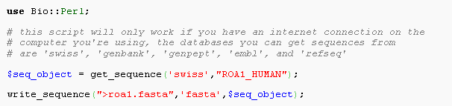
Oo Bioperl usage

Slide 24
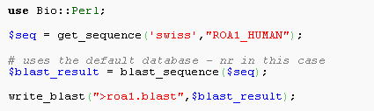
Running Blast

Slide 25
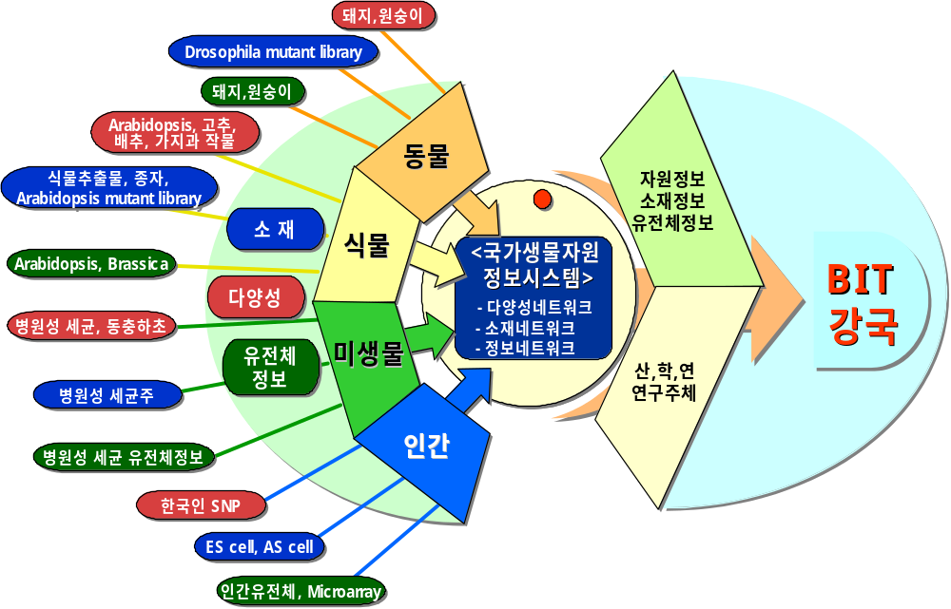
추 진 체 계
범 자원적 연계시스템 구축

Slide 26
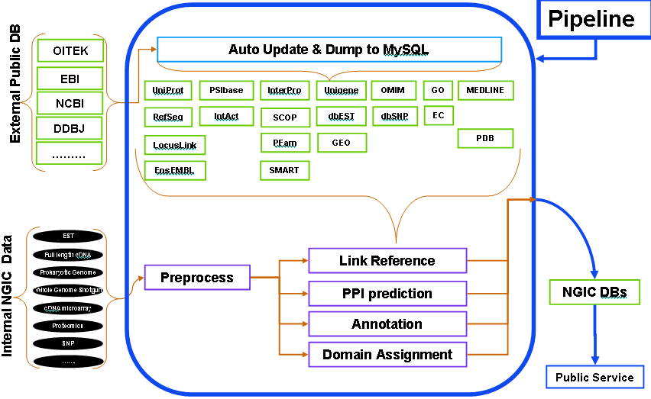

추 진 전 략
■ 국내 생물정보 BioMatrix 연구/개발/분석 시스템 구축
- 생명공학 주요 연구주제별 매트릭스 정보 시스템 구축 및 지원
생물자원
정보
매트릭스
자
원
유전체
다양성
소재
의료
서열
소재
구조
분석
정보
기능
문헌
자원
생물자원정보통합
정보

