Slide 1
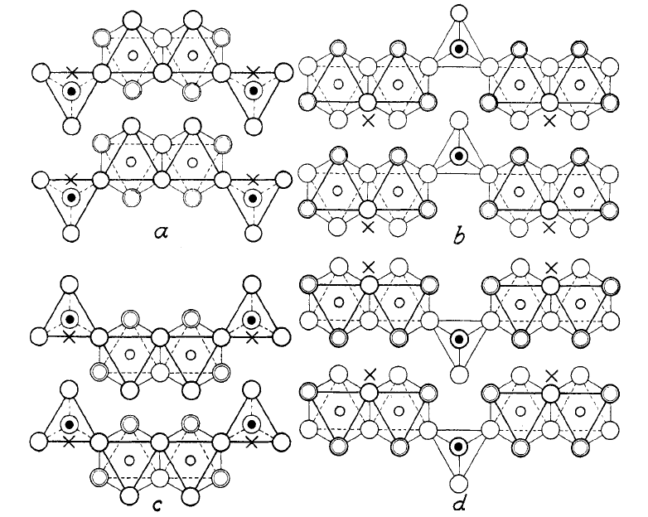
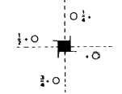
Race to the bottom:
Comparing optimisation routes for different materials classes
Keith T. Butler

Slide 2
Optimisation strategies
The ISIF problem
3
2
4
7
There is no unique route to the optimised structure
Is there possibly a quickest route?
Does it depend on system type?

Slide 3
Some possible recipes
Straight full optimisation (cell + coordinates): ISIF = 3
Pre-optimise coordinates then full optimisation: ISIF = 2 -> ISIF = 3
Pre-optimise coordinates, then volume, then full: ISIF = 2 -> ISIF = 7 -> ISIF = 3
Pre-optimise coordinates, then volume, then shape, then full: ISIF: 2 -> 7 -> 4 -> 3
Possible inclusion of rough optimisation before these using gamma point version, reduced cutoffs, light k-mesh etc…

Slide 4
The ISIF = 3 caveat
It is possible the VASP can think that a structure is fully optimised (cell + positions) and will terminate your ISIF = 3 run. Yet, if you restart from the CONTCAR it will start optimise the energy again.
It is strongly advised to repeat an ISIF = 3 calculation on the structure that you obtain from an ISIF = 3 and to iterate until the test ISIF = 3 calculation takes only 1 step.
N
Steps == 1
Optimise Structure
ISIF = 3 check
Y
Stop

Slide 5
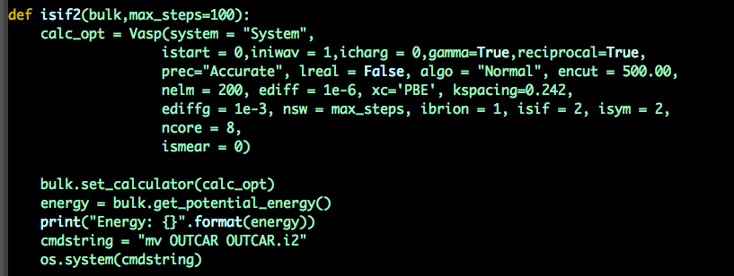
Automating a workflow
A function is defined for each optimisation type.
You can change the max steps in the workflow.

Slide 6
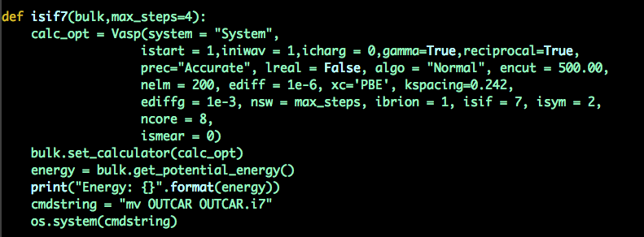
The ISIF = 7 step
Cell shape optimisation can get stuck – never finding a minimum.
BUT: It should, in principle, have done all that it can do within 4 steps.

Slide 7
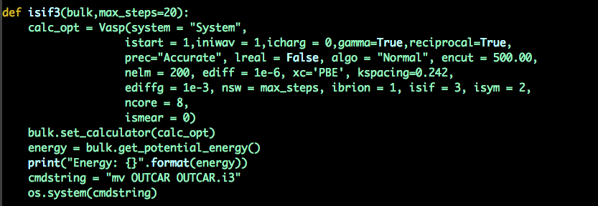
The ISIF = 3 step
Generally, the greater the number of steps at ISIF = 3, the greater the chances of encountering the ISIF = 3 caveat.
It is, therefore a good idea to limit the number of steps.

Slide 8
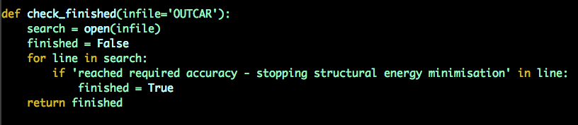
Checking for completion
This simply loos for the line in the requested OUTCAR that means the job is done

Slide 9
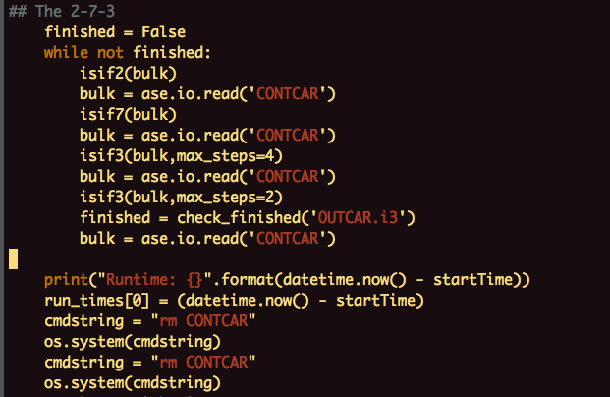
The workflow
Ion relaxation
Cell relaxation
Total relaxation
Test relaxation
Completion test

Slide 10
The test cases
BaO
CdS
CsCl
PbS
SrO
ZnO
AlCl₃
BeF₂
MoO₃
Si₃N₄
TiO₂ – rutile
TiO₂ – anatase
BeSiN₂
BiTeI
SbSI
SrTiO₃
ZnSnO₃
ZnSnP₂
(NH₃NH₂)Co(CHO₂)₃
(NH₃NH₂)Mg(CHO₂)₃
MIL-53

Slide 11
Notes
ISIF 3 sometimes hangs when using newer compilations of VASP
Using an older compilation seemed to stop this from happening

Slide 12
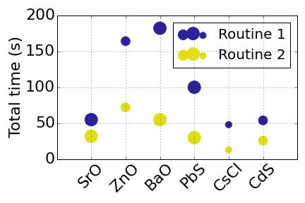
Simple binaries
ISIF 2 -> 7 -> 3
ISIF 3 (6 steps)
Routine 2 much quicker

Slide 13
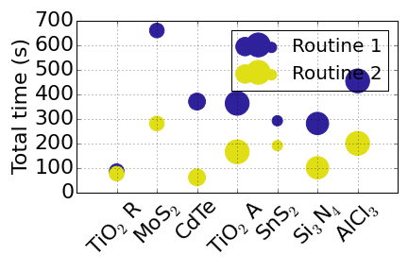
Complex binaries
ISIF 2 -> 7 -> 3
ISIF 3 (6 steps)
Routine 2 much quicker

Slide 14
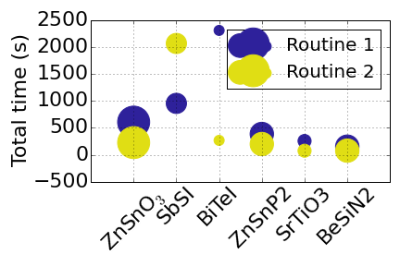
Ternaries
ISIF 2 -> 7 -> 3
ISIF 3 (6 steps)
First instance where routine 1 is quicker

Slide 15
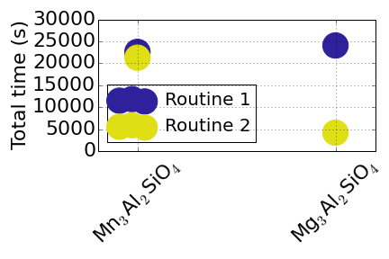
Quaternatries
ISIF 2 -> 7 -> 3
ISIF 2 (6 steps)-> 3 (6 steps)
Two garnet type structures.
Pure ISIF = 3 routine resulted in systems not converging.

Slide 16
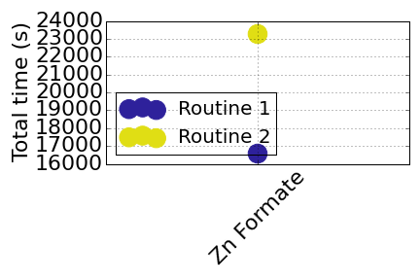
Hybrids
ISIF 2 -> 7 -> 3
ISIF 2 (6 steps)-> 3 (6 steps)
Pure ISIF = 3 routine resulted in systems not converging.
Routine 1 also finds a lower energy structure.

Slide 17
General observations
Straight up ISIF=3 seems to be safe enough for simple, symmetric structures – as long as one restarts the optimiser regularly (NSW = 6 ish)
As systems get more complex straight ISIF = 3 leads to divergence, it is necessary to include an ionic routine too (NSW = 6ish for both)
For hybrid systems simple routines no longer work best. ISIF 2 – 7 – 4 – 3 is quicker and also finds a lower energy structure.
For ISIF 7 use NSW = 4.

