Slide 1
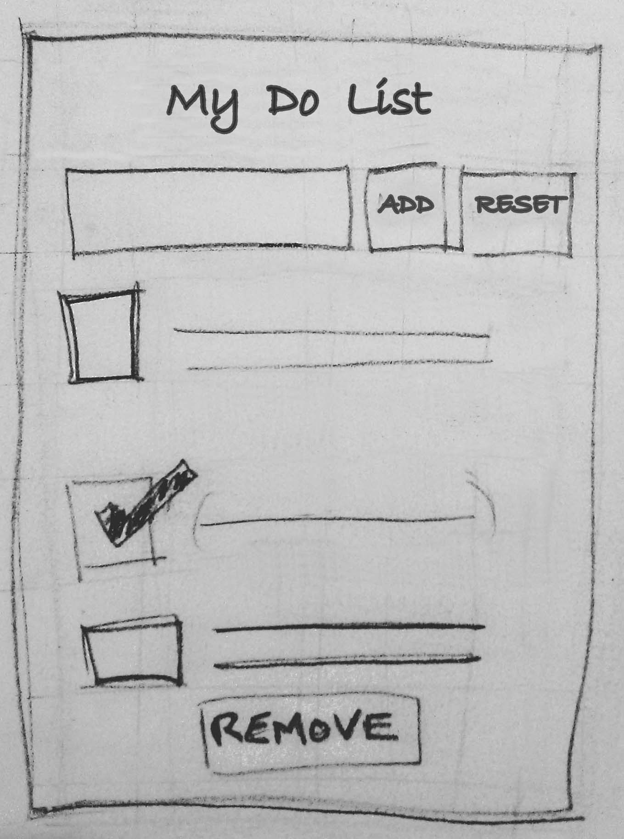
Design to code of To Do App – Start with mockup
To Do App (Mock up sketch)
Header - Title
Add/Reset section
-Input field
-add / reset button
Task List - List of to do items/tasks
- Each List item has checkbox
and label.A check
mark indicates that the task
has been completed
Remove button to remove
done items ie items with check
next to them.
The app will allow user to add tasks, remove done tasks and reset all the tasks to a default state. The added task entered in the input field will be displayed in the task list. Each task in the task list will have a check box. User will tick the checkbox to indicate that the task was done. The remove button will remove all tasks that are checked.

Slide 2
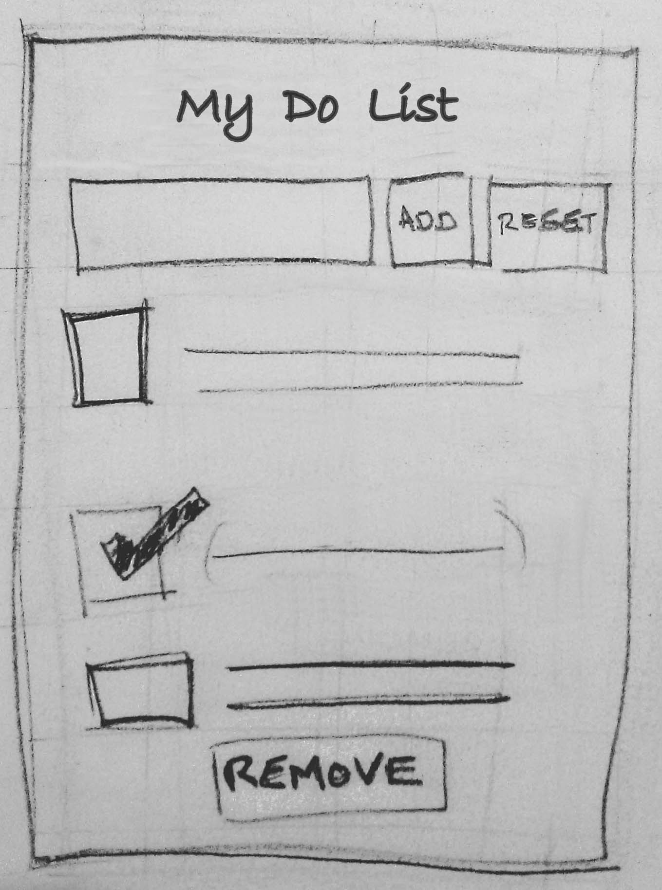
Design to code – Break down of UI into Component hierarchy, Layout containers and Interactions
Component | Layout containers |  | Buttons/Interactions
ToDoApp
(Main component)
_handleAddItem()
header - title
new_item,add,
reset
_handleResetList()
ToDoList
(Child component)
_handleCheckBoxClick()
todo_item
_handleRemoveDoneItems()
footer – remove button

Slide 3
Design to code of To Do App – Create Master Layout (markup and CSS)
todo_widget
header
new_item,add,
reset
todo_item
https://codepen.io/kv-olm/pen/JezQRe
footer – remove button
<ul id="todo_widget">
<li class="header"><h2 class="title">My to do list</h2></li>
<li class="new_item"><input ref="newItem" placeholder="Add a new task..." /> </li>
<li class="button add"><button v-on:click="_handleAddItem">Add</button></li>
<li class="button reset"><button v-on:click="_handleResetList">Reset</button></li>
<li class="todo_item"><input class="checkbox" type="checkbox" onclick="_handleUpdateDoneList"/>Item 1</li>
<li class="todo_item"><input class="checkbox" type="checkbox" onclick="_handleUpdateDoneList"/>Item 2</li>
<li class="todo_item"><input class="checkbox" type="checkbox" onclick="_handleUpdateDoneList"/>Item 3</li>
<li class="todo_item"><input class="checkbox" type="checkbox" onclick="_handleUpdateDoneList"/>Item 4</li>
<li class="footer"> <button class="remove" onClick="_handleRemoveDoneItems">Remove</button></li>
</ul>

Slide 4
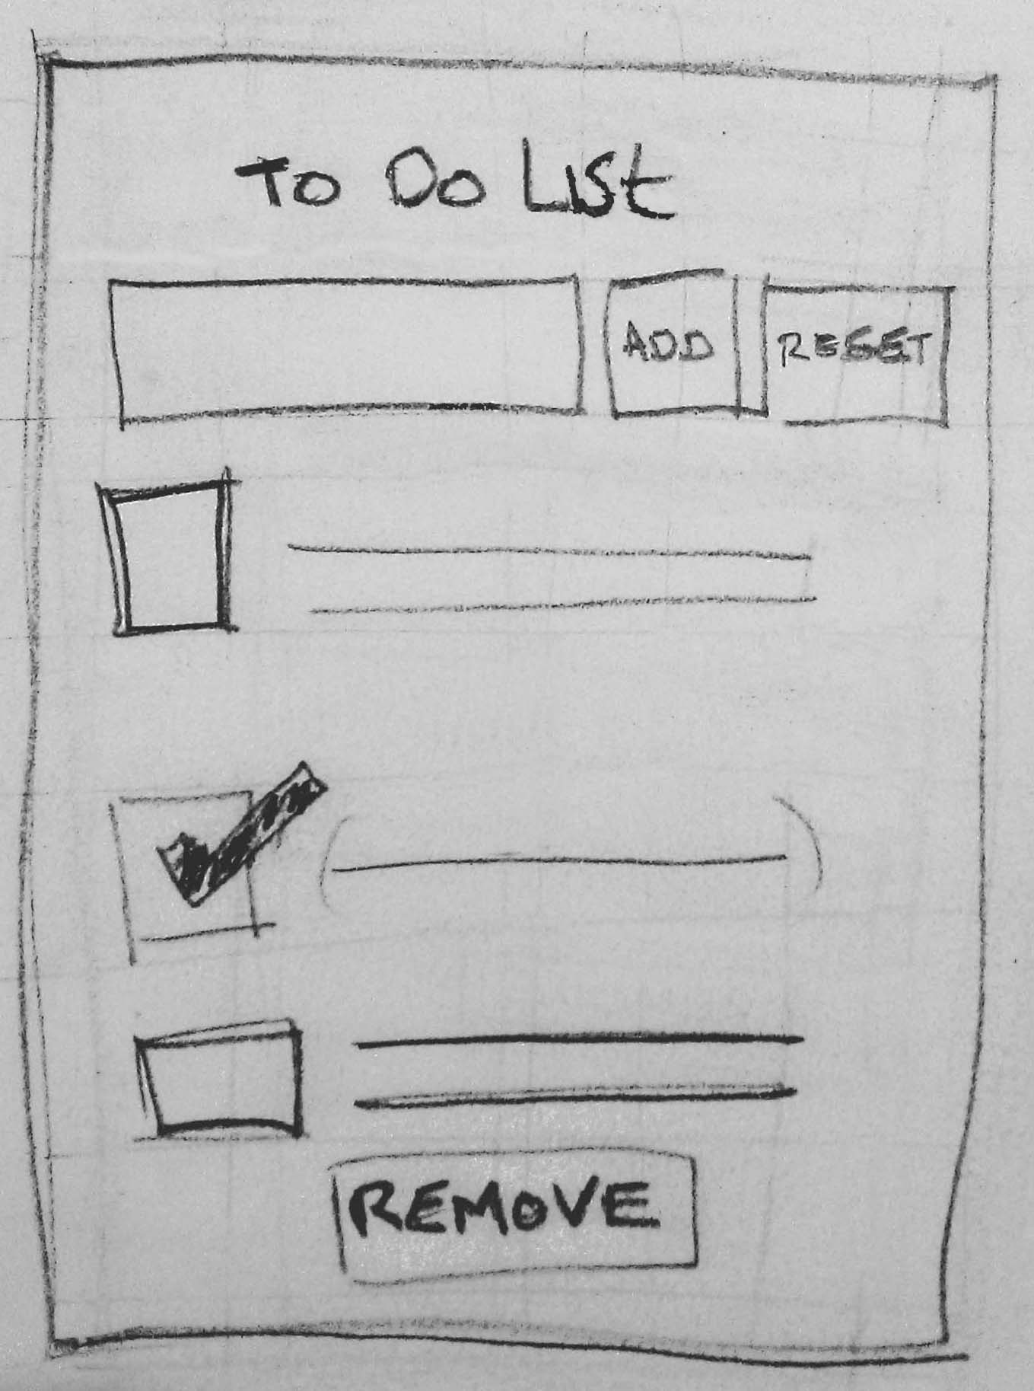
Design to code of To Do App – Create React.js skeleton code
class ToDoApp extends React.Component {
constructor(props) {}
componentWillUpdate(nextProps, nextState) {}
render() {}
_handleAddItem = () => {};
_handleResetList = () => {};
_handleRemoveDoneItems = e => {};
_handleUpdateDoneList = () => {};
}
ToDoApp.propTypes = {
list: PropTypes.array
};
ToDoApp.defaultProps = {
list: ["Get up in the morning", "Brush my teeth"],
doneList: []
};
class ToDoList extends React.Component {
constructor(props) {}
componentWillReceiveProps(nextProps) {}
_handleCheckBoxClick = e => {}
render() {}
componentWillUnmount() {}
}
_handleAddItem()
ToDoApp
(Main component)
_handleResetList()
ToDoList
(Child component)
_handleCheckBoxClick()
_handleRemoveDoneItems()

Slide 5
Design to code of To Do App – Vue.js skeleton code
<template>
<ul id="todo_widget">
<li class="header"><h2 class="title">My to do list</h2></li>
<li class="new_item"><input ref="newItem" placeholder="Add a new task..." /> </li>
<li class="button add"><button v-on:click="_handleAddItem">Add</button></li>
<li class="button reset"><button v-on:click="_handleResetList">Reset</button></li>
<li class="todo_item" v-for="(item, index) in list" :key="index"><input class="checkbox" type="checkbox" onclick="_handleUpdateDoneList"/>{{item}}</li>
<li class="footer"> <button class="remove" onClick="_handleRemoveDoneItems">Remove</button></li>
</ul>
</template>
<script>
export default {
name: "ToDoApp",
data() {
return { list: ["Get up in the morning", "Brush my teeth"'],doneList:[] };
},
methods: {
init() { },
_handleAddItem() {
},
_handleUpdateDoneList(e) {
},
_handleRemoveDoneItems(e) {
},
_handleResetList() {
}
},
mounted(){
this.init()
}
};
_handleAddItem()
ToDoApp
(Main component)
_handleResetList()
)
_handleCheckBoxClick()
_handleRemoveDoneItems()

Slide 6
Initialisation of code and
data
init()
Css
<style>
Css
<style>
Interaction handlers
ie code to
handle button clicks etc
<button click=’’doStuff”/>
Framework specific life cycle
hooks.Ie. Code to run before
Render and after render
beforeRender(){...}
Framework specific Rendering code ie JSX or some
sort of templating engine code
<input>{mydata}</input>

Slide 7
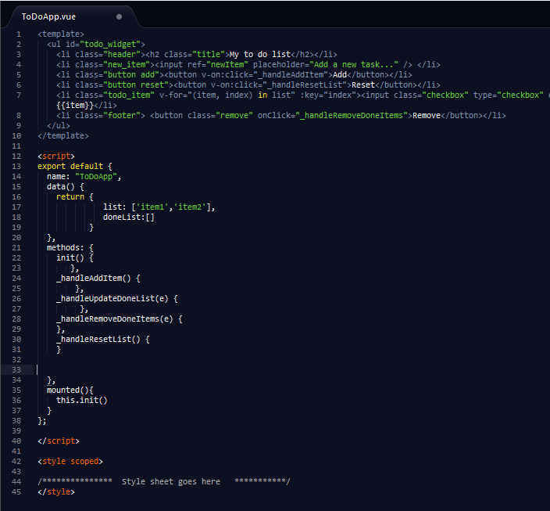
rendering code
initialise data
interaction handlers
life cycle hooks + constructor
css styles

Slide 8
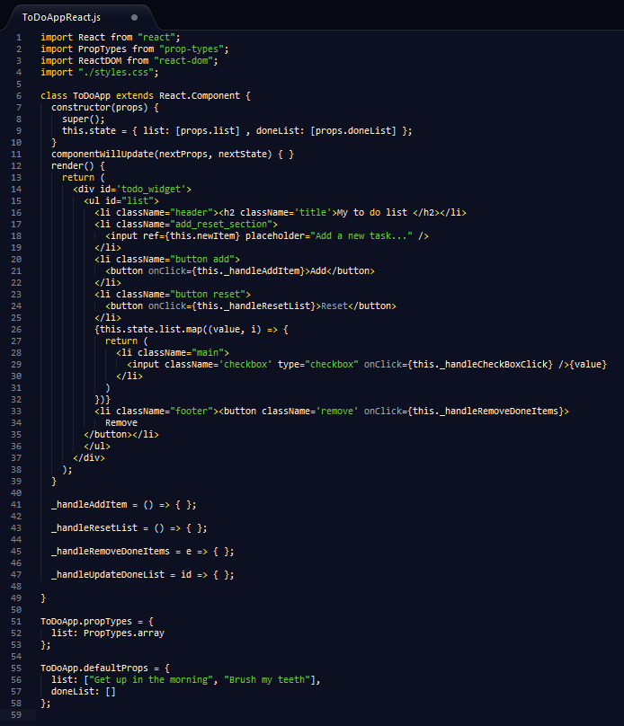
css styles constructor/initial data
rendering code
interaction handlers
default data
life cycle hook

Slide 9
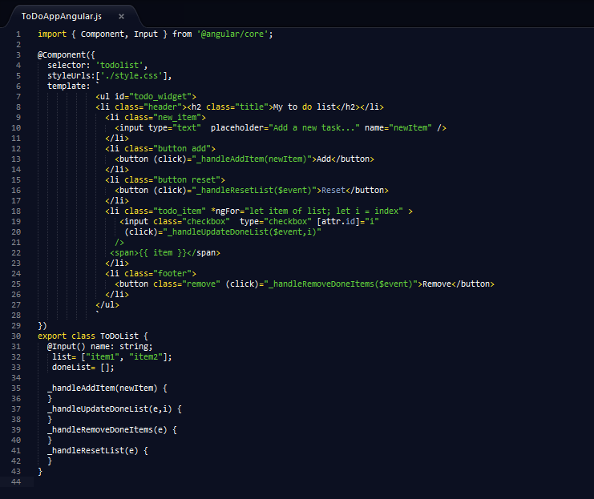
css styles
Rendering code
constructor/initial data
interaction handlers

Slide 10
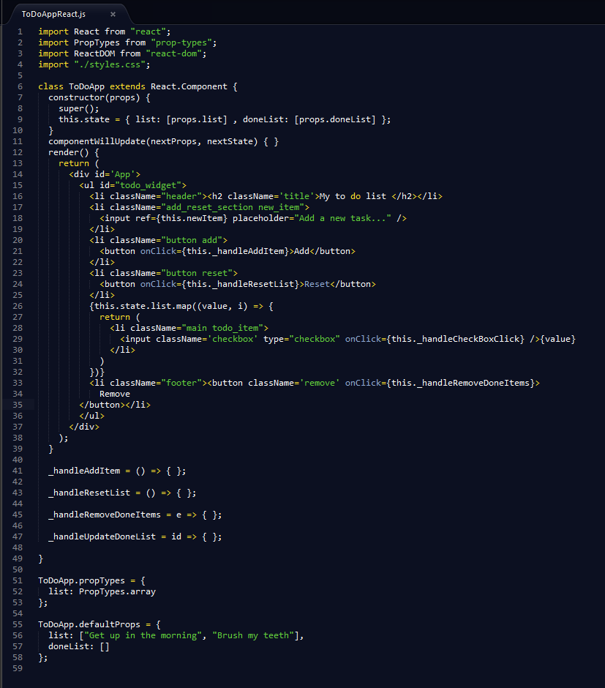
css styles
constructor / Initial data
life cycle hook
rendering code
interaction handlers
default data

