Slide 1
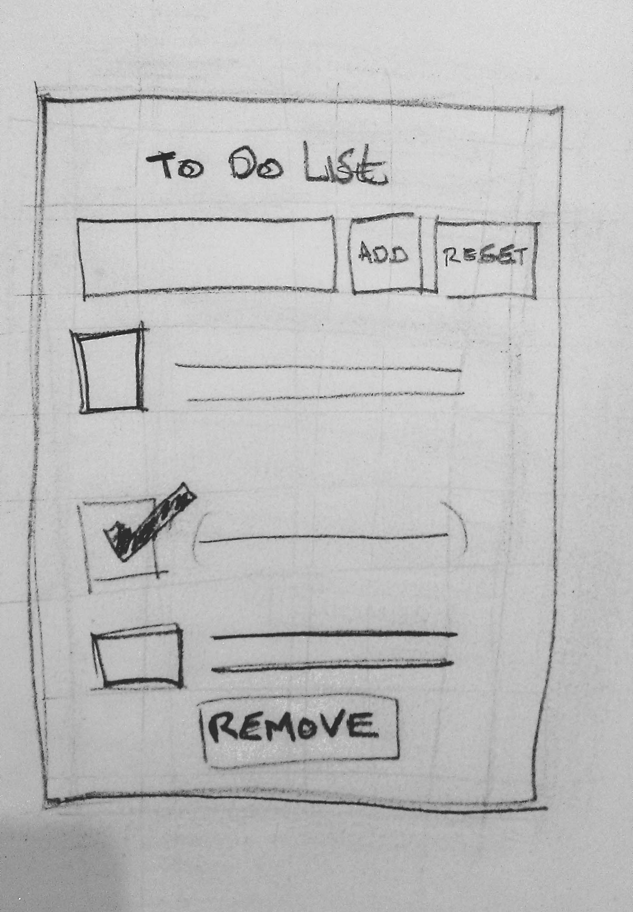
To Do app layout (Top level component)
Title
Add/Reset section
-Input field
-add / reset button
(Event handler for Add
And reset)
List of to do items/tasks
- List items
- List Item has checkbox
And label (Child component)
Remove button to remove
done items (Event handler for remove)

Slide 2
ToDoApp
title
add_reset_section
todo_list

Slide 3
ToDoApp
Title

