Slide 1
CSS Basics

Slide 2
Adding CSS to a page
Notes:
15 minutes

Slide 3

The style attribute
<p style="background: red; padding: 15px; color: white">
A red box!
</p>
CSS can be added to any element using the style attribute

Slide 4

The style tag
<style type="text/css">
p {
color: green;
}
</style>
<p>
This text will be green.
</p>
<p style="color: blue">
The style attribute
can override the green.
</p>
The <style> element can be included inside the <head> or <body> of the document, and the styles will still be applied
however it is recommended that you include your styles in the <head> for organizational purposes

Slide 5
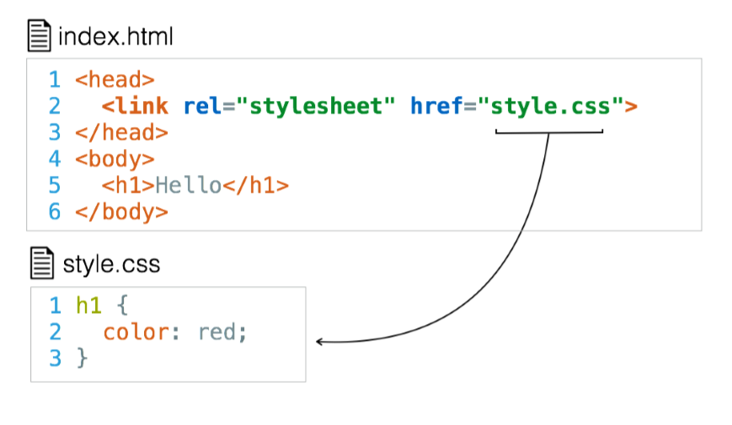
External stylesheet
The HTML External Resource Link element (<link>) links the current document to an external resource
It is most commonly used to link to stylesheets, but is also used to set site icons among other things

Slide 6
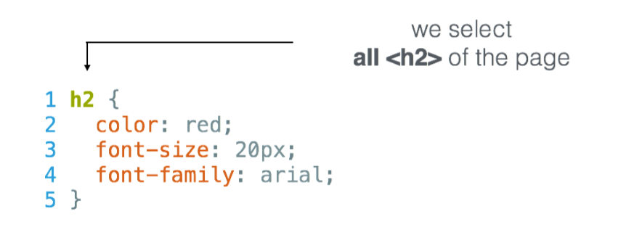
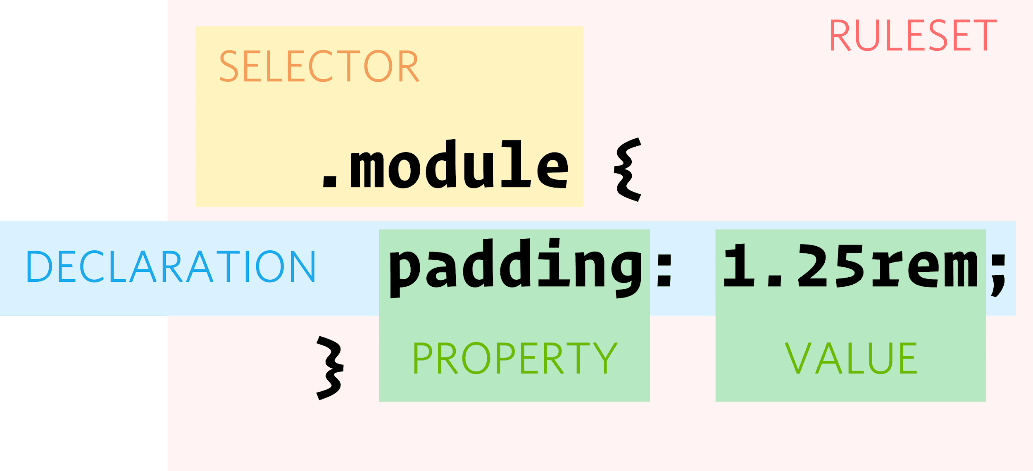
Syntax & Vocabulary

Slide 7

Exercise
Research how to add a site icon using the link element. Set an icon on your profile page from the previous class

Slide 8
CSS Selectors
Notes:
20 minutes

Slide 9

Element Selectors
<p>What color do you like?</p>
<div>I like blue.</div>
<p>I prefer BLACK!</p>
/* Make p elements are red */
p { color: red; }
/* Make div elements are blue */
div { color: blue; }
This is the simplest way to target all elements of a given type

Slide 10

Class Selectors
<ul>
<li class="first done">HTML</li>
<li class="second done">CSS</li>
<li class="third">JavaScript</li>
</ul>
.first { font-weight: bold; }
.done { text-decoration: line-through; }
Syntax is a dot followed by a class name
A class name can be value without spaces, placed within an HTML class attribute
It’s up to you to choose a class names
Many elements can have the same class
One element can have multiple classes separated by whitespace

Slide 11

ID Selectors
<p id="first">Docus Inzikuru</p>
<p id="second">Yekaterina Volkova</p>
<p id="third">Jeruto Kiptum</p>
p {
text-transform: uppercase;
}
#first { background-color: goldenrod; }
#second { background-color: silver; }
#third { background-color: #CD7F32; }
The ID selector consists of a hash(#), followed by the ID of a given element
Any element can have a unique ID set with the id attribute.
Up to you to choose an ID name
Best way to select a single element.

Slide 12
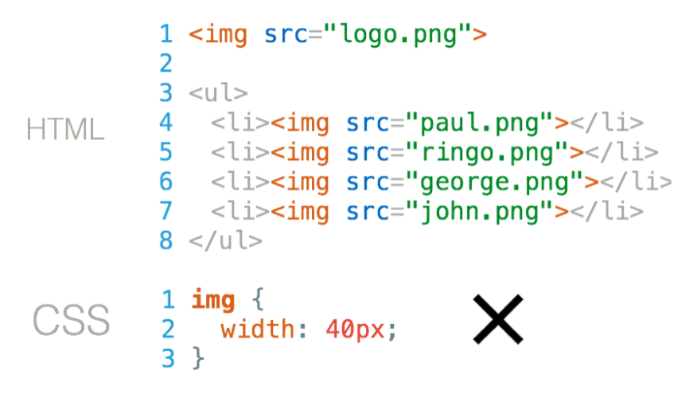
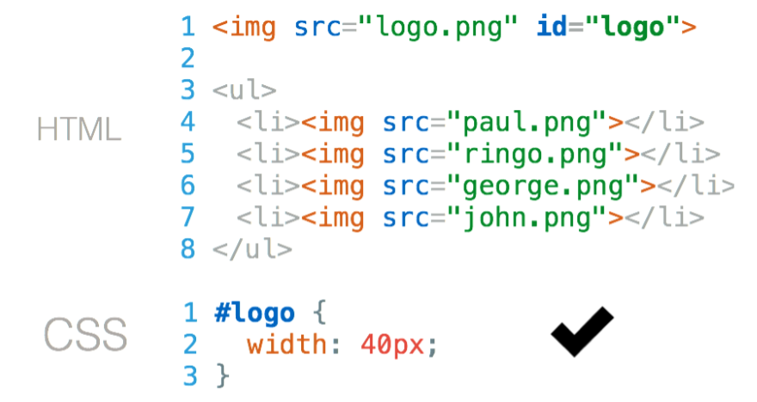
ID Selectors
How do you style logo image?
Give your tag an “id”

Slide 13
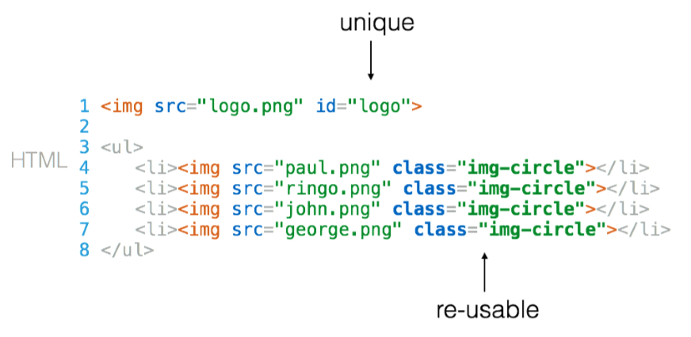
ID vs Class
Use an ID to style only one element on the page
Use a class to reuse styles on more than one element on the page

Slide 14
Exercise
Research other CSS selectors and what they do. Use the following type of selectors in your code
Element selector
ID and Class selector
Descendant selector
Direct descendant selector
Attribute selector

Slide 15
Text Properties
Notes:
20 minutes

Slide 16
text-color
body { color: blue; }
h1 { color: green; }
The color property is used to set the color of the text

Slide 17
text-align
h1 { text-align: center; }
h2 { text-align: left; }
h3 { text-align: right; }
The text-align property is used to set the horizontal alignment of a text.
A text can be left or right aligned, centered, or justified.

Slide 18
text-decoration
a { text-decoration: none; }
h1 { text-decoration: overline; }
h2 { text-decoration: line-through; }
h3 { text-decoration: underline; }
The text-decoration property is used to set or remove decorations from text.
The value text-decoration: none; is often used to remove underlines from links
The other text-decoration values are used to decorate text

Slide 19
text-transform
p.uppercase { text-transform: uppercase; }
p.lowercase { text-transform: lowercase; }
p.capitalize { text-transform: capitalize; }
The text-transform property is used to specify uppercase and lowercase letters in a text.
It can be used to turn everything into uppercase or lowercase letters, or capitalize the first letter of each word

Slide 20
font-size
h1 { font-size: 40px; }
h2 { font-size: 30px; }
p { font-size: 14px; }
The font-size property sets the size of the text.

Slide 21
font-weight
p.normal { font-weight: normal; }
p.thick { font-weight: bold; }
p.very-thick { font-weight: 700; }
font-weight is meant for setting the weight (boldness) of the font. normal is the default.
the value can be anything between 100 to 700
can also be normal, light, bold

Slide 22
font-family
p.a {
font-family: "Times New Roman", Times, serif;
}
p.b {
font-family: Arial, Helvetica, sans-serif;
}
The font-family property specifies the font for an element.
The font-family property can be several font names as backup
If the browser does not support the first font, it tries the next font

Slide 23

text-shadow
h1 {
text-shadow: 3px 2px red;
}
The text-shadow property adds shadow to text.
The example specifies the position of the horizontal shadow (3px), the position of the vertical shadow (2px) and the color of the shadow (red)

Slide 24
Exercise
Research other text properties and write code to prove that you understand them
What is the difference between serif and a san-serif fonts? Get examples of both

Slide 25
CSS Values
Notes:
15 minutes

Slide 26
Colors
Name of Color | orange, blue, purple
Hexadecimal | #FFFFFF, #ffaabb
RGB | rgb(255, 255, 255)
HSL | hsl(0, 0%, 100%)
HSV | hsv(0, 0%, 100%)
HWB | hwb(0, 100%, 0%)
CMYK | cmyk(0%, 0%, 0%, 0%)
Colors can be represented in different ways in CSS
CSS has inbuilt colors - use by name
RGB stands for Red Green Blue. Each value is between 0 and 255. For same values of R, G and B, you get a shade of grey
HSL, HSV, HWB, CMYK are rarely used, research how they work and when you can use them

Slide 27
Units
Unit | Description
px | Pixels are relative to the viewing device
pt | points
em | 2em means twice the size of the current font size
% | Relative to the parent element
CSS has several different units for expressing a length
Many CSS properties take "length" values, such as width, margin, padding, font-size
Length is a number followed by a length unit, such as 10px, 2em, etc
If the value is 0, the unit is not needed
For some CSS properties, negative lengths are allowed

Slide 28
Exercise
Research all units that can be used in CSS and use them in your code as you see fit

Slide 29
CSS Layout
Notes:
20 minutes

Slide 30
The display property
.inline { display: inline; }
.inline-block { display: inline-block; }
.block { display: block; }
.no-display { display: none; }
Display property defines how elements are going to be placed on the web page
There are mainly four types of display
Block
Inline
Inline-Block
None

Slide 31
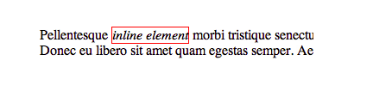
Inline Display
Inline elements ignore the height and the width
An inline element does not start on a new line and only takes up as much width as necessary
Example include <a>, <b>, <i>

Slide 32
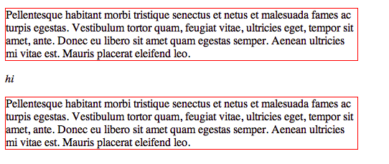
Block Display
A block element always starts on a new line and takes up the full width available (stretches out to the left and right as far as it can)
Elements like <div>, <section>, and <ul> are block
Block elements are usually used as containers for other elements

Slide 33
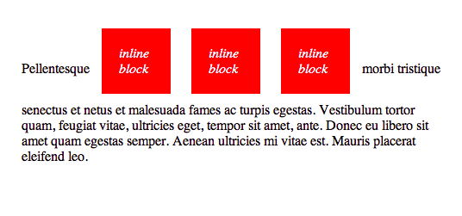
Inline Block Display
An element set to inline-block is very similar to inline in that it will be in line with the natural flow of text
The difference is that you are able to set a width and height which will be respected.

Slide 34
Display None
Totally removes the element from the page
While the element is still in the in the page, it is removed visually

Slide 35
Exercise
Research other values of CSS Display and write code to show that you understand the other CSS display properties

Slide 36
CSS Box Model
Notes:
20 minutes

Slide 37
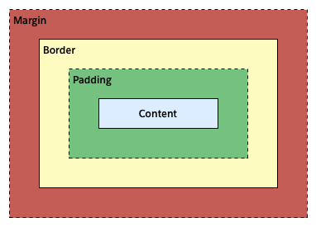
Box Model
The content area contains the "real" content of an element like text, images
The padding area extends from the content area to include additional space
The border area extends from the padding area to give the element a borders
The margin area extends from the border area to include an empty area used to separate the element from its neighbors

Slide 38
Width & Height
div {
border: 1px solid red;
}
/* or */
div {
border-top: 1px solid red;
border-right: 2px dotted black;
border-bottom: 1px dashed green;
border-left: 2px dotted black;
}
The height and width properties are used to set the height and width of an element.
The height and width can be set to auto (this is default - the browser calculates the height and width),
You can also specify length values, like px, cm, etc., or percent (%) of the containing block.
The max-width/min-width property is used to set the maximum/minimum width of an element. Same for height

Slide 39
Padding
div { padding: 5px; }
div { padding: 5px 10px 5px; }
div { padding: 5px 10px 5px 5px; }
div {
padding-top: 5px;
padding-right: 5px;
padding-bottom: 5px;
padding-left: 5px;
}
The CSS padding properties are used to generate space around an element's content, inside of any borders
There are properties for setting the padding for each side of an element (top, right, bottom, and left)
To shorten the code, it is possible to specify all the padding properties in one property

Slide 40
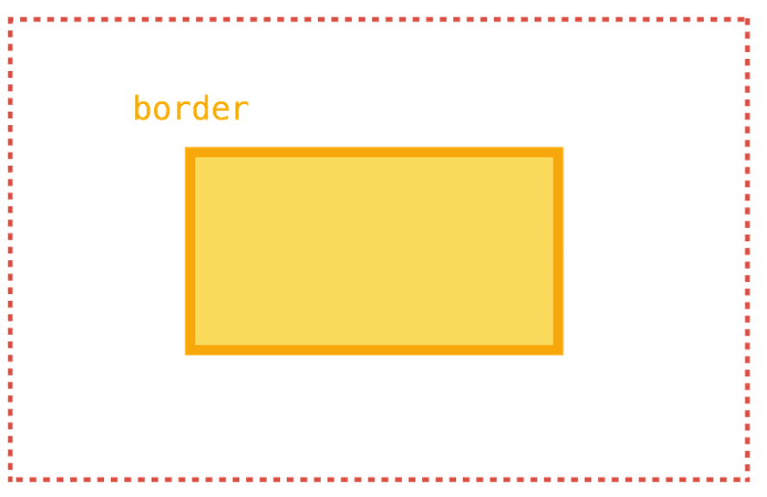
Border
div { border: 1px solid red; }
div {
border-width: 1px;
border-color: red;
border-style: solid;
}
div {
border-top: 1px solid red;
border-right: 2px dotted black;
border-bottom: 1px dashed green;
border-left: 2px dotted black;
}

Slide 41
Margin
div { margin: 5px; }
div { margin: 5px 10px 5px; }
div { margin: 5px 10px 5px 5px; }
div {
margin-top: 5px;
margin-right: 5px;
margin-bottom: 5px;
margin-left: 5px;
}
The CSS margin properties are used to create space around elements, outside of the defined borders
There are properties for setting the margin for each side of an element (top, right, bottom, and left)
To shorten the code, it is possible to specify all the margin properties in one property

Slide 42
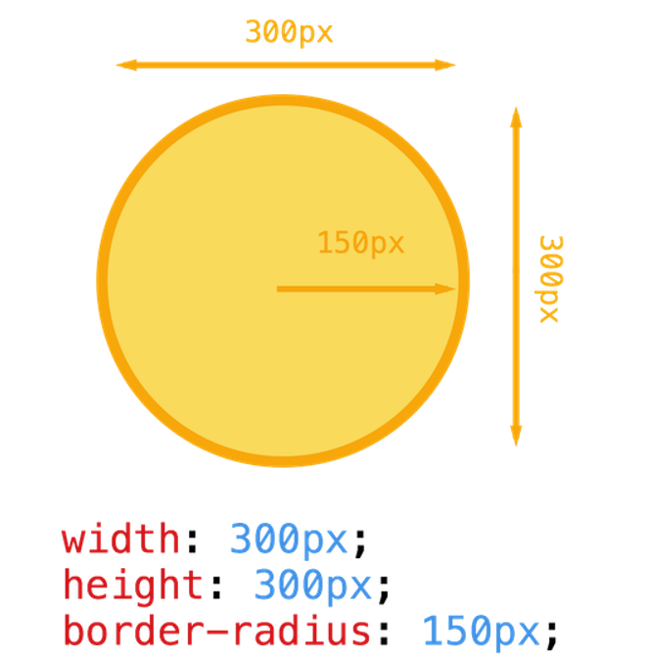
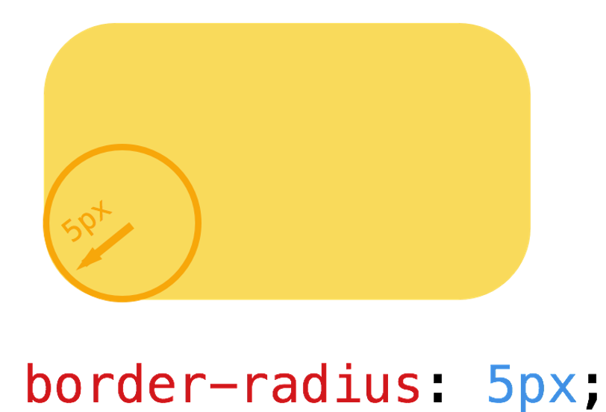
Border Radius

Slide 43
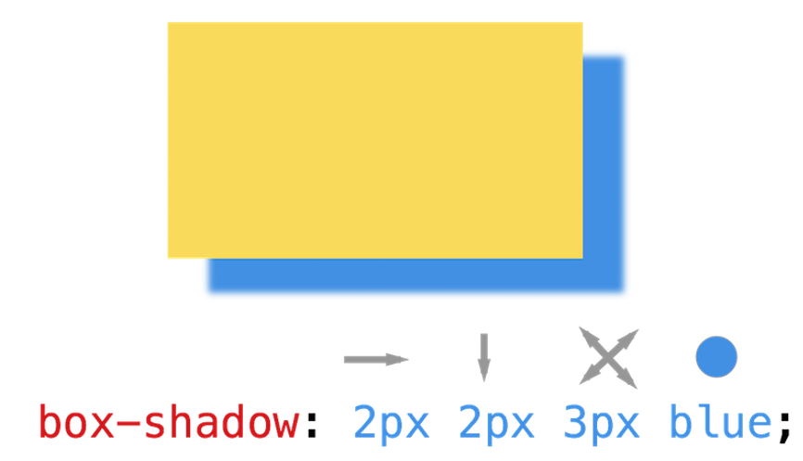
Box Shadow
/* Absolute */ p { width: 50px; }
/* Relative to parent */ p { width: 50%; }
/* Relative to font size */ p { width: 2em; }

Slide 44
Exercise
Does the amount of padding/margin increase the width/height of an element?
How can this behaviour be changed?
Write some code that illustrates this behavior and how it can be changed

Slide 45


