Slide 1
CATALOG MUSIC CO.
digital shopfront.
--- DEVELOPED BY ROB DIRKEN AND DANIEL KEEFER ---

Slide 2
WHO? WHAT? WHY?
MEET ISSAC, RECORD STORE OWNER.
Issac is a music lover and business owner with a new record store just opened in fortitude valley. It is a boutique music shop dealing in new and preloved vinyl that really wants to connect with the local electronic music scene.
ISSAC IS LOOKING FOR A DIGITAL SOLUTION TO SELL HIS STOCK.
Catalog Music Co. is a brick and mortar store in the heart of Brisbane. Issac processes his sales by using his Square reader to sell to customer that physically come into store and browse the vinyl. He wants to be able to expand his customer base by getting his business online.
DIGITAL PRESENCE REACHES PEOPLE NOT IN STORE AND STREAMLINES SALES PIPELINE.
Issac wants to be able to review music and provide editorials to his customers as online blog and info card attached to stock. He also wants a simple way for his consumers to organise a click and collect encouraging more sales throughput.

Slide 3
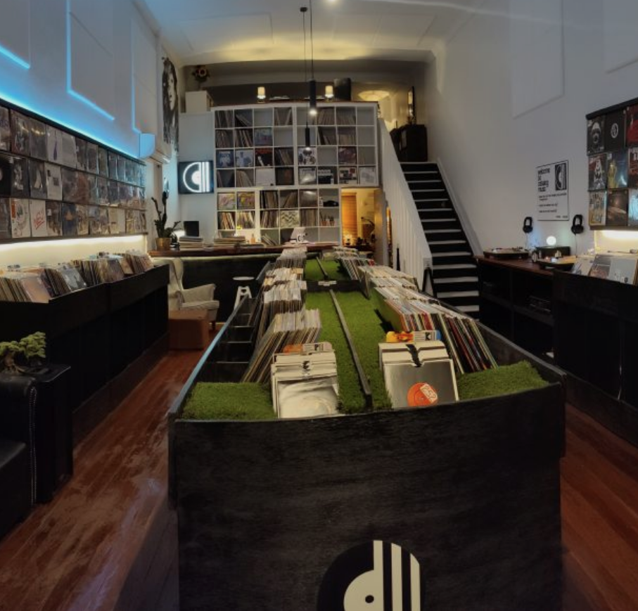
Hello!
We are Rob and Keef.
We’re here because this presentation is a requirement of the assignment.
Find us @_rdrkn and @xxKeefer, respectively

Slide 4
APPLICATION ARCHITECTURE
1.
Let’s start with a high level view.

Slide 5
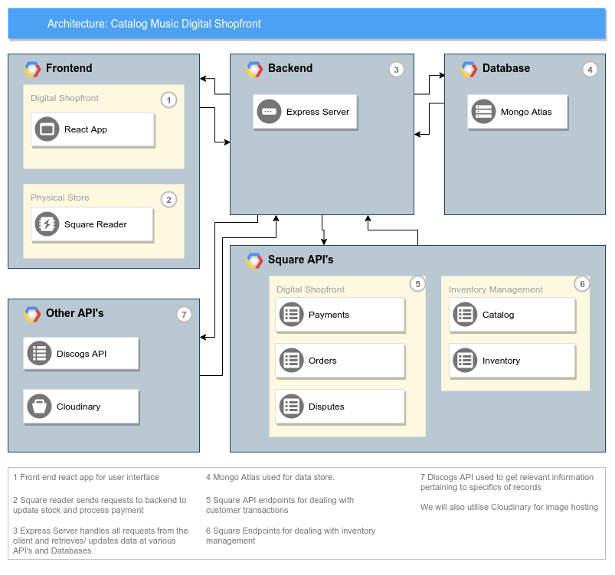
IN ADDITION TO THE MERN STACK, WE UTILISE THIRD PARTY APIS LIKE SQUARE TO PROCESS SALES.

Slide 6
DATA FLOW DIAGRAMS
2.
Now let’s dive into the nitty gritty.

Slide 7
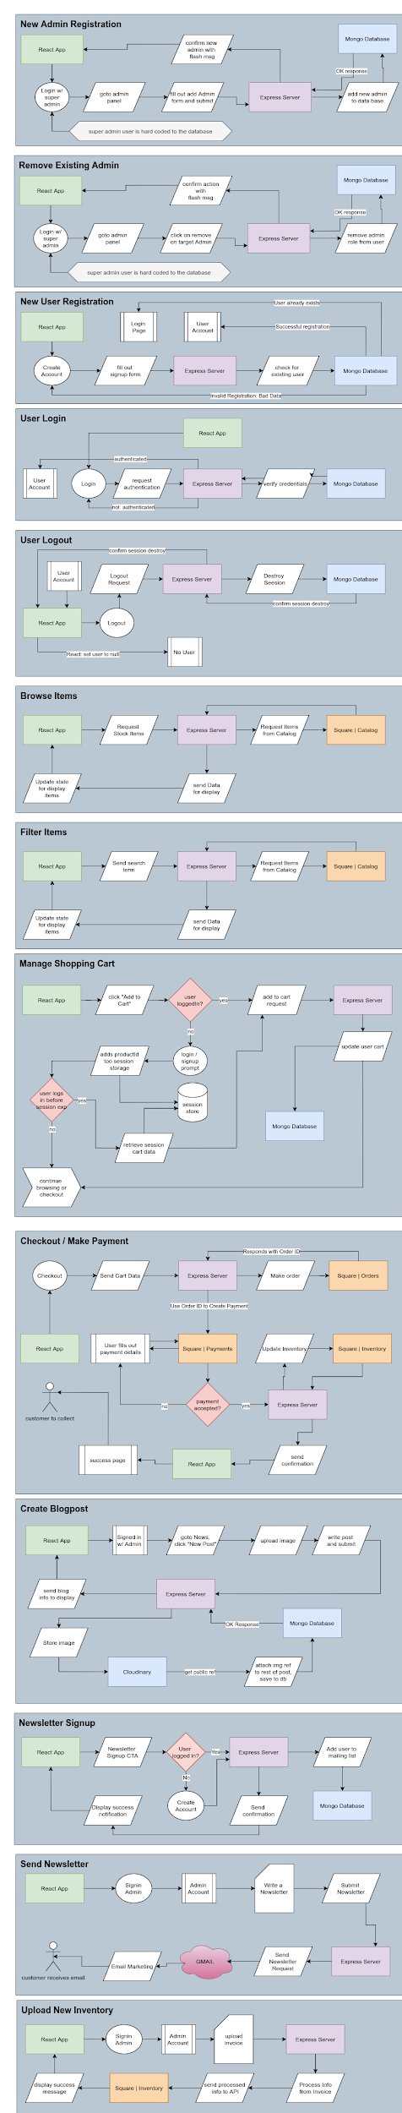
ADMIN ACTIONS

Slide 8
USER AUTH FLOW

Slide 9
BROWSE STORE

Slide 10
BLOGPOSTS & NEWSLETTERS

Slide 11
INVENTORY MANAGEMENT

Slide 12
WIREFRAMES
3.
Finally, let’s go over the look and feel.

Slide 13
Styling Brief
Isaac already had branding created for the store with a strong black and white, minimalist theme. This contrasts well with the colourful record covers, allowing them to take centre stage.
He asked that we follow this clean black and white theme, while adding touches of animation to give some interactivity and authenticity to the website.

Slide 14
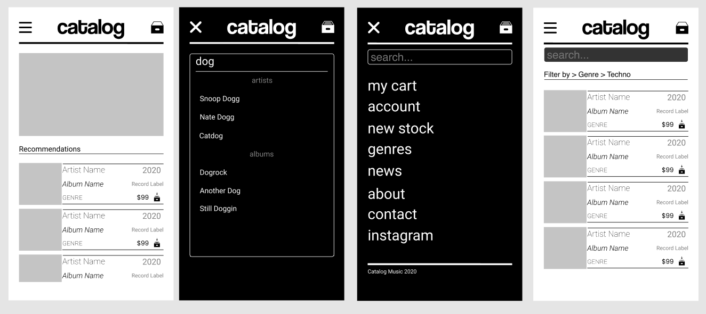

Slide 15
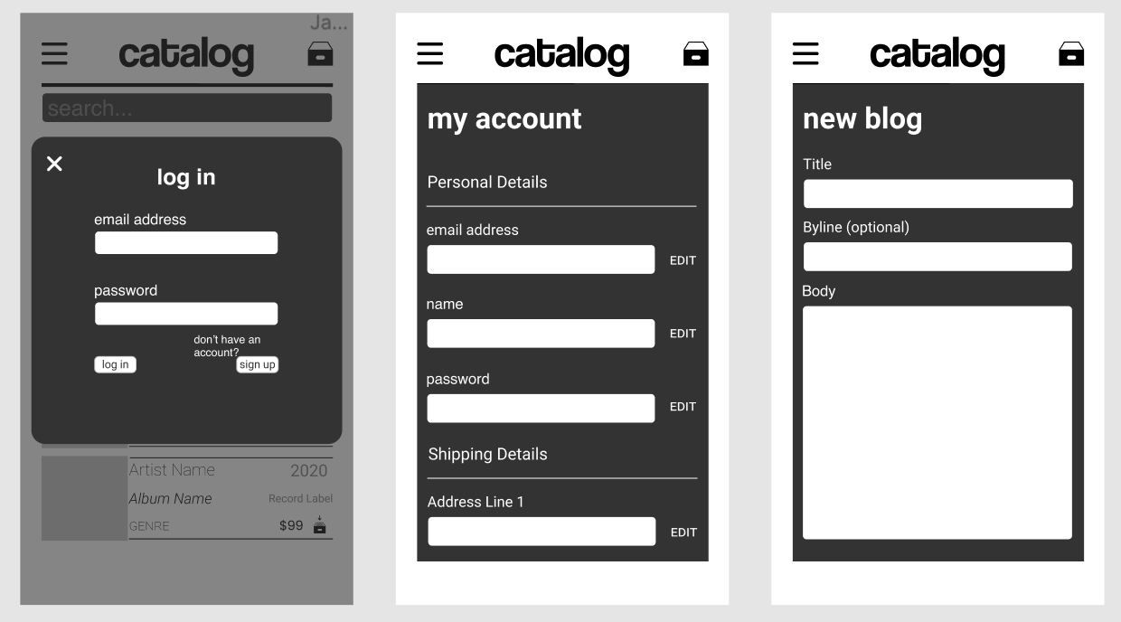

Slide 16
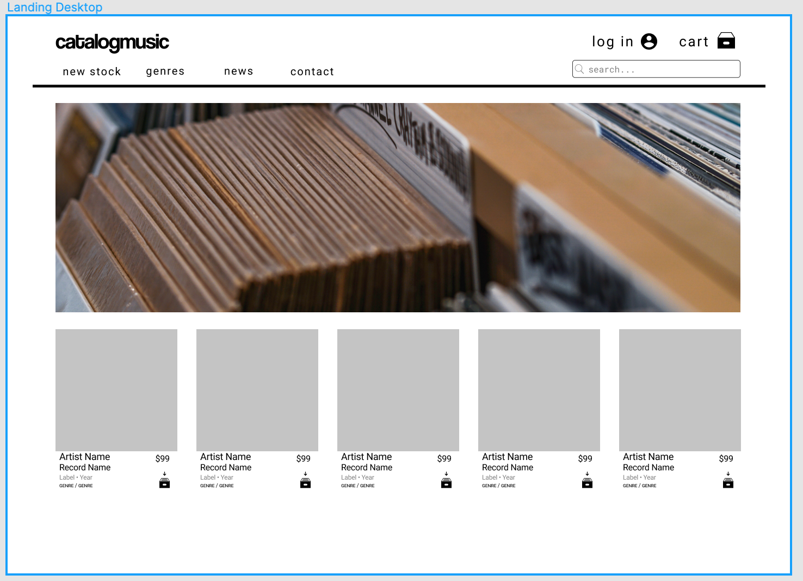

Slide 17
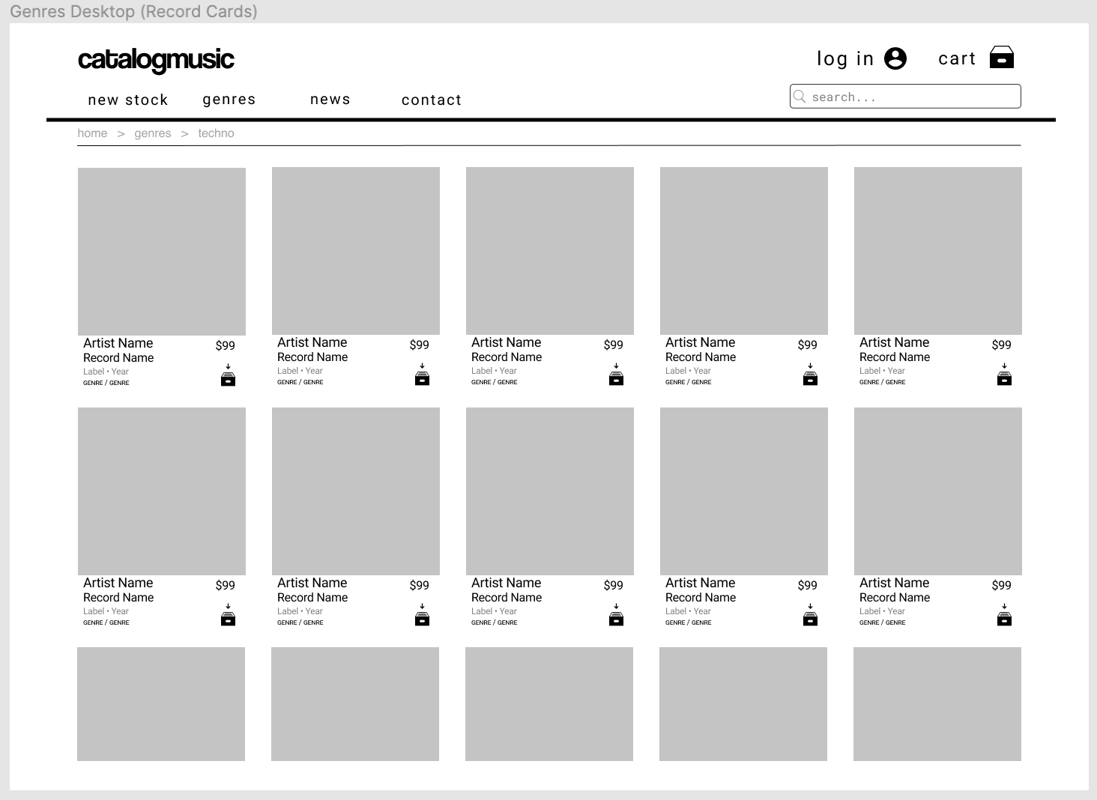

Slide 18
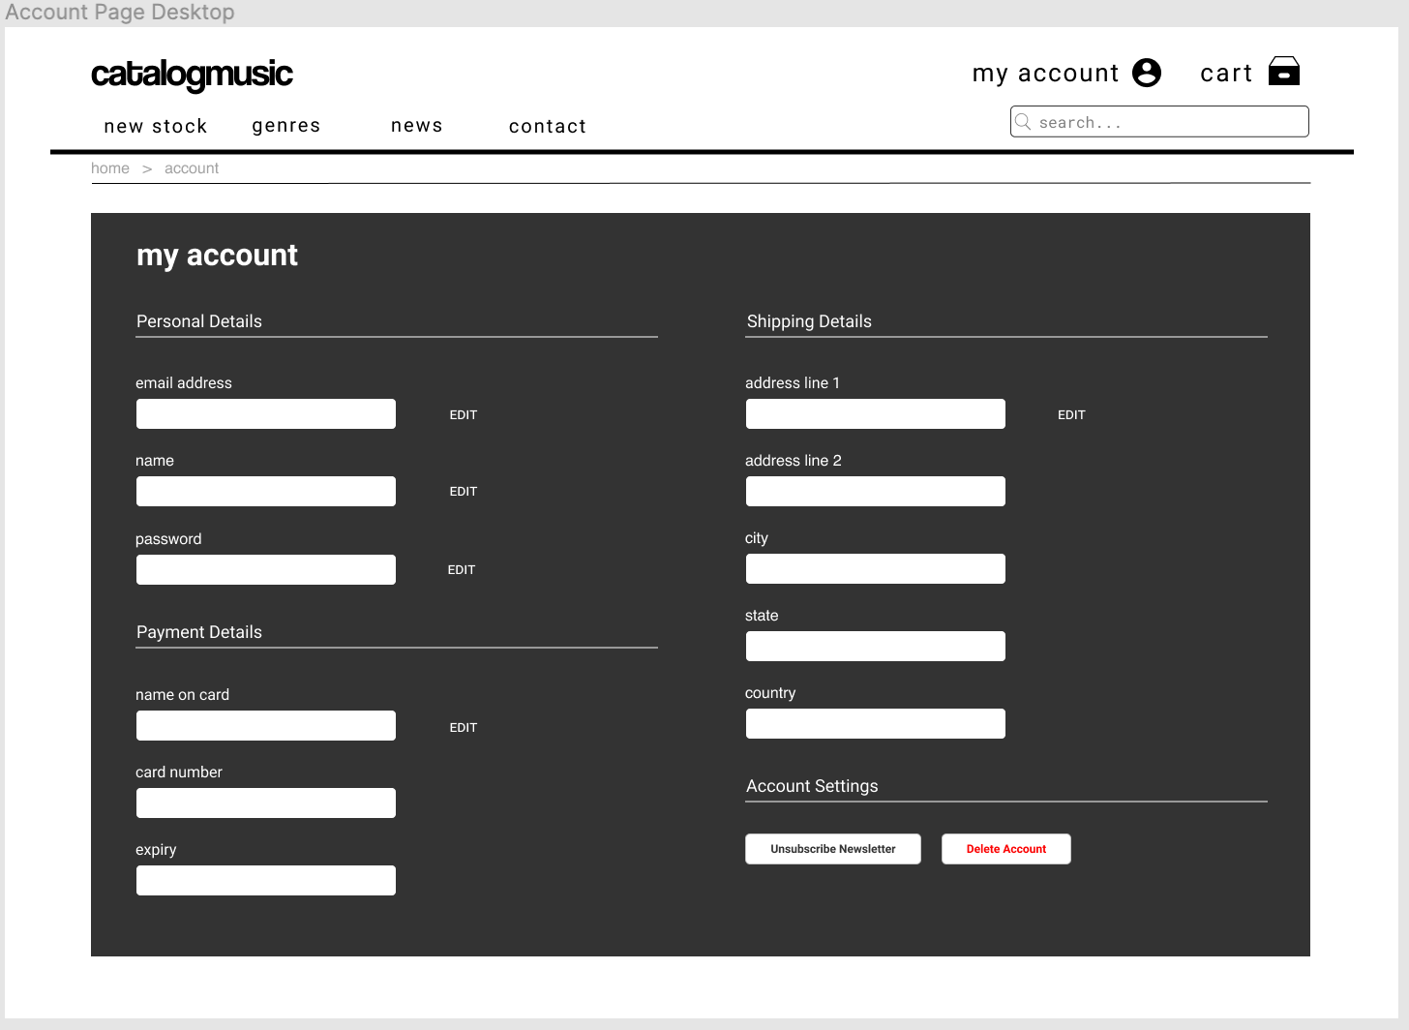

Slide 19
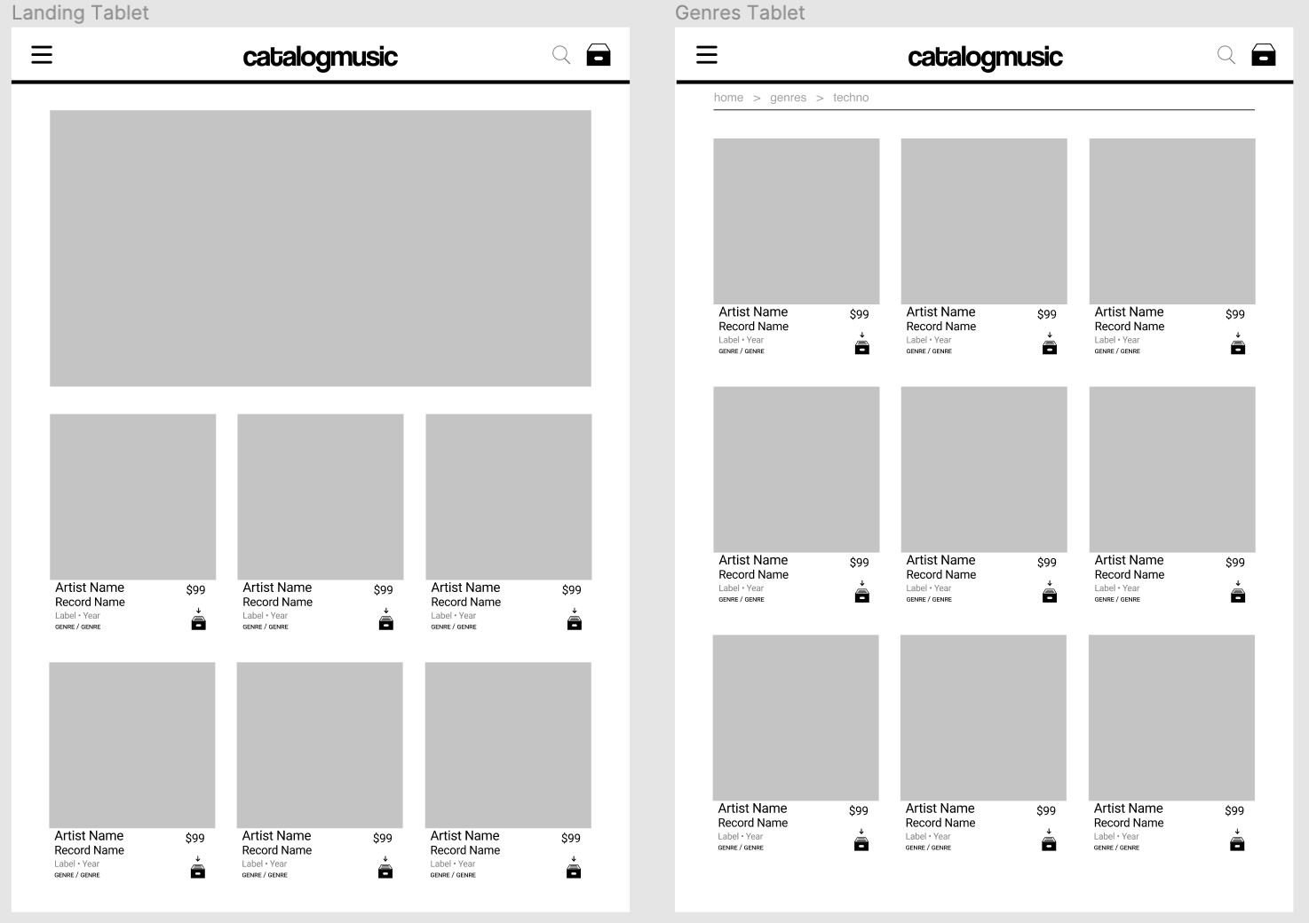

Slide 20
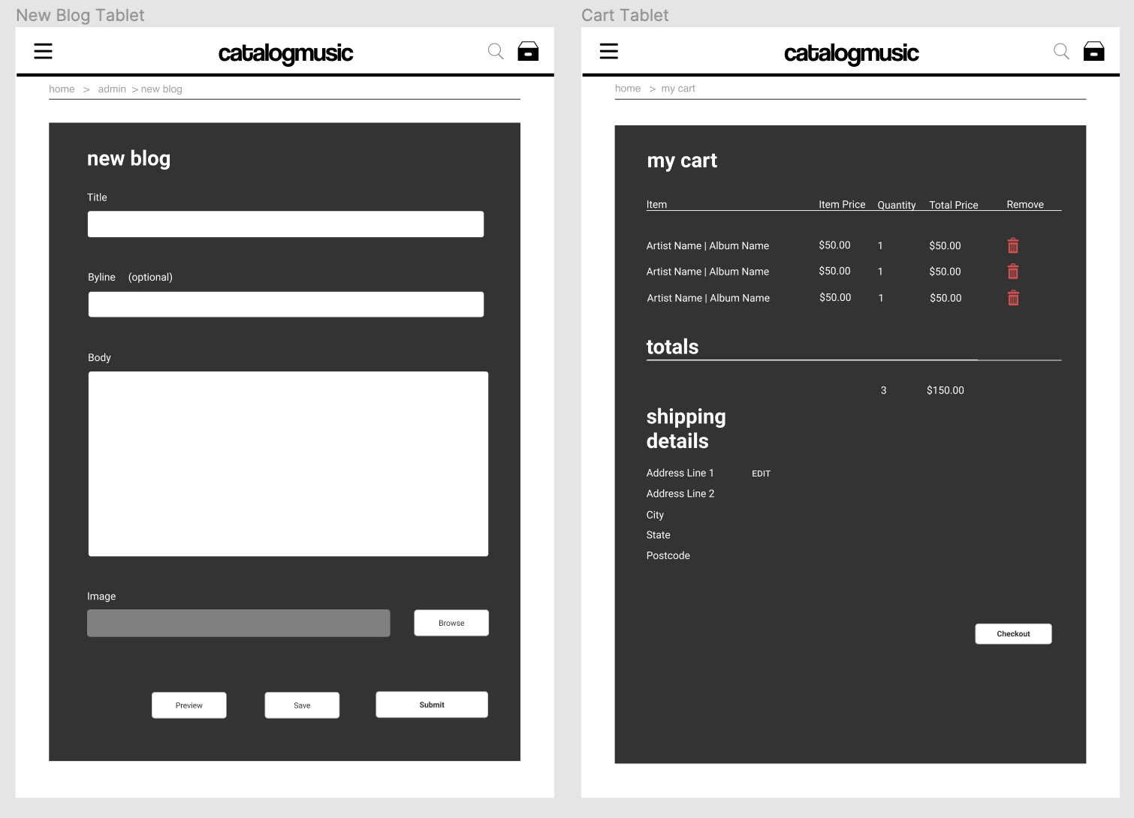

Slide 21
THANKS!
Any questions?
That’s too bad. We have probably run out on our 5 minutes.
But hit us up later. :D

