Slide 1
DPLYR

Slide 2
WHAT IS DPLYR?
A grammar of data manipulation that helps to solve the most common data manipulation challenges

Slide 3
WHAT CHALLENGES?
Add new variables that are functions of existing variables | mutate()
Pick variable based on their names | select()
Pick cases based on their values | filter()
Reduce mutiple values down to a single summary | summarise()
Change the ordering of the rows | arrange()

Slide 4
WHAT IS TIDY DATA?
Each variable forms a column.
Each observation forms a row.
Each type of observational unit forms a table

Slide 5
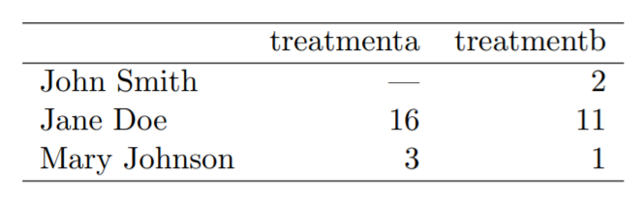

Slide 6
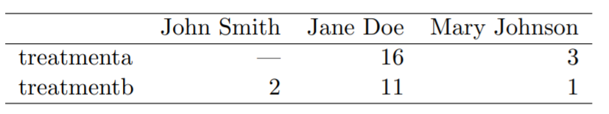

Slide 7
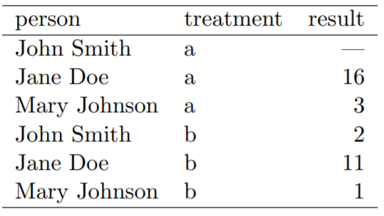

Slide 8
Split, Apply, Combine

Slide 9
Pipe operator %>%
Shortcut: ctrl/cmd + shift + m
Links together a sequence of functions by taking the output of preceding functions as input for subsequent functions
Increased readability

Slide 10
Sources
Introduction to dplyr: https://cran.r-project.org/web/packages/dplyr/vignettes/dplyr.html
Data transformation: https://r4ds.had.co.nz/transform.html
Data Wrangling with R: https://cengel.github.io/R-data-wrangling/

