Slide 1
DPLYR

Slide 2
WHAT IS DPLYR?
A grammar of data manipulation that helps to solve the most common data manipulation challenges

Slide 3
WHAT CHALLENGES?
Add new variables that are functions of existing variables | mutate()
Pick variable based on their names | select()
Pick cases based on their values | filter()
Reduce mutiple values down to a single summary | summarise()
Change the ordering of the rows | arrange()

Slide 4
WHAT IS TIDY DATA?
Each variable forms a column.
Each observation forms a row.
Each type of observational unit forms a table

Slide 5
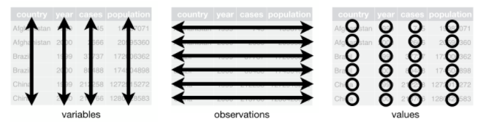

Slide 6
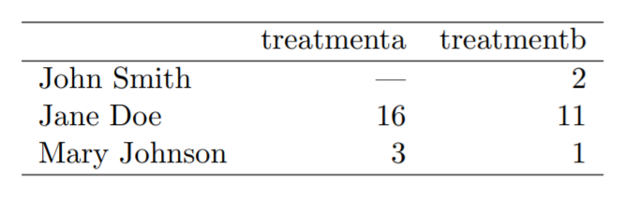

Slide 7
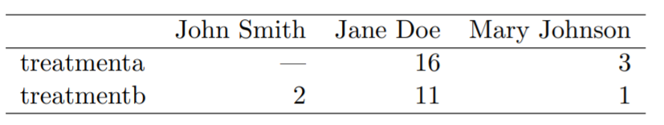

Slide 8
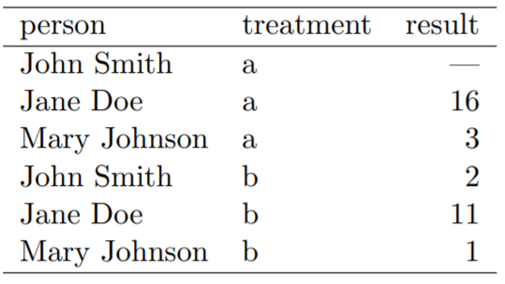

Slide 9
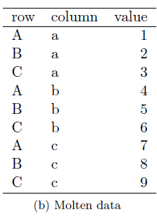
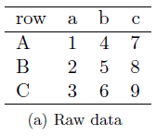

Slide 10
Pipe operator %>%
Shortcut: ctrl/cmd + shift + m
Links together a sequence of functions by taking the output of preceding functions as input for subsequent functions
Increased readability

Slide 11
Single table „verbs“
Rows:
filter() chooses rows based on column values.
slice() chooses rows based on location.
arrange() changes the order of the rows.
Columns:
select() changes whether or not a column is included.
rename() changes the name of columns.
mutate() changes the values of columns and creates new columns.
relocate() changes the order of the columns.
Groups of rows:
summarise() collapses a group into a single row.

Slide 12
EXERCISE: SPLIT, APPLY, COMBINE
Split the dataset into subsets or groups
Apply functions to the groups or subsets
Combine the results

Slide 13
Dataset: „dataset_1.xlsx“ under „econdata“
Variables: country name, region, GPD per capita, capital stock, total-factor-productivity, size of population
Task 1: Plot the development of the logged average GDP per capita by region between 1950 and 2017.
Task 2: Create a table of the top 10 countries with the highest growth rates during the period 1950 – 2017 using the following formula:
(x₂₀₁₇ – x₁₉₇₀)/ x₁₉₇₀

Slide 14
Sources
Introduction to dplyr: https://cran.r-project.org/web/packages/dplyr/vignettes/dplyr.html
Data transformation: https://r4ds.had.co.nz/transform.html
Data Wrangling with R: https://cengel.github.io/R-data-wrangling/

