Slide 1
The slides contain copyright material that belongs to Color Accounting International, Toby York and Middlesex University.
Use is subject to fair usage.
Notes:
Welcome to Middlesex University

Slide 2
Today’s structure
Conversation 1:
A butterfly recap
Conversation 2:
Deriving profit
Conversation 3:
Classic Transactions
Notes:
Today is about doing….
The board set-up is important so take your time with this. It can take around 10 minutes for the participants to get everything straight.
Tips, tricks and pitfalls
We have done definitions of assets, liabilities and equity in the butterfly.
This section does them again and introduces the all-important definitions of VGA (value generating activity) income and VSA (value sacrificing activity) expense.
These are “educational definitions”, not official definitions. They’ve proved to work really well in overcoming classic errors, like thinking that income is money.
To derive the income part of the framework you’ll do some of the Classic Transactions [ 1; 2; 6a and 6b ], but with different numbers:
Borrow money from lender £30,000
Owner invests money as equity £20,000
Make a sale £700
Cost associated with that sale £300
We use the last two transactions to introduce the concept of profit as generated equity.

Slide 3


2. A butterfly flutter by (quick recap)
https://en.butterflycorner.net
Notes:
Do a super-quick re-cap of the butterfly conversation
Point students to re-run of induction session at 3pm on Tuesday, or recordings if that session has passed.

Slide 4
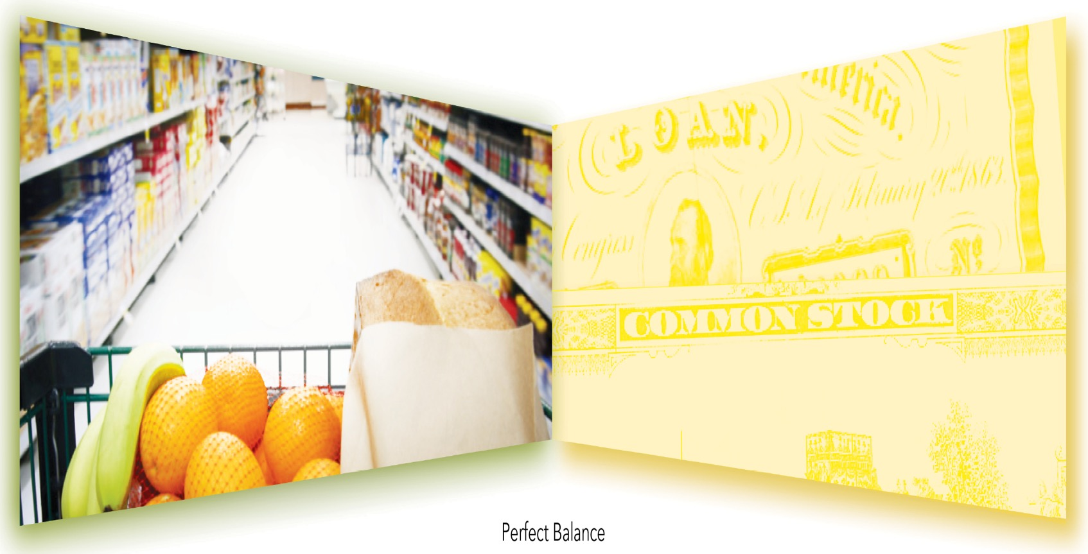
My Supermarket Limited
Uses of funds
Sources of funds
Assets
Liabilities
30,000
50,000
=
+
Equity
20,000
Notes:
Headlines
Build the story with numbers:
A = 50,000
L = 30,000
E = 20,000
Sequence Steps
Say: let’s assume this is a start-up business and we need all these assets we’ve identified. Let’s say we need £50,000 worth of assets. [ CLICK ] to reveal 50,000 in assets wing.
Ask: where will we get the 50,000 from for the assets?
Start with debt. Ask them what accountants call this element of the story – Liabilities and get them to write it in the wing like your example [ CLICK ]. State that we can borrow the funds from the lenders (creditors) and then we are contractually obligated to return those assets later. Say: let’s assume we have borrowed £30,000 – [ CLICK ] to reveal 30,000 in blue.
Ask: where else can we get funds for the assets we need?
From the owners. Accountants call this element of the story? Equity. [ CLICK ] to reveal Equity in the wing. State that if we source the funds from the owners (shareholders) then we are “morally” obliged to return those assets later (should also be a growth in net assets from profits).
How much do the owners? £20,000 – [ CLICK ] to reveal 20,000 in blue.
Note the POV distinction with owners – students may say ‘investment’ or ‘savings’ which are only correct if you are using the owners’ POV, which we are not. These examples can only be Assets from the entity’s POV.
If necessary, refer to “Point of view” discussion “A rabble of butterflies” on page 10. Also consider using ‘pineapple’ example if not done already.
Write ‘sources’ and ‘uses’ names to head each side and highlight ‘sources’ wing in yellow and ‘uses’ wing in green – they should replicate in their workbook. From here on, only refer to the sides by their colour or title – don’t use ‘right hand’ or ‘left hand’ as this can be very confusing for some people who mix up directions.

Slide 5
My Supermarket Limited
Uses of funds
Sources of funds
Assets
Liabilities
30,000
50,000
=
+
Equity
20,000
Equity and liabilities are never valuable
The only place you will find anything of value
Equity and liabilities are never valuable
Notes:
Headlines
The green side defines assets as VALUABLE THINGS – the only place you will find anything of value, and the yellow side defines liabilities and equity as OBLIGATIONS of the entity – assets come with obligations – the duality.
And also CLAIM per the accounting standards. Obligation is cleaner from entity POV.
They have created a balance sheet: Assets, Liabilities & Equity.

Slide 6
My Supermarket Limited
Uses of funds
Sources of funds
Assets
Liabilities
30,000
50,000
=
+
Equity
20,000
Assets
=
Liabilities
+
Equity
Assets
–
Liabilities
=
Equity
Notes:
Headlines
Address meaning of the equals sign: Equivalence of amount, but not of nature.
Facilitate the Accounting Equation underneath and the expression of the accounting equation in its other form:
A – L = Net assets
Discuss intention of business, which is to grow net assets (more so than just growing assets).
Address source of confusion: monetisation (both sides) versus money (green asset side only). Expressing values in currency, versus actual money. Add currency symbols.

Slide 7
My Supermarket Limited
Uses of funds
Sources of funds
Assets
Liabilities
$30,000
$50,000
=
+
Equity
$20,000
Assets
=
Liabilities
+
Equity
Assets
–
Liabilities
=
Equity
Notes:
Headlines
Address source of confusion: monetisation (both sides) versus money (green asset side only). Expressing values in currency, versus actual money.
Add currency symbols.

Slide 8
A rabble of butterflies
Entity 2
Loan receivable
Liabilities
Entity 1
Equity
Liabilities
Assets
Equity
Entity 3
Investment in equity
Liabilities
Equity
Notes:
Headlines
Point of view
Equity is never an asset. EQUITY IS NEVER VALUABLE
Detailed notes
Point of view is such a common cause for erroneous thinking. For example, people think equity is valuable/an asset because they are standing in the owners’ position but talking from the entity’s position.
Talking of equity: whenever we can, it’s impactful and usefully dramatic in a Colour Accounting session to make big, absolute statements such as:
“Equity is never an asset!”
People love absolutes. Hopefully a learner will challenge you and you can stand your ground: From the entity’s own point of view, equity’s never an asset. It’s an obligation. (It’s only an asset from the owner’s perspective and then it’s not called equity, but more likely investment).
This page supports the discussion why a heading identifying the entity on the butterfly diagram is so important… to lock down the point of view.
‘Rabble’ is one of the collective nouns for a group of butterflies.

Slide 9
3. Deriving profit
Uses of funds
Sources of funds
_Assets
Liabilities_
Equity_
Notes:
Conversation 3
The Accounting Framework
The value cycle
Accrual accounting
Tips, tricks and pitfalls
You will have done definitions of assets, liabilities and equity in the butterfly.
This section does them again and introduces the all-important definitions of VGA (value generating activity) income and VSA (value sacrificing activity) expense.
These are “educational definitions”, not official definitions. They’ve proved to work really well in overcoming classic errors, like thinking that income is money.
To derive the income part of the framework you’ll do some of the Classic Transactions [ 1; 2; 6a and 6b ], but with different numbers:
Borrow money from lender £30,000
Owner invests money as equity £20,000
Make a sale £700
Cost associated with that sale £300
We use the last two transactions to introduce the concept of profit as generated equity.

Slide 10
My Consulting Limited
Uses of funds
Sources of funds
_Assets
Liabilities_
Equity_
Notes:
Headlines
Relate “butterfly” to Accounting Framework
There’s another source of funds – income
Students should do what you do, in their workbooks, pages 12 – 13.
Sequence Steps
Point out that the Funding Butterfly is now shown as the top 3 boxes in the Framework – the balance sheet and they can ignore the bottom section for now.
Explain that we are now going to use some transactions to explore the third source of funds – that received from the customers. To do so we will start an imaginary consulting business.
Whose story? Reveal an entity name at top [ CLICK ]. Point of view!
Say: this story is a funding story.
Tell students to highlight the Uses of funds heading box in green and also the border of the assets box.
Tell students to highlight the Sources of funds heading box in yellow and also the border of liabilities and equity boxes and the dividing line.

Slide 11
My Consulting Limited
Uses of funds
Sources of funds
_Assets
Liabilities_
Bank loan
↑
↑
30,000
Cash
30,000
Equity_

Slide 12
My Consulting Limited
Uses of funds
Sources of funds
_Assets
Liabilities_
Bank loan
↑
↑
30,000
Cash
30,000
↑
Equity_
Cash
20,000
Contributed equity
↑
20,000

Slide 13
My Consulting Limited
Uses of funds
Sources of funds
_Assets
Liabilities_
Bank loan
↑
↑
30,000
Cash
30,000
↑
Equity_
Cash
20,000
Contributed equity
↑
20,000
↑
Cash
700

Slide 14
My Consulting Limited
Uses of funds
Sources of funds
_Assets
Liabilities_
Bank loan
↑
↑
30,000
Cash
30,000
↑
Equity_
Cash
20,000
Contributed equity
↑
20,000
↑
Cash
700
Cash
↑
300

Slide 15
My Consulting Limited
Uses of funds
Sources of funds
_Assets
Liabilities_
Bank loan
↑
↑
30,000
Cash
30,000
↑
Equity_
Cash
20,000
Contributed equity
↑
20,000
↑
Cash
700
Generated equity
Cash
↑
300
↑
400

Slide 16
My Consulting Limited
 | A | B | C
Sales | 700) | 401) | 1,000)
Cost of sales | (300) | (1) | (600)
Gross profit | £400) | £400) | £400)
 | 58% | 99% | 40%

Slide 17
My Consulting Limited
Uses of funds
Sources of funds
_Assets
Liabilities_
Bank loan
↑
↑
30,000
Cash
30,000
↑
Equity_
Cash
20,000
Contributed equity
↑
20,000
↑
Cash
700
Generated equity
Cash
↑
300
↑
400
_
_

Slide 18
My Consulting Limited
Uses of funds
Sources of funds
_Assets
Liabilities_
Bank loan
↑
↑
30,000
Cash
30,000
↑
Equity_
Cash
20,000
Contributed equity
↑
20,000
↑
Cash
700
Generated equity
Cash
↑
300
↑
400
_
_
Notes:
Headlines
Determine which is income and which is expense.
Let them try to work this out.
Sequence Steps
Give the following instructions very clearly and precisely – they should copy what you are doing on the whiteboard into their workbooks.
They can now continue the colour of each side down the page to the two smaller boxes in the Income Statement section. Green on the Uses of Funds Side and yellow on the Sources of Funds side. [ CLICK ]
Don’t write Income and Expense headings in yet or tell which is which.
Explain the double-click computer analogy where a folder opens and reveals sub-folders (more detailed info). This is how the Income Statement works – we ‘double-click’ the single Profit number in Equity, and the Income Statement explains how it was calculated.

Slide 19
My Consulting Limited
Uses of funds
Sources of funds
_Assets
Liabilities_
Bank loan
↑
↑
30,000
Cash
30,000
↑
Equity_
Valuable things
Cash
20,000
Contributed equity
Obligations
↑
20,000
↑
Cash
700
Generated equity
Cash
↑
300
↑
400
_Expenses
Income_
VSA
VGA

Slide 20
My Consulting Limited
Uses of funds
Sources of funds
_Assets
Liabilities_
Bank loan
↑
↑
30,000
Cash
30,000
↑
Equity_
Valuable things
Cash
20,000
Contributed equity
Obligations
↑
20,000
↑
Cash
700
Generated equity
Cash
↑
300
↑
700
_Expenses
Income_
VSA
VGA
Consulting
↑
700

Slide 21
My Consulting Limited
Uses of funds
Sources of funds
_Assets
Liabilities_
Bank loan
↑
↑
30,000
Cash
30,000
↑
Equity_
Valuable things
Cash
20,000
Contributed equity
Obligations
↑
20,000
↑
Cash
700
Generated equity
Cash
↑
300
↑
400
700
_Expenses
Income_
VSA
VGA
Travelling
↑
300
Consulting
↑
700

Slide 22
My Consulting Limited
Uses of funds
Sources of funds
_Assets
Liabilities_
Bank loan
↑
↑
30,000
Cash
30,000
↑
Equity_
Valuable things
Cash
20,000
Contributed equity
Obligations
↑
20,000
↑
Cash
700
Generated equity
Cash
↑
300
↑
400
_Expenses
Income_
VSA
VGA
Travelling
↑
300
Consulting
↑
700

Slide 23
My Consulting Limited
Uses of funds
Sources of funds
_Assets
Liabilities_
Equity_
Valuable things
Obligations
Profit
_Expenses
Income_
VSA
VGA

Slide 25
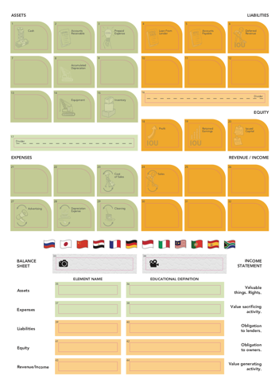
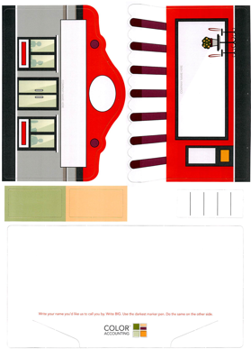

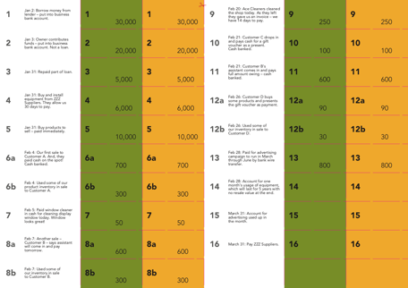
4. Classic Transactions

Slide 26
Global Books Limited
Uses of funds
Sources of funds
_Assets
Liabilities_
Equity_
Profit
_Expenses
Income_

Slide 27
Global Books Limited
2 January
1
30,000
30,000
대출기관에서 돈을 빌려 사업용 계좌에 입금하다.
Cash
30,000
Bank loan
30,000
생각의 흐름 (먼저 큰 그림부터 보기):
이 거래의 결과로 무엇이 더 많아졌는가, 또는 무엇이 더 줄어들었는가?
(in terms of Assets, Liabilities, Equity,
Revenue & Expenses?)

Slide 28
Global Books, Inc.
Uses of funds
Sources of funds
_Assets
Liabilities_
1
30,000
Bank loan
Equity_
Profit
1
30,000
Cash at bank
_Expenses
Revenue_
1
30,000
30,000
대출기관에서 돈을 빌려 사업용 계좌에 입금하다
Cash
30,000
Bank loan
30,000
Notes:
Have them open a green bucket in assets and a yellow bucket in liabilities.
Walk around and check that they only have the three buckets open on their board: assets, liabilities, equity (profit).
Ask what further information can we add to the story so far?
Facilitate their responses to get ‘account names’.
Direct them to the stickers or ask for suggestions – facilitate the asset account being ‘Cash’ (they can also add Bank label if they want) and the Liability account being ‘Loan from:”.
Say: Look inside the the cash account – what is its current balance? (facilitate – zero).
Say: What should its balance be? (facilitate – 30,000).
Say: So, we need to increase our cash account balance – a way to make this green account, more green.
Which colour ticket (green or yellow) will make our green account, more green? (facilitate – green).
Hint: if someone responds orange (it’s rare), it may be that they weren’t following you closely. Or they may have a logic error happening which you will need to help them with.
Say: So, we have a rule. If we place a green ticket into a green bucket, that means ‘increase’.

Slide 29
Global Books Limited
3 January
2
20,000
20,000
소유주가 자금을 출자하여 사업용 계좌에 입금함. 대출이 아님.
Cash
20,000
contributed capital
20,000
생각의 흐름 (먼저 큰 그림부터 보기):
이 거래의 결과로 무엇이 더 많아졌는가, 또는 무엇이 더 줄어들었는가?
(in terms of Assets, Liabilities, Equity,
Revenue & Expenses?)

Slide 30
Global Books, Inc.
Uses of funds
Sources of funds
_Assets
Liabilities_
1
30,000
Bank loan
Equity_
Profit
2
20,000
1
30,000
2
20,000
Cash at bank
Contributed capital
_Expenses
Revenue_
2
20,000
20,000
소유주가 자금을 출자하여 사업용 계좌에 입금함. 대출이 아님.
Cash
20,000
Contributed capital
20,000
Notes:
As the ticket moves into a bucket say “I am increasing the cash account by $20,000” which is more useful than saying “I am putting a green ticket into a green bucket”.
Have the participants use all their primary learning senses while putting the ticket in the bucket: feel ticket, see movement, say “I’m increasing/decreasing the x account by $x).
Carefully drill the increase rule when you get to that.
Ask the group: Are we in balance?
Stand centred in front of the screen with your arms out straight out from your sides and horizontal to floor (nothing in your hands).
Say: we had an increase in Assets (lift your right arm) and the same increase in Equity (lift your left arm) so we remain in balance (return both arms to level position).
Additional:
Point to Liabilities and Equity on the whiteboard and say: How much money is here in Liabilities and Equity? Facilitate: None.
Money is an asset and can only be shown there.
Everything in Liabilities and Equity are just intangible legal concepts – evidencing obligation against the assets.
The current accounting net worth will be the owner’s contribution.

Slide 31
Global Books Limited
31 January
3
5,000
5,000
대출금의 일부를 상환함.
Bank loan
5,000
Cash
5,000

Slide 32
Global Books, Inc.
Uses of funds
Sources of funds
_Assets
Liabilities_
3
5,000
1
30,000
Bank loan
Equity_
3
5,000
Profit
2
20,000
1
30,000
2
20,000
Cash at bank
Contributed capital
_Expenses
Revenue_
3
5,000
5,000
대출금의 일부를 상환함.
Bank loan
5,000
Cash
5,000
Notes:
In the debrief, drill the new rule for decreases.
Say: If we use the same colour ticket as the bucket, that means increase.
And if we use the opposite colour ticket and bucket, that means decrease.
That’s debits and credits using colour.
The flight attendant pose will this time see a decrease on each side.
Remain vigilant for any students using a ‘positive / negative’ model to explain how accounting works and encourage them to just use green and yellow for now.
More options:
Tickets represent ‘effects’.
Realising that that is all a ticket is, just an effect, is an ‘aha’ for learners. They often think tickets have more meaning than they do.
Note also, we use the word ‘impact’ to refer to the result of the ticket upon a bucket, i.e., an increasing impact or a decreasing impact.
Conclusion: There are two effects: green and yellow and there are two impacts: increase and decrease.

Slide 33
Uses of funds
Sources of funds
Cash at bank
Bank loan

Slide 34
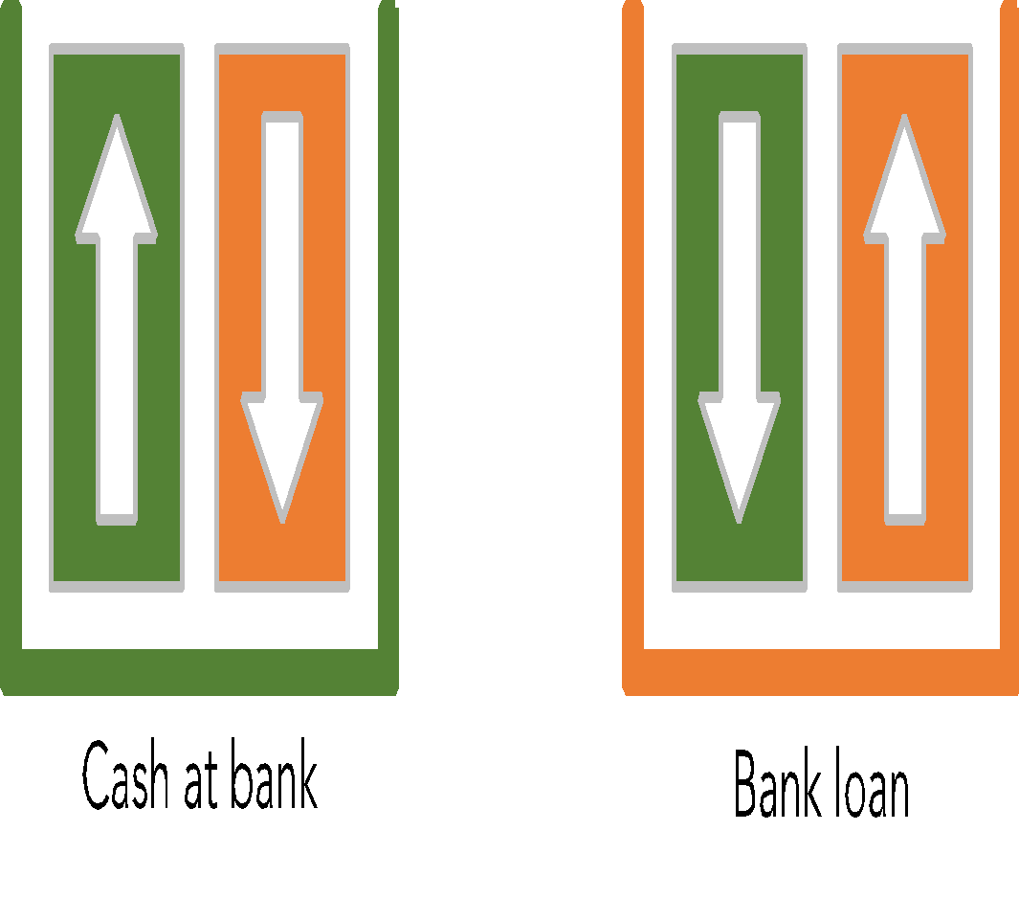
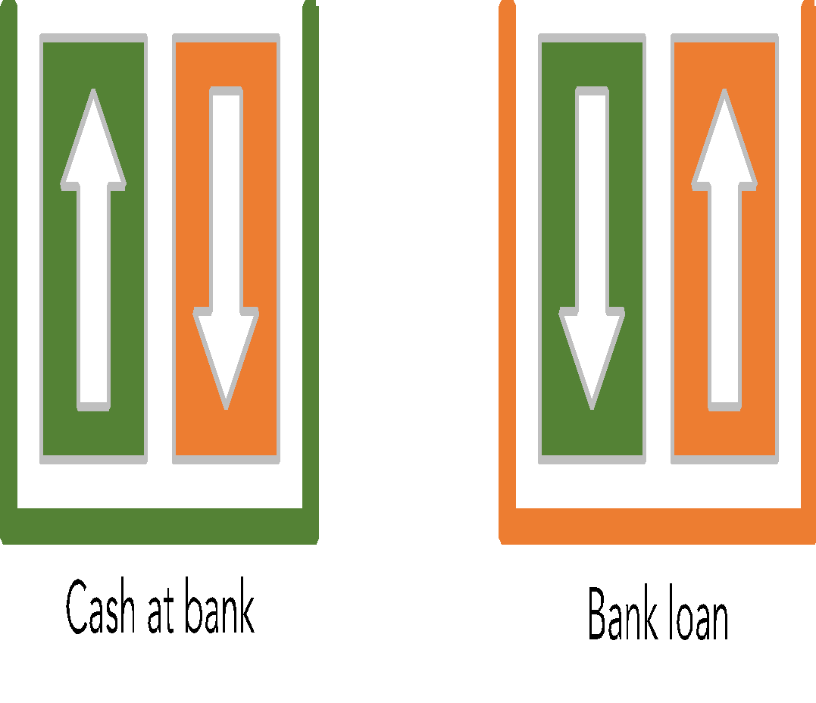
Uses of funds
Sources of funds

Slide 35
Global Books Limited
31 January
4
6,000
6,000
ZZZ 공급업체로부터 장비를 구매 및 설치함. 결제 기한은 30일 후.
Equipment
6,000
Accounts payable
6,000

Slide 36
Global Books, Inc.
Uses of funds
Sources of funds
_Assets
Liabilities_
3
5,000
4
6,000
1
30,000
Accounts payable
Bank loan
Equity_
3
5,000
Profit
2
20,000
4
6,000
1
30,000
2
20,000
Equipment
Cash at bank
Contributed capital
_Expenses
Revenue_
4
ZZZ 공급업체로부터 장비를 구매 및 설치함. 결제 기한은 30일 후.
Equipment
6,000
Accounts payable
6,000
6,000
6,000
Notes:
In debrief, work through logic carefully.
New asset and new obligation.
In accounting, we record things as they occur, not necessarily when cash is received or paid.
Today we owe – tomorrow we’ll pay – we record the payment only when it happens.

Slide 37
Global Books Limited
31 January
5
10,000
10,000
판매용 상품을 구매하고 즉시 결제함.
Inventory
10,000
Cash
10,000
Notes:
First Tx with both effects on the same side.

Slide 38
Global Books, Inc.
Uses of funds
Sources of funds
_Assets
Liabilities_
3
5,000
4
6,000
1
30,000
Accounts payable
Bank loan
Equity_
5
10,000
3
5,000
Profit
2
20,000
4
6,000
1
30,000
5
10,000
2
20,000
Equipment
Cash at bank
Inventory
Contributed capital
_Expenses
Revenue_
5
판매용 상품을 구매하고 즉시 결제함.
Inventory
10,000
Cash
10,000
10,000
10,000
Notes:
Watch participants as they look over at the yellow side of the board thinking that there must be a yellow bucket.
Let them work it out.
If necessary, prompt them with a vague question like ‘Why are you looking at the yellow side?’
When doing the solution piece, get them to start with the cash entry first (good form, and eliminates half of the entry in one go!).
In flight attendant pose, show decrease first (right arm for assets) and then increase back to level.

Slide 39
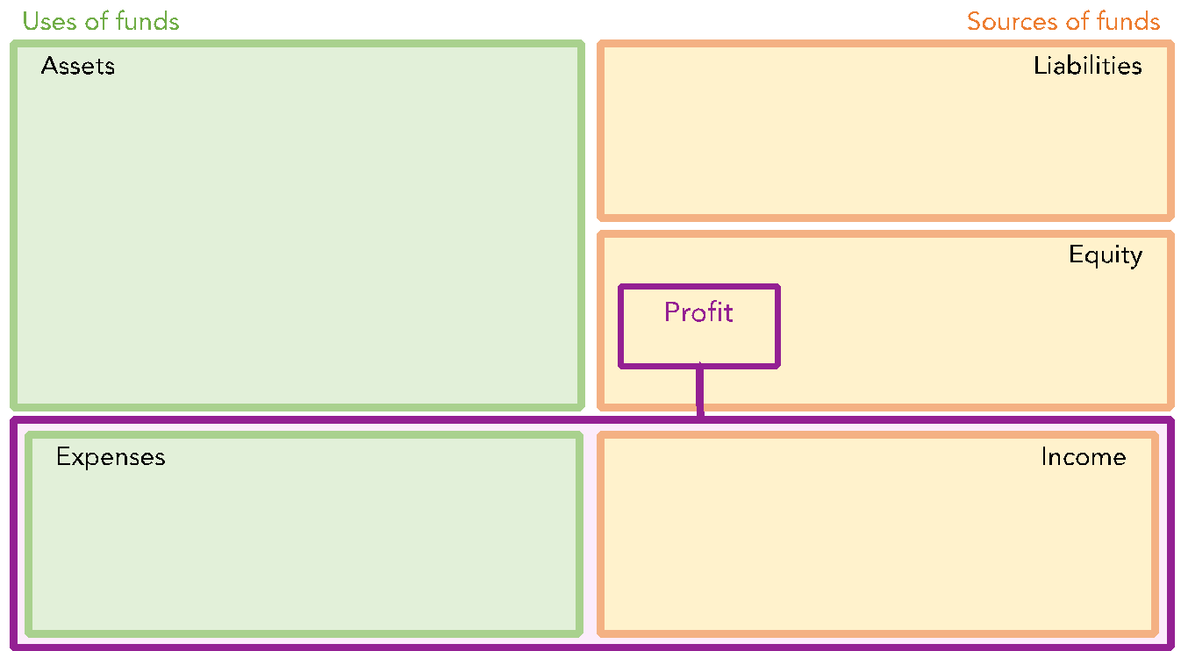
4: Classic Transactions

Slide 40
4: Classic Transactions

Slide 41
4: Classic Transactions

Slide 42
4: Classic Transactions

Slide 43
Global Books Limited
4 February
6a
700
700
고객 A에게 첫 판매를 진행했고, 현장에서 현금으로 결제받아 은행에 입금함.
Cash
700
Sales
700

Slide 44
Global Books, Inc.
Uses of funds
Sources of funds
_Assets
Liabilities_
6a
고객 A에게 첫 판매를 진행했고, 현장에서 현금으로 결제받아 은행에 입금함.
Cash
700
Sales
700
700
700
3
5,000
4
6,000
1
30,000
Accounts payable
Bank loan
6a
700
Equity_
5
10,000
3
5,000
Profit
2
20,000
700
4
6,000
1
30,000
5
10,000
2
20,000
Equipment
Cash at bank
Inventory
Contributed capital
_Expenses
Revenue_
6a
700
Revenue (sales)
Notes:
It’s OK for them to struggle a bit here while they work it out.
If helpful, act out a little role play while you say: a customer came in, picked up some books and brought them to the cash register to buy them.
Have we earned (income) the right to be paid (asset)? Yes.
And were we paid? Yes.
(This sets up an anchor for later Tx 8a, 9, 12a and 13 – separation of cash from accrual).
In the debrief, ask them – if the clock stopped now, what would our profit show as?
Facilitate how the income statement is a detailed version of the single number for profit in Equity. Double-click!

Slide 45
Global Books Limited
4 February
6b
300
300
고객 A에게 첫 판매를 진행했고, 현장에서 현금으로 결제받아 은행에 입금함.
Cost of sales
300
Inventory
300

Slide 46
Global Books, Inc.
Uses of funds
Sources of funds
_Assets
Liabilities_
3
5,000
6b
300
고객 A에게 판매하면서 일부 재고를 사용함.
Cost of sales
300
Inventory
300
6,000
300
4
1
30,000
Accounts payable
Bank loan
6a
700
Equity_
5
10,000
3
5,000
Profit
2
20,000
6b
300
700
400
4
6,000
1
30,000
5
10,000
2
20,000
Equipment
Cash at bank
Inventory
Contributed capital
_Expenses
Revenue_
6b
300
6a
700
Cost of sales
Revenue (sales)
Notes:
Drill the causal effect between the sale event triggering the cost of sale event.
Ask: what effect do sales and other income have on Equity? So, do the owners love or hate income? Love.
Ask: what effect do expenses have on Equity?
So, do the owners love or hate income? Hate. (necessary evil)
Point out that 6a and 6b are the classic VGA and VSA transactions that we referred to in the Value Cycle conversation. The business sacrifices value (inventory walks out the door) in order to generate more value (cash flows into the bank account).
More value is generated than sacrificed. Assets overall have increased by $400, and to whom is the business obligated for the $400 of additional assets… the owners, which is what profit is… the increase in the net assets on behalf of the owners.
OPTIONAL DISCUSSION ABOUT MARGIN
Margin - Facilitate a discussion on the new information that has appeared in the Income Statement – the Gross Profit Margin $ & %. Ask: Is this enough? Facilitate some discussion around, ‘it depends’ – type of business, length of operating cycle etc. Give following example:
Let’s say we were selling loads of paper clips, and for everyone we sold we made $400 gross profit – would that work?
But let’s say we were making submarines, one every two years, and we made $400 gross profit – would that work?
Summarise: the business needs to make sufficient gross margin so as to pay the other expenses, service the debt, pay the taxes, replenish the assets and reward the owners. Therefore, they must pay close attention to this important metric.
*** FINISH HERE UNLESS TIME ALLOWS FOR MORE ***

Slide 47
Global Books Limited
5 February
7
50
50
오늘 진열창 청소를 해준 창문 청소업자에게 현금으로 비용을 지불함. 창문이 정말 깨끗해졌어요!
Cleaning
50
Cash
50

Slide 48
Global Books, Inc.
Uses of funds
Sources of funds
_Assets
Liabilities_
7
50
오늘 진열창 청소를 해준 창문 청소업자에게 현금으로 비용을 지불함. 창문이 정말 깨끗해졌어요!
Cleaning
50
Cash
50
50
3
5,000
4
6,000
1
30,000
Accounts payable
Bank loan
7
50
6a
700
Equity_
5
10,000
3
5,000
Profit
2
20,000
6b
300
400
350
4
6,000
1
30,000
5
10,000
2
20,000
Equipment
Cash at bank
Inventory
Contributed capital
_Expenses
Revenue_
7
50
Cleaning
6b
300
6a
700
Cost of sales
Revenue (sales)
Notes:
Profit effect? Cash impact?
Did this affect the gross profit?
No – not a direct expense.
It is an expense of doing business, so comes between the gross profit and the net profit.

Slide 49
Global Books Limited
7 February
8a
600
600
고객 B에게 또 다른 판매를 진행함. 그녀는 결제 담당자가 내일 와서 결제할 것이라고 말함.
Accounts receivable
600
Sales
600

Slide 50
Global Books, Inc.
Uses of funds
Sources of funds
_Assets
Liabilities_
8a
600
Accounts receivable
3
5,000
4
6,000
1
30,000
Accounts payable
Bank loan
8a
600
고객 B에게 또 다른 판매를 진행함. 그녀는 결제 담당자가 내일 와서 결제할 것이라고 말함.
Accounts receivable
600
Sales
600
7
50
600
6a
700
Equity_
5
10,000
3
5,000
Profit
2
20,000
6b
300
950
350
4
6,000
1
30,000
5
10,000
2
20,000
Equipment
Cash at bank
Inventory
Contributed capital
_Expenses
Revenue_
7
50
Cleaning
8a
600
6b
300
6a
700
Cost of sales
Revenue (sales)
Notes:
Some students may still muddle up 8a (the sale event) and 8b (the consequent COS event).
Refer back to Tx 6.
They should be able to work this out with minimal guidance from you.
If helpful, act out a little role play while you say: a customer came in, picked up some books and brought them to the cash register to buy them.
Have we earned (income) the right to be paid (asset)? Yes.
And were we paid? No. (separation of cash from accrual).
So the customer got the books, what did we get?
Objection: ‘But we haven’t been paid, so how can we recognise the sale?’ remind them of the definition of income – have we generated value (a receivable is valuable).
Note also that Global Books would only grant credit if at the time of the sale it was believed that the customer would keep their promise. A business would not want to make a credit sale to a bad credit risk. So at the time of sale Global Books believes the promise to be paid is a valuable promise.
Remind them that the definition of income is ‘value generating activity’ not ‘cash generating activity’. The form of the value-generated can be cash or accounts receivable or gold watches!
Note: you could draw your Receivables account immediately beside the Cash account to spatially demonstrate the closeness of these two accounts: cash and pre-cash.

Slide 51
Global Books Limited
7 February
8b
300
300
고객 B에게 판매하면서 일부 재고를 사용함.
Cost of sales
300
Inventory
300

Slide 52
Global Books, Inc.
Uses of funds
Sources of funds
_Assets
Liabilities_
8a
600
Accounts receivable
3
5,000
8b
300
고객 B에게 판매하면서 일부 재고를 사용함.
Cost of sales
300
Inventory
300
6,000
300
4
1
30,000
Accounts payable
Bank loan
7
50
6a
700
Equity_
5
10,000
3
5,000
8b
300
Profit
2
20,000
6b
300
650
950
4
6,000
1
30,000
5
10,000
2
20,000
Equipment
Cash at bank
Inventory
Contributed capital
_Expenses
Revenue_
7
50
Cleaning
8b
300
8a
600
6b
300
6a
700
Cost of sales
Revenue (sales)
Notes:
Review the margin on this sale – same $ but different %.

Slide 53
Global Books Limited
20 February
9
250
250
오늘 Ace Cleaners가 가게를 청소했으며, 14일 이내에 결제할 수 있는 청구서를 남겼습니다.
Cleaning
250
Accounts payable
250

Slide 54
Global Books, Inc.
Uses of funds
Sources of funds
_Assets
Liabilities_
8a
600
Accounts receivable
9
250
3
5,000
4
6,000
1
30,000
Accounts payable
Bank loan
7
50
9
오늘 Ace Cleaners가 가게를 청소했으며, 14일 이내에 결제할 수 있는 청구서를 남겼습니다.
Cleaning
250
Accounts payable
250
6a
700
250
250
Equity_
5
10,000
3
5,000
8b
300
Profit
2
20,000
6b
300
650
400
4
6,000
1
30,000
5
10,000
2
20,000
Equipment
Cash at bank
Inventory
Contributed capital
_Expenses
Revenue_
9
250
7
50
Cleaning
8b
300
8a
600
6b
300
6a
700
Cost of sales
Revenue (sales)
Notes:
We got a clean shop to the value of $250.
What did the cleaners get in return?
Another operating expense.
Should we have a separate account or a single cleaning account? Depends on what questions we will later need to answer. Cost-benefit.
Introduce the terms Debit and Credit about now
Get them to re-articulate the solution using the terms Debit and Credit instead of Increase and Decrease.
When talking about effects, try and use the words debiting and crediting. When talking about accounts (buckets), talk about debit and credit accounts.

Slide 55
Global Books Limited
21 February
10
고객 C가 방문하여 선물용 상품권을 현금으로 구매함. 현금은 은행에 입금함.
Cash
100
Deferred income
100
100
100

Slide 56
Global Books, Inc.
Uses of funds
Sources of funds
_Assets
Liabilities_
8a
600
Accounts receivable
9
250
3
5,000
4
6,000
10
100
1
30,000
10
100
Accounts payable
Deferred revenue
Bank loan
7
50
6a
700
Equity_
5
10,000
3
5,000
8b
300
Profit
2
20,000
6b
300
400
4
6,000
1
30,000
5
10,000
2
20,000
Equipment
Cash at bank
Inventory
Contributed capital
_Expenses
Revenue_
10
고객 C가 방문하여 선물용 상품권을 현금으로 구매함. 현금은 은행에 입금함.
Cash
100
Deferred revenue
100
9
250
100
100
7
50
Cleaning
8b
300
8a
600
6b
300
6a
700
Cost of sales
Revenue (sales)
Notes:
The customer gave us $100.
What did we give them in return?
(It must be something that the customer believes is worth at least $100).
Let them struggle a bit. We gave them a promise (to serve) in return.
To us, that is an obligation.
Since we haven’t yet delivered goods or services in return for the cash (and thereby haven’t earned anything), the obligation is clearly to the creditor (in this case a customer becomes a creditor), not the owners.

Slide 57
Global Books Limited
21 February
11
고객 B의 비서가 방문하여 미지급 금액 전액을 결제함. 현금은 은행에 입금함.
Cash
600
Accounts receivable
600
600
600

Slide 58
Global Books, Inc.
Uses of funds
Sources of funds
_Assets
Liabilities_
11
600
8a
600
Accounts receivable
9
250
3
5,000
11
600
4
6,000
10
100
1
30,000
10
100
Accounts payable
Deferred revenue
Bank loan
7
50
6a
700
Equity_
5
10,000
3
5,000
8b
300
Profit
2
20,000
6b
300
400
4
6,000
1
30,000
5
10,000
2
20,000
Equipment
Cash at bank
Inventory
Contributed capital
_Expenses
Revenue_
11
250
600
600
고객 B의 비서가 방문하여 미지급 금액 전액을 결제함. 현금은 은행에 입금함.
Cash
600
Accounts receivable
600
9
7
50
Cleaning
8b
300
8a
600
6b
300
6a
700
Cost of sales
Revenue (sales)
Notes:
Global Books has swapped one asset (a promise to be paid) for another, better asset––cash.
Note that the receipt of cash had no impact on income––income is activity that generates value, it is not the value.
Detail oriented students (audit types) may notice that the payment was late – promised payment within 1 day – took 2 weeks. Not good form.

Slide 59
Global Books Limited
26 February
12a
90
90
고객 D가 일부 상품을 구매하고, 결제 수단으로 상품권을 제시함.
Deferred income
90
Sales
90

Slide 60
Global Books, Inc.
Uses of funds
Sources of funds
_Assets
Liabilities_
11
600
8a
600
Accounts receivable
9
250
12a
90
3
5,000
11
600
4
6,000
10
100
1
30,000
10
100
Accounts payable
Deferred revenue
Bank loan
7
50
12a
700
90
90
고객 D가 일부 상품을 구매하고, 결제 수단으로 상품권을 제시함.
Deferred revenue
90
Sales
90
6a
Equity_
5
10,000
3
5,000
8b
300
Profit
2
20,000
6b
300
400
490
4
6,000
1
30,000
5
10,000
2
20,000
Equipment
Cash at bank
Inventory
Contributed capital
_Expenses
Revenue_
9
250
7
50
Cleaning
12a
90
8b
300
8a
600
6b
300
6a
700
Cost of sales
Revenue (sales)
Notes:
Demonstrate them how the obligation associated
with $90 of the $100 cash has shifted from creditors
to owners (via generated equity – profit).

Slide 61
Global Books Limited
26 February
12b
고객 D에게 판매하면서 일부 재고를 사용함.
Cost of sales
30
Inventory
30
30
30

Slide 62
Global Books, Inc.
Uses of funds
Sources of funds
_Assets
Liabilities_
11
600
12b
8a
600
Cost of sales
30
Inventory
30
고객 D에게 판매하면서 일부 재고를 사용함.
30
30
Accounts receivable
9
250
12a
90
3
5,000
11
600
4
6,000
10
100
1
30,000
10
100
Accounts payable
Deferred revenue
Bank loan
7
50
6a
700
Equity_
5
10,000
12b
30
3
5,000
8b
300
Profit
2
20,000
6b
300
460
490
4
6,000
1
30,000
5
10,000
2
20,000
Equipment
Cash at bank
Inventory
Contributed capital
_Expenses
Revenue_
9
250
7
50
Cleaning
12b
30
12a
90
8b
300
8a
600
6b
300
6a
700
Cost of sales
Revenue (sales)

Slide 63
Global Books Limited
28 February
13
800
800
3월부터 6월까지 진행될 광고 캠페인 비용을 은행 이체로 결제함.
Deferred expenses
800
Cash
800

Slide 64
Global Books, Inc.
Uses of funds
Sources of funds
_Assets
Liabilities_
11
600
8a
600
13
800
Accounts receivable
9
250
12a
90
3
5,000
11
600
4
6,000
10
100
1
30,000
10
100
Accounts payable
Deferred revenue
Bank loan
50
13
800
7
6a
700
Deferred expenses
Equity_
5
10,000
12b
30
3
5,000
8b
300
Profit
2
20,000
6b
300
460
4
6,000
1
30,000
5
10,000
2
20,000
Equipment
Cash at bank
Inventory
Contributed capital
13
800
800
3월부터 6월까지 진행될 광고 캠페인 비용을 은행 이체로 결제함.
Deferred expenses
800
Cash
800
_Expenses
Revenue_
9
250
7
50
Cleaning
12b
30
12a
90
8b
300
8a
600
6b
300
6a
700
Cost of sales
Revenue (sales)
Notes:
They will typically think it is an expense: because we spent money or because advertising is an expense.
Help them work through the logic – refer them to the dates.
We gave the supplier $800. What did they give us in return?
The business has bought the right to receive advertising.
Only if a participant raises the issue: acknowledge that simplified bookkeeping practice can expense the payment immediately, and then – as a closing entry for the period/year - capitalise the portion that is not yet consumed.
Same result at the end of the period but the monthly P&Ls will not reflect the underlying business activities.

Slide 65
Global Books Limited
31 March
14
해당 장비는 잔존가치 없이 5년간 사용할 예정이며, 이번 달 사용분에 대해 회계 처리함.
Depreciation
100
Accumulated depreciation
100
100
100

Slide 66
Global Books Limited
Uses of funds
Sources of funds
_Assets
Liabilities_
Net book value
14
100
Accumulated depreciation
Equity_
Profit
4
6,000
17
100
2
20,000
Equipment
Dividends
contributed capital
_Expenses
Income_
14
100
Depreciation charge

Slide 67
Global Books Limited
Uses of funds
Sources of funds
_Assets
Liabilities_
Equity_
Profit
17
1,000
2
20,000
Dividends
contributed capital
_Expenses
Income_

Slide 68
Global Books, Inc.
Uses of funds
Sources of funds
_Assets
Liabilities_
11
600
8a
600
13
800
Accounts receivable
9
250
12a
90
3
5,000
Net book value
11
600
4
6,000
10
100
1
30,000
10
100
Accounts payable
Deferred revenue
Bank loan
50
13
800
7
14
100
6a
700
Deferred expenses
Equity_
Accumulated depreciation
5
10,000
12b
30
3
5,000
8b
300
Profit
2
20,000
6b
300
360
460
4
6,000
1
30,000
5
10,000
2
20,000
Equipment
Cash at bank
Inventory
Contributed capital
14
100
해당 장비는 잔존가치 없이 5년간 사용할 예정이며, 이번 달 사용분에 대해 회계 처리함.
Depreciation
100
Accumulated depreciation
100
_Expenses
100
Revenue_
9
250
7
50
Cleaning
12b
30
12a
90
8b
300
8a
600
14
100
6b
300
6a
700
Depreciation
Cost of sales
Revenue (sales)
Notes:
Monthly depreciation amount is $100 being
$6,000 divided by 60 months.
Depreciation causes a lot of confusion, in part, because it is doing two things at once, and students need to know which part of the transaction they are looking at.
Accounting duality means that depreciation does two things:
– it Books, Inc. the reduction of an asset’s value as it is used up and this “loss of value” accumulates (builds up) in the balance sheet.
This is the “credit”
– it Books, Inc. the sacrifice of value as an expense: the depreciation charge.
This is the “debit”

Slide 69
Global Books Limited
31 March
15
200
200
3월 31일까지 사용된 이연 광고비를 회계 처리함.
Advertising
200
Deferred expenses
200
Notes:
Let the students attempt the calculation.
Account for deferred advertising used up in the month to 31 March.

Slide 70
Global Books, Inc.
Uses of funds
Sources of funds
_Assets
Liabilities_
11
600
8a
600
13
800
Accounts receivable
9
250
12a
90
3
5,000
11
600
4
6,000
10
100
1
30,000
100
15
200
Accounts payable
Deferred revenue
Bank loan
10
800
7
50
13
14
100
6a
700
Deferred expenses
Equity_
Accumulated depreciation
5
10,000
12b
30
3
5,000
8b
300
Profit
2
20,000
6b
300
160
360
4
6,000
1
30,000
5
10,000
2
20,000
Equipment
Cash at bank
Inventory
Contributed capital
15
3월 31일까지 사용된 이연 (deferred) 광고비 를 회계 처리함.
200
Deferred expenses
200
Advertising
200
200
_Expenses
Revenue_
9
250
7
50
Cleaning
12b
30
12a
90
8b
300
8a
600
14
100
15
200
6b
300
6a
700
Depreciation
Advertising
Cost of sales
Revenue (sales)
Notes:
One quarter of the advertising is consumed, according to the dates and using a straight-line matching/pro rata concept for recognising the expense.

Slide 71
Global Books Limited
31 March
16
6,000
6,000
ZZZ 공급업체에게 전액 지급함.
Accounts payable
6,000
Cash
6,000

Slide 72
Global Books, Inc.
Uses of funds
Sources of funds
_Assets
Liabilities_
11
600
16
6,000
8a
600
16
6,000
13
800
Accounts receivable
9
250
12a
90
3
5,000
11
600
4
6,000
10
100
1
30,000
100
15
200
Accounts payable
Deferred revenue
Bank loan
10
800
7
50
13
14
100
6a
700
Deferred expenses
Equity_
Accumulated depreciation
5
10,000
12b
30
3
5,000
8b
300
Profit
2
20,000
6b
300
160
4
6,000
1
30,000
5
10,000
2
20,000
Equipment
Cash at bank
Inventory
Contributed capital
_Expenses
Revenue_
16
6,000
6,000
ZZZ 공급업체에게 전액 지급함.
Accounts payable
6,000
Cash
6,000
9
250
7
50
Cleaning
12b
30
12a
90
8b
300
8a
600
14
100
15
200
6b
300
6a
700
Depreciation
Advertising
Cost of sales
Revenue (sales)

Slide 73
Global Books Limited
Uses of funds
Sources of funds
_Assets
Liabilities_
11
600
16
6,000
8a
600
16
6,000
13
800
Accounts receivable
9
250
12a
90
3
5,000
11
600
4
6,000
10
100
1
30,000
100
15
200
Accounts payable
Deferred income
Bank loan
10
800
7
50
13
14
100
6a
700
Deferred expenses
Equity_
Accumulated depreciation
5
10,000
12b
30
3
5,000
300
Profit
8b
Profit
2
20,000
6b
300
160
4
6,000
1
30,000
5
10,000
160
2
20,000
Equipment
Cash at bank
Inventory
contributed capital
_Expenses
Income_
9
250
7
50
Cleaning
12b
30
12a
90
8b
300
8a
600
14
100
15
200
6b
300
6a
700
Depreciation
Advertising
Cost of sales
Revenue (sales)

Slide 75



