Slide 1
Chapter 4: Statement of Cash Flows
1

Slide 2
Table of Contents
1. Objectives and Utility of Cash Flow Reporting
2. Classification of Cash Inflows and Outflows
3. Direct Method vs. Indirect Method – Cash Flows from Operating Activities
2
Notes:
We will move through six sections, starting with why we need accounting information, moving through the mechanics of the statements, and finishing with how to analyze those statements using ratios like ROE.

Slide 3
Objectives and Utility of Cash Flow Reporting
3

Slide 4
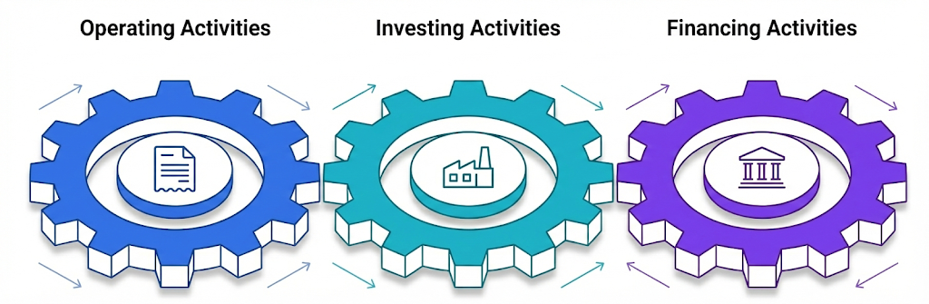
The Three Engines of Cash Flow
4

Slide 5
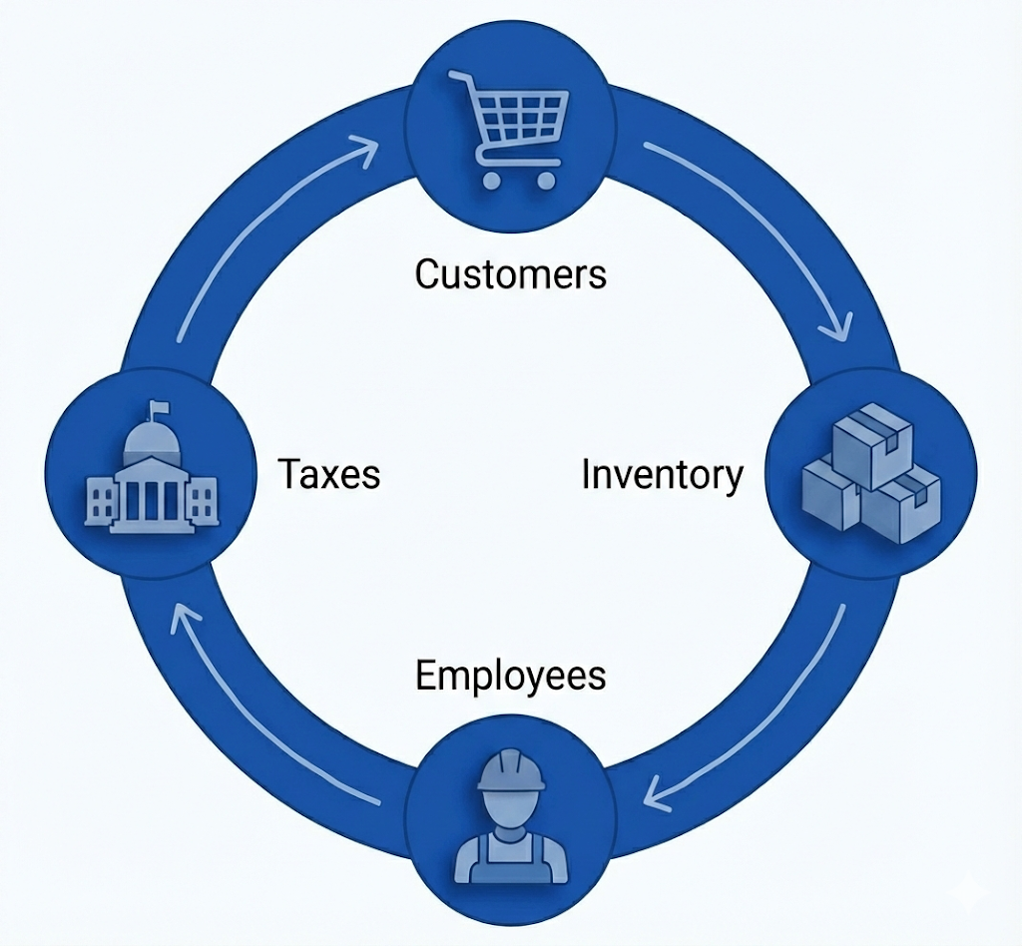
Operating Activities : The Heartbeat of the Business
Operating Activities involve income statement items reported on a cash basis
Cash Inflows
Sale of goods/services
Dividends received
Interest Revenue *
Cash Outflows
To Suppliers
To Employees
To Government (Taxes)
To Lenders (Interest expense)*
* Careful! These are reported in operating, not investing/financing sections of statement of cash flows
5

Slide 6
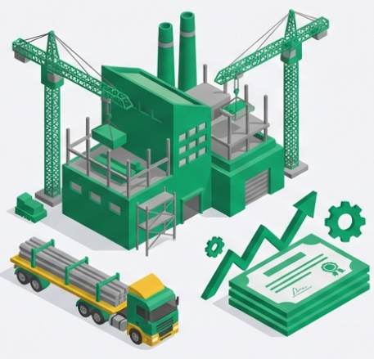
Investing Activities :Spending now to grow later
Investing activities focus on long-term assets and investment
Cash Inflows (Selling)
Sale of PP&E
Sale of Investments
Collection of Loans
Cash Outflows (Buying)
Purchase of PP&E
Purchase of Investments
Lending to others
PP&E : Property, Plant and Equipment
6

Slide 7
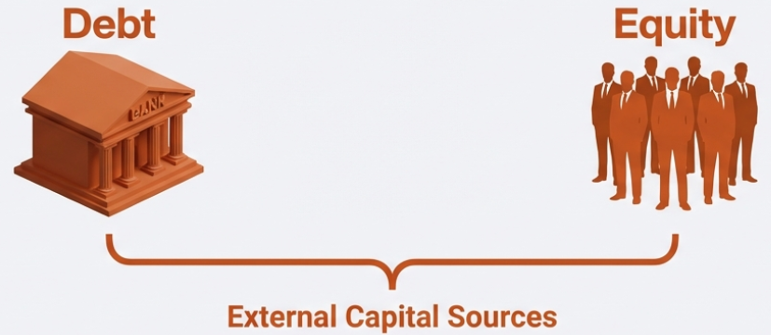
Financing Activities :Managing the Capital supply
Financing activities represents how the company funds its capital needs
Cash Inflows (Selling)
Issuing Bonds/Notes
Selling Stock
Cash Outflows (Buying)
Repaying Principal
Paying Dividends
Buying back its own Stock (Treasury stocks)
7

Slide 8
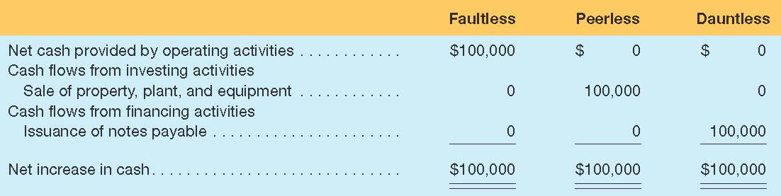
Usefulness of Classification
Three competitors generated $100,000 of cash:
Summary Information for Three Competitors
A likely recurring source that can sustain the company.
Repayment required
Not likely to recur.
Will replacement assets be needed?
8

Slide 9
Concept Quiz 1
Issued common stock ($300k)
Financing
Inflow
Purchased equipment ($35k)
Investing Outflow
Paid salaries ($17k)
Operating Outflow
Paid salaries ($17k)
Operating
Outflow
Sold delivery truck ($8k)
Investing Inflow
Sold inventory ($11k)
Operating
Inflow
Paid cash dividend ($1OOk)
Received cash dividend ($50k)
Operating
Inflow
Financing
Outflow
9

Slide 10
Classification Issue: U.S. GAAP vs. IFRS
Classification of the payment/receipt of dividend and Interest is different under the U.S. GAAP and the IFRS.
U.S. GAAP
Operating Activities
Dividends received
Interest received
Interest paid
Investing Activities
Financing Actives
Dividends paid
IFRS
Operating Activities
Investing Activities
Dividends received
Interest received
Financing Actives
Dividends paid
Interest paid
10

Slide 11
Cash Flows From Operating Activities : Direct vs. Indirect Method
11

Slide 12

Two Ways to Report Operating Cash Flows
DIRECT METHOD
The Checkbook Approach
Cash Receipts – Cash Payments
Cash Flow
Calculation
INDIRECT METHOD
Net Cash Flow
From Operating Activities
The Reconciliation Approach
Net Income +/- Adjustments
12
Notes:
Accounting is more than just math; it is a system of communication. The key distinction is the audience. Financial accounting targets outside decision-makers like banks and shareholders, whereas Managerial accounting is for the internal team running the business.

Slide 13
The Direct Method – Receipts & Disbursements
Case Study: United Brands Corporation (Year Ended Dec 31, 2021)
Cash Flows from Operating Activities ($ in millions)
From customers: | +98
From investment revenue: | +3
To suppliers of goods: | (50)
To employees: | (11)
For interest: | (3)
For Insurance: | (4)
For income taxes: | (11)
Net cash flows from operating activities: | $22
13
Notes:
Accounting is more than just math; it is a system of communication. The key distinction is the audience. Financial accounting targets outside decision-makers like banks and shareholders, whereas Managerial accounting is for the internal team running the business.

Slide 14
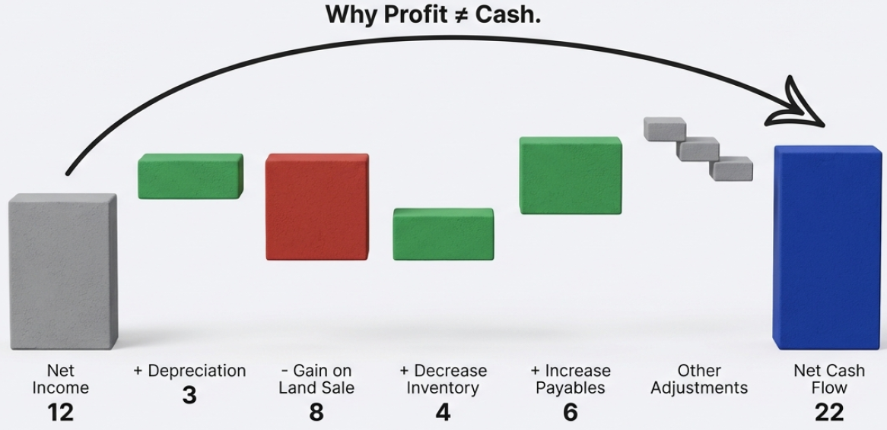
The Indirect Method – Reconciliation of Net Income to Cash Flow
14
Notes:
Accounting is more than just math; it is a system of communication. The key distinction is the audience. Financial accounting targets outside decision-makers like banks and shareholders, whereas Managerial accounting is for the internal team running the business.

Slide 15
The Indirect Method – More common form
Cash Flows from Operating Activities ($ in millions)
Net Income: | $12
Adjustments for non-cash effects:
Depreciation expense: | 3
Gain on sale of land: | (8)
Loss on sale of equipment: | 2
Changes in Operating Assets/Liabilities
Increase in A/R: | (2)
Decrease in Inventory: | 4
Increase in A/P: | 6
Increase in salaries payable: | 2
Discount on bonds payable: | 2
Decrease in prepaid insurance: | 3
Decrease in income tax payable: | (2)
Net cash flows from operating activities: | $22
Matched Direct Method Result
15
Notes:
Accounting is more than just math; it is a system of communication. The key distinction is the audience. Financial accounting targets outside decision-makers like banks and shareholders, whereas Managerial accounting is for the internal team running the business.

Slide 16
The Complete Picture – United Brands
Operating
 | Net cash flows from operating activities: | $22
Investing
 | Purchase of land: | (30)
 | Purchase of short-term investment | (12)
 | Sale of land: | (18)
 | Sale of equipment: | 5
 | Net cash flows from investing activities: | (19)
Financing
 | Sale of common shares: | 26
 | Retirement of bods payable: | (15)
 | Payment of cash dividends: | (5)
 | Net cash flows from financing activities: | 6
 | Net increase in cash: | 9
 | Cash balance, Ja1: | 20
 | Cash balance, Dec 31 | $29
16
Notes:
Accounting is more than just math; it is a system of communication. The key distinction is the audience. Financial accounting targets outside decision-makers like banks and shareholders, whereas Managerial accounting is for the internal team running the business.

Slide 17
Example
United Brands Corporation
Statement of Cash Flows
For Year Ended Dec 31,2021
Cash Flows from Operating Activities | ($ in millions)
Cash inflows:
From customers | $ 98
From investment revenue | 3
Cash outflows:
To suppliers of goods | (50)
To employees | (11)
For interest | (3)
For insurance | (4)
For income taxes | (11)
Net cash flows from operating activities |  | $ 22
Cash Flows from Investing Activities
Purchase of land | (30)
Purchase of short-term investment | (12)
Sale of land | 18
Sale of equipment | 5
Net cash flows from investing activities |  | (19)
Cash Flows from Financing Activities
Sale of common shares | 26
Retirement of bonds payable | (15)
Payment of cash dividends | (5)
Net cash flows from financing activities |  | 6
Net increase in cash |  | 9
Cash balance, January 1 |  | 20
Cash balance, December 31 |  | $29
17

Slide 18
Analyzing United Brands’ Performance
Operating Cash: + $22M
Investing Cash: - $19M
Financing Cash: +6M
Positive & Strong.
Cash Flow ($22M) >
NI ($12M).
High quality of earnings.
Negative (Outflow).
Company is in growth mode, purchasing land and investments. Not liquidating assets.
Positive (Inflow).
Raising capital via stock ($26M) while responsibly retiring ($15M) and paying dividends.
Verdict: United Brands Corporation is a healthy, growing company funded by strong operations and new equity
18

Slide 19
Key Takeaways – Statement of Cash Flows
Operating
Investing
Financing
The Engine
(Performance)
The Future
(Growth)
The Fuel
(Solvency)
19

