Slide 1
Chapter 5: Financial Statement Analysis - Ratios
1

Slide 2
Table of Contents
Vertical & Horizontal Analysis
Return on Investment
Liquidity & Solvency
Common-size statements
Trend analysis
ROE, ROA, and ROFL
Short-term and long-term financial health
Plus: Altman Z-Score • Working Capital Analysis • Key Ratio Formulas
Extra: Using Ratios Analyzing and Interpreting Core Operating Activities
2

Slide 3
Part 1
Vertical & Horizontal
Analysis
3

Slide 4
Vertical & Horizontal Analysis
4

Slide 5
What is Financial Statement Analysis?
Identifies relationships and trends within financial statements over time and compared to other companies or industry averages.
Who Uses It?
Investors
Creditors
Managers
Assess investment risk
and growth potential
Evaluate credit risk
and repayment ability
Monitor performance
and make decisions
Before Analyzing — Understand the Business Context
Life cycle stage: Start-up, growth, or mature?
Competitive position: How does it compare to rivals?
Capital structure: Reliance on debt vs. equity?
Regulatory environment: Laws affecting operations?
5
Notes:
The uncertainty gap

Slide 6
Vertical Analysis – Common-Size Statement
Expresses each line item as a percentage of a designated base amount
Income Statement
Balance Sheet
Base = Net Sales (100%)
Base = Total Assets (100%)
Net Sales
100%
Cash
15%
COGS
45%
Receivables
20%
Gross Profit
55%
Inventory
25%
Operating Expenses
35%
PP&E
40%
Net Income
12%
Total Assets
100%
Why Use Vertical Analysis?
Compare companies of different sizes • Analyze cost structure • Compare across time periods • Reveal asset/liability composition
6
Notes:
The uncertainty gap

Slide 7
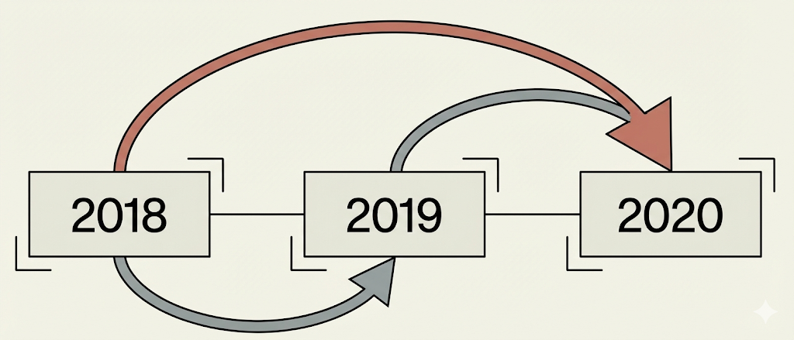
Horizontal Analysis – Trend Analysis Over Time
Identify trends over time
Compares financial data across periods (year-to-year or quarter-to-quarter)
Two Measure of Change [ex. Revenue: $70,372 (yr 2) & $67,161 (yr 1) ]
Dollar Change
Percent Change
Current Year − Prior Year
$70,372 – $67,161 = $3,211
(Current − Prior) / Prior
= 4.8%
Caution: Look at BOTH % and $ change — a tiny base can create misleading % changes!
7
Notes:
The uncertainty gap

Slide 8
Part 2
Return on Investment
ROE • ROA • ROFL • DuPont Model
8

Slide 9
Return on Equity (ROE)
$$ROE= \frac{Net income}{\text{Average} \text{stockholder}\text{′}\text{s} \text{equity}}$$
Measures how effectively a company generates profit from shareholders' investment
Warren Buffett's Focus
Cautions
High ROE & Low or reasonable debt
High debt can artificially boost ROE
ROE can be boosted by using more debt
Excessive debt raises bankruptcy risk
High ROE ≠ always good if driven by leverage
Use average balance (beginning + ending / 2) when comparing Balance Sheet amounts to Income Statement amounts
9
Notes:
The uncertainty gap

Slide 10
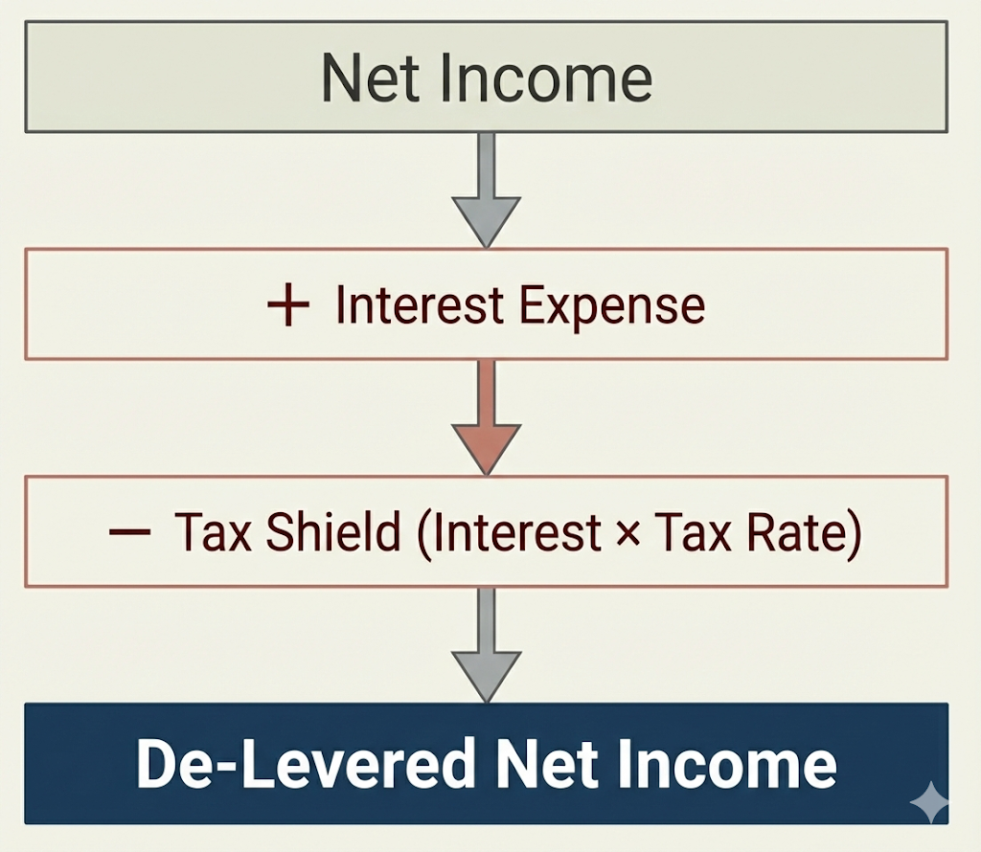

Return on Assets (ROA) – De-Levered ROA
$$ROE= \frac{Net income+\text{Interest} \text{expense}×(1−\text{Tax} \text{rate})}{\text{Average} \text{Total} \text{Assets}}$$
Measures how efficiently a company uses its assets to generate profit — regardless of financing method
Why Add Back After-Tax Interest?
Net income already includes interest expense.
Interest is a financing cost, not an operational flaw. To measure pure asset performance, we remove the penalty of debt.
This allows for comparison across companies regardless of their capital structure.
10
Notes:
Why add back interest?
Interest is a finance cost, not an operational flaw. To measure pure asset performance, we remove the penalty of debt.
This allows for comparison across companies regardless of their capital structure.

Slide 11
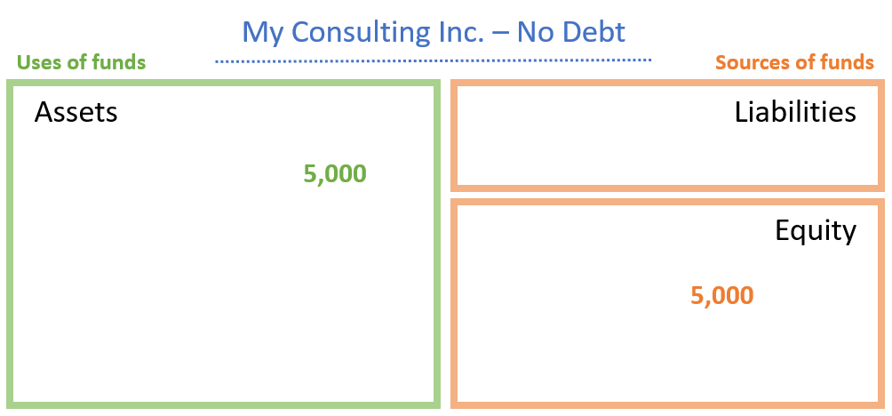
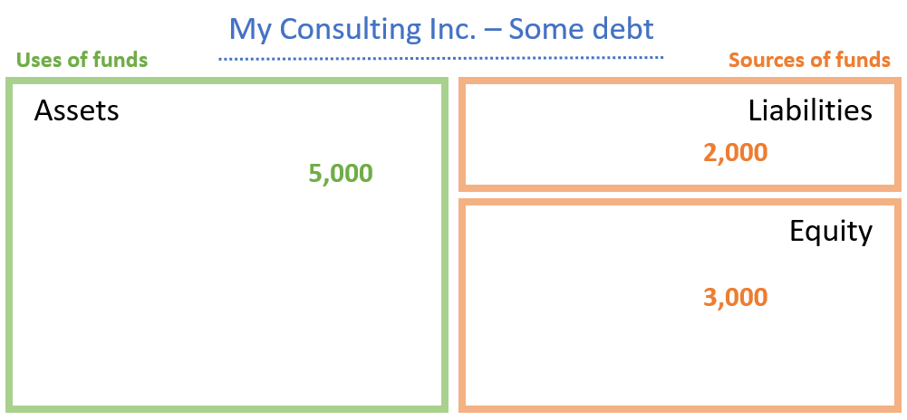
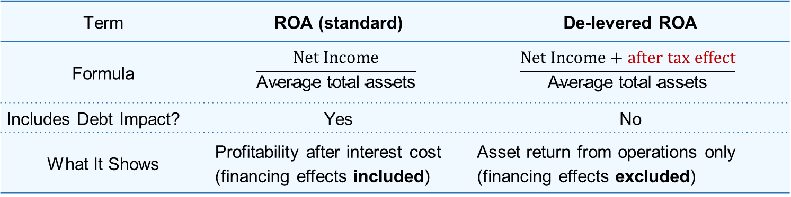
Standard ROA vs. De-Levered ROA
Term | ROA (standard) | De-levered ROA
Formula | $$\frac{Net Income}{\text{Average} \text{total} \text{assets}}$$ | $$\frac{Net Income+after tax effect}{\text{Average} \text{total} \text{assets}}$$
Includes Debt Impact? | Yes | No
What It Shows | Profitability after interest cost (financing effects included) | Asset return from operations only (financing effects excluded)
Illustration: How de-levering NI removes the effects of capital structure:
 | No debt | Some debt
Pretax, pre-interest income | $300 | $300
Interest expense | 0 | (50)
Pretax income | 300 | 250
Taxes (35%) | (105) | (87.5)
Net income | 195 | 162.5
De-levered Net Income | $195 | $195ª
ª after tax effect : NI+ Interest expense ×(1-Tax rate)= [162.5 + 50(1 - .35)] = $195
11
Notes:
The uncertainty gap

Slide 12
Return on Financial Leverage (ROFL)
ROFL = ROE − ROA
Measures how much of ROE is driven by financial leverage (use of debt) vs. operations
Key Concepts with PepsiCo 2020 Example:
ROE = 50.5% returns AFTER financing costs (includes debt effect)
ROA = 9.5% returns BEFORE financing costs (excludes debt effect, i.e., de-levered ROA)
ROFL = 41.0% the difference — shows leverage's contribution to shareholder returns
Interpretation:
Positive ROFL
Negative ROFL
Higher ROFL
Leverage increases ROE
Debt used effectively
Leverage reduces ROE
Debt costs exceed benefits
= Higher Risk
Amplifies gains AND losses
12
Notes:
The uncertainty gap

Slide 13
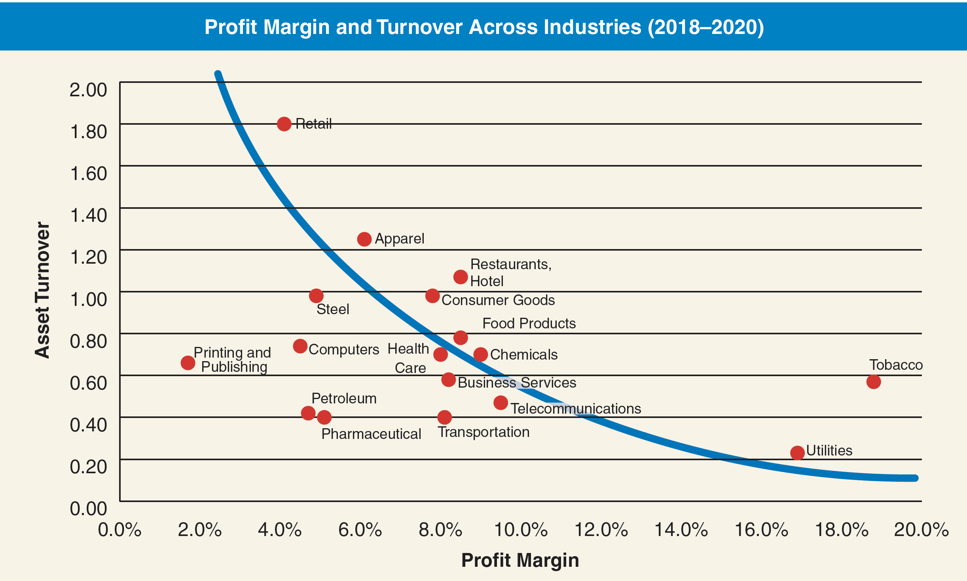
Trade-Off Between Profit Margin & Asset Turnover
ROA = Profit Margin (Profitability) X Asset Turnover (Efficiency)
Why the Trade-Off Happens
Firms achieve the same ROA through different PM–AT combinations
High PM strategies: Premium pricing, lower volume, heavier asset investment (e.g., Utilities)
High AT strategies: Low margins, high volume, efficient asset use (e.g., Retail)
Movement along an iso-ROA curve reflects a change in strategy, not performance
Shifts to higher iso-ROA curves indicate improved operating performance
13
Notes:
Why This Matters
ROA increases when a company:
Earns strong profits (high PM), or
Efficiently uses assets (high AT) — ideally both
Helps diagnose whether performance changes are due to:
Margins falling or costs rising, or
Assets not generating enough sales
The optimal mix depends on the business model, strategy, and industry structure.

Slide 14
Further Disaggregation of Profit Margin (PM)
Sales ($1.00)
Operating Expenses
(SG&A, R&D)
Operating Income (EBIT)
COGS (Production Costs)
1. Gross Profit Margin (GPM)
2. Expense-to-Sales Ratio (ETS)
Sales $1.00
－COGS ($0.45)
Gross Profit $0.55
－ SG&A
－ R&D ($0.41)
－ Marketing
Operating Income $0.04
－ Interest Expense ($0.01)
－ Income Tax Exp ($0.01)
Net Income (Profit) $0.02
(Sales - COGS) / Sales
Operating Expenses / Sales
Reflects product pricing, production efficiency, and cost control.
PepsiCo 2020 : 54.8%
55¢ of every dollar is retained after making the product. High GPM funds R&D and Marketing.
Includes selling, general & administrative (SG&A), marketing, R&D, and advertising.
PepsiCo 2020: 40.5%
41¢ of every dollar goes to selling, admin, and overhead.
14
Notes:
Why This Matters ROA increases when a company:
Earns strong profits (high PM), or
Efficiently uses assets (high AT) — ideally both
Helps diagnose whether performance changes are due to:
Margins falling or costs rising, or
Assets not generating enough sales
Profit (=net profit=net income)

Slide 15
ROA Disaggregation
$\text{RO}\text{A}=\frac{\text{Earnings}\text{ ( }\text{NI} \text{or} \text{EWI}\text{)}}{\text{Average} \text{total} \text{assets}}=\frac{\text{Earnings}}{\text{Sales} \text{revenue}}×\frac{\text{Sales} \text{revenue}}{\text{Average} \text{total} \text{assets}}$
(Profit Margin) (Asset Turnover)
Profit Margin (PM)
Asset Turnover (AT)
Earnings / Net Sales
Net Sales / Avg Total Assets
Measures: Profit per dollar of sales (Profitability)
Influenced by:
Gross profit (price vs. COGS)
Operating expenses
Pricing power & cost control
Measures: Sales per dollar of assets (Efficiency)
Driven by:
Inventory management
Receivables collection
Asset intensity (industry)
ROA increases when a company earns strong profits (high PM) OR efficiently uses assets (high AT)
15
Notes:
Why This Matters
ROA increases when a company:
Earns strong profits (high PM), or
Efficiently uses assets (high AT) — ideally both
Helps diagnose whether performance changes are due to:
Margins falling or costs rising, or
Assets not generating enough sales

Slide 16
ROE Decomposition – The DuPont Model
$\text{ROE}=\text{Profit} \text{Margin}×$ Asset Turnover x Financial Leverage
(Profitability) (Efficiency) (Use of Debt)
Profit Margin (PM)
Asset Turnover (AT)
Earnings / Net Sales
Net Sales / Avg Total Assets
Measures: Profit per dollar of sales (Profitability)
Influenced by:
Gross profit (price vs. COGS)
Operating expenses
Pricing power & cost control
Measures: Sales per dollar of assets (Efficiency)
Driven by:
Inventory management
Receivables collection
Asset intensity (industry)
ROA increases when a company earns strong profits (high PM) OR efficiently uses assets (high AT)
16
Notes:
Why This Matters
ROA increases when a company:
Earns strong profits (high PM), or
Efficiently uses assets (high AT) — ideally both
Helps diagnose whether performance changes are due to:
Margins falling or costs rising, or
Assets not generating enough sales

Slide 17
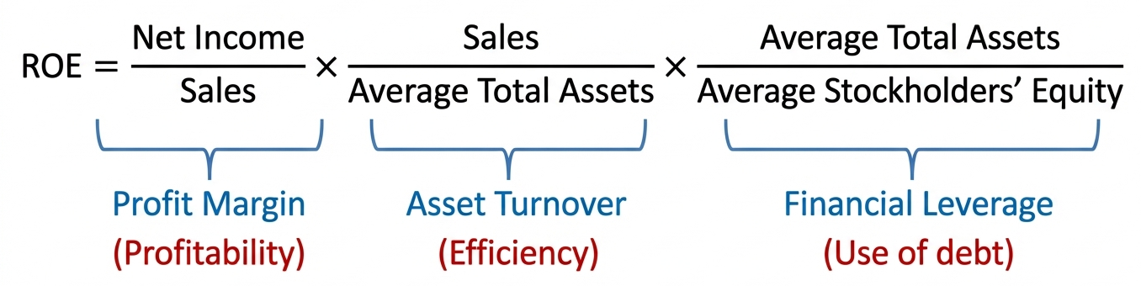
ROE Decomposition – The DuPont Model
ROA
ROFL
Useful for identifying whether performance comes from:
Operational strength (profitability, efficiency)
Or financial structure (use of debt)
Limitation
Uses net income (not EWI), so leverage affects both Profit Margin and ROE.
Hard to isolate operating performance, but widely used.
ROE increases when a firm:
• Earns more profit per sales dollar (↑ PM) • Uses assets efficiently (↑ AT) • Employs more leverage (↑ FL)
17
Notes:
ROE increases when a firm:
Earns more profit per sales dollar (↑ profit margin)
Uses assets efficiently to generate sales (↑ asset turnover)
Employs more leverage to amplify returns (↑ financial leverage)
Useful for identifying whether performance comes from:
Operational strength (profitability, efficiency)
Or financial structure (use of debt)
Limitation
Uses net income, not earnings without interest expense (EWI). → So, financial leverage affects both margin and ROE, making it hard to isolate pure operating performance.
Despite this, it remains a simple and widely used framework for analyzing ROE.
The traditional DuPont Model uses net income instead of earnings without interest expense (EWI) in the profit margin component. Because net income includes interest expense, the model does not clearly separate operating performance from financing effects. As leverage increases, interest expense rises—reducing net income and profit margin—while at the same time increasing the financial leverage ratio and boosting ROE. This overlap means the model blends operating and financing effects, making it difficult to tell whether a higher ROE results from stronger operations or greater debt use. In short, the DuPont Model can misstate true operating efficiency when firms differ in their leverage levels.

Slide 18
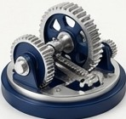
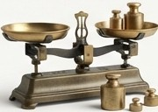
How Debt Can Increase ROE
Two Engines of Return: Operations and Financing
ROE = ROA + ROFL
Operating Efficiency
Return on Assets generated by the core business.
Financing Strategy
Return on Financial Leverage generated by debt.
1. Tax Shield: Interest is tax-deductible (at 25% tax rate, $1 interest costs only $0.75)
2. Lower Cost: Debt is cheaper than equity (lenders have payment priority)
3. Leverage Effect: Generate more profit without raising new equity
Why Debt Boosts ROE:
18
Notes:
ROE increases when a firm:
Earns more profit per sales dollar (↑ profit margin)
Uses assets efficiently to generate sales (↑ asset turnover)
Employs more leverage to amplify returns (↑ financial leverage)
Useful for identifying whether performance comes from:
Operational strength (profitability, efficiency)
Or financial structure (use of debt)
Limitation
Uses net income, not earnings without interest expense (EWI). → So, financial leverage affects both margin and ROE, making it hard to isolate pure operating performance.
Despite this, it remains a simple and widely used framework for analyzing ROE.
The traditional DuPont Model uses net income instead of earnings without interest expense (EWI) in the profit margin component. Because net income includes interest expense, the model does not clearly separate operating performance from financing effects. As leverage increases, interest expense rises—reducing net income and profit margin—while at the same time increasing the financial leverage ratio and boosting ROE. This overlap means the model blends operating and financing effects, making it difficult to tell whether a higher ROE results from stronger operations or greater debt use. In short, the DuPont Model can misstate true operating efficiency when firms differ in their leverage levels.

Slide 19
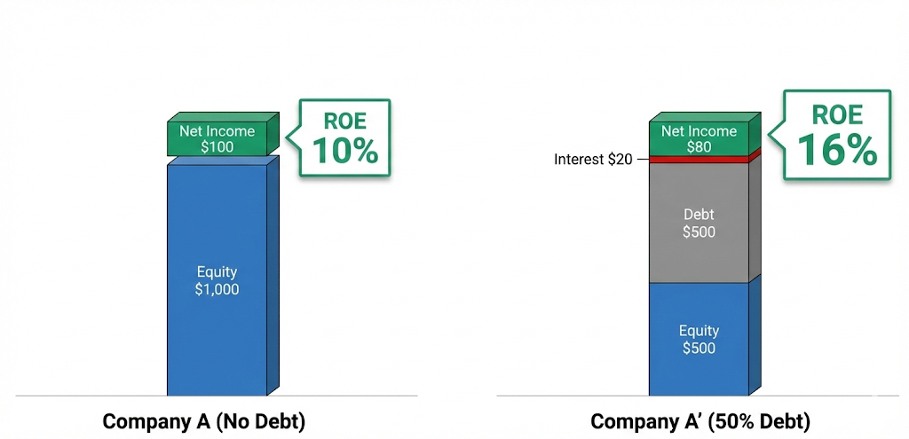


Capital Structure and ROE
When Leverage Works FOR You
When business is performing well, leverage magnifies returns
i.e., ROA (10%) > Interest Rate (4%)
ROE = $\frac{\$100}{\$1000}$
ROA = $\frac{\$100}{\$1000}$
$$\text{ROE}\text{ = }\frac{\$80}{\$500}$$
$$\text{RO}\text{A}\text{ = }\frac{\$100}{\$1000}$$
No Debt
ROE(10%) = ROA(10%) +ROFL(0%)
50% Debt
ROE(16%) = ROA(10%) +ROFL(6%)
* ROA is unlevered ROA.
19
Notes:
Net income is lower, but $A=πr^{2}$

Slide 20
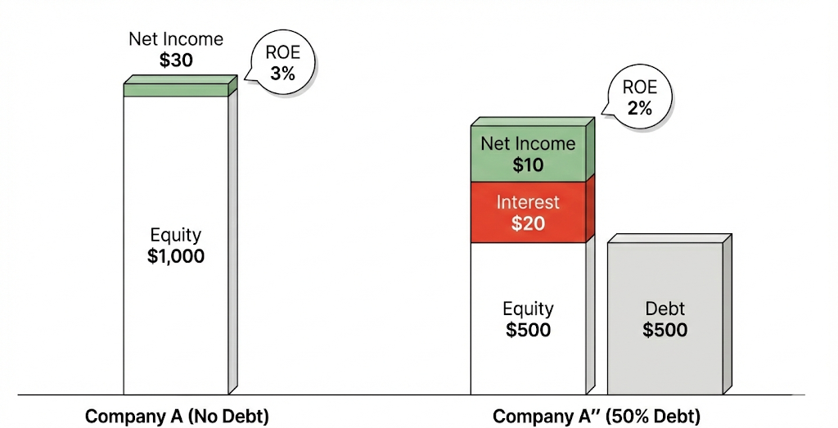
Capital Structure and ROE
When Leverage Works AGAINST You
In underperforming markets, fixed interest payments erode value.
i.e., ROA (3%) < Interest Rate (4%)
No Debt
ROE(3%) = ROA(3%) +ROFL(0%)
50% Debt
ROE(2%) = ROA(3%) +ROFL(-1%)
20
Notes:
Net income is lower, but $A=πr^{2}$

Slide 21
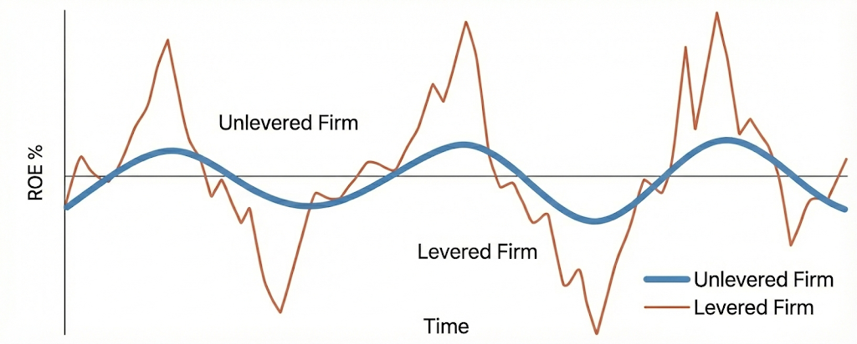
Downside Risk of Leverage
Leverage does not just magnify returns.
It magnifies volatility
Default Risk: Higher chance of missing interest or principal payments (debt covenants violation)
Amplification: Losses grow faster in downturns
Ultimate Cost: Excessive debt can wipe out equity
The Cost of Leverage
21
Notes:
Default Risk:
The probability that the firm cannot meet interest or principal payments.
Amplification:
In downturns, leverage makes poor performance worse, potentially spiraling into financial distress.
The Ultimate Cost:
Excessive debt leads to bankruptcy, where equity value is often wiped out entirely.

Slide 22
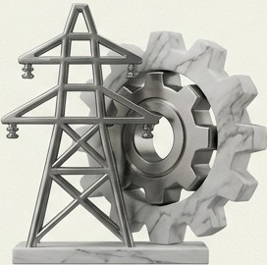
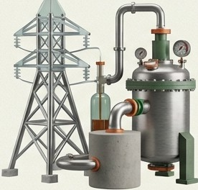

Matching Capital Structure to Strategy
High Debt Tolerance
Low Debt Tolerance
Utilities
Stable cash flows, hard assets
Telecom / Chemicals
Large fixed investments
Tech / Pharma
Intangible assets, volatile R&D
Firms with predictable cash flows can safely carry more debt.
Firms driven by innovation and intangibles must rely more on equity
22
Notes:
Default Risk:
The probability that the firm cannot meet interest or principal payments.
Amplification:
In downturns, leverage makes poor performance worse, potentially spiraling into financial distress.
The Ultimate Cost:
Excessive debt leads to bankruptcy, where equity value is often wiped out entirely.

Slide 23
Part 3
Liquidity & Solvency
Short-term and Long-term Financial Health
23

Slide 24
Liquidity Analysis
Can the company meet SHORT-TERM obligations?
Current Ratio
Quick Ratio
Current Assets / Current Liabilities
(Cash + AR) / Current Liabilities
Above 1.0 = positive Working Capital
Excludes inventory
OCF to CL
Cash Burn Rate
Operating Cash Flow / Current Liabilities
Free Cash Flow / 365
Operations can cover short-term debt?
How fast cash depletes
Too low liquidity = default risk
Too high liquidity = inefficient asset use
24
Notes:
Net income is lower, but $A=πr^{2}$

Slide 25
Solvency Analysis
Can the company meet LONG-TERM obligations?
Debt-to-Equity (D/E)
Times Interest Earned (TIE)
Total Liabilities / Stockholders' Equity
(Operating Inc + Int Exp) / Int Exp
Measures: Reliance on debt vs equity
Higher D/E = More debt, lower solvency
Lower D/E = Conservative, more stable
Measures: Can operating income cover interest?
Higher TIE = Comfortably covers interest
Lower TIE = May struggle to pay interest
Strong Solvency Position Means:
Company can sustain debt levels and meet obligations over time
Lower credit risk for lenders
Greater borrowing capacity for future needs
25
Notes:
Net income is lower, but $A=πr^{2}$

Slide 26
Altman Z-Score (1968)
Altman Z-score predicts Bankruptcy Risk
Z-Score = 1.2(WC/TA) + 1.4(RE/TA) + 3.3(EBIT/TA) + 0.6(MVE/TL) + 1.0(Sales/TA)
Variables:
WC/TA: Working Capital / Total Assets → Liquidity
RE/TA: Retained Earnings / Total Assets → Long-term profitability
EBIT/TA: Operating profit / Total Assets → Efficiency
MVE/TL: Market Value Equity / Total Liabilities → Capital strength
Sales/TA: Sales / Total Assets → Asset turnover
Interpretation:
Z > 3.0
Z = 1.8 - 3.0
Z < 1.8
Healthy
Low bankruptcy risk
Gray Zone
Moderate risk
Distressed
High bankruptcy risk
Originally 95% accurate 1 year before bankruptcy. Still widely used by banks and credit analysts → ??
26
Notes:
Net income is lower, but $A=πr^{2}$

Slide 27
Working Capital Requirements
27

Slide 28
Traditional View – Working Capital as Liquidity
Working capital management deals with efficient control of cash and current assets to maintain liquidity
Formula
Interpretation
Net Current Assets = Current Assets – Current Liabilities
A positive figure indicates short-term solvency and operational stability
Key Insight
Traditionally viewed as a liquidity measure — ensuring obligations can be met as they come due
But this is only ONE way to view working capital...
28

Slide 29
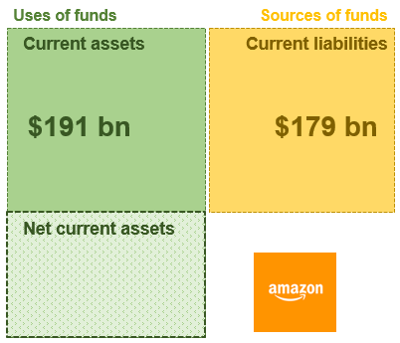
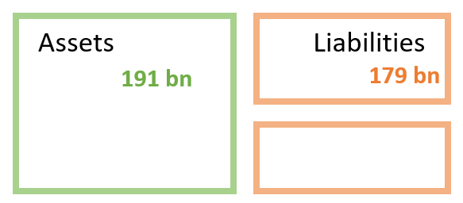
Source-of-Funds View – The Working Capital Requirement
Concept Shift
Working capital can also be understood as the amount of long-term financing required to fund current operations.
Key Points
Net current assets create a working capital requirement [$12 bn (= $191 – $179)]
It represents the portion of current assets NOT financed by current liabilities (or suppliers)
The business must use long-term funds (equity or long-term debt) to cover this shortfall
When CA > CL, the gap must be financed by long-term capital — this is the true "working capital requirement."
12 bn
29

Slide 30
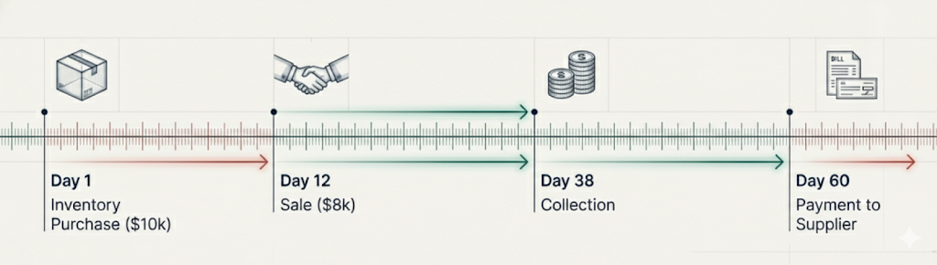
The Cycle of Cash Lag
The Funding Gap
During this duration the business requires long-term funding to bridge the timing gap between inventory payments and cash collections.
30

Slide 31
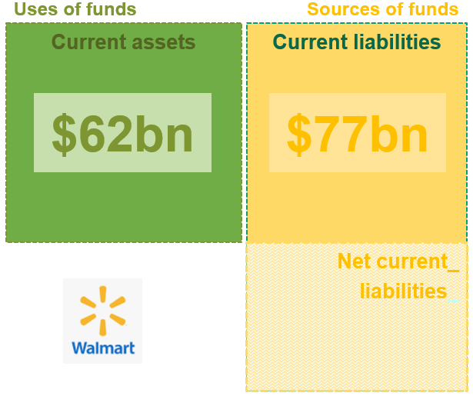
Negative Working Capital: Risk vs. The ‘Walmart’ Advantage
What It Means
Occurs when current liabilities exceed current assets (CL > CA)
Implications – A Typical View (Risk)
Short-term liabilities appear sufficient to fund current assets
However, this position is often financially unhealthy and can signal liquidity risk
The firm may struggle to meet short-term obligations
Remedies
Increase current assets by selling non-current assets, or
Raise additional long-term capital (equity or debt) to restore positive working capital
Walmart Example: CA = $62 bn vs. CL = $77 bn → Net current liabilities of $15 bn.
Walmart uses vendors' capital to finance operations. → Is it a bad thing?
31

Slide 32
Summary – Key Takeaways on Working Capital
Positive Working Capital: Healthy ( Not Always Good)
CA > CL → strong liquidity & solvency
Too much WC = capital stuck in low-return assets
Working Capital = Funding Requirement
Long-term capital needed to fund operations
Not just liquidity — a capital allocation choice
Negative Working Capital: Risky (Not Always Bad)
CL > CA → potential liquidity stress
Can be efficient in some models
Example: Walmart funds operations with supplier capital
32

Slide 33
Limitations of Ratio Analysis
33

Slide 34
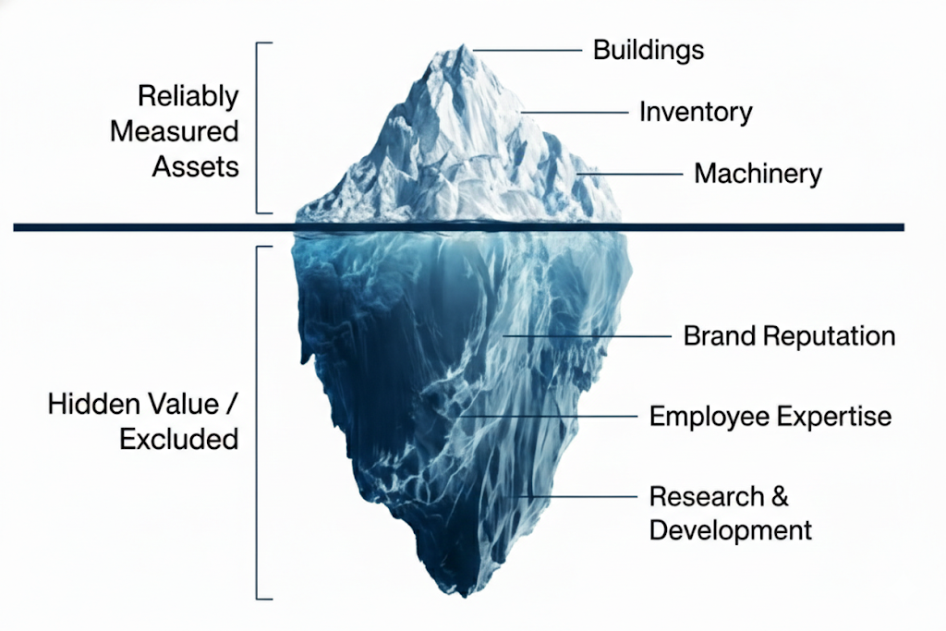
The Blind Spot 1: GAAP - Measurability
Measurability
Financial statements include only items that can be reliably measured
Intangible but valuable assets such as brand reputation, employee expertise, are often excluded, which can understate assets on the balance sheet
Therefore, ROA can be higher
Non-Capitalized Costs
Many expenditures that add long-term value (R&D, advertising) are expensed rather than capitalized
This leads to understated assets on the balance sheet
34
Notes:
These GAAP limitations mean ratios may understate true asset values, overstate expense ratios, and miss key value drivers
Analysts must adjust for these limitations when comparing companies or making investment decisions

Slide 35

The Blind Spot 2: Historical Cost vs. Market Reality
The Rule:
Assets are recorded at original acquisition cost
The Distortion:
Ratios based on these costs fail to reflect current market value, especially for long-held assets like real estate.
The Result:
Financial ratios can change simply because of accounting rules, not because performance.
An Example:
Land acquired at $1 million 20 years ago, but it is $10 million at today’s market value.
35

Slide 36
Structural Distortions: The Comparability Problem
Company Changes
Mergers, Acquisition and divestitures further complicate year-over-year comparison
Conglomerate Effects
Large corporations operate across multiple industries.
Consolidated statements obscure the specific risk and performance of individual segments
Timing Factors
Seasonality and Life Cycle
A start-up’s ratios vs. mature “cash cow”
Example
Amazon spans e-commerce, AWS, advertising, and entertainment.
Consolidated ratios mix businesses with very different margins.
Segment-level analysis is essential.
36

Slide 37
Ratios Are a Means to an End
Core Principle
Ratios condense complex operations into single numbers.
Ratios miss qualitative factors (management, innovation, strategy).
Effective analysis looks beyond ratios to overall performance and direction.
What Ratios CAN tell You
What Ratios CANNOT Tell You
Trends in financial performance over time
Relative positioning vs. industry peers
Areas of potential concern (liquidity, leverage, profitability)
Quick screening for investment analysis
Quality of management and corporate governance
Strategic direction and competitive advantage
Innovation pipeline and brand value
Customer satisfaction and employee morale
Best Practice
Use ratios as a starting point for deeper analysis — not as the final answer.
37

Slide 38
The Enlightened Analyst: Synthesis
Successful analysis requires looking beyond the ratios to understand the true funding architecture and strategic direction of the firm.
Data has Structural Limits
Working Capital is a Funding Requirement
Ratios are a Means to an End
GAAP excludes intangibles and distorts values.
Not just a liquidity check.
They cannot capture management, innovation, or strategy.
True insight lies in the gap between the number and the narrative.
38

Slide 39
Analyzing & Interpreting Core Operating Activities
39

Slide 40
Bifurcating the Business Model
The split: Every company runs two engines — one creates value, the other funds it.
Operating Activities
Nonoperating Activities
The Engine. Central transactions needed to produce and deliver goods or services.
Drivers: Sales, Production, R&D, Marketing.
The Support. Financing and investing activities that fund the business but are distinct from operations.
Drivers: Debt management, Investments.
Primary Value Driver
Secondary Driver
Why it matters: RNOA isolates the first engine so performance is not confused with financing.
40

Slide 41
The Metric of True Efficiency: RNOA
RNOA = Net Operating Profit After Taxes (NOPAT) ÷ Average Net Operating Assets (NOA)
Measures Return
Compares to Capital
Removes Distortion
Captures return generated strictly by operating activities.
Relates that return to the capital actually invested in those operations.
Strips out the distortions created by financing decisions.
In short: ROE mixes operating skill with financing choices; RNOA reports the operating engine on its own.
41

Slide 42
The Numerator: Purifying the Profit (NOPAT)
Goal: Start from Net Income, then strip out everything that is not operating.
Keep (Operating)
Remove (Nonoperating)
• Sales Revenue
• Cost of Goods Sold
• SG&A
• R&D
• Depreciation
• Interest Income
• Interest Expense
• Investment Gains / Losses
Result — NOPAT: the profit the business would earn with no debt and no investment income.
42

Slide 43
Calculating NOPAT
NOPAT = Net Income − (Nonoperating Revenues − Nonoperating Expenses) × (1 − Tax Rate)
Key Insight
Why this formula? We are effectively adding back the after-tax cost of debt.
We want to see the profit the company would report if it had no debt and no investment income.
Nonoperating Revenues
Nonoperating Expenses
Interest and investment income — remove it, it is not from operations.
Interest cost of debt — add it back, it is a financing choice.
43

Slide 44
Case Study: PepsiCo (2020)
Objective: Determine the efficiency of the core business, separate from its capital structure.
Net Income
Nonoperating Revenues
Nonoperating Expenses
Tax Rate
$7,175M
$117M
$1,128M
25%
Note: All figures in millions of USD. The 25% rate is the effective rate used in the NOPAT adjustment on the next slide.
Why adjust: Net Income alone reflects PepsiCo’s financing mix. NOPAT and NOA remove it.
44

Slide 45
PepsiCo: The NOPAT Adjustment
Net Income
Less: After-Tax Nonoperating Net
NOPAT
$7,175.0
−$758.3
$7,933.3
($117 − $1,128) × (1 − 0.25) = −$758.3 → $7,175.0 − (−$758.3) = $7,933.3
Observation
NOPAT is higher than Net Income. By removing the “drag” of interest payments, we see the true earning power of the operations — the profit available to all capital providers, debt and equity alike.
45

Slide 46
The Denominator: Capital at Work (NOA)
Question: Split the balance sheet — which items actually run the business?
Operating Assets
Operating Liabilities
Cash • Receivables • Inventory
PP&E • Intangibles
Accounts Payable • Accrued Expenses
Employee Benefits
Nonoperating Assets
Nonoperating Liabilities & Equity
Investments in affiliates and marketable securities.
Debt and interest-bearing liabilities • Equity.
NOA = Operating Assets − Operating Liabilities
46

Slide 47
PepsiCo: Isolating Operating Capital
Total Operating Assets
Minus Operating Liabilities
Net Operating Assets (NOA)
$91,059
−$35,216
$55,843
$91,059 − $35,216 = $55,843
What This Number Means
This $55.8 billion is the equity and debt capital actively funded into the machinery, inventory
and brand of PepsiCo — the capital the operating engine is actually working with.
47

Slide 48
The Verdict: PepsiCo's Operating Efficiency
RNOA = NOPAT ÷ Average NOA = $7,933.3 ÷ $51,082.5 = 15.5%
NOPAT
Average NOA
RNOA
$7,933.3 million
($55,843 + $46,322) ÷ 2
= $51,082.5 million
15.5%
Strong operating efficiency: For every dollar invested in core operations, PepsiCo generates 15.5 cents of after-tax profit.
48

Slide 49
Signal vs. Noise: RNOA vs. ROE
50.5%
Operating engine
leverage
+35.0%p
Financing effect
15.5%
RNOA
Core Performance
ROE
Shareholder Return
Reading the Gap
Most of the shareholder return is engineered through leverage (nonoperating), not by selling more product (operating). Use RNOA to judge the business; use ROE to judge the capital structure.
49

Slide 50
The Analyst's Checklist
1
2
3
4
Distinguish
Adjust Income
Adjust Capital
Interpret
Separate operating (value creation) from nonoperating (financing).
Convert Net Income to NOPAT by removing interest and investment noise.
Convert Total Assets to NOA by isolating working capital and PP&E.
Use RNOA to judge the business manager; use ROE to judge the capital structure.
The two questions: RNOA answers “how good is the business?” ROE answers “how good is the business plus its financing?”
50

Slide 51
Clarity in Capital
Operating activities are central to value creation.
The Payoff
By isolating them, we move from simply reading the statements to understanding the business engine.
Distinguish
Adjust
Interpret
Operating vs. nonoperating
NOPAT and NOA
RNOA vs. ROE
51

