Slide 1
Chapter 7: Reporting and Analyzing Inventory
1

Slide 2
Table of Contents
Part 1: Basics
Part 2: Cost Methods
Part 3: Valuation
Inventory Classification
Recording Transactions
Product vs Period Costs
Ownership & Freight Terms
FIFO Method
LIFO Method
Weighted Average
Financial Statement Effects
Lower of Cost or NRV
Inventory Turnover Ratio
Days in Inventory
Conservatism Principle
2

Slide 3
Inventory Classification
3

Slide 4
Inventory Classification Depends on Business Model
Service Companies
No Inventory – sell services only
Merchandising Companies (Wholesaler or Retailer
Merchandize Inventory – Ready for Sale
Single category
Manufacturing Companies
Raw Materials – Basic parts not yet in production
Working in Process – In production, not complete
Finished Goods – Completed, ready for sale
4
Notes:
The uncertainty gap

Slide 5
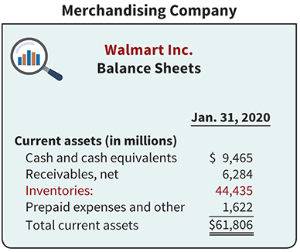
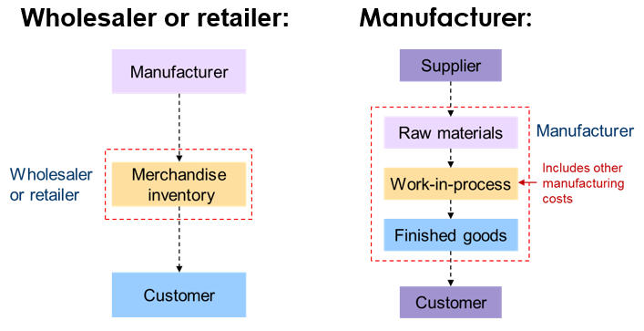
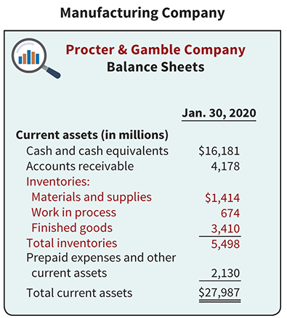
Inventory Classification – Continued
5
Notes:
The uncertainty gap

Slide 6
Recording Inventory Transactions
6

Slide 7
Recording Purchase of Inventory
At the time of Purchase – Company purchases $500 of goods on credit.
Inventory (Dr.) ↑ $500
A/P (Cr.) ↑ $500
The cost is capitalized into the Inventory asset account immediately, not expensed.
7

Slide 8
Recording the Sale (Perpetual System) – Two Steps
A sale requires two distinct journal entries: one for revenue, one for cost.
Example: Company sold goods for $1,000 on credit. Original cost was $600.
Step 1: Recognize Revenue
Account Receivables (Dr.) ↑ $800
Sales Revenue (Cr.) ↑ $800
Step 2: Match Cost (Expense)
Cost of Goods Sold (Dr.) ↑ $600
Inventory (Cr.) ↑ $600
8

Slide 9
Product vs. Period Costs
9

Slide 10
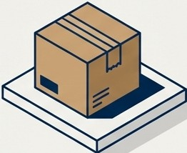

The Cost Principle: Product vs. Period Costs
When a cost is incurred, THE KEY question is:
Did this expenditure help get the product ready for resale? Yes or No?
YES
Product Cost (Asset)
Stored on Balance Sheet
No
Period Cost (Expense)
Expense on Income Statement
10

Slide 11
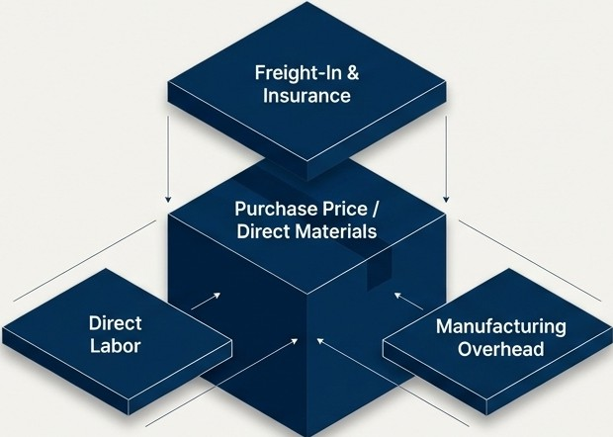
Product Costs
All costs incurred to acquire goods and prepare them for sale (or in a sellable condition).
Merchandising
Purchase Price
Freight-in (Shipping to warehouse)
Unpacking & Unloading
Insurance in Transit
Manufacturing
Direct materials
Direct Labor
Manufacturing Overhead
These costs are capitalized, and they live in the inventory account until sold.
11

Slide 12

Period Costs
Costs indirectly related to acquisition:
Costs that are attributable to the passage of time rather than to the production of inventory.
Costs incurred after the inventory has reached a saleable condition.
Key Examples
Selling Expenses: Marketing, sales commissions, delivery to customers.
Administrative Expenses: Executive salaries, office supplies.
Interest Costs: Money paid to finance inventory purchases.
These costs are Expensed as Incurred.
They impact the Income Statement immediately, bypassing the Balance Sheet.
12

Slide 13
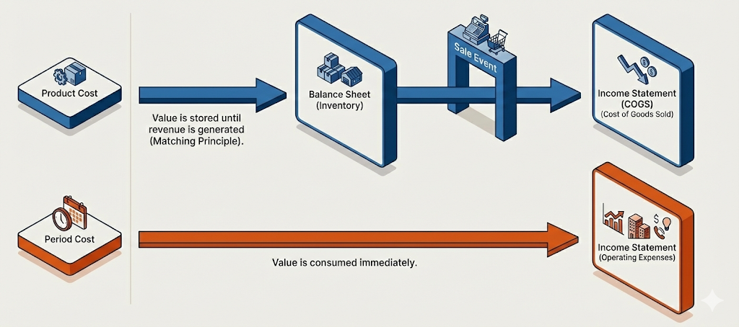
Product vs. Period Costs Visualization
13

Slide 14
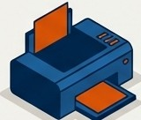





Illustration : The Office Depot Printer
Phase 1: Acquisition
+
$500 Cost
$100 Freight-In
$50 Insurance
Inventory Value: $650
Phase 2: The Sale
COGS
$50 Freight-Out
The $50 delivery fee is recorded immediately as a selling expense.
14
Isl\ NotebookLM

Slide 15
Perpetual vs. Periodic Inventory System
15

Slide 16


The Tracking Systems: Periodic vs. Perpetual
Beginning Inventory+ Net Purchases= COGS+ Ending Inventory
Perpetual System (The Standard)
Periodic System (The Old Way)
Updates continuously at point of sale
Ending Inventory derived in real-time
Superior control and reporting
Updates only at end of period
COGS unknown until physical count
Formula: Beg Inv + Purchase - Ending Count= COGS
16

Slide 17
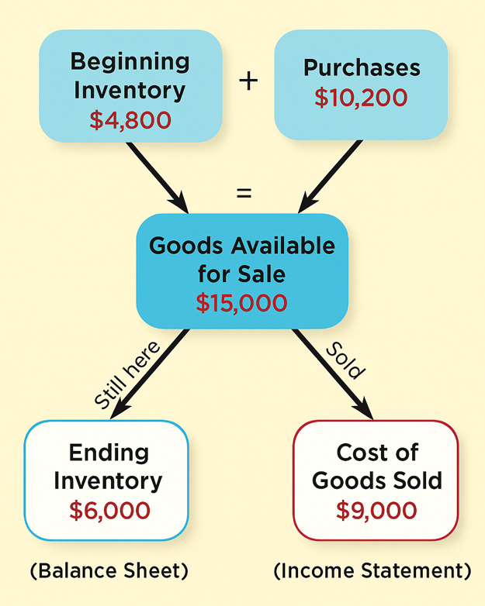
Example – Determining Cost of Goods Sold
Beginning Inventory+ Net Purchases= COGS+ Ending Inventory
Perpetual System (The Standard)
Known
Beg Inv | + Purchases | − COGS | = End Inv
Known | Known | Recorded | Recorded/Derived
$4,800 | $10,200 | $9,000 | $6,000
Periodic System (The Old Way)
Beg Inv | + Purchases | − End Inv | COGS
Known | Known | Counting | Recorded/Derived
$4,800 | $10,200 | $6,000 | $9,000
Unknown
???
???
17

Slide 18
Determining Ownership of Inventory
18

Slide 19
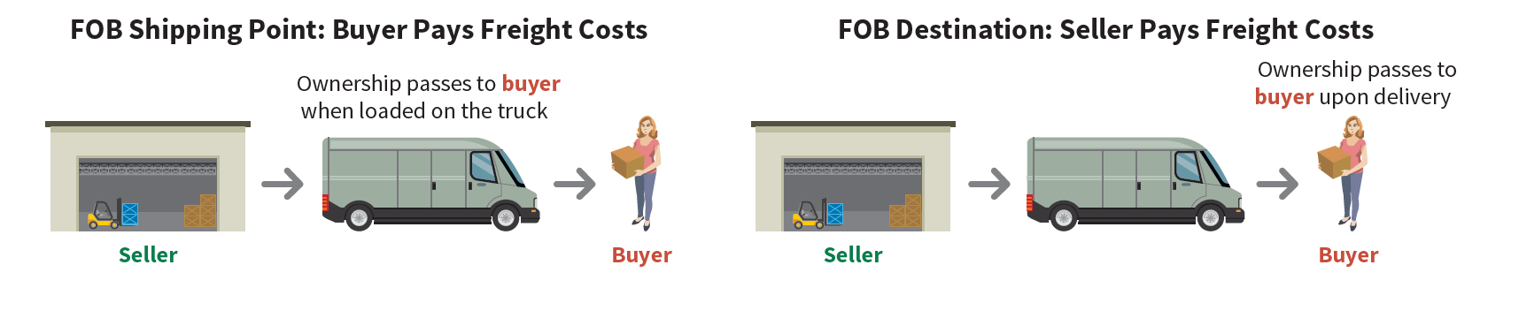
Inventory Ownership
Two questions related to the inventory ownership:
(1) Do all the goods included in the physical count belong to the company?
(2) Does the company own any goods that were not included in the count?
Inventory belongs to the company that holds legal title.
Consigned Goods: Title remains with the consignor, not the holder. Do not count them in consignee’s inventory.
19

Slide 20
Costing Methods in Determining COGS and End Inv
20

Slide 21
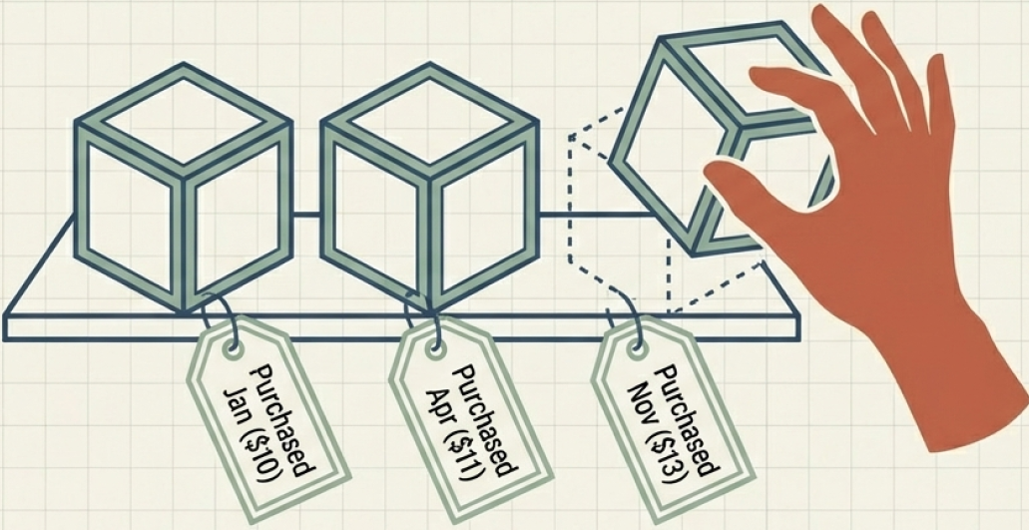
Cost Flow Assumptions to Determine COGS
Dilemma
When Identical items are purchased at different times and different prices, which
cost do we match to the sale?
Sold for $20
What is the profit?
$20 - $10 = $10?
$20 - $11 = $9?
$20 - $13 = $7?
Physical Flow ≠ Cost Flow : 1) Specific ID; 2) FIFO; 3) LIFO; 4) Average Cost Methods
21

Slide 22
Cost Flow Assumption 1 : First-in First-Out (FIFO)
Suppose you open a bicycle store on 11/1. Your beginning inventory is zero. During November and December, you make the following bicycle purchases:
During November and December, you sold 7 bicycles.
Compute COGS and Ending Inventory
Purchases | Quantity | Unit Cost | Total Cost
11/2 | 5 | $100 | $500
12/8 | 4 | $125 | $500
12/20 | 6 | $130 | $780
Goods Available for Sale | 15 |  | $1,780
FIFO: COGS (7 bikes sold)
5 @ $100 = $500
2@$125 = $250
7 = $750 (COGS)
FIFO: Ending Inventory (8 bikes remaining)
6 @ $130 = $500
2@$125 = $250
8 = $1,030 (EI)
22

Slide 23
Cost Flow Assumption 2 : Last-In Last-Out(LIFO)
Suppose you open a bicycle store on 11/1. Your beginning inventory is zero. During November and December, you make the following bicycle purchases:
During November and December, you sold 7 bicycles.
Compute COGS and Ending Inventory
Purchases | Quantity | Unit Cost | Total Cost
11/2 | 5 | $100 | $500
12/8 | 4 | $125 | $500
12/20 | 6 | $130 | $780
Goods Available for Sale | 15 |  | $1,780
LIFO: COGS (7 bikes sold)
6@ $130 = $780
1@$125 = $125
7 = $905 (COGS)
LIFO: Ending Inventory (8 bikes remaining)
5 @ $100 = $500
3 @ $125 = $375
8 = $875 (EI)
23

Slide 24
Cost Flow Assumption 3 : Average Cost
Suppose you open a bicycle store on 11/1. Your beginning inventory is zero. During November and December, you make the following bicycle purchases:
During November and December, you sold 7 bicycles.
Compute COGS and Ending Inventory
Purchases | Quantity | Unit Cost | Total Cost
11/2 | 5 | $100 | $500
12/8 | 4 | $125 | $500
12/20 | 6 | $130 | $780
Goods Available for Sale | 15 |  | $1,780
The average cost of bike = Goods available for sale / # of bikes available for sale
= $1,780 /15 = $118.67 / bike
Avg Cost: COGS (7 bikes sold)
7 @ 118.67 = $831
Avg Cost: Ending Inventory (8 bikes remaining)
8 x $118.67 = $949
24

Slide 25
The Effect of Cost Flow Assumptions on F/S
In period of rising prices, LIFO reports the lowest net income, resulting in the lowest tax liability.
 |  | FIFO | Average | LIFO
 | Sales | $20,000 | $20,000 | $20,000
Lowest | Cost of Goods Sold | 7,500 | 8,307 | 9,050
 | Gross Profit | 12,500 | 11,693 | 10,950
 | Admin & Selling Expenses | 7,700 | 7,700 | 7,700
 | Income before Taxes | 4,800 | 3,993 | 3,250
 | Income Tax Expense | 960 | 800 | 650
Highest | Net Income | $3,840 | $3,193 | $2,600
 | Inventory Balance at Year-End | $10,300 | $9,493 | $8,750
25

Slide 26
Inventory Valuation after Purchase
26

Slide 27
The Problem: Obsolete Inventory
📠
Case Study: MTP, Inc.
MTP, Inc. has been selling typewriters and fax machines for 30 years. Due to technological advancement, these products are becoming obsolete in the late 1990’s. Inventory recorded at: $300,000 & Actual market value: $100,000
Obsolete
⌨️
Obsolete
❓ What should the accountant report on the balance sheet?
Answer: Report inventory at $100,000 and recognize a $200,000 loss immediately.
Journal Entry:
Dr. Loss on Inventory Write-down $200,000 ↑
Cr. Inventory $200,000 ↓
27

Slide 28
Accounting Conservatism
Principle: Recognize losses immediately, defer gains until realized
📉 LOSSES
📈 GAINS
Recognize IMMEDIATELY
when they become known
• Write down inventory now
• Record loss on income statement
DEFER until realized
(actually sold)
• Do NOT write up inventory
• Wait until sale occurs
Why? To prevent overstating assets and income — protecting investors and creditors.
28

Slide 29

What if Market Value Increases? – IFRS vs. U.S. GAAP
Scenario: Typewriters suddenly become popular! Market value jumps to $400,000.
🌍 IFRS
U.S. GAAP
REVERSAL ALLOWED
• Can write back UP to $300,000
• Limited to ORIGINAL cost only
• Cannot exceed $300,000
• Recognize $200,000 gain
DO NOTHING
• Inventory stays at $100,000
• Write-down is PERMANENT
• No reversal allowed
• Gain recognized only when sold
29

Slide 30
The LCNRV Rule (Lower-of-Cost or Net Realizable Value)
Report inventory at the LOWER of:
1. Cost — what you originally paid
2. Net Realizable Value (NRV) — expected selling price minus costs to complete and sell
NRV Formula
NRV = Selling Price − Cost to Complete − Selling Costs
(What you'll actually receive in your pocket)
Decision Process:
Cost
vs
NRV
→
Report the LOWER
30
Notes:
GAAP does not specify a numerical threshold (e.g., 10%, 20%). The key is whether the decline is "permanent" or "other than temporary" — not just normal market fluctuation.

Slide 31
LCNRV Example : Starbucks
Given: Unfinished inventory
Inventory Cost:
Estimated Selling Price:
Cost to Complete:
Selling Costs:
NRV Calculation
$950
$1,000
$50
$200
Selling Price
− Cost to Complete
− Selling Costs
= NRV
$1,000
($50)
($200)
$750
Compare:
Cost
$950
>
NRV
$750 ✓
Report at
$750
Journal Entry:
Dr. Loss Due to Decline in Inventory $200 ↑
Cr. Inventory $200 ↓
31
Notes:
GAAP does not specify a numerical threshold (e.g., 10%, 20%). The key is whether the decline is "permanent" or "other than temporary" — not just normal market fluctuation.

Slide 32
Concept Check
If NRV rises after an inventory write-down, how does IFRS differ from U.S. GAAP?
A.
IFRS also prohibits reversals
B.
IFRS allows reversals up to the original cost
C.
IFRS allows unlimited upward revaluations
D.
IFRS requires immediate recognition of any gain above cost
32

Slide 33
Inventory Analysis Ratio
33

Slide 34
Inventory Management Ratios
Inventory Turnover Ratio
Example Calculation
COGS
Average Inventory
COGS $80,000
Beginning Inventory $14,000
Ending Inventory $18,000
How many times inventory is sold during the period
Avg Inventory = (Beginning + Ending) ÷ 2
Avg Inv = ($14K + 18K) ÷ 2 = $16,000
Days in Inventory
Turnover Ratio
5 times
Days in Inventory
73 days
365
Inventory Turnover
Average days to sell inventory (also = Avg. Inventory age)
Turnover = $80,000 / $16,000 = 5 times/year
Days = 365 / 5 = 73 days
34
Notes:
Average Inventory = ($14,000 + $18,000) / 2 = $16,000
Turnover = $80,000 / $16,000 = 5 times/year
Days = 365 / 5 = 73 days

Slide 35
Interpreting the Ratios
HIGH Turnover
(Low Days in Inventory)
LOW Turnover
(High Days in Inventory)
Efficient inventory management
Strong sales performance
Lower holding costs
Risk: Stockouts & lost sales
Too much inventory on hand
Higher storage & insurance costs
Risk of obsolescence/damage
Cash tied up in inventory
Goal: Find the RIGHT balance
Enough inventory to meet demand, but not so much that costs pile up.
35
Notes:
Average Inventory = ($14,000 + $18,000) / 2 = $16,000
Turnover = $80,000 / $16,000 = 5 times/year
Days = 365 / 5 = 73 days

