Slide 1

Introduction to Financial Accounting
Introduction to Valuation
Time Value · DCF · Cost of Capital · Multiples · Margin of Safety

Slide 2
Table of Contents
Topic 1: The Time Value of Money -The Engine of Valuation
Topic 2: Meet Mr. Market — Price vs. Value
Topic 3: Discounted Free Cash Flow (DCF) Valuation
Topic 4: The Cost of Equity
Topic 5: The Price-Earnings (P/E) Ratio
Topic 6: Free Cash Flow vs. Net Income as Valuation Input
Topic 8: The Marin of Safey
Topic 6: Earnings Quality
Notes:
We will move through six sections, starting with why we need accounting information, moving through the mechanics of the statements, and finishing with how to analyze those statements using ratios like ROE.

Slide 3
1. The Time Value of Money

Slide 4
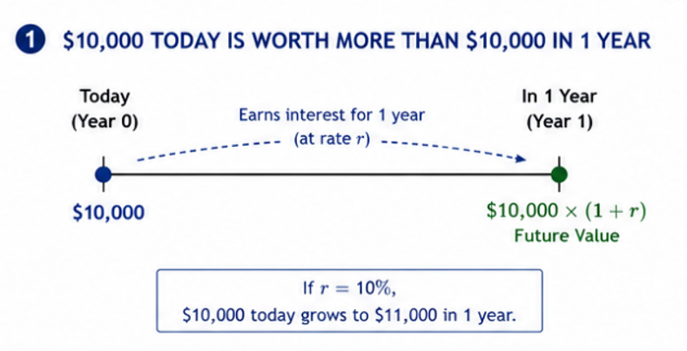
Future Value – 1 Year Later

Slide 5
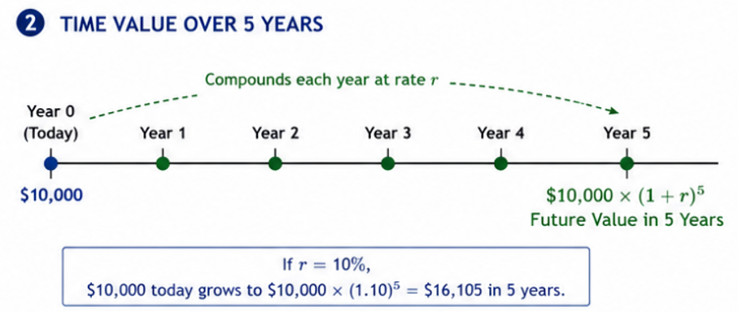
Future Value – 5 Years Later

Slide 6
TOPIC 1
1. Future Value & Present Value
Future Value (compounding)
Present Value (discounting)
FV = PV × (1 + r)ⁿ
What a sum today grows into.
PV = FV ÷ (1 + r)ⁿ
What a future sum is worth today.
Example · r = 10%
$10,000
× 1.10
$11,000
× 1.10⁵
$16,105
today (t = 0)
in 1 year
in 5 years
Run it backwards — discounting — and $16,105 in five years is worth exactly $10,000 today.
5

Slide 7
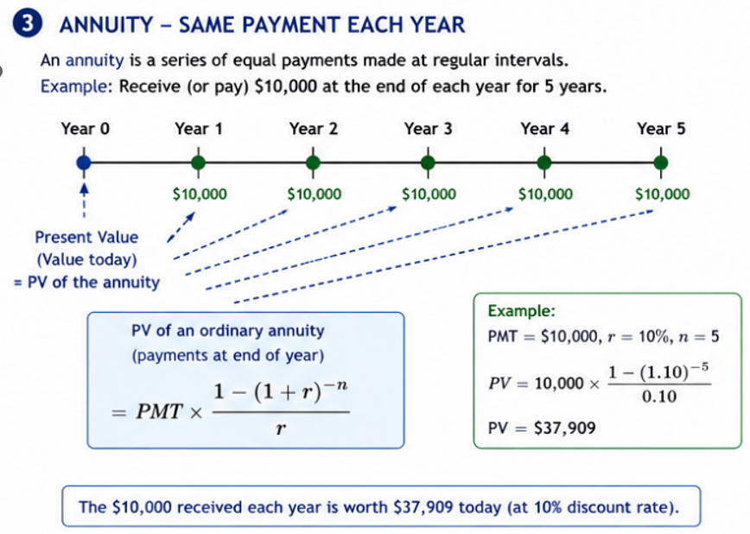
Annuity

Slide 8
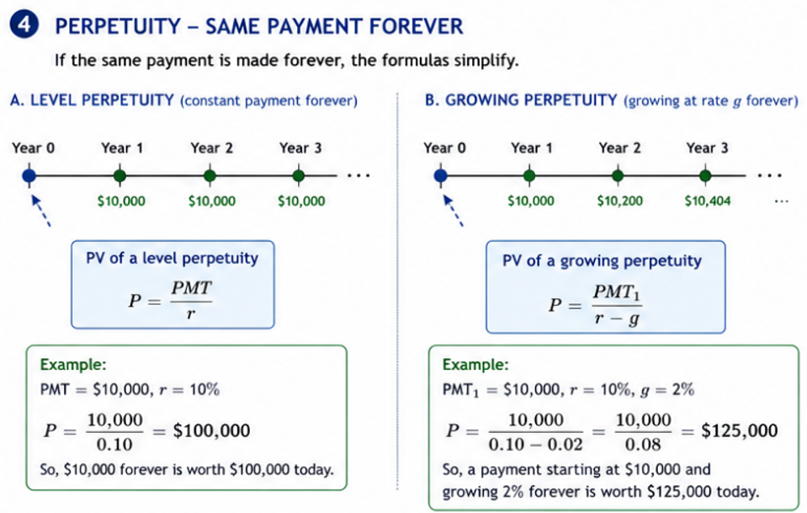
Perpetuity

Slide 9
2. Meet Mr. Market – Price vs Value

Slide 10
Who is Mr. Market?
The parable told by Benjamin Graham in The Intelligent Investor
Warren Buffett retold the story in his 1987 letter to Berkshire Hathaway shareholders
Imagine you own a small business with a partner, Mr. Market. Every day, without fail, he offers to either buy your share or sell you his — and he names a price.
Mr. Market is emotional. Some days he is euphoric and quotes a wildly high price; other days he is despondent and quotes a price far below the business’s worth. His mood, not the business, drives his quote.
The crucial point: Mr. Market is there to serve you, not to instruct you. You may trade with him when his price is attractive and ignore him when it is not. He will be back tomorrow with a new quote.
The Parable (in brief)

Slide 11
The Lesson: Price ≠ Value
Price is what Mr. Market quotes today; value is what the business is actually worth. The two diverge constantly because price is set by crowd psychology in the short run.
Graham’s famous formulation: in the short run the market is a voting machine; in the long run, a weighing machine. Sentiment sets prices day to day; fundamentals set them over time.
The investor’s job is therefore not to predict Mr. Market’s mood, but to (a) form an independent estimate of value, and (b) act only when price departs far enough from value to offer a margin of safety (Topic 5).

Slide 12
Two Ways People try to Beat the Market
Fundamental Analysis
Estimates intrinsic value from the business’s cash flows and financial statements (the approach of this course), then buy when price is below value.
Technical Analysis
Studies patterns in past prices and volume to predict future prices. It ignores intrinsic value and focuses on Mr. Market’s mood swings themselves.

Slide 13
A Note on Market Efficiency
The efficient market hypothesis
Holds that prices already reflect all available information, so Mr. Market is rarely “wrong.” Reality is more nuanced: markets are largely efficient, but emotion, frictions, and information gaps create periodic mispricings.
Implication for Investors
Whether or not you can consistently beat the market, the Mr. Market discipline — knowing your own estimate of value and refusing to be ruled by price — protects you from the most common and costly investing mistakes.

Slide 14
Discussion Questions
a. In your own words, explain the difference between the price of a stock and the value of the underlying business. Why do the two diverge?
b. Buffett writes that Mr. Market is there to serve you, not to instruct you. What does this imply about how an investor should react to a sudden 20% drop in a stock’s price?
c. Graham distinguishes a voting machine from a weighing machine. Give one example (real or hypothetical) of each force acting on a stock price.
d. If markets were perfectly efficient, would the Mr. Market parable still be useful? Explain.

Slide 15
3. Discounted Free Cash Flow (DCF) Valuation

Slide 16
Discounted Cash Flow (DCF) Model
To Value a Business , FCF to firm is used
The value of a business equals the present value of the free cash flow it will generate to the firm.
FCF to Firm (FCFF) = CFO + Interest (1-t) – CapEx
To Value Equity Value, FCF to Equity should be used
The value of a business equals the present value of the free cash flow it will generate to the equity holder
FCF to Equity (FCFE) = CFO – CapEx + net borrowing
DCF Formula in Practice
V₀ = Σ FCFₜ ÷ (1 + r)ᵗ + Terminal Value ÷ (1 + r)ᴺ

Slide 17

DCF in Practice : Five-Step Procedure
1. Forecast Sales (Revenue)
for the explicit horizon, anchored to the most recent actual results.
2. Project Expenses
from the sales forecast to arrive at operating income.
3. Convert Income into Free Cash Flow (FCF)
(adjust for non-cash items and reinvestment).
4. Estimate the Terminal Value (TV)
at the end of the horizon, assuming FCF grows at a steady long-run rate forever:
$$\text{Terminal} \text{Value} \left(\text{end} \text{of} \text{Year} n\right)=\frac{{FCF}_{n+1}}{r−g}$$
5. Discount the explicit FCFs and the TV :
to the present at the discount rate r, and sum them to obtain firm value.

Slide 18
DCF Model – A Worked Example
A Set-up
Assume a discount rate r = 10% and a long-run growth rate g = 3%. The projected free cash flows and their present values are shown below ($ in millions).
FCF for Years 1 -5
Year | FCF ($M) | Discount factor @ 10% | PV of FCF ($M)
1 | 100.0 | 0.9091 | 90.9
2 | 115.0 | 0.8264 | 95.0
3 | 130.0 | 0.7513 | 97.7
4 | 145.0 | 0.6830 | 99.0
5 | 160.0 | 0.6209 | 99.3

Slide 19
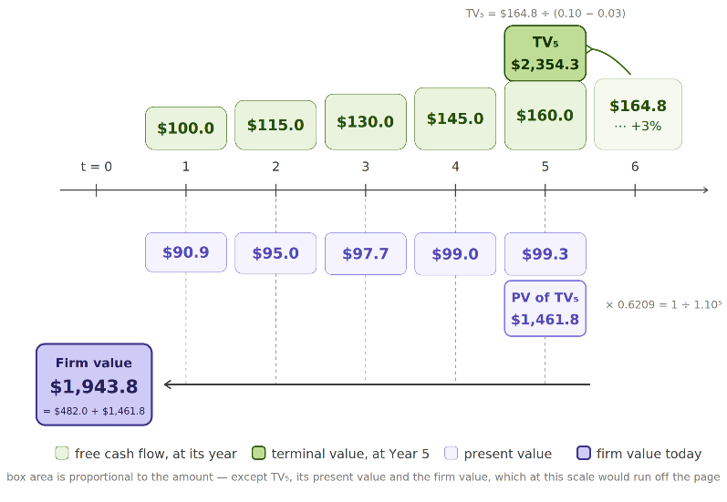
DCF Model – A Worked Example

Slide 20
4. Cost of Capital vs. Cost of Equity

Slide 21
TOPIC 4
4. One Number, Three Names
The discount rate for equity is the same number seen from three seats — identical in an efficient market.
Expected return
Cost of capital
Discount rate
The investor's view — what shareholders expect to earn for the risk.
The firm's view — what it must deliver to attract equity. One person's return is another's cost.
The analyst's view — the rate that converts future cash flows to today's value.
Golden rule — match the rate to the cash flows
Equity cash flows (dividends, FCFE) → discount at the cost of equity.
Whole-firm cash flows (FCFF) → discount at the WACC.
Discounting equity cash flows at WACC overstates value — a classic error.
18

Slide 22
TOPIC 4
4. The Building Blocks — CAPM
Cost of Equity = Risk-free rate + β × Equity Risk Premium
The three ingredients
Risk-free rate — a government-bond yield; match its maturity to the cash flows (10-yr, not 3-month). 4.6% (Aug 2026)
β (beta) — how much the stock amplifies market risk; β = 1 is average.
ERP — the extra return demanded for holding stocks over bonds. (about 5%)
In words: pay for waiting + pay for worrying.
Cost of Equity = 4.6% + 1*5% = 9.6%
β × ERP
(price of risk)
Cost of
equity
Risk-free rate
(price of time)
Expected stock return = compensation for time + compensation for risk.
19

Slide 23
TOPIC 4
4. Equity Risk Premium & the Cost of Capital
The Equity Risk Premium (ERP)
From Cost of Equity to Cost of Capital
The market's “hazard pay” — extra expected return for holding risky stocks over safe bonds.
Historical ≈ 5–6%; implied (today) ≈ 4–5%. A common working choice is ~5%.
A firm raises money from shareholders AND lenders. Its overall cost is the WACC — a weighted blend:
WACC = wₑ × cost of equity + w_d × after-tax cost of debt
Example · cost of equity 10%, cost of debt 5%, tax 20%, 60% equity / 40% debt
Equity 60% × 10% = 6.0%
Debt 40% × 4% = 1.6%
7.6%
WACC
Debt is cheaper (lower risk + tax-deductible interest), so some debt lowers WACC — but too much raises risk.
20

Slide 24
5. The Price-Earnings (P/E) Ratio

Slide 25
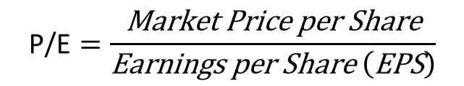
What is P/E Ratio?
The P/E Ratio answers a simple question:
how many dollars will investors pay today for one dollar of the company’s annual earnings?
Computed as follows:
A Quick worked example:
Company A earns EPS of $4.00 and trades at $60.00 per share:
$$\text{P}\text{/}\text{E}=\frac{\text{Market} \text{Price} \text{per} \text{Share}}{\text{Earnings} \text{per} \text{Share} \left(\text{EPS}\right)}$$
Market price per share | $60.00
Earnings per share (EPS) | $ 4.00
P/E ratio | 15.0x
P/E ratio is often used to value a share:
If comparable firms trade at 18× and Company A is expected to earn $4.50 next year, a quick comp-based value is 18 × $4.50 = $81.00 per share.

Slide 26
What Drives the P/E?
Growth
faster expected earnings growth → higher P/E.
Risk
higher risk (a higher discount rate) → lower P/E.
Earnings Quality
more durable, cash-backed earnings → higher P/E

Slide 27

The Algebra Behind the Three Forces – Step 1
Step 1 – No Growth
A firm that pays out all of its earnings (E) in perpetuity with no earnings growth.
$$P=\frac{E}{r} so \text{P}\text{/}\text{E}=\frac{1}{r}$$
What goes in the numerator
A business is worth the present value of its cash flows, so the formula strictly wants free cash flow — not accounting earnings.
Step 1 is the one case where they coincide:
No growth means net new investment is zero
CapEx merely replaces depreciation; working capital is flat
The non-cash items that split earnings from cash flow cancel
Earnings = Dividends = Free cash flow — by the assumption, not by approximation.

Slide 28

The Algebra Behind the Three Forces – Step 2
Step 2 – Let the firm reinvest
Write the payout ratio as b, so the numerator = b × E₁. The Gordon growth model then gives:
$$P=\frac{b ∗ E_{1}}{r} so \text{P}\text{/}\text{E}=\frac{b}{r−g}$$
Step 1 is the special case where g = 0 and b = 1. Growth enters by eating into the denominator — it does not act on its own, it acts on the spread between r and g.
Earnings = Dividends = Free cash flow — by the assumption, not by approximation.

Slide 29
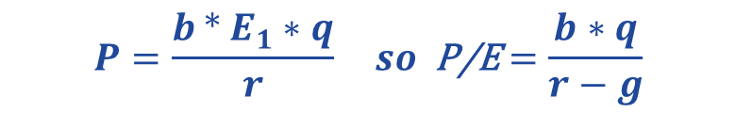
The Algebra Behind the Three Forces – Step 3
Step 3 – Let earnings quality matter
If only a fraction q of reported earnings is durable (earnings quality issue) and cash-backed, the market capitalizes q × E rather than E:
$$P=\frac{b ∗ E_{1}∗q}{r} so \text{P}\text{/}\text{E}=\frac{b∗q}{r−g}$$
Earnings quality sits in the numerator. Two firms with identical growth and risk will trade at different multiples if one firm’s earnings are accrual-heavy (Topic 6).

Slide 30
Appendix- Warren Buffett’s Famous Investing Quotes

Slide 31
Warren Buffett’s Famous Investing Quotes
“Price is what you pay. Value is what you get.” → Focus on intrinsic value, not just the stock price.
“Rule No. 1: Never lose money. Rule No. 2: Never forget Rule No. 1.” → Protecting capital matters enormously.
“Be fearful when others are greedy and greedy when others are fearful.” → Great opportunities can appear when markets are pessimistic.
“Our favorite holding period is forever.” → Buy excellent businesses you’d be comfortable owning for decades.
“It’s far better to buy a wonderful company at a fair price than a fair company at a wonderful price.” → Business quality often matters more than getting the absolute cheapest valuation.
Buffett’s philosophy in one sentence: Buy high-quality businesses at sensible prices, understand what you own, avoid permanent losses, and let compounding work for a very long time.

