Slide 1
Welcome!
Financial Accounting
홍필립기재

Slide 2
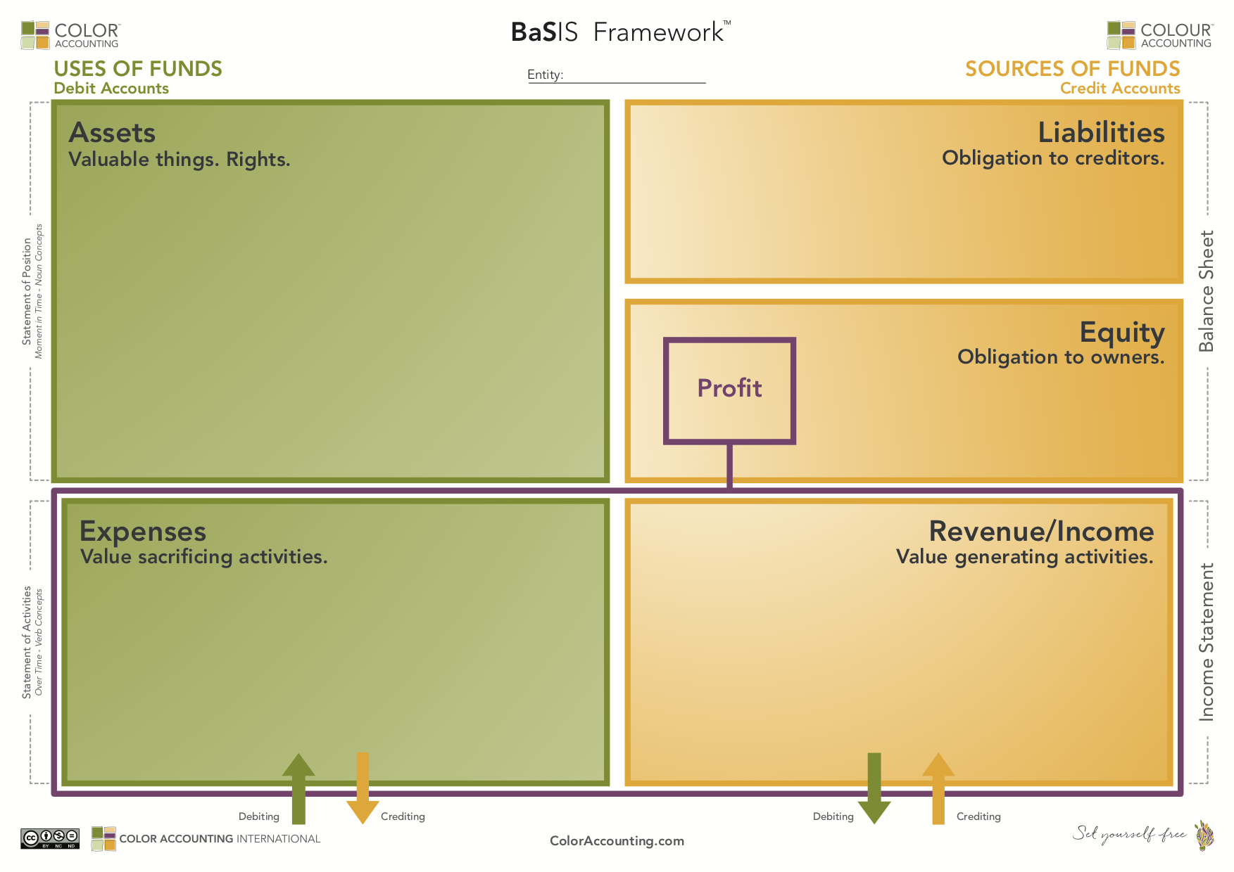

Induction Program
0. Accounting Foundation
1. Funding Butterfly
2. Accounting Framework – Deriving Profit
3. Classic Transactions
4. Summary
5. Business Narrative
Notes:
Academic Educator’s Guide
2.BaSIS Framework - estimated time: 60 mins.

Slide 3
도입 프로그램 (Color Accounting)
0. 회계 기초
자금 흐름 나비도
회계 프레임워크 – 이익 산출 방식
고전적인 거래 사례
요약
비즈니스 서사

Slide 4
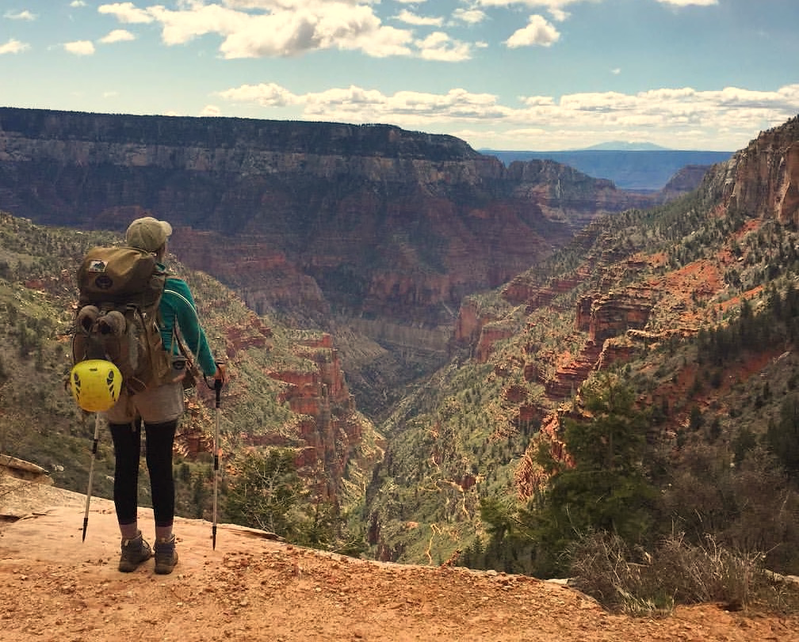


0. 회계의 기초 (Accounting foundations)

Slide 5
Our learning purpose
Business acumen
Financial literacy
Accounting literacy
Accounting literacy 회계 이해력/소양/지식
Financial literacy 금융 이해력
Business acumen 비지니스 감각 / 경영 통찰력

Slide 6

BALANCE SHEETS | Sep. 26, 2020 | Sep. 28, 2019
Current assets:
Cash and cash equivalents | $ 38,016 | $ 48,844
Marketable securities | 52,927 | 51,713
Accounts receivable, net | 16,120 | 22,926
Inventories | 4,061 | 4,106
Vendor non-trade receivables | 21,325 | 22,878
Other current assets | 11,264 | 12,352
Total current assets | 143,713 | 162,819
Non-current assets:
Marketable securities | 100,887 | 105,341
Property, plant and equipment, net | 36,766 | 37,378
Other non-current assets | 42,522 | 32,978
Total non-current assets | 180,175 | 175,697
Total assets | 323,888 | 338,516
Current liabilities:
Accounts payable | 42,296 | 46,236
Other current liabilities | 42,684 | 37,720
Deferred revenue | 6,643 | 5,522
Commercial paper | 4,996 | 5,980
Term debt | 8,773 | 10,260
Total current liabilities | 105,392 | 105,718
Non-current liabilities:
Term debt | 98,667 | 91,807
Other non-current liabilities | 54,490 | 50,503
Total non-current liabilities | 153,157 | 142,310
Total liabilities | 258,549 | 248,028
Commitments and contingencies
Shareholders’ equity:
Common stock | 50,779 | 45,174
Retained earnings | 14,966 | 45,898
Accu. other comprehensive income/(loss) | (406) | (584)
Total shareholders’ equity | 65,339 | 90,488
Total liabilities and shareholders’ equity | $ 323,888 | $ 338,516
STATEMENTS OF OPERATIONS | 12 Months Ended
 | Sep. 26, 2020 | Sep. 28, 2019 | Sep. 29, 2018
Net sales | $ 274,515 | $ 260,174 | $ 265,595
Cost of sales | 169,559 | 161,782 | 163,756
Gross margin | 104,956 | 98,392 | 101,839
Operating expenses:
Research and development | 18,752 | 16,217 | 14,236
Selling, general and administrative | 19,916 | 18,245 | 16,705
Total operating expenses | 38,668 | 34,462 | 30,941
Operating income | 66,288 | 63,930 | 70,898
Other income/(expense), net | 803 | 1,807 | 2,005
Income before provision for income taxes | 67,091 | 65,737 | 72,903
Provision for income taxes | 9,680 | 10,481 | 13,372
Net income | $ 57,411 | $ 55,256 | $ 59,531
Earnings per share:
Basic (in dollars per share) | $ 3.31 | $ 2.99 | $ 3.00
Diluted (in dollars per share) | $ 3.28 | $ 2.97 | $ 2.98
Shares used in computing earnings per share:
Basic (in shares) | 17,352,119 | 18,471,336 | 19,821,510
Diluted (in shares) | 17,528,214 | 18,595,651 | 20,000,435
Products
Net sales | $ 220,747 | $ 213,883 | $ 225,847
Cost of sales | 151,286 | 144,996 | 148,164
Services
Net sales | 53,768 | 46,291 | 39,748
Cost of sales | $ 18,273 | $ 16,786 | $ 15,592

Slide 7

관점을 바꾸면 모든 것이 바뀐다
Perspective changes everything

Slide 8

Purchase
Sale

Slide 9

중요한 물건은 어떻게 그리고 왜 정리하나요?
How and Why do we organize important stuff?
https://www.instagram.com/p/Bi55EWKHqRT/?taken-by=sweetbookobsession

Slide 10


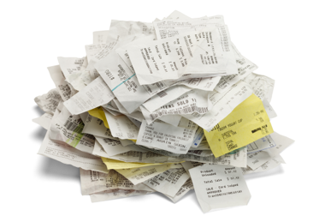
What is accounting?
Assets
Revenue
Liabilities
Expense
회계는 결정을 돕기 위해 재무 정보를 정리하는 것이다
Equity

Slide 11

A Duality (이중성) – The Cornerstone of Modern Accounting
A scenario – Portugal in Year 1508
Spice Venture
My Assets
Land
Castles
Gold/Cash
Livestock
Jewels
Assets
Obligations
Gold
Livestock
Accounting Duality : Assets = Obligations

Slide 12
그래서 회계는 왜 만들어졌는가?
부(wealth), 수익(earnings), 그리고 책무성 (설명책임,accountability)을측정하여 이해관계자들의 의사결정을 지원하는 정보를 제공한다.
It’s all about assets
As a means of measuring wealth, earnings and accountability…
… so decisions could be made

Slide 13
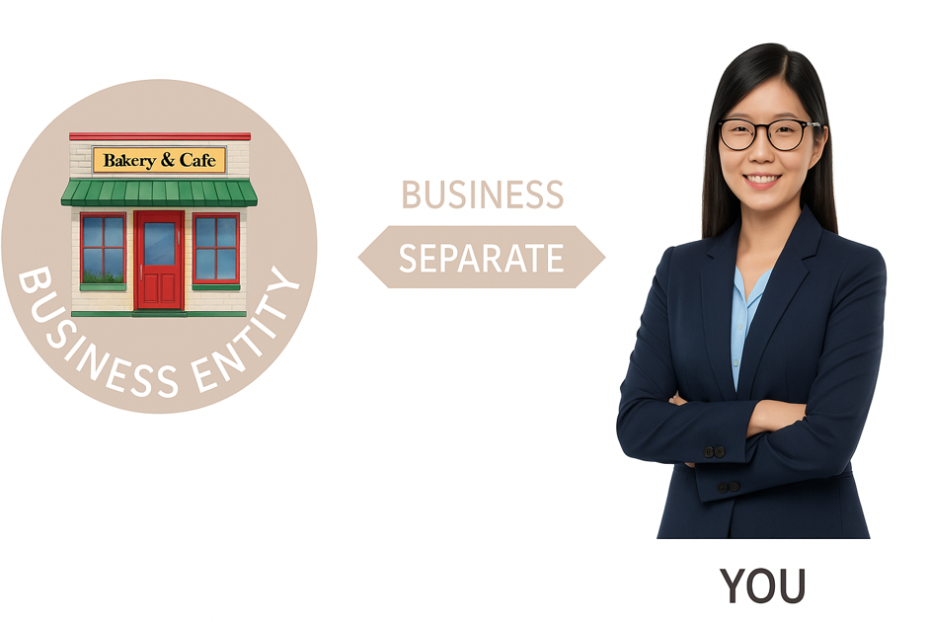
법인격 분리 원칙 (Entity Concept)
Your Business is not You
Notes:
Your Business is not You. → 당신의 사업은 곧 당신이 아닙니다. → 또는 더 회계적 관점에서: 사업은 개인과 구분되는 별개의 존재입니다.
이 문장은 회계의 법인격 분리 원칙 (Entity Concept) 을 강조하는 데 자주 쓰입니다.

Slide 14
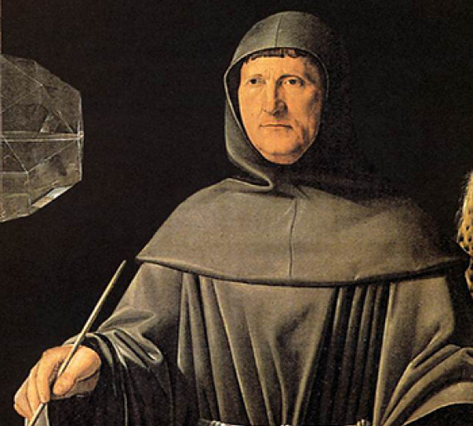
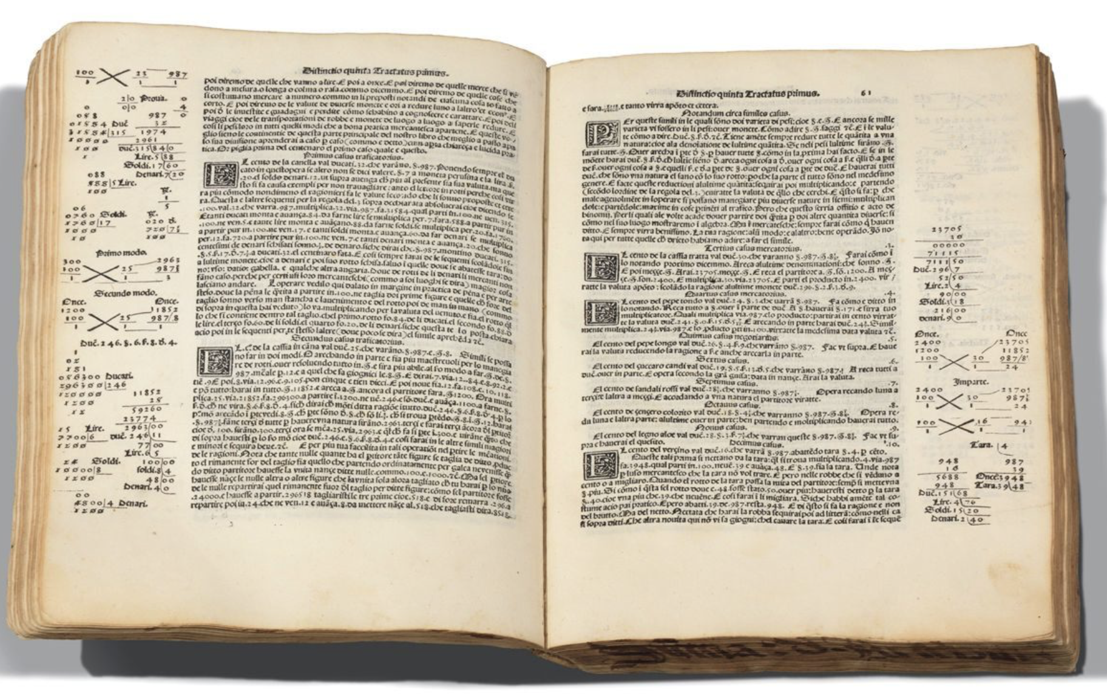
언제 누구에 의해서 만들어 졌나?
Luca Pacioli
1447 - 1517
1494

Slide 15
왜 재무상태표 ( Balance Sheet) 은
양쪽으로 나누어 져있나요?

Slide 16
왜 balance sheet은 양쪽으로 나누어 져있나요?
ASSETS
OBLIGATIONS
The Duality ( 이중성)
Assets: 자산
Obligations: 의무

Slide 17
왜 재무상태표는 좌우가 같아야 하나요?
=
ASSETS
OBLIGATIONS
Assets 이 있고 그 Assets은 같은 값의 Obligations이 있다
We have ASSETS. And those assets have OBLIGATIONS of equivalent value.

Slide 18
Induction Program
0. Accounting Foundation
1. Funding Butterfly
2. Accounting Framework – Deriving Profit
3. Classic Transactions
4. Summary
5. Business Narrative

Slide 19


1. The funding butterfly – 자금 조달의 나비 모형
https://en.butterflycorner.net

Slide 20

Recap
500년 전 발명된 회계는 그래서 회계는 어떤 문제를 해결했나요?
What problem did accounting solve when it was created
over 500 years ago?

Slide 21

Recap
자산에 대한 설명 책임성을 확보하는 문제를 해결했다
Control
Obligation
It solved the problem of accountability for assets

Slide 22
왜 재무상태표는 항상 균형을 이룰까요?
ASSETS
OBLIGATIONS
Assets 이 있고 그 Assets은 같은 값의 Obligations이 있다
We have ASSETS. And those assets have OBLIGATIONS of equivalent value.
Recap

Slide 23
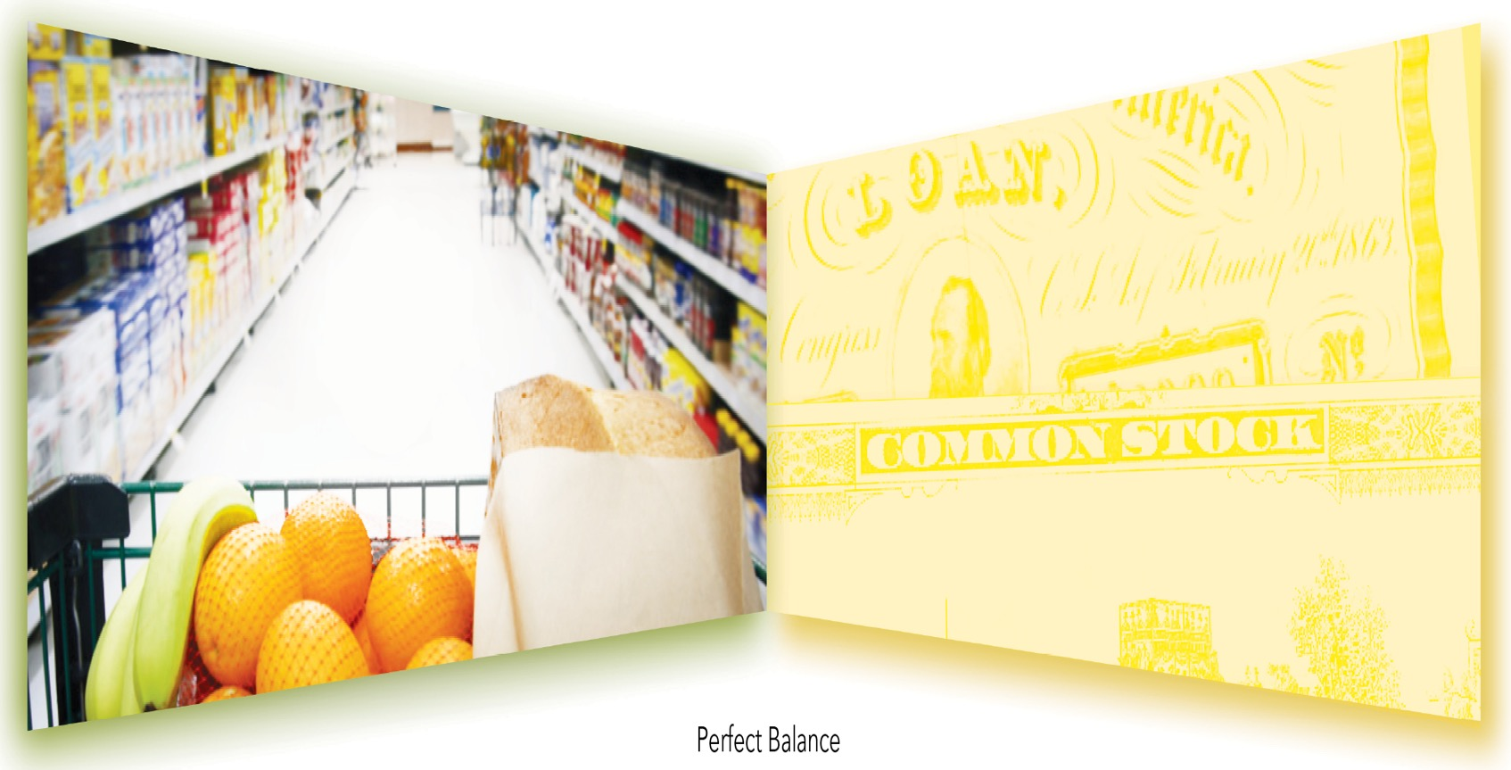

Slide 24
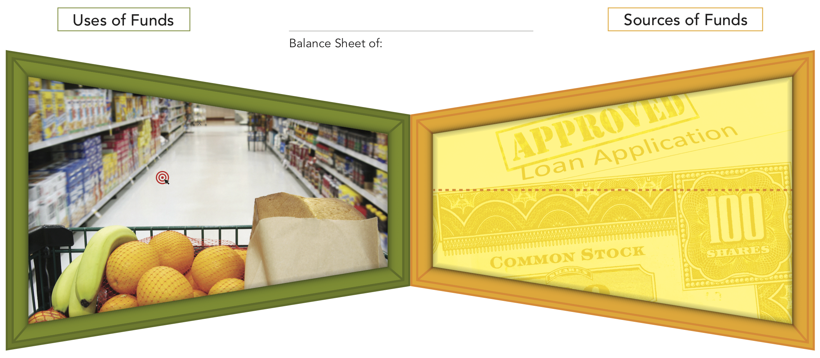
The accounting duality … a funding butterfly

Slide 25
What type of business is this?

Slide 26
?

Slide 27
Perspective
?
(aka ‘point of view’)

Slide 28

Perspective

Slide 29
Global Super-mart

Slide 30
Global Super-mart
ASSETS
Assets are valuable (things)

Slide 31
Global Super-mart
ASSETS
Assets are valuable (things)
Assets은 값이 나가는 것

Slide 32
Global Super-mart
ASSETS
Inventory

Slide 33
Global Super-mart
ASSETS
Shelves
Inventory

Slide 34
Global Super-mart
Shelves
Cart
Flooring
Display rack
Building (& land)
ASSETS
Inventory

Slide 35
Global Super-mart
Shelves
Cart
Flooring
Display rack
Building (& land)
Equipment
ASSETS
Inventory

Slide 36

Global Super-mart
Non-Current Assets
Shelving
Cart
Flooring
Display rack
Building (& land)
Equipment
Computers
ASSETS
Current Assets
Cash
Inventory
Receivables

Slide 37
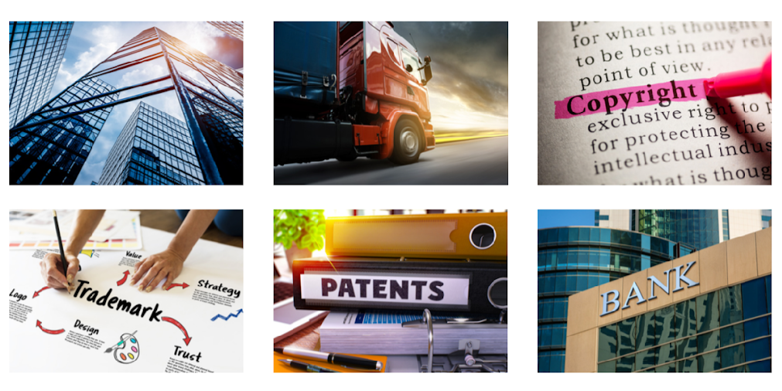
Assets are valuable things
언제 장부에 기록(인식)이 되는가?
권리(rights/control): 기업이 소유하고 통제하는 것
가치 (value /measurable): 화폐 단위로 측정 가능한 것
미래의 경제적 효익 (expected future benefits)
과거의 거래나 사건의 결과로 발생 (past events)
그러면 직원은 asset인가?

Slide 38
Global Super-mart
Non-Current Assets
Shelving
Cart
Flooring
Display rack
Building (& land)
Equipment
Computers
ASSETS
Current Assets
Cash
Inventory
Receivables

Slide 39
Global Super-mart
Non-Current Assets
Shelving
Cart
Flooring
Display rack
Building (& land)
Equipment
Computers
IP (purchased)
Brand (purchased)
IP (cost)
Brand (cost)
Location
Customers
ASSETS
Current Assets
Cash
Inventory
Receivables
Notes:
.

Slide 40
My Supermarket Limited
Assets

Slide 41
My Supermarket Limited
Uses of funds
Sources of funds
Assets
Liabilities
30,000
50,000
=
+
Equity
20,000

Slide 42
My Supermarket Limited
Uses of funds
Sources of funds
Assets
Liabilities
30,000
50,000
=
+
Equity
20,000
Equity and liabilities are never valuable
The only place you will find anything of value
Equity and liabilities are never valuable

Slide 43
My Supermarket Limited
Uses of funds
Sources of funds
Assets
Liabilities
30,000
50,000
=
+
Equity
20,000
Assets
=
Liabilities
+
Equity
Assets
–
Liabilities
=
Equity

Slide 44
My Supermarket Limited
Uses of funds
Sources of funds
Assets
Liabilities
$30,000
$50,000
=
+
Equity
$20,000
Assets
=
Liabilities
+
Equity
Assets
–
Liabilities
=
Equity

Slide 45
A rabble of butterflies
(나비무리)
Point
Of
View
Entity 2
Loan receivable
Liabilities
Entity 1
Equity
Liabilities
Assets
Equity
Entity 3
Investment in equity
Liabilities
Equity

Slide 46



Slide 47
Induction Program
0. Accounting Foundation
1. Funding Butterfly
2. Accounting Framework – Deriving Profit
3. Classic Transactions
4. Summary
5. Business Narrative

Slide 49
3. The Accounting Framework
Uses of funds
Sources of funds
_Assets
Liabilities_
Equity_

Slide 50
My Consulting Inc.
Uses of funds
Sources of funds
_Assets
Liabilities_
Equity_

Slide 51
My Consulting Inc.
Uses of funds
Sources of funds
_Assets
Liabilities_
Bank loan
↑
↑
30,000
Cash
30,000
Equity_

Slide 52
My Consulting Inc.
Uses of funds
Sources of funds
_Assets
Liabilities_
Bank loan
↑
↑
30,000
Cash
30,000
↑
Equity_
Cash
20,000
Contributed
Capital
↑
20,000

Slide 53
My Consulting Inc.
Uses of funds
Sources of funds
_Assets
Liabilities_
Bank loan
↑
↑
30,000
Cash
30,000
↑
Equity_
Cash
20,000
Contributed capital
↑
20,000
↑
Cash
700

Slide 54
My Consulting Inc.
Uses of funds
Sources of funds
_Assets
Liabilities_
Bank loan
↑
↑
30,000
Cash
30,000
↑
Equity_
Cash
20,000
Contributed capital
↑
20,000
↑
Cash
700
Cash
↑
300

Slide 55
My Consulting Limited
Uses of funds
Sources of funds
_Assets
Liabilities_
Bank loan
↑
↑
30,000
Cash
30,000
↑
Equity_
Cash
20,000
Contributed capital
↑
20,000
↑
Cash
700
Generated equity
Cash
↑
300
↑
400

Slide 56
My Consulting Limited
 | A | B | C
Sales | 700) | 401) | 1,000)
Cost of sales | (300) | (1) | (600)
Gross profit | $400) | $400) | $400)
 | 58% | 99% | 40%

Slide 57
My Consulting Limited
Uses of funds
Sources of funds
_Assets
Liabilities_
Bank loan
↑
↑
30,000
Cash
30,000
↑
Equity_
Cash
20,000
Contributed capital
↑
20,000
↑
Cash
700
Generated equity
Cash
↑
300
↑
400
_
_

Slide 58
My Consulting Limited
Uses of funds
Sources of funds
_Assets
Liabilities_
Bank loan
↑
↑
30,000
Cash
30,000
↑
Equity_
Cash
20,000
Contributed capital
↑
20,000
↑
Cash
700
Generated equity
Cash
↑
300
↑
400
_
_
Notes:
Headlines
Determine which is income and which is expense.
Let them try to work this out.
Sequence Steps
Give the following instructions very clearly and precisely – they should copy what you are doing on the whiteboard into their workbooks.
They can now continue the color of each side down the page to the two smaller boxes in the Income Statement section. Green on the Uses of Funds Side and yellow on the Sources of Funds side. [ CLICK ]
Don’t write Income and Expense headings in yet or tell which is which.
Explain the double-click computer analogy where a folder opens and reveals sub-folders (more detailed info). This is how the Income Statement works – we ‘double-click’ the single Profit number in Equity, and the Income Statement explains how it was calculated.

Slide 59
My Consulting Limited
Uses of funds
Sources of funds
_Assets
Liabilities_
Bank loan
↑
↑
30,000
Cash
30,000
↑
Equity_
Valuable things
Cash
20,000
Contributed capital
Obligations
↑
20,000
↑
Cash
700
Generated equity
Cash
↑
300
↑
400
_Expenses
Revenue_
VSA
VGA

Slide 60
My Consulting Limited
Uses of funds
Sources of funds
_Assets
Liabilities_
Bank loan
↑
↑
30,000
Cash
30,000
↑
Equity_
Valuable things
Cash
20,000
Contributed capital
Obligations
↑
20,000
↑
Cash
700
Generated equity
Cash
↑
300
↑
400
700
_Expenses
Revenue_
VSA
VGA
Travelling
↑
300
Consulting
↑
700

Slide 61
My Consulting Limited
Uses of funds
Sources of funds
_Assets
Liabilities_
Bank loan
↑
↑
30,000
Cash
30,000
↑
Equity_
Valuable things
Cash
20,000
Contributed capital
Obligations
↑
20,000
↑
Cash
700
Generated equity
Cash
↑
300
↑
400
_Expenses
Revenue_
VSA
VGA
Travelling
↑
300
Consulting
↑
700

Slide 62

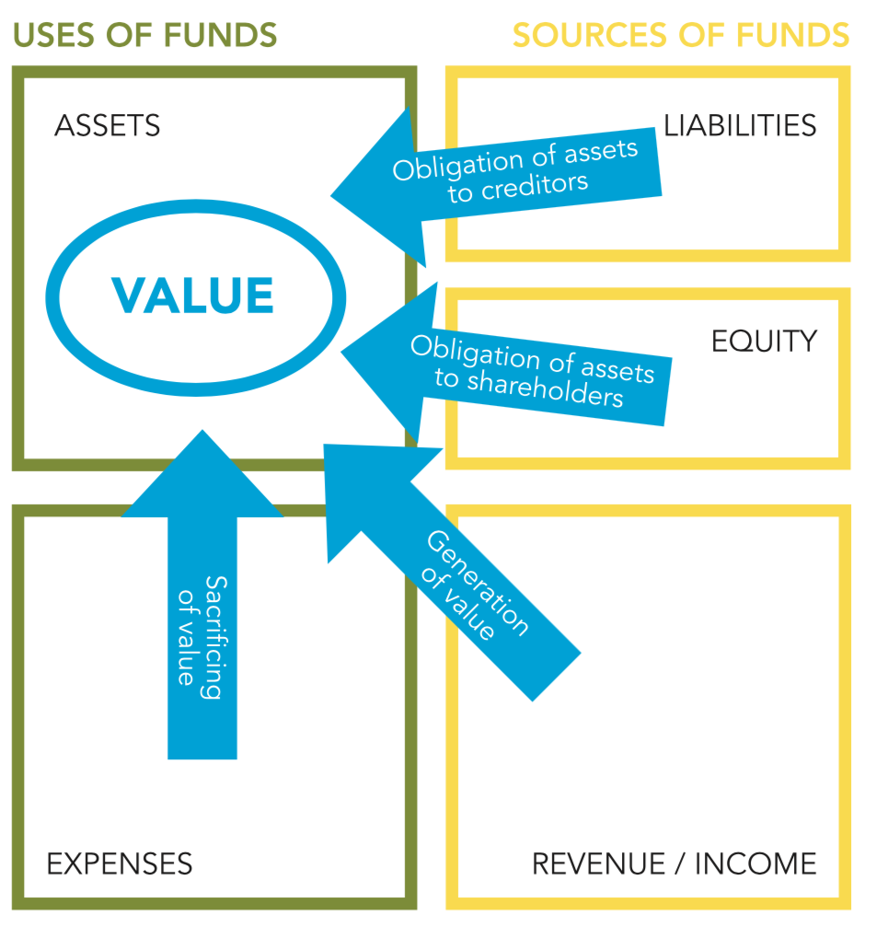
회계는 Asset 중심의 이야기 입니다.
Accounting is an asset-centric story

Slide 63
Entity: My Consulting Limited
Uses of Funds
Sources of Funds
Assets
Valuable things
Liabilities
Obligation to creditors
Equity
Obligation to owners
Profit
Expenses
Value Sacrificing Activities
Revenue
Value Generating Activities

Slide 64


Who can still see it?

Slide 65
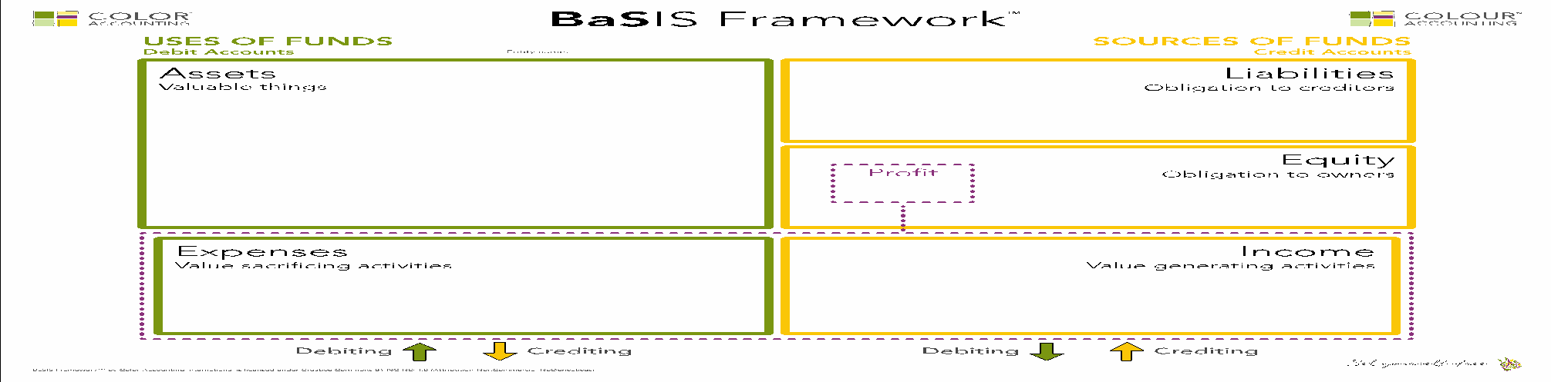
Only 2 things happening in any business
Value Sacrificing Activities
Value Generating Activities

Slide 66
Only 2 things happening in any business
Revenue / Income
Value Sacrificing Activities
Value Generating Activities

Slide 67
Only 2 things happening in any business
Revenue / Income
Value Sacrificing Activities
Value Generating Activities

Slide 68
Assets
Liabilities
The
Value
Cycle
Equity
Expenses
Revenue

Slide 69
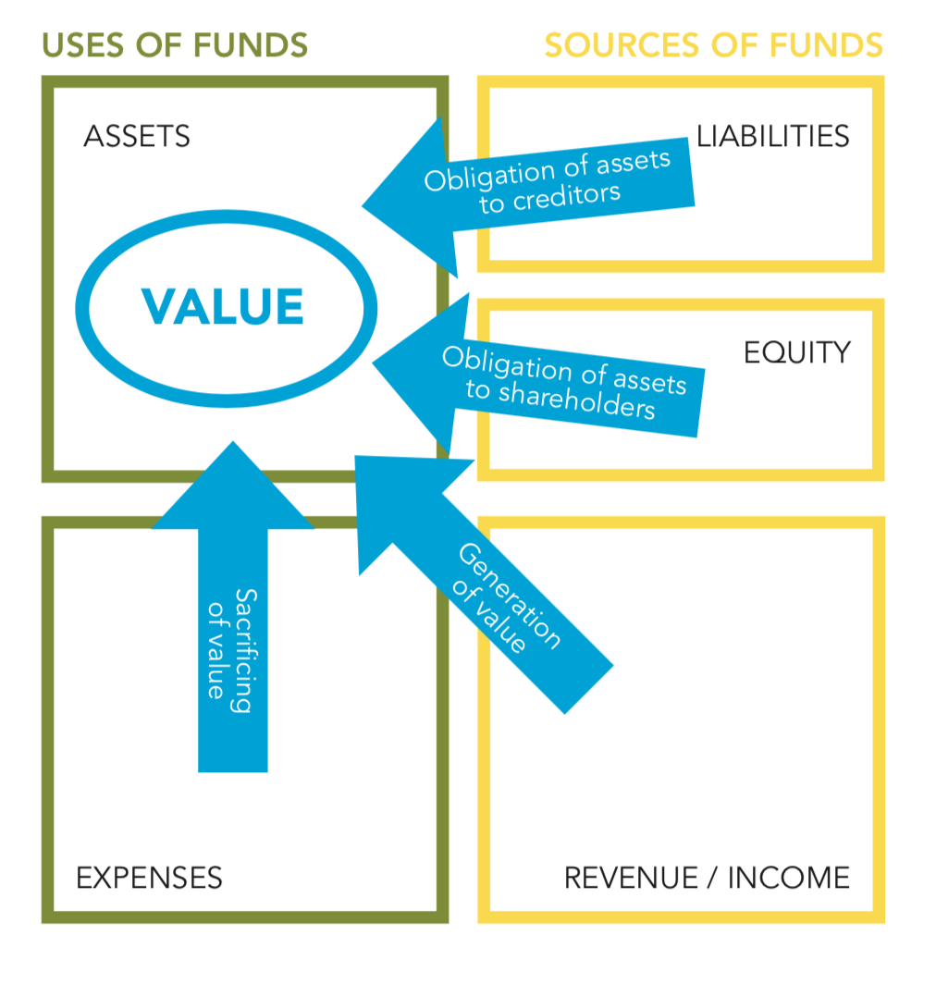
Accounting is an asset-centric story

Slide 70
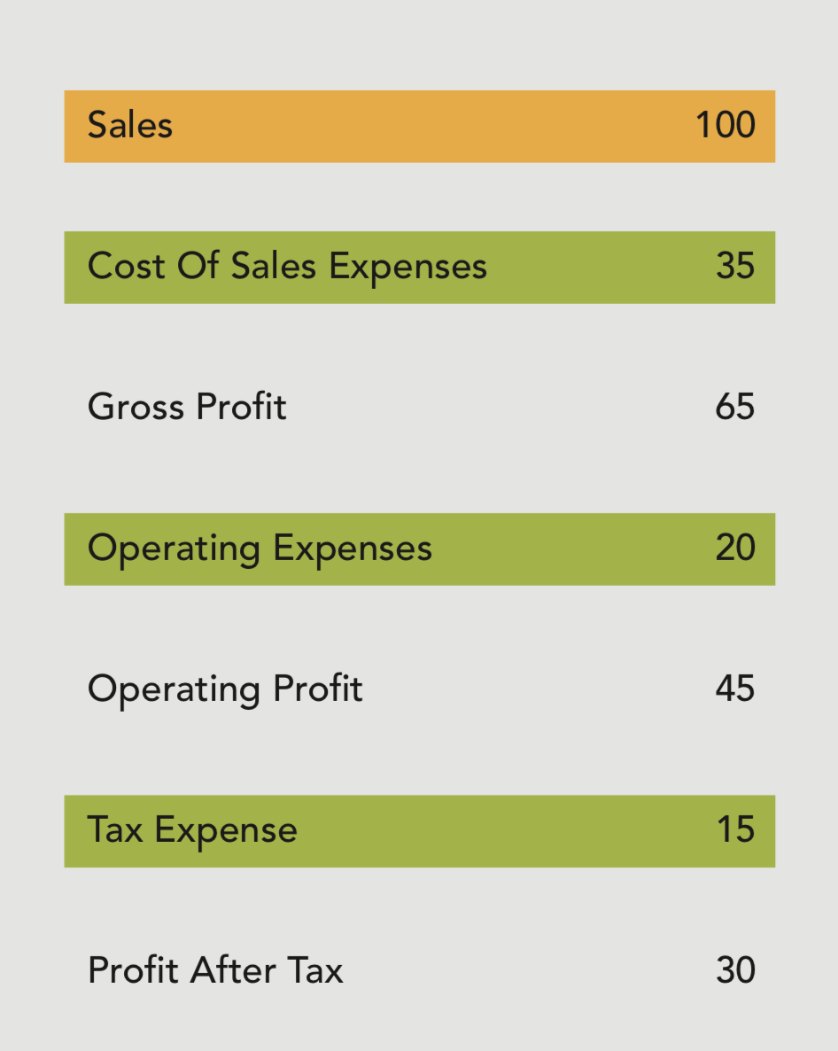
The Income Statement
손익 계산서

Slide 71
The Income Statement

Slide 72
The Income Statement

Slide 73
The Income Statement

Slide 74
The Income Statement

Slide 75
The Income Statement
Notes:
Guide
Use this slide to ‘create’ a typical Income Statement, from top to bottom.
Instructions:
Ask: What is the definition of operating profit / net profit? (revenue minus all of the expenses excluding income tax)
Ask: And next? (Tax Expense)
Next slide…

Slide 76
The Income Statement

Slide 77
The Income Statement
a.k.a.
The Statement of Financial Activities
재무 활동 보고서

