Slide 1
Graph-based Movie Recommender System
using Sentiment, Emotion Analysis of BERT
Sentiment Graph
Emotion Graph
Graph Neural Network (GNN)
Presenter : Cheonsol Lee
Date : 2021.09.10
Notes:
안녕하세요.
BERT의 감성분석을 활용한 그래프 기반의 영화 추천시스템에 대한 연구를 말씀드리겠습니다.

Slide 2
1. Introduction
Thank you

Slide 3
1. Introduction
Problem
There are a lot of data with missing rating in Rotten tomato.
Recommendation based only on rating is incomplete.
Suggestion
Recommendation reflecting sentiment & emotion analysis makes a more precise rating prediction compared to only using rating data.
Graph
Graph Type | Contents
Rating | Movie | Rating | User
Sentiment | Movie | Sentiment | User
Emotion | Movie | Emotion | User

Slide 4

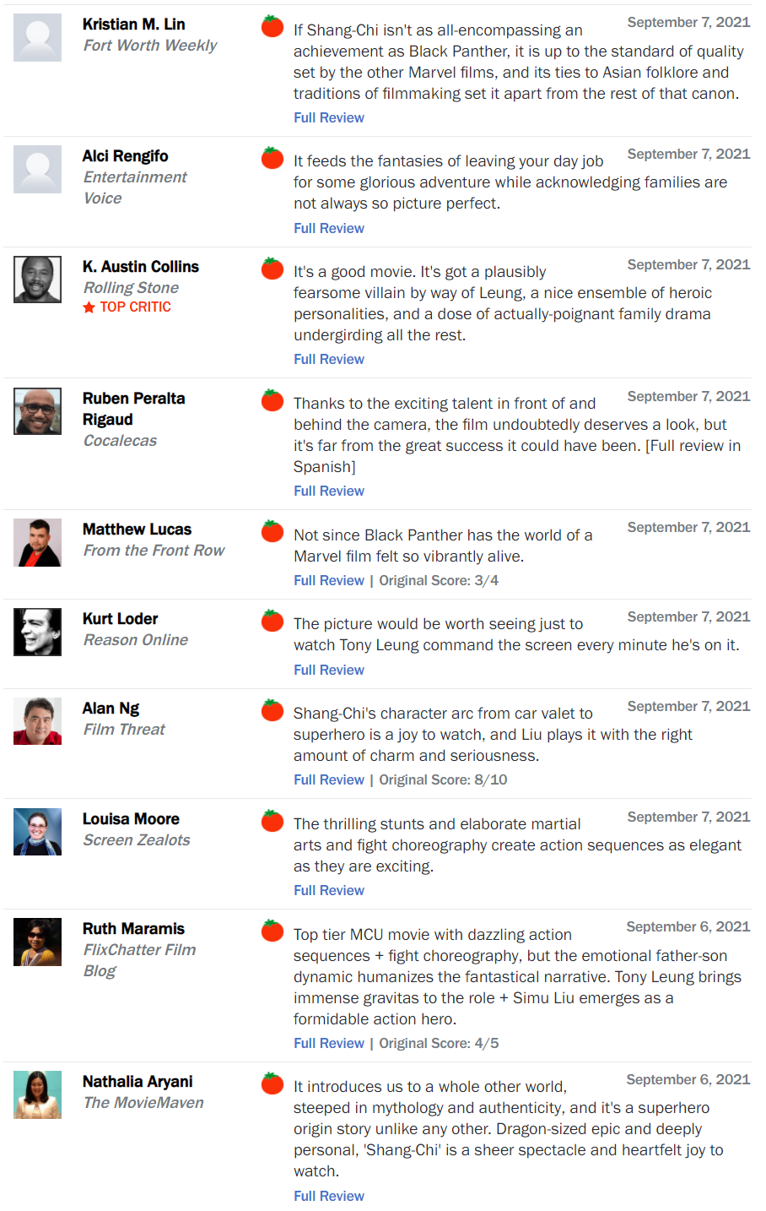
1. Introduction – Problem
Problem
Many missing rating
Ex) Title: Shan-chi (Date: 2021.9.7)
Total: 1,130,017
No rating data is 82% of missing data.
Rating | Review | Amount | Rate
O | O | 758,709 | 67%
X | O | 305,502 | 27%
O | X | 65,372 | 5%
X | X | 434 | 0.03%

Slide 5
2. Related Work
Thank you

Slide 6
2. Related Work
Sentiment Analysis
[1] Integrating Collaborative Filtering and Sentiment Analysis : A Rating Inference Approach (ECAI 06’ workshop)
Approach sentiment analysis with statistical techniques
[2] BERT 기반 감성분석을 이용한 추천시스템 (KCI 21')
Comparing Emotional Analysis with ML/DL Techniques and Presenting the Performance of BERT
Limitation : rating inference was only carried out, and explainable recommendation is not possible.
[3] Movie Recommendation System Using Sentiment Analysis From Microblogging Data (IEEE transactions on css 20’)
Hybrid RS from collaborative filtering(CF) and content-based filtering(CBF) along with sentiment analysis
[4] Using Affective Features from Media Content Metadata for Better Movie Recommendations (KDIR 20’)
Detect movie overviews’ implicit affective features like emotion and sentiment.
Strength: reflect dynamic information like user’s emotion and sentiment

Slide 7
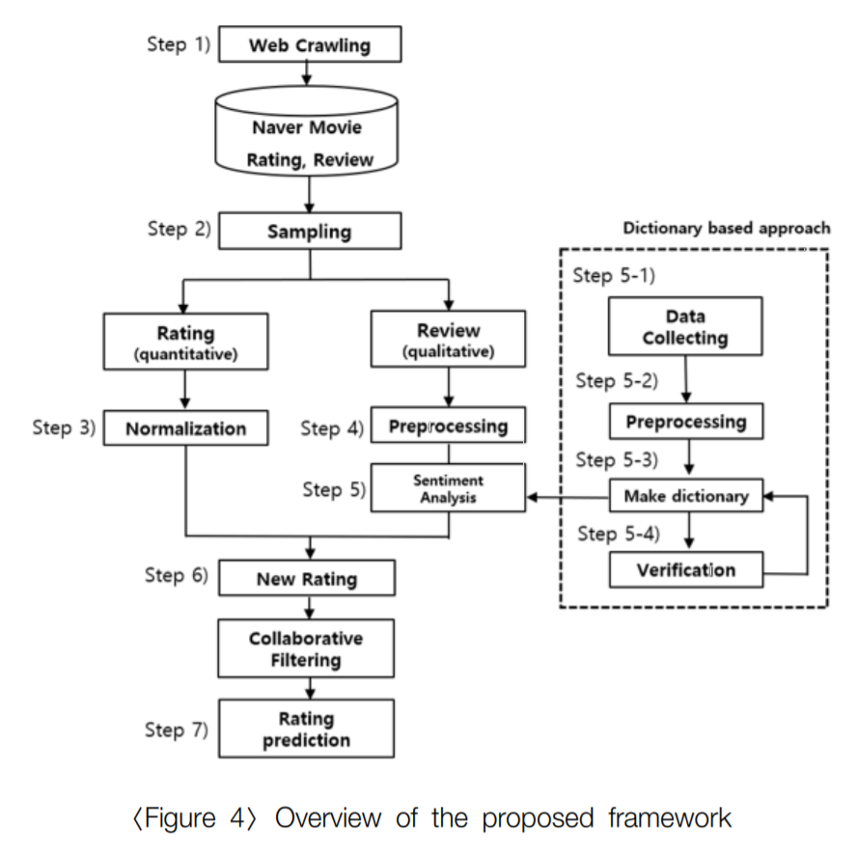
2. Related Work
Sentiment Analysis
[5] How to improve the accuracy of recommendation systems: Combining ratings and review texts sentiment scores. (JIIS 2019)
Emotion Analysis
[6] Tensor-based tag emotion aware recommendation with probabilistic ranking. (KSII 2019)
[7] Item recommendation using tag emotion in social cataloging services. (ScienceDirect 2017)

Slide 8
3. Methodology
Thank you

Slide 9
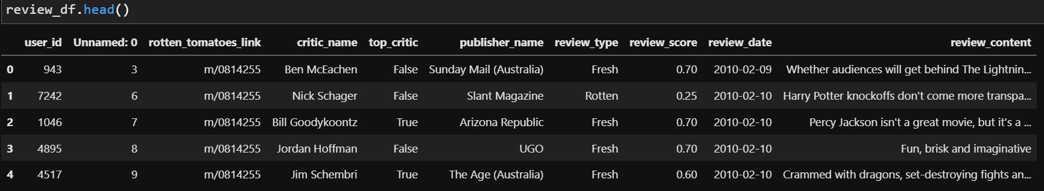
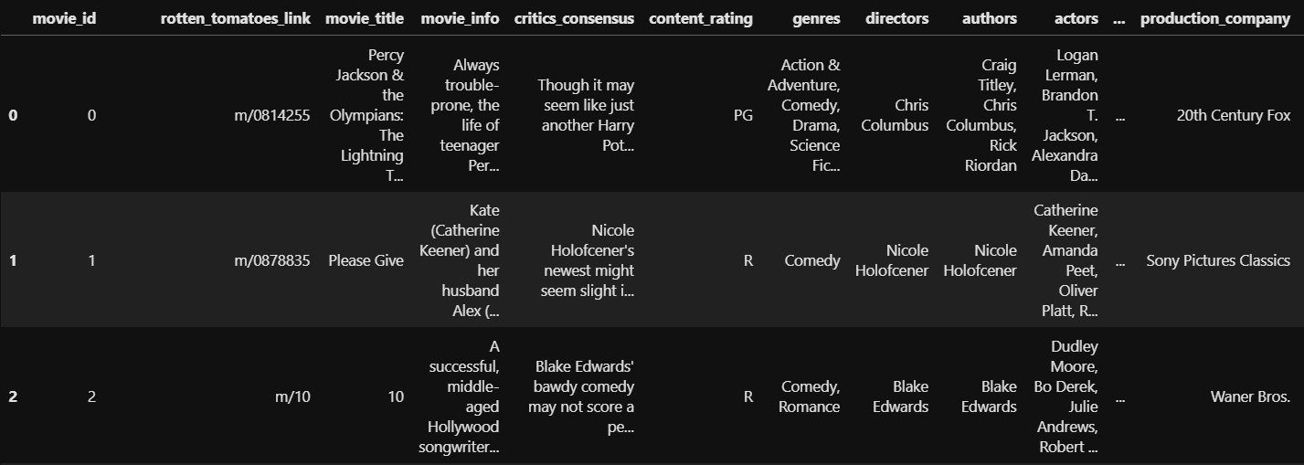
3. Pre-processing
Dataset
Rating matrix
Group : critic_name, top_critic, publisher_name
The number of users : 9,821
Movie matrix
The number of movies: 17,712

Slide 10
3. Framework
Movie System
Movie Database
Review Data
Meta Data
BERT
Graph Module
Sentiment/Emotion
Movie/Review Graph
Graph Representator
Graph Neural Network
Movie Recommendation
(In planning)

Slide 11


3. Framework - Methodology
M | R | U
0 | 0.5 | 1
1 | 0.7 | 1
2 | 0.3 | 2
Sum of relation values
Multi-layer Graph
(Rating graph)
M | S | U
0 | 1 | 1
1 | 3 | 1
2 | 2 | 2
Graph
model
(Sentiment graph)
[Predicted Rating]
Metric: RMSE/MAE
[Baseline]
Traditional: CF, SVD, NCF
Graph: NGCF, GCN, GAT, GraphSAGE
M | B | U
0 | 1 | 1
1 | 2 | 1
2 | 5 | 2
Ablation Study
(Emotion graph)
Notes:
그래프를 단순 합으로 결합
Multi-layer로 구성하여 GNN 학습

Slide 12
3. Result Table
Result
Graph type : Rating, Sentiment, Emotion
Data : 60%(rating, review)
Ideal result
Type | Method | F1-score | Data
Baselines | CF MF FM NCF | Low | Rating
Graph (in general) | GCN GAT GraphSAGE Graphormer | Middle | Rating
Graph (our model) | GNN + “novelty” | High | Rating
 |  |  | Rating + Sentiment
 |  |  | Rating + Emotion
 |  |  | Rating + Sentiment + Emotion

Slide 13
4. Sentiment, Emotion
Analysis Model
Thank you

Slide 14
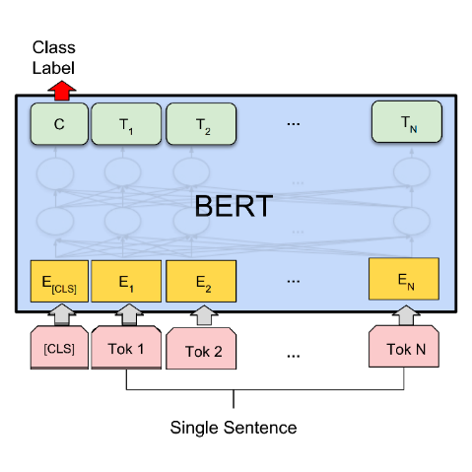
4. Sentiment Analysis
BERT
Scaled rating (Not sentiment value)
Training : Input(Review), Output(Rating)
Range (rating 0~1)
0(negative): rating 0 ~ 0.3
1(neutral) : rating 0.3 ~ 0.7
2(positive) : rating 0.7 ~ 1.0
Review
Rating
Review data
Result
M | S | U
0 | 1 | 1
1 | 0 | 1
2 | 2 | 2
Uma Thurman as Medusa, the gorgon with a coiffure of writhing snakes and stone-inducing hypnotic gaze is one of the highlights of this bewitching fantasy
Scaled rating
(Sentiment graph)

Slide 15
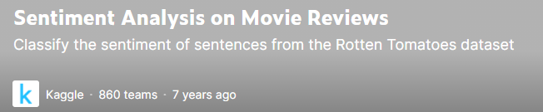
4. Sentiment Analysis
BERT
Learning data for sentiment analysis
The sentiment labels
0 – Negative
1 – Somewhat Negative
2 – Neutral
3 – Somewhat Positive
4 - Positive
Review data
Result
M | S | U
0 | 1 | 1
1 | 3 | 1
2 | 2 | 2
Uma Thurman as Medusa, the gorgon with a coiffure of writhing snakes and stone-inducing hypnotic gaze is one of the highlights of this bewitching fantasy
Sentiment value
(Sentiment graph)

Slide 16
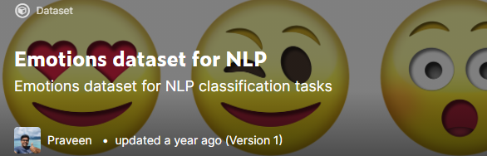
4. Emotion Analysis
BERT
Learning data for emotion analysis
The sentiment labels
0 – anger
1 – fear
2 – joy
3 – love
4 – sadness
5 - surprise
Review data
Result
M | S | U
0 | 1 | 1
1 | 3 | 1
2 | 2 | 2
Uma Thurman as Medusa, the gorgon with a coiffure of writhing snakes and stone-inducing hypnotic gaze is one of the highlights of this bewitching fantasy
Emotion value
(Emotion graph)

Slide 17
4. Framework
M | R | U
0 | 0.5 | 1
1 | 0.7 | 1
2 | 0.3 | 2
Sum of relation values
Multi-layer Graph
(Rating graph)
M | S | U
0 | 1 | 1
1 | 3 | 1
2 | 2 | 2
Graph
model
(Sentiment graph)
[Predicted Rating]
Metric: RMSE/MAE
[Baseline]
Traditional: CF, SVD, NCF
Graph: NGCF, GCN, GAT, GraphSAGE
M | B | U
0 | 1 | 1
1 | 2 | 1
2 | 5 | 2
Ablation Study
(Emotion graph)
Notes:
그래프를 단순 합으로 결합
Multi-layer로 구성하여 GNN 학습

Slide 18
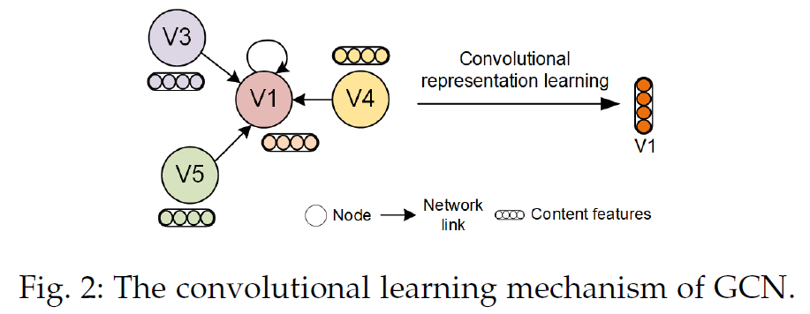
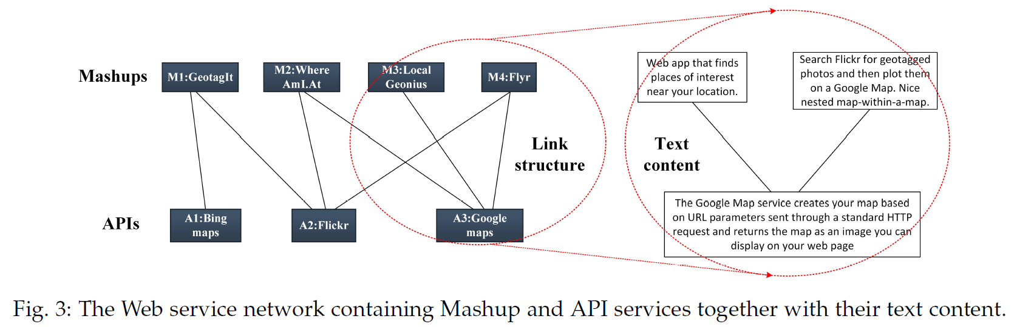
4. Contribution & Reference
Contribution
Improve accuracy of link prediction
Baseline: Rating data & Model
Solution: Rating + Sentiment + Emotion & Model + Novelty(Multi-layer)
Reference
Web Service Network Embedding based on Link Prediction and Convolutional Learning
IEEE Transactions on Services Computing 2020
Data: Node features + text content

Slide 19
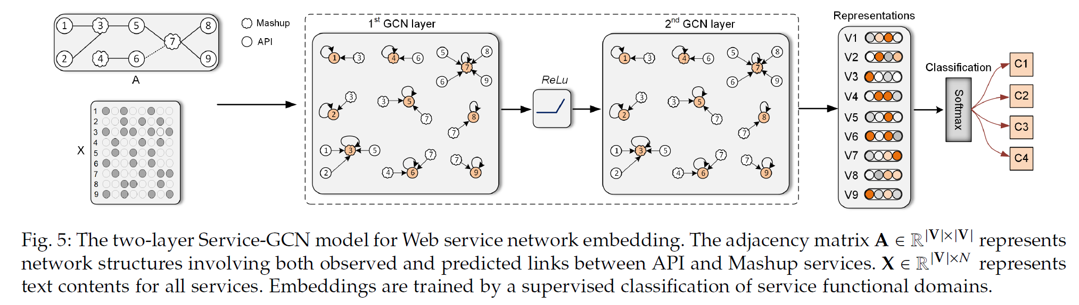
4. Conclusion
Conclusion
1) 네트워크가 sparse할 때, contents 내용을 참고하는게 도움이 됨
2) 예측된 link를 포함시킨 네트워크 구조를 이용할 때, node 임베딩 성능이 향상됨 (원래 있어야할 link가 포함된 경우로 보임)
3) GCN이 node 간의 관계 파악에 도움
4) WSNE모델(제안 모델)은 클러스터링에서 구별가능한 경계를 생성하는 방법으로 제일 좋은 결과를 냄.
Difference

Slide 20
5. Summary
Thank you

Slide 21
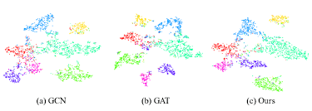
5. Summary
정리
문제점(수정요망): missing rating 데이터가 많음 (불완전한 추천)
차별점: 감성/감정 그래프를 반영한 그래프 기반의 추천시스템 사례가 없음
솔루션: movie, review 정보가 있다면 정교한 평점 예측이 가능
Graph 기반의 추천 목적?
User의 성향이 review의 감성/감정 정보로 구체화 됨.
Ex) Cora 데이터셋: 논문의 Category가 주변 논문과의 인용 관계로 구체화 됨.
출처 : Rethinking Kernel Methods for Node Representation Learning on Graphs

Slide 22
Thank you

Slide 23
Appendix
Thank you

Slide 24
1. Framework - Methodology
M | R | U
0 | 0.5 | 1
1 | 0.7 | 1
2 | 0.3 | 2
Sum of relation values
Multi-layer Graph
(Rating graph)
M | S | U
0 | 1 | 1
1 | 3 | 1
2 | 2 | 2
Graph
model
(Sentiment graph)
[Predicted Rating]
Metric: RMSE/MAE
[Baseline]
Traditional: CF, MF, NCF
Graph: NGCF, GCN, GAT, GraphSAGE
M | B | U
0 | 1 | 1
1 | 2 | 1
2 | 5 | 2
Ablation Study
(Emotion graph)
Notes:
그래프를 단순 합으로 결합
Multi-layer로 구성하여 GNN 학습

