Slide 1
(ICLR 2020)
Inductive Matrix Completion based on Graph Neural Networks
Improved GCMC (transductive)
Inductive Model
Presenter : Cheonsol Lee
Date : 2021.10.25
Notes:
안녕하세요.
BERT의 감성분석을 활용한 그래프 기반의 영화 추천시스템에 대한 연구를 말씀드리겠습니다.

Slide 2
1
Introduction
2
Related Work
3
Method
INDEX
4
Experiment
5
Results
6
Conclusion

Slide 3
1. Introduction
Thank you

Slide 4
1. Introduction – Problems of related works
Problems of Matrix Completion
Matrix factorization(MF) is transductive, meaning that the learned latent features for users/items are not generalizable to users/items unseen during the training.
Cons: When the rating matrix has changed values, it requires a complete retraining to get the new embeddings.
For inductive matrix completion, IMC[1] uses side information of users and items.
Cons: when high-quality content is not available, it leads to inferior performance.
Exchangeable matrix layers[2] which apply permutation equivariant operations on the rating matrix to reconstruct missing entries
Cons: it takes the whole rating matrix as input (Scalability challenges)
[1] Provable Inductive Matrix Completion(IMC) (ICLR 2013)
[2] Deep Models of Interactions Across Sets (ICLR 2018)

Slide 5
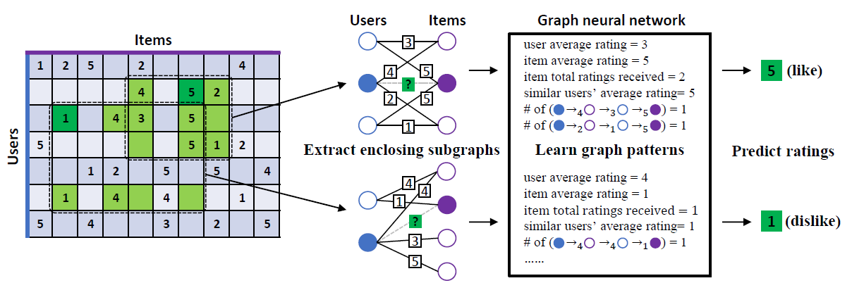
1. Introduction – IGMC
Inductive Graph-based Matrix Completion (IGMC)
It does not use any content and the whole rating matrix.
Local graph pattern
Without retraining, it can be applied to unseen users/items.
IGMC is more robust than transductive methods GCMC

Slide 6
1. Introduction – IGMC
(4+2)/2
Begin
End
(5+5)/2
(5+5)/2
Begin
End
(4+3+5)/2
1/1
1/1

Slide 7
2. Related Work
Thank you

Slide 8
2. Related Work
GNN
Node-level GNN vs Edge-level GNN vs Graph-level GNN
Noun
Verb
Noun
Noun
Verb
1
2
3
4
5
Node-level
2
3
Attention
Is
All
You
Need
1
Citation
?
Citation
5
4
1
2
3
4
5
Edge-level
paper1
paper2
paper3
paper4
paper5
1
2
3
4
5
Negative
Graph-level
She
does
not
like
it

Slide 9
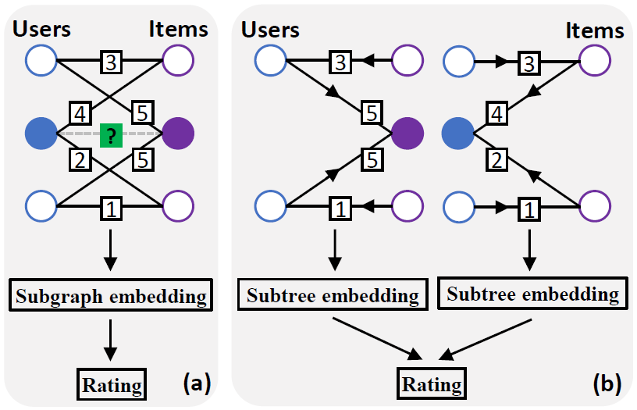
2. Related Work
GNNs for matrix completion
Node-level GNN: It cannot reflect the interactions between the two graphs.
Graph-level GNN: The learning is confined to the subgraphs.
<Node-level GNN>
<Graph-level GNN>
ex) GCMC, PinSage
ex) IGMC

Slide 10
3. Method
Thank you

Slide 11
3. Method
Overview of IGMC
Subgraph extraction and labeling
Subgraph feature extraction
Rating prediction
Users
Rating
Items
Subgraph
Embedding
Users
Rating
Items
1
3
2
3
3
4
5
4
5
?
5
2
5
2
5
1
1
Figure 1. Overview of IGMC

Slide 12
3. Method
Enclosing Subgraph Extraction
1) In the entire Bipartite graph, it expands to neighbors around specific users and items to create a subgraph.
2) New nodes associated with the current user and item set are added to the subgraph node set.
3) In the entire graph, delete edges associated with nodes that do not belong to subgraph node set.
4) Delete the edge between the target user and item that want to predict the rating.
Users
Rating
Items
Subgraph
Embedding
Users
Rating
Items
1
3
2
3
3
4
5
4
5
?
5
2
5
2
5
1
1
Figure 1. Overview of IGMC

Slide 13
3. Method
Node Labeling
Global context must be removed for the model to be inductive.
To read only the subgraph's pattern, new labels are attached.
Process
Divide the target node and the context node. (0/1)
Divide the user and item node. (even/odd)
Divide nodes added to different hop. (h)
Type | User ID | Item ID
target | 0 | 1
1-hop | 2 | 3
2-hop | 4 | 5
h-hop | 2h | 2h+1
Users
Rating
Items
Subgraph
Embedding
Users
Rating
Items
1
3
2
3
3
4
5
4
5
?
5
2
5
2
5
1
1
Figure 1. Overview of IGMC

Slide 14
3. Method
Passing GNN
Extract the characteristics of the subgraph using GNN.
Each node has a unique embedding of the assigned label.
Relational-GNN (R-GNN) is used.
R-GNN : extended model to identify different features according to the type of edge
The output of multiple layers of GNN is concatenated and defined as the representation of node(subgraph embedding).
Users
Rating
Items
Subgraph
Embedding
Users
Rating
Items
1
3
2
3
3
4
5
4
5
?
5
2
5
2
5
1
1
Figure 1. Overview of IGMC

Slide 15
3. Method
Rating Prediction
Among the feature vectors of node identified through R-GNN, feature vectors of users and items who want to predict ratings are concatenated and defined as the final representation of the subgraph.
Embeddings of target subgraphs pass through the MLP prediction layer to regress the rating.
Users
Rating
Items
Subgraph
Embedding
Users
Rating
Items
1
3
2
3
3
4
5
4
5
?
5
2
5
2
5
1
1
Figure 1. Overview of IGMC

Slide 16
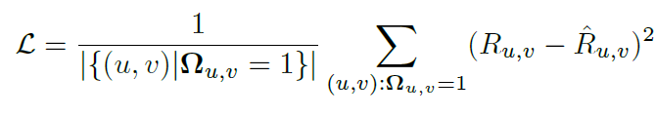

3. Method
Model Training
Mean Square Error(MSE) Loss
Adjacent Rating Regularization(ARR) Loss
Each rating uses a different weight matrix, and the weight of a nearest rating should be more similar than the weight of a distant rating.
Frobinous normal loss is taken to the weight of the adjacent rating.
ex) In rating(1,2,3,4,5), 4 is closer to 5 than 1.
<MSE Loss>
<ARR Loss>

Slide 17
4. Experiment
Thank you

Slide 18
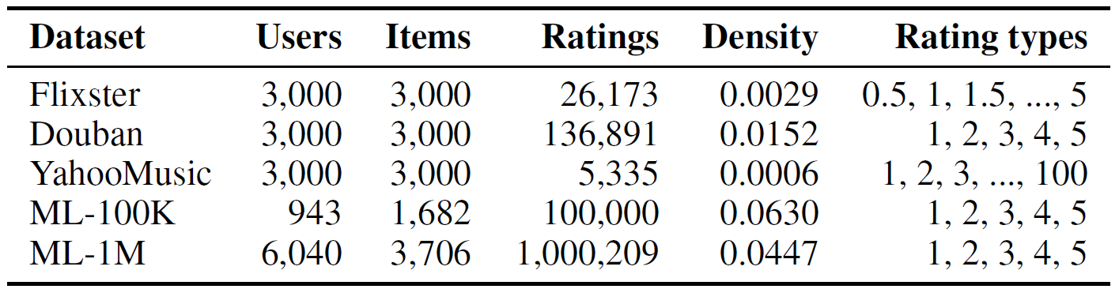
4. Experiment – Dataset
Benchmark Dataset
5 types dataset : Flixster, Douban, YahooMusic, ML-100K, and ML-1M
<Dataset>

Slide 19
5. Results
Thank you

Slide 20
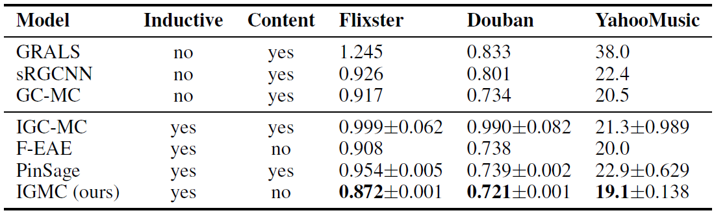
5. Result
Result
RMSE test results on Flixster, Douban, and YahooMusic
This highlights IGMC’s great performance advantages without relying on content.

Slide 21
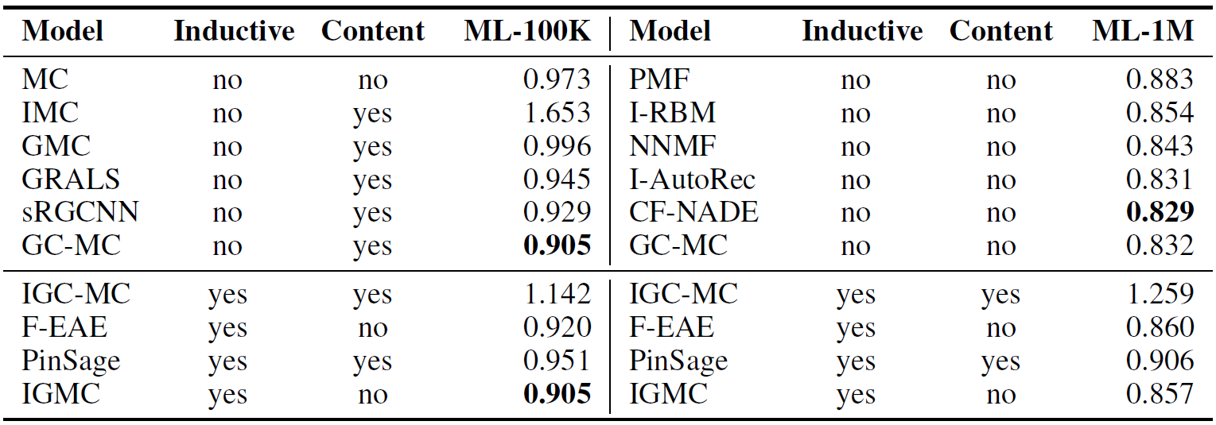
5. Result
Result
RMSE test results on MovieLens-100K(left) and MovieLens-1M(right)
For ML-100K, IGMC achieves the best performance in parallel with GCMC.
For ML-1M, IGMC cannot catch up with SOTA transductive models, but outperforms other inductive models.

Slide 22
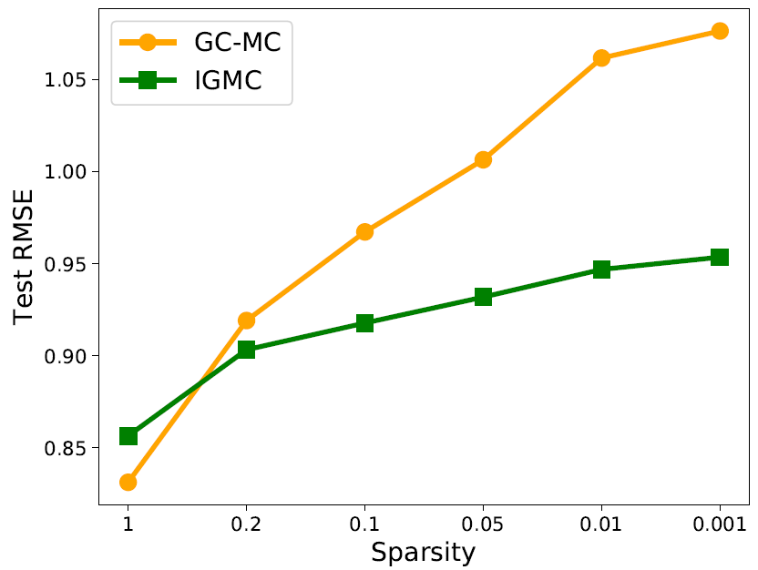
5. Result
Sparse Rating Matrix Analysis
IGMC is a better choice than transductive methods when there is not a large amount of training data, which is particularly suitable for the initial rating collection phase of a recommender system.
Transductive matrix completion relies more on the dense user-item interactions than inductive models.
<ML-1M results under different sparsity ratios>

Slide 23
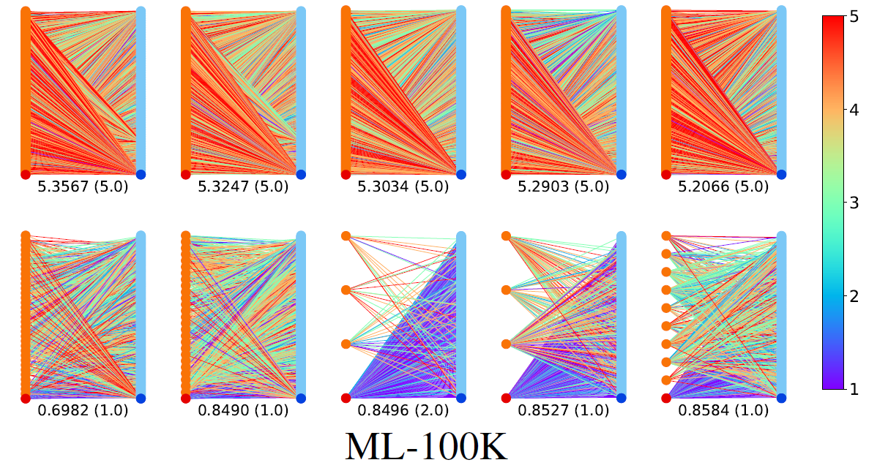
5. Result
Visualization
In order to see what pattern the learned model read, the actual relationship of the five cases with the highest/lowest rating was visualized.
It shows that subgraphs are enough to predict ratings.

Slide 24
6. Conclusion
Thank you

Slide 25
6. Conclusion
This paper proposes an inductive recommendation model using GNN.
IGMC does not rely on side information of users/items.
The effects of the model are well shown in several aspects such as performance comparison, transfer learning ability, and visualization.

Slide 26
To do
Thank you

Slide 27
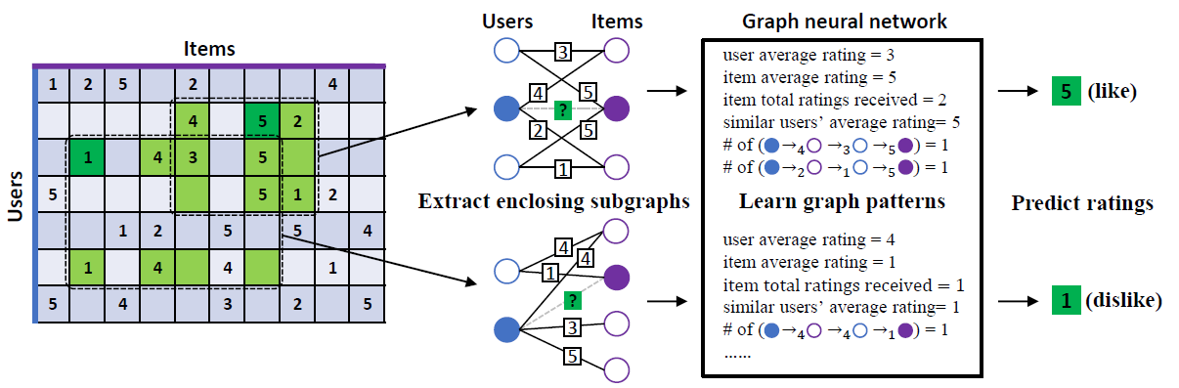
IGMC (Inductive Graph-based Matrix Completion)
IGMC (ICLR 2020)
The model that improved the shortcomings of GCMC
It is the state-of-the-art model among rating inference models using bipartite graphs.
Characteristics
Inductive for generalization
No side-information needed
Efficient because it learns in units of sub-graphs, not in units of total-graphs
Sub-graph
Notes:
그래프를 단순 합으로 결합
Multi-layer로 구성하여 GNN 학습

Slide 28


Framework1: Combined embedding
Subgraph
Embedding
Users
Rating
Items
3
Rating
4
5
?
Target
2
5
1
$$y_{ui}$$
New
Embedding
Users
Sentiment
Items
3
4
5
MLP
Sentiment
?
$${\hat{y}}_{ui}$$
2
5
Prediction
1
Users
Emotion
Items
3
[Aggregation Functions]
Mean
Sum
Avg
Concat
Emotion
4
5
?
2
5
1
Notes:
그래프를 단순 합으로 결합
Multi-layer로 구성하여 GNN 학습

Slide 29

Framework2: Knowledge Distillation
Subgraph
Embedding
New
Embedding
Users
Rating
Items
3
Prediction
MLP
Rating
4
5
$${\hat{y}}_{ui}$$
?
2
5
A
1
Users
Sentiment
Items
3
$$y_{ui}$$
Sentiment
4
5
Target
?
2
5
B
1
Users
Emotion
Items
3
Train Loss : |A-B| + |A-C| + |Prediction-Target|
Testset : only rating dataset (Cover: rating O, review X)
Emotion
4
5
?
2
5
C
1
Notes:
그래프를 단순 합으로 결합
Multi-layer로 구성하여 GNN 학습

Slide 30
Feedback
Thank you

Slide 31
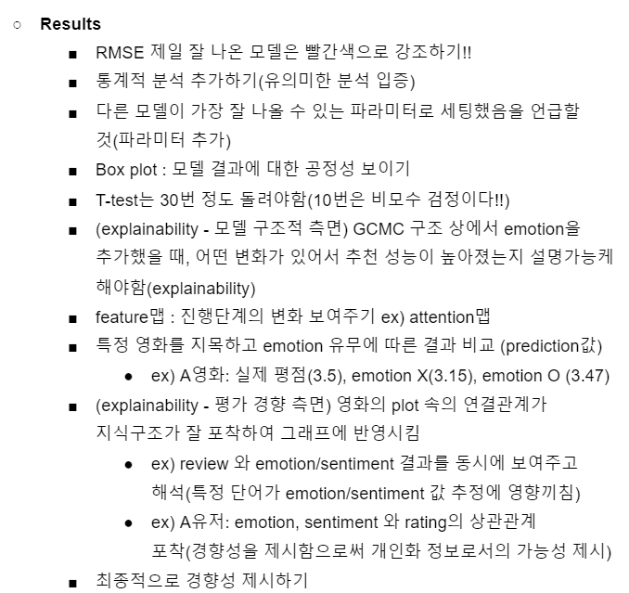
Feedback (이문용 교수님)
Visualization 이용
<Emotion or Sentiment>

