Slide 1
Movie dataset
IMDB Movies Top 1000
MovieLens-2019
Presenter : Cheonsol Lee
Date : 2021.07.30
Notes:
Translation model : 벡터 연산을 통해 지식 완성을 수행

Slide 2
Movie datasets – MovieLens-2019, IMDb
Notes:
Translation model : 벡터 연산을 통해 지식 완성을 수행

Slide 3
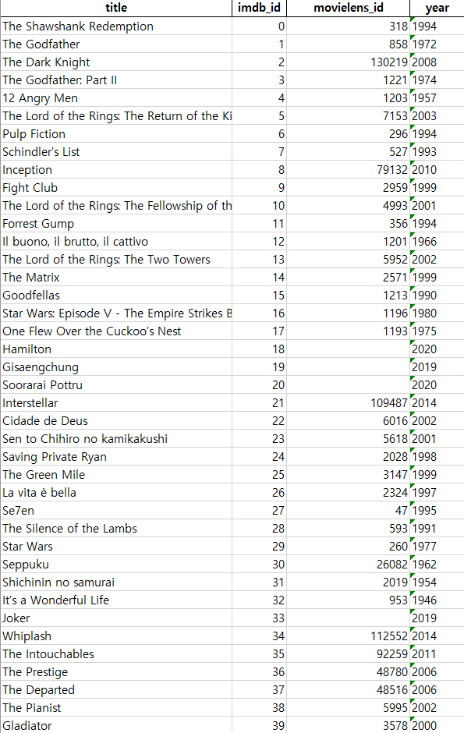
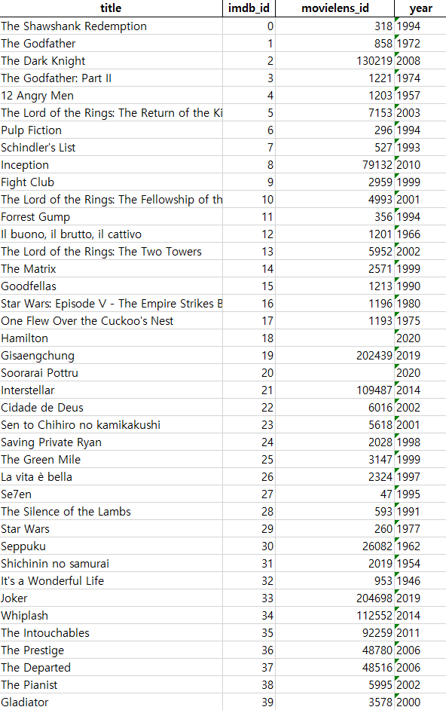
Missing values
Old version
New version
36/40 * 100(%)
= 90%
36/40 * 100(%)
= 95%

Slide 4
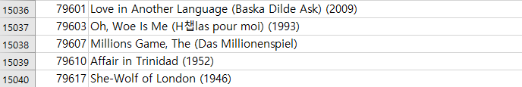
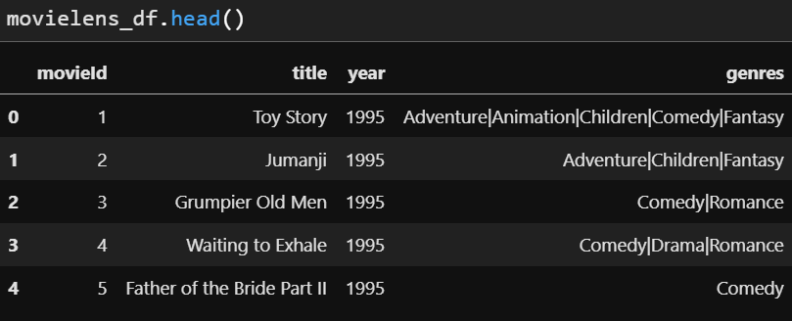
Missing values
Missing values - year
Movielens dataframe format
* Idea : year extraction

Slide 5
Data Analysis
Notes:
Translation model : 벡터 연산을 통해 지식 완성을 수행

Slide 6
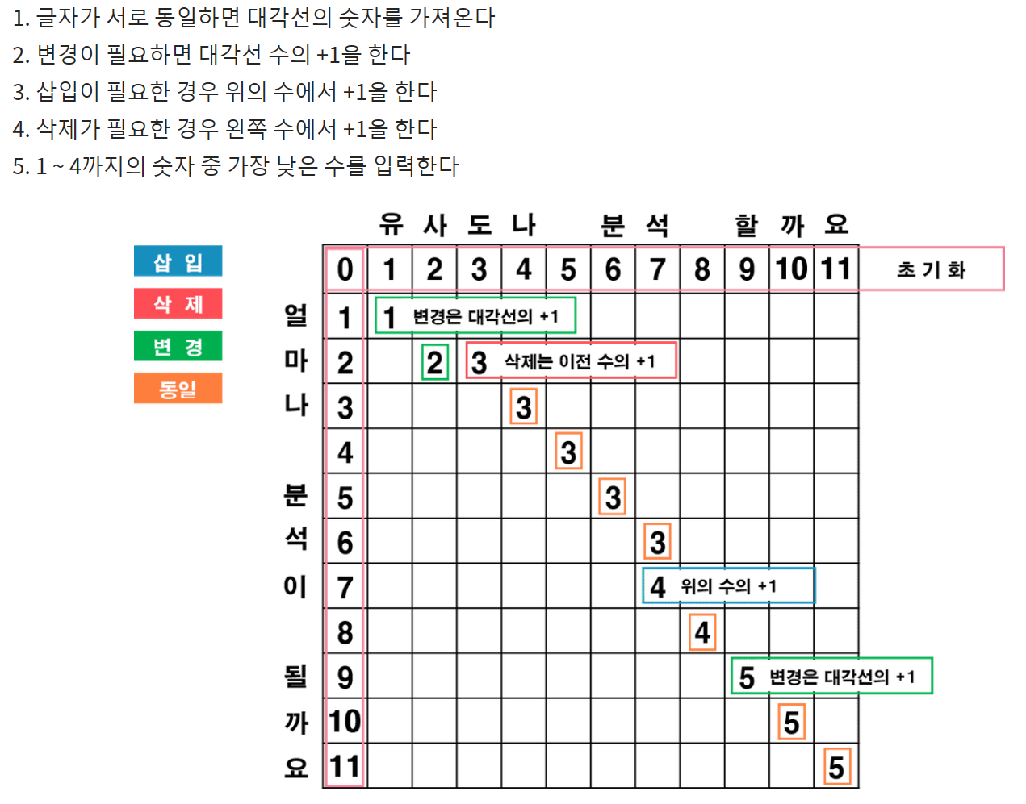
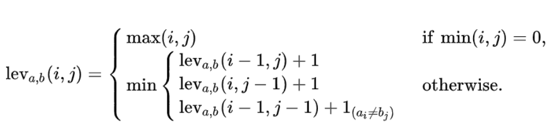
Levenshtein Distance
알고리즘

Slide 7
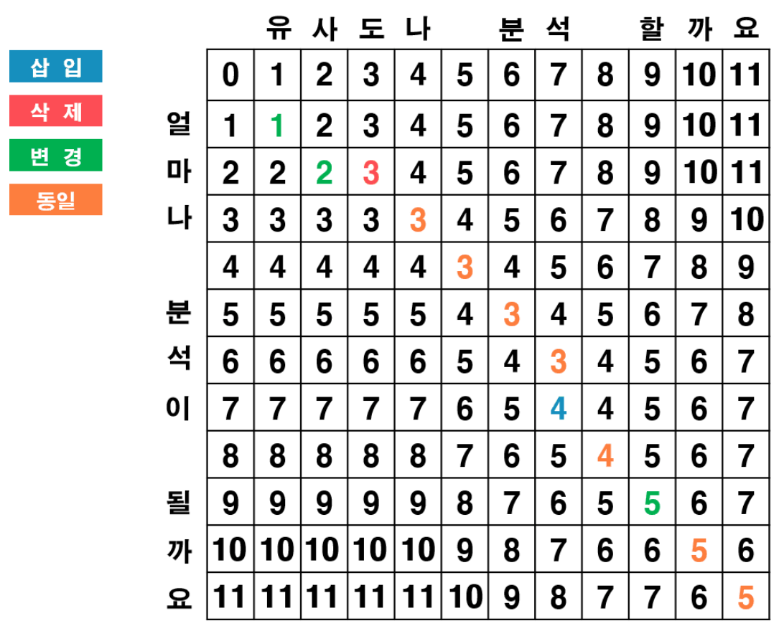
Levenshtein Distance

Slide 8
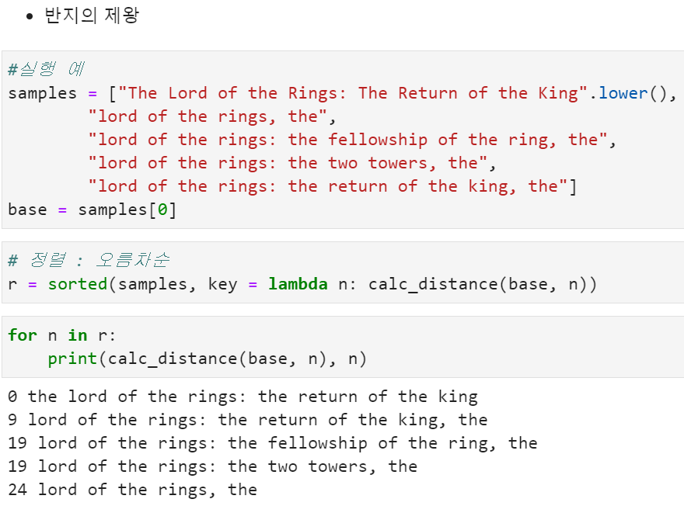
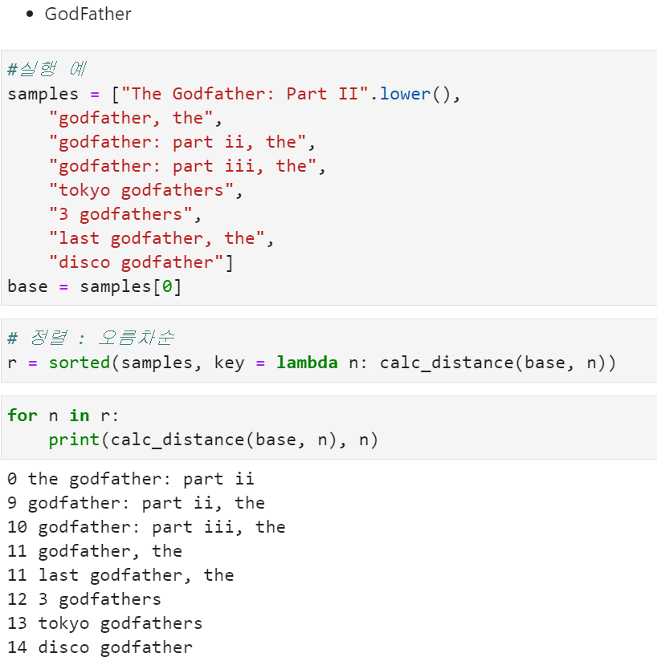
Levenshtein Distance

Slide 9
Thank you

Slide 10
Appendix
Thank you

Slide 11
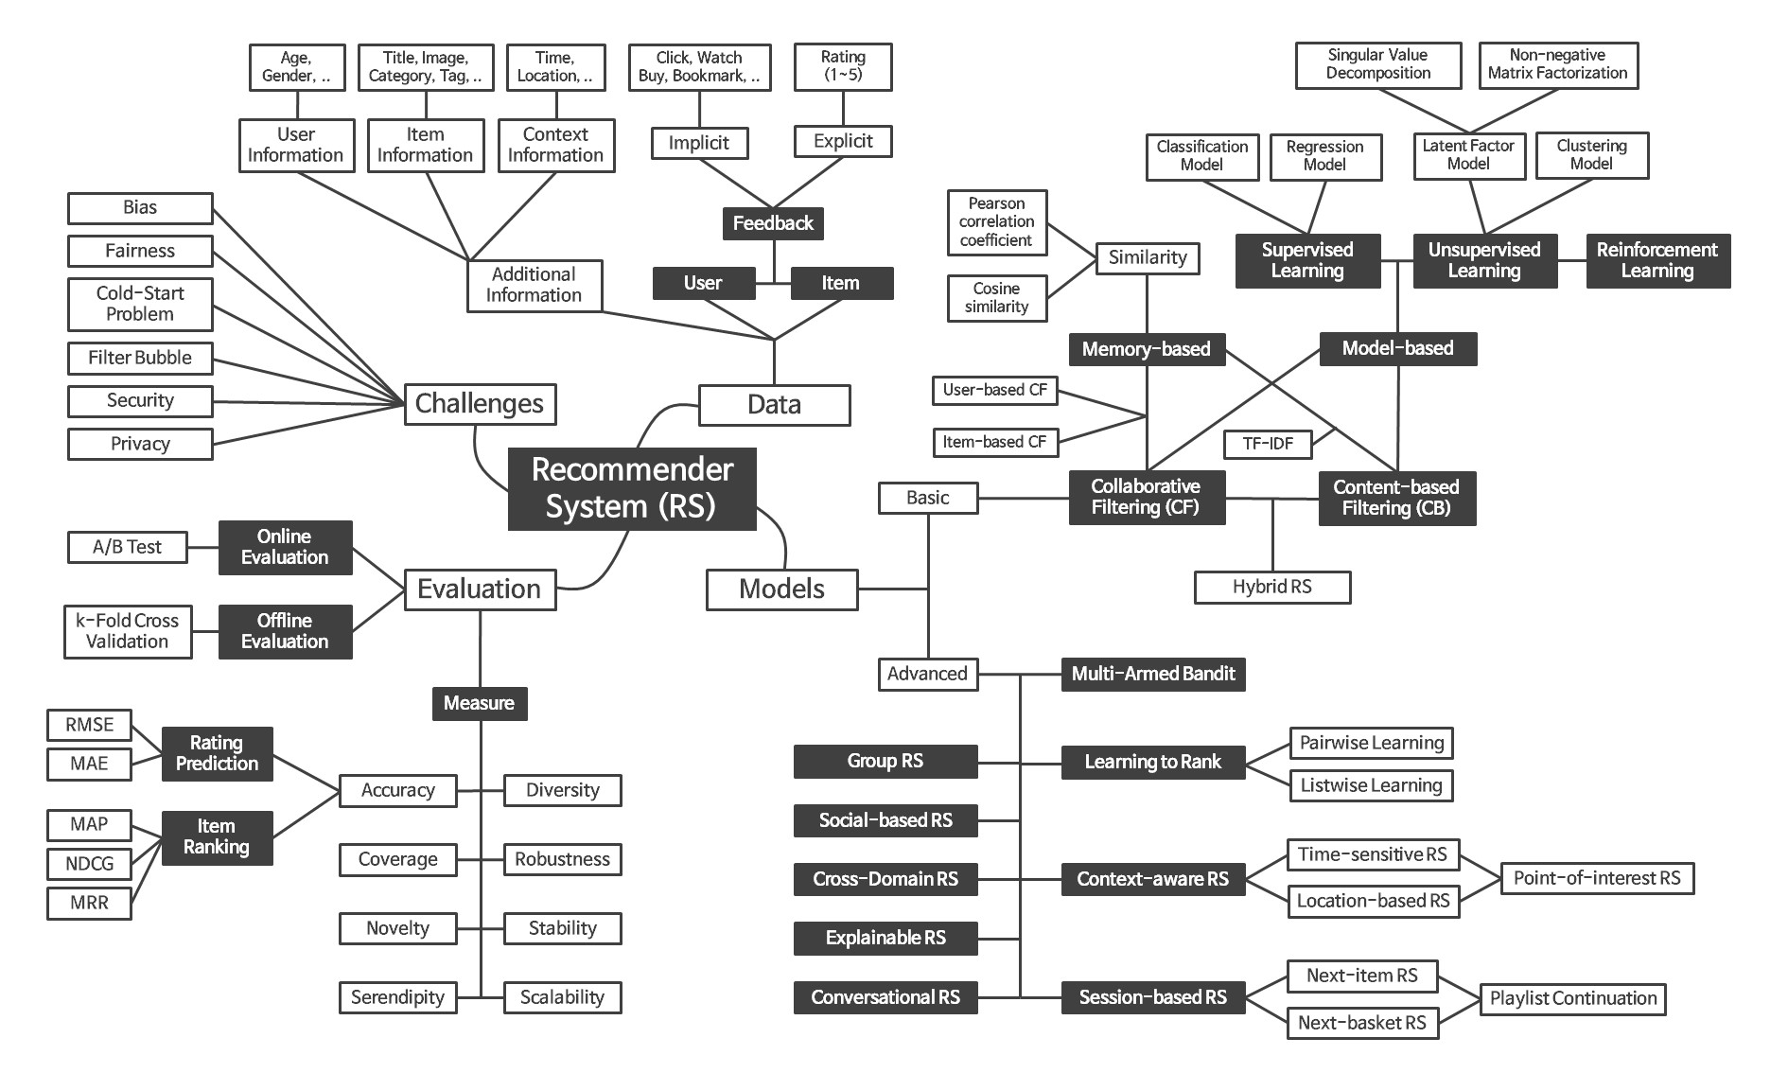
Recommender System Framework

