Slide 1
Graph-based Movie Recommender System
using Sentiment, Emotion Analysis of BERT
Sentiment Graph
Emotion Graph
Graph Neural Network (GNN)
Presenter : Cheonsol Lee
Date : 2021.09.24
Notes:
안녕하세요.
BERT의 감성분석을 활용한 그래프 기반의 영화 추천시스템에 대한 연구를 말씀드리겠습니다.

Slide 2
1. Long-tail Graph
Thank you

Slide 3
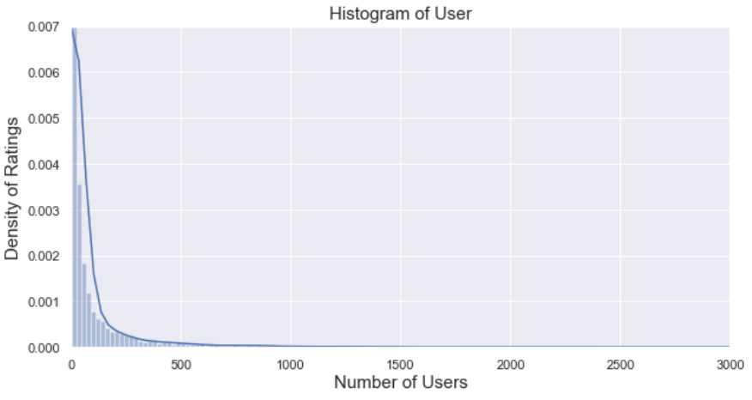
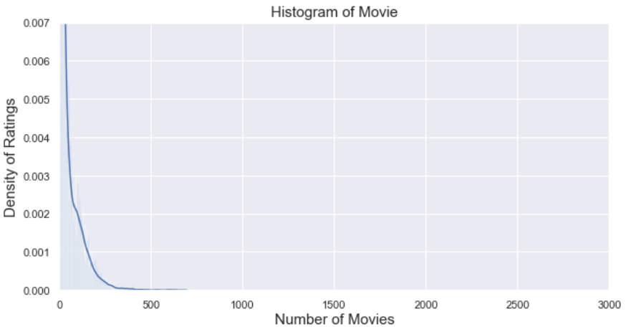
1. Long-tail Graph
Histogram
Group: User, Movie
Range
X-axis : 0 ~ 3,000
Y-axis : 0 ~ 500
Bins : 100
Range | User | Movie
Total | 9,794 | 17,614
< 3 | 3,552 (36%) | 993 (6%)
< 5 | 4,653 (48%) | 2,892 (16%)
>= 100 | 1,343 (14%) | 2,490 (14%)
>= 500 | 345 (4%) | 13 (0%)
Reviews >= 100
<User>
<Movie>

Slide 4
2. Baselines
Thank you

Slide 5

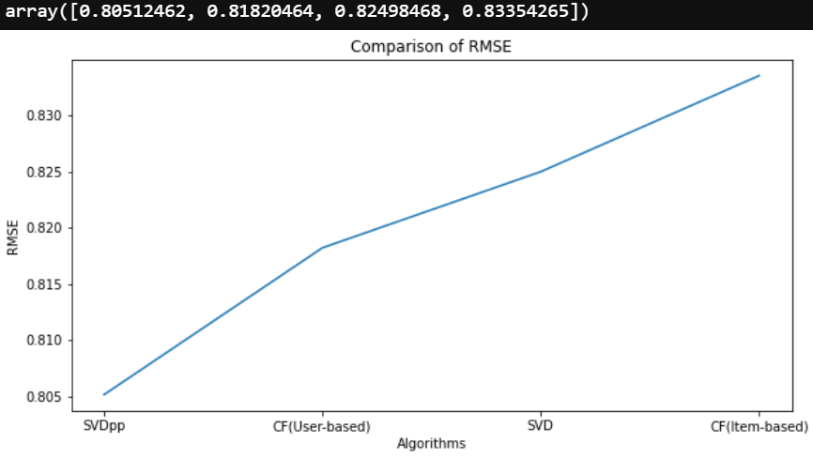
2. Baselines
Surprise
Algorithms:
CF(Item, User-based) : k=30
MF: SVD, SVD++

Slide 6
3. Framework
Thank you

Slide 7
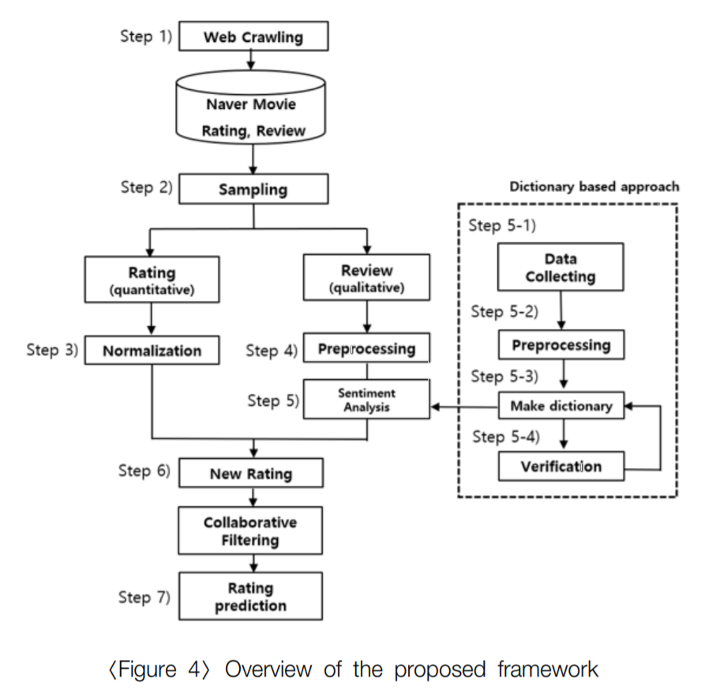
3. Framework
Web Crawling
Movie Database
Sampling
Review
Rating
Review
BERT
BERT
Normalization
Sentiment / Emotion
Sentiment
Emotion
Multi-layer embedding
Graph Model
Rating Prediction

Slide 8


3. Framework - Methodology
M | R | U
0 | 3.5 | 1
1 | 4.7 | 1
2 | 1.3 | 2
Sum of relation values
Multi-layer Graph
(Rating graph)
M | S | U
0 | 1 | 1
1 | 3 | 1
2 | 2 | 2
Graph
model
(Sentiment graph)
[Predicted Rating]
Metric: RMSE/MAE
[Baseline]
Traditional: CF, SVD, NCF
Graph: GCMC, IGMC, IMC-GAE
M | B | U
0 | 1 | 1
1 | 2 | 1
2 | 5 | 2
Ablation Study
(Emotion graph)
Notes:
그래프를 단순 합으로 결합
Multi-layer로 구성하여 GNN 학습

Slide 9
3. Result Table
Result
Graph type : Rating, Sentiment, Emotion
Data : 60%(rating, review)
Ideal result
Type | Method | F1-score | Data
Baselines | CF MF: SVD, SVD++ FM NCF | Low | Rating
Graph (in general) | GCN (GCMC) GAT GraphSAGE Graphormer | Middle | Rating
Graph (our model) | GNN + “novelty” | High | Rating
 |  |  | Rating + Sentiment
 |  |  | Rating + Emotion
 |  |  | Rating + Sentiment + Emotion

Slide 10
4. Graph Model
Thank you

Slide 11
4. GNN
GNN Model
Graph Convolutional Matrix Completion (GCMC) [KDD 2018] (세팅 완료, 데이터 적용 중)
Inductive Matrix Completion Based on Graph Neural Networks (IGMC) [ICLR 2020] (예정)
Inductive Matrix Completion Using Graph Autoencoder (IMC-GAE) [CIKM 2021] (세팅 완료, 데이터 적용 중)

Slide 12
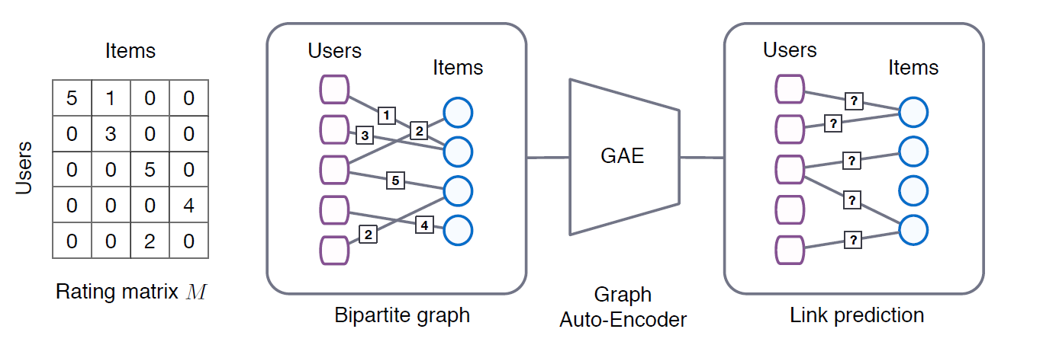
4. GCMC
Graph Convolutional Matrix Completion [KDD 2018]
Rating
Node features
GCN

Slide 13
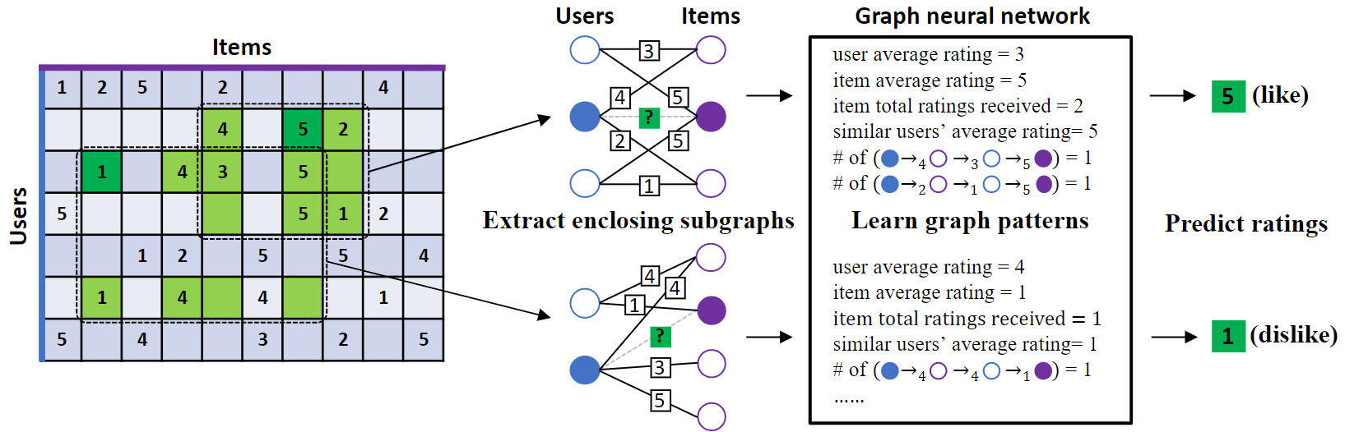
4. IGMC
Inductive Matrix Completion Based on Graph Neural Networks (IGMC) [ICLR 2020]
Rating

Slide 14
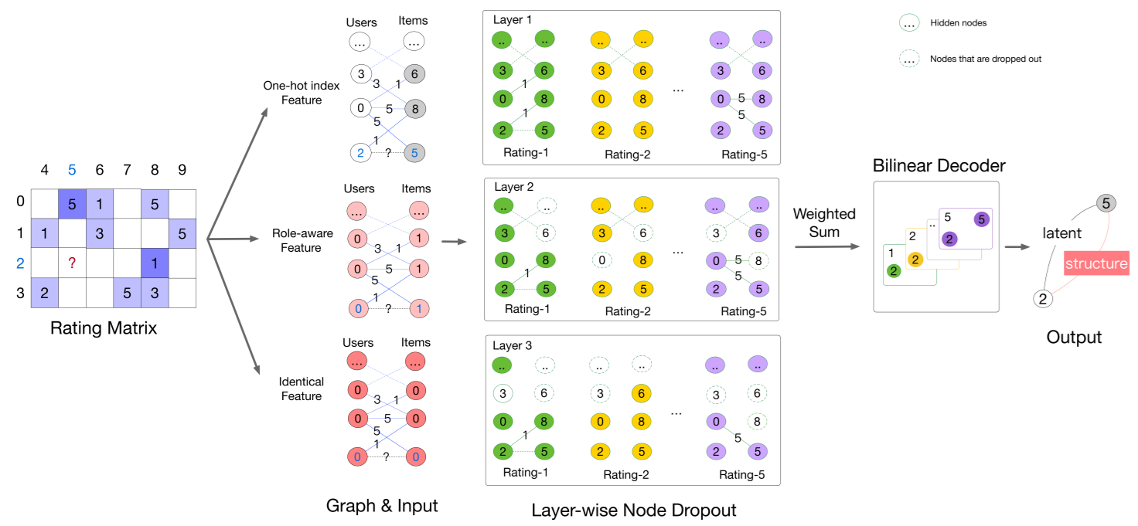
4. IMC-GAE
Inductive Matrix Completion Using Graph Autoencoder (IMC-GAE) [CIKM 2021]
Rating

Slide 15
Thank you

Slide 16
Appendix
Thank you

Slide 17
2. Related Work
Sentiment Analysis
[5] How to improve the accuracy of recommendation systems: Combining ratings and review texts sentiment scores. (JIIS 2019)
Emotion Analysis
[6] Tensor-based tag emotion aware recommendation with probabilistic ranking. (KSII 2019)
[7] Item recommendation using tag emotion in social cataloging services. (ScienceDirect 2017)

Slide 18
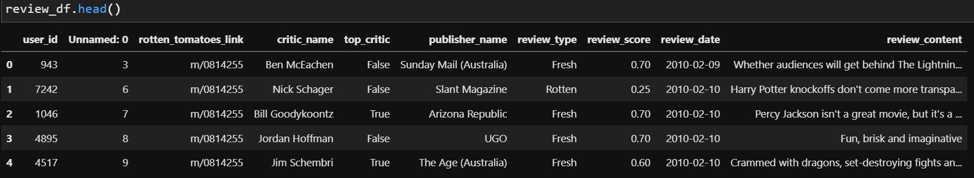
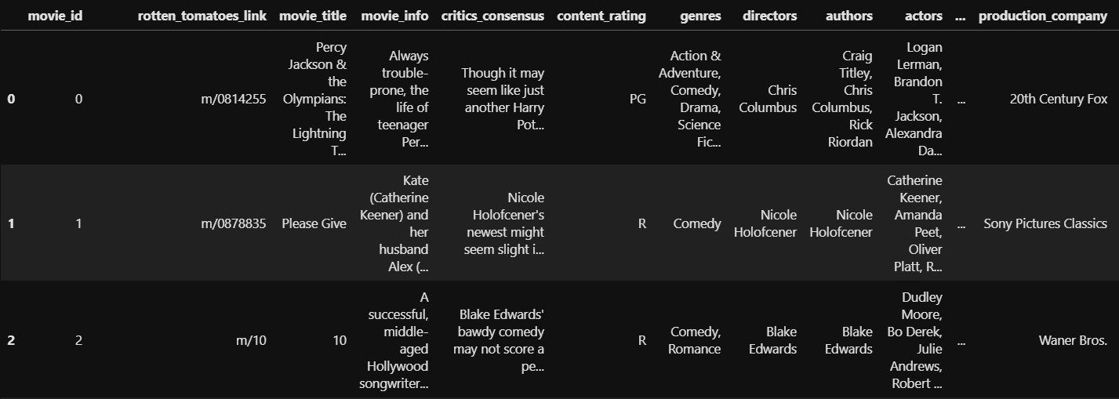
3. Pre-processing
Dataset
Rating matrix
Group : critic_name, top_critic, publisher_name
The number of users : 9,821
Movie matrix
The number of movies: 17,712

Slide 19
3. Framework - Methodology
M | R | U
0 | 0.5 | 1
1 | 0.7 | 1
2 | 0.3 | 2
Sum of relation values
Multi-layer Graph
(Rating graph)
M | S | U
0 | 1 | 1
1 | 3 | 1
2 | 2 | 2
Graph
model
(Sentiment graph)
[Predicted Rating]
Metric: RMSE/MAE
[Baseline]
Traditional: CF, SVD, NCF
Graph: NGCF, GCN, GAT, GraphSAGE
M | B | U
0 | 1 | 1
1 | 2 | 1
2 | 5 | 2
Ablation Study
(Emotion graph)
Notes:
그래프를 단순 합으로 결합
Multi-layer로 구성하여 GNN 학습

Slide 20
3. Result Table
Result
Graph type : Rating, Sentiment, Emotion
Data : 60%(rating, review)
Ideal result
Type | Method | F1-score | Data
Baselines | CF MF FM NCF | Low | Rating
Graph (in general) | GCN (GCMC) GAT GraphSAGE Graphormer | Middle | Rating
Graph (our model) | GNN + “novelty” | High | Rating
 |  |  | Rating + Sentiment
 |  |  | Rating + Emotion
 |  |  | Rating + Sentiment + Emotion

