Slide 1
Movie dataset
IMDB Movies Top 1000
MovieLens
Presenter : Cheonsol Lee
Date : 2021.07.15
Notes:
Translation model : 벡터 연산을 통해 지식 완성을 수행

Slide 2
Movie datasets – MovieLens, IMDb
Notes:
Translation model : 벡터 연산을 통해 지식 완성을 수행

Slide 3
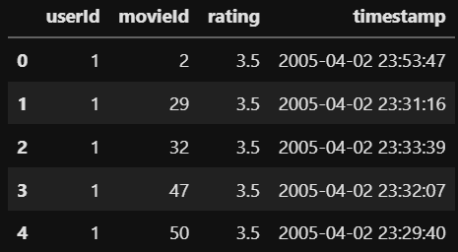
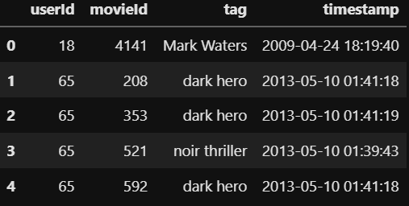
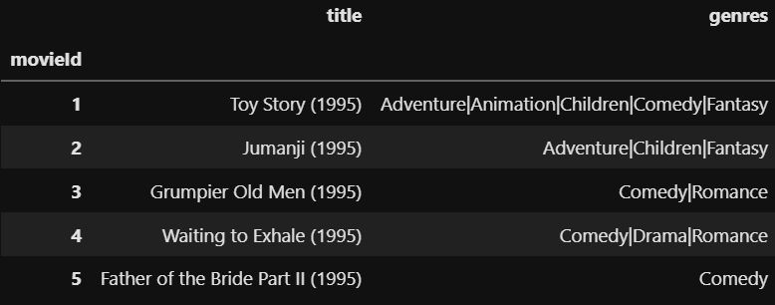
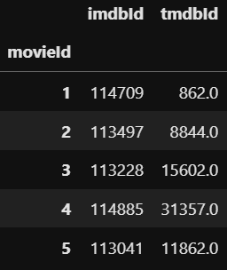
Movie dataset - MovieLens
MovieLens
Rating.csv
Tag.csv
Movie.csv
Link.csv
ratings_df
tags_df
movies_df
links_df

Slide 4
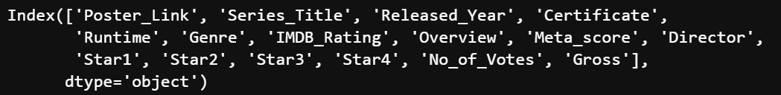
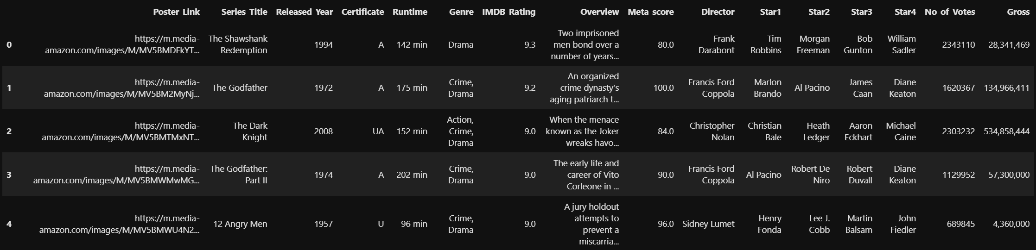
Movie dataset - IMDb
IMDb
imdb_top_1000.csv
columns
imdb_df

Slide 5
Data Analysis
Notes:
Translation model : 벡터 연산을 통해 지식 완성을 수행

Slide 6
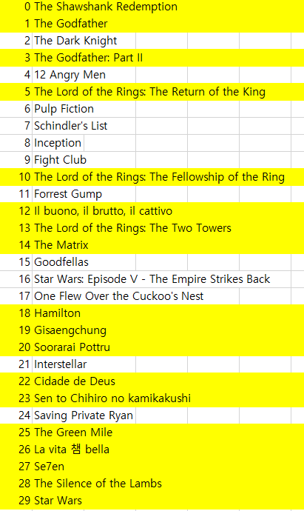
IMDb top 30 vs MovieLens
Data analysis
Volume : IMDb(30) < MovieLens(26216)
Intersection based on title
Precision : 12 / 30 * 100(%) = 40%
Missing : 16 / 30 * 100(%) = 53%
Reasons of missing values
Article ex) the, a ,an (No.0,1,3,5,10,13,14,25)
Upper/lower case
Character
Roman (No.26)
Korean ex) Parasite ↔ Gisaengchung (No.19)
Episodes
Ex) Star Wars (No.29)
IMDB
Top30
missing

Slide 7
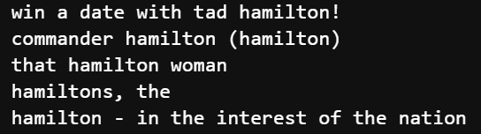
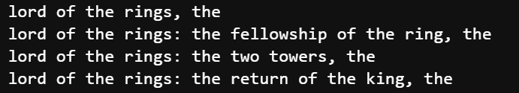

Missing values
Parentheses
Se7en (No.27)
La vita e bella (No.26)
Article
Hamilton (No.18)
The lord of the rings (No.5,10,13)
Character
Gisaengchung (No.19)

Slide 8
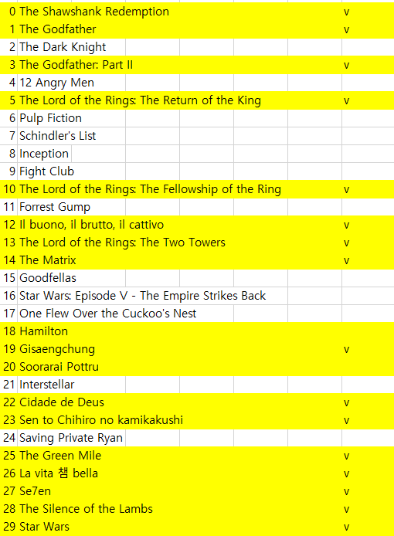

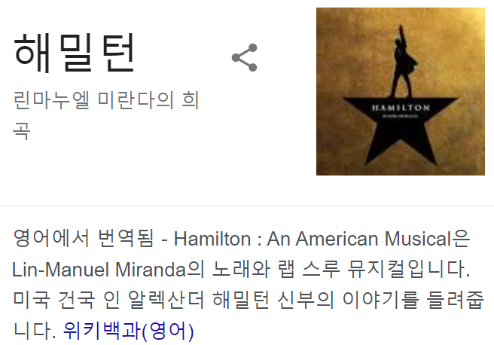
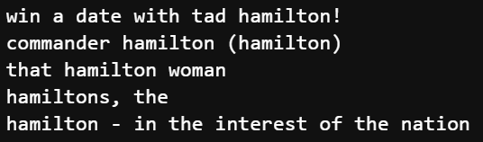
Missing values
Supplementation about missing values
27 / 30 * 100(%) = 93%
MovieLens의 Parasite는 예전 영화
Different movies
Hamilton (No.18)
missing
MovieLens
IMDb
MovieLens
Notes:
Year/director 정보가 필요할 듯

Slide 9
Thank you

Slide 10
Appendix
Thank you

Slide 11
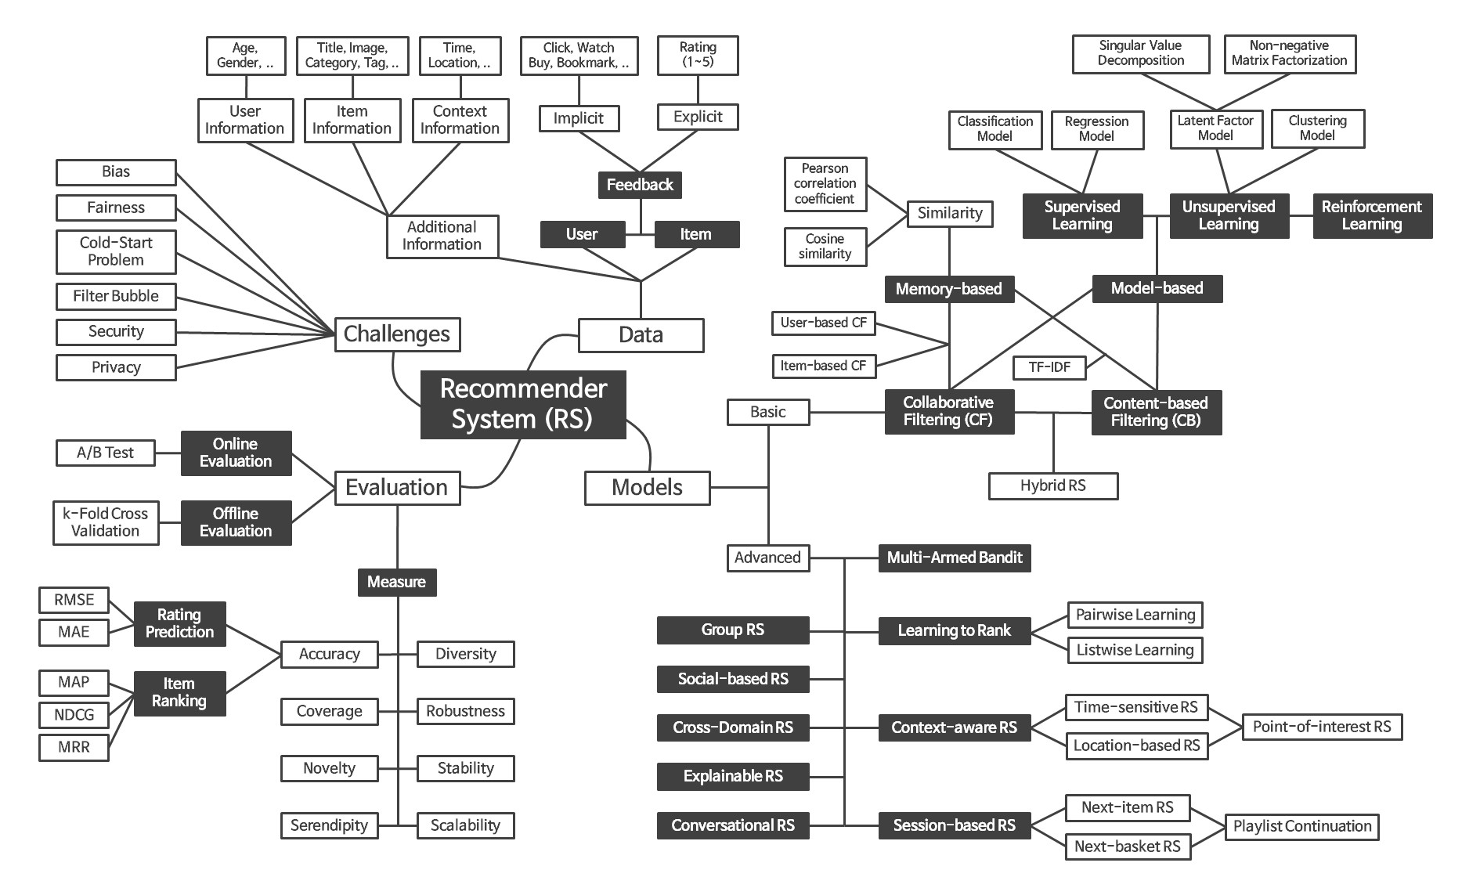
Recommender System Framework

