Slide 1
Graph-based Movie Recommender System
using Sentiment Analysis of BERT
Knowledge Structure (KS)
Graph Neural Network (GNN)
Presenter : Cheonsol Lee
Date : 2021.08.20
Notes:
안녕하세요.
BERT의 감성분석을 활용한 그래프 기반의 영화 추천시스템에 대한 연구를 말씀드리겠습니다.

Slide 2
1. Pre-processing
Thank you

Slide 3
1. Pre-processing
Rating score analysis
A | B | C | D | F
1 | 0.7 | 0.5 | 0.3 | 0
Before | After
95/95 | 1.0
96/100 | 0.96
3/5 | 0.6
7/5 | 1.4
0/4 | 0.94
5/0 | 0.0
A+ | 1.0
B- | 0.7
C | 0.5

Slide 4
1. Pre-processing
Rating score analysis
Positive range : 0.7 ~ 1.0
Negative range : 0.0 ~ 0.3
Before | After
1.0 | 1
0.96 | 1
0.6 | -
1.4 | -
0.94 | 1
0.0 | 0
1.0 | 1
0.7 | 1
0.5 | -
Type | Number
Positive Label | 363,810
Negative Label | 53,597
Total | 417,407

Slide 5
2. Evaluation
Thank you

Slide 6
2. Evaluation
Training/Testing rate: 7:3
Accuracy
Testing
 | Number | Accuracy
Training set | 8,218 | 96%
Validation set | 914 | 92%
Testing set | 3,914 | 92%
 | Sentence | Prediction | Actualization
1 | A little bit worse than lifeless; it's clueless, like a Medusa running around with her head cut off. | 0 | 0
2 | Maybe if you're aged between eight and 12, or exceptionally dim-witted, you may not notice that this is a tenth-rate rip-off of Harry Potter, with Greek mythology taking the place of magic. | 1 | 0
3 | ...an agreeable fantasy adventure that should leave fans of the genre satisfied. | 1 | 1
4 | shit!!! this is terrible | 0
5 | first section is fun, but final section is terrible | 0
6 | first section is terrible, but final section is fun | 1
BERT model puts importance on the back part.

Slide 7
3. Method, Dataset
Thank you

Slide 8
3-1. Methodology – Framework
Movie System
Sentiment Analysis
Movie Database
Review Data
Meta Data
BERT
Graph Module
Positive/Negative
Movie/Review Graph
Graph Representator
Filter Sentiment
Graph Neural Network
Knowledge Structure
Movie Recommendation
(In planning)

Slide 9
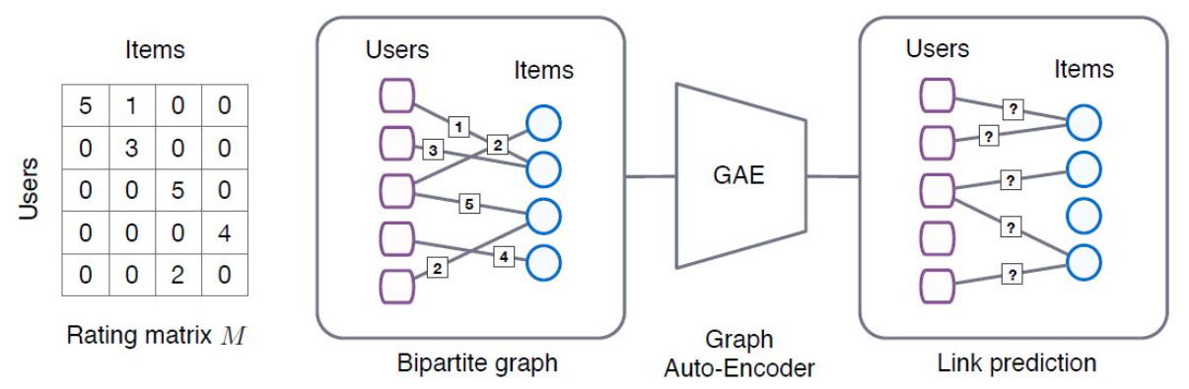
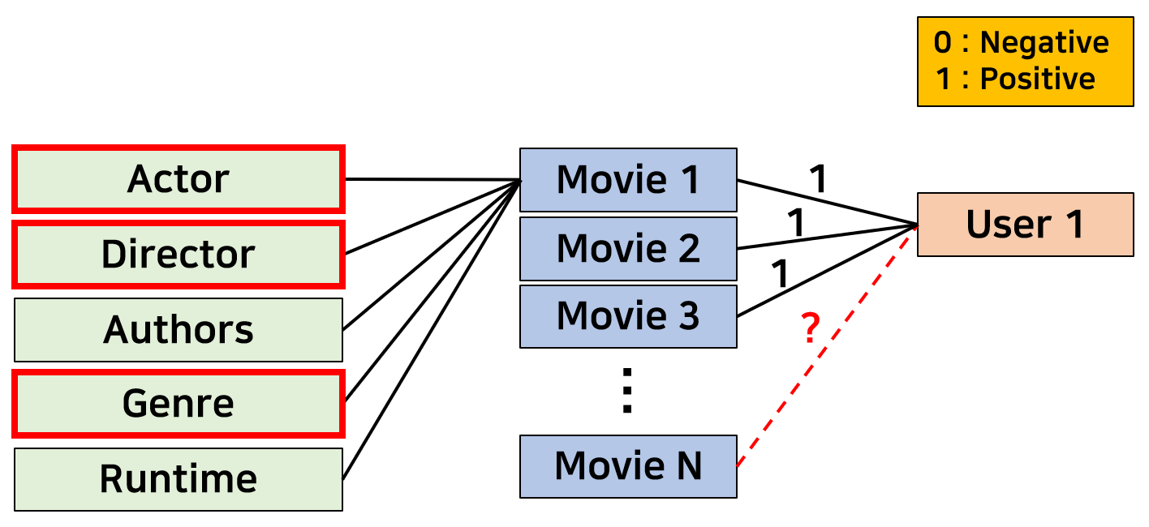
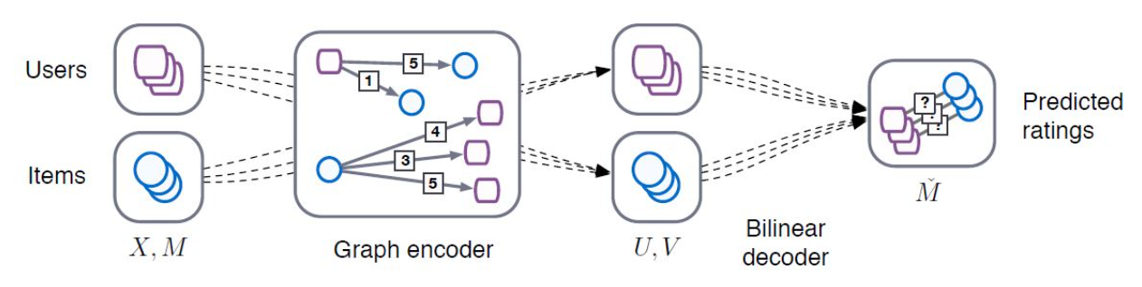
3-1. Methodology – GNN
(KDD 18’) Graph Convolutional Matrix Completion (GCMC)
Describe the process of projecting the methodology of the Graph structure onto the recommender system, especially Matrix Factorization.
Regard matrix completion as link prediction problem .
(In planning)
<Framework>
<Detail>
Our model
Notes:
GCMC : 그래프 구조의 방법론을 추천시스템, 특히 MF에 투영하는 과정

Slide 10
3-2. Dataset
Rotten Tomato Dataset
Period : ~ 2020.10.31
Link : https://www.kaggle.com/stefanoleone992/rotten-tomatoes-movies-and-critic-reviews-dataset
Data
File name | Dimension | Columns
Movie data | (17713, 22) | 'rotten_tomatoes_link', 'movie_title', 'movie_info', 'critics_consensus', 'content_rating', 'genres', 'directors', 'authors', 'actors', 'original_release_date', 'streaming_release_date', 'runtime', 'production_company', 'tomatometer_status', 'tomatometer_rating', 'tomatometer_count', 'audience_status', 'audience_rating', 'audience_count', 'tomatometer_top_critics_count', 'tomatometer_fresh_critics_count', 'tomatometer_rotten_critics_count'
Review data | (1048576, 8) | rotten_tomatoes_link, critic_name, top_critic, publisher_name, review_type, review_score, review_date, review_content

Slide 11
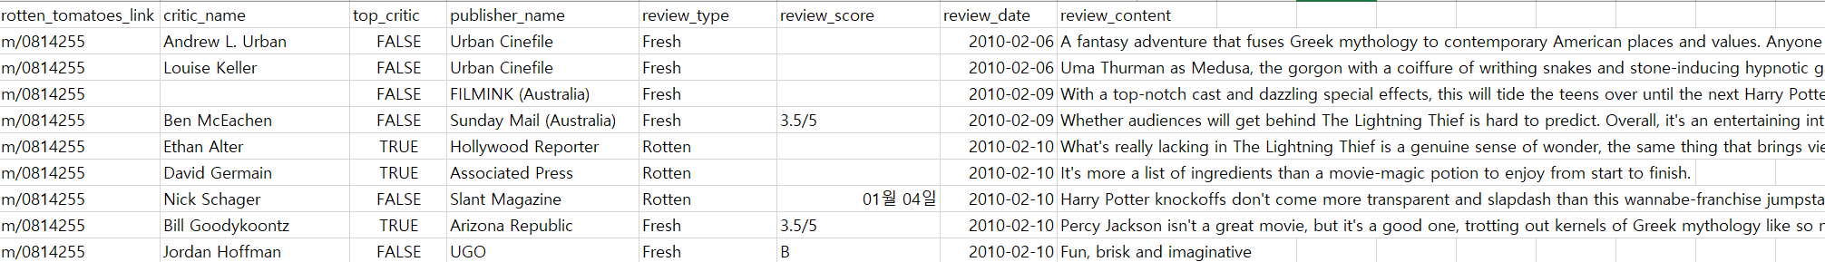
3-2. Dataset
Review
MovieID, name, top_critic, publisher_name, review_type, score, date, review
Movie
MovieID, title, summary, content_rating, genres, directors, actors, authors, date, …

Slide 12
4. Schedule
Thank you

Slide 13
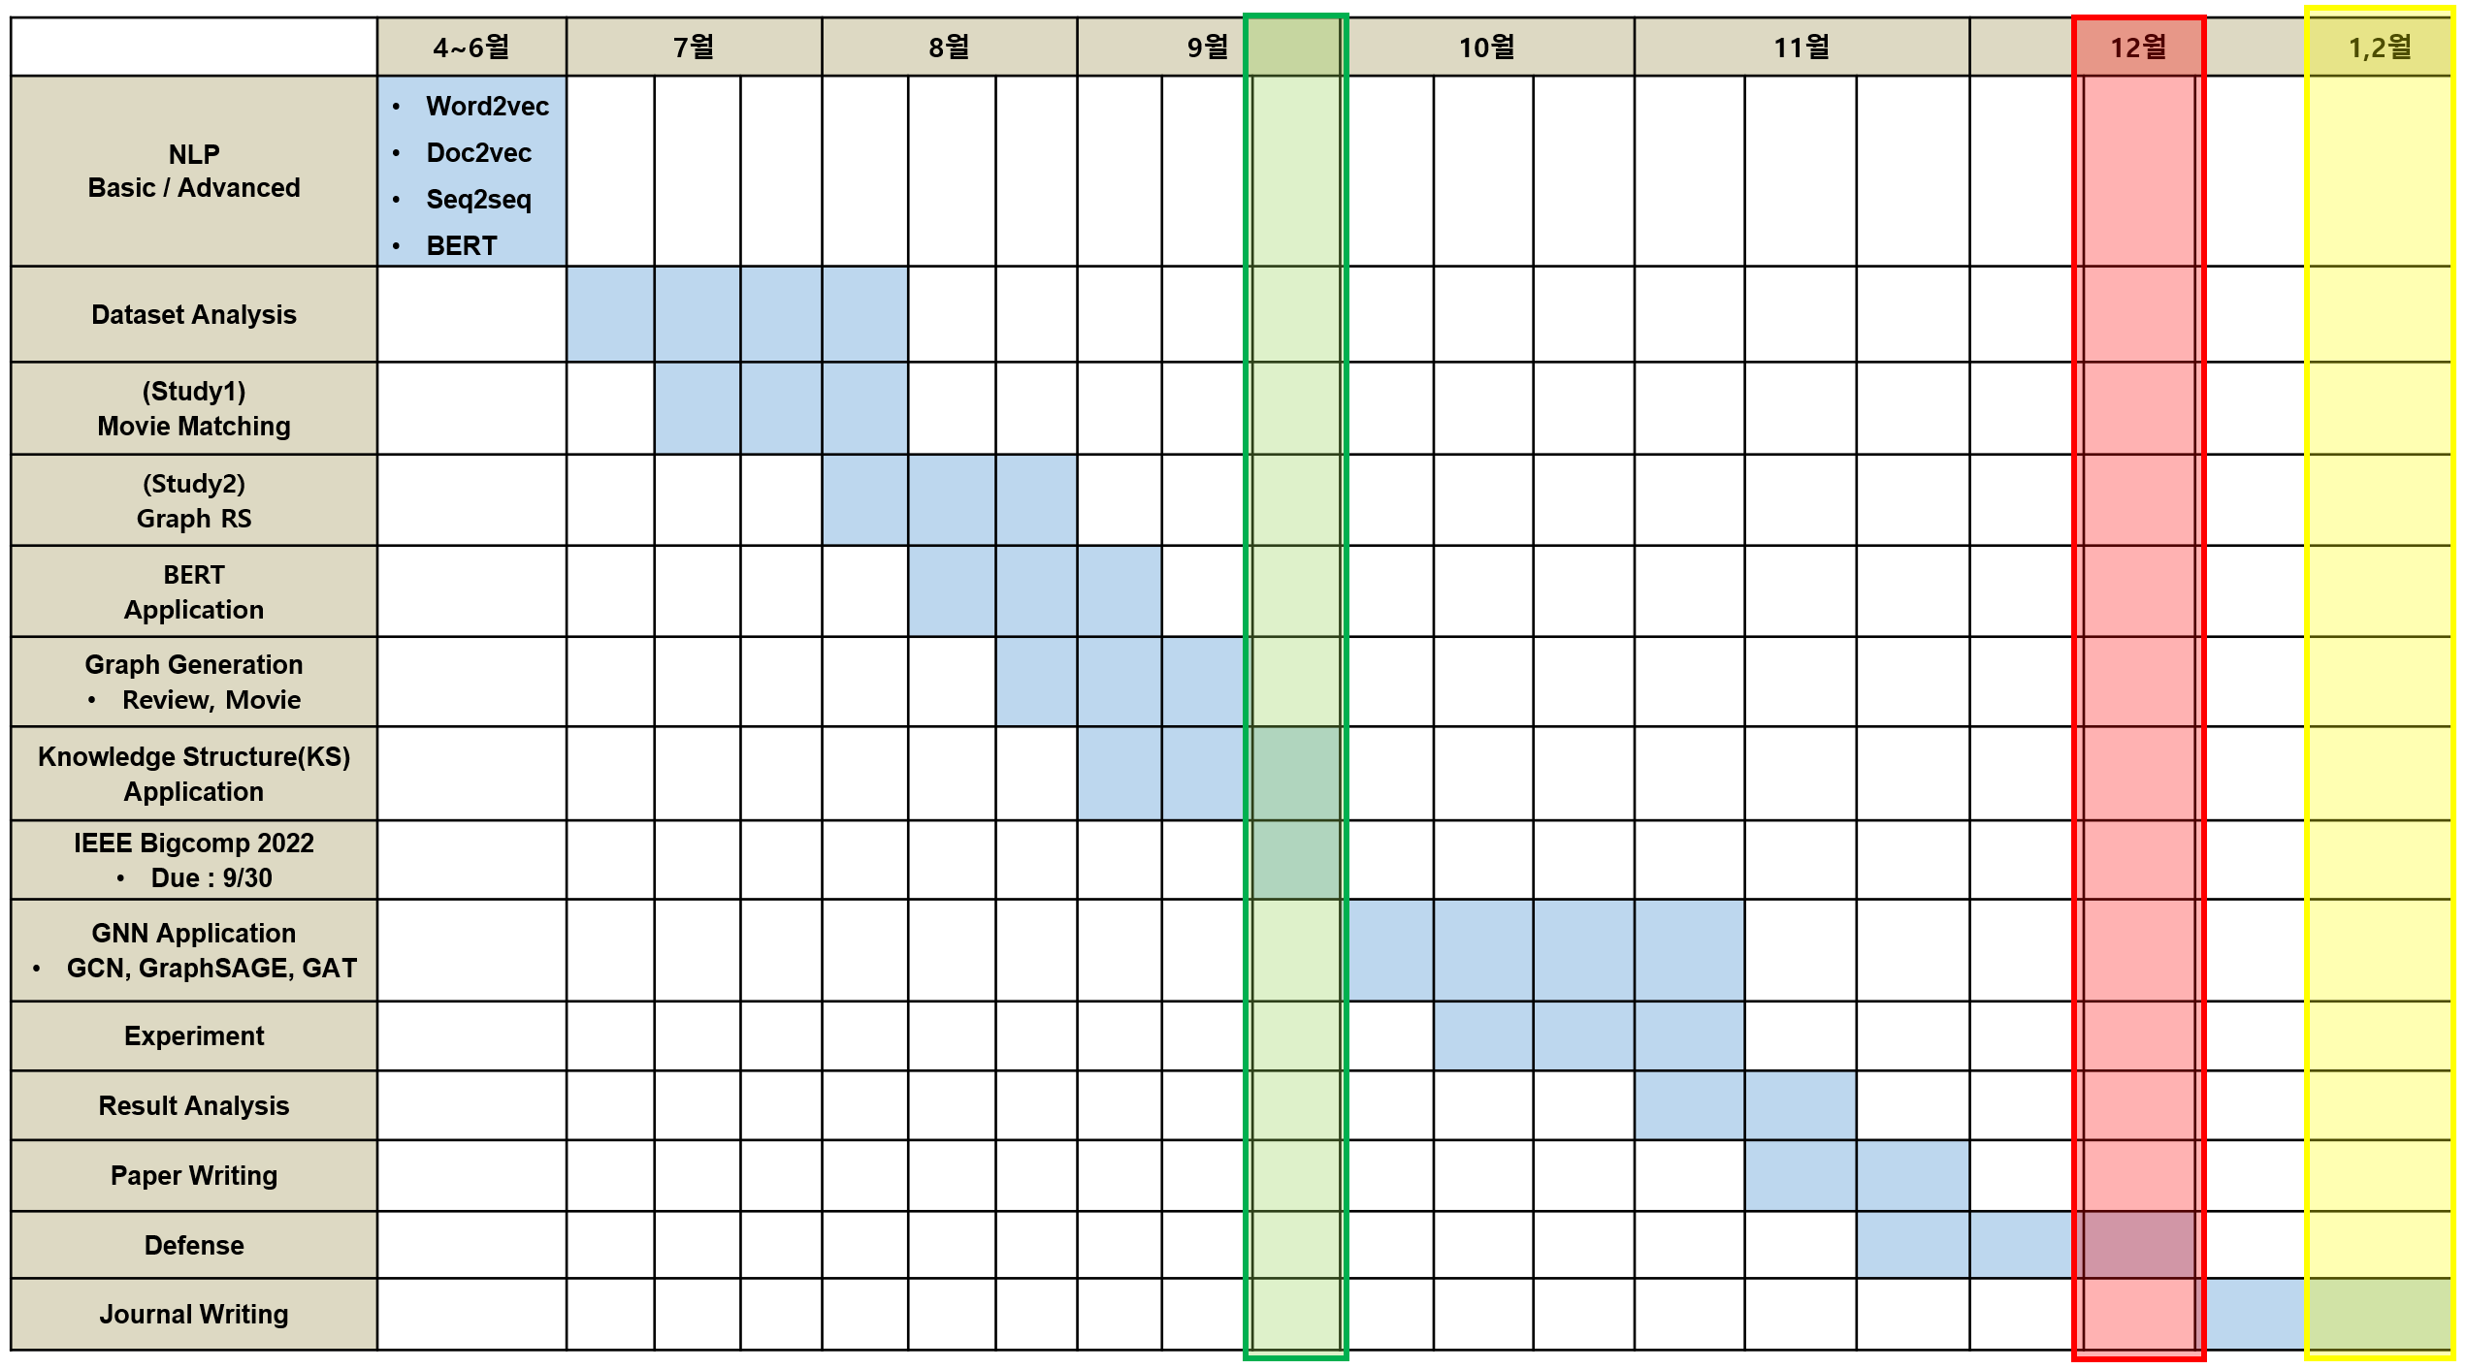
5. Schedule
현재 날짜
IEEE Bigcomp2022
Defense
Journal

Slide 14
Thank you

Slide 15
Appendix
Thank you

Slide 16
Link Prediction
Review Triple
Review Data
Critics (tomatometer)
Regular user
Movie Triple
Data
Meta information
0 : Negative
1 : Positive
Actor
Critic 1
0
Director
1
Critic 2
Authors
Movie 1
0
Movie 1
Genre
1
User 1
Movie 2
0
Production_
company
User 2
…
?
preference
Runtime
Movie N
Content_rating

Slide 17
Link Prediction
0 : Negative
1 : Positive
User 1
0
1
User 2
Actor
Movie 1
0
1
User 3
Director
0
Movie 2
Authors
User 4
…
?
Genre
preference
Runtime
Movie N

Slide 18
Link Prediction
0 : Negative
1 : Positive
Actor
Movie 1
1
1
User 1
Director
Movie 2
1
Authors
Movie 3
?
…
Genre
Runtime
Movie N

Slide 19
 | 4~6월 | 7월 |  |  | 8월 |  |  | 9월 |  |  | 10월 |  |  | 11월 |  |  | 12월 |  |  | 1,2월
NLP Basic / Advanced | Word2vec Doc2vec Seq2seq BERT
Dataset Analysis
(Study1) Movie Matching
(Study2) Graph RS
BERT Application
Graph Generation Review, Movie
Knowledge Structure(KS) Application
IEEE Bigcomp 2022 Due : 9/30
GNN Application GCN, GraphSAGE, GAT
Experiment
Result Analysis
Paper Writing
Defense
Journal Writing

