Slide 1
Movie dataset
OTT datasets
Related works
영화진흥 위원회 오픈 API
Presenter : Cheonsol Lee
Date : 2021.07.09
Notes:
Translation model : 벡터 연산을 통해 지식 완성을 수행

Slide 2
1
OTT datasets
INDEX
2
Related Works
3
영화진흥위원회 오픈API

Slide 3
OTT datasets
Notes:
Translation model : 벡터 연산을 통해 지식 완성을 수행

Slide 4
Movie dataset
Netflix
Watcha
MovieLens
IMDb
Amazon Prime Video
MUBI
Disney +
Integrated Movie Data : Netflix, Amazon Prime Video, Hulu, Disney+

Slide 5

Movie dataset - Netflix
Netflix
Dataset name : Netflix Prize Data
Period : 1890 ~ 2005
Volume : 2GB
Link : https://www.kaggle.com/netflix-inc/netflix-prize-data
Data : Movie information file, Customer rating file, Qualifying data file(testset)
Dataset name : Netflix Movies and TV shows
Period : ~ 2021.1
Volume : 3MB
Link : https://www.kaggle.com/shivamb/netflix-shows
Data :
File name | Columns
Netflix_titles.csv | id, type, title, director, cast, country, date_added, release_year, rating, duration, listed_in, description

Slide 6

Movie dataset - Watcha
Watcha
Dataset name : Watcha Data
Period : 2012.11 ~ 2016.04
Volume : 1.5GB
Link : https://proinlab.com/archives/1685
Data
File name | Columns
Movie data | code, title, filmrate, year, genre, running_time, nation, review_count
Review data | comment_code, movie_unique_id, usercode, rating, like_count, updated_at, text

Slide 7

Movie dataset - MovieLens
Movielens
Dataset name : MovieLens 20M Dataset
Period : 1995.01 ~ 2015.03
Volume : 885MB
Link : https://www.kaggle.com/grouplens/movielens-20m-dataset
Data
File name | Columns
tag.csv | userId, movieId, tag, timestamp
rating.csv | userId, movieId, rating, timestamp
movie.csv | movieId, title, genres
link.csv | movieId, imdbId, tmbdId
genome_scores.csv | movieId, tagId, relevance
genome_tags.csv | tagId, tag

Slide 8

Movie dataset - IMDb
IMDb
Dataset name : IMDB_movie_2020
Period : ~ 2020
Volume : 2GB
Link : https://www.kaggle.com/nikhileshkos/imdb-movie-2020
Data
File name | Columns
name_baiscs.tsv | title, startYear, isAdult, endyear, runTimes, genres
title_akas.tsv | titleId, ordering, title, region, language, types, attributes isOriginalTitle
title_basic.tsv | tconst, titleType, primaryTitle, originalTitle, isAdult, startYear, endYear, runtimeMinutes, genres
title.crew.tsv.gz | tconst, directors, writers
title.ratings.tsv.gz | tconst, averageRating, numVotes

Slide 9

Movie dataset – Amazon Prime Video
Amazon Prime Video
Dataset name : Amazone Prime Movies
Period : ~ 2020
Volume : 2.3MB
Link : https://www.kaggle.com/padhmam/amazon-prime-movies
Data
File name | Columns
Amazon_prime_movies.csv | Movie Name, Language, IMDb Rating, Running Time, Year of Release, Maturity Rating, Plot

Slide 10

Movie dataset – MUBI
MUBI
Dataset name : MUBI SVOD Platform Database for Movie Lovers
Period : ~ 2020.04
Volume : 6GB
Link : https://www.kaggle.com/clementmsika/mubi-sqlite-database-for-movie-lovers
Data
File name | Columns
Mubi_lists_data.csv | …
Mubi_lists_user_data.csv | …
Mubi_moive_data.csv | …
Mubi_ratings_data.csv | …
Mubi_ratings_user_data.csv | …

Slide 11

Movie dataset – Disney+
Disney +
Dataset name : Disney Plus Movies and TV Shows
Period : ~ 2020
Volume : 409KB
Link : https://www.kaggle.com/unanimad/disney-plus-shows
Data
File name | Columns
disney_plus_shows.csv | Imdb_id, title, plot, type, rated, year, released_at, added_at, runtime, genre, director, writer, actors, language, country, awards, metascore, imdb_rating, imdb_votes

Slide 12


Movie dataset – Integrated Movie Data
Integrated Movie Data
Dataset name : Movies on Netflix, Prime Video, Hulu and Disney+
Period : ~ 2020
Volume : 2MB
Link : https://www.kaggle.com/ruchi798/movies-on-netflix-prime-video-hulu-and-disney
Feature : IMDb rating, Rotten Tomatoes % by OTT types
Data
File name | Columns
MoviesOnStreamingPlatforms_updated.csv | ID, Title, Year, Age, IMDb, Rotten Tomatoes, Netflix, Hulu, Prime Video, Disney+, Type, Directors, Genres, Country, Language, Runtime

Slide 13
Related Works / Company Cases
Notes:
Translation model : 벡터 연산을 통해 지식 완성을 수행

Slide 14
DBLP : Movie, Recsys
Movie dataset linking case
(LDOW ‘09) Linked Movie Data Base (LinkedMDB)
(towards data science '21) Data Analysis on OTT Platforms: Which Service Should I Choose?
Papers related in movie
(RecSys ‘16) Exploring the Value of Personality in Predicting Rating Behaviors: A Study of Category Preferences on MovieLens
(RecSys ‘13) Movie recommender system for profit maximization
(SCI ‘14) Tuning metadata for better movie content-based recommendation systems
(IEEE ICAIS ’21) A Comprehensive Survey on Movie Recommendation Systems

Slide 15

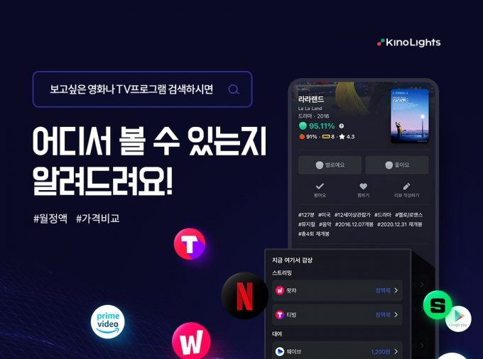
Meta Search Engine Services on OTT Platform 1
KinoLights
Data
Netflix, Wavve, Wacha, Amazon prime, Tiving, Naver Series on, Google Play Movie, Yes24, Indiplug, Cinefox, Lotte Cinema VOD
Utility
Work information by OTT service
New update list, proprietary,
upcoming expiration of license information
Price information by platform

Slide 16

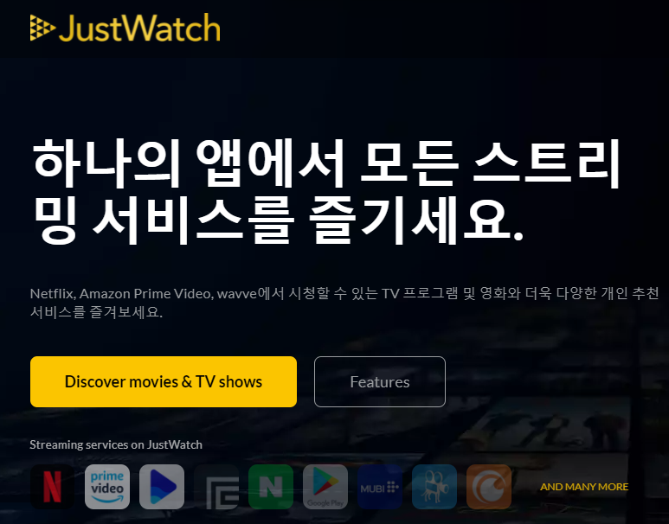
Meta Search Engine Services on OTT Platform 2
JustWatch
Data
Utility
Work information by OTT service
New update list, proprietary,
upcoming expiration of license information
Price information by platform

Slide 17
영화진흥 위원회 오픈 API
Notes:
Translation model : 벡터 연산을 통해 지식 완성을 수행

Slide 18
영화 진흥 위원회 오픈 API
일별 박스오피스 API 서비스
특정 일자 상영작들의 박스오피스 정보를 영화구분(다양성영화,상업영화), 한국/외국 구분, 상영지역 등의 조건을 통해 조회
REST/SOAP 방식 중 선택적으로 호출 가능
REST 방식의 응답형식은 XML과 JSON을 지원
링크 : http://www.kobis.or.kr/kobisopenapi/homepg/apiservice/searchServiceInfo.do
데이터 형태
요 청 | 응 답
key, targetDt, itemPerPage, multiMovieYn, repNationCd, wideAreaCd | boxofficeType, showRange, rnum, rank, rankInten, rankOldAndNew, movieCd, movieNm, openDt, salesAmt, salesShare, salesInten, salesChange, salesAcc, audiCnt, audiInten, audiChange, audiAcc, scrnCnt, showCnt

Slide 19
Thank you

Slide 20
Appendix
Thank you

Slide 21
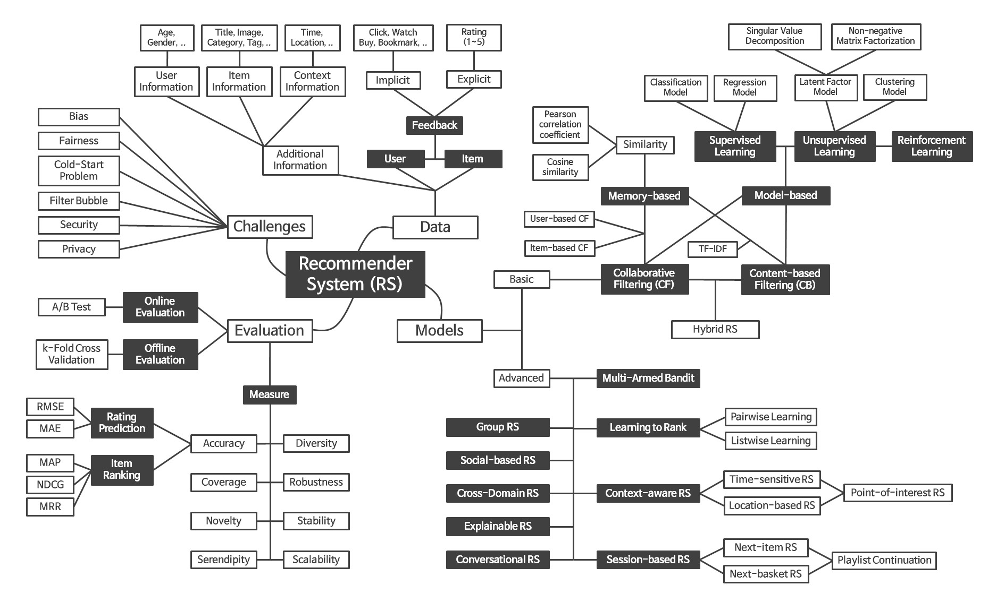
Recommender System Framework

