Slide 1
Graph-based Movie Recommender System
using Sentiment Analysis of BERT
Knowledge Structure (KS)
Graph Neural Network (GNN)
Presenter : Cheonsol Lee
Date : 2021.08.18
Notes:
안녕하세요.
BERT의 감성분석을 활용한 그래프 기반의 영화 추천시스템에 대한 연구를 말씀드리겠습니다.

Slide 2
1
Introduction
2
Related Work
3
Methodology
INDEX
Study1 : Knowledge Structure (KS)
Study2 : Graph Neural Network (GNN)
4
Dataset
5
Schedule

Slide 3
1. Introduction
Thank you

Slide 4
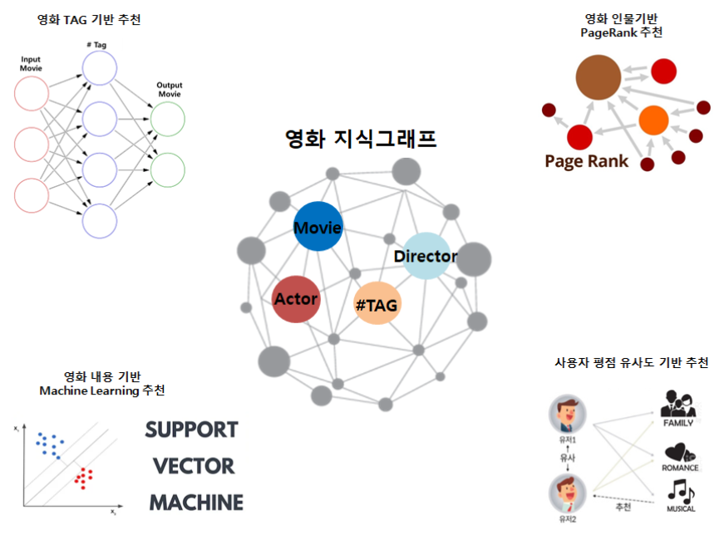
1. Introduction – Why do you use Graph??
With the growing number of movie contents and users, recommender system(RS) considering efficiency of data storage is needed.
Graph-based RS stores users' evaluation information about content in the graph structure itself and applies graph algorithms and recommendation techniques.
Advantages of Graphs
Efficiency of data storage : Solve the sparse matrix problems
Diversified recommendations by leveraging user and relationship information
Applications of graph technologies : PageRank, Random walk, GNN, …
Notes:
새로 생성되는 컨텐츠 양과 사용자 수가 증가하면서 데이터 저장의 효율성을 고려한 추천시스템을 필요함. 그래프 기반 추천 시스템은 그래프 구조 자체에 사용자의 컨텐츠에 대한 평가 정보를 저장하고 이러한 구조를 활용하여 그래프 알고리즘과 추천 기법을 적용 가능함.
1. 데이터 저장의 효율성 : CF 방식은 희소행렬을 구축함으로써 공간 낭비, 새로운 컨텐츠가 추가되었을 때 확장이 어렵다는 단점이 있다.
지식그래프 형태로 컨텐츠를 관리할 경우는 컨텐츠의 속성만 그래프 값으로 가질 수 있고, 새로운 컨텐츠가 추가되어도 새 노드에 에지만 연결하면 되므로 희소성과 확장성 문제를 해결함.
2. 개인화 추천 모델 관리의 편의성 : 노드(director, actor, writer 등) 간의 관계와 사용자 정보를 추천에 활용함으로써 다각화된 추천 모델 구현이 가능함.
3. 그래프 분석 기술의 적용이 가능함 : PageRank, Random Walk, GNN 등

Slide 5


1. Introduction (cont’d) – Problems
Limitations of Rating-based Recommendation
In general, there are many methods based on the ratings that are explicit feedbacks, but these reveal the limitations of intelligent & personalization recommendations.
There are studies that combine the ratings and sentiment analysis of review, but it is limited only to rating inference.
Notes:
새로 생성되는 컨텐츠 양과 사용자 수가 증가하면서 데이터 저장의 효율성을 고려한 추천시스템을 필요함. 그래프 기반 추천 시스템은 그래프 구조 자체에 사용자의 컨텐츠에 대한 평가 정보를 저장하고 이러한 구조를 활용하여 그래프 알고리즘과 추천 기법을 적용 가능함.
1. 데이터 저장의 효율성 : CF 방식은 희소행렬을 구축함으로써 공간 낭비, 새로운 컨텐츠가 추가되었을 때 확장이 어렵다는 단점이 있다.
지식그래프 형태로 컨텐츠를 관리할 경우는 컨텐츠의 속성만 그래프 값으로 가질 수 있고, 새로운 컨텐츠가 추가되어도 새 노드에 에지만 연결하면 되므로 희소성과 확장성 문제를 해결함.
2. 개인화 추천 모델 관리의 편의성 : 노드(director, actor, writer 등) 간의 관계와 사용자 정보를 추천에 활용함으로써 다각화된 추천 모델 구현이 가능함.
3. 그래프 분석 기술의 적용이 가능함 : PageRank, Random Walk, GNN 등

Slide 6
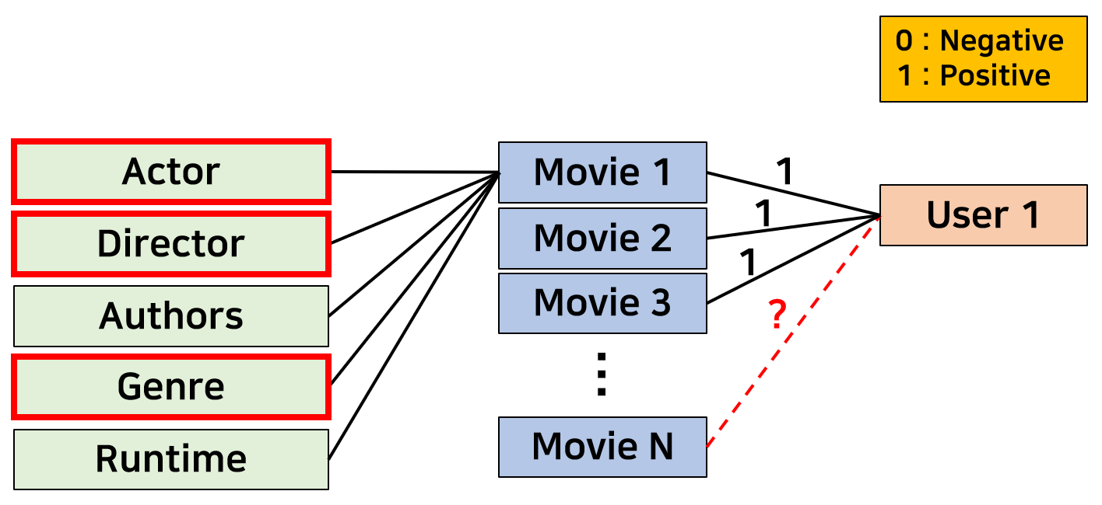
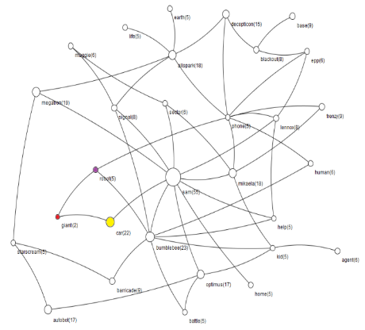
1. Introduction (cont’d) – IDEA
In this study, we suggest a system filters films based on sentiment analysis result about review and extract their unique characteristics.
Recommend movies with similar characteristics.
By generating knowledge graphs with reviews of the same polarity, the characteristics that represent the movie can be compared in the sentiment aspect. (Knowledge Structure)
Diverse & Explainable recommendation is possible using graph algorithms. (GNN)
boring
Fun
action
VS
bad
Low quality
happy
Positive Movie recommendation
Positive Graph
Negative Graph
Notes:
본 연구에서는 지능형 추천을 위해서, 감성분석 결과로 영화를 필터링하여 특정 감성에 해당하는 영화들만의 특징을 추출하고 해당 특징을 지닌 영화를 추천하는 시스템을 제안함.
동일한 감성을 가진 리뷰만을 모아 지식그래프를 제작함으로써, 해당 영화를 대표하는 특성을 감성비교해볼 수 있음.
feature들 간의 상관관계를 반영한 그래프 기반의 추천으로 설명가능한 추천이 가능함.

Slide 7
2. Related Work
Thank you

Slide 8
2. Related Work
Sentiment Analysis
[1] Integrating Collaborative Filtering and Sentiment Analysis : A Rating Inference Approach (ECAI 06’ workshop)
Approach sentiment analysis with statistical techniques
[2] BERT 기반 감성분석을 이용한 추천시스템 (KCI 21')
Comparing Emotional Analysis with ML/DL Techniques and Presenting the Performance of BERT
Limitation : rating inference was only carried out, and explainable recommendation is not possible.
[3] Movie Recommendation System Using Sentiment Analysis From Microblogging Data (IEEE transactions on css 20’)
Hybrid RS from collaborative filtering(CF) and content-based filtering(CBF) along with sentiment analysis
[4] Using Affective Features from Media Content Metadata for Better Movie Recommendations (KDIR 20’)
Detect movie overviews’ implicit affective features like emotion and sentiment.
Strength: reflect dynamic information like user’s emotion and sentiment

Slide 9
2. Related Work (cont’d)
Survey
[5] A Review of Movie Recommendation System: Limitations, Survey and Challenges (ELCVIA 20’)
Survey paper
Compare Methods : CF, CBF, Hybrid, DL
Compare similarity measures of company
Recommendation based on polarity weighting
[6] Incorporating Distinct Opinions in Content Recommender System (AIRS 15’)
Recommendation by adding weights to user’s polarity information
Future work: Classify users on the basis of analyzing rating patterns
Problem in rating-based movie recommendation
[7] Solving Sparsity Problem in Rating-Based Movie Recommendation System (Springer Computational CIDM 17’)
Point out a sparsity problem in rating-based recommendation
Suggest incorporating user, movie, review and rating information
Notes:
서베이 논문
사용자의 양극성 정보에 weight를 추가함으로써 추천에 접목한 사례
사용자를 평점 패턴에 따라 분류하는 것을 future work로 하였지만, 제 연구에서는 사용자의 감성 패턴에 따라 분류할 예정
3. 평점 기반의 추천은 sparsity 문제가 있어서 추천의 한계점을 지닌다고 언급함.

Slide 10
3. Methodology
Thank you

Slide 11
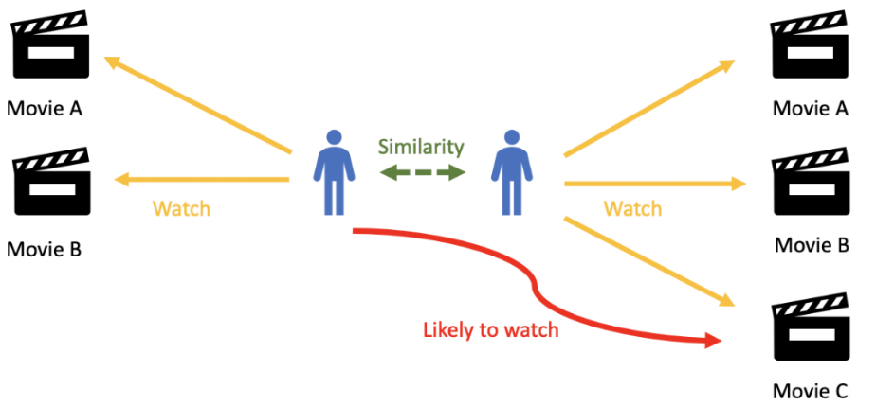
3. Methodology
Recommendation Process
Analyze features of movies that had positive/negative reviews by users
Recommend movies with similar features using Graph-algorithm
Differences from previous studies
CF recommends movies to watch in the future based on watched movie.[7]
In our study, the system recommends movies reflecting implicit information like sentiment polarity.[4]
General CF
Graph RS
Notes:
[4]번 논문에서 얘기했던 것처럼 감성의 극성정보를 반영하여 영화를 추천한다.

Slide 12
3. Methodology – Framework
Movie System
Sentiment Analysis
Movie Database
Review Data
Meta Data
BERT
Graph Module
Positive/Negative
Movie/Review Graph
Graph Representator
Filter Sentiment
Graph Neural Network
Knowledge Structure
Movie Recommendation
(In planning)

Slide 13
3. Methodology – Knowledge Structure
Assumption
The reviews are a mixture of positive/negative information, so specific polarity information can represent movies.
If it is similar to a movie with positive reviews, it will be seen favorably.
Comparison
Creating a knowledge structure by separating positive and negative reviews
Directions
Recommend similar movies by using knowledge structure based on results of sentiment analysis.
Recommend similar movies by using knowledge structure based on movie summary.
Advantages
Quick recommendation to disable deep learning
Reflect user preferences by recommending movies that are similar to the knowledge structure of films with positive reviews.
Fun
action
happy
Notes:
(목적)
감성분석 결과의 지식구조를 이용하여 해당 리뷰와 유사한 지식구조에 해당하는 영화 추천(긍정/부정)
영화의 요약(description)을 지식구조로 제작하여 유사한 구조의 지식구조를 띠는 영화 추천

Slide 14
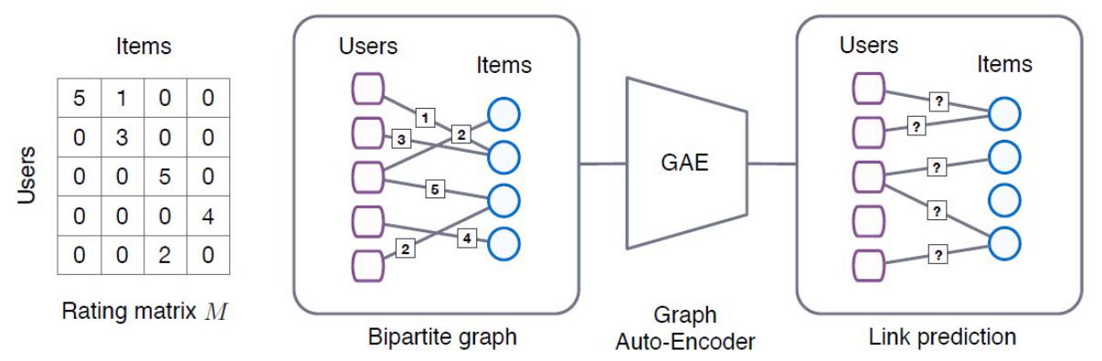
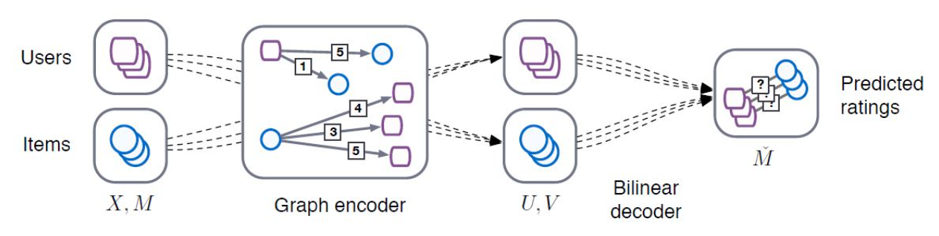
3. Methodology – GNN
(KDD 18’) Graph Convolutional Matrix Completion (GCMC)
Describe the process of projecting the methodology of the Graph structure onto the recommender system, especially Matrix Factorization.
Regard matrix completion as link prediction problem .
(In planning)
<Framework>
<Detail>
Our model
Notes:
GCMC : 그래프 구조의 방법론을 추천시스템, 특히 MF에 투영하는 과정

Slide 15
4. Dataset
Thank you

Slide 16








4. Dataset
Movie Dataset Comparison
Considerations : Period, Volume, Features
Selected!!
Reason for selection: Latest dataset, high volume, many columns, many specific reviews (experts/publics)

Slide 17
4. Dataset
Rotten Tomato Dataset
Period : ~ 2020.10.31
Link : https://www.kaggle.com/stefanoleone992/rotten-tomatoes-movies-and-critic-reviews-dataset
Data
File name | Dimension | Columns
Movie data | (17713, 22) | 'rotten_tomatoes_link', 'movie_title', 'movie_info', 'critics_consensus', 'content_rating', 'genres', 'directors', 'authors', 'actors', 'original_release_date', 'streaming_release_date', 'runtime', 'production_company', 'tomatometer_status', 'tomatometer_rating', 'tomatometer_count', 'audience_status', 'audience_rating', 'audience_count', 'tomatometer_top_critics_count', 'tomatometer_fresh_critics_count', 'tomatometer_rotten_critics_count'
Review data | (1048576, 8) | rotten_tomatoes_link, critic_name, top_critic, publisher_name, review_type, review_score, review_date, review_content

Slide 18
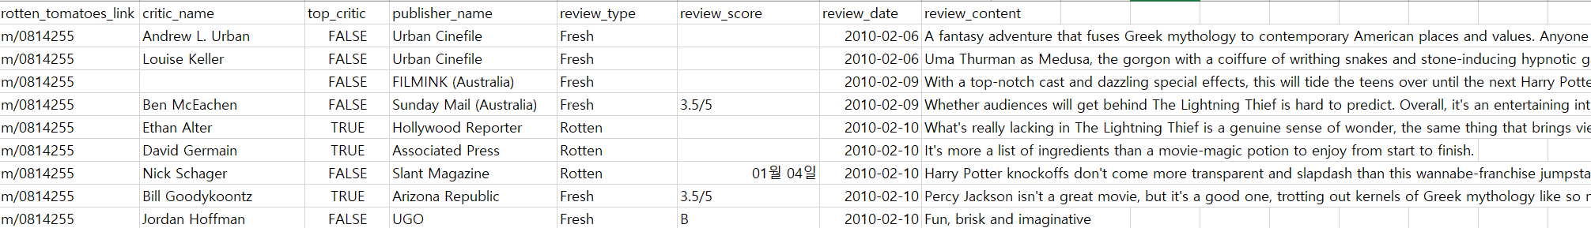
4. Dataset
Review
MovieID, name, top_critic, publisher_name, review_type, score, date, review
Movie
MovieID, title, summary, content_rating, genres, directors, actors, authors, date, …

Slide 19
4. Dataset
Review Graph
Review Data
Critics (tomatometer)
Regular user
Movie Graph
Data
Meta information
0 : Negative
1 : Positive
Actor
Critic 1
0
Director
1
Critic 2
Authors
Movie 1
0
Movie 1
Genre
1
User 1
Movie 2
0
Production_
company
User 2
…
?
preference
Runtime
Movie N
Content_rating

Slide 20
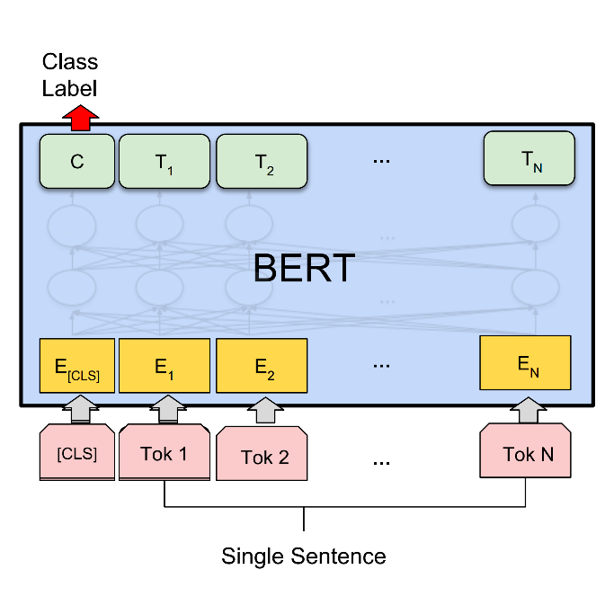
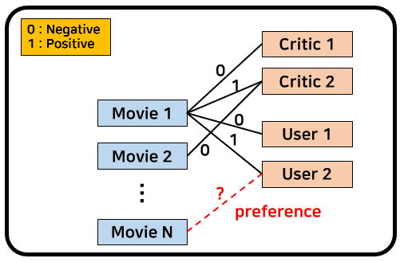
4. Dataset
Labeling
Sentiment analysis using BERT
Review data
Result
Uma Thurman as Medusa, the gorgon with a coiffure of writhing snakes and stone-inducing hypnotic gaze is one of the highlights of this bewitching fantasy
0 / 1
Fill the triple’s edge with sentiment analysis results.

Slide 21
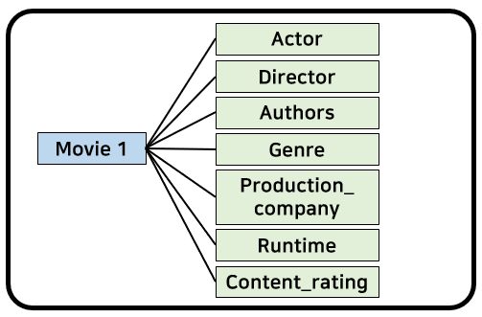
4. Dataset
Explainable Recommendation (XAI)
Movie meta information
Algorithm : KS & GNN
Movie features about positive review
Compare features for ‘Movie N’

Slide 22
5. Schedule
Thank you

Slide 23
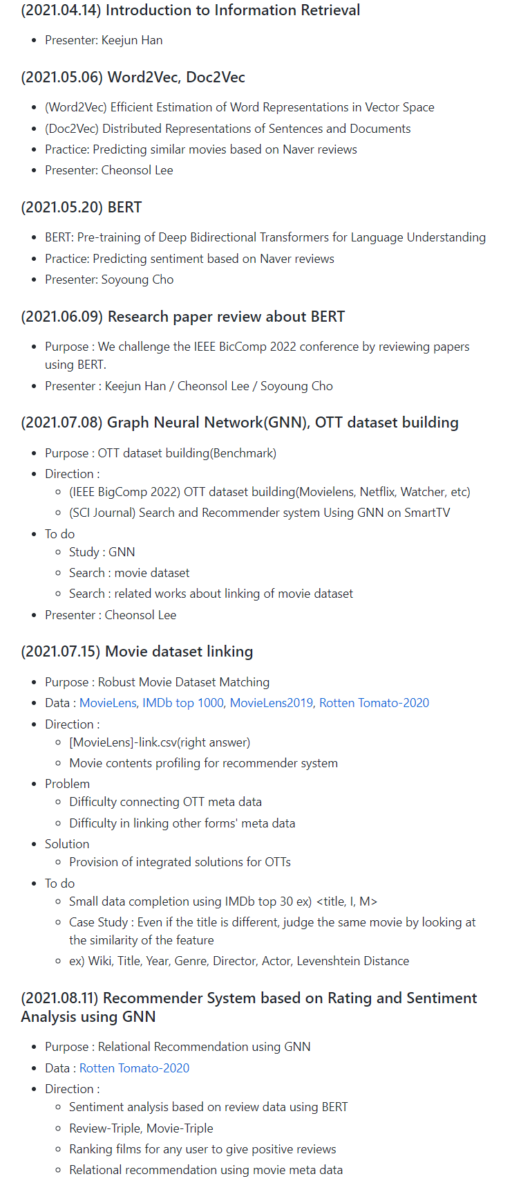
5. Schedule
Research Study
Main Advisor : Munyong Yi (Professor)
Sub Advisor : Keejun Han (Ph.D)
Link : https://github.com/keejun-han/NLP_GNN_STUDY
Period : Once a week

Slide 24
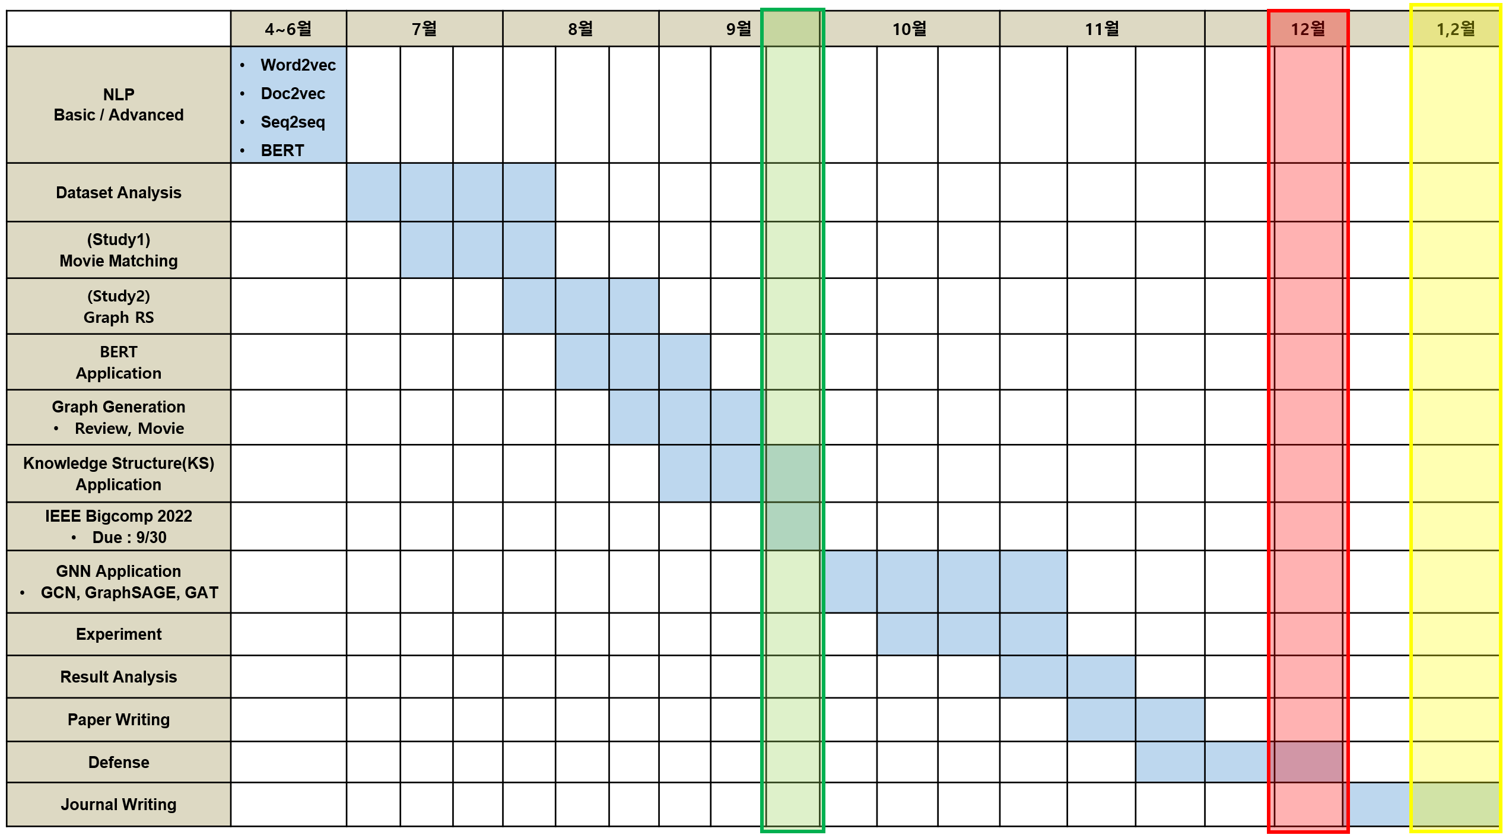
5. Schedule
IEEE Bigcomp2022
Defense
Journal

Slide 25
Thank you

Slide 26
Appendix
Thank you

Slide 27
Link Prediction
Review Triple
Review Data
Critics (tomatometer)
Regular user
Movie Triple
Data
Meta information
0 : Negative
1 : Positive
Actor
Critic 1
0
Director
1
Critic 2
Authors
Movie 1
0
Movie 1
Genre
1
User 1
Movie 2
0
Production_
company
User 2
…
?
preference
Runtime
Movie N
Content_rating

Slide 28
Link Prediction
0 : Negative
1 : Positive
User 1
0
1
User 2
Actor
Movie 1
0
1
User 3
Director
0
Movie 2
Authors
User 4
…
?
Genre
preference
Runtime
Movie N

Slide 29
Link Prediction
0 : Negative
1 : Positive
Actor
Movie 1
1
1
User 1
Director
Movie 2
1
Authors
Movie 3
?
…
Genre
Runtime
Movie N

Slide 30
 | 4~6월 | 7월 |  |  | 8월 |  |  | 9월 |  |  | 10월 |  |  | 11월 |  |  | 12월 |  |  | 1,2월
NLP Basic / Advanced | Word2vec Doc2vec Seq2seq BERT
Dataset Analysis
(Study1) Movie Matching
(Study2) Graph RS
BERT Application
Graph Generation Review, Movie
Knowledge Structure(KS) Application
IEEE Bigcomp 2022 Due : 9/30
GNN Application GCN, GraphSAGE, GAT
Experiment
Result Analysis
Paper Writing
Defense
Journal Writing

